Slide 1

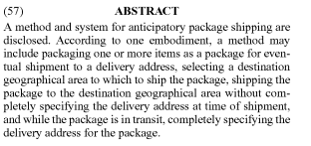
Amazon “Anticipatory Shipping”
Patent filed for ship-before-you-buy logistics system | Global, 2013
Amazon filed a patent in December 2013 for what it calls “Anticipatory Shipping”, a method for delivering packages before the customer even makes a purchase.
The company has said that it may consider several factors, including purchase history, product searches, wish-lists, shopping-cart contents, and even the length of time the customer’s cursor hovers over an item, in deciding what to ship and when to ship it in anticipation of a purchase. According to the patent, the packages could wait at the shippers’ hubs or on trucks until an order arrives.
The scheme promises to cut delivery times, addressing the disadvantage that many online merchants express - the necessary delay between the ordering and the receiving of a purchased item.
CONNECTED TRENDS
Culture of Immediacy | Probability Gets Personal
RELATED SECTORS
Retail | FMCG
Link: http://1.usa.gov/1awfajA

