Slide 1
Bicycle Of the Mind
created by Steve Jobs

Slide 2
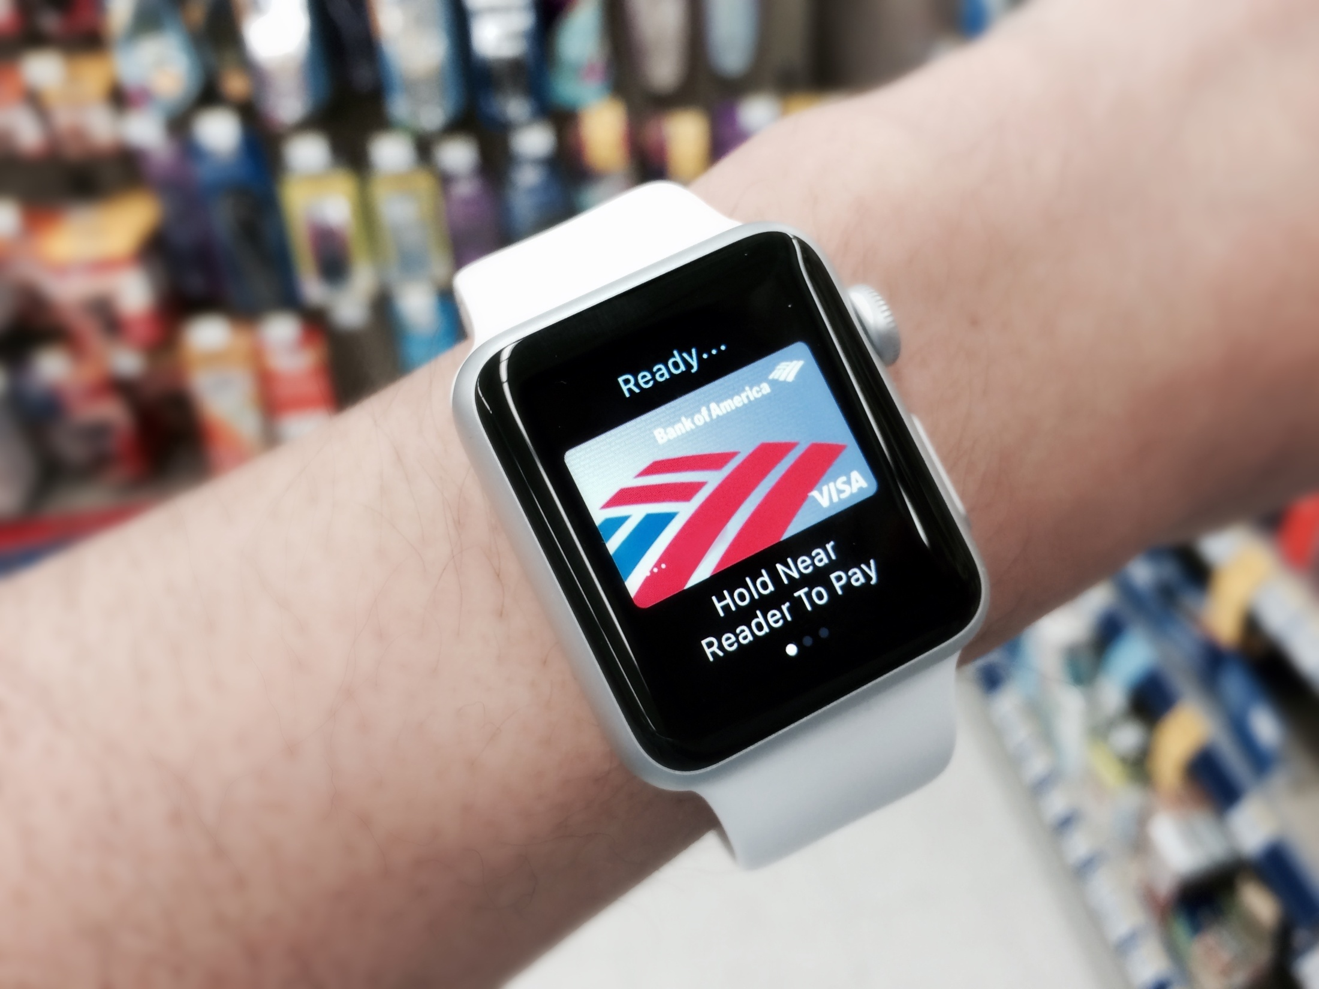
Cashless Society
Contactless credit/debit cards, NFC- and web-enabled phones and digital wallets continue to transform the future of payment methods - with major implications for the way we will shop and interact with brands in the future.

Slide 3
What will happen next?
5 Years ago |  | Now |  | 5 Years time
1 |  | 2 |  | 3
4 |  | 5 |  | 6
7 |  | 8 |  | 9

Slide 4
Test Header
Test paragraph 1
Test paragraph 2
list 1
List 2
A bold word

Slide 5
Why Mac?
Its cool!
Its light!

Slide 6
Why Iphone?
Its fast!
Its cheap!

Slide 7

JPG Logo

Slide 8
Text Pic Split
Here is a string
here is another

Slide 9
PNG Logo

Slide 10
Pic Desc
Here is a string
here is another

Slide 11

JPG Logo
descriptions

Slide 12
GIF Logo

Slide 13
Why Android?
Its great!
Its sweet!

