Slide 1
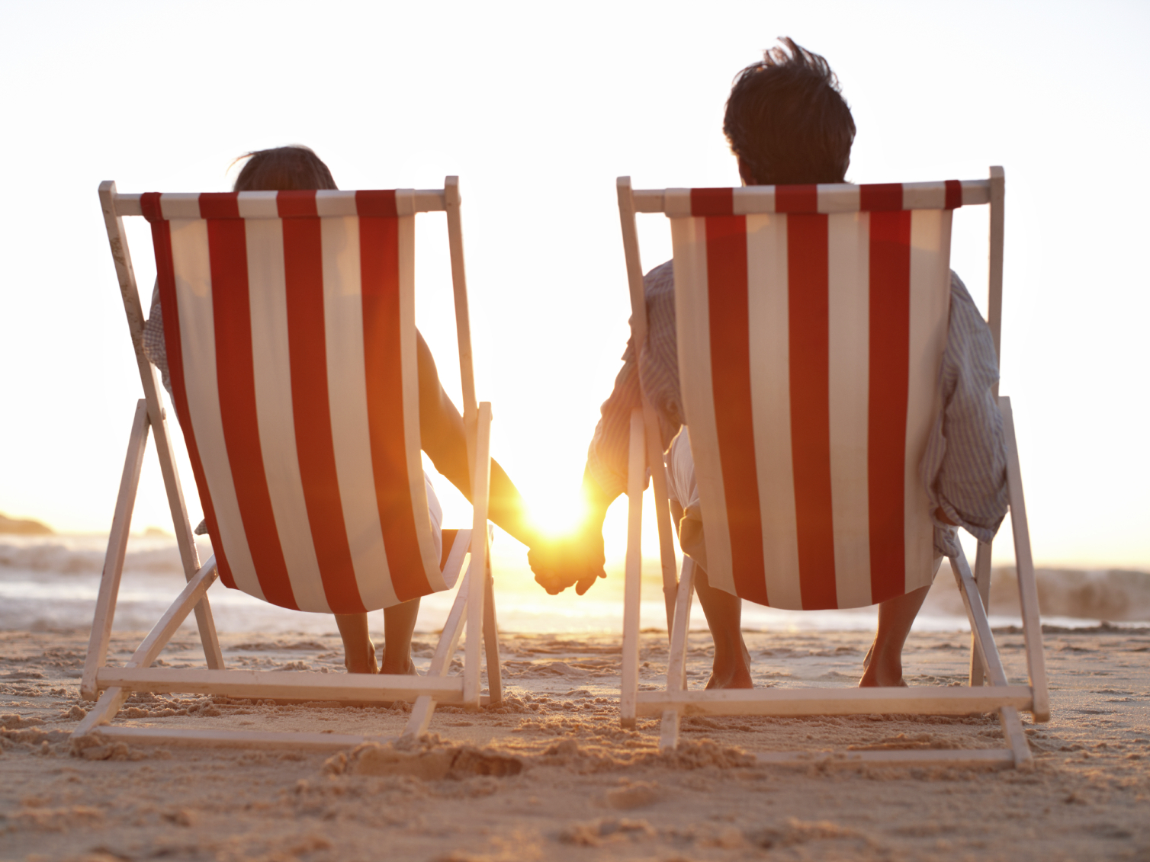
Reasons for going on holiday
“What were your main reasons for going on holiday in 2015? Firstly? And then?” | EU topline and by country | 2016
Notes:
Flash Eurobarometer 432, Preferences of Europeans Towards Tourism
Fieldwork was completed in January 2016.
Image: CC iStock

Slide 2
Reasons for going on holidays in 2015
“What were your main reasons for going on holiday in 2015? Firstly? And then?” | EU 28 | 2016
Sun and beach are still the most popular reasons given for travelling but it has lost some popularity in the last year. Sun alone is less of a determining factor for holiday choices, as consumers look to gain more from their precious moments of downtime
Source: Eurobarometer/FFOnline | Base: 30,105 respondents aged 15+, 2016
Notes:
Flash Eurobarometer 432, Preferences of Europeans Towards Tourism
Fieldwork was completed in January 2016.
Sun/beach Visiting family/friends/relatives Nature (mountain, lake, landscape etc…) City trips Culture (e.g. religious, gastronomy, arts) Wellness/Spa/Health treatment Sport-related activities (e.g. scuba-diving, cycling etc…) Specific events (Sporting events/festivals/clubbing) Rest/recreation (including Wellness/health treatment) Spending time with your family

Slide 3
Reasons for going on holidays in 2015
“What were your main reasons for going on holiday in 2015? Firstly? And then?” | By gender | EU 28 | 2016
Source: Eurobarometer/FFOnline | Base: 30,105 respondents aged 15+, 2016
Notes:
Flash Eurobarometer 432, Preferences of Europeans Towards Tourism
Fieldwork was completed in January 2016.

Slide 4
Reasons for going on holidays in 2015
“What were your main reasons for going on holiday in 2015? Firstly? And then?” | By age | EU 28 | 2016
Sun seeking is less popular with older respondents, who instead are more motivated by cultural holidays.
Source: Eurobarometer/FFOnline | Base: 30,105 respondents aged 15+, 2016
Notes:
Flash Eurobarometer 432, Preferences of Europeans Towards Tourism
Fieldwork was completed in January 2016.

Slide 5
Sun/beach
“What were your main reasons for going on holiday in 2015? Firstly? And then? Sun/beach” | EU 28 | 2016
Right-click on chart and select Edit Data for more countries
Source: Eurobarometer/FFOnline | Base: 30,105 respondents aged 15+, 2016
Notes:
Flash Eurobarometer 432, Preferences of Europeans Towards Tourism
Fieldwork was completed in January 2016.

Slide 6
Visiting family / friends / relatives
“What were your main reasons for going on holiday in 2015? Firstly? And then? Visiting family / friends / relatives” | EU 28 | 2016
Right-click on chart and select Edit Data for more countries
Source: Eurobarometer/FFOnline | Base: 30,105 respondents aged 15+, 2016
Notes:
Flash Eurobarometer 432, Preferences of Europeans Towards Tourism
Fieldwork was completed in January 2016.

Slide 7
Nature (mountain, lake, landscape etc)
“What were your main reasons for going on holiday in 2014? Firstly? And then? Nature (mountain, lake, landscape etc)” | EU 28 | 2016
Right-click on chart and select Edit Data for more countries
Source: Eurobarometer/FFOnline | Base: 30,105 respondents aged 15+, 2016
Notes:
Flash Eurobarometer 432, Preferences of Europeans Towards Tourism
Fieldwork was completed in January 2016.

Slide 8
Culture (religious, gastronomy, arts)
“What were your main reasons for going on holiday in 2015? Firstly? And then? Culture (religious, gastronomy, arts)” | EU 28 | 2016
Right-click on chart and select Edit Data for more countries
Source: Eurobarometer/FFOnline | Base: 30,105 respondents aged 15+, 2016
Notes:
Flash Eurobarometer 432, Preferences of Europeans Towards Tourism
Fieldwork was completed in January 2016.

Slide 9
City Trips
“What were your main reasons for going on holiday in 2015? Firstly? And then? City trips” | EU 28 | 2016
The popularity of city holiday destinations continues; going on city trips has increased by 35% among the EU28 population since 2013.City holidays are most popular with the youngest and oldest respondents and among Poles, Czechs, Italians and Britons.
Right-click on chart and select Edit Data for more countries
Source: Eurobarometer/FFOnline | Base: 30,105 respondents aged 15+, 2016
Notes:
Flash Eurobarometer 432, Preferences of Europeans Towards Tourism
Fieldwork was completed in January 2016.

Slide 10
Wellness / Spa / Health treatment
“What were your main reasons for going on holiday in 2015? Firstly? And then? Wellness / Spa / Health treatment” | EU 28 | 2016
Right-click on chart and select Edit Data for more countries
Source: Eurobarometer/FFOnline | Base: 30,105 respondents aged 15+, 2016
Notes:
Flash Eurobarometer 432, Preferences of Europeans Towards Tourism
Fieldwork was completed in January 2016.

Slide 11
Sport-related activities
“What were your main reasons for going on holiday in 2015? Firstly? And then? Sport-related activities (e.g. scuba-diving, cycling etc.)” | EU 28 | 2016
Right-click on chart and select Edit Data for more countries
Source: Eurobarometer/FFOnline | Base: 30,105 respondents aged 15+, 2016
Notes:
Flash Eurobarometer 432, Preferences of Europeans Towards Tourism
Fieldwork was completed in January 2016.

Slide 12
Specific events
“What were your main reasons for going on holiday in 2015? Firstly? And then? Specific events (sporting events/festivals/ clubbing)” | EU 28 | 2016
Right-click on chart and select Edit Data for more countries
Source: Eurobarometer/FFOnline | Base: 30,105 respondents aged 15+, 2016
Notes:
Flash Eurobarometer 432, Preferences of Europeans Towards Tourism
Fieldwork was completed in January 2016.

