Slide 1
UK Health
Social Media Research

Slide 2
The evolution of regulation debates through the lens of social media
BIG DATA ANALYSIS
The potential introduction of a fat or sugar tax has created substantial debate in the UK - and some of it has naturally unfolded on social media. The chart below looks at conversations regarding such regulation on Twitter, Facebook, blogs and forums and summarises the percentage of social media mentions in each category over a 4.5 year period.
Note how the conversation about a “sugar tax” has overtaken debates surrounding a “fat tax” in 2014.
“Rather than a tax on sugar, why don't they just get food companies to reduce their sugar content & see how that goes before taking my cash!”
“Reading about the tax increase for Cornish pasties & Sausage rolls - Greggs prices will go up 20% for the Tory Fat Tax! unbelievable!........”
Source: nVision’s Social Media Analysis/Crimson Hexagon, UK (English speakers), 2015
Notes:
Period: 01.01.2011 – 19.07.2015
Total number of posts: 34,122
Source breakdown: Twitter (94%), Facebook (2%), blogs (<1%), forums (4%)
Keywords: ((sugar OR fat OR soda) AND (tax OR taxes OR taxed))~1
Country: UK

Slide 3

The Self-Discipline Narrative : growing consumer interest
BIG DATA ANALYSIS
An increasing number of people are looking for online information on “How many calories…”, as indicated by the upward line on the chart to the right, which highlights the consumer interest in more balanced lifestyles. Also note the seasonality pattern, with interest peaking consistently in January, linked to people’s New Year’s resolution mindset.
Consumers turn to the internet in search for advice on how to achieve their self-discipline goals. Phrases such as “How to reduce” and “How to lose weight” were also amongst the popular searches in 2014.
Google Trends is a valuable resource for nVision, allowing us to monitor our social and consumer trends through another lens : the popularity of Google searches over a period of time. (Please refer to the notes page for further information on methodology).
Source: Google Trends (www.google.com/trends/nVision), UK (English speakers), 2015
Notes:
About Google Trends (http://www.google.com/trends)
Google Trends analyses a percentage of Google web searches to determine how many searches have been done for the terms you have entered compared to the total number of Google searches done during that time.
The numbers on the graph reflect how many searches have been done for a particular term, relative to the total number of searches done on Google over time. They do not represent absolute search volume numbers, because the data is normalised and presented on a scale from 0-100. Each point on the graph is divided by the highest point, or 100. When we do not have enough data, 0 is shown. A downward trending line means that a search term's popularity is decreasing. It does not mean that the absolute, or total, number of searches for that term is decreasing.
Trends data is relative, not absolute. Just because two regions show the same number for a particular search term does not mean that their absolute, or total, search volumes are the same. Data from two regions with significant differences in search volumes can be compared equally because the data has been normalised by the total searches from each region.
Source : About Google Trends, 2014.

Slide 4
“In Moderation” : from alcohol to food and everything in between...
BIG DATA ANALYSIS
Purposeful self-moderation has become the dominant theme of health-related behaviours for many, as illustrated by the widespread use of the phrase “in moderation” on Twitter and Facebook. The chart below categorises all social media posts related to moderation over a one year period in three main groups.
Alcohol, wine, food and chocolate are amongst the most mentioned. Many of the posts are health tips or news shares about the positive effects of moderation.
“Be careful of drinking juices. Many contain high sugar and can ruin your diet. Drink in moderation. #healthtip." ”
“You want some ice cream have some gosh darn ice cream friend you earned it but in moderation serving sizes are there for reason.”
“Moderation isn't the point, chemical laden food is, even if you eat itin moderation your still putting something into your body that over time can be changed by the toxins.........”
Source : nVision’s Social Media Analysis/nVision, UK (English speakers), 2015
Notes:
Period: 01.07.2014 - 19.07.2015
Total number of posts: 93,522
Source breakdown: Twitter (89%), Facebook (11%)
Keywords: ("in moderation") AND -https AND -https
Country: UK

Slide 5
“Super-foods” : a niche market staring to go mainstream
BIG DATA ANALYSIS
“Super-foods” and so called “functional foods” have increasingly been attracting more consumer attention.
Brands have been partly responsible for this growing interest, as they respond to concerns about the nutritional value of foods by introducing restorative, functional, beneficial food to their traditional offerings.
From ancient grains to fruit packed with antioxidants and vitamins, foods which were until recently considered health-obsessed consumer territory have firmly moved towards the mainstream.
A certain seasonality is also evident from the chart to the right, as exemplified by the Kale searches. Their popularity typically peaks at the beginning of each year, perhaps as a result of health-oriented New Year’s resolutions, and declines slowly in December and during the holiday period, associated with more indulgence.
100 = Peak searches
Google Trends is a valuable resource for nVision, allowing us to monitor our social and consumer trends through another lens : the popularity of Google searches over a period of time. (Please refer to the notes page for further information on methodology).
Source: Google Trends (www.google.com/trends)/nVision, UK , 2015
Notes:
About Google Trends (http://www.google.com/trends)
Google Trends analyses a percentage of Google web searches to determine how many searches have been done for the terms you have entered compared to the total number of Google searches done during that time.
The numbers on the graph reflect how many searches have been done for a particular term, relative to the total number of searches done on Google over time. They do not represent absolute search volume numbers, because the data is normalised and presented on a scale from 0-100. Each point on the graph is divided by the highest point, or 100. When we do not have enough data, 0 is shown. A downward trending line means that a search term's popularity is decreasing. It does not mean that the absolute, or total, number of searches for that term is decreasing.
Trends data is relative, not absolute. Just because two regions show the same number for a particular search term does not mean that their absolute, or total, search volumes are the same. Data from two regions with significant differences in search volumes can be compared equally because the data has been normalised by the total searches from each region.
Source : About Google Trends, 2014.

Slide 6
Diet control and “free from” foods
BIG DATA ANALYSIS
Consumers’ interest in controlling their nutrition is evident on their social media feeds. The chart below explores mentions of fat-free, gluten-free, sugar-free, dairy-free and carb-free foods on Twitter and Facebook, summarising the percentage of total social media mentions falling within each category between March 2014 and March 2015.
We noted almost 300,000 mentions of foods free from the aforementioned ingredients over a one year period. Gluten-free is a particularly popular topic.
“Thank you @AldiUK for your new line of gluten-free products that I can afford! They're awesome, bring it on!”
“@Tesco why would my local store have stopped stocking gluten-free bread?”
“@TheCooperative just been for gluten-free Coop oats and triple chocolate cookies, best supermarket for gluten-free.”
Source : nVision Social Media Analysis/Crimson Hexagon, UK (English speakers), 2015
Notes:
Period : 30.03.2014 - 30.03.2015
Total number of posts : 246,886
Source breakdown : Twitter (94%), Facebook (6%)
Keywords : (((dairy OR lactose OR gluten OR flour OR wheat OR grain OR carbs OR carb OR carbohydrates OR fat OR cholesterol OR sugar OR nuts OR soya) AND (free OR less OR lower OR low))~2 OR egg-free OR eggs-free OR "egg free" OR "eggs free" OR "no fat" OR #glutenfree OR #dairyfree OR #fatfree OR #lowfat OR #sugarfree OR #lowcarb) AND -(http OR https OR "free range" OR freerange OR “blood sugar”)
Country: UK

Slide 7
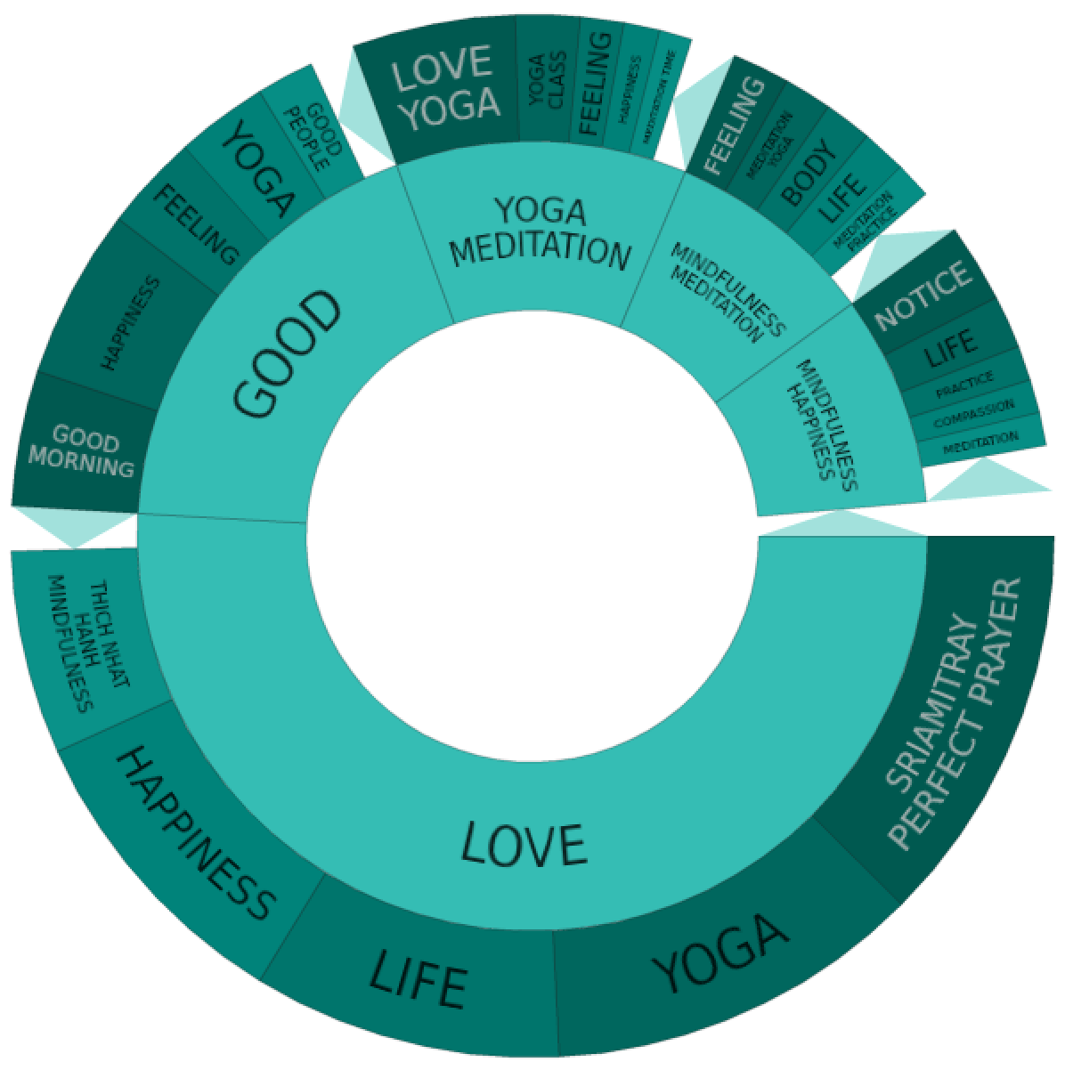
Funda-mentally in control
BIG DATA ANALYSIS
Controlling mood and stress levels has become another goal of consumers and we have seen a recent surge of consumer interest in mindfulness. In the period from March 2014 - March 2015 we measure almost 600,000 mentions of “mindfulness” and “meditation”. The topic wheel illustrates the phrases most frequently mentioned by consumers when sharing on Facebook and Twitter, the outer wheel shows general themes and the inner wheel shows more detailed topics and phrases.
We note the overwhelmingly positive connections to mindfulness (“love”, “good”).
“Can't wait to start meditation class on Saturday. Always nice to cross paths with like minded people”
"Putting foods on a "forbidden" list elevates them to scary status. Don't give it that power. Honing #mindfulness is the ultimate in control”
“Just did my first 10 minute meditation session with the Headspace app - amazing! Thanks @essiebutton for the recommendation : )”
Source : nVision Social Media Analysis/Crimson Hexagon, UK (English speakers), 2015
Notes:
Period : 30.03.2014- 30.03.2015
Total number of posts : 169,972
Source breakdown : Twitter (99%), Facebook (1%)
Keywords : (mindfulness OR #mindfulness OR meditation) AND -http AND –https Country: UK
* The Topic Visualizer shows groups of related posts, based on the themes and topics of conversation.

Slide 8
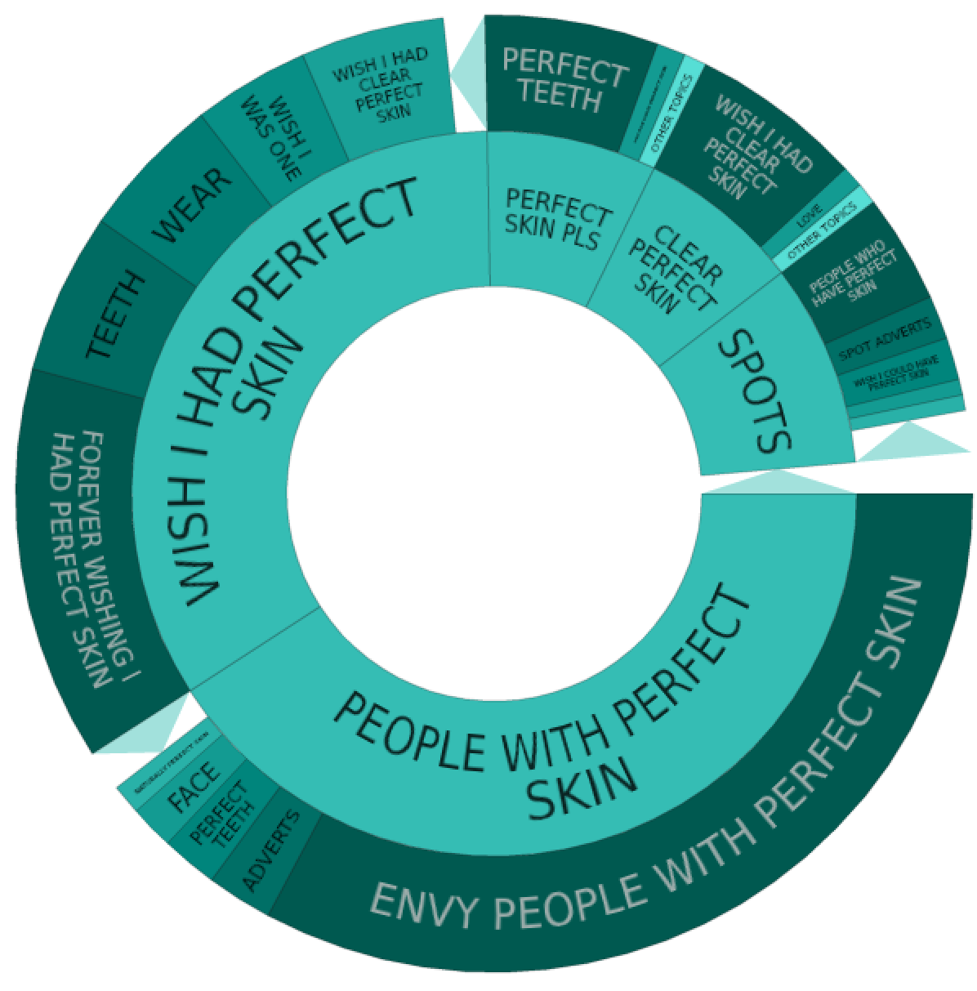
The body perfection dilemma : “I just want to be perfect”
BIG DATA ANALYSIS
The wish for appearance perfection is palpable. We gather here posts mentioning body perfection by category: almost 300,000 over a three year period. More than 30% refer to having a perfect skin. In the topic visualizer on the right we look in detail those who express desire for this and their most common words and phrases: wishing, wanting and envy for those having perfect skin are widespread.
“I wish shops didn't sell beauty products that didn't work. Just sell the perfect skin treatment that'll make us all perfect, k? Thanks..”
Conversations dominated by women: 73% vs 27%
“Just wish I had perfect skin, and didny have to worry about wearing foundation, and not having to cover any spots.”
“Wish I had perfect skin so I didn't have to bother about wearing make up to school.”
“The things I would do for perfect skin. I envy all girls who have good skin. They really don't realize how lucky they are.”
Source: nVision’s Social Media Analysis/Crimson Hexagon, UK (English speakers), 2015
Notes:
Period: 01.01.2012 - 20.07.2015
Total number of posts: 261,415
Source breakdown: Twitter (97%), Facebook (1%), forums (1%)
Keywords: ("perfect body" OR "perfect weight" OR "perfect skin" OR "perfect nose" OR "perfect boobs" OR "perfect appearance" OR "perfect looks" OR "perfect face" OR "perfect eyes" OR "perfect lips" OR "perfect mouth" OR "perfect body") AND -(http OR https OR "perfect in my eyes" OR "in your perfect eyes" OR "skin tone" OR "endless supplies of money")
Country: UK

Slide 9
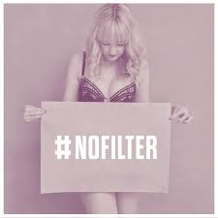
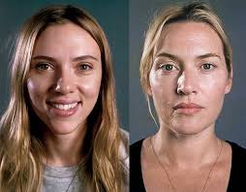


The body perfection dilemma : embracing imperfection also on-trend
BIG DATA ANALYSIS
Social media has been a popular platform for the backlash against body perfection. There are a number of viral hashtags to date, even sometimes supported by celebrities, that signal some fatigue over body-obsession. Interestingly, these campaigns are mostly supported by young female social networkers.
POPULAR HASHTAGS
#nofilter This hashtag has been more than half million times to date in the UK only #nomakeup More than 100,000 mentions
#beyourself More than 50,000 mentions
#loveyourself More than 30,000 mentions
Millennials
“No makeup. No filter. Just all natural beauty and some really good lighting.
#nofilter
#nomakeup
#imcute”
Source: nVision’s Social Media Analysis/Crimson Hexagon, UK (English speakers), 2015
Notes:
Period: 01.01.2012 - 20.07.2015
Total number of posts: 1,475,731
Source breakdown: Twitter (100%)
Keywords: (loveyourself OR beyourself OR "love yourself" OR loveyourbody OR "love your body" OR nofilter OR nomakeup OR "against plastic surgery" OR dontjudgechallenge OR beautyinallchallenge OR choosebeautiful OR "movement for self-esteem" OR girlyoudontneedmakeup)
Country: UK

Slide 10
The emerging conversation about health tracking
BIG DATA ANALYSIS
The chart below explores mentions of several types of tracking apps/devices on Twitter, Facebook and online forums, summarising the percentage of total social media feeds falling within each category since 2011.
Consumer awareness of the new possibilities of smart data is at an explosive stage. Mentions of general fitness apps are most common, followed closely by health apps.
“"Y'day in london was amazing, (first time ive ever hit 10,000 steps on my fitness app) today is going to be better. #LoveLondon”
“Fun nite, i've brushed my teeth wrapped my hair, and put my jam jams on lol..now im gona lay it down and play my "relax n sleep" app!”
"Okay, I was skeptical about this running app I got last night, but it turned out to be so good that I went ahead and got the running beginner's training app for it!”
Source: nVision’s Social Media Analysis/Crimson Hexagon, UK (English speakers), 2015
Notes:
Period : 01.01.2011 - 20.07.2015
Total number of posts : 185,812
Source breakdown : Twitter (96%), forums (2%), Facebook (1%), reviews (1%)
Keywords : ("health tracking" OR "health app" OR "health apps" OR "quantify health" OR "health monitoring app" OR "health monitoring device" OR "health monitoring gadget" OR "fitness tracking" OR "fitness app" OR "fitness apps" OR "fitness monitoring app" OR "fitness monitoring device" OR "fitness monitoring gadget" OR "activity tracking" OR "activity app" OR "activity apps" OR "activity monitoring app" OR "activity monitoring device" OR "activity monitoring gadget" OR "sleep tracking" OR "sleep app" OR "sleep apps" OR "sleep monitoring app" OR "sleep monitoring device" OR "sleep monitoring gadget" OR "exercise tracking" OR "exercise app" OR "exercise apps" OR "exercise monitoring app" OR "exercise monitoring device" OR "exercise monitoring gadget" OR "running app" OR "running apps" OR "quantify running" OR "cycling app" OR "cycling apps" OR "nutrition tracking" OR "nutrition app" OR "nutrition apps" OR "nutrition monitoring app" OR "nutrition monitoring device" OR "nutrition monitoring gadget" OR "diet tracking" OR "diet app" OR "diet apps" OR "diet monitoring app" OR "diet monitoring device" OR "diet monitoring gadget" OR "healthcare tracking" OR "healthcare app" OR "healthcare apps" OR "healthcare monitoring app" OR "healthcare monitoring device" OR "healthcare monitoring gadget" OR "heart rate tracking" OR "heart rate app" OR "heart rate apps" OR "heart rate monitoring app" OR "heart rate monitoring device" OR "heart rate monitoring gadget" OR "diabetes tracking" OR "diabetes app" OR "diabetes apps" OR "diabetes monitoring app" OR "diabetes monitoring device" OR "diabetes monitoring gadget")
Country: UK

Slide 11


For more information including tailored implications for your brand, please contact your Account Team.
Notes:
Photo credits : Cc vancouverfilmschool

