Slide 2
JSP Expression language
The Expression Language (EL) simplifies the accessibility of data stored in the Java Bean component, and other objects like request, session, application etc.
There are many implicit objects, operators and reserve words in EL.
It is the newly added feature in JSP technology version 2.0.

Slide 3
SYNTAX OF EL
${ expression }

Slide 4
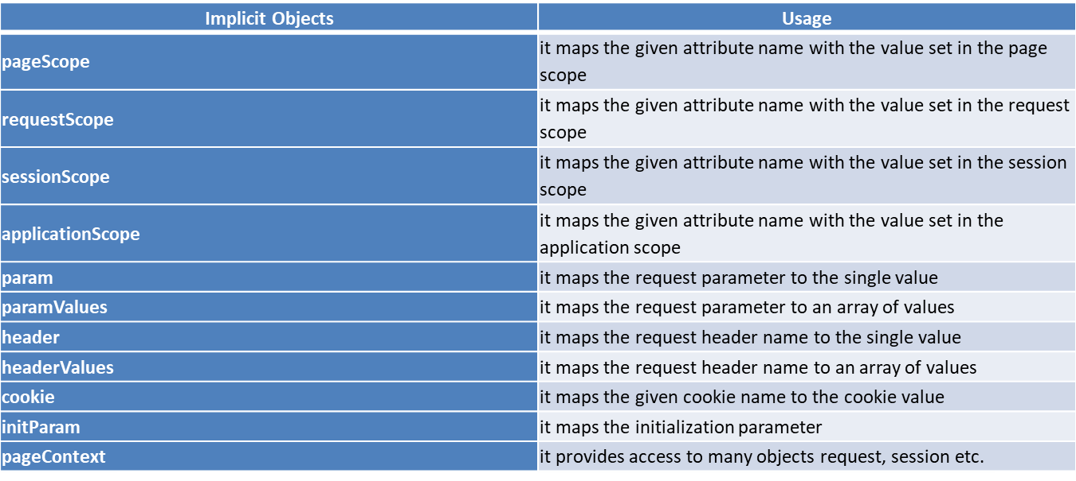
IMPLICIT OBJECTS

Slide 5
EL param example
index.jsp
<form action="process.jsp">
Enter Name:<input type="text" name="name" /><br/><br/>
<input type="submit" value="go"/>
</form>
process.jsp
Welcome, ${ param.name }

Slide 6
EL Sesssion scope
index.jsp
<h3>welcome to index page</h3>
<%
session.setAttribute("user","aaa");
%>
<a href="process.jsp">visit</a>
process.jsp
Value is ${ sessionScope.user }

Slide 7
EL COOKIE
index.jsp
<h1>First JSP</h1>
<%
Cookie ck=new Cookie("name",“lakshan");
response.addCookie(ck);
%>
<a href="process.jsp">click</a>
process.jsp
Hello, ${cookie.name.value}

Slide 8
Precedence ofoperators
[] .
()
-(unary) not ! empty
* / div % mod
+ - (binary)
< <= > >= lt le gt ge
== != eq ne
&& and
|| or
?:

Slide 9
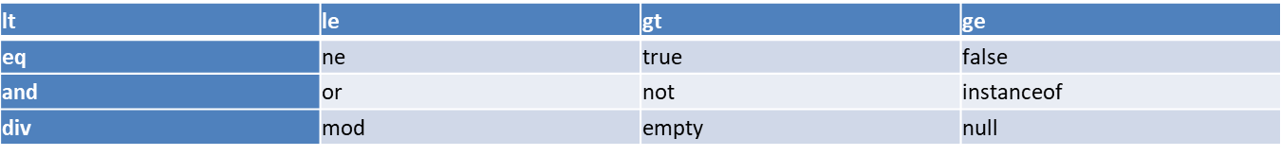
Reserved words

