Slide 1
Quick Guide to SCRUM (Agile)
Richard Speirs
Head of Product Centre
July 2017

Slide 2
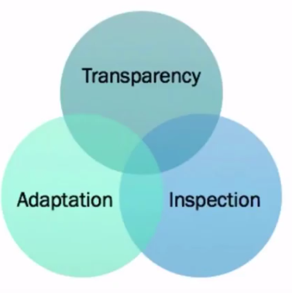
SCRUM
What is SCRUM
Framework, not a methodology
Lightweight
Empirical
Iterative

Slide 3

SCRUM
SCRUM Values

Slide 4
SCRUM
What is SCRUM
Framework, not a methodology
Lightweight
Empirical
Iterative

Slide 5
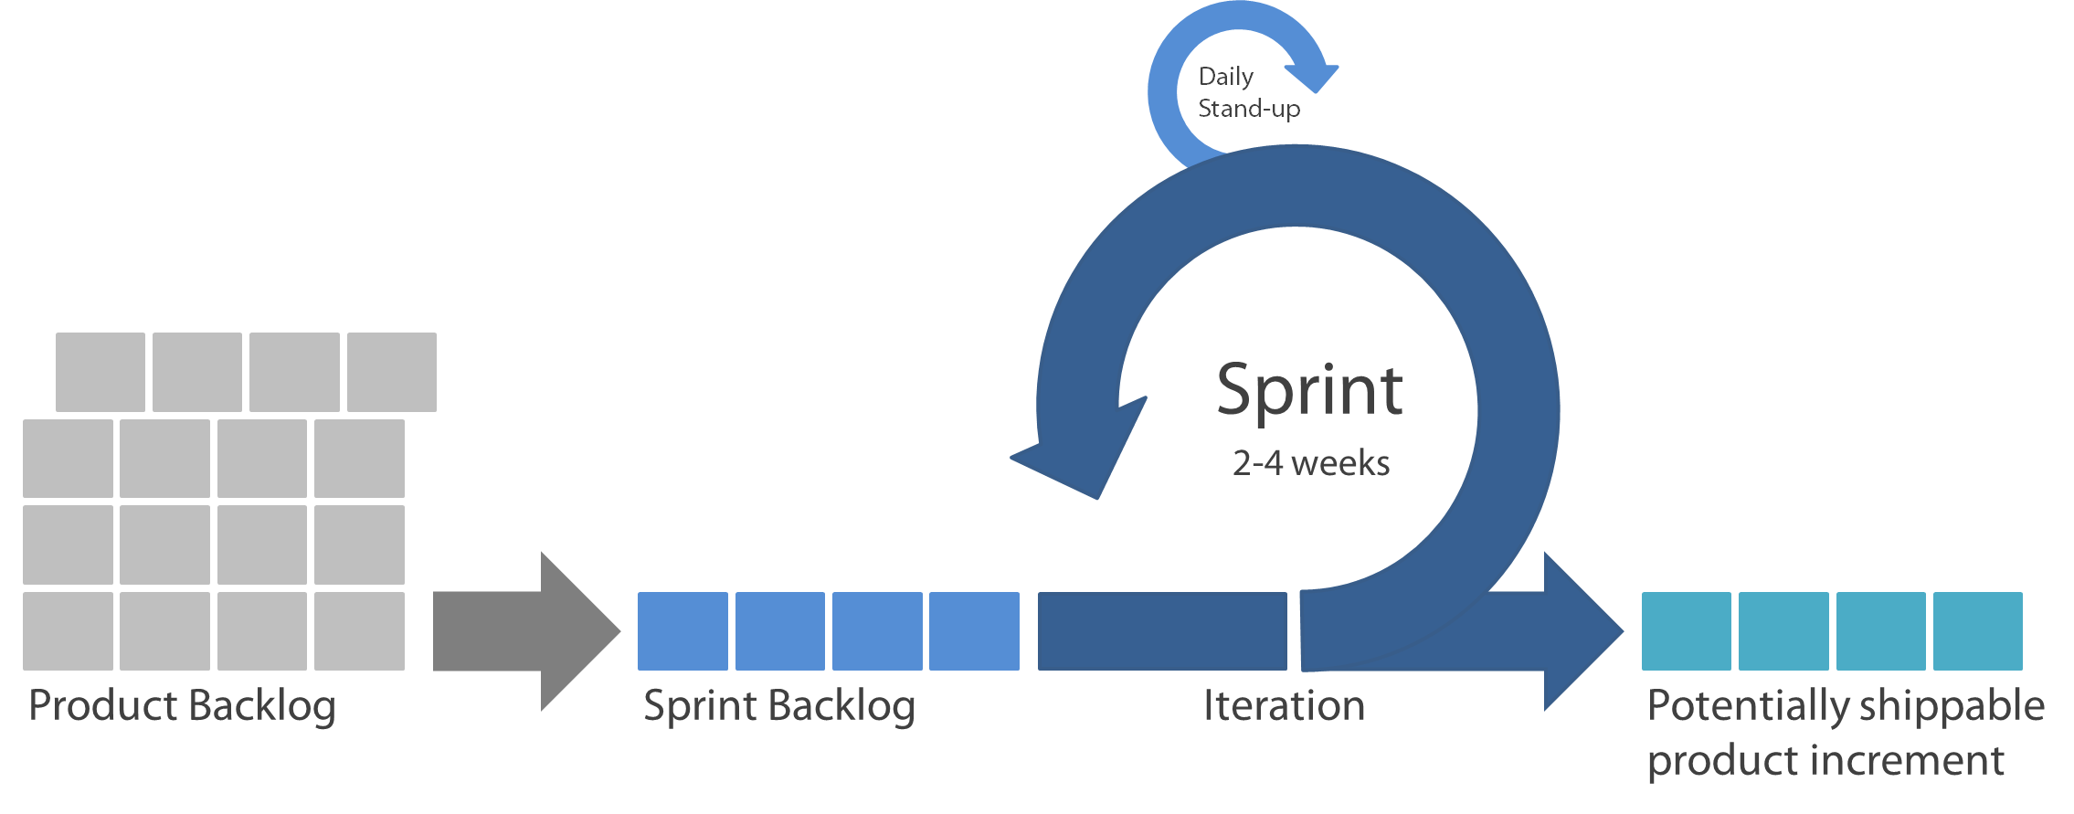
SCRUM
How to comes together
Demonstrated to product owner at sprint review
Retrospective follows demo
PBIs Prioritised by product owner
Effort point estimation by Dev Team
Sprint Planning
PBIs committed to sprint
Tasked out and estimated

Slide 6

SCRUM
Roles
SCRUM Master
Facilitates SCRUM meetings
Removes impediments
Product Owner
Owns product backlog
Responsible for documenting and prioritising PBIs (Requirements)
Development Team
Responsible for delivery of PBIs into Increments
Guides team on how to apply the methodology
Validates product delivers value
Self-Managing
Self-Organising
Coaches
Forecasts not commitments

Slide 7



SCRUM
Artefacts
Product Backlog Item
Unit of work or deliverable
Contributes to the realisation of value (the end product)
Product Backlog
List of ALL PBIs (product backlog items) in priority order
Ordered list of everything that needs to be delivered
Task
A task that needs to be completed
Contributes to delivery of a PBI
Sprint Backlog
List of PBIs that the team has committed to deliver in a sprint
Burndown
Shows progress towards sprint goal
Reflects hours of work remaining in a sprint

Slide 8
SCRUM
Backlog
Only list of open work for the Product
Owned by the Product Owner
Anyone can make suggestions and add to the Backlog
Regularly refined by the SCRUM Team
Ordered, estimated, refined, public and available

Slide 9
SCRUM
Sprint Backlog
All PBIs selected for a Sprint & The Development Teams plan to deliver them
Owned by the Development Team

Slide 10
SCRUM
Events
Meeting | Description | Time Limit | Participants
Daily Stand-up | Did yesterday? Doing today? Impediments? | 15 mins | DT, PO*, SM*
Backlog Refinement | Prioritise, review and estimate product backlog items | 4 hours | PO, DT, SM*
Sprint Planning | Commit product items to sprint and task out | 8 hours | DT, SM*
Sprint Review | Demonstrate completed PBIs to product owner and other interested stakeholders | 4 hours | DT, PO, SM*
*attendance optional
DT = Dev Team PO = Product Owner SM = Scrum Master

Slide 11
SCRUM
Events
Meeting | Description | Time Limit | Participants
Sprint Retrospective | Opportunity for team to reflect on what went well and what didn’t and identify improvement actions | 3 hours | DT, PO, SM
Sprint | Think of it as a mini-project where the team works to deliver the PBIs it committed to deliver in the sprint planning meeting | 1 month | DT
*attendance optional
DT = Dev Team PO = Product Owner SM = Scrum Master

Slide 12
SCRUM
Rules
A team should establish a “definition of done”
The product owner should specify an acceptance criteria for every PBI
Impediments should always be referred to the SCRUM Master
The SCRUM Master doesn't need to be in every meeting
Only the development can speak in the stand-up
Time-boxes must be adhered to
Product owner engagement is essential

Slide 13
SCRUM
In Summary
A Team commits to delivering working software in a Sprint lasting 30 days or less
A time is scheduled to show that software
The Teams creates the software
The team offers their work for inspection and adapts the plan for the next cycle
Repeat…

