Slide 1
Visual Studio Team Services and SCRUM Engagement
Richard Speirs
August 2017

Slide 2
VSTS & SCRUM Engagement
Agenda
Using VSTS
Create dashboards
Reporting Options
Estimates
Creating test plans – How does the testing side of VSTS work and what can it do
Linking Work Item Types
Walkthrough of Work Item Types workflows
Impediments
More reporting options

Slide 3
Using VSTS

Slide 4
But, Before That…

Slide 5
Quick Guide to SCRUM (Agile)
Richard Speirs
September 2017

Slide 6
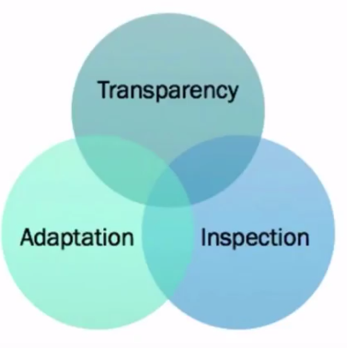
Quick Guide to SCRUM
What is SCRUM
Framework, not a methodology
Lightweight
Empirical
Iterative

Slide 7

Quick Guide to SCRUM
SCRUM Values

Slide 8
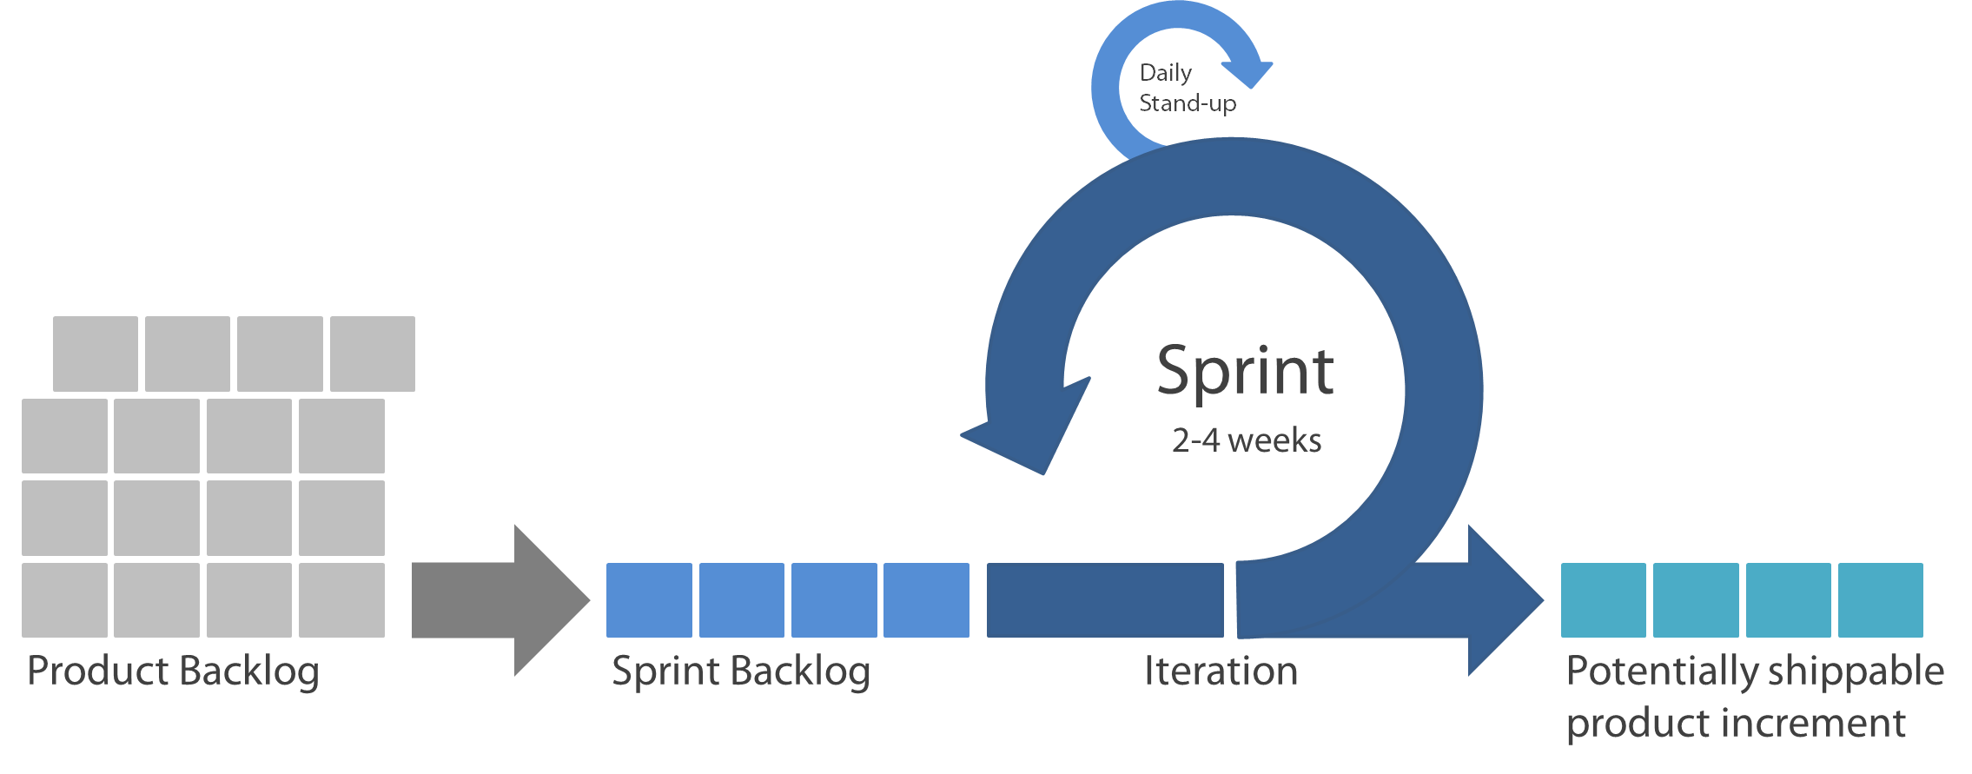
Quick Guide to SCRUM
How SCRUM comes together
Demonstrated to product owner at sprint review
Retrospective follows demo
PBIs Prioritised by product owner
Effort point estimation by Dev Team
Sprint Planning
PBIs committed to sprint
Tasked out and estimated

Slide 9

Quick Guide to SCRUM
SCRUM Roles
SCRUM Master
Facilitates SCRUM meetings
Removes impediments
Product Owner
Owns product backlog
Responsible for documenting and prioritising PBIs (Requirements)
Development Team
Responsible for delivery of PBIs into Increments
Guides team on how to apply the methodology
Validates product delivers value
Self-Managing
Self-Organising
Coaches
Forecasts not commitments

Slide 10



Quick Guide to SCRUM
SCRUM Artefacts
Product Backlog Item
Unit of work or deliverable
Contributes to the realisation of value (the end product)
Product Backlog
List of ALL PBIs (product backlog items) in priority order
Ordered list of everything that needs to be delivered
Task
A task that needs to be completed
Contributes to delivery of a PBI
Sprint Backlog
List of PBIs that the team has committed to deliver in a sprint
Burndown
Shows progress towards sprint goal
Reflects hours of work remaining in a sprint

Slide 11
Quick Guide to SCRUM
The Backlog
Only list of open work for the Product
Owned by the Product Owner
Anyone can make suggestions and add to the Backlog
Regularly refined by the SCRUM Team
Ordered, estimated, refined, public and available

Slide 12
Quick Guide to SCRUM
Sprint Backlog
All PBIs selected for a Sprint & The Development Teams plan to deliver them
Owned by the Development Team

Slide 13
Quick Guide to SCRUM
SCRUM Events
Meeting | Description | Time Limit | Participants
Daily Stand-up | Did yesterday? Doing today? Impediments? | 15 mins | DT, PO*, SM*
Backlog Refinement | Prioritise, review and estimate product backlog items | 4 hours | PO, DT, SM*
Sprint Planning | Commit product items to sprint and task out | 8 hours | DT, SM*
Sprint Review | Demonstrate completed PBIs to product owner and other interested stakeholders | 4 hours | DT, PO, SM*
*attendance optional
DT = Dev Team PO = Product Owner SM = Scrum Master

Slide 14
Quick Guide to SCRUM
SCRUM Events
Meeting | Description | Time Limit | Participants
Sprint Retrospective | Opportunity for team to reflect on what went well and what didn’t and identify improvement actions | 3 hours | DT, PO, SM
Sprint | Think of it as a mini-project where the team works to deliver the PBIs it committed to deliver in the sprint planning meeting | 1 month | DT
*attendance optional
DT = Dev Team PO = Product Owner SM = Scrum Master

Slide 15
Quick Guide to SCRUM
SCRUM Rules
A team should establish a “definition of done”
The Product Owner should specify an acceptance criteria for every PBI
Impediments should always be referred to the SCRUM Master
The SCRUM Master doesn't need to be in every meeting
Only the development team can speak in the stand-up
Time-boxes must be adhered to
Product Owner engagement is essential

Slide 16
Quick Guide to SCRUM
SCRUM Summary
A Team commits to delivering working software in a Sprint lasting 30 days or less
A time is scheduled to show that software
The Teams creates the software
The team offers their work for inspection and adapts the plan for the next cycle
Repeat…
Go to:
https://www.scrum.org/ (PSM)
https://www.scrumalliance.org/ (CSM)

Slide 17
Using VSTS

Slide 18
VSTS & SCRUM Engagement
Using VSTS
Access
https://universityofnottingham.visualstudio.com/ProductCentre.Main/
Security
All-IS-Staff (AD Group) has access to all projects
Non-IS Staff need adding to individual projects on case-by-case
Can be accessed outside UoN network
Licencing
Free to MSDN Licence holders
Limited for non-MSDN Licence holders
CAL (Client Access Licence) licences could be purchased

Slide 19
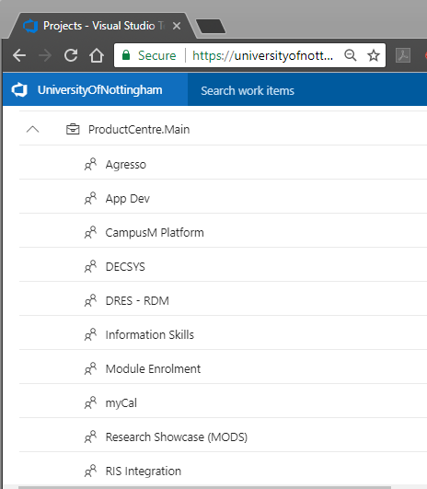
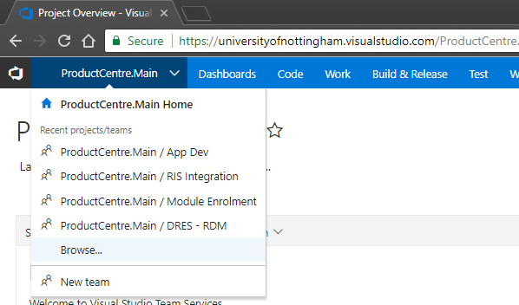
VSTS & SCRUM Engagement
Using VSTS
Browse for your projects…

Slide 20
Creating Dashboards

Slide 21
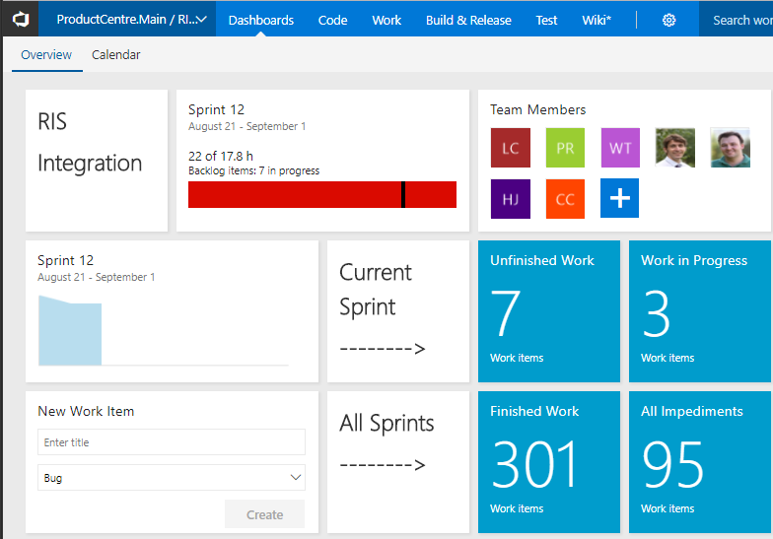
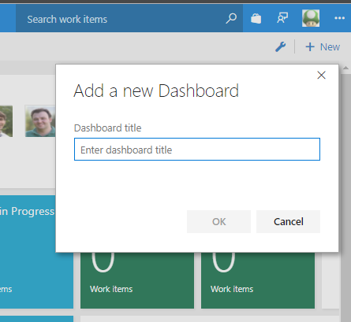
VSTS & SCRUM Engagement
Creating Dashboards
Information Rich Metrics

Slide 22
Reporting Options

Slide 23
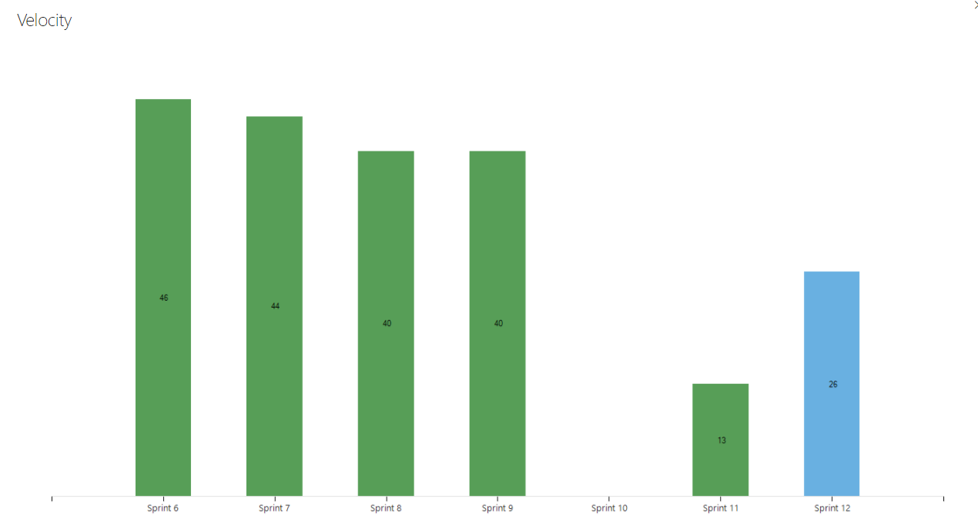
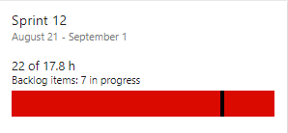
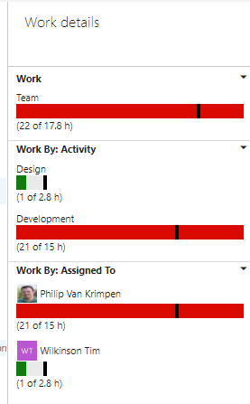
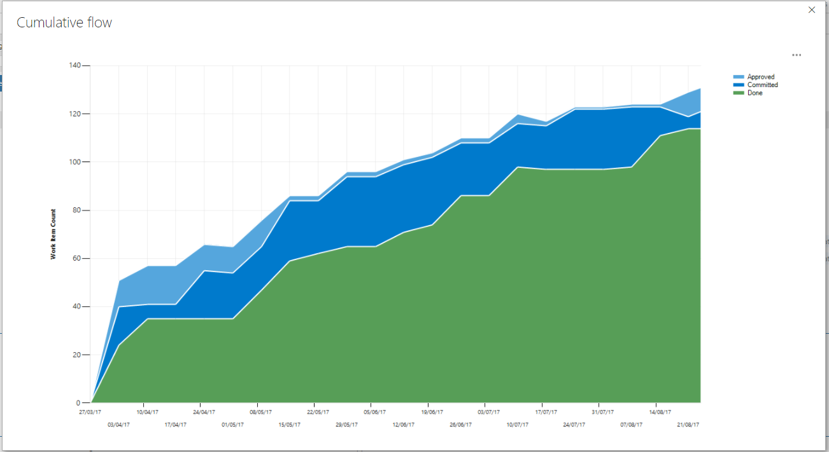
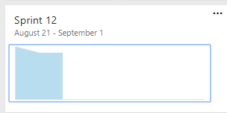
VSTS & SCRUM Engagement
Reporting Options
At a glance - Live

Slide 24
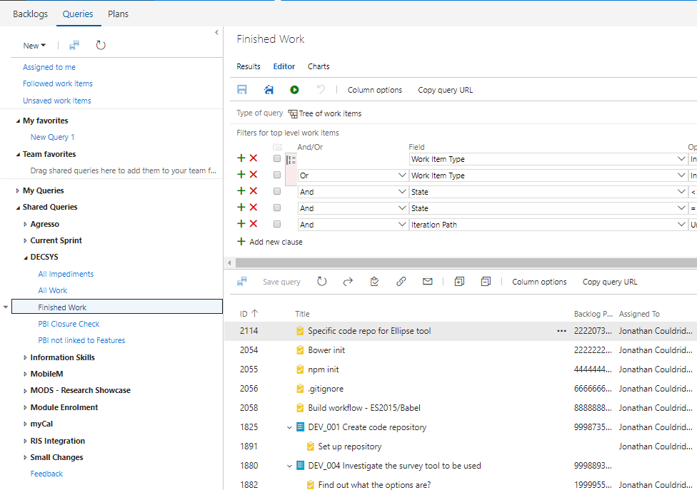
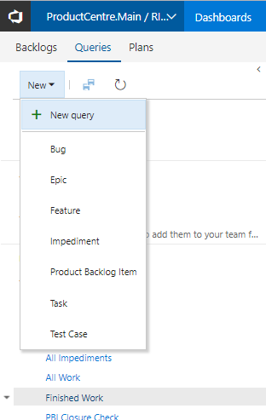
VSTS & SCRUM Engagement
Reporting Options
Deep dive with queries

Slide 25
Estimating Process

Slide 26
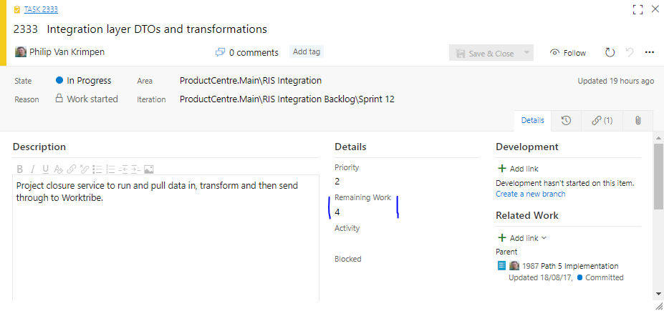
VSTS & SCRUM Engagement
Estimating in VSTS
Remaining Hours

Slide 27
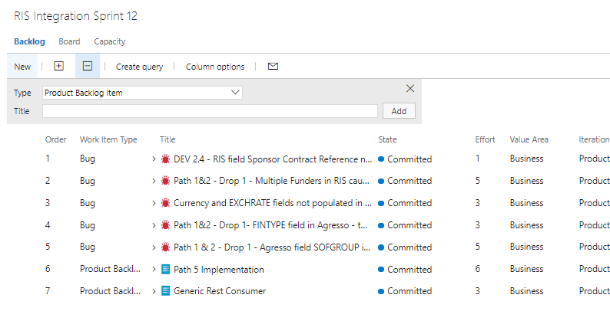

VSTS & SCRUM Engagement
Estimating in VSTS
Effort Points… Fibonacci Scale
(Planning Poker)

Slide 28
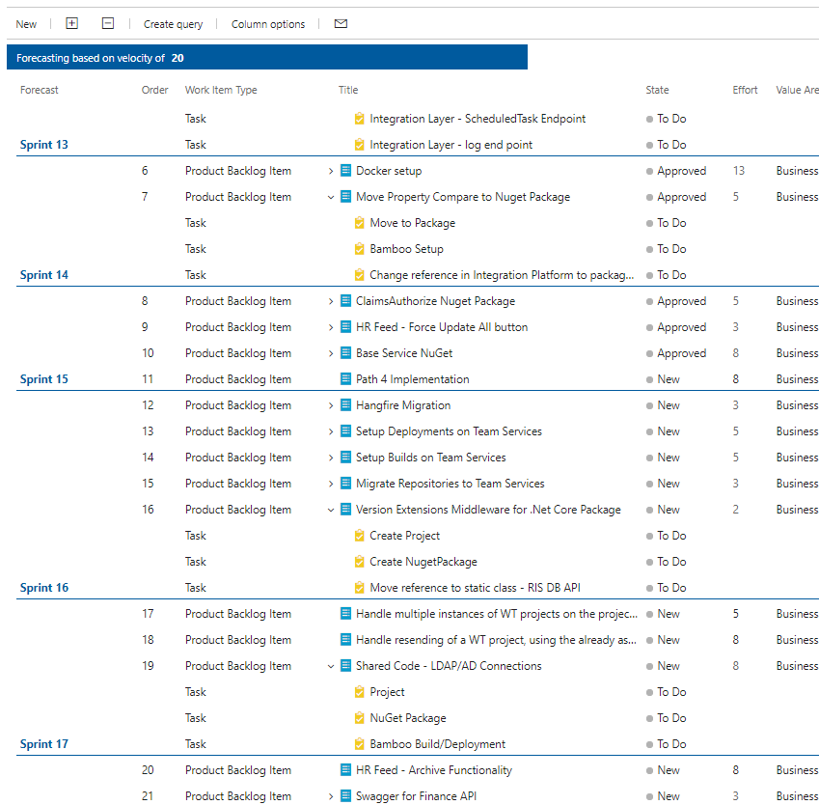
VSTS & SCRUM Engagement
Estimating in VSTS
Effort Points… For forecasting

Slide 29
Linking Item Types

Slide 30
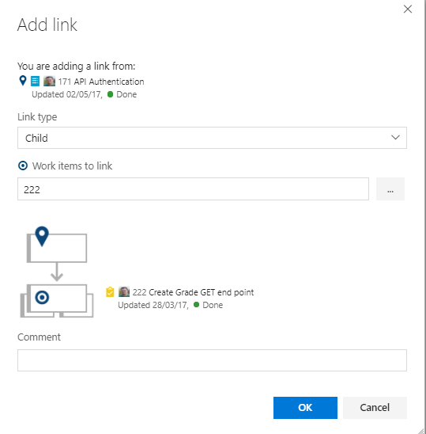
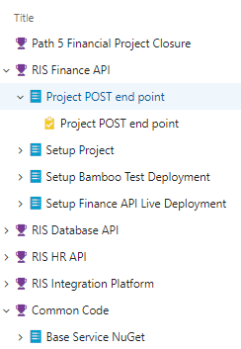
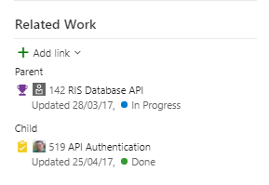
VSTS & SCRUM Engagement
Linking Types
Feature → PBI → Task

Slide 31
WIT Workflows

Slide 32
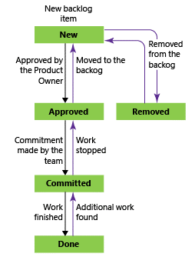
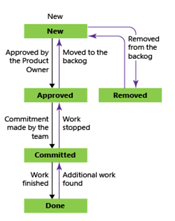
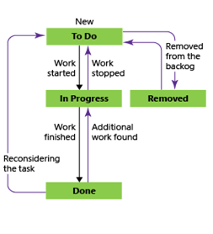
VSTS & Project Team Engagement
VSTS & SCRUM Engagement
At a WITs end?
Product Backlog Item (PBI)
Bug
Tasks

Slide 33
Test Specific Information

Slide 34

VSTS & SCRUM Engagement
Test Specific

Slide 35
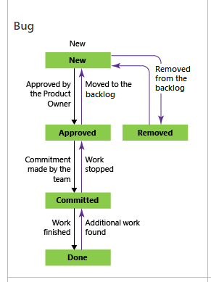
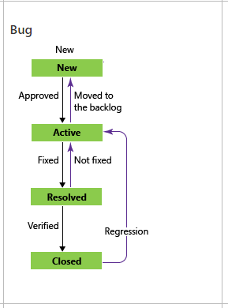
VSTS & SCRUM Engagement
Test Specific
Currently…
To Be…

Slide 36
Impediments

Slide 37
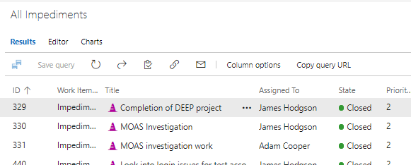
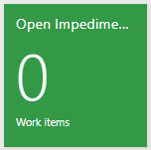
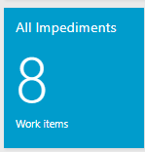
VSTS & SCRUM Engagement
Impediments
Anything that prevents a team member from performing work as efficiently as possible is an impediment.
Each team member has an opportunity to announce impediments during the daily Scrum meeting.
The Scrum Master & Product Owners are charged with ensuring impediments get resolved.
Scrum Masters can arrange sidebar meetings when impediments cannot be resolved on the spot in the daily Scrum meeting.

Slide 38
More Reporting

Slide 39

VSTS & SCRUM Engagement
More Reporting

Slide 40
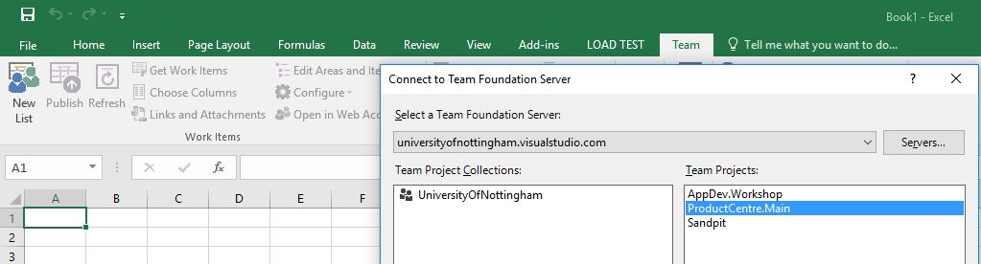
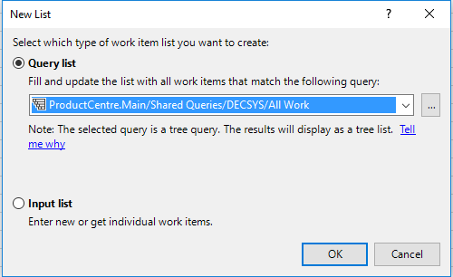
VSTS & SCRUM Engagement
More Reporting

Slide 41
VSTS & SCRUM Engagement
Reporting Options
Remember this…

Slide 42
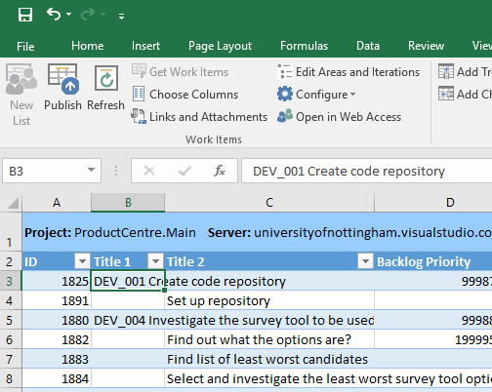
VSTS & SCRUM Engagement
More Reporting

Slide 43
Q&A

