Slide 1
Knowledge Review
Chapters 24-27

Slide 2
24 Electric Potential
1 Electric Potential & Potential Energy 电势和势能
2 Electric Potential due to Point Charges 点电荷电势
3 Calculating Potential from Field 从电场算电势
4 Calculating Potential by Superposition 叠加原理算电势
5 Calculating Field from Potential 从电势算电场

Slide 3
Keywords:
Conservative Force, Potential Energy
Electric Potential, Electric Potential Energy, Electron-volt
Equipotential Surface
Potential Difference, Zero Potential

Slide 4
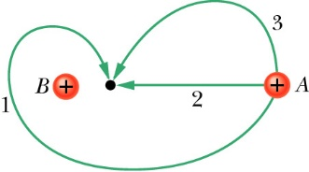
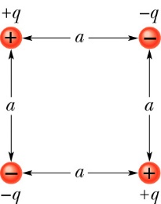
(1) Electric potential energy 电势能
Like the gravitational force, the electrostatic force is conservative.. There is a potential energy associated with a conservative force. 保守力
Circuital theorem of electrostatic field 环路定理
The difference of the electric potential energy of a system changing from an initial configuration 构型 to a final configuration is related to the work done W by the electrostatic force on the system by

Slide 5
(2) Electric potential 电势
The potential energy per unit charge at a point in an electric field set up by other objects is called the electric potential of the field.
Electric potential difference
Unit: 1 V = 1 J/C
▲ Electric potential is associated with the electric field.
▲ The charged object sets up electric potential V at points throughout its electric field.
▲ If we place a charged particle q at a point where we know the pre-existing electric potential V, we can immediately find the potential energy of the configuration.
Notes:
注意区分电势和电势能

Slide 6
Example 1: In a uniform electric field E = 150 N/C, an electron moves a distance d = 5.20 m along the opposite direction of the field.
(a) What is the change in the electric potential energy of the electron? (b) What is the change in the electric potential of the field?
Solution: (a)
electron-volt 电子伏特 unit of energy
-e
(b)

Slide 7
● The reference point cannot be at ∞ or 0.
选择无穷远为零势能点的前提是带电体几何尺寸有限。

Slide 8
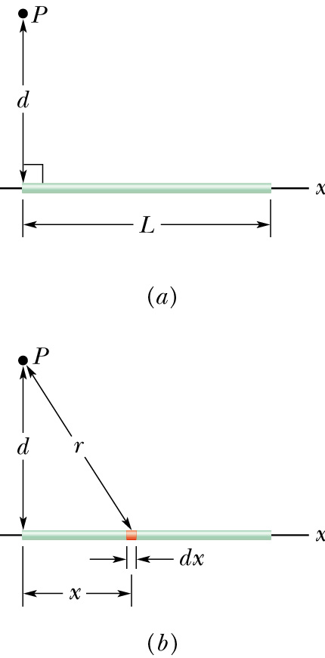
Example 6: From the electric potential calculate the electric field of a line of charge at point P (perpendicular distance d from the left end).
r
At point P(0,y)
x
dx

Slide 9
25 Capacitance
1 Capacitor and Capacitance 电容器和电容
2 Calculating Capacitance 计算电容
3 Capacitors in Parallel and in Series 电容并联和串联
4 Energy of Electric Field 电场的能量
5 Capacitor with a Dielectric 电介质
6 Gauss’ Law in Dielectric 电介质中的高斯定理

Slide 10
Keywords:
Capacitance, Capacitor, Parallel-plate capacitance
Two Isolated conductors, Positive terminal, Negative terminal
Capacitors in parallel, Capacitors in series
Equivalent capacitor
Electric potential energy, Electric field energy density
Dielectric, Dielectric constant
Breakdown potential
Polar dielectrics, Nonpolar dielectrics
Gauss’ law with a dielectric

Slide 11
(2) Capacitance 电容
The capability of how much charge a capacitor can store is called capacitance.
q is the charge of a plate and V_{ab} is the potential difference between the two plates.
C depends only on geometry (几何结构) of the conductor.
Unit: farad 法[拉], 1 F = 1 C/V
1μF=10⁻⁶ F 微法 1pF= 10⁻¹² F 皮法

Slide 12
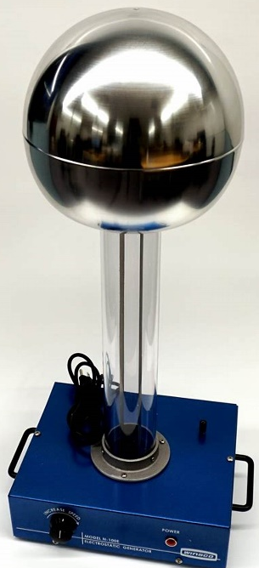
(3) Spherical Capacitor 球形电容器
A capacitor consists of two spherical shells of radii a<b.
a
b
Large radius
Narrow gap

Slide 13
When there is a combination of capacitors in a circuit, we can replace that combination with an equivalent capacitor. 等效电容器
(1) Capacitors in Parallel 并联
+q₁
+q₂
+q₃
V
B
等压
电荷求和
-q₁
C₁
-q₂
C₂
-q₃
C₃
V =V₁ =V₂ =V₃
q = q₁+ q₂+ q₃

Slide 14
(2) Capacitors in Series 串联
q = q₁= q₂=q₃
+q
-q
V =V₁ +V₂ +V₃
C₁
+q
-q
C₂
+q
-q
C₃
等电荷
电压求和

Slide 15
Example 2: A 3 μF capacitor and a 6 μF capacitor are connected
(a) in parallel and (b) in series across an 18 V battery. Determine the equivalent capacitance and total charge deposited.
a
(a)
a
(b)
C₂
C₁
+Q₁
C₁
+Q₁
+Q₂
-Q₁
V=V_{ab}
V=V_{ab}
c
-Q₁
-Q₂
C₂
+Q₂
-Q₂
b
b
Equivalent capacitance
Equivalent capacitance
Total charge
Total charge

Slide 16
Example 3: (a) Find the equivalent capacitance.
(b) If V =12.5 V, what is the charge on C₁?
Solution (a)
C₁
C₂
V
C₃
Solution (b)
C₁ = 12.0 μF
C₂ = 5.30 μF
C₃ = 4.50 μF

Slide 17
To charge a capacitor and store electric potential energy in it, work must be done by an external force.
V’
q’
-q’
B
parallel-plate capacitor
Energy density of an electric field 能量密度
A
d

Slide 18
Example 4: V = 48V, C₁ = 9.0μF, C₂ = 4.0 μF and C₃ = 8.0 μF.
(a) Determine the equivalent capacitance of the circuit.
(b) Determine the total energy stored in the three capacitors.
Solution:
The equivalent capacitance of C₂ and C₃:
C₁
V
C₂
C₃
The equivalent capacitance of the three capacitors:
The energy stored in the capacitors:

Slide 19
(2) A point charge in a dielectric
In a region completely filled by a dielectric, all electrostatic equations containing permittivity constant ε₀ are to be replaced with κ ε ₀.
Vacuum
Dielectric
q
q
For a fixed distribution of charges
Without dielectric
With dielectric

Slide 20
Example 7: A parallel-plate capacitor, C=13.5pF, charged V=12.5V and then disconnected. A porcelain (瓷) slab κ = 6.5 is slipped between the plates.
(a) What is the potential energy before and after insertion?
(b) What is the work done by the person who inserts the dielectric slab?
Solution: (a)
(b)
The capacitor will pull the dielectric slab in.

Slide 21

Without the dielectric, charge on the plate is q
+
+
+
+
+
+
+
+
+
+
+
+
+
+
-
-
-
-
-
-
-
-
-
-
-
-
-
-
Gauss’s Law in Vacuum
A
With the dielectric，there is induced charge 感应电荷 (-q’)
Gauss’s Law for induced charge
Notes:
‹#›
‹#›
‹#›
‹#›
‹#›
‹#›

Slide 22
1. The flux integral involves , not just
Electric displacement vector 电位移矢量
Gauss’ law with dielectric
2. The charge q enclosed by the Gaussian surface is the free charge only.
q: free charge
3. Original statement of Gauss’s law in vacuum.
4. Modified statement of Gauss’s law with dielectric.

Slide 23

Example 8: A conducting sphere of radius a with charge q is surrounded by a concentric dielectric spherical shell of radius b, the dielectric constant is κ. Find the electric field at any point in the space.
Solution:
r < a：
E=0
a < r < b：
Using Gauss’ law with dielectric
b
o
r
a
r
r > b

Slide 24
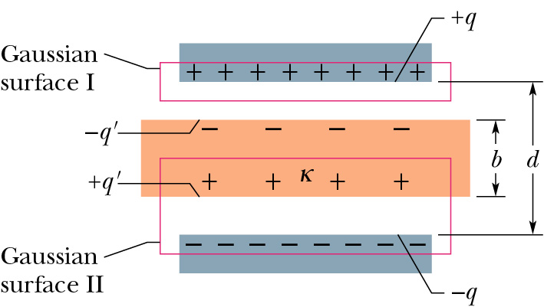
Example 9: A parallel-plate capacitor of plate area A = 115 cm² and plate separation d = 1.24cm. A potential difference V₀ = 85.5V is applied by connecting a battery. The battery is then disconnected, and a dielectric slab of thickness b = 0.78cm and dielectric constant κ =2.61 is placed between the plates.
(a) What is the capacitance C₀ before the dielectric slab is inserted?
(b) What is the free charge appearing on the plates?
(c) What is the electric field E₀ in the gaps between the plates and the dielectric slab?
For Gaussian surface I:

Slide 25
(d) What is the electric field E₁ in the dielectric slab?
For Gaussian surface II:
(e) What is the potential difference V between plates after the slab has been introduced?
(f) What is the capacitance C with the slab in place between the plates of the capacitor?

Slide 26
Chapter 26 Current and Resistance
1 Electric Current 电流
2 Current Density 电流密度
3 Resistance and Resistivity 电阻和电阻率
4 Ohm’s Law 欧姆定律
5 Power in Electric Circuits 电流的功率

Slide 27
Keywords:
Electric current, Motion of charge carriers, Conduction electrons
Current density, Current density vector, Streamlines
Drift speed, Carrier charge density
Resistance, Resistivity, Conductivity
Ohm’s law, Mean free time, Mean free distance
Power in electric circuits
Semiconductor, Superconductor

Slide 28
-e
Charge dq passes through a hypothetical plane in time dt, then the current i through that plane is defined as
-e
-e
-e
Area A
电荷的时间微分是电流
Total charge q passes through surface A from t₁ to t₂
电流的时间积分是电荷

Slide 29
We determine the resistance between any two points of a conductor by applying a potential difference V between those points and measuring the current i that results. The resistance R is defined as
Resistor symbol
The resistivity 电阻率 of a material is defined as
The unit of resistivity in SI is ohm-meter (Ω·m).
Conductivity 电导率
Notes:
Need capacitors pictures

Slide 30
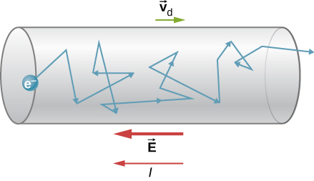
Microscopic view of conduction in metals
No current → Charge carriers move randomly → No net motion in any direction
A current → Charge carriers still move randomly, but tend to drift → A net motion in a direction
Drift speed vd
漂移速率
ne carrier charge density
Random-motion speed of an electron: v ~ 10⁶ m/s
Drift speed 漂移速率 of an electron: v_{d} ~ 10⁻⁴ to 10⁻⁵ m/s

Slide 31
If the density and the mean free time of electrons in metals are independent of the electric field, then metals obey Ohm’s law.

Slide 32
i
B
Device
V
i
Power is the rate of electric energy transfer from the battery to the device.
For any device
(resistor, motor, capacitor)
For a resistor only
Notes:
Need capacitors pictures

Slide 33
27 Circuits
1 Emf and Emf Devices 电动势和电源
2 Single-Loop Circuit 单环路电路
3 Resistances in Series and in Parallel
4 Multiloop Circuits 多环路
5 RC Circuits

Slide 34
Keywords:
Electromotive force (emf)电动势, emf device,
Ideal emf device, Real emf device
Change in potential in traversing a resistance
Change in potential in traversing an ideal emf device
Resistance in series, Resistance in parallel
Potential difference across a real battery
Kirchhoff’s Loop rule环路定则, Kirchhoff’s junction rule结点定则
Power of energy transfer, Power of energy dissipation
Ammeter, Voltmeter
RC circuit, capacitive time constant

Slide 35
2 Single-Loop Circuit 单环路
Potential method to analyze electric circuits
Thus the potential here is V_{a} + E
In a resistor, the current flows from higher to lower potential.
i
As we move across the battery, the potential increases by E .
As we move across the resistor, the potential decreases by iR .
E
R
a
Start here at point a. Call the potential here V_{a}.
The potential here is V_{a} + E - i R.
But this the same as V_{a}.
V_{a} + E - i R = V_{a}
ε - i R = 0
Kirchhoff’s loop rule 基尔霍夫环路定理: The algebraic sum (代数和) of the changes in potential encountered in a complete traversal 遍历 of any loop of a circuit must be zero.

Slide 36
3 Resistances in Series and in Parallel
b
i
b
i
R₁
i₁
i₂
i₃
V₁
E
V
R₁
R₂
R₃
E
V
R₂
V₂
a
R₃
V₃
b
i
a
b
E
R_{eq}
i
V
E
R_{eq}
a
V
a

Slide 37
Kirchhoff’s junction rule: 基尔霍夫结点定律 The sum of the currents entering any junction must be equal to the sum of the currents leaving that junction. (Conservation of charge for steady flow)
R₁
R₃
i₁
a
i₃
i₂
R₂
E₃
E₁
Loop
1
Loop
2
E₂
R₄
i₁
i₃
b
R₅
3 unknowns,
3 independent equations
Junction rule at junction a
Loop rule on loop 1
Loop rule on loop 2

Slide 38
Definition of parallel: Two elements are in parallel if (and only if) you can make a loop that contains only those two elements.
Definition of series: Two elements A and B are in series if (and only if) every loop that contains A also contains B.
I₁
R₁=10 Ω
Example 2: (a) Identify if resistors R₁ and R₂ are in parallel or in series.
(b) Find the currents I₁ and I₂.
I₂
R₂=10 Ω
Answer: (a) Neither.
E₂ = 5.0 V
I
Answer: (b) I₁ = 1.0A, I₂ = 0.5A
-
+
E₁ = 10 V

Slide 39
5 RC Circuits 电阻-电容电路
Charging a capacitor 充电
a
R
i
a
R
S
S
b
b
E
C
E
C
No charge
initial
At t = 0, switch to position a

Slide 40
一阶微分方程
解的一般形式

Slide 41
Example 4: In discharging a capacitor, in terms of RC, (a) when will the charge on the capacitor be half its initial value? (b) when will the energy stored in the capacitor be half its initial value?
Solution (a)

Slide 42
Solution (b)

