Slide 1
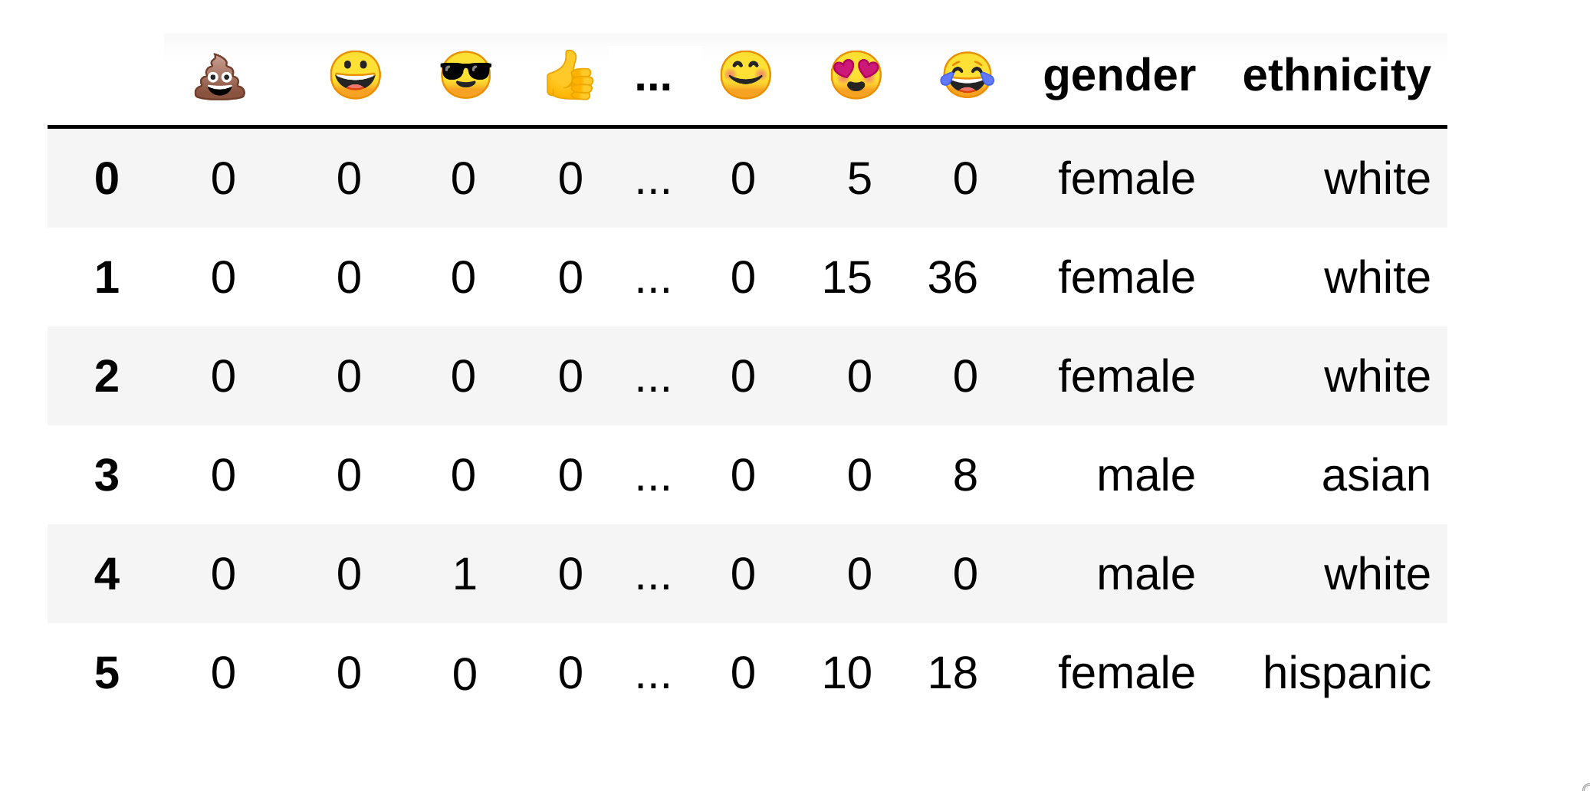
Emoji Count
User

