Slide 1
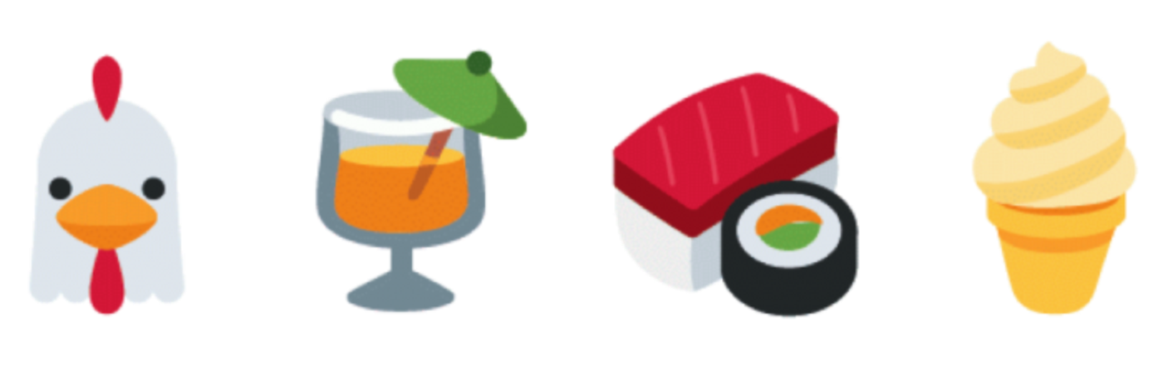
Emojis Usage in Social Media by Demographics
BY:
STYLIANOS NICOLETTI
SUPERVISOR:
PROFESSOR WALID MAGDY

Slide 2
Quick Reminder
Analyze usage of emojis across Tweeter
Know if emojis are used differently by different groups
Groups:
  Gender (Male, Female)
  Race (White, Black, Hispanic, Asian)
  Location (Worldwide, London, New York City, Johannesburg)

Slide 3
Why is this important?
Text mining is getting a lot attention the last years
Emojis have become popular
Use captured data to:
  Find new trends,
  Make recommendations,
  Gather feedback on products or services

Slide 4
What I have done so far
Gathered millions of public Tweets
Extracted Emojis
Performed statistical analysis
Built models for gender and race detection of users using emoji

Slide 5
Annotated Tweeter Data
Annotated users data with valid photos
Thanks to Alexander Robertson - Research Postgraduate Student
 | White | Black | Asian | Hispanic | Total
Male | 5,244 | 4,203 | 509 | 249 | 10.025
Female | 4,704 | 3,936 | 782 | 205 | 9,627
Total | 8,948 | 8,139 | 1,291 | 454 | 19,382

Slide 6
Statistical Analysis
For each group of persona, the following analysis was applied:
  Percentage of usage of emojis
  Top used emojis
  Distinctive emojis

Slide 7
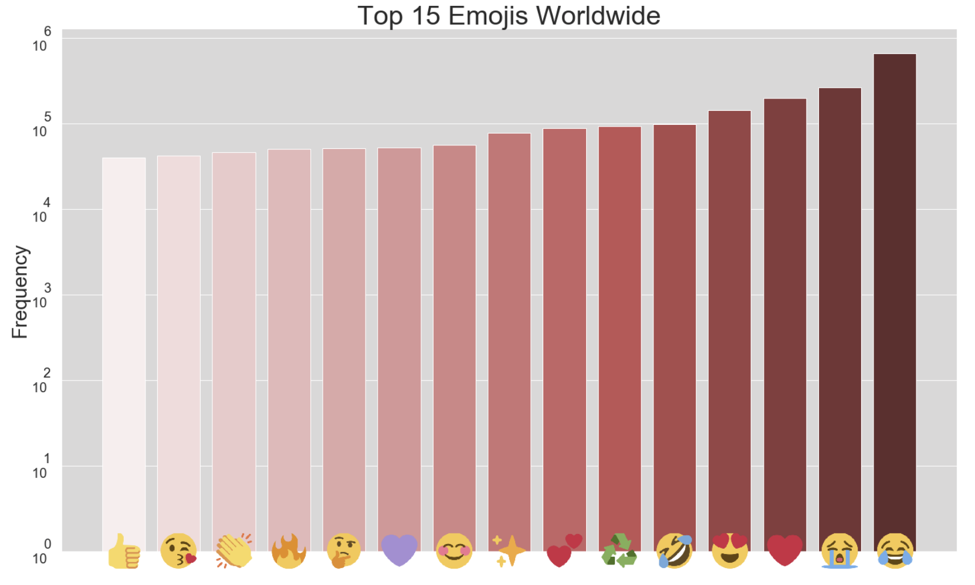
Top Used Emojis

Slide 8
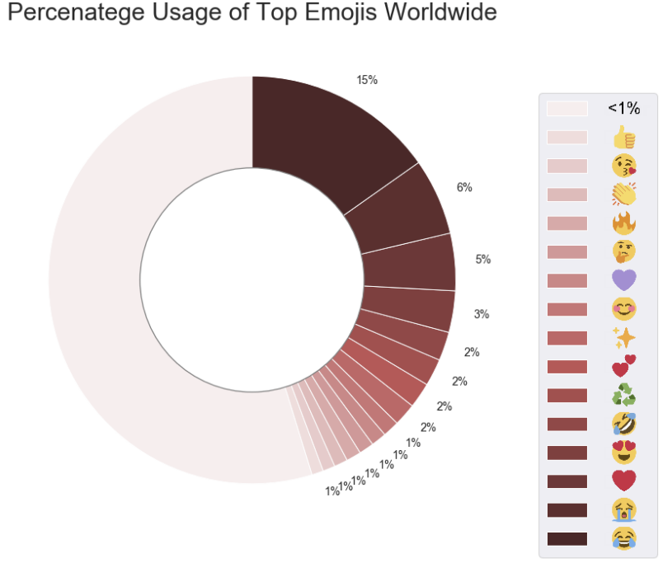
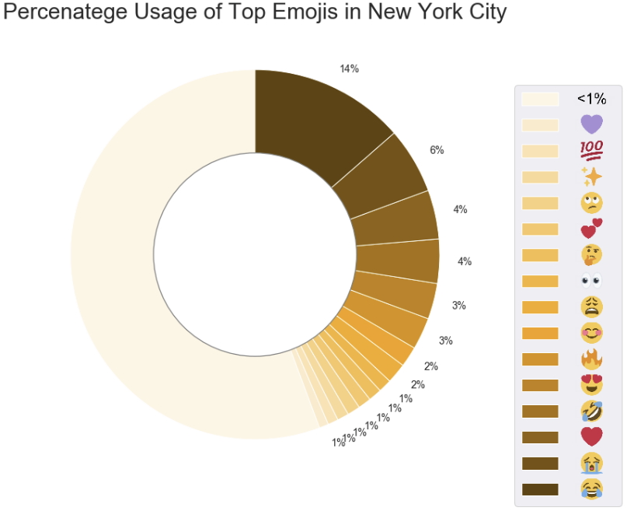
Percentage Usage by Location

Slide 9
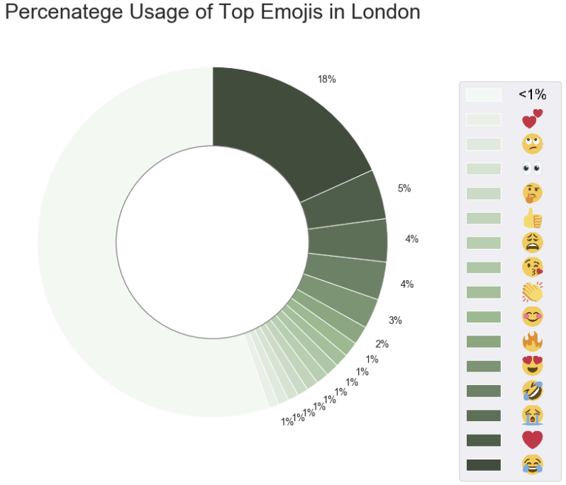
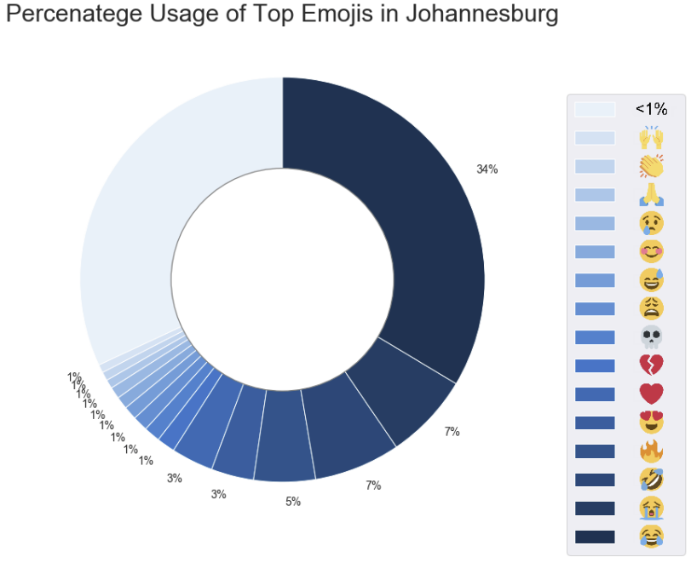
Percentage Usage by Location

Slide 10
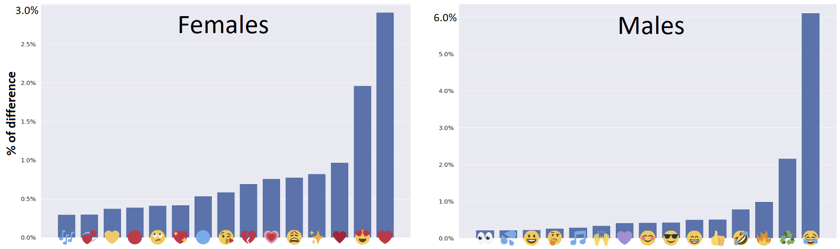
Distinctive Emojis by Gender

Slide 11
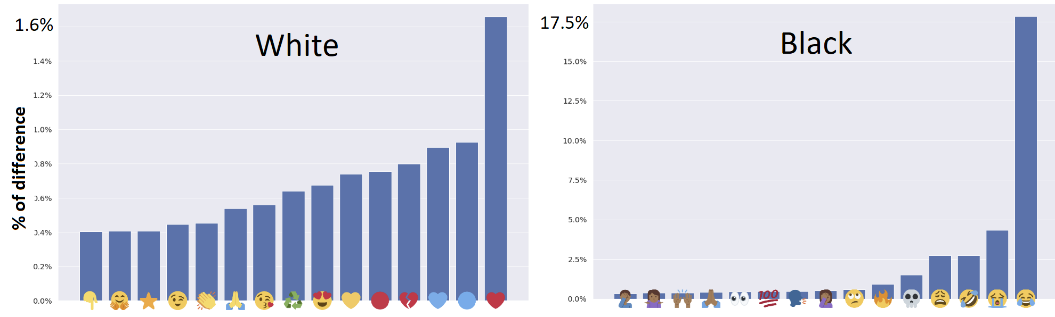
Distinct Emojis by Race

Slide 12
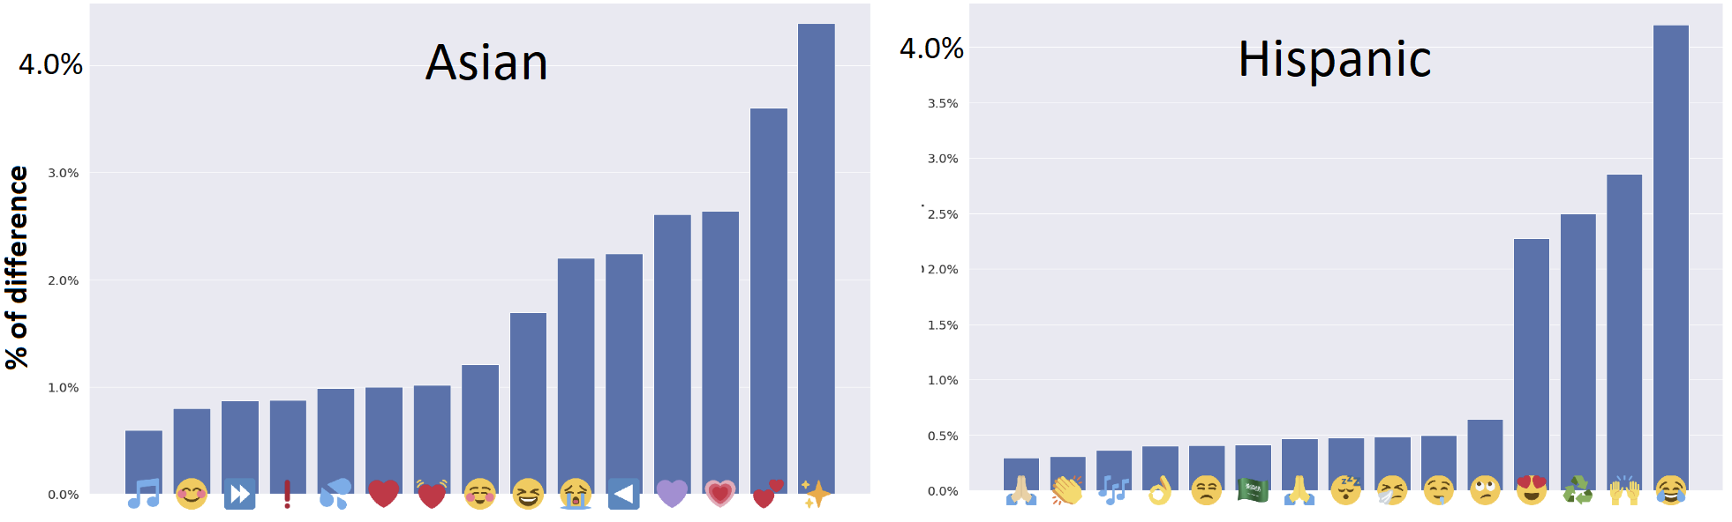
Distinct Emojis by Race

Slide 13
Gender & race detection models
2579 unique emoji were used as feature set
Percentage of usage of emoji by the user as value for each feature
Split the data-set into 80% for training and 20% for testing

Slide 14
Gender Classifier Results
Method | Accuracy | F1 Score
Prior Dummy | 0.521 | 0.343
Naive Bayes | 0.629 | 0.602
K-Nearest Neighbor | 0.677 | 0.574
Random Forest | 0.778 | 0.762
SVM (Linear kernel) | 0.759 | 0.744
SVM (χ² kernel) | 0.782 | 0.766

Slide 15
Race Classifier Results
Method | White | Black | Asian | Hispanic | Accuracy
Prior Dummy | 1.00 | 0.00 | 0.00 | 0.00 | 0.51
Naive Bayes | 0.36 | 0.47 | 0.38 | 0.33 | 0.41
K-Nearest Neighbor | 0.70 | 0.79 | 0.04 | 0.00 | 0.68
Random Forest | 0.88 | 0.79 | 0.05 | 0.00 | 0.78
SVM (Linear kernel) | 0.82 | 0.82 | 0.03 | 0.00 | 0.76
SVM (χ² kernel) | 0.89 | 0.80 | 0.19 | 0.00 | 0.80

Slide 16
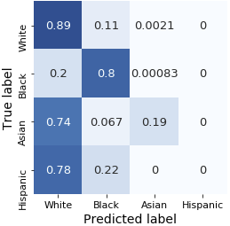
SVM (χ² kernel) Race Classifier
Confusion Matrix

Slide 17
Next Steps
February - April
  Models for Mix Group Prediction
  Final Report

Slide 18

Thank you! Any questions?

