Slide 1

Emojis Usage in Social Media by Demographics
BY:
STYLIANOS NICOLETTI
SUPERVISOR:
PROFESSOR WALID MAGDY

Slide 2
Introduction
Analyze usage of emojis across Tweeter
Know if emojis are used differently by different groups
Groups to analyze: Gender, Age, Language, Country, Popularity in Social Media

Slide 3
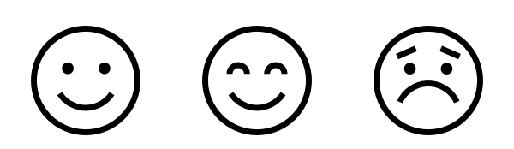
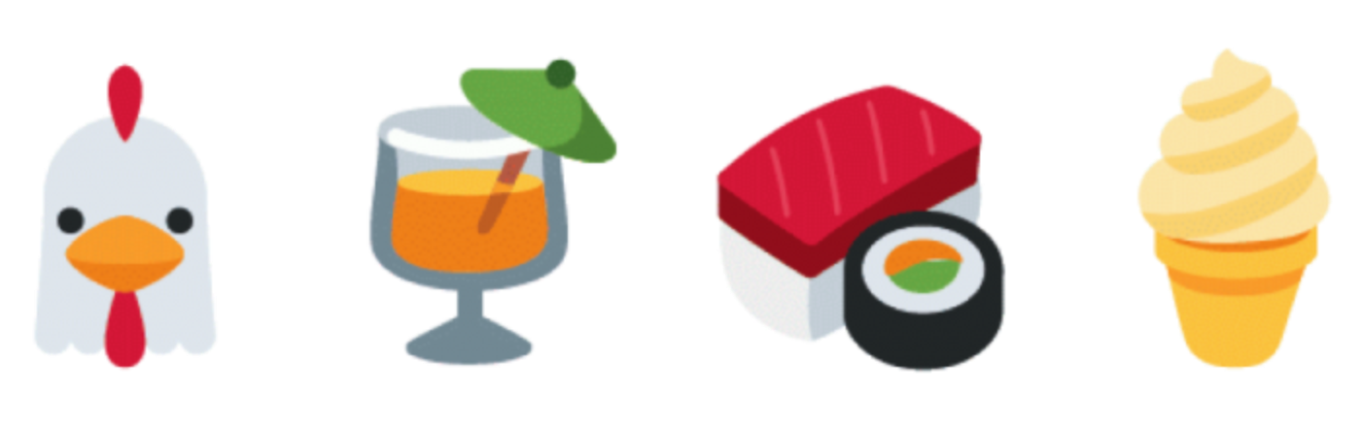
What are emojis?
Emoticons from the late 1990s are pictorial representation of facial expressions.
Emojis offer a wider spectrum of concepts such as foods, sports, buildings, animals etc.

Slide 4
Why it is interesting and important?
Text mining is getting a lot attention the last years, due to an exponential increase in digital text data from web
The use of emojis has become popular in the latest platforms (Android, iOS)
Captured data can be used in different use cases such as : finding trends, making recommendations, gathering feedback about new products or services.

Slide 5
Approaching the problem
Gather millions of public Tweets
Capture emojis used
Predict in which group of persona the poster of Tweet belongs to
Perform statistical analysis
Build models for recommendation of emojis

Slide 6
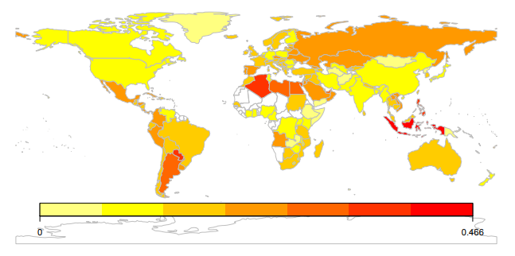
Statistical Analysis
Percentage usage of emojis for each group

Slide 7
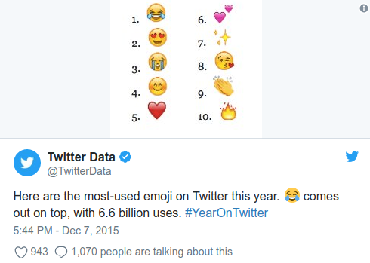
Statistical Analysis
Top used emojis
Twitter Industry Report 2015
Twitter’s data twitter account, @TwitterData, tweeted on December 7th the social platform’s most-used emoji for 2015. The “Face with Tears of Joy” emoji came in first place with a total of $6.6 billion uses.

Slide 8
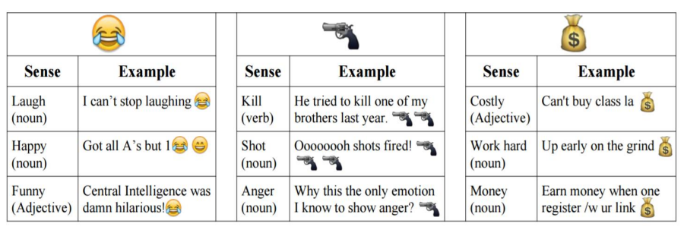
Statistical Analysis
Topics of usage
Suggesting emojis based on topic
Emoji Usage in Social Media with Multiple Senses (Balasuriya, Doran, Sheth, & Wijeratne, 2016).

Slide 9
What I have done so far
Got Twitter API Credentials
Got Access to one of University's Computing servers
Created a script for streaming public tweets that include specified words

Slide 10
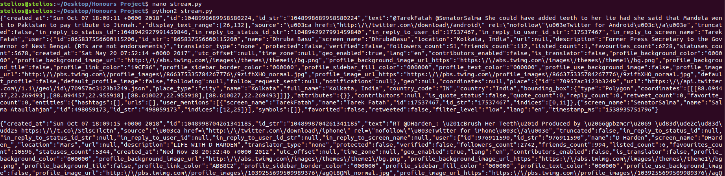
Results For Word “Teeth”

Slide 11
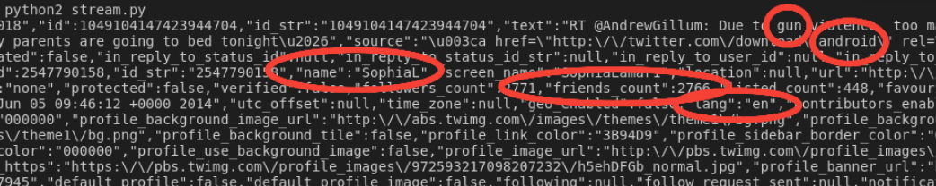
Example for Word “Gun”

Slide 12
Next Steps
Get a list of all Emojis and there identifications
Extract Emojis from tweets
Identify Gender and Age from posts
Find the top used Emojis per group
Find percentage usage of each Emoji per group

Slide 13
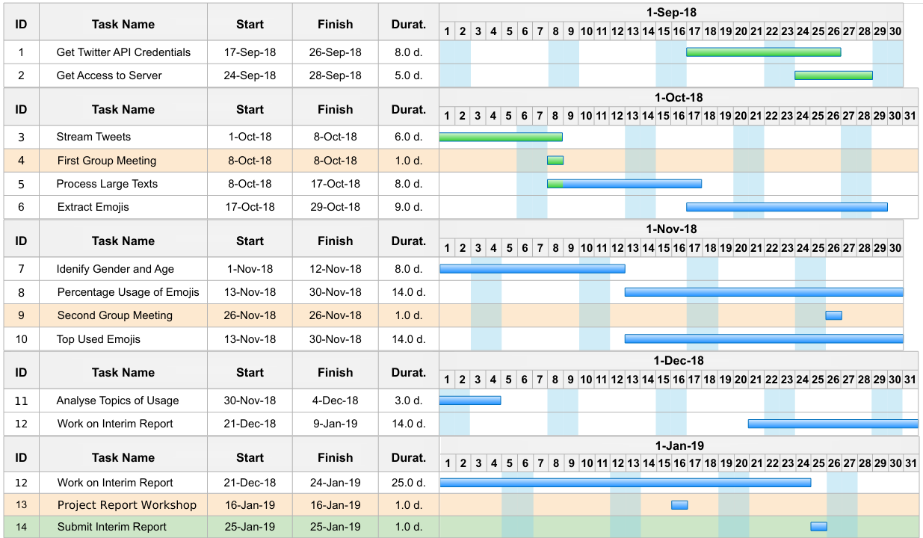
Gantt Chart September - January

Slide 14
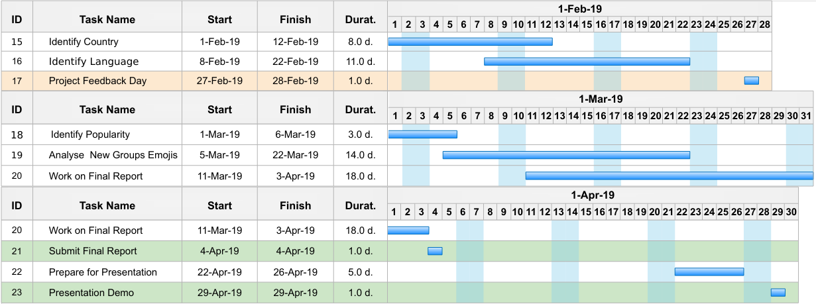
Gantt Chart February - April

Slide 15
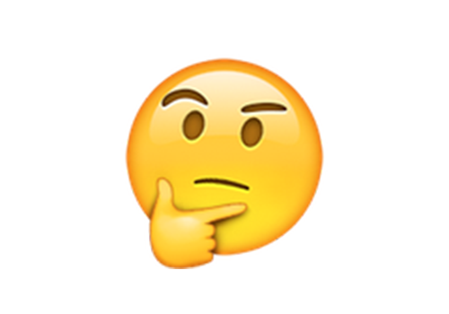
Thank you! Any questions?

