Slide 1
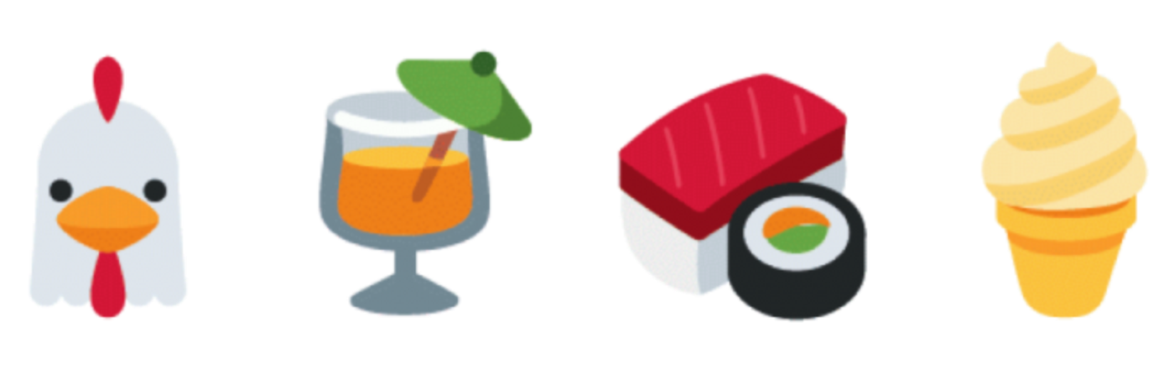
Emojis Usage in Social Media by Demographics
BY:
STYLIANOS NICOLETTI
SUPERVISOR:
PROFESSOR WALID MAGDY

Slide 2
Quick Reminder
Analyze usage of emojis across Tweeter
Know if emojis are used differently by different groups
Groups:
  Gender
  Race
  Country
  Age
  Language

Slide 3
Why is this important?
Text mining is getting a lot attention the last years
Emojis have become popular
Use captured data to:
  Find new trends,
  Make recommendations,
  Gather feedback on products or services

Slide 4
What I have done so far
Gathered millions of public Tweets
Captured Emojis
Tried different ways to predict in which group of persona the poster of Tweet belongs to
Performed some statistical analysis

Slide 5
Predicting Gender & Age Attempt
Users’ profile picture
Open-CV trained classifiers for detecting face
Age & Gender estimation trained on IMDB celebrities and Wikipedia face images

Slide 6



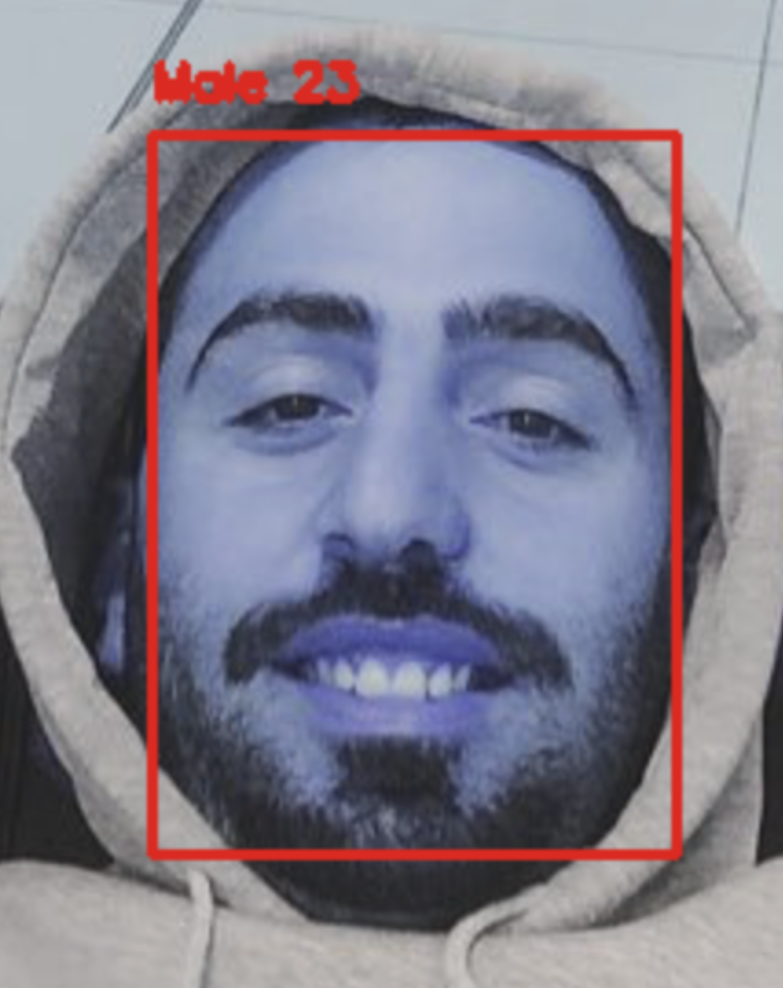
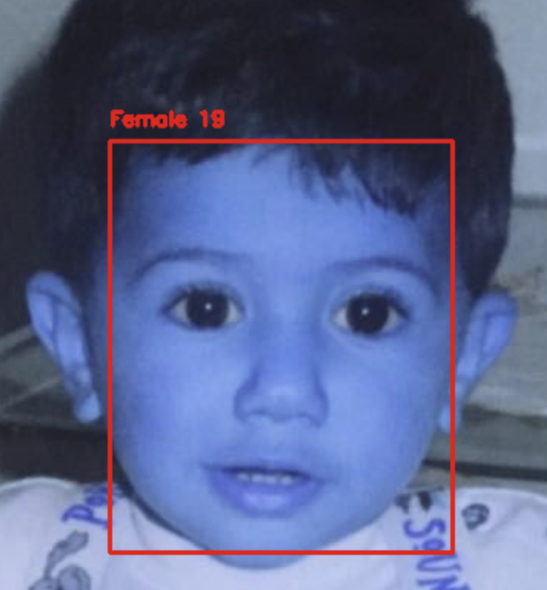

Result on classification

Slide 7
Annotated Tweeter Data
Annotated users data
Level of confidence
Reason that photo is not valid
Thanks to Alexander Robertson - Research Postgraduate Student

Slide 8
Statistical Analysis
By Gender
By Race
By Location
Mixture of above

Slide 9
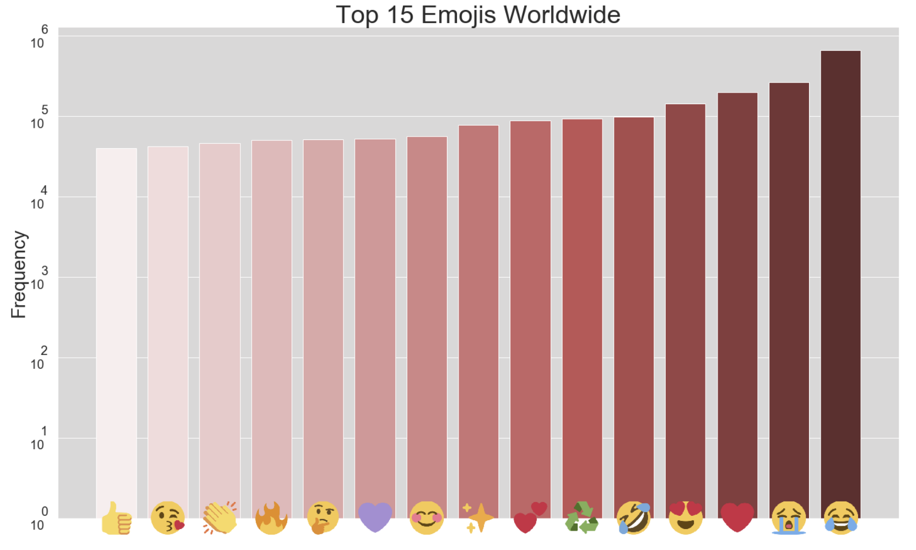
Top Used Emojis

Slide 10
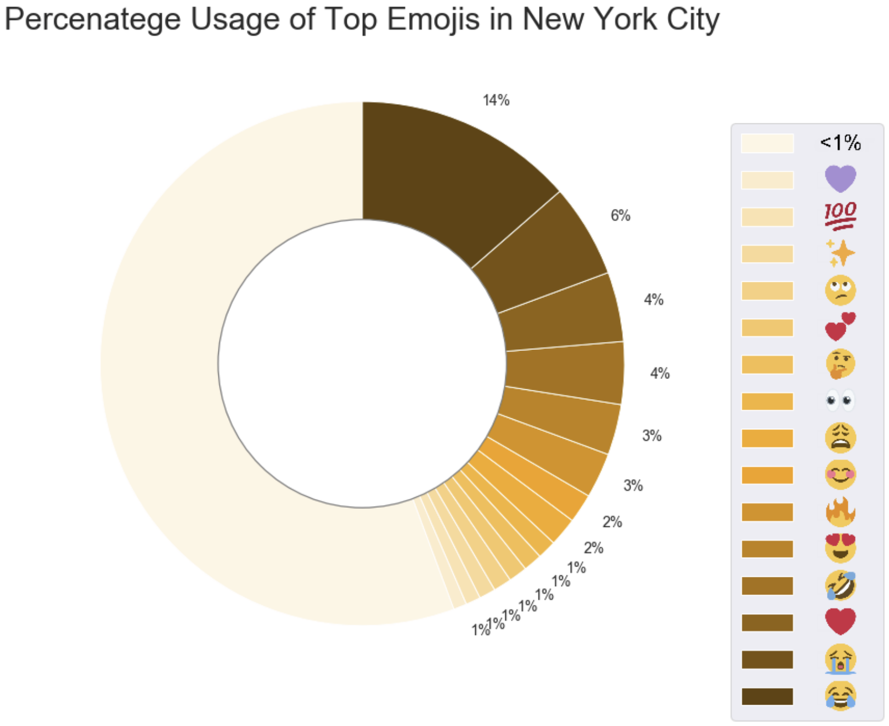
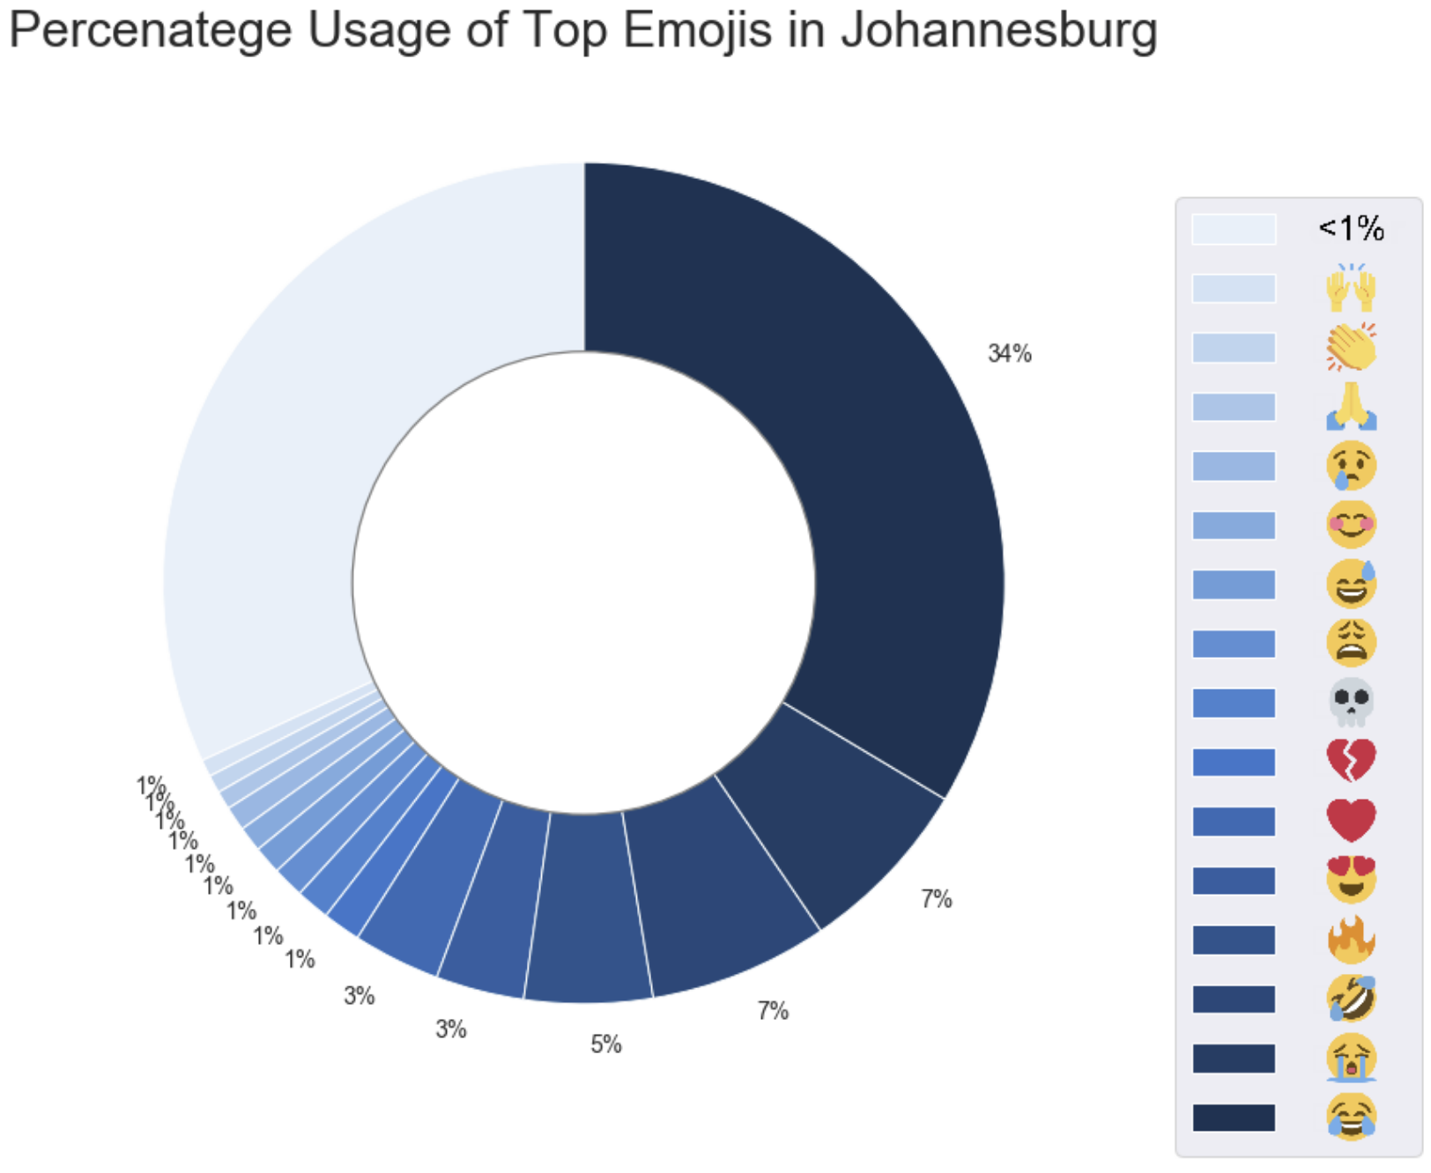
Percentage Usage by Location

Slide 11
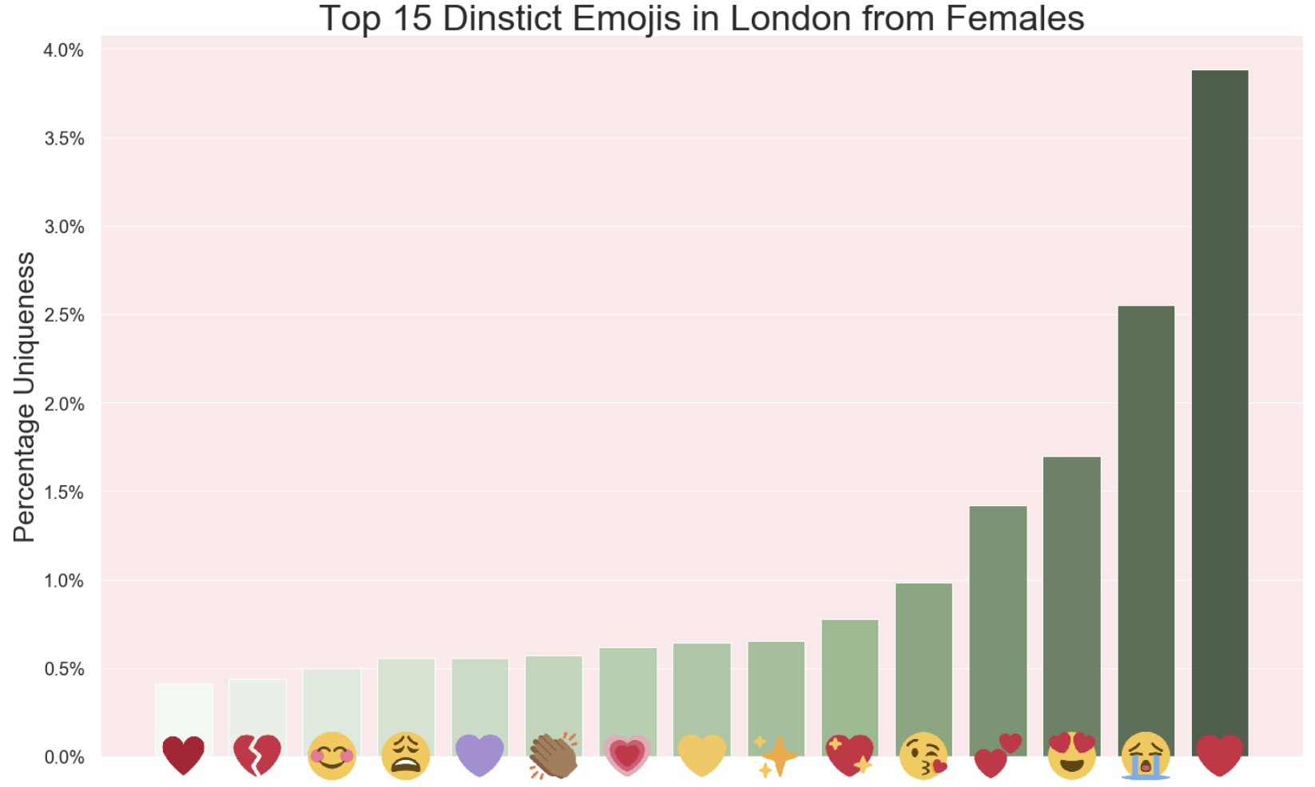
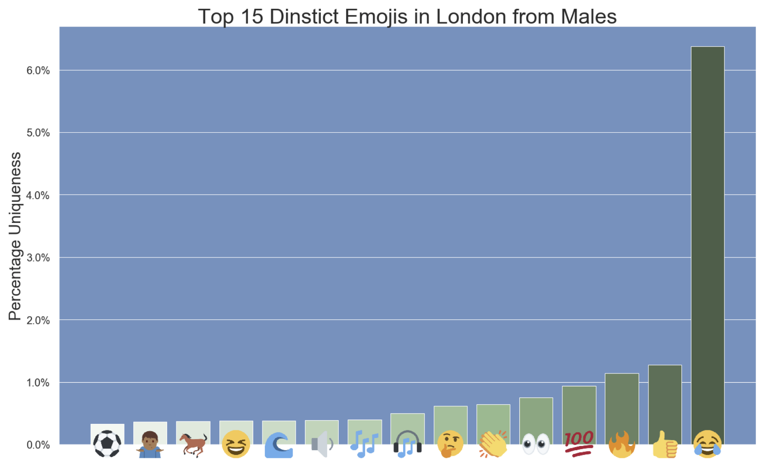
Distinct Emojis used by Gender & Location

Slide 12
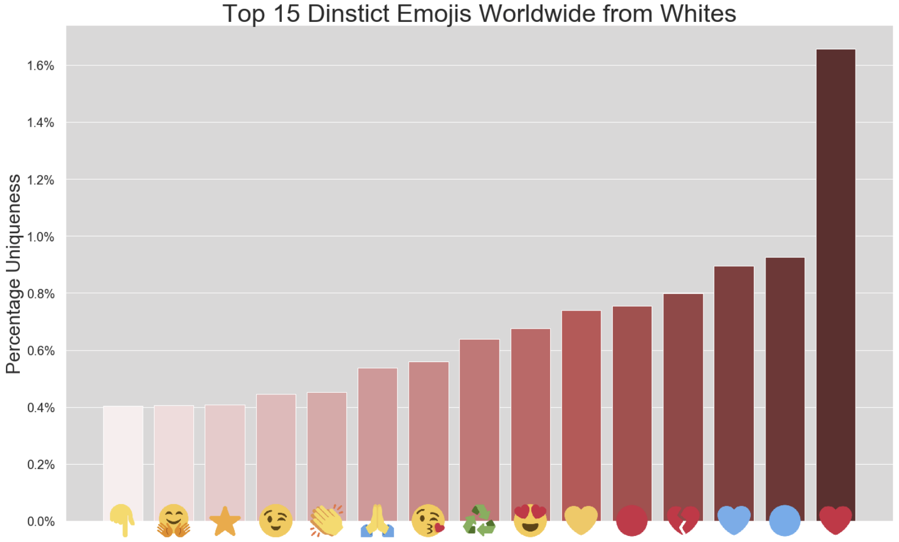
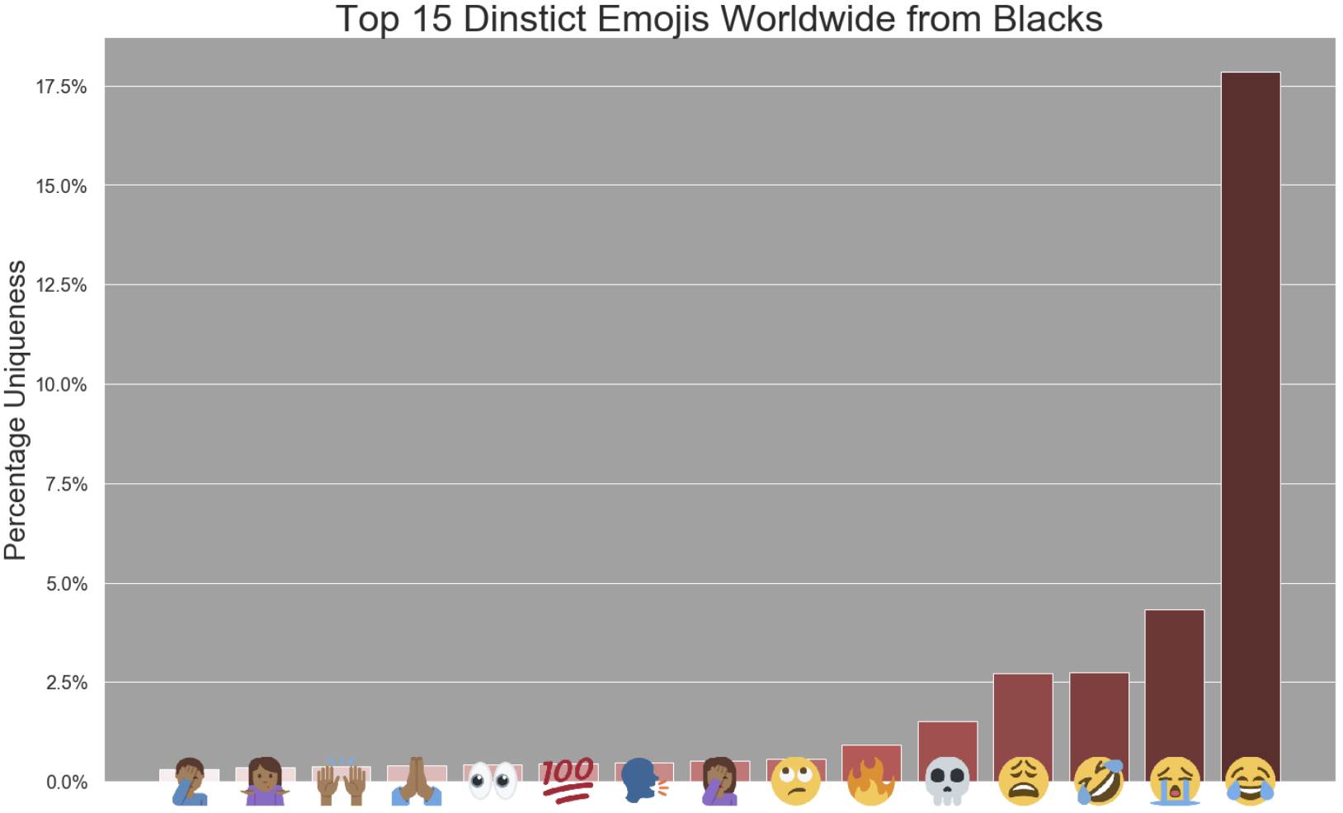
Distinct Emojis used by Race

Slide 13
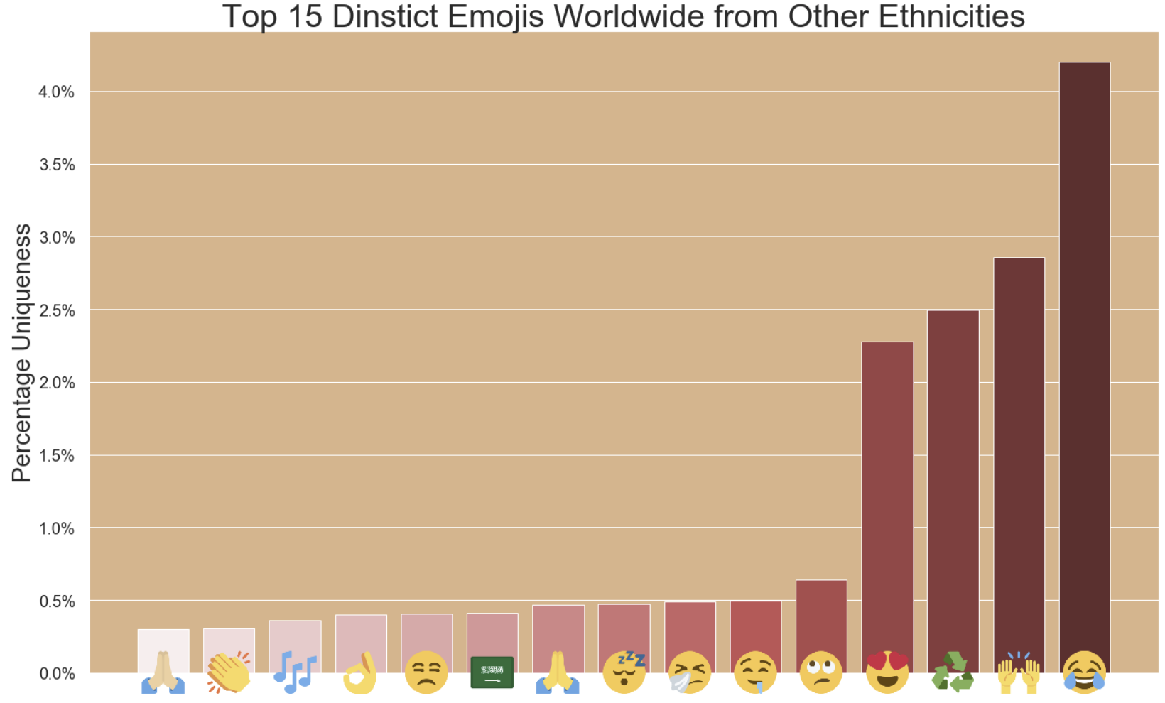
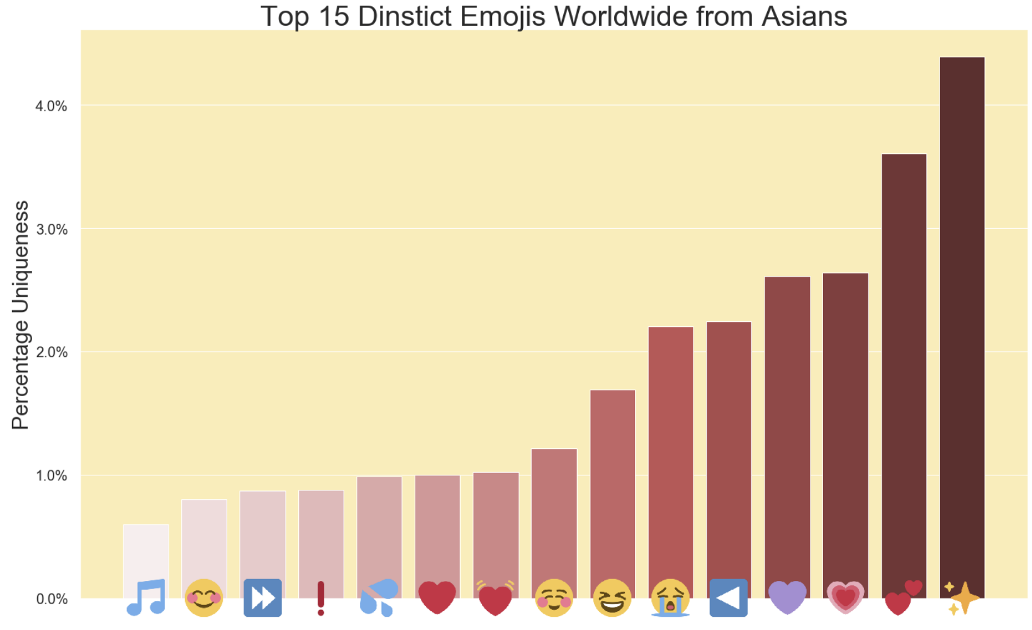
Distinct Emojis used by Race

Slide 14
Next Steps
December - January
  Emojis Topic of Usage
  More Analysis on Mix of Groups (+Distinct Usage)
  Interim Report
February - April
  Recommendation System (Android App)
  Final Report

Slide 15

Thank you! Any questions?

Slide 16
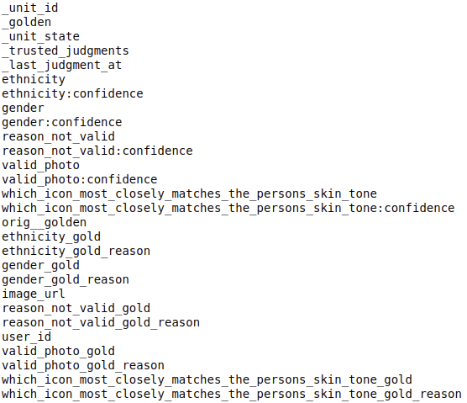
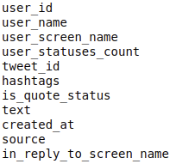
Tweets Data
Users Data

