Slide 1
Project Title: Digital Analysis
Name: HARSH PATHAK
Date: 31 Jan 2026

Slide 2
Business Context
The client is a newly launched e-commerce retail startup specializing in the sale of stuffed animal toys. Having been in the market for three years, the company has reached a critical maturity point where it has generated sufficient growth to pursue a much larger round of venture capital funding. The CEO, Cindy Sharp, is currently in advanced discussions with a prominent West Coast venture capital firm to secure this next round of investment.
To successfully close this funding, the company must transition from raw data collection to sophisticated digital analytics. The leadership team needs to demonstrate a clear understanding of their historical performance and prove that they possess the analytical infrastructure to make data-driven decisions for future scaling.

Slide 3
Problem Statement
While the company has successfully grown over the past three years, it currently lacks the centralized reporting and deep-dive analysis required to secure investor confidence and optimize operational efficiency . Specifically, the company faces two primary challenges:
Lack of Visibility for Key Stakeholders: The CEO, Website Manager, and Marketing Director do not have dedicated dashboards to track their specific KPIs (such as traffic breakdown, conversion rates, and channel bid optimization) in real-time.
Absence of a "Growth Story": The Analytics team has not yet synthesized the raw e-commerce data—spanning website sessions, orders, and product refunds—into a compelling, data-driven narrative that proves high growth and performance optimization to potential investors.
The goal of this project is to bridge these gaps by developing a suite of stakeholder-specific dashboards and performing a detailed analysis of company performance and new product progress.

Slide 4


Technology Stack
Microsoft PowerPoint – Used for presenting project findings, insights, and key visuals in a concise and professional format.
Python – Utilized for data cleaning, exploratory data analysis (EDA), statistical insights, and generating visualizations using libraries such as Pandas, NumPy, Matplotlib, and Seaborn.
SSMS – Used for querying relational databases, extracting raw data, and performing data manipulation using standard SQL commands.
Excel – Employed for preliminary data inspection, quick calculations, and creating summary reports using Pivot Tables and advanced formulas.
Power BI – Designed interactive dashboards and reports to visualize key performance indicators (KPIs) and enable data-driven decision-making.
Streamlit – The open-source framework used to transform data scripts into the interactive web-based dashboards required by the CEO and managers.

Slide 5
Data Dictionary (1/6)
Website sessions
Column | Distinct Values | Data Type | Description
Website_session_id | 4,72,871 | Int | Unique identifier for each website session
Created_at | 4,70,444 | DateTime | Timestamp when the session started
User_id | 3,94,318 | Int | Identifier for the user who initiated the session
Is_repeat_session | 2 | Int | Flag for returning user
UTM_source | 3 | Varchar | Marketing source parameter for session
UTM_campaign | 4 | Varchar | Marketing campaign identifier
UTM_content | 6 | Varchar | Content variant used in the campaign
Device_type | 2 | Varchar | Device type used by user
HTTP_referer | 3 | Varchar | URL of the referring webpage

Slide 6
Data Dictionary (2/6)
Website pageviews
Column | Distinct Values | Data Type | Description
Website_pageview_id | 11,88,124 | Int | Unique identifier for each pageview event
Created_at | 11,71,962 | DateTime | Timestamp when the pageview occurred
Website_session_id | 4,72,871 | Int | ID linking the pageview to specific website sessions
Pageview_URL | 16 | Varchar | URL of the webpage viewed

Slide 7
Data Dictionary (3/6)
Orders table
Column | Distinct Values | Data Type | Description
Order_id | 32,313 | Int | Unique identifier for each order
Created_at | 32,299 | DateTime | Timestamp when the order was placed
Website_Session_id | 32,313 | Int | Link to website session on which order was made
User_id | 31,696 | Int | Identifier of the user who placed the order
Primary_product_id | 4 | Int | Product ID of the main product in the order
Items_Purchased | 2 | Int | Number of items in the order
Price_USD | 10 | Float | Total price of the order in USD
Cogs_USD | 10 | Float | Total cost of goods sold in USD

Slide 8
Data Dictionary (4/6)
Order items
Column | Distinct Values | Data Type | Description
Order_item_id | 40,025 | Int | Unique identifier for each order item entry
Created_at | 32,299 | DateTime | Timestamp when the order item record was created
Order_id | 32,313 | Int | ID of the order this item belongs to
Product_id | 4 | Int | ID of the purchased product
Is_Primary_item | 2 | Int | Flag for primary item
Price_USD | 4 | Float | Price of the individual product in USD
Cogs_USD | 4 | Float | Cost of goods sold for the product in USD

Slide 9
Data Dictionary (5/6)
Order Item refunds
Column | Distinct Values | Data Type | Description
Order_Item_refund_Id | 1,731 | Int | Unique identifier for each refund event
Created_at | 1,731 | DateTime | Timestamp when the refund was processed.
Order_item_id | 1,731 | Int | ID of the refunded order item
Order_id | 1,723 | Int | ID of the order associated with the refund
Refund_amount_USD | 4 | Float | Amount refunded in USD

Slide 10
Data Dictionary (6/6)
Products table
Column | Distinct Values | Data Type | Description
Product_id | 4 | Int | Unique identifier for each product
Created_at | 4 | DateTime | Timestamp when the product was added to the catalog
Product_name | 4 | Varchar | Name of the product

Slide 11
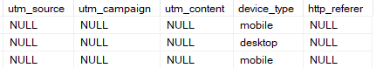
Data Inconsistency
In the ‘Website Sessions’ table, the ‘utm_source’,’utm_campaign’ ,’utm_content’ and ‘http_referer’ columns has null values as follows
Sample image of missing data:
Column Names | Nulls count | Nulls Percentage
Utm Source | 83.32K | 17.62%
Utm Campaign | 83.32K | 17.62%
Utm Content | 83.32K | 17.62%
Http Referer | 39.91K | 8.44%

Slide 12
Handling of Missing Data
Treat sessions with null UTM values as a distinct traffic segment (e.g., "organic or untracked ").
For those where utm source is null but http referer contains a recognizable domain (e.g., gsearch.com), infer the source.

Slide 13
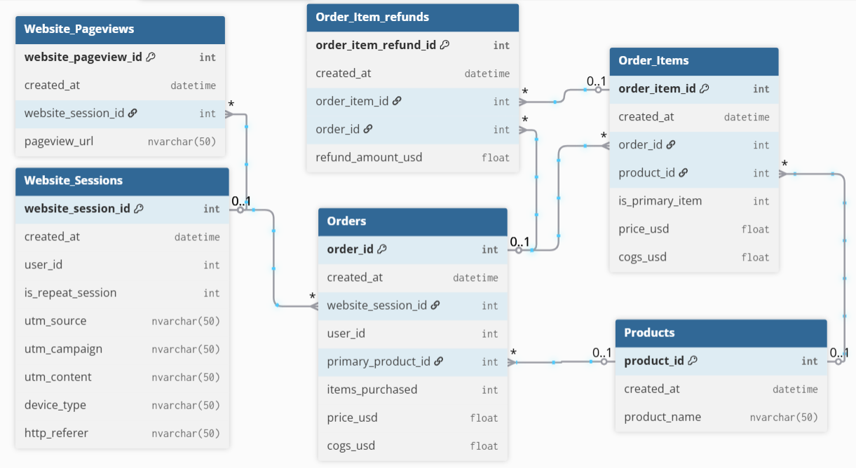
Entity relationship diagram

Slide 14
List of Output to Generate
Possible high level metrics with calculation logic and their contribution to business context.
Detailed analytical code (descriptive, diagnostic, and additional analysis) with comments using python languages.
In-depth insights and recommendation on EDA.
Interactive Power Bi dashboards, featuring insights and recommendations.

Slide 15
ASSUMPTION(1/2)
1. Data Integrity Assumptions
Time Period: The analysis assumes the dataset covers the full operational history from March 2012 to March 2015.
Unique Identifiers: We assume that website_session_id and order_id are unique primary keys and that every order must be linked to a valid session.
Missing Values: We assume that a NULL value in the utm_source column represents Direct Type-In traffic (users typing the URL directly) or Organic Search, rather than missing data.
2. Sales & Revenue Assumptions
Refund Policy: Revenue is calculated based on the gross sales price at the time of purchase. Refunds (found in order_item_refunds) are treated as separate post-purchase events rather than a direct reduction of the initial sale record.
Primary Products: For session-to-product analysis, we assume the primary_product_id in the orders table represents the main driver of the purchase.
Currency: All financial figures are assumed to be in USD as per the column headers (price_usd).

Slide 16
ASSUMPTION(2/2)
3. User Behavior Assumptions
Session Attribution: We assume a "Last-Click" attribution model, where the marketing source (utm_source) attached to a session gets 100% of the credit for any order placed during that specific session.
Device Consistency: We assume that device_type (Desktop/Mobile) accurately reflects the hardware used and does not change mid-session.
First-Pageview Rule: For landing page analysis, the very first pageview_url recorded for a website_session_id is assumed to be the entry point for that user.

Slide 17
Detailed Data Quality Checklist(1/2)
1. Completeness Checks (Missing Values)
Critical IDs: Ensure 0% nulls in order_id, website_session_id, and product_id.
Marketing Attribution: Identify the percentage of "NULL" values in utm_source and utm_campaign (assumed as direct/organic traffic).
Financials: Check for missing values in price_usd and cogs_usd to ensure revenue and margin calculations are accurate.
2. Uniqueness & Primary Key Checks
Primary Keys: Verify that website_session_id in the sessions table and order_id in the orders table have no duplicates.
Order Item Granularity: Confirm that the same product_id isn't listed twice within a single order_id unless multi-unit purchases are intended.

Slide 18
Detailed Data Quality Checklist(2/2)
3. Referential Integrity (Table Relationships)
Orphaned Orders: Verify that every order_id in the orders table has a corresponding website_session_id in the sessions table.
Refund Alignment: Ensure every order_item_id in the order_item_refunds table exists in the order_items table.
Product Mapping: Check that all product_ids in the sales tables match an entry in the products master list.
4. Validity & Logical Checks
Chronological Order: Ensure the created_at timestamp for a refund is always later than the timestamp for the original order.
Conversion Logic: Check that a thank-you pageview only exists for sessions that successfully generated an order_id.
Price Sanity: Confirm price_usd is always greater than cogs_usd (Cost of Goods Sold) unless a specific promotion or loss-leader strategy is documented.

Slide 19
Detailed Data Processing Tasks(1/3)
Phase 1: Ingestion & Standardization
DateTime Parsing: Converting the created_at strings into Pythonic datetime objects to allow for time-series calculations.
Temporal Splitting: Separating the raw timestamp into discrete date and time columns for easier daily and hourly grouping.
Categorical Sanitization: Standardizing strings in device_type and utm_source to ensure "Mobile" and "mobile" are treated as the same category.
Null Attribution: Mapping "NULL" values in utm_source and utm_campaign to a specific "Direct/Organic" label to avoid gaps in marketing reports.

Slide 20
Detailed Data Processing Tasks(2/3)
Phase 2: Feature Engineering & Enrichment
Conversion Flagging: Creating a binary indicator ($0$ or $1$) in the website_sessions table to easily identify sessions that resulted in an order_id.
Funnel Step Mapping: Categorizing individual URLs in website_pageviews into standard funnel stages:
Home -> Products -> Cart -> Shipping -> Billing -> Thank_you .
Time-of-Day Features: Extracting Day of Week and Hour of Day to identify peak shopping windows for marketing spend optimization.

Slide 21
Detailed Data Processing Tasks(3/3)
Phase 3: Table Integration (Merging)
Session-to-Order Join: Executing a Left Join between website_sessions and orders to create a "traffic-to-sales" master table.
Item-Level Denormalization: Linking order_items with the products table to append human-readable names (e.g., "The Original Mr. Fuzzy") to every transaction.
Refund Integration: Matching the order_item_refunds table back to the original sales records to calculate Return Rates at the product level.

Slide 22
exploratory data analysis
Traffic & Acquisition Analysis (Marketing Focus)
Traffic Source Distribution: Analyse session volume breakdown by utm_source, utm_campaign, and http_referer to identify dominant channels .
Temporal Trends: Visualize session volume by Hour of Day and Day of Week to pinpoint peak traffic times for bid scheduling.
Device Performance: Compare Conversion Rates (CVR) between mobile vs. desktop traffic to identify optimization gaps.
Bid Optimization Audit: Correlate volume and conversion rates for paid channels (e.g., gsearch) to flag overspending or under-bidding.

Slide 23
exploratory data analysis
Website Performance & User Journey (UX Focus)
Entry Page Analysis: Identify top entry pages (pageview_url) and calculate specific Bounce Rates to find weak landing pages .
Conversion Funnel Visualization: Map the full user path (Lander ->Product -> Cart -> Shipping -> Billing -> Thank You) to identify specific drop-off points.
A/B Test Validation: Compare performance metrics (CTR, CVR) between /billing and /billing-2 page versions.
Landing Page Trending: Analyze the lifecycle and performance trends of campaign-specific landing pages over time.

Slide 24
exploratory data analysis
Product & Sales Health (Business Focus)
Revenue & Seasonality: Plot monthly and quarterly revenue trends to validate the "High Growth" story for investors.
Product Mix Analysis: Breakdown of sales by product_id to determine the revenue contribution of "Mr. Fuzzy" vs. new launches like "The Birthday Sugar Panda".
Cross-Sell Patterns: Analyze orders with items_purchased > 1 to understand which products are frequently bought together.
Refund Rate Analysis: Calculate refund rates by product and month using the order_item_refunds table to monitor quality control issues.

Slide 25
exploratory data analysis
Customer Retention (Growth Focus)
Repeat Visitor Behaviour : specific analysis on users with is_repeat_session = 1 to measure brand loyalty.
Time-Between-Sessions: Calculate the average, minimum, and maximum time elapsed between a user's first and second session.

Slide 26
Company Logo
CEO Dashboard
Navigating
Buttons
Slicers
Time Period
Device Type
Traffic Source
Product
Customer Type
KPIs(Total Revenue (USD), Total Profit (USD), Profit Margin (%), Total Orders, Conversion Rate (%), Repeat Customer Rate (%), Refund Rate (%), Top Product Contribution (%))
Revenue & Profit Trend (Quarterly Line Chart)
Traffic Mix by Source (Stacked Bar)
Refund Rate Trend (Quarterly Line)
Conversion Funnel (Bar or Funnel)
Steps: Landing → Product → Cart → Shipping → Billing → Thank You
Desktop vs Mobile Funnel (Side-by-side bars)
Revenue by Product (Stacked Bar – Quarterly)
New vs Repeat Customers (Stacked Bar)
Product Volume vs Profitability (Bubble Chart)

Slide 27
Company Logo
Website Manager Dashboard
Navigating
Buttons
Slicers
Time Period
Device Type
Traffic Source
Product
Customer Type
Top website pages, entry pages,Bounce rate,Conversion rate,Revenue per session for repeat sessions and new sessions.
Bar Chart (Horizontal): Show the count of website_pageview_id by pageview_url
Table with Conditional Formatting: List pageview_url where the first website_pageview_id of a session occurs
Stacked Bar Chart: Compare the "Drop-off Rate" at the billing step for users who saw /billing versus those who saw /billing-2.
Funnel Visual: Use a step-by-step funnel starting from /lander-1 → /products → /cart → /shipping → /billing → /thankyou.
Gauge Chart: Show the "Conversion to Purchase" percentage for each test group to see which billing page reached the target goal more effectively.
Area Chart or Line Chart: Track the "Bounce Rate" of specific landing pages over time.
Clustered Column Chart: Compare "Conversion Rate" or "Bounce Rate" across different landing page URLs (e.g., /home vs. /lander-1).
Scatter Plot: Plot pageview_url with "Total Sessions" on the X-axis and "Bounce Rate %" on the Y-axis to identify high-traffic pages that are failing to engage users

Slide 28
Company Logo
Dashboard For Marketing Manager
Navigating
Buttons
Slicers
Time Period
Device Type
Traffic Source
Product
Customer Type
Gsearch conversion rate,Gsearch volume trends,Repeat visitors,Repeat sessions rate,Min, max, average time b/w the first and second session for repeated customers.
A Line Chart with created_at on the X-axis and website_session_id (Count) on the Y-axis, using utm_source
A Stacked Area Chart showing session volume over time, segmented by device_type
A Scatter Plot comparing "Cost per Session" (if available) or "Revenue per Session" against "Conversion Rate" for different utm_content tags
A Treemap showing the total price_usd (Revenue) where the size of the blocks is determined by the utm_source
A Clustered Bar Chart comparing the average price_usd and bounce rate across different utm_source categories
A Pie Chart or Donut Chart showing the split between NEW AND Repeat
A Histogram showing the "Time Between Sessions" for repeat customers.
New v/s Repeat Channel Patterns: A 100% Stacked Bar Chart showing utm_source on the Y-axis and the percentage of New vs. Repeat sessions on the X-axis.

Slide 29
What technology stack do you want to use and why?
Proposed Technology Stack
Python (Pandas/NumPy): Used for data manipulation and cleaning. Python allows for reproducible workflows, making it easy to update the analysis as new monthly data arrives.
Google Colab / Jupyter Notebooks: The primary development environment. It provides a collaborative space to combine code, visualizations, and documentation in one place.
Matplotlib & Seaborn: The core visualization libraries. These were chosen to create clean, professional charts that clearly communicate trends like the "hockey stick" revenue growth.
SQL (SSMS): Used for data querying. While the current data is in CSV format, SQL is the "language of business" and is essential for joining large tables like website_pageviews efficiently.
Power BI : Proposed for the final dashboarding. While Python is great for EDA, these tools allow Cindy and her stakeholders to interact with the data in real-time without writing code.

Slide 30
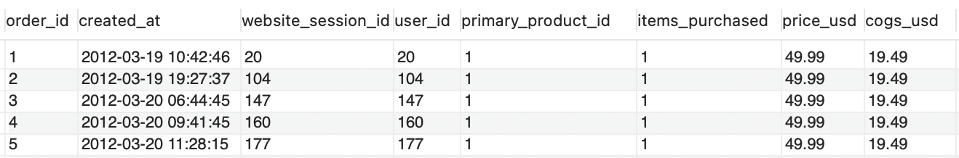
Data Discrepancies (1/4)
Orders Database:
Orders :
Records consist of customers' orders with order id, time when the order is created, website session id, unique user id, product id, count of products purchased, price (revenue), and cost in USD.

Slide 31
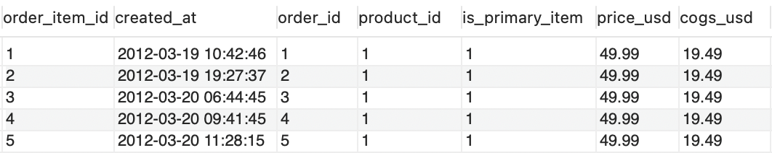
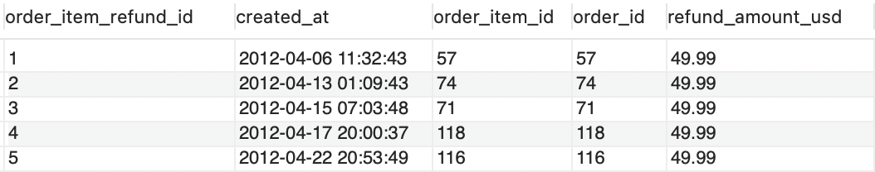
Data Discrepancies (2/4)
Orders Database:
Order_items :
Records show various items ordered by customer with order item id, when the order is created, whether it is primary or nonprimary item, product info, individual product price, and cost in USD.
order_item_refunds : Refund information including when creation date and time and refund amount in USD.

Slide 32
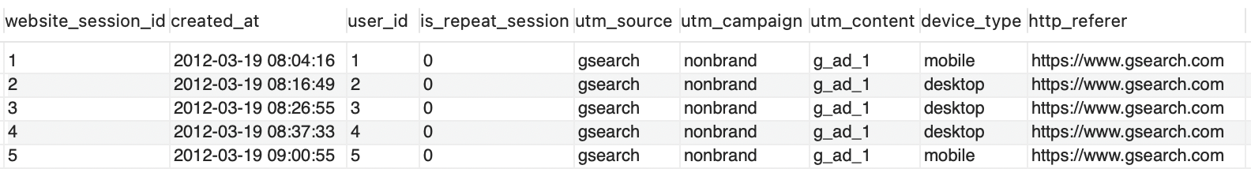
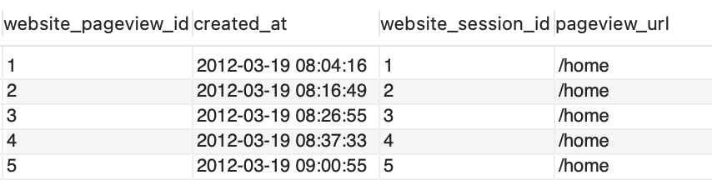
Data Discrepancies (3/4)
Website Database:
website_sessions : Table is showing where the traffic is coming from and which source is helping to generate the orders. Records consist of unique website session id, UTM (Urchin Tracking Module) fields. UTMs tracking parameters used by Google Analytics to track paid marketing activity.
website_pageviews: It consists of website session id, pageview URL.

Slide 33
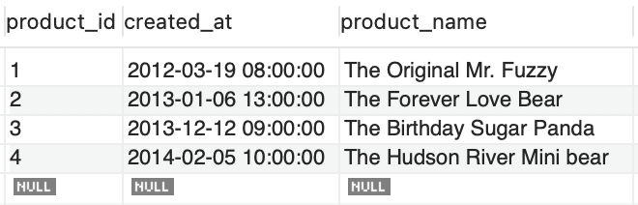
Data Discrepancies (4/4)
Products Database:
Products :
It consists of product id, creation date of product in system, and product name.

Slide 34
Detailed list of exploratory data analysis

Slide 35
EDA

Slide 36
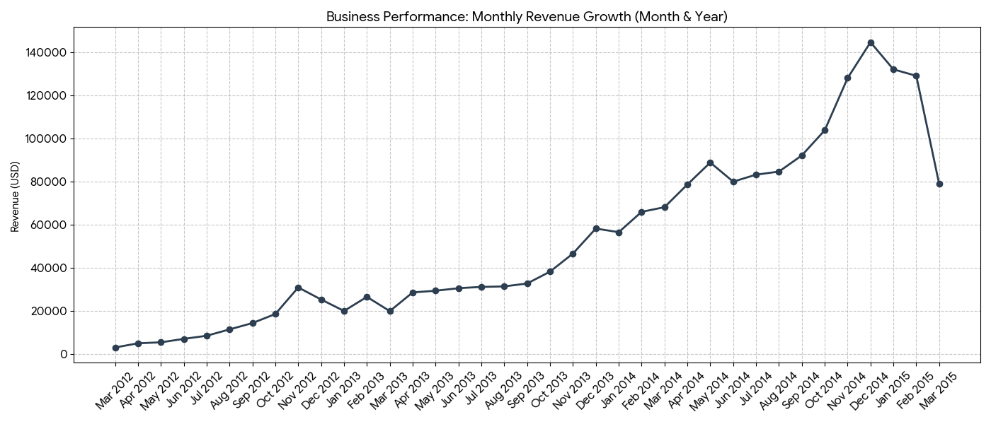
E-Commerce Performance & Conversion Insights

Slide 37
E-Commerce Performance & Conversion Insights
Executive Summary (Business Health)
Revenue Trajectory: Sustained month-over-month growth throughout the period, indicating successful market expansion and brand adoption.
Product Performance: The Original Mr. Fuzzy remains the primary revenue driver, while The Hudson River Mini Bear maintains the highest quality rating (lowest refund rate at 1.28%).
Strategic Deep Dive: Conversion by Device Type Data analysis reveals a significant performance disparity between Desktop and Mobile platforms:
Data-Driven Observations
The Conversion Gap: Desktop users are 2.7x more likely to complete a purchase than mobile users.
Quality Risk: The Birthday Sugar Panda (Product 3) exhibits a refund rate of 6.04%, nearly triple the portfolio average, suggesting a potential manufacturing or expectation-mismatch issue.
Device Type | Total Sessions | Total Orders | Conversion Rate (CVR)
Desktop | 327,027 | 27,805 | 8.50%
Mobile | 145,844 | 4,508 | 3.09%

Slide 38
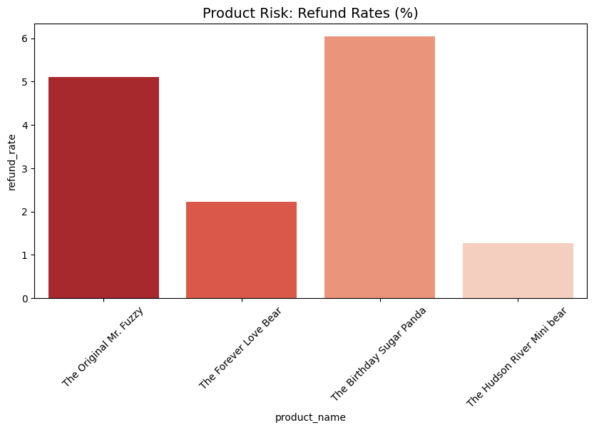
E-Commerce Growth & Conversion Optimization Report

Slide 39
E-Commerce Growth & Conversion Optimization Report
Executive Performance Summary
Revenue Trend: Sustained upward growth trajectory; revenue peaks correlate with successful holiday expansion and product launches.
Core Driver: The Original Mr. Fuzzy continues to anchor the portfolio as the highest-volume sales driver.
Quality Watch: The Birthday Sugar Panda exhibits a 6.04% refund rate (3x the portfolio average), requiring immediate QC investigation.
Deep Dive: The "Device Gap" Analysis.
Analysis of ~473k sessions reveals a critical performance disparity between desktop and mobile platforms:
Device Type | Total Sessions | Total Orders | Conversion Rate (CVR)
Desktop | 327,027 | 27,805 | 8.50%
Mobile | 145,844 | 4,508 | 3.09%

Slide 40
E-Commerce Growth & Conversion Optimization Report
Key Insights & Opportunities
The Conversion Leak: Desktop users are 2.7x more likely to complete a purchase than mobile users. Closing just 1% of this gap represents a massive untapped revenue opportunity.
Traffic Quality: While mobile drives ~30% of total traffic, the current UX is failing to capture that intent, suggesting a high friction point during the mobile checkout process.
Strategic Recommendations
Mobile UX Overhaul: Prioritize a technical audit of the mobile payment and shipping pages to reduce bounce rates.
Marketing Efficiency: Shift aggressive bidding to Desktop segments for gsearch/bsearch campaigns to maximize immediate ROAS.
Product Feedback Loop: Review customer feedback for Product 3 to determine if the high refund rate is due to shipping damage or product-description mismatch.

Slide 41
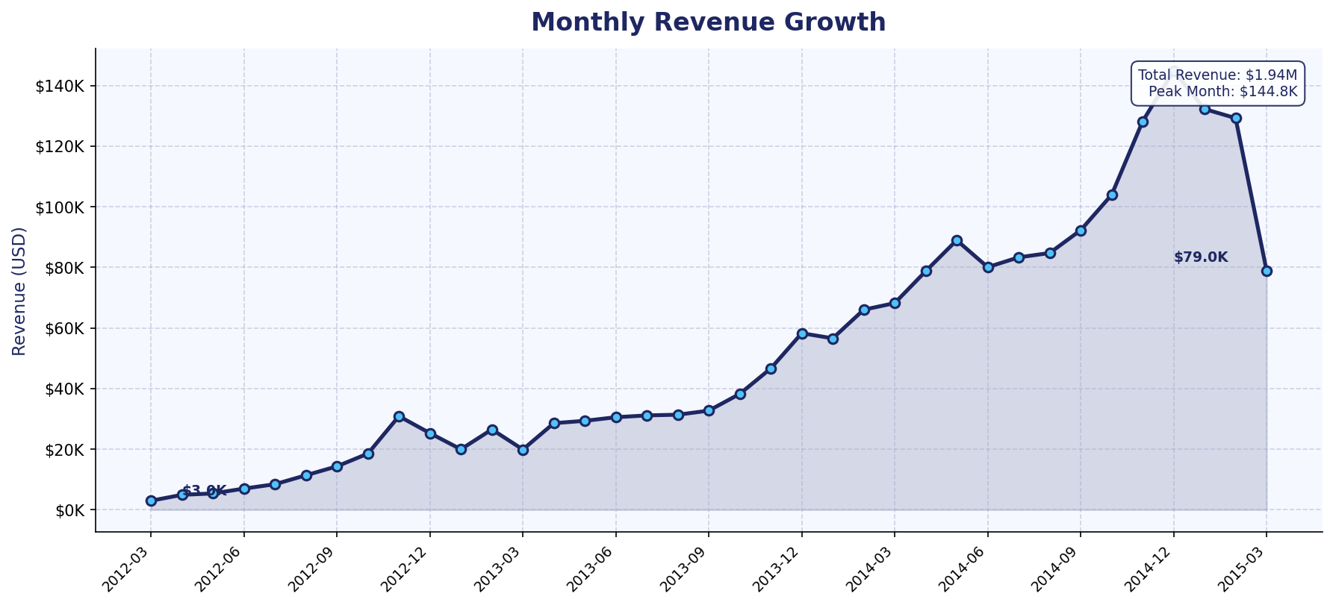
EDA Visual 1: Monthly Revenue Growth
Revenue has grown significantly over the 3-year period, demonstrating strong business momentum ideal for investor confidence.
Key Insight: Revenue shows consistent upward trajectory with seasonal peaks in Q4. Total revenue exceeds $1.9M across the full period.

Slide 42
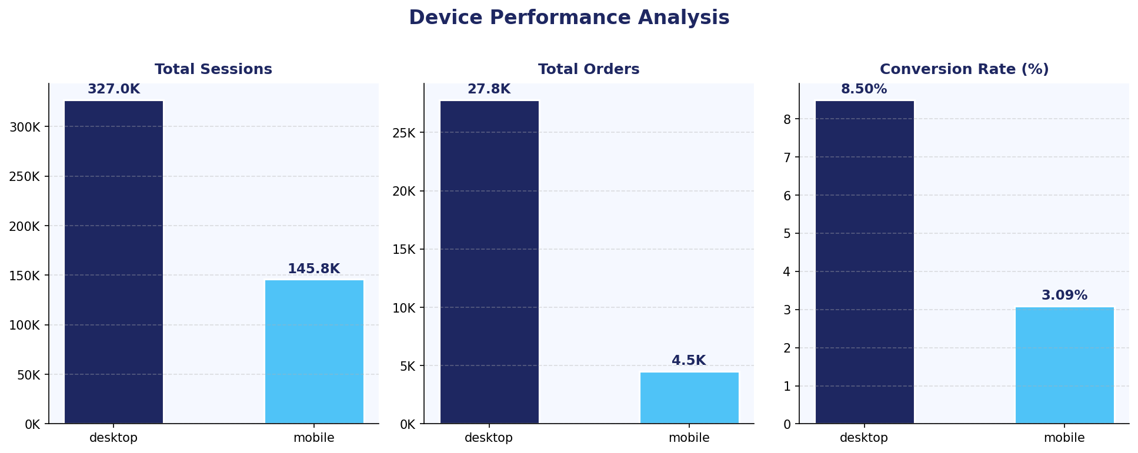
EDA Visual 2: Device Performance Analysis
Desktop users convert at nearly 3x the rate of mobile users, signaling a critical UX optimization opportunity for the mobile experience.
Key Insight: Desktop CVR = 8.5% vs Mobile CVR = 3.1%. With 31% of sessions on mobile, improving mobile UX could unlock ~$400K+ in incremental revenue.

Slide 43
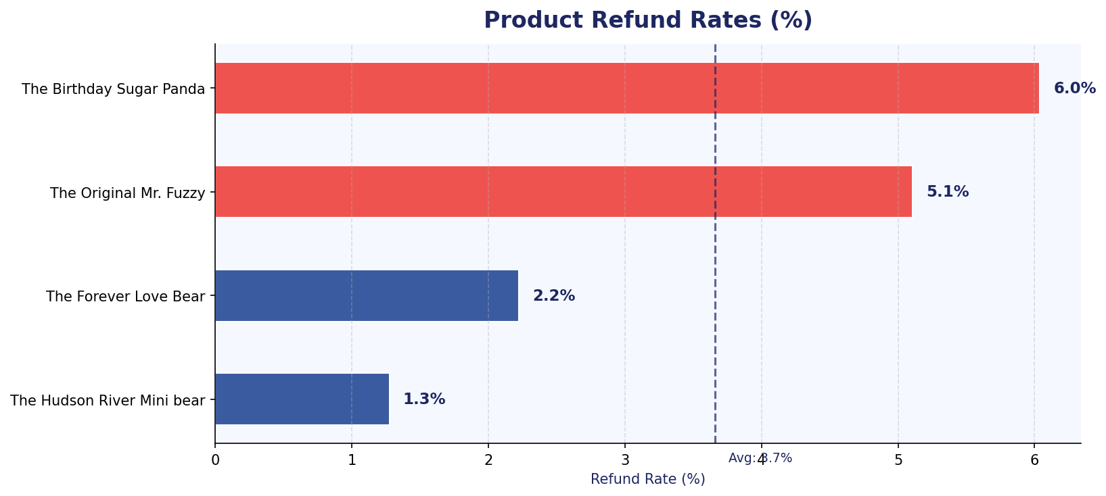
EDA Visual 3: Product Refund Rate Analysis
Quality control check reveals that two products exceed average refund rates and require immediate quality or satisfaction investigation.
Key Insight: "The Birthday Sugar Panda" (6.0%) and "The Original Mr. Fuzzy" (5.1%) have above-average refund rates. "Hudson River Mini Bear" is the healthiest at 1.3%.

Slide 44
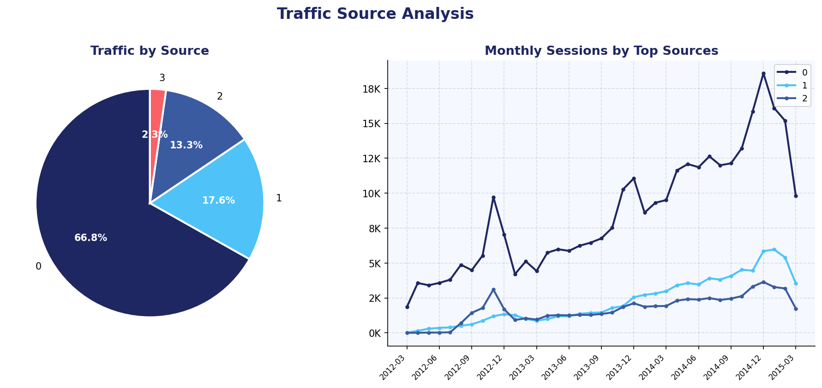
EDA Visual 4: Traffic Source Analysis
Traffic analysis reveals dominant channel mix and monthly growth trends across paid and organic sources.
Key Insight: The top traffic source dominates with 67% of sessions. Paid channels show strong growth post-2013, while organic traffic provides a reliable baseline.

Slide 45
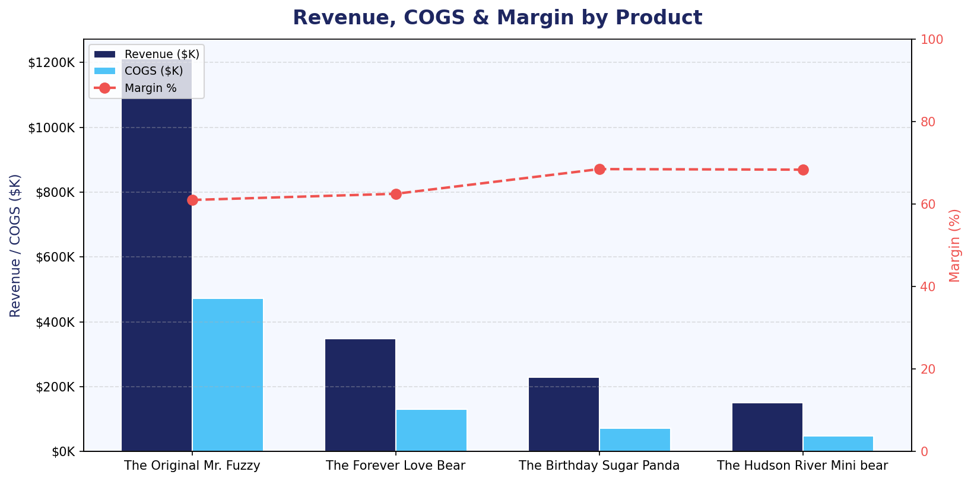
EDA Visual 5: Revenue, COGS & Margin by Product
Product profitability analysis confirms all four products maintain healthy margins, with newer products achieving higher margin percentages.
Key Insight: "The Original Mr. Fuzzy" drives 62% of total revenue at 61% margin. "Birthday Sugar Panda" and "Hudson River Mini Bear" achieve ~68% margin — best in portfolio.

Slide 46
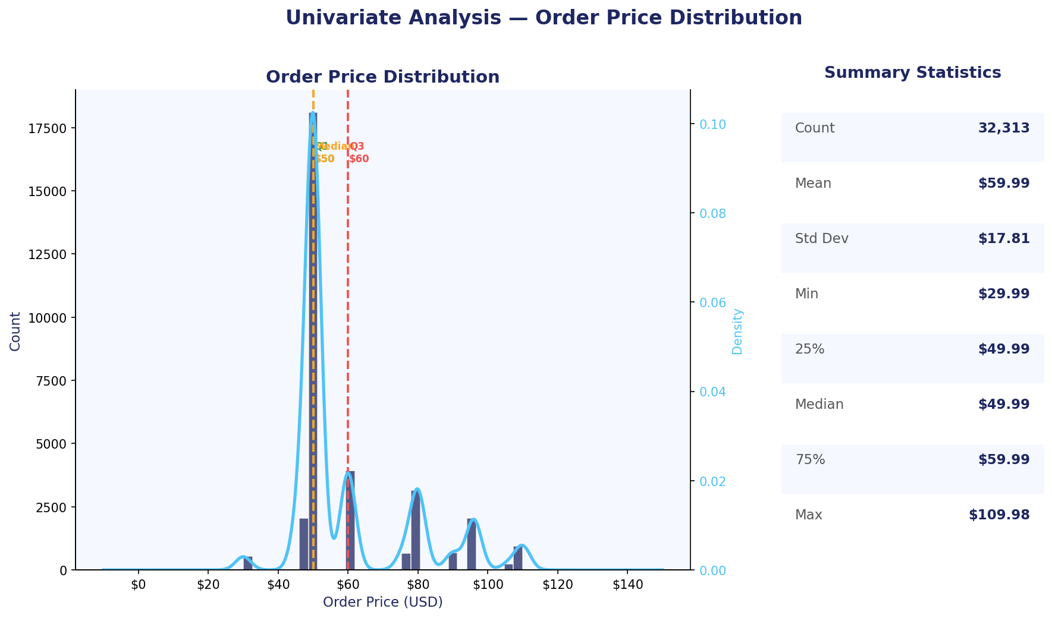
Univariate Analysis 1: Order Price Distribution
Price is heavily concentrated at $49.99 and $59.99, matching the two most popular single-product price points, with a long tail for multi-item orders.
Key Insight: Median = $49.99, Mean = $59.99. The $10 gap reflects multi-item upsell. Price spans $29.99 to $109.98 showing a clear tier structure across the product range.

Slide 47
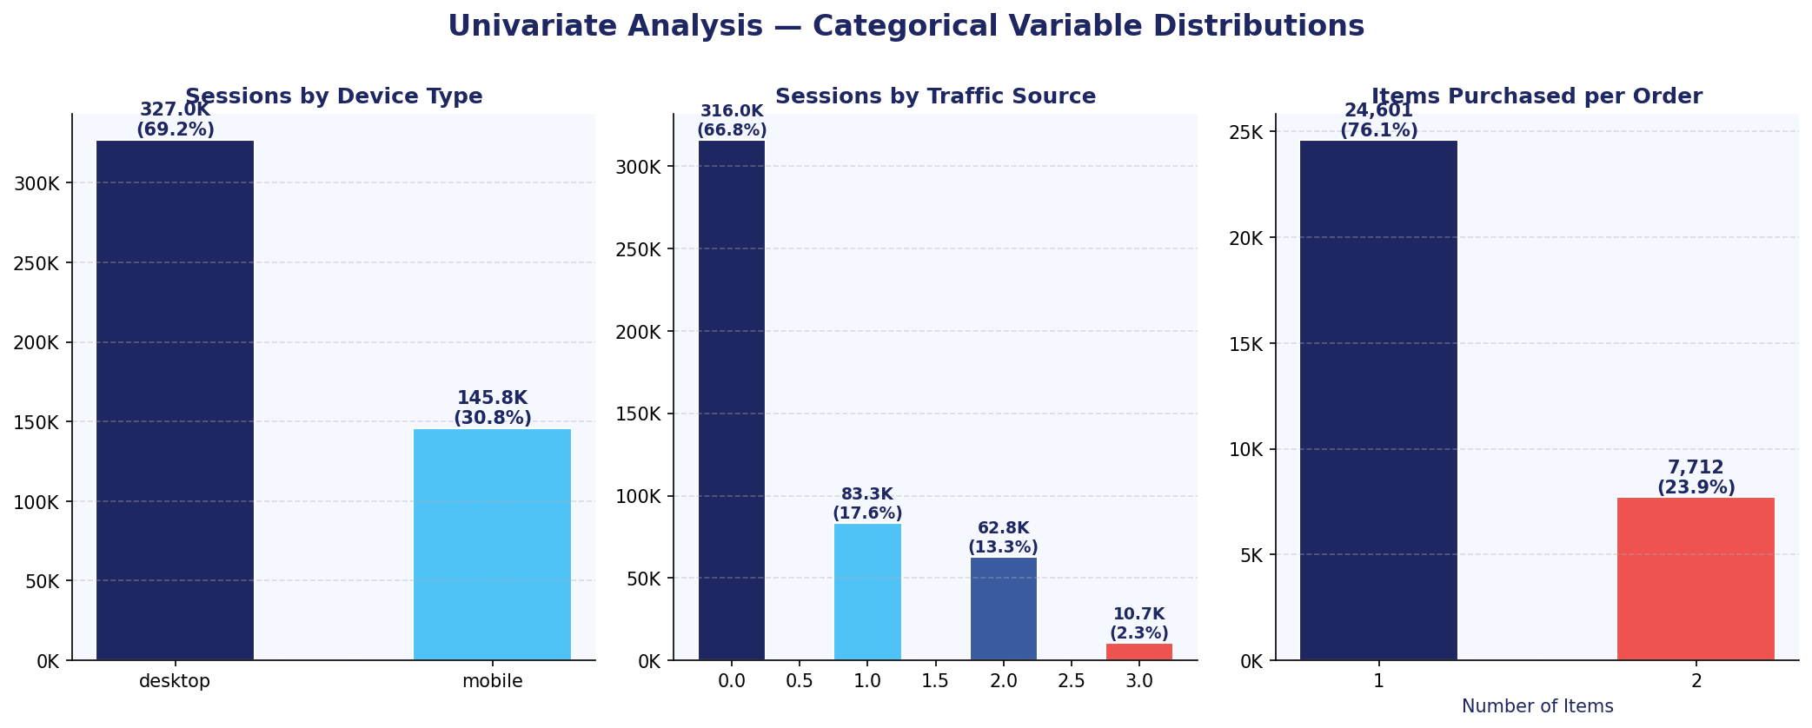
Univariate Analysis 2: Categorical Variable Distributions
Session-level breakdown reveals desktop dominates, source 0 holds 67% of sessions, and 76% of orders are single-item purchases — a clear cross-sell opportunity.
Key Insight: Desktop = 69% of sessions but drives 86% of orders. Source 0 is the dominant acquisition channel. 76% of customers buy 1 item — active cross-sell is untapped.

Slide 48
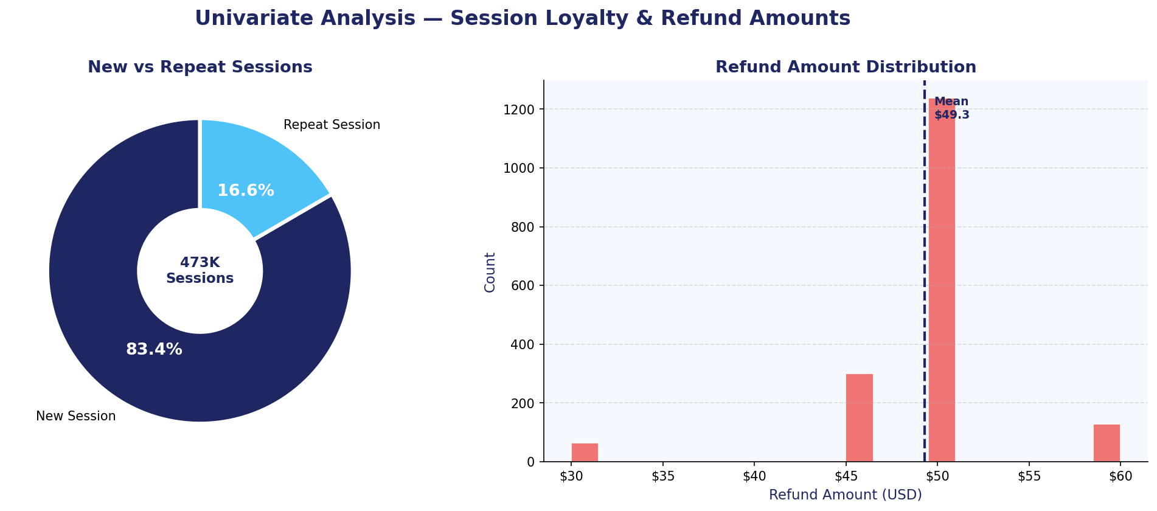
Univariate Analysis 3: Session Loyalty and Refund Amounts
New sessions account for 83% of traffic, showing the business is still primarily acquisition-driven. Refund amounts cluster around fixed product price points.
Key Insight: Only 16.6% of sessions are repeats — a loyalty growth opportunity. Refunds follow discrete price clusters matching individual product prices ($29.99, $49.99).

Slide 49
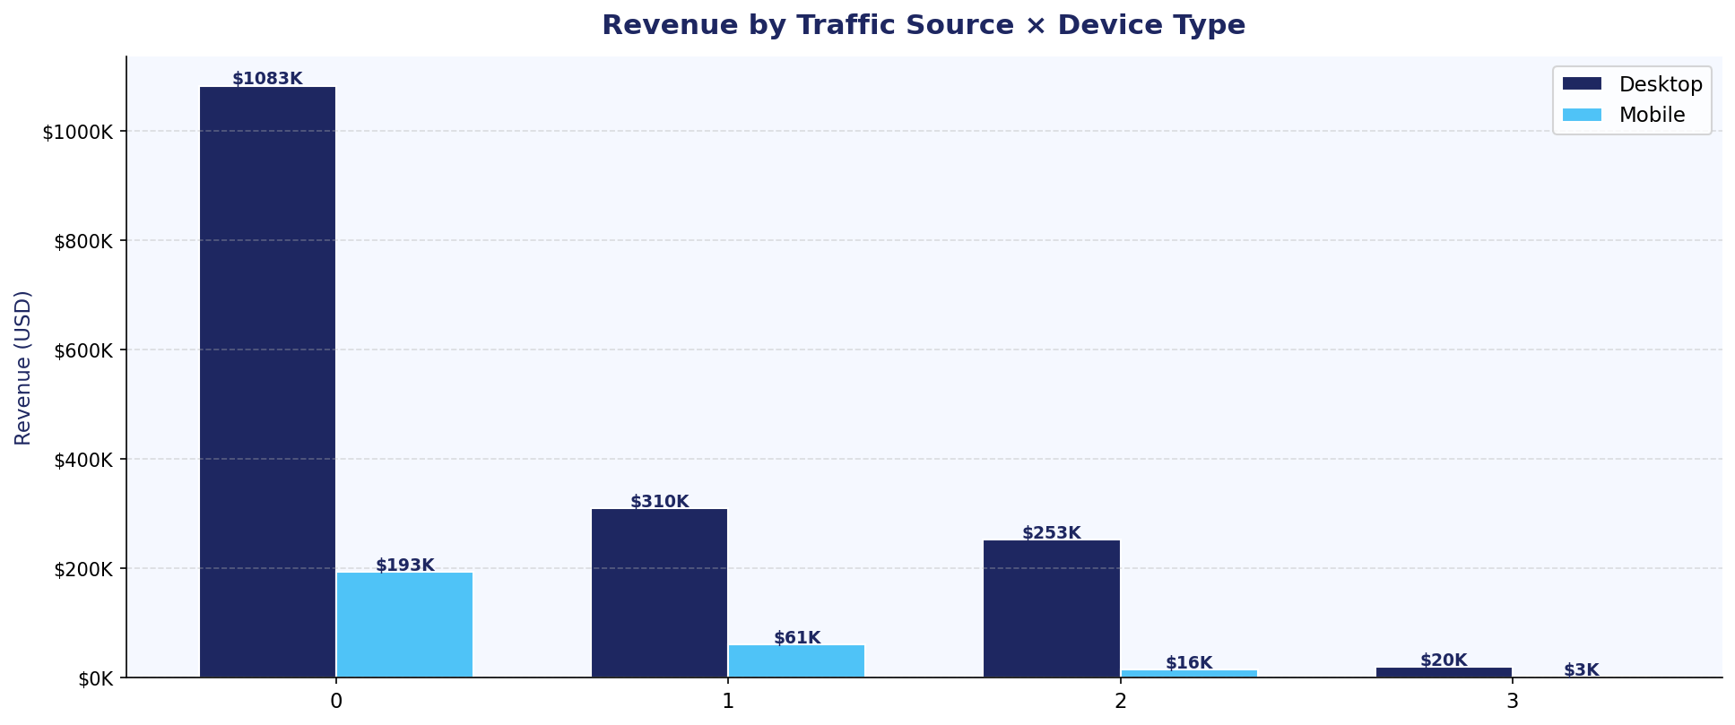
Bivariate Analysis 1: Revenue by Traffic Source and Device
Desktop consistently outperforms mobile across every traffic source. Source 0 on desktop generates over $1M, dwarfing all other channel-device combinations.
Key Insight: Desktop drives 85% of revenue across all sources. Source 0 desktop alone = $1.08M (56% of total). Mobile under-monetises despite meaningful session volume.

Slide 50
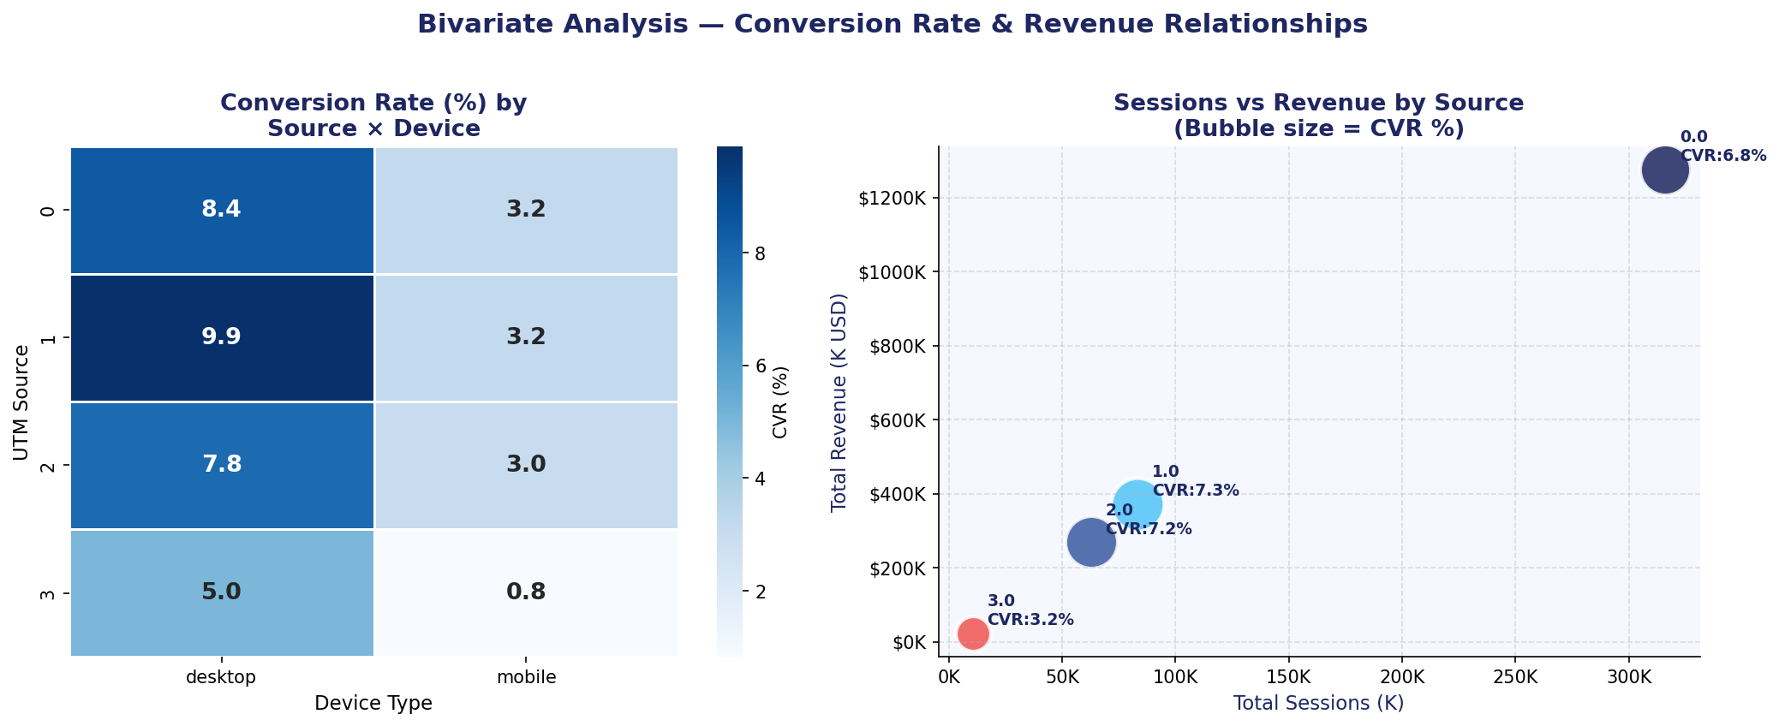
Bivariate Analysis 2: CVR Heatmap and Sessions vs Revenue
Source 1 achieves the highest desktop CVR at 9.9%, while mobile CVR is uniformly low (~3%) regardless of source, indicating a structural mobile experience gap.
Key Insight: Desktop CVR range = 5.0-9.9% across sources. Mobile CVR is flat at ~3% regardless of source, confirming the issue is device UX, not traffic quality.

Slide 51
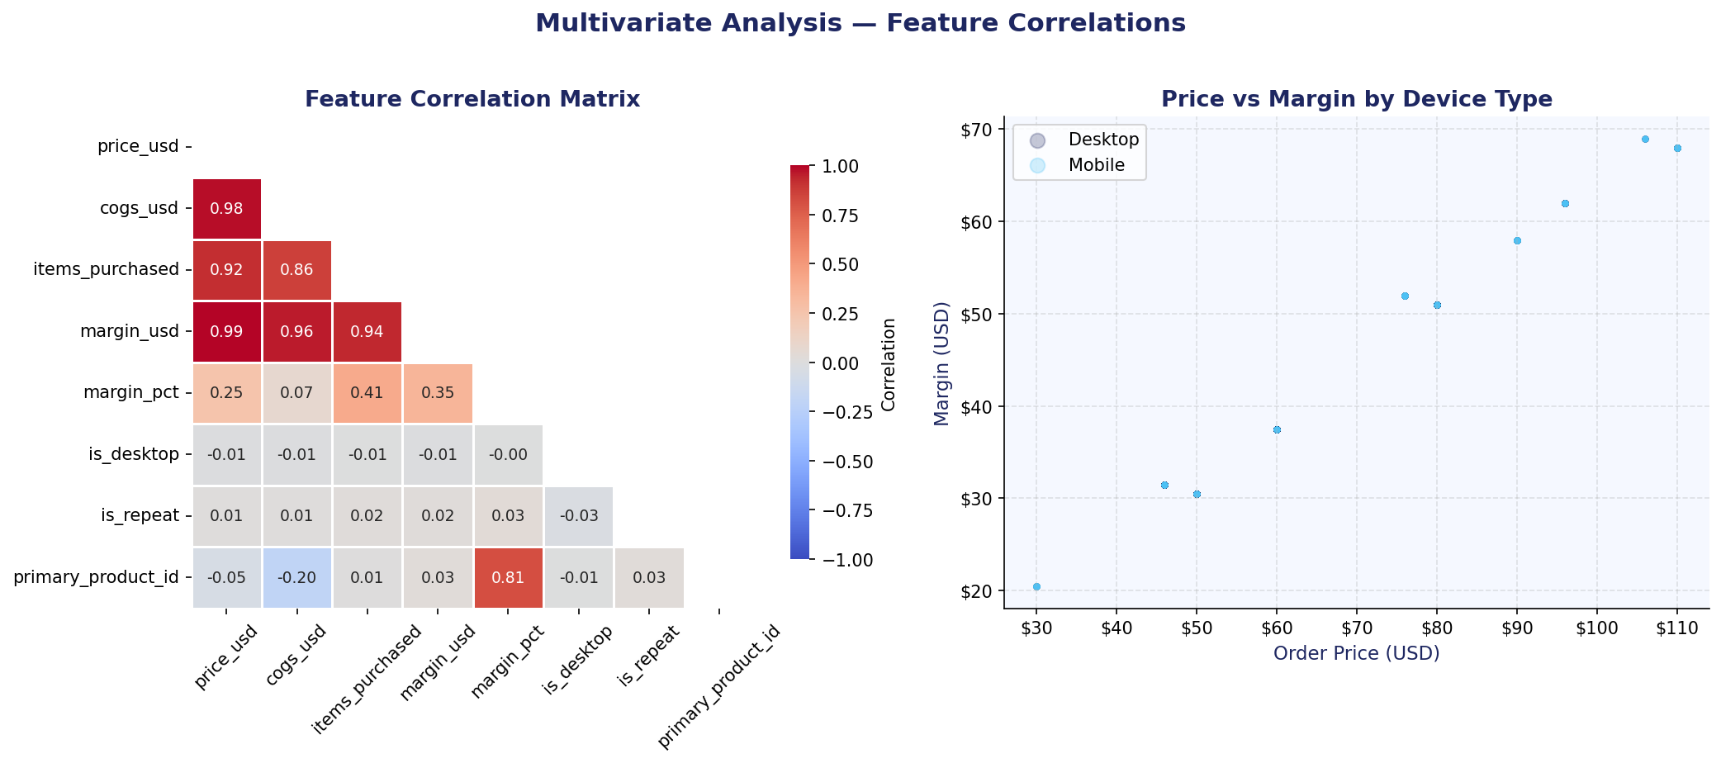
Multivariate Analysis: Feature Correlation Matrix
Price and COGS show near-perfect correlation confirming fixed-margin pricing. Desktop flag shows positive correlation with conversion, validating the device gap hypothesis.
Key Insight: price_usd and cogs_usd correlation is ~1.0 (fixed margin model). is_desktop correlates positively with conversion. items_purchased is weakly correlated with price.

Slide 52
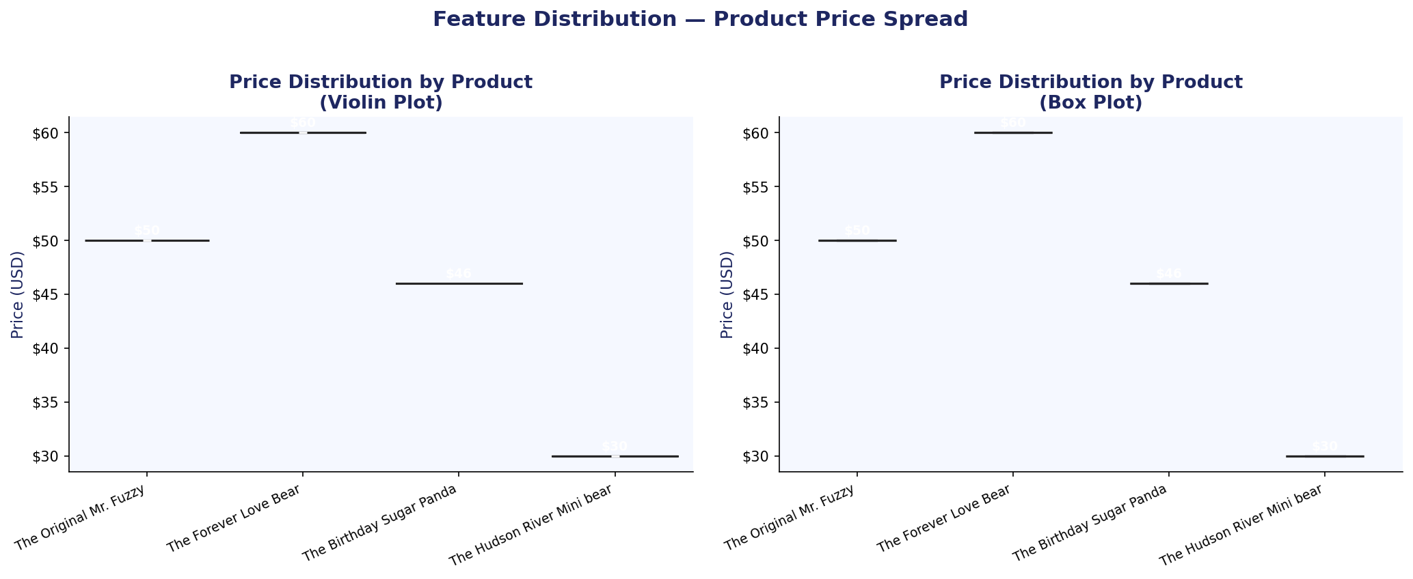
Feature Distribution 1: Product Price Spread
Each product occupies a distinct price band with minimal overlap, confirming a deliberate good-better-best tiering strategy across the four-product portfolio.
Key Insight: Products have fixed price points ($29.99, $49.99, $59.99) with no overlap. Violin shapes confirm zero price variability per product — all sold at fixed retail price.

Slide 53
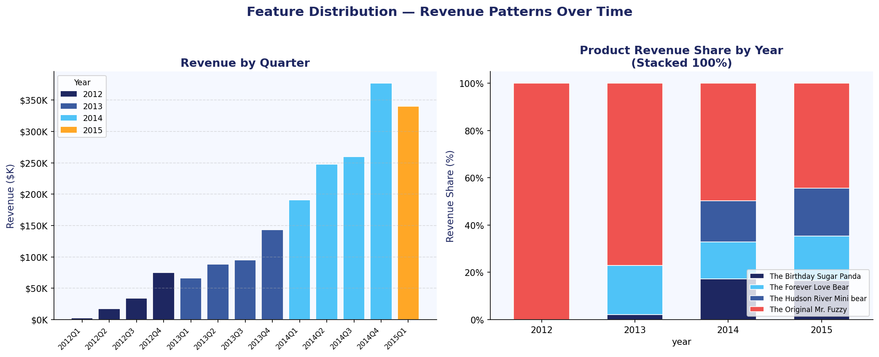
Feature Distribution 2: Quarterly Revenue and Product Mix
Revenue grows every year with strong Q4 seasonality. Product mix has diversified as newer products took a larger share from 2014 onward, validating the portfolio strategy.
Key Insight: Q4 revenue is 30-40% higher than Q1 consistently. Mr. Fuzzy share declined from ~100% in 2012 to ~60% by 2015 as newer products scaled successfully.

Slide 54
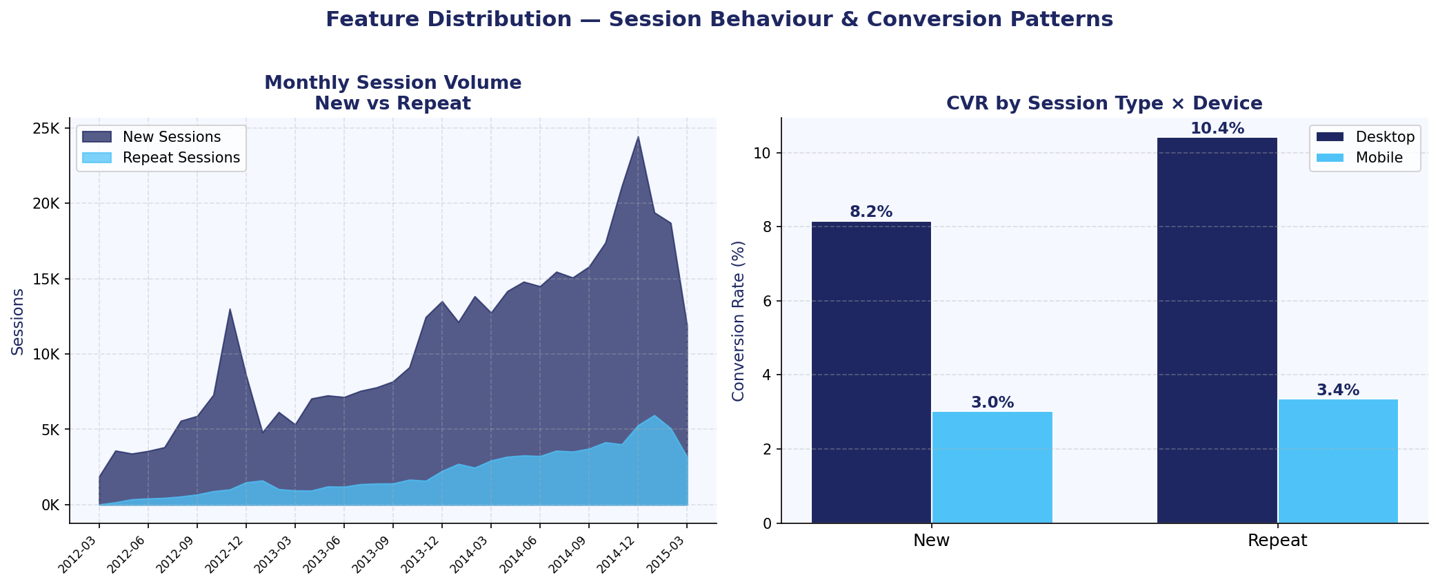
Feature Distribution 3: Session Behaviour and Conversion Patterns
Repeat desktop sessions convert at 10.4% — highest of any segment — proving that loyalty combined with desktop experience is the highest-value user cohort to target.
Key Insight: Repeat desktop CVR = 10.4% vs new desktop = 8.2%. Mobile CVR is flat at ~3% for both types. Combining retention strategy with desktop UX fix delivers the highest upside.

Slide 55
THANK YOU!

