Slide 1
CS410 Course project
SaveIt - Panther Moderns

Slide 2





App overview
Backend
Scrape
website urls
web app
Index
Retrieve
query input
query results

Slide 3
App installation
Clone the project’s git repo:
git clone https://github.com/styloooo/CourseProject.git
Create a virtual environment for the project (one option is to use virtualenvwrapper, follow this link to download the package and activate a virtual environment)
Install the project dependencies. Executes from the top project directory:
pip install -r requirements.txt
Generate a Django secret key:
python -c 'from django.core.management.utils import get_random_secret_key; print(get_random_secret_key())’
With your newly created virtual environment activated, open this text file: $VIRTUAL_ENV/bin/postactivate and add the value generated by the previous command to the environmental variable DJANGO_SECRET_KEY:
export DJANGO_SECRET_KEY='secret-key-that-you-just-generated’

Slide 4
App installation
Push the database migrations:
./bin/makemigrations.sh
./bin/migrate.sh
Download the required NLTK corpora:
./bin/setup_nltk.sh
Seed the database with a set of initial documents:
./bin/seed_db.sh
Finally, to run the APP:
./bin/runserver.sh
* If any issues are encountered during the installation/set-up process, please refer to https://github.com/styloooo/CourseProject/blob/main/README.md for detailed instructions (e.g: set-up steps without virtual environment set-up)

Slide 5
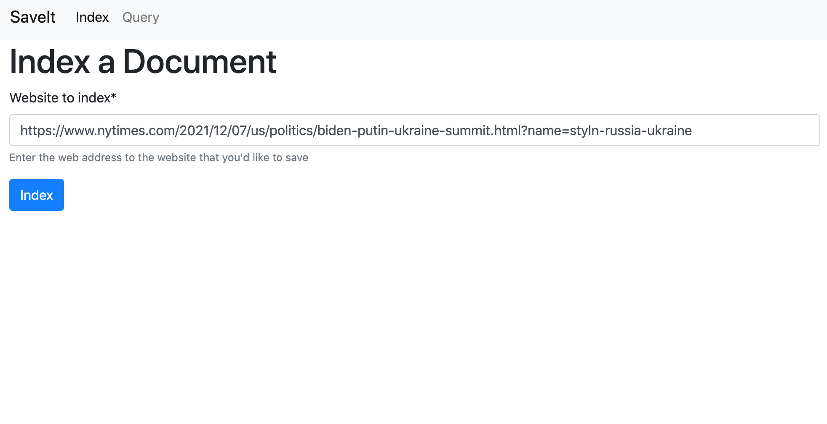
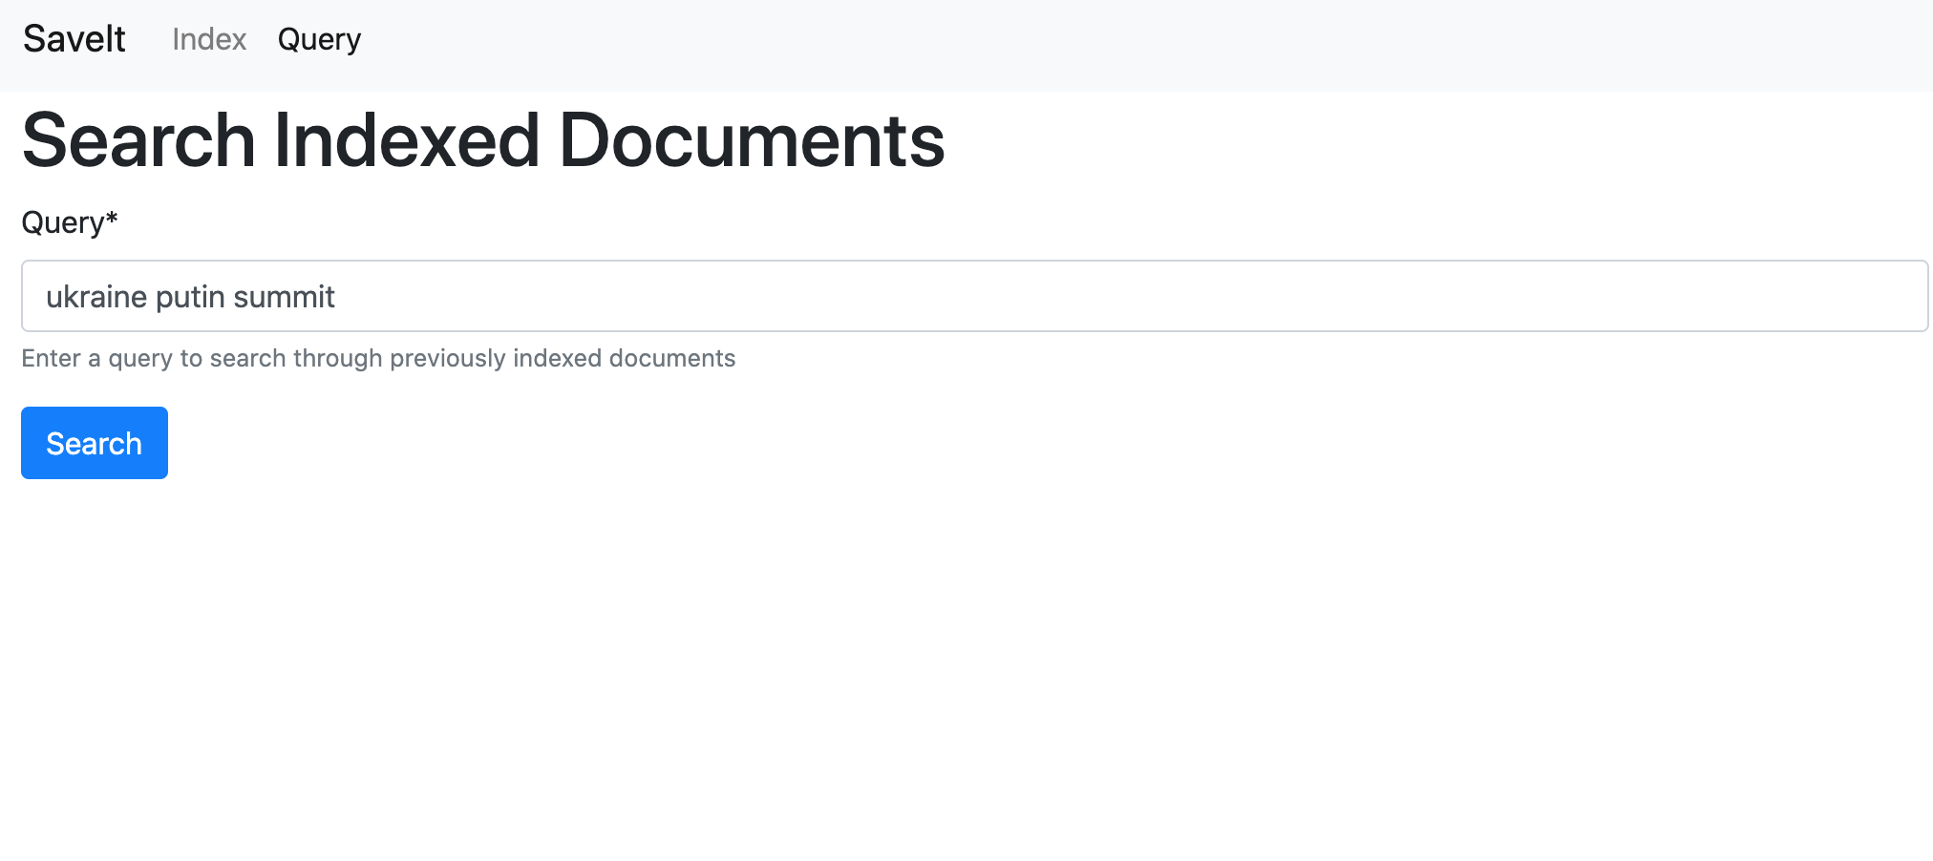
Instructions to use the app
2. Users will then input a query on the app
1. Users will input a URL on the APP that they want to save and index in the database

Slide 6
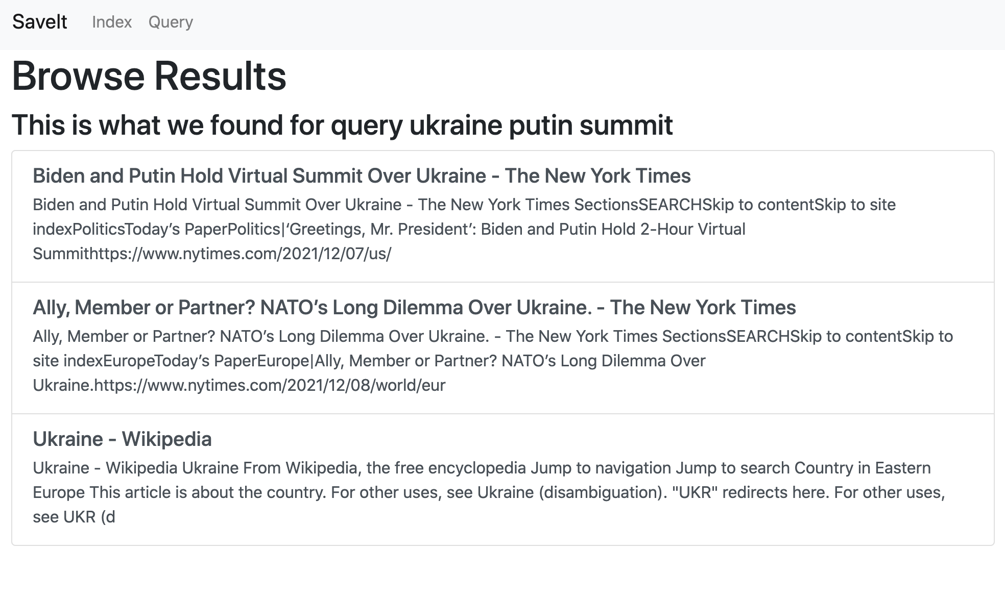
Instructions to use the app
3. The APP will be able to return a ranked list of previously indexed documents that are relevant to the input query

Slide 7
Sample Use case - click the black box to see a demo
Get a URL to index
Enter that URL into the index input
Browse to the query page
Enter a query relevant to that indexed document’s page text
Browse ranked list of retrieved documents
Click through to URL of indexed document

