Slide 1



Escape the Matrix
Game Development in 3D : CSEB434
Name: Satyam Raj
Reg. No.: 12106615
Roll No.: RKE095A27

Slide 2

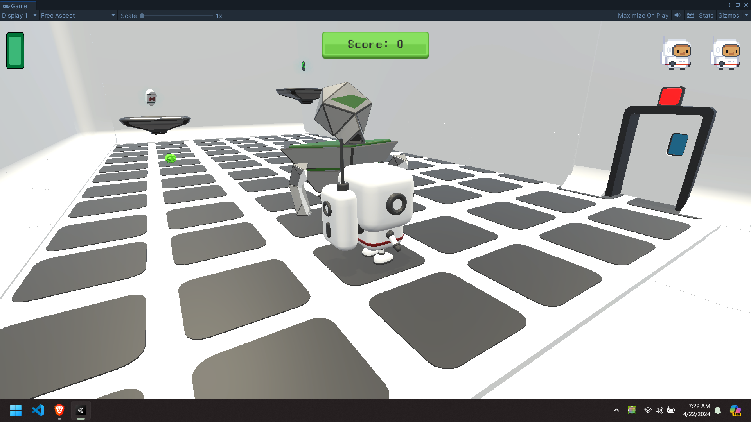
Game Features
Multiple Levels
Fight the Enemies
Find the Key
Survive

Slide 3
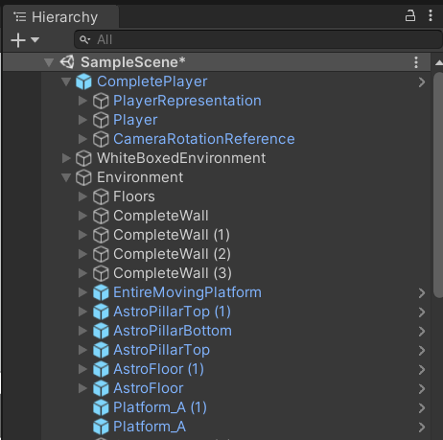
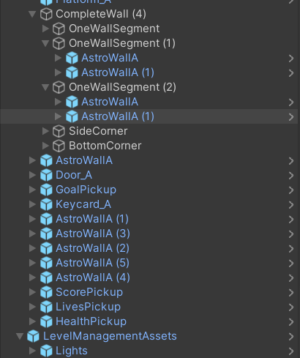
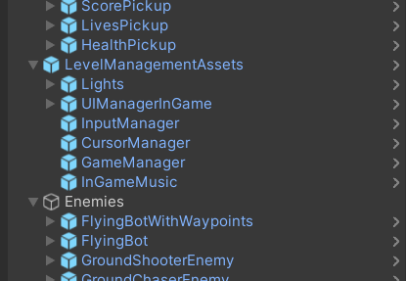
Game Objects Hierarchy

Slide 4
Player Controls:
Move forward : W
Move Left : A
Move backward : S
Move Right : D
Jump : Space Bar

Slide 5
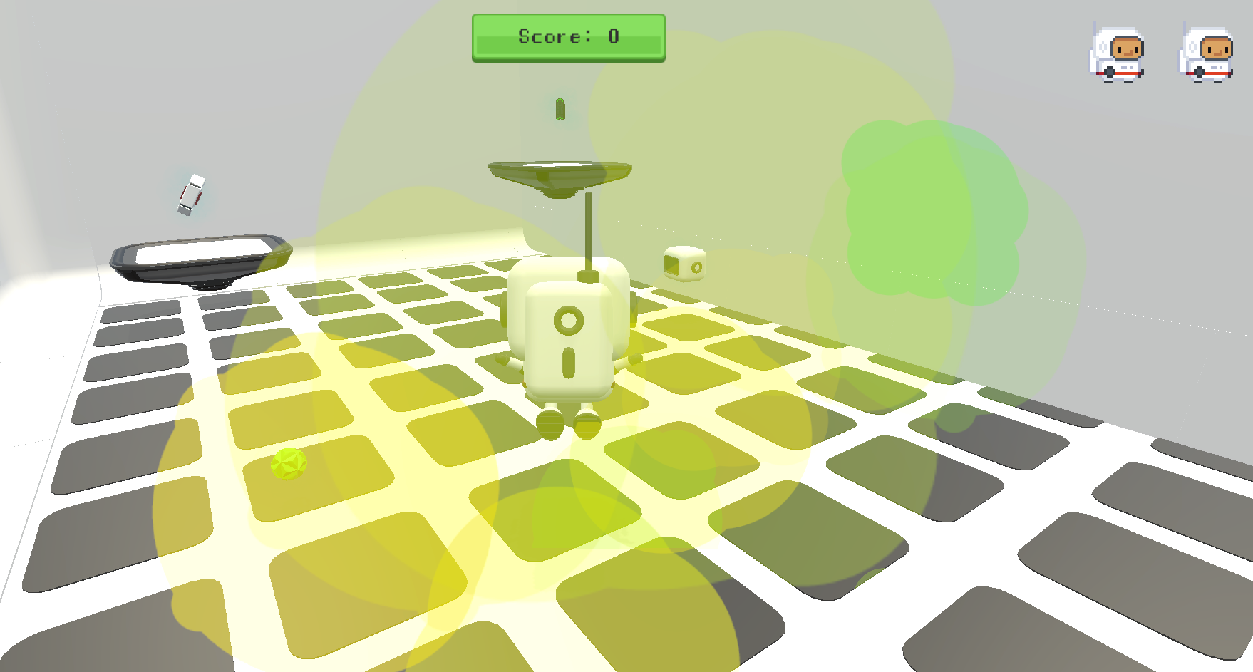
Kill the enemies

Slide 6
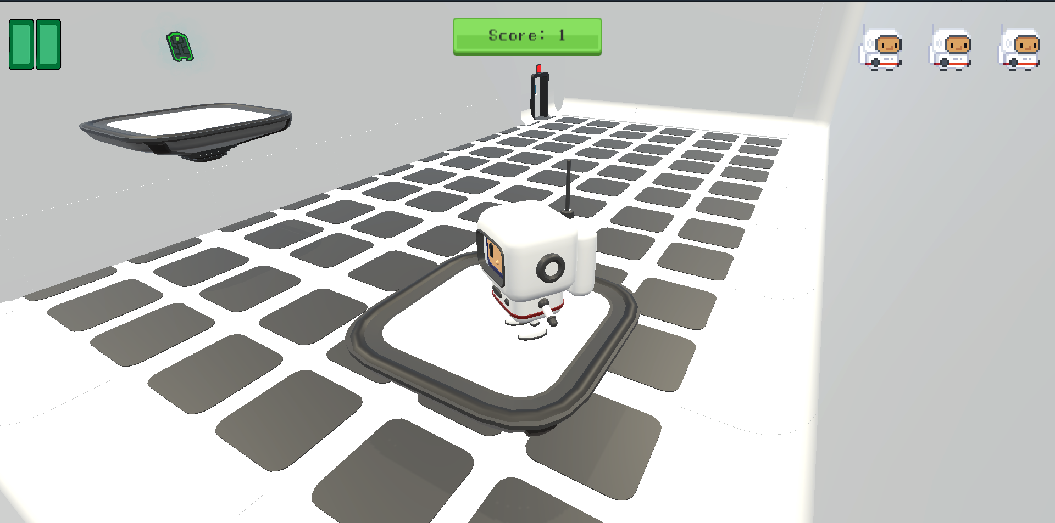
Take the Health points and capture the key

Slide 7
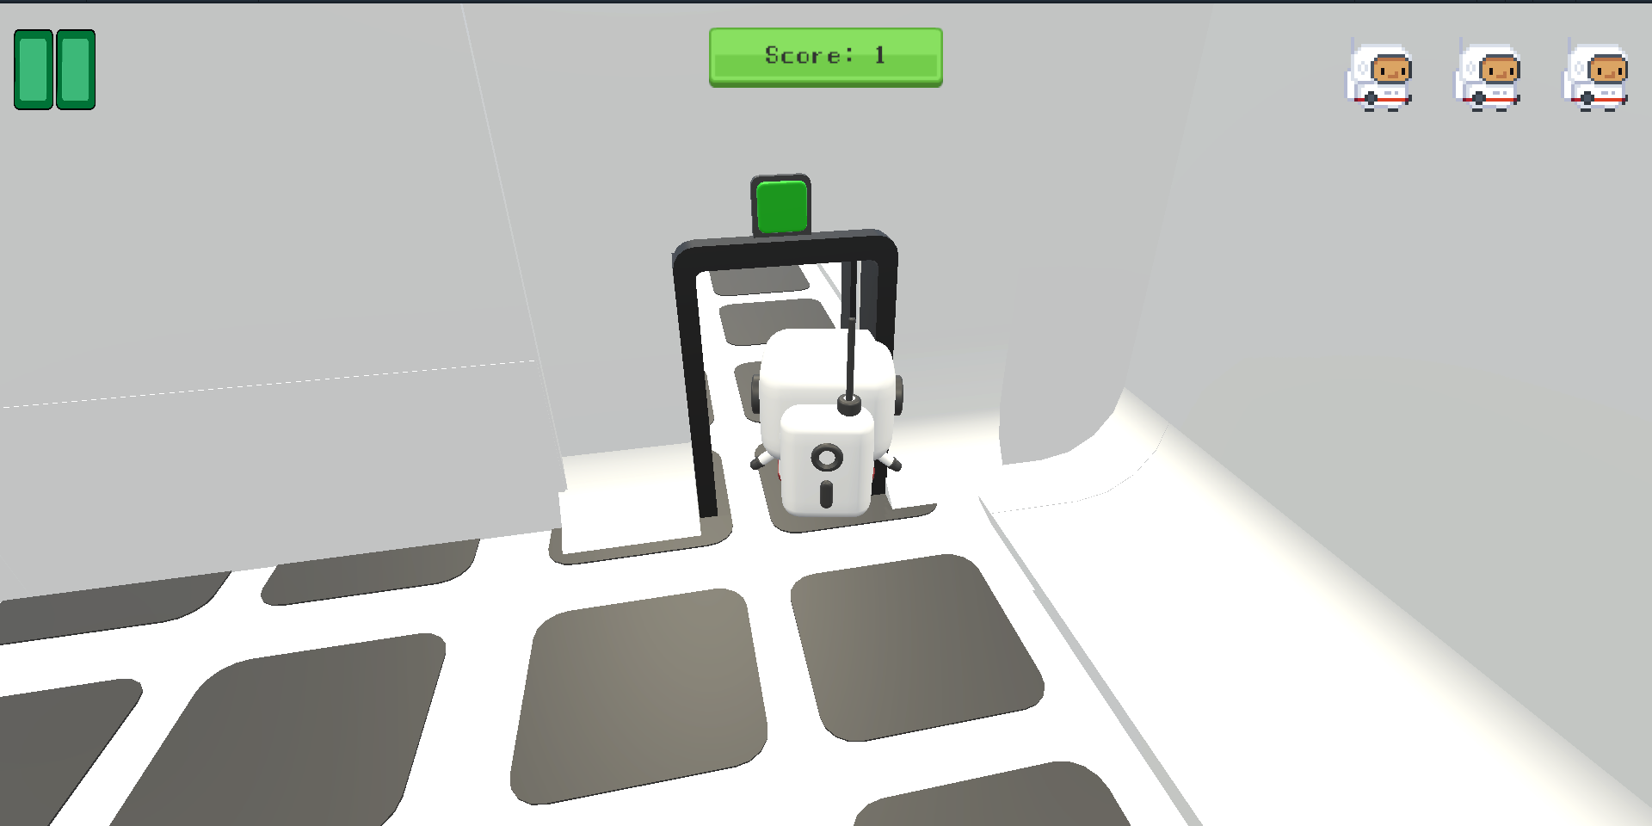
Unlock the next Level

Slide 8
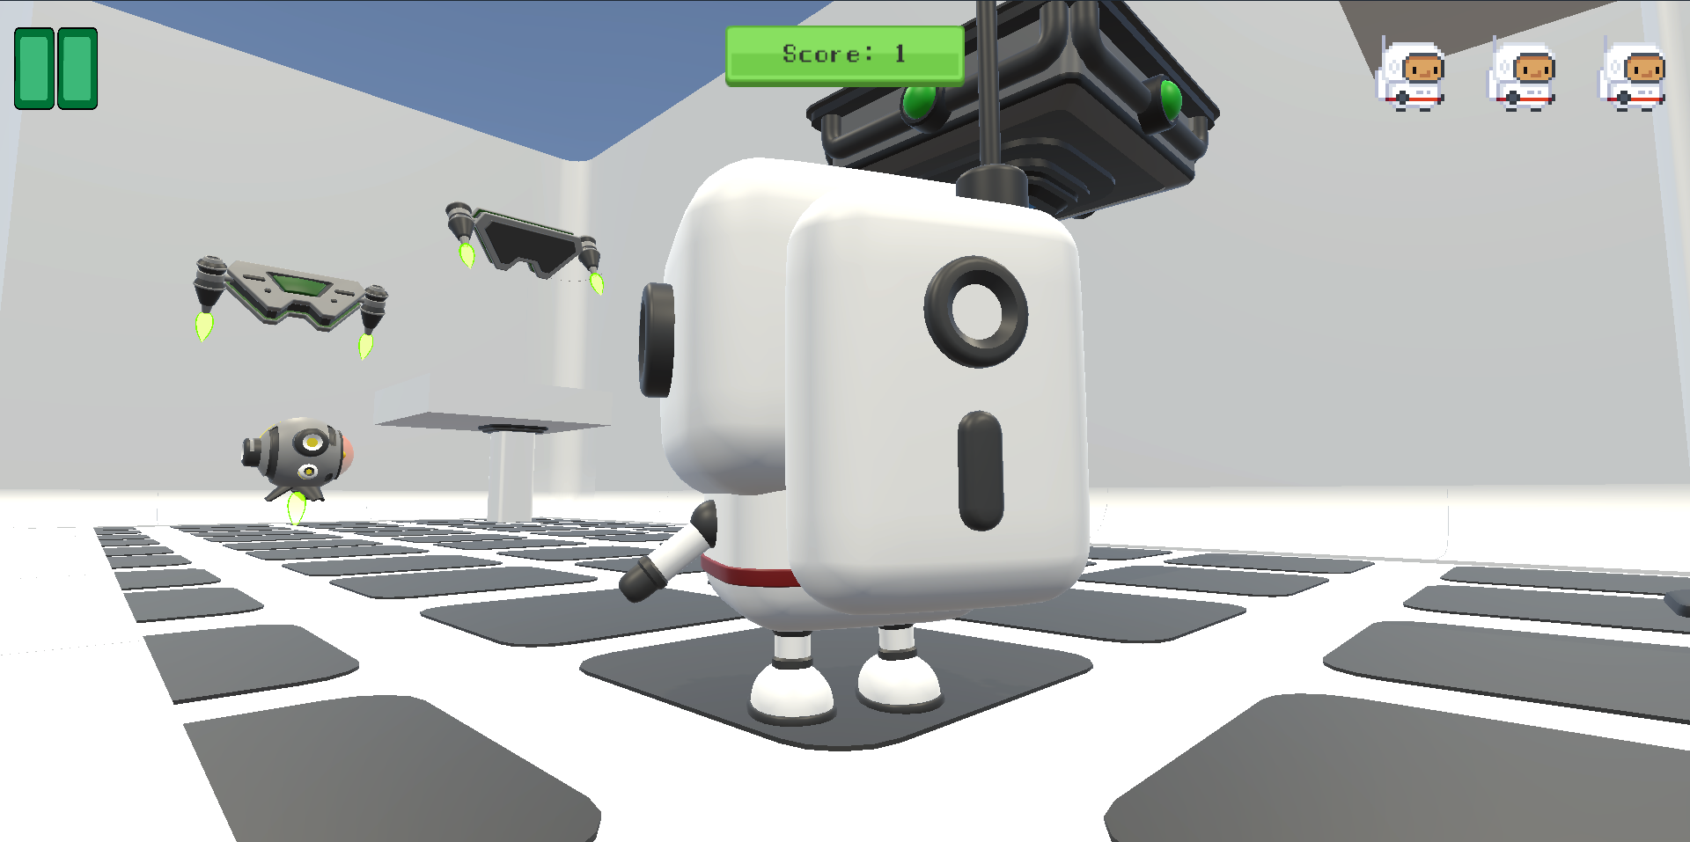
Next level

Slide 9
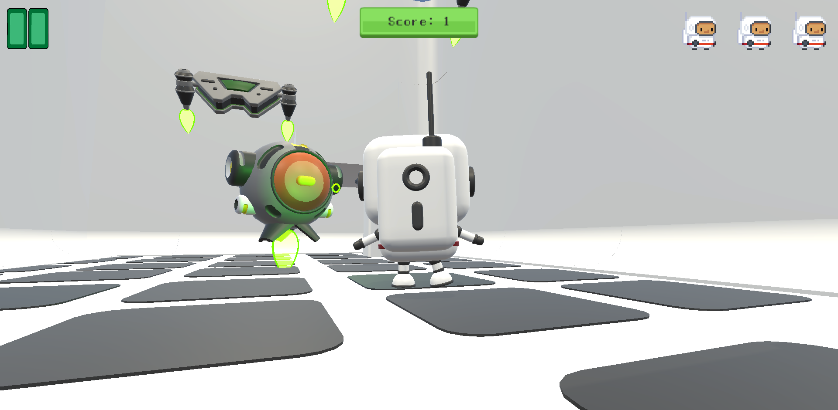
Don't get hit by the enemies

Slide 10
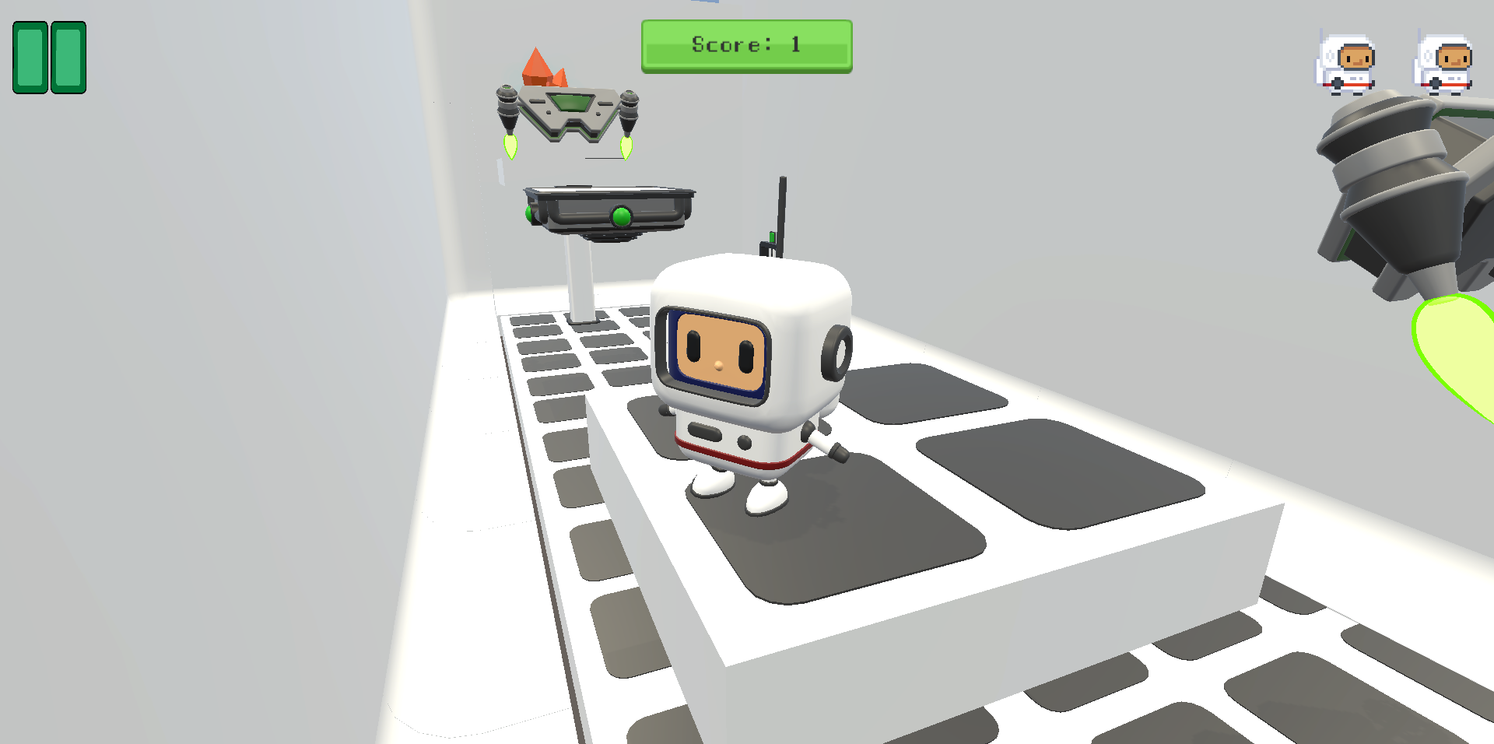
Reach the main target

Slide 11
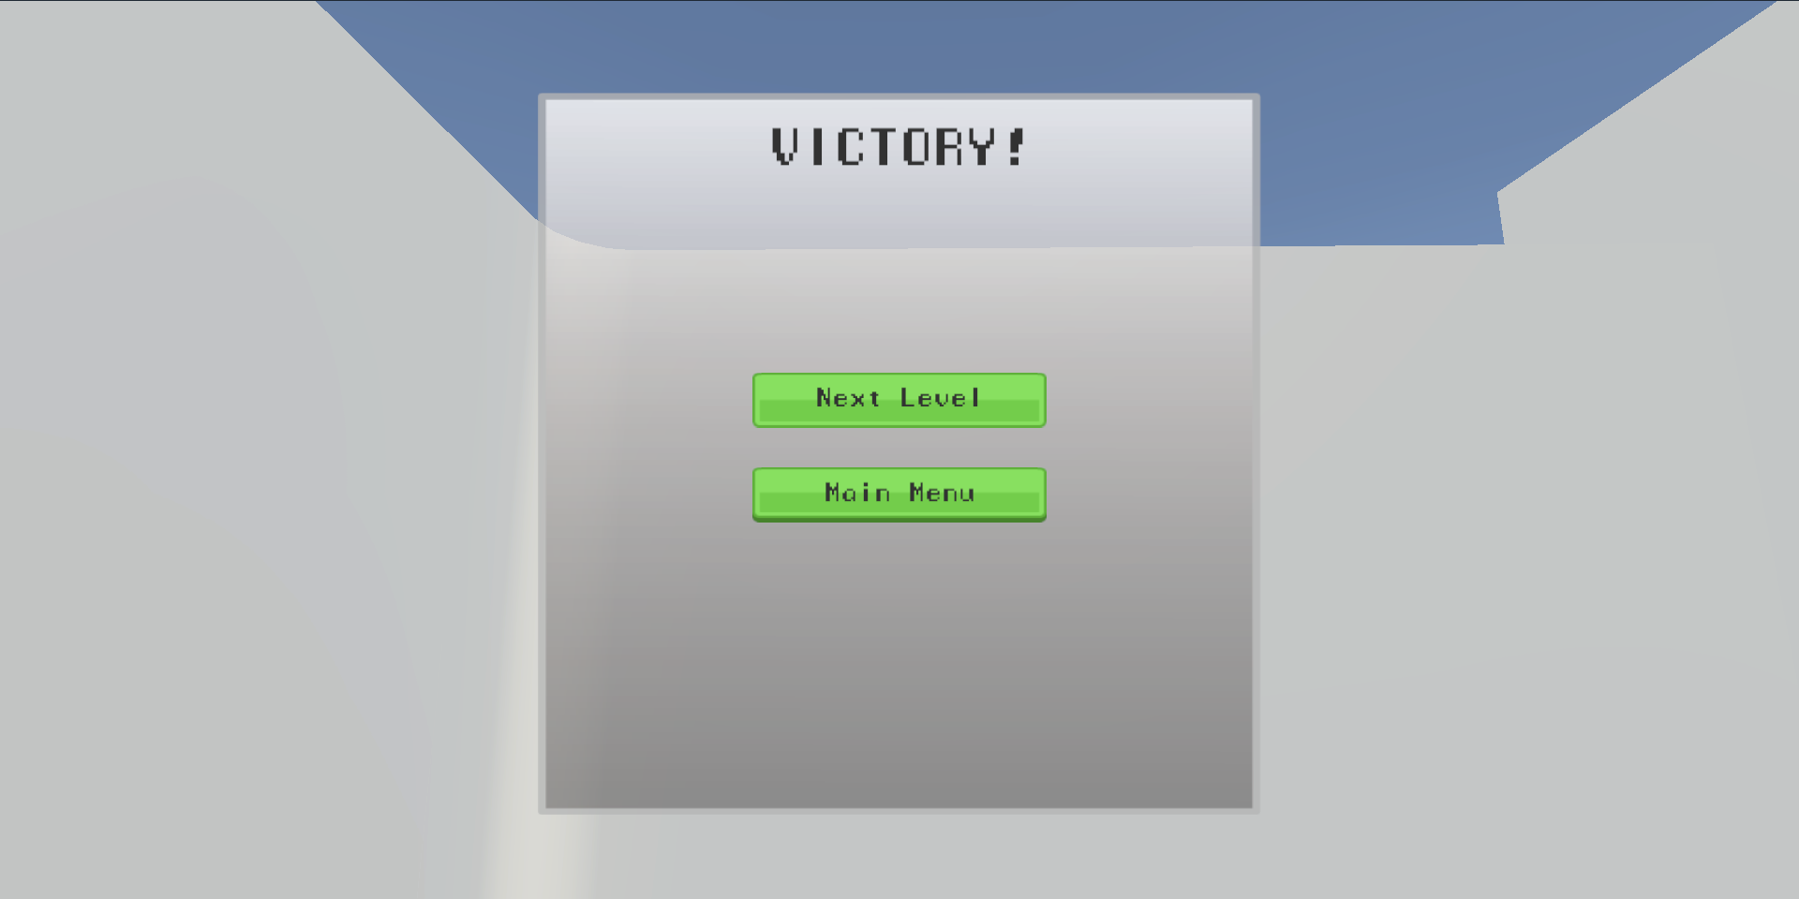
Victory!!

Slide 12
Future Aspects :
Scalability and Cross-Platform Compatibility
Monetization Strategy
Integration of Emerging Technologies like AR
Addition of newer levels

Slide 13
Thankyou!

