Slide 1
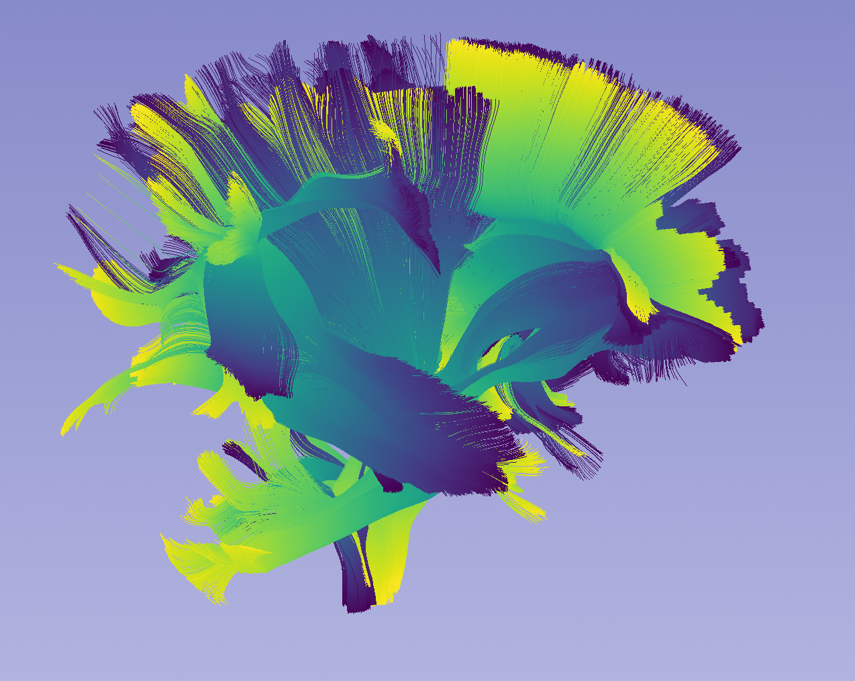
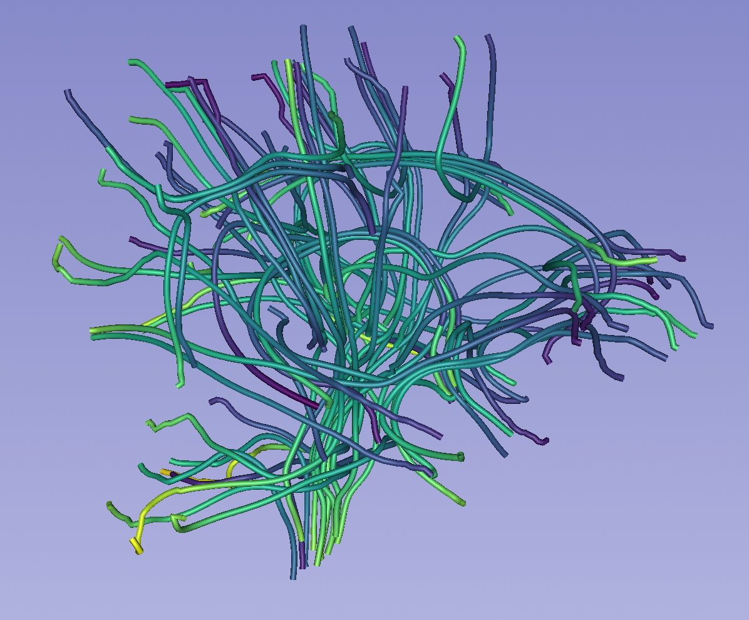
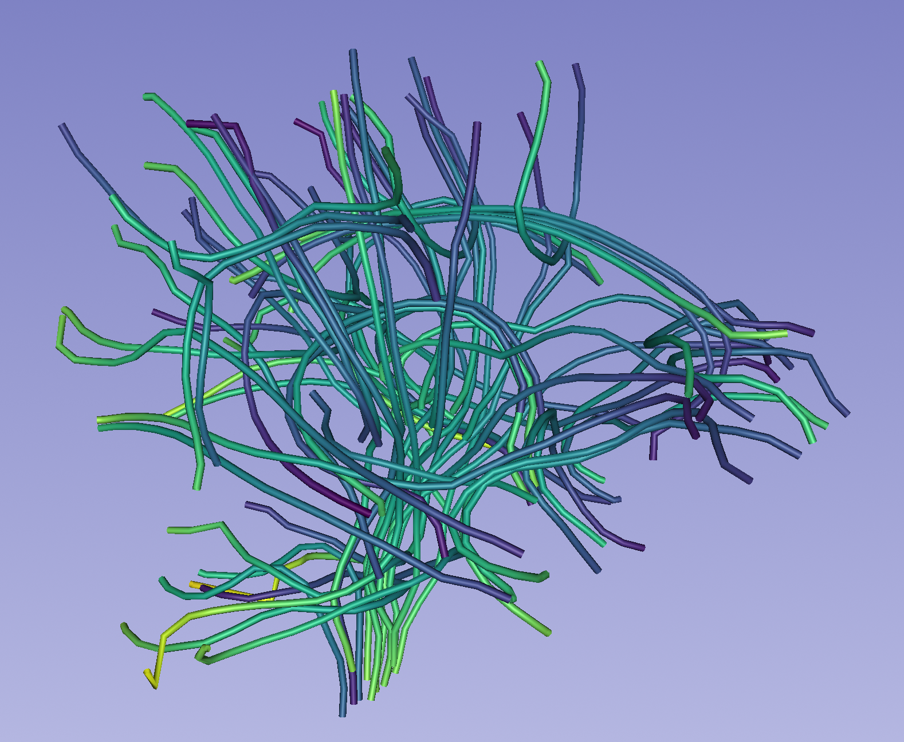
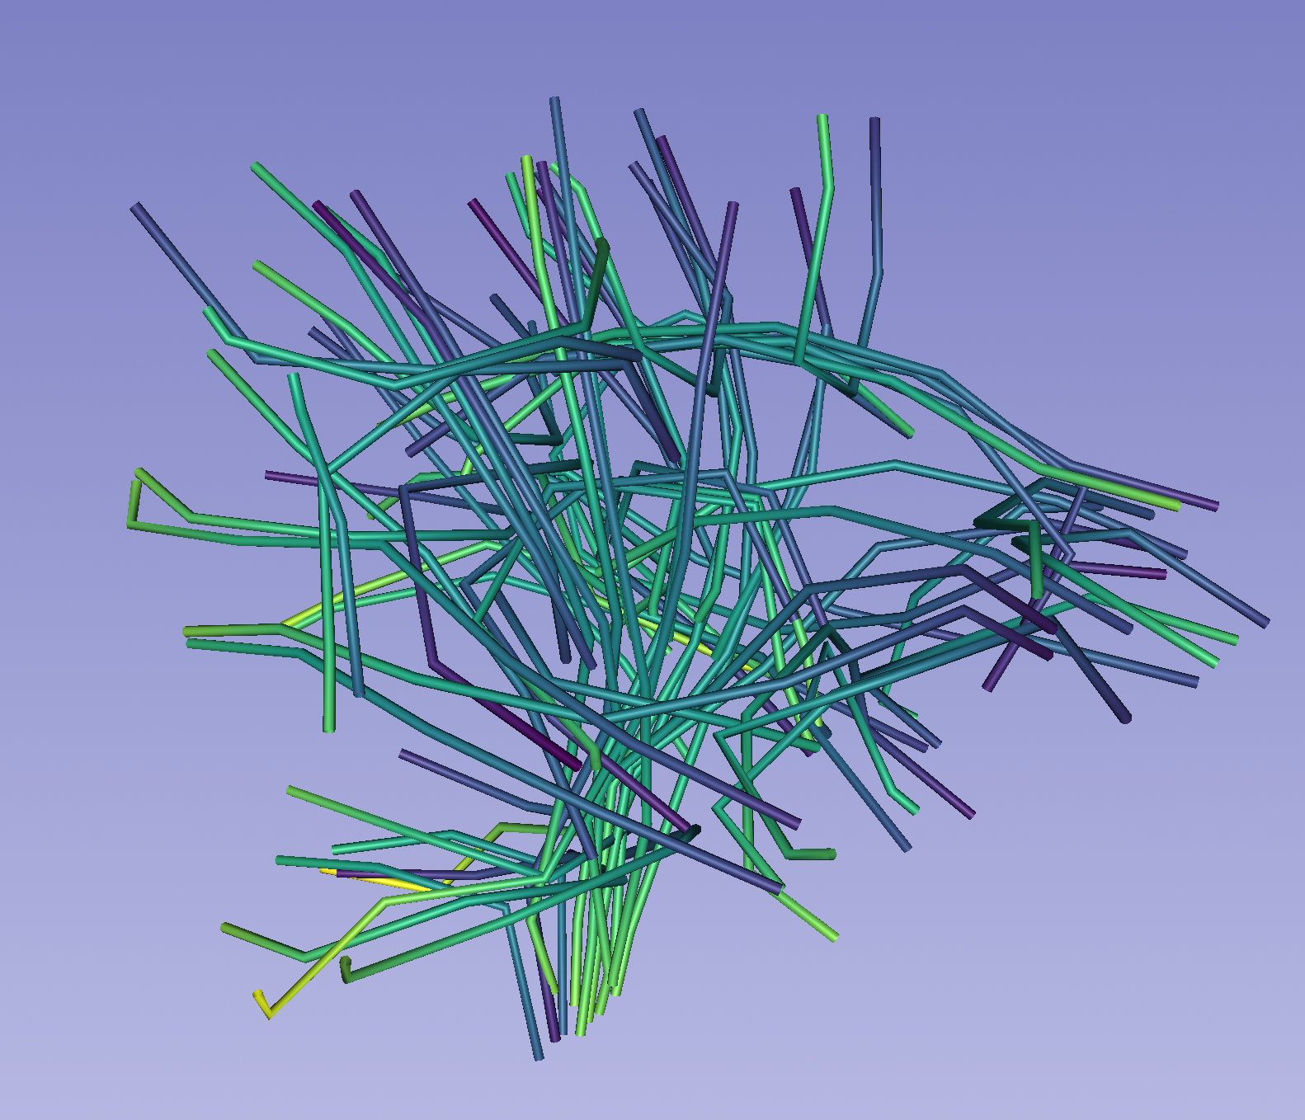

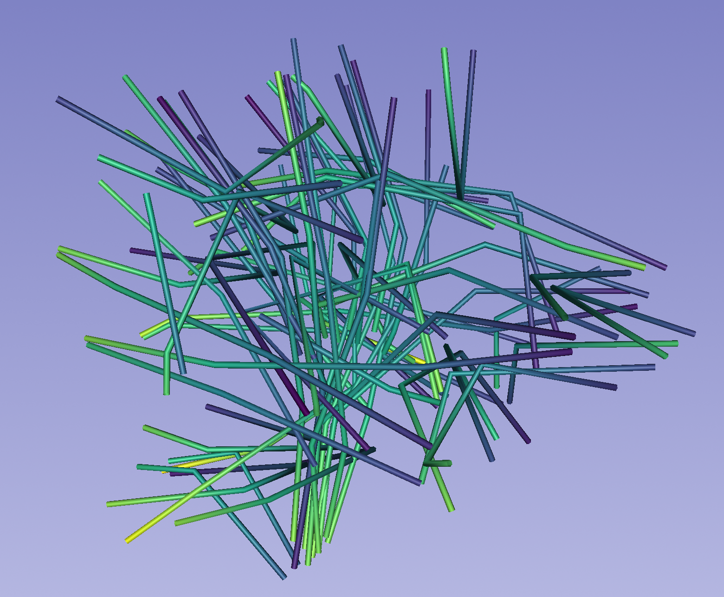
Parametrized Fiber Bundles
Parametrized Fiber Axes (L0)
Data Imputation
Multi-resolution Graph
GCN Classification & Regression
INR / SIREN based
Imputation of
Per subject missing diffusion metrics
L2
Single Level GCN
L3
Multi-scale Concat
L4
Graph U-Net
66 Bundles, 5 metrics
Median Axes
Shared Front + Backend

