Slide 1
House Prices - Advanced Regression Techniques
EPL448 – Data Mining on the Web
Stylianos Sofokleous – Sofoklis Kyriakou – Stavros Spyrou

Slide 2
Goal: Create a model to predict house prices in Ames, Iwoa as accurately as possible
Data: Consists of 81 different attributes, from lot size to number of bedrooms and the house’s location.
Training Set: 1460 entries Test Set: 1460 entries

Slide 3
Our Work
THE PARTS
01
Analysis
02
Pre Procesing
03
Training
04
Evaluation

Slide 4
Preprocessing
Removed columns with a lot of nulls
For columns that had missing values:
a) For strings we set the value that appears most often
b) For numbers we set the average of the values
For columns that have a very high correlation between them we removed the one we found appropriate
Removed columns that have a very low correlation with Sales Price
Removed outliers
Removed columns that contain unbalanced categories
After observing the graphs of our data we decided to transform our data using the natural logarithm (ln)
For columns that had set categories we tried to use one hot encoding to break them up into multiple binary columns

Slide 5
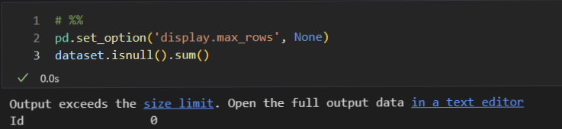
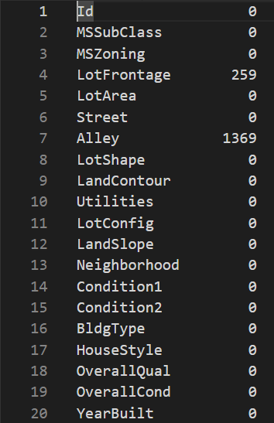
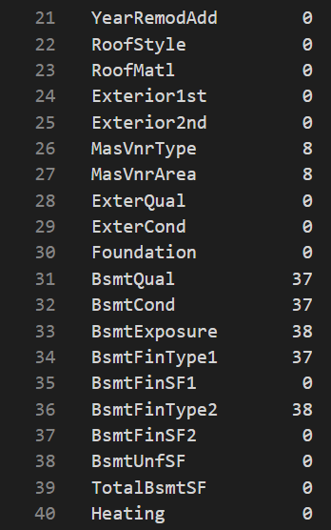
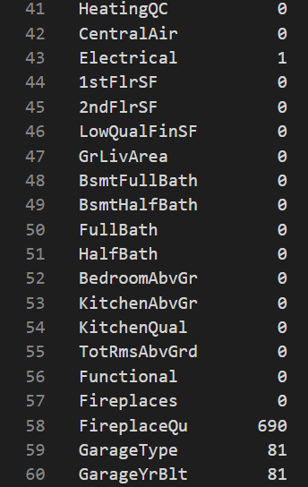
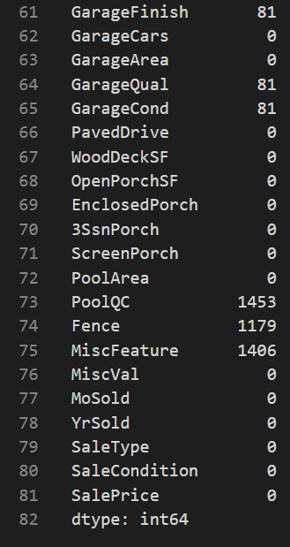
Removed columns with a lot of nulls (80+)
Removed
LotFrontage
Alley,
FirePlaceQu
PoolQC
Fence
MiscFeature

Slide 6
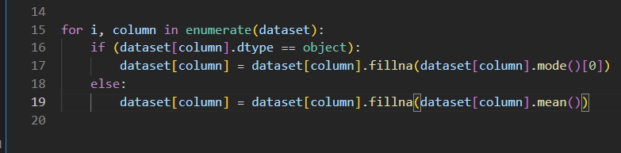
For columns that had missing values: a) For strings we set the value that appears most often b) For numbers we set the average of the values

Slide 7
For columns that have a very high correlation between them we removed the one we found appropriate
Removed | Kept
GarageCars | GarageArea
GarageYrBlt | YearBuilr
Exterior2nd | Exterior1st
TotRmsAbvGrd, 1stFlrSf | GrLivArea
MSSubClass | BldgType

Slide 8
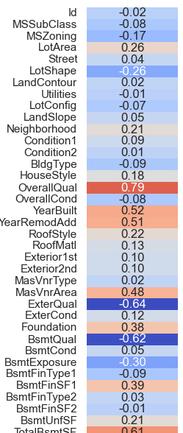
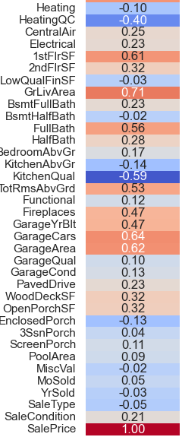
Removed columns that have a very low correlation with Sales Price
Removed::
Street | LowQualFinSf
LandContour | 3SsnPorch
Utilities | MiscVal
LotConfig | MoSold
LandSlope | YrSold
Condition2 | Heating
MasVnrType | Electrical
BsmtCond | RoofMatl
BsmtFinType2 | GarageQual
PoolArea | GarageCond
BsmtHalfBath | PavedDrive

Slide 9
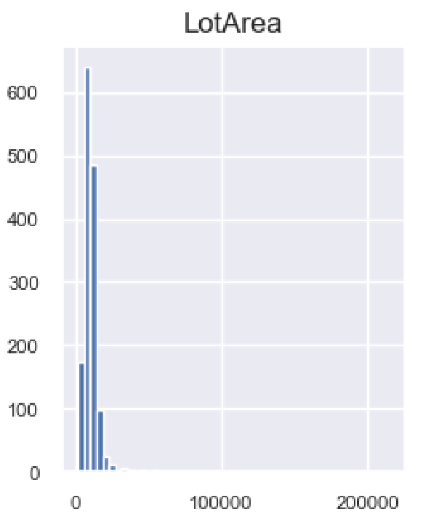
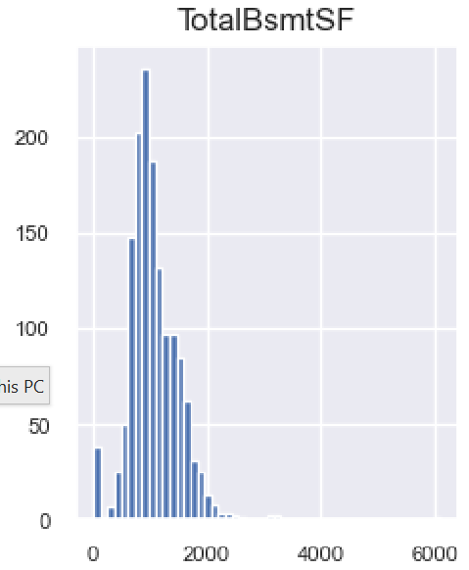
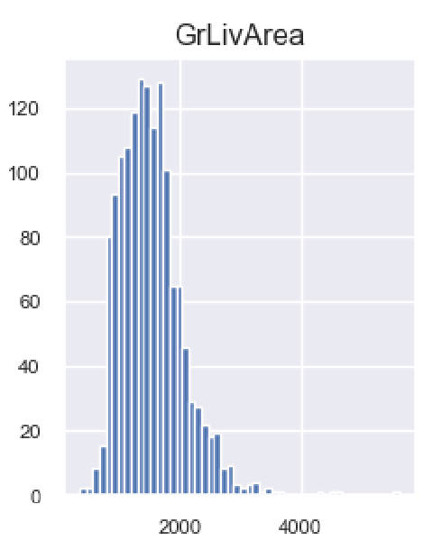
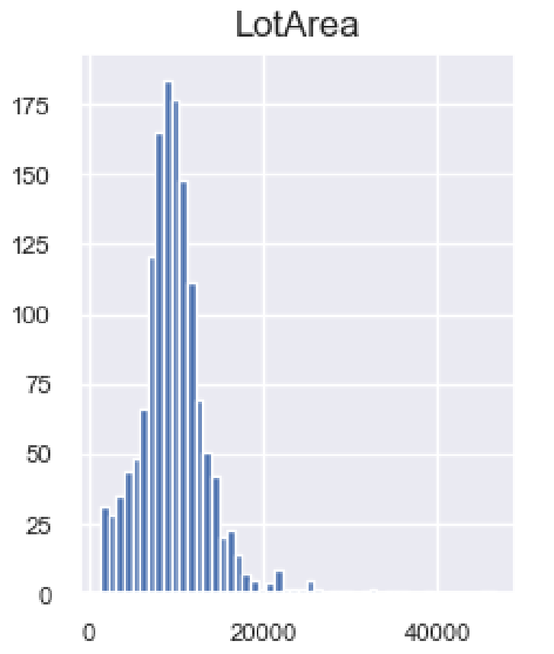
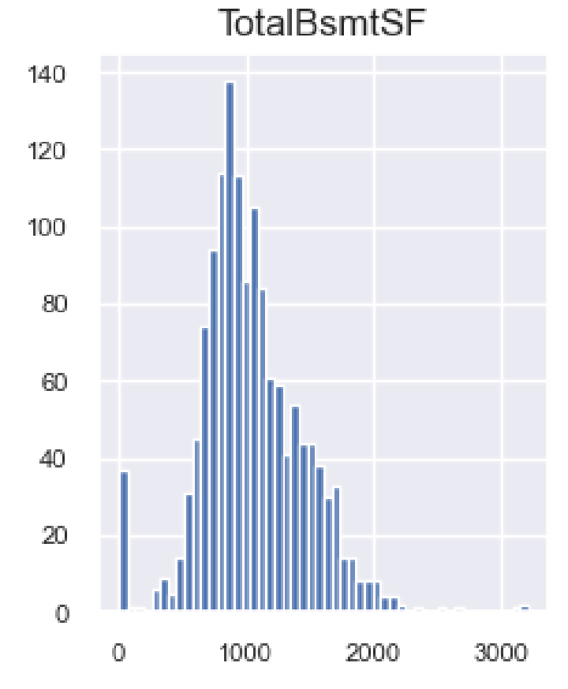
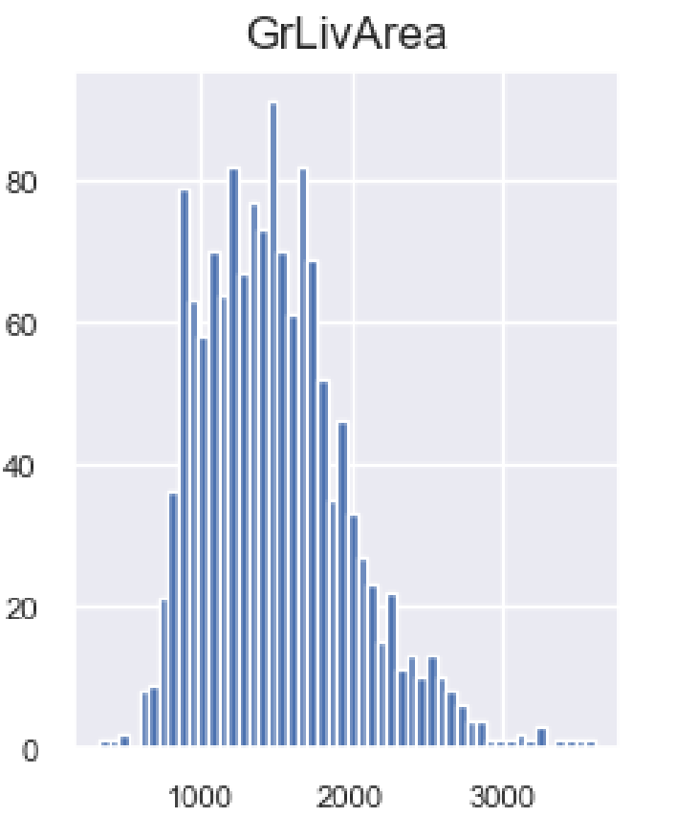
Removed outliers
Before
After

Slide 10
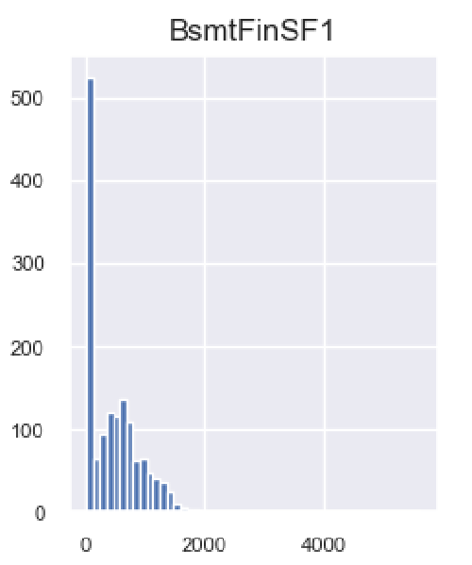
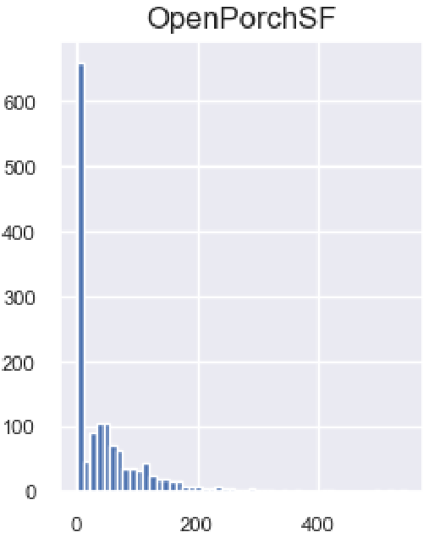
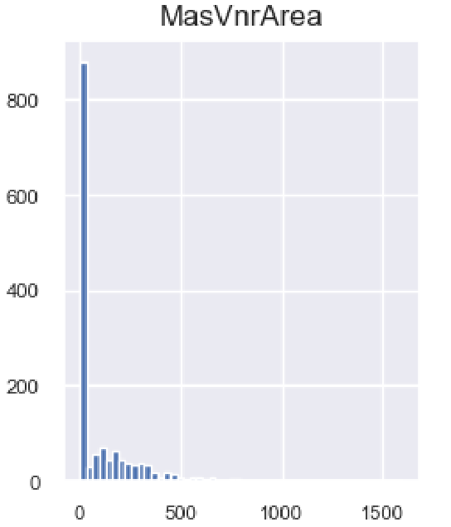
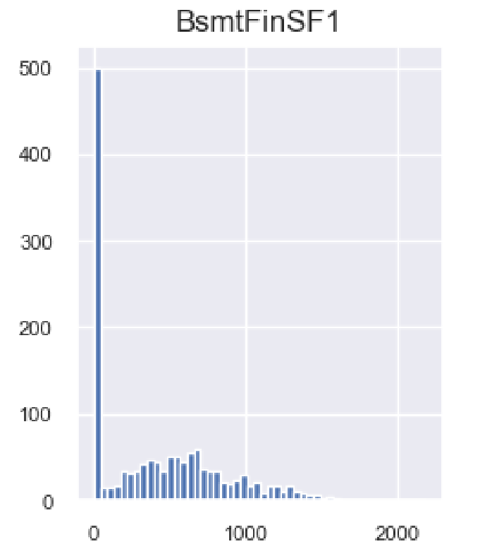
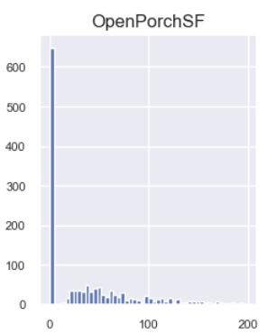
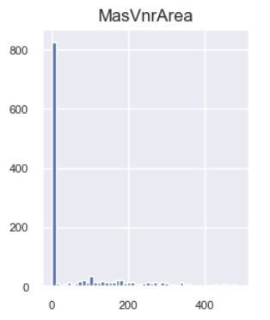
Removed outliers
Before
After

Slide 11
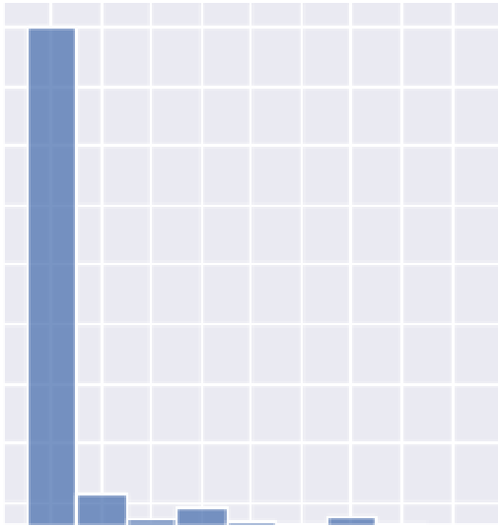
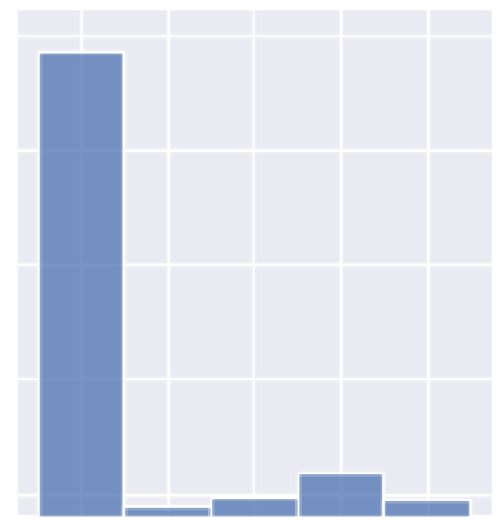
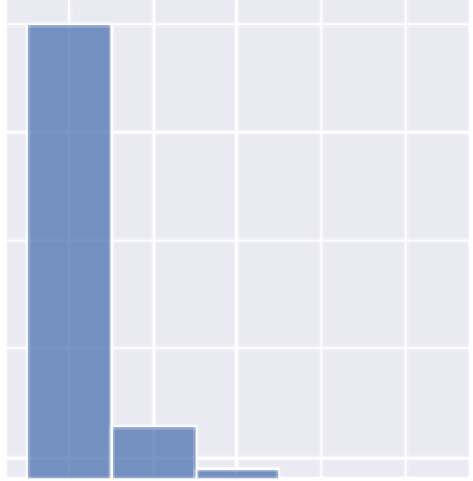
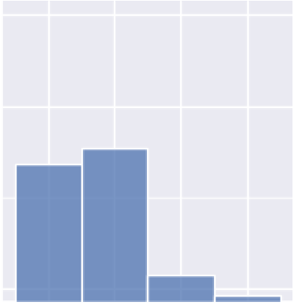
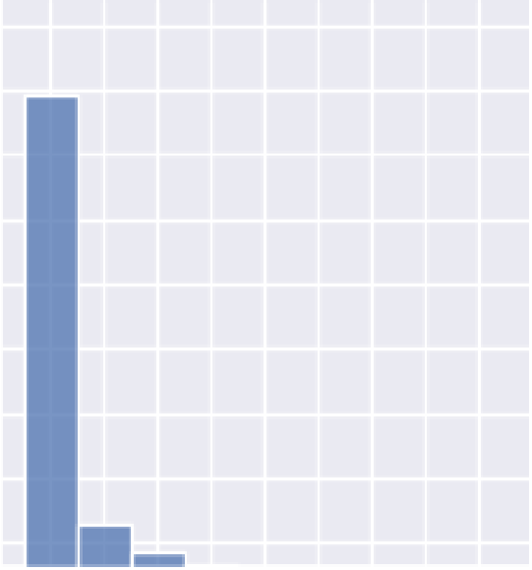
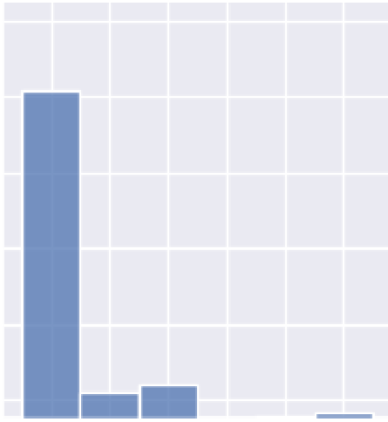
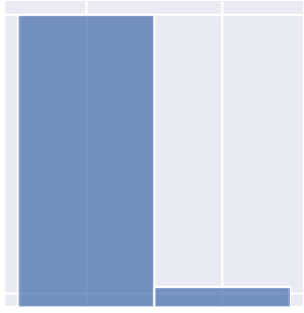
Removed columns that contain unbalanced categories
Condition1
Bldg Type
ExterCond
BsmtQual
CentralAir
SaleType
SaleCondition

Slide 12
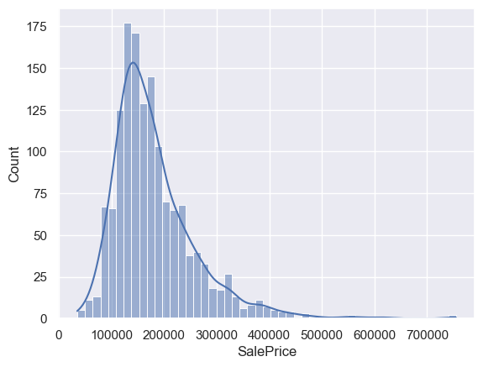
Sale Price is positively skewed
Count 1460
mean 180921.2
std 79442.5
min 34900.
25% 129975
50% 163000
75% 214000
max 755000

Slide 13
In our case, we noticed that the distribution of the housing prices data was positively skewed. This skewness could lead to biased model results, as the model may give more weight to the extreme values To address this issue, we used the natural logarithm (ln) to transform the data The logarithm transformation helps to reduce the impact of extreme values and make the distribution of the data more symmetric. After applying the natural logarithm transformation, we observed a significant reduction in skewness, as shown by the plots. The transformed data followed a more normal distribution, which is a better assumption for many statistical models.

Slide 14
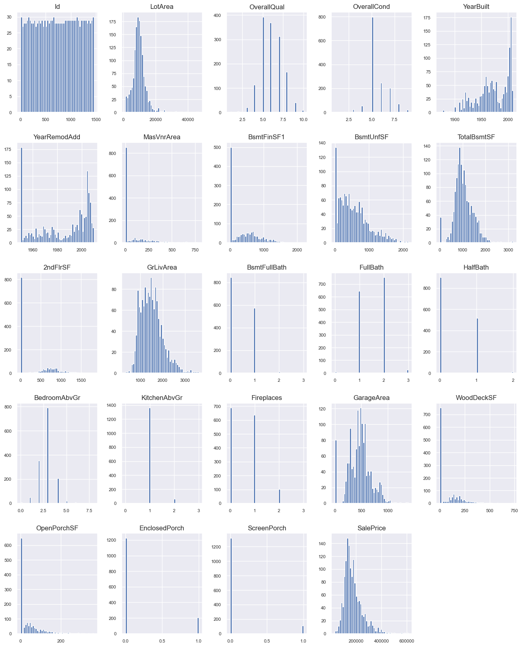
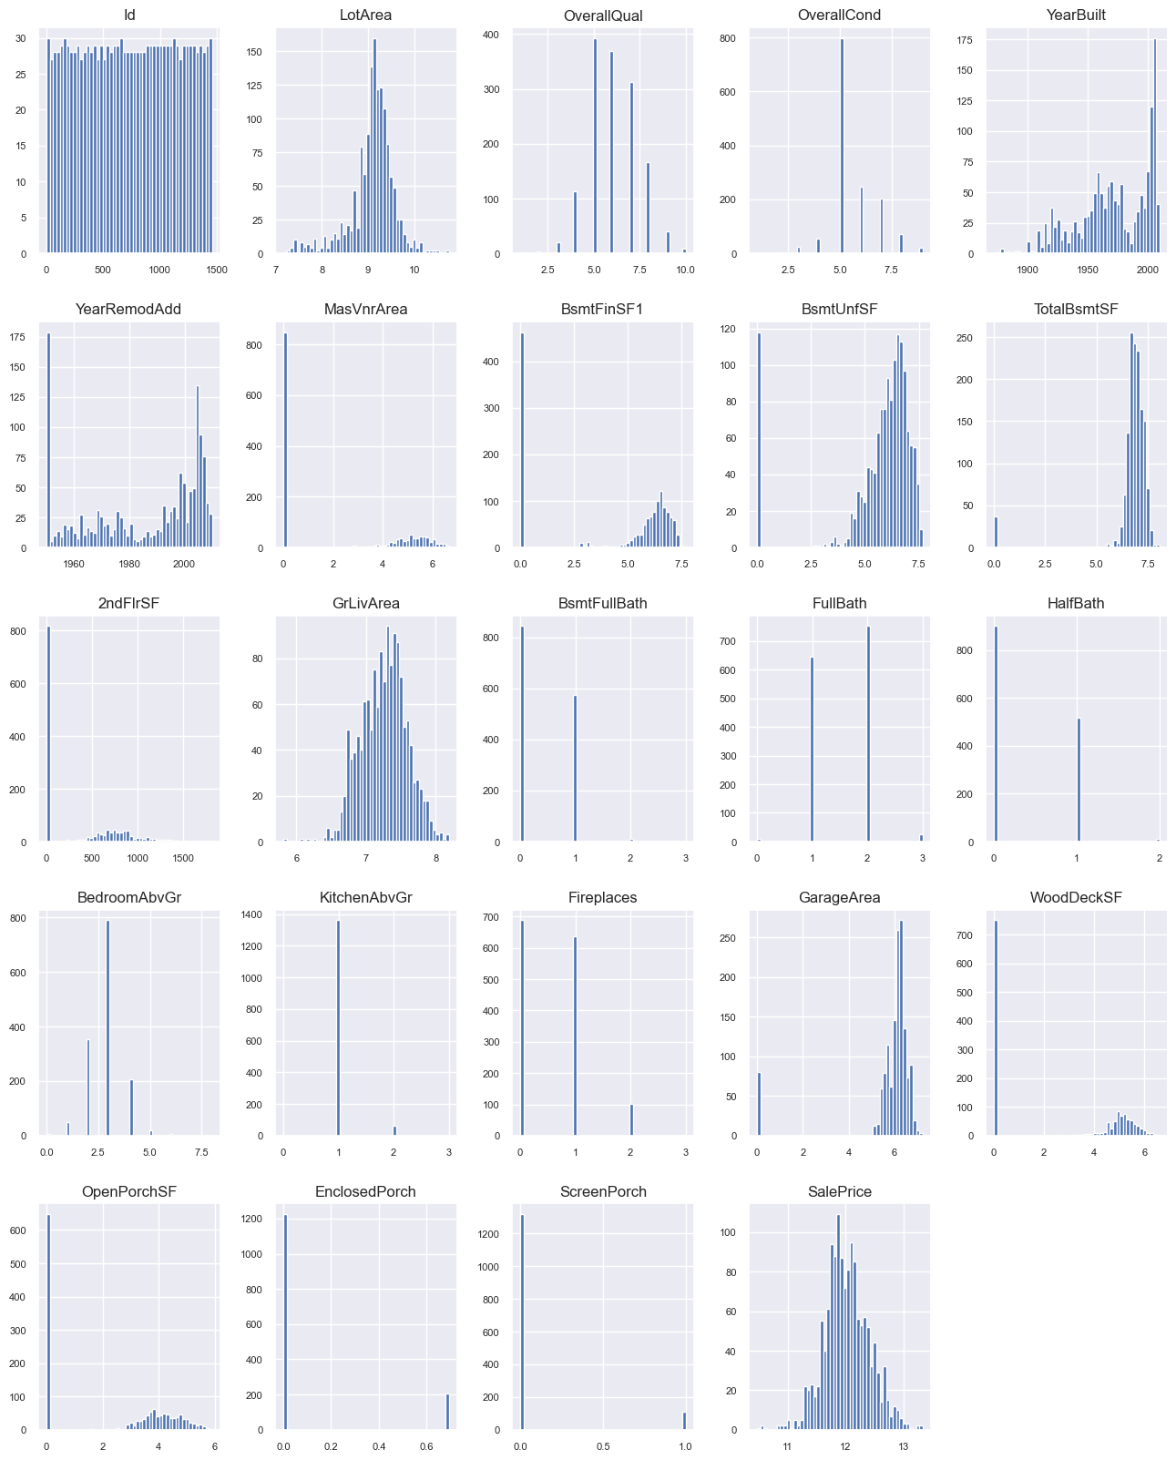
Before Applying ln | After Applying ln

Slide 15
For categorical variables in our dataset we attempted to use one hot encoding to convert them into a binary matrix representation The results we got were worse when we tried one hot encoding so we decided against using it
Why?
Noise
Redundancy
Overfitting

Slide 16
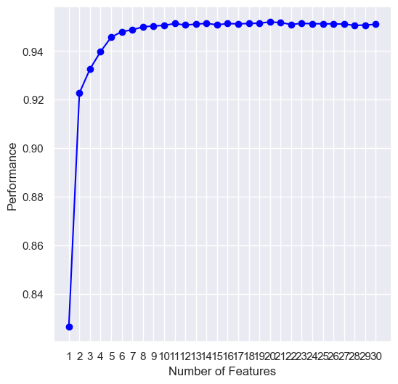
Feature Selection
The competition is judged by the lowest RMSE (Root mean square error). We created the RMSE function which returns the RMSE of 2 values to be used by the forward selector. The forward selector runs all possible combinations of features and gives us the best combination.)
The forward selector reached 95% accuracy

Slide 17
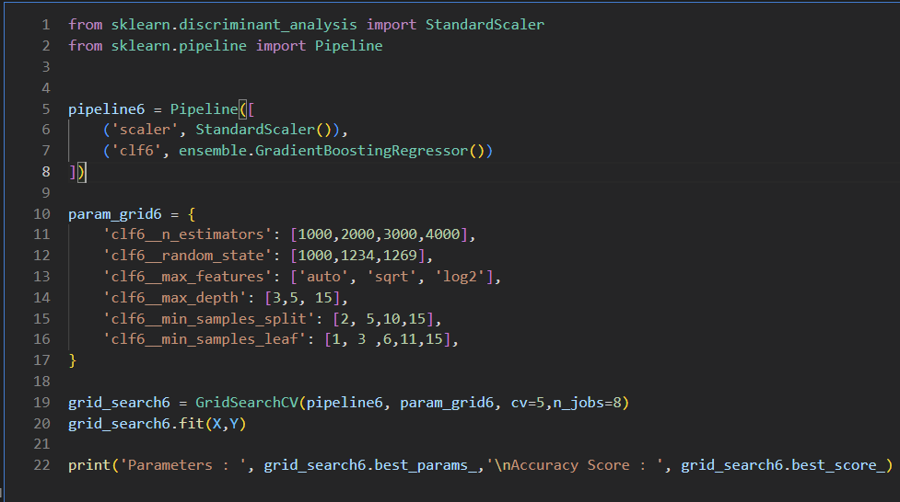
After extracting the best features from the sequential selector, we created 6 pipelines with which we tested combinations of different regressors and their parameters to find out which regressor would give us the best result. We settled on the Gradient Boosting Regressor which gave us the lowest RMSE equal to ~0.11.

Slide 18
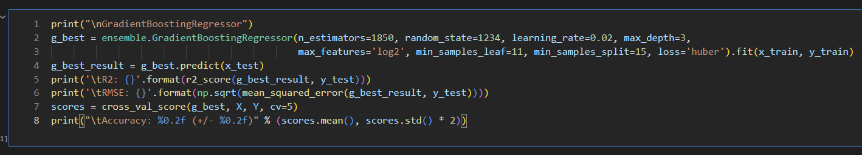
We used the gradient boosting regressor with the parameters taken from the gradient boosting regressor pipeline and ran the test file with this regressor.

Slide 19
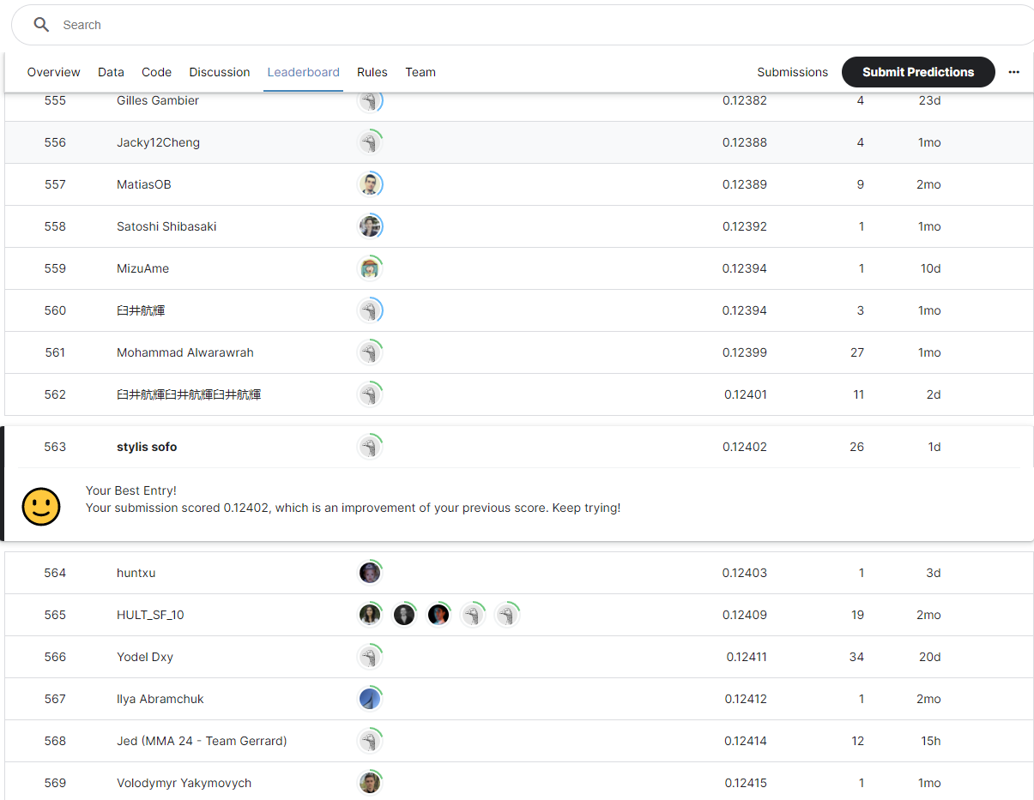
Result
The competition’s metric was RMSE (Root Mean Square Error)
Our best score was 0.12402
We were in the top 10% of all teams in this competition

