Slide 1
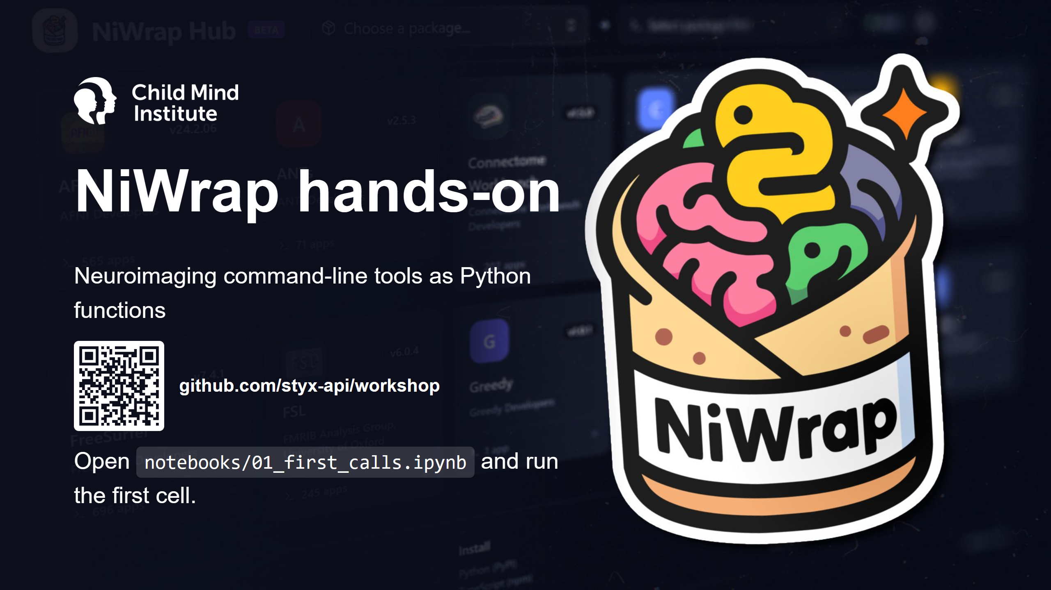
Notes:
Ask everyone to run the first cell now. Docker problems should show up in the first 10 minutes, not at minute 40.
Quick poll: who ran the smoke test? Who has no Docker? Those people set RUNNER = "dry" (FACILITATOR.md).

Slide 2
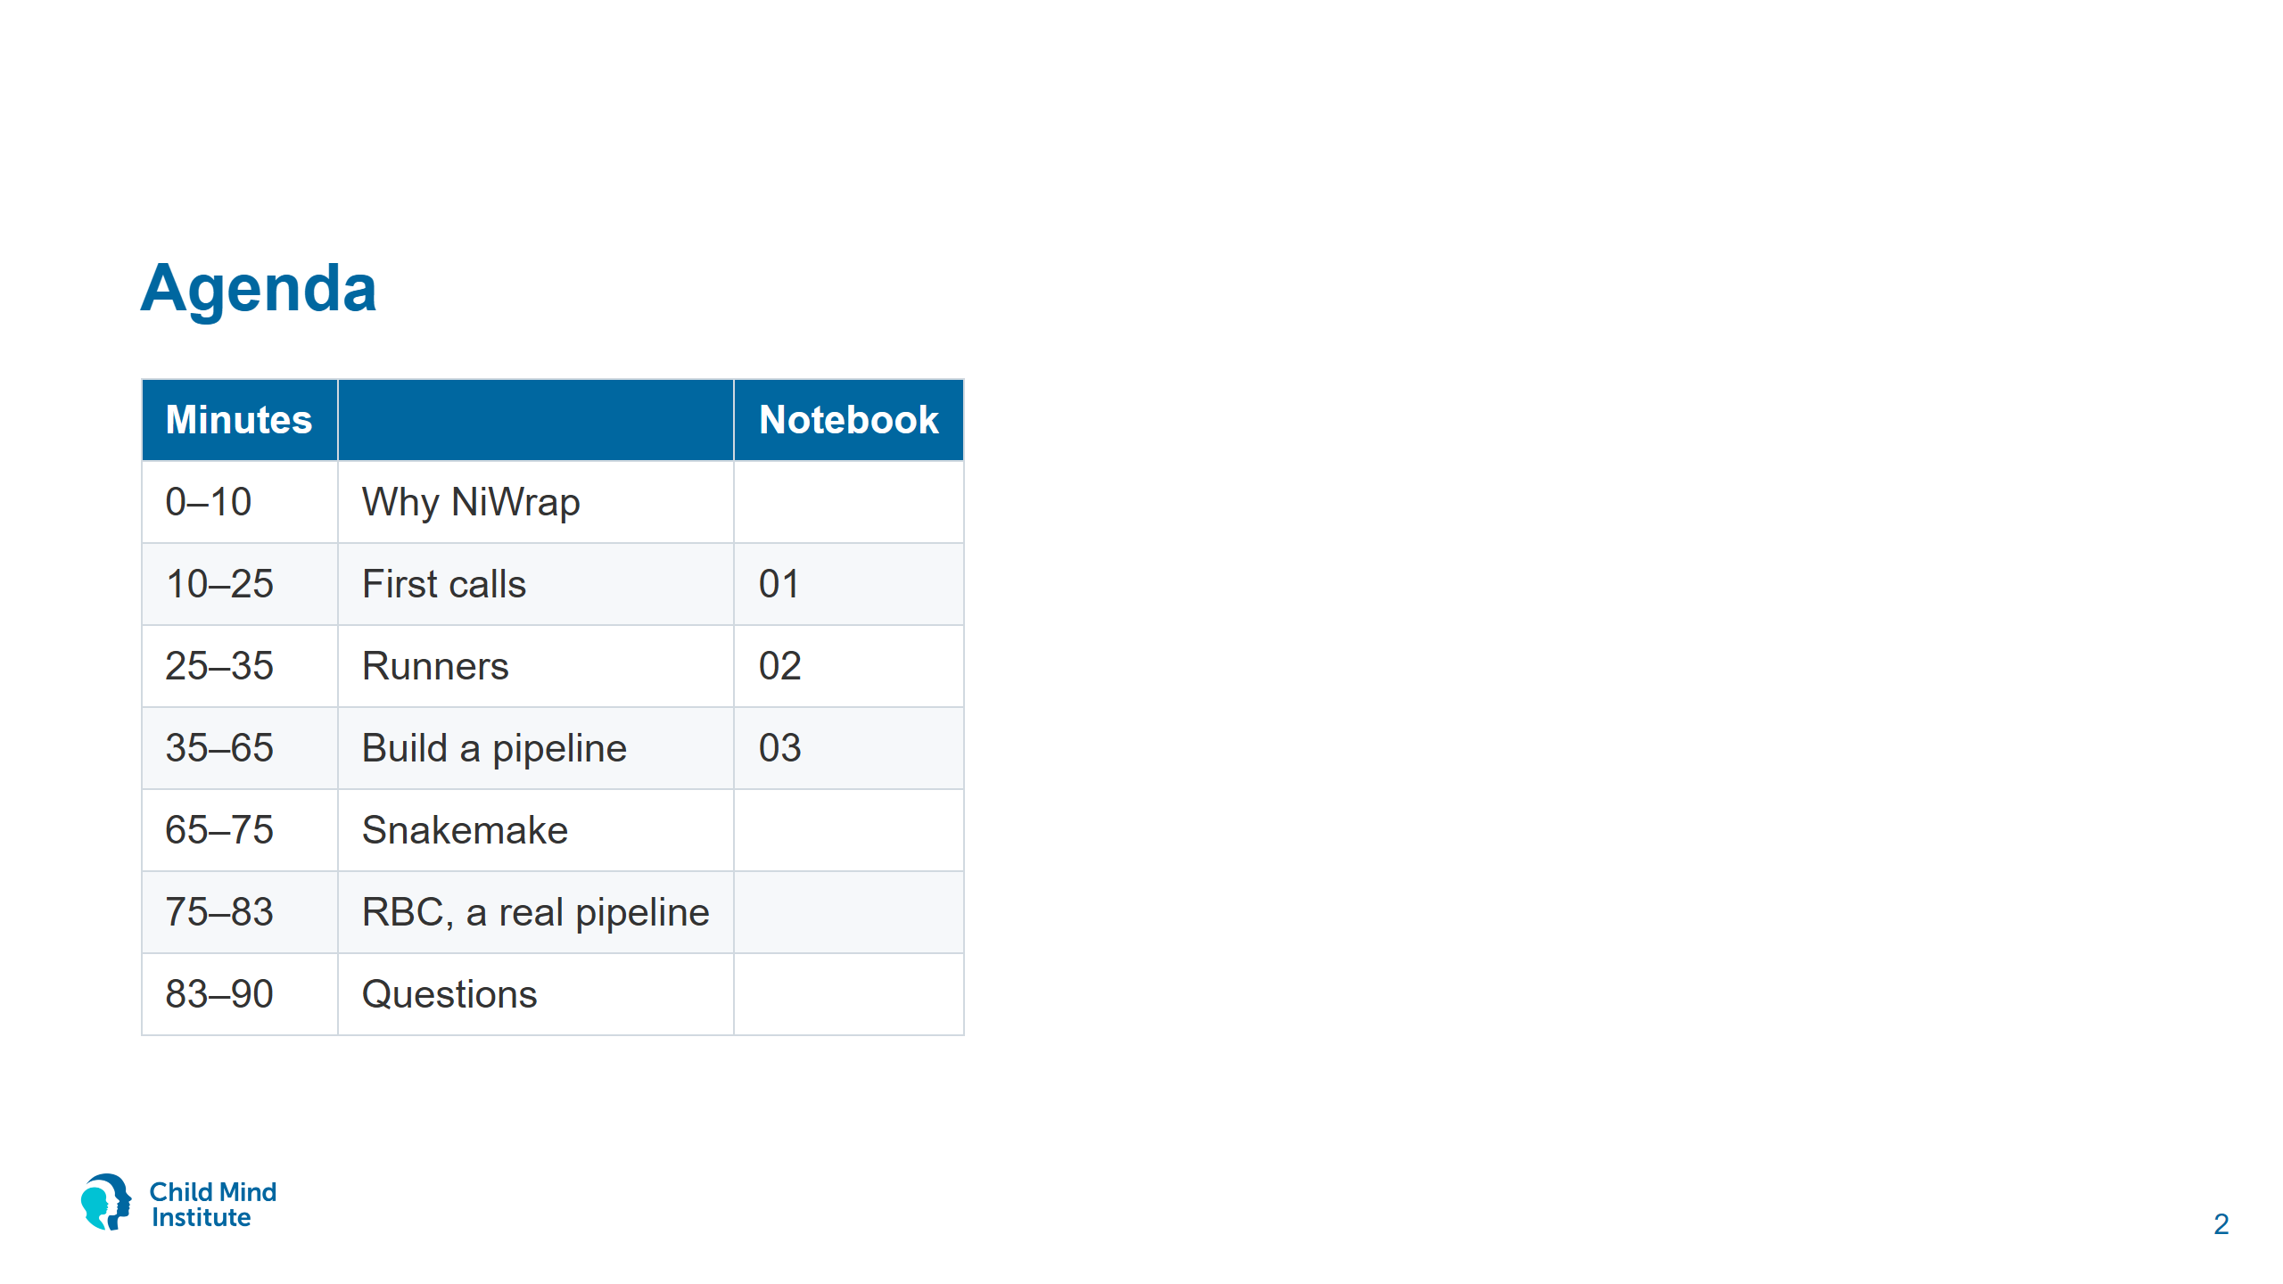
Notes:
Today is about using NiWrap. Questions about writing descriptors or the compiler go to the end.

Slide 3


Slide 4
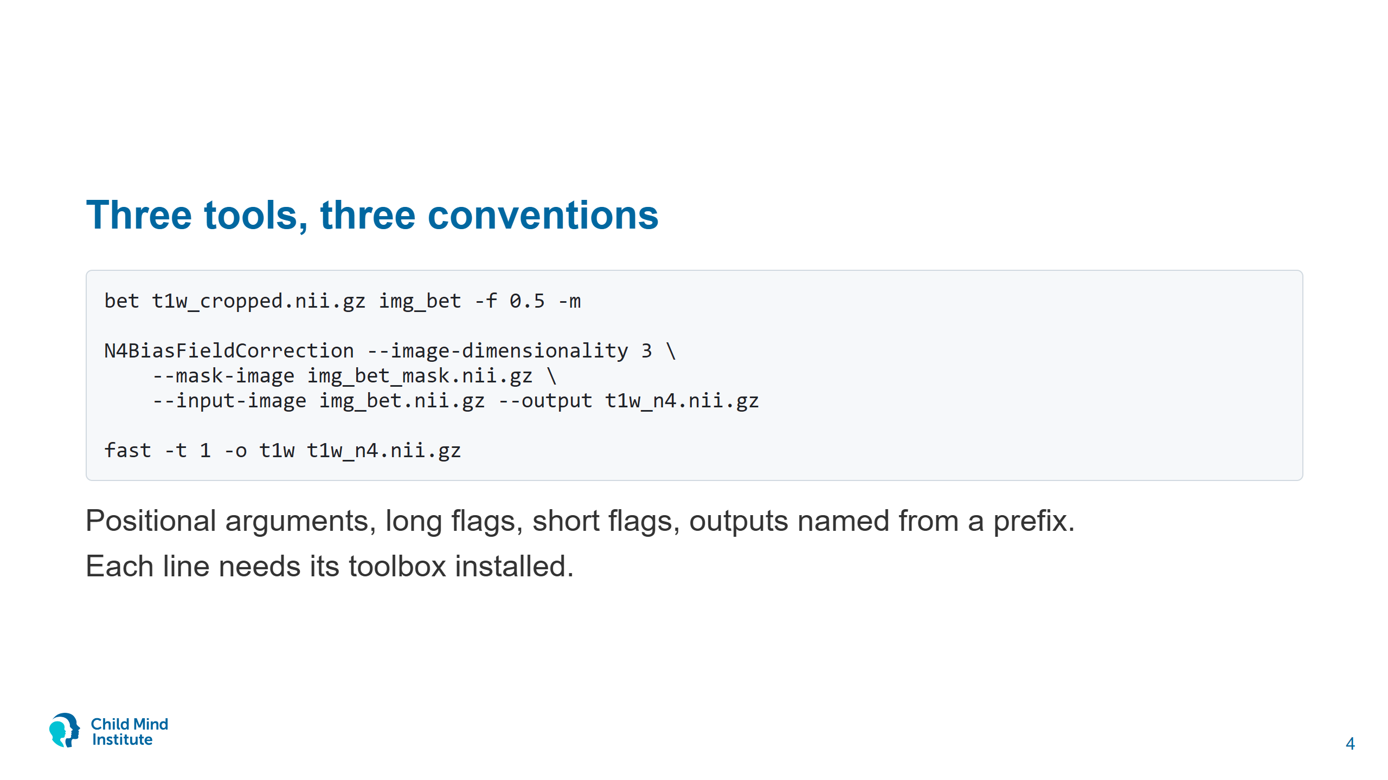
Notes:
These are real commands from today's pipeline. bet takes input and output positionally; ANTs uses long flags; FAST names its outputs from a prefix (t1w_seg.nii.gz, t1w_pve_0.nii.gz, ...).
Ask: who has a bash script like this? Who has lost a run to a typo in a flag?

Slide 5
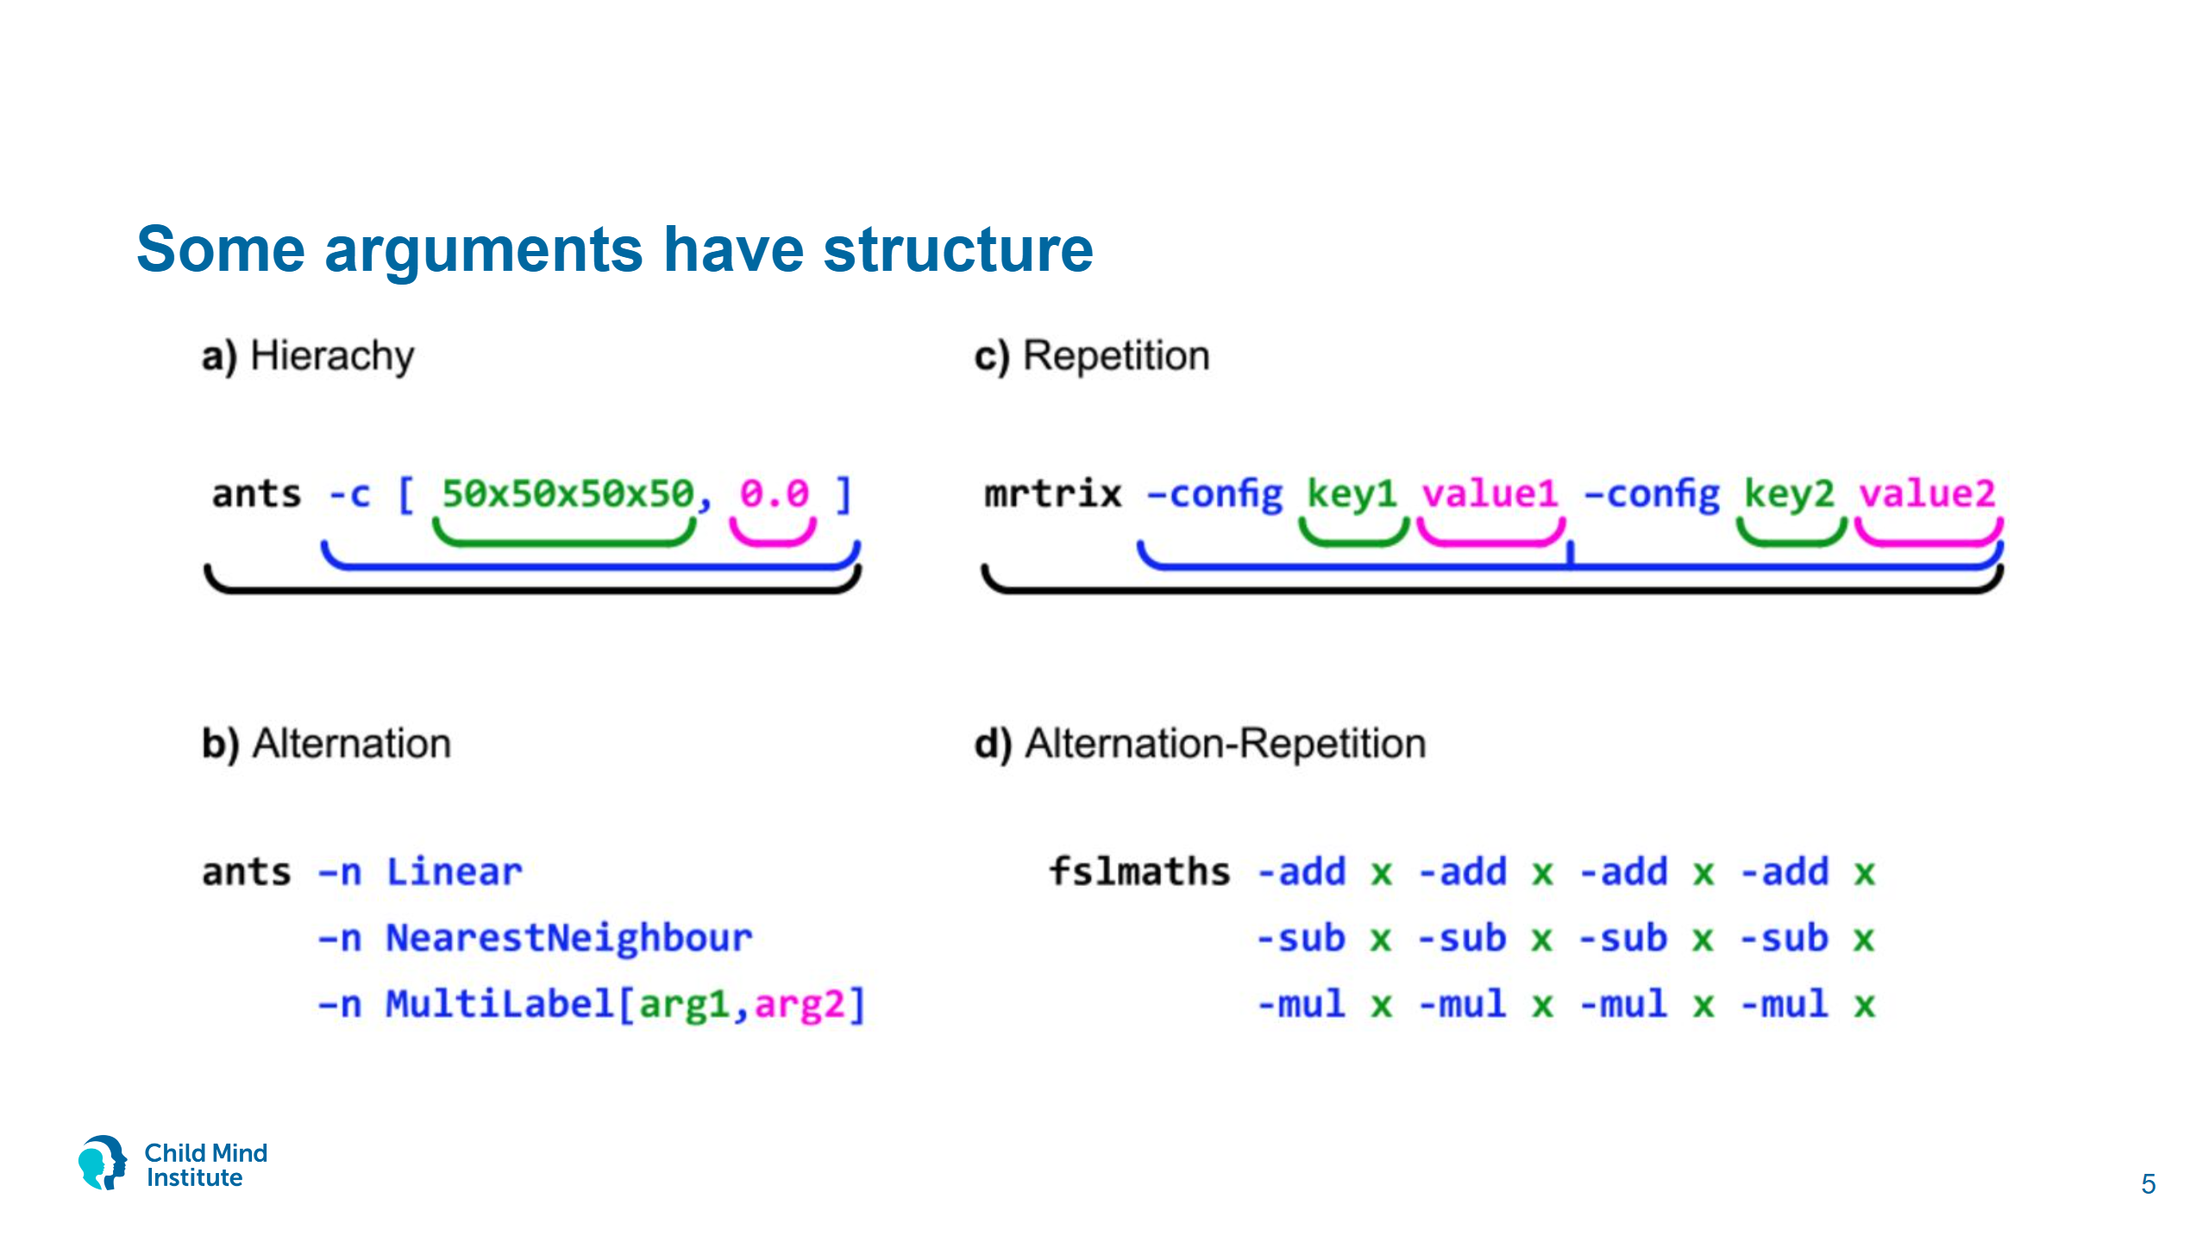
Notes:
Styx preprint (bioRxiv 2025), Fig. 1. Arguments nest (ANTs -c [iterations,threshold]), pick one of several forms (interpolation), repeat (MRtrix -config), or repeat with a choice each time (fslmaths operation chains). Plain Boutiques can't describe all of these; Styx extends it.
In NiWrap nested arguments are helper functions: convergence=ants.n4_bias_field_correction_convergence_params([50, 50, 50, 50], 0.0) becomes --convergence '[50x50x50x50,0.0]'. You never write the brackets yourself.

Slide 6
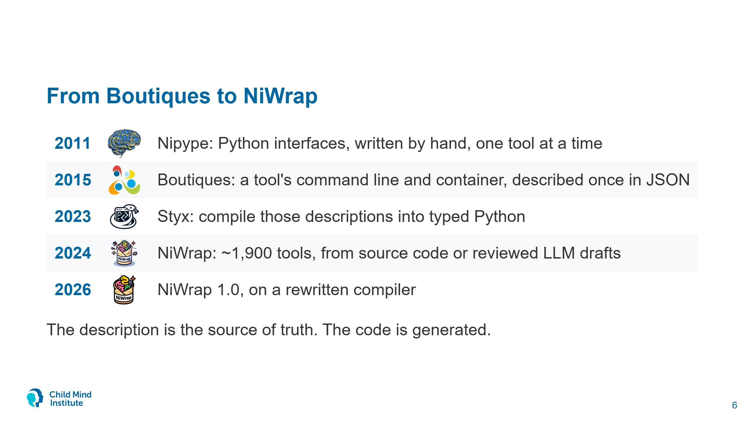
Notes:
Nipype: Gorgolewski et al. 2011. Its interfaces are Python classes, so every new tool or flag means writing code, and only Python can use them.
Boutiques: Glatard et al. 2018, GigaScience (repo since 2015). Describes a tool instead of changing it: inputs, outputs, command-line template, container. Language-neutral, but you still need code to call a tool from Python.
Styx (2023) is a compiler from Boutiques to Python, later TypeScript. Real CLIs needed three extensions to Boutiques: nested subcommands (N4's -c [iters,threshold]), alternatives (antsRegistration interpolation), repeats (fslmaths operation chains). Styx can still write plain Boutiques back out.
NiWrap (2024, first release September): Workbench and MRtrix3 descriptors are extracted from their source code; FSL, AFNI, FreeSurfer, ANTs and others were drafted by LLMs from help text and checked by hand.
1.0 (June 2026) switched to Styx 2, a rewrite of the compiler. Same idea, today's version is 1.1.

Slide 7
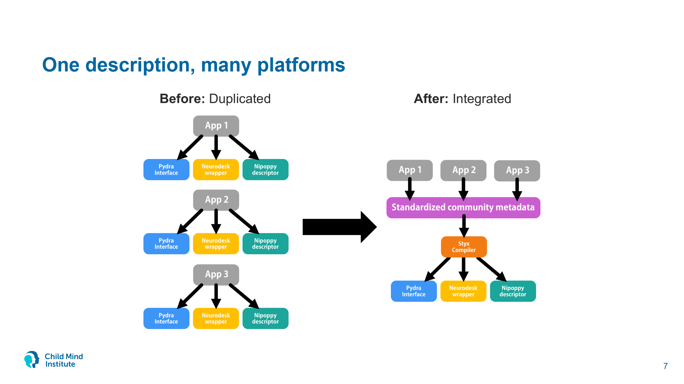
Notes:
From the OHBM 2026 poster "A Collaborative Infrastructure Around Shared Tool Interfaces for Neuroimaging".
Before: Pydra, Neurodesk and Nipoppy each wrapped the same tools themselves. Now they share NiWrap's descriptors: Pydra builds task interfaces from them, Neurodesk ships them in its containers to check tool versions, Nipoppy runs them and sends fixes back. A fix to one descriptor reaches every platform.

Slide 8
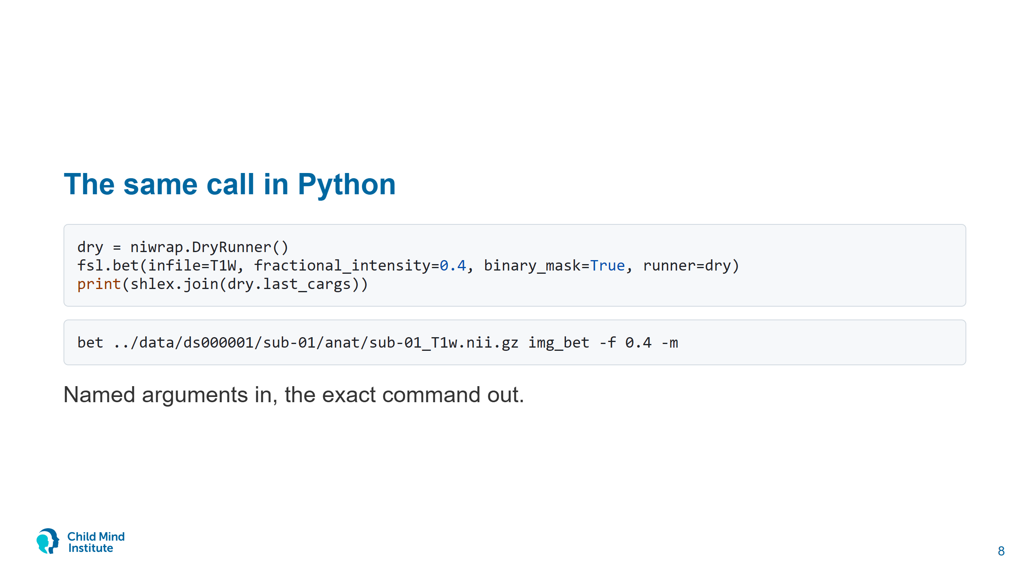
Notes:
The function knows every bet flag, its type and its valid range. The DryRunner shows the command without running it. img_bet is bet's default output prefix.

Slide 9
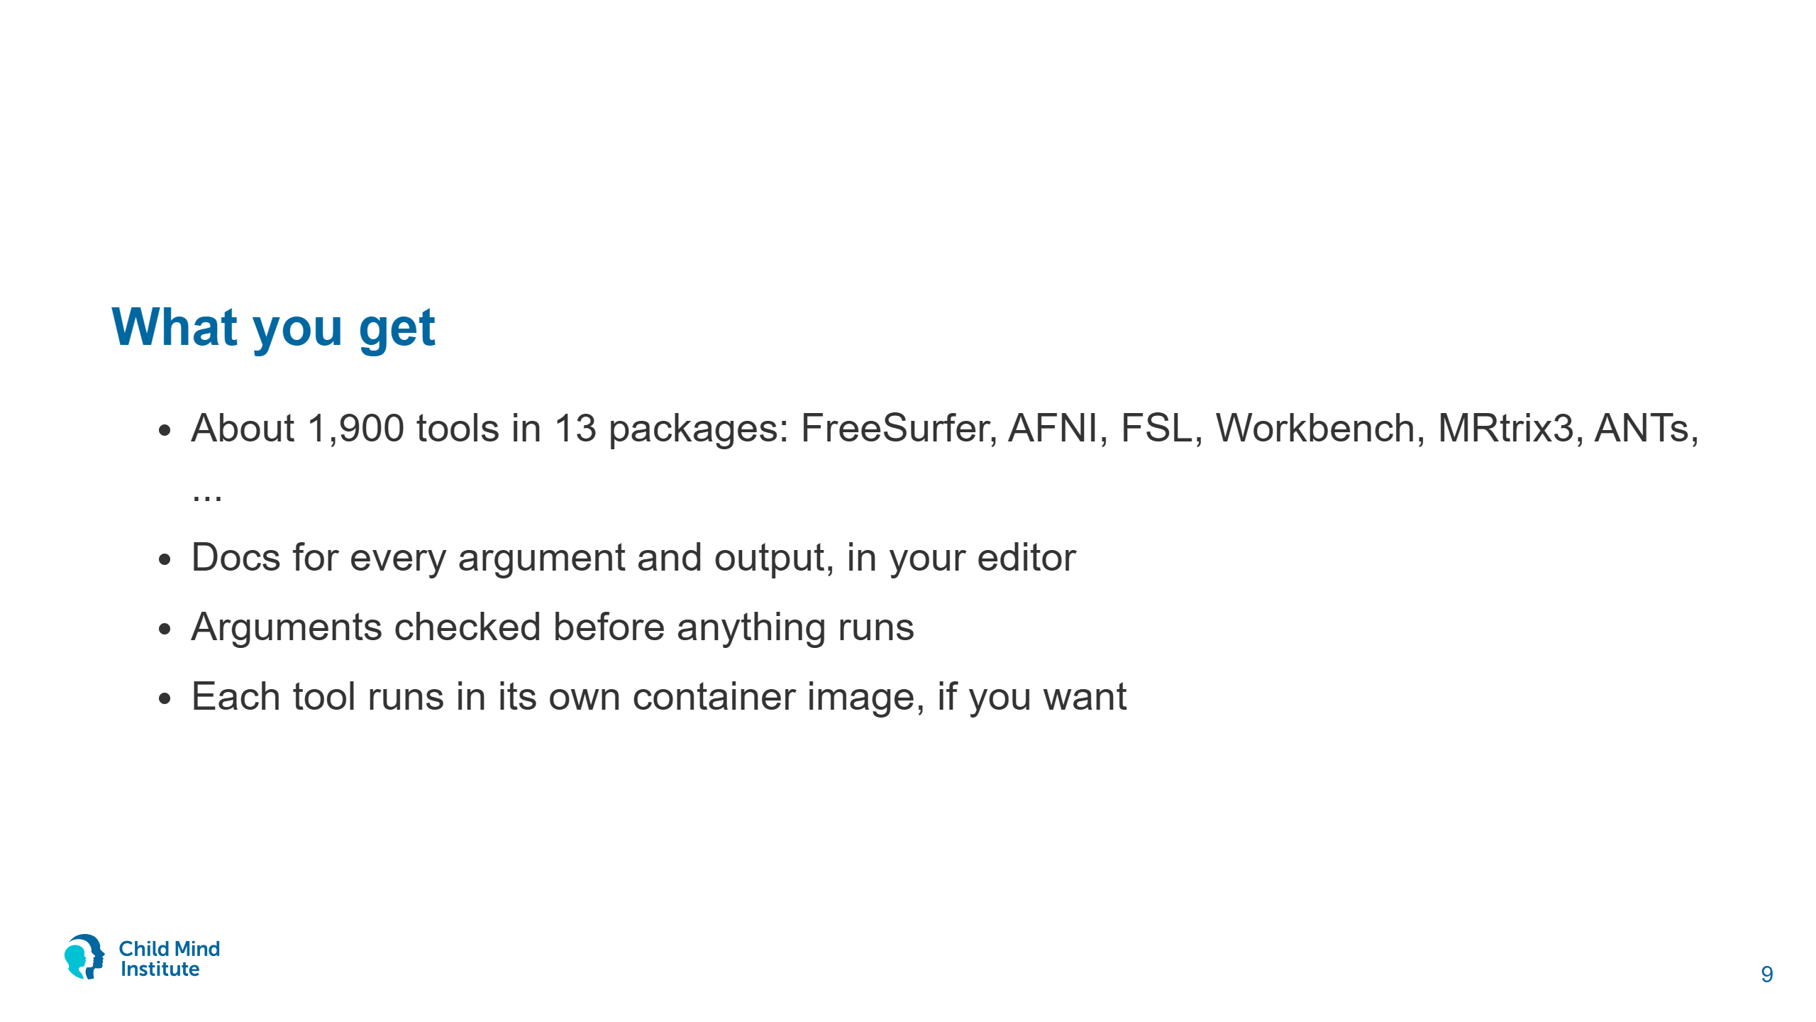
Notes:
Counts from the niwrap README coverage table (FreeSurfer 672, AFNI 552, FSL 243, Workbench 203, MRtrix3 121, ANTs 72): binaries with a descriptor, not every flag of every binary.
Coverage is broad and consistent because the wrappers are generated. Same API in TypeScript.

Slide 10
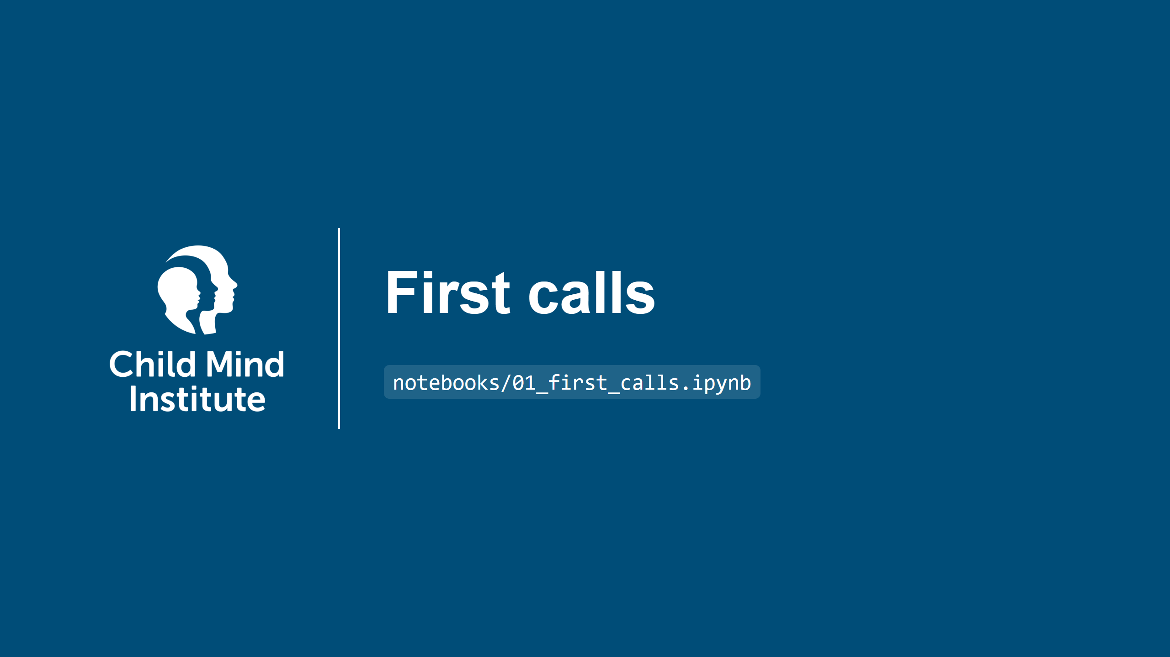

Slide 11
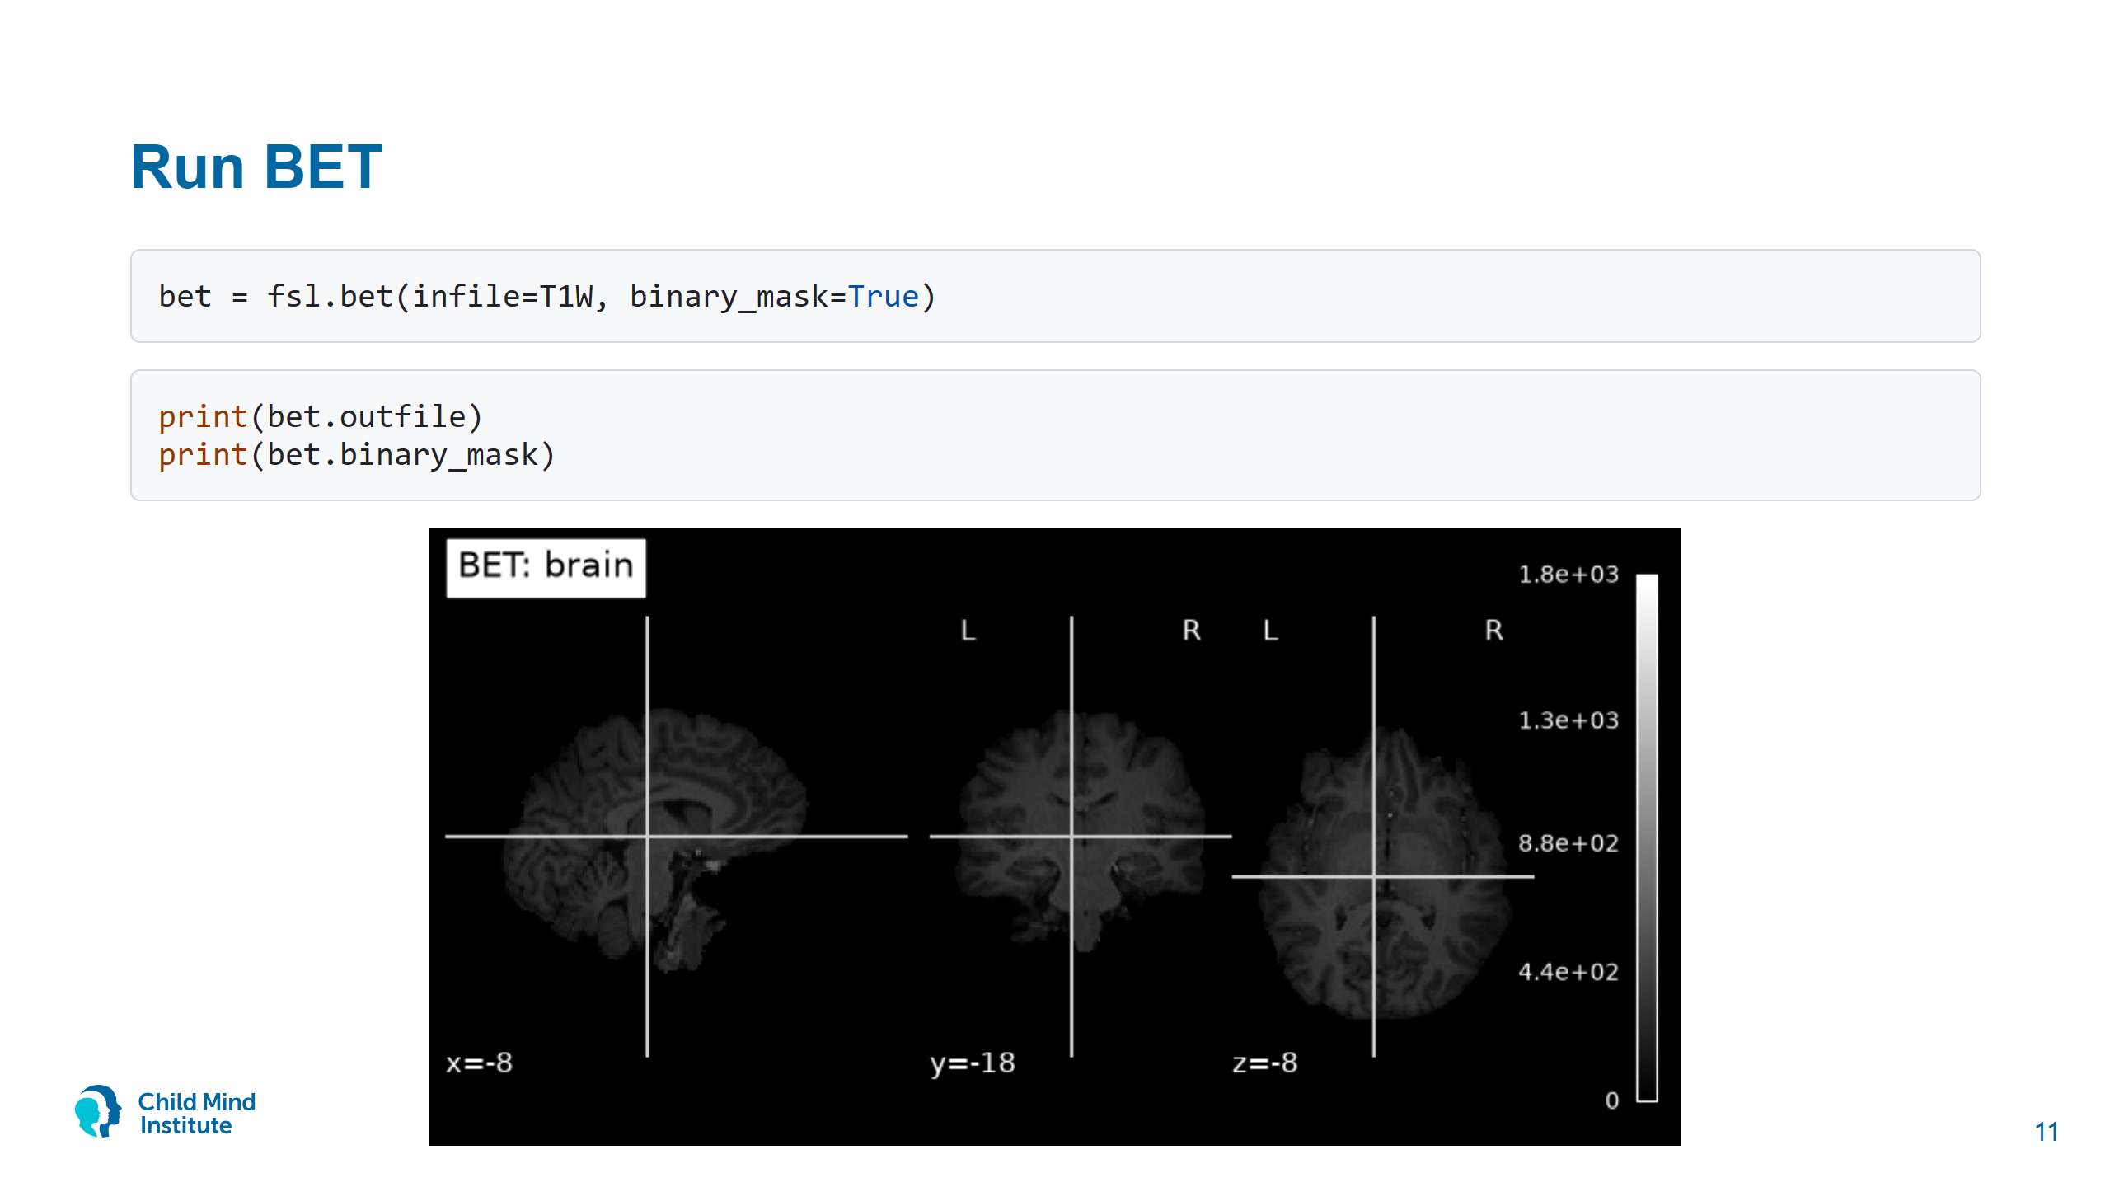
Notes:
Point at the log: "Running docker: docker run ..." and "Running command: bet /styx_input/0/... img_bet -m". The second line is what ran in the container.

Slide 12
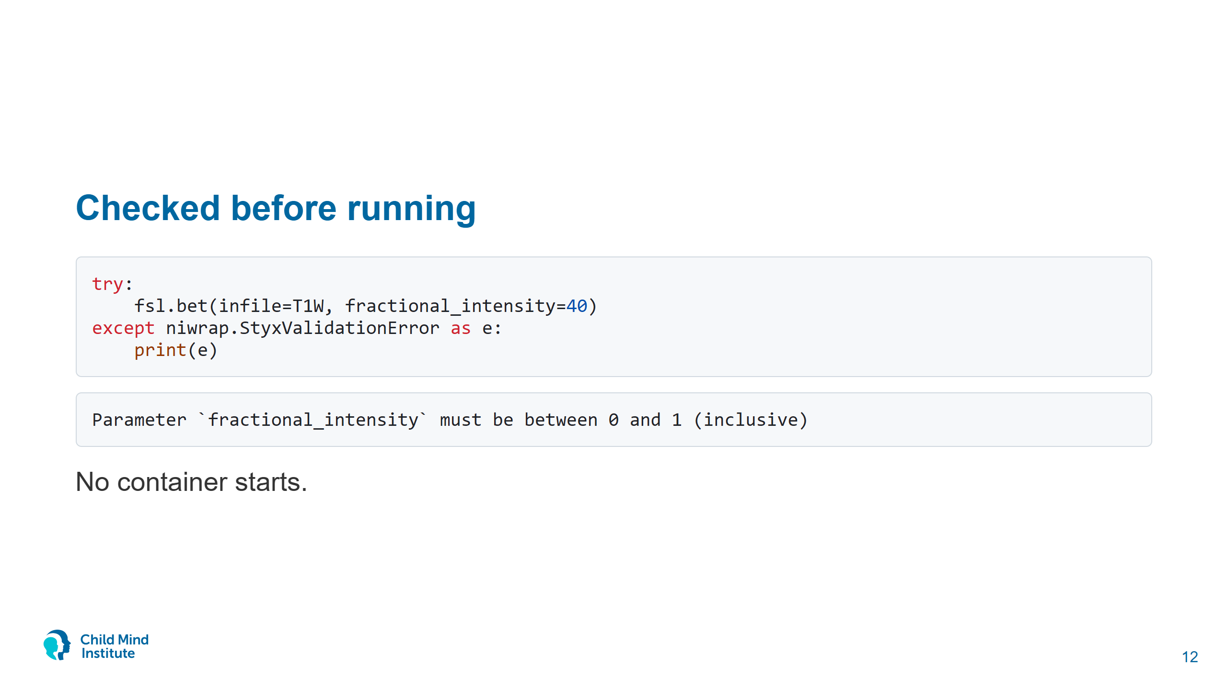
Notes:
In a bash script you'd find this percent-vs-fraction mistake after the run, or never.

Slide 13
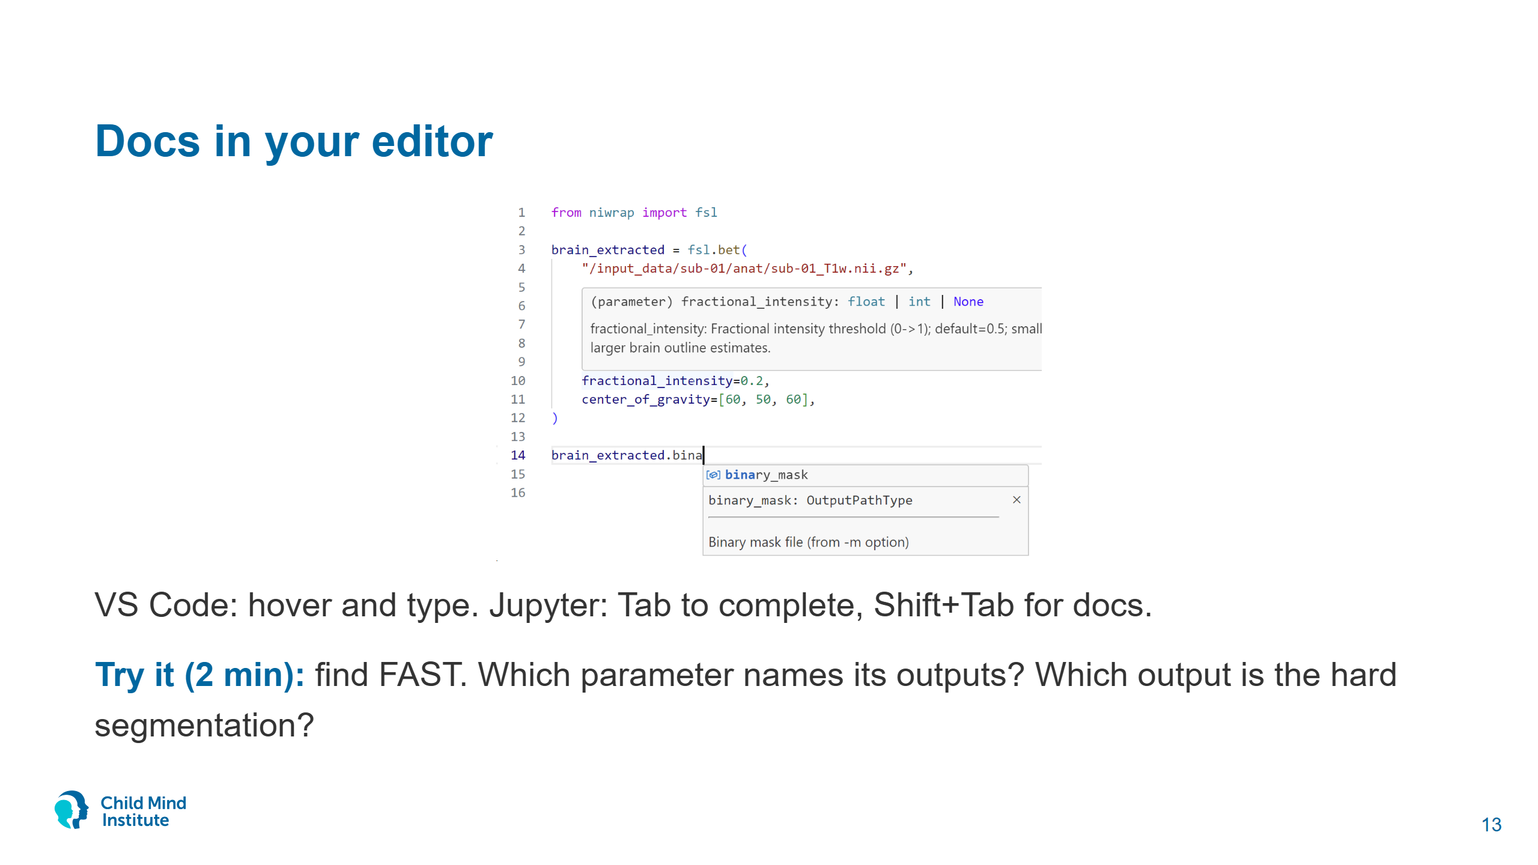
Notes:
Screenshot from the 2024 OHBM and INCF Styx posters. Hover on a parameter shows its type and description; typing after an output object lists the output files with their descriptions. NiWrap 1.1 shows the type as float | None rather than float | int | None; otherwise identical.
Answer: out_basename; tissue_class_map (_seg.nii.gz).
Jupyter completion needs an idle kernel. VS Code (Pylance) works from the type hints even while a cell runs. In Jupyter, `fsl.bet?` prints the whole docstring.

Slide 14
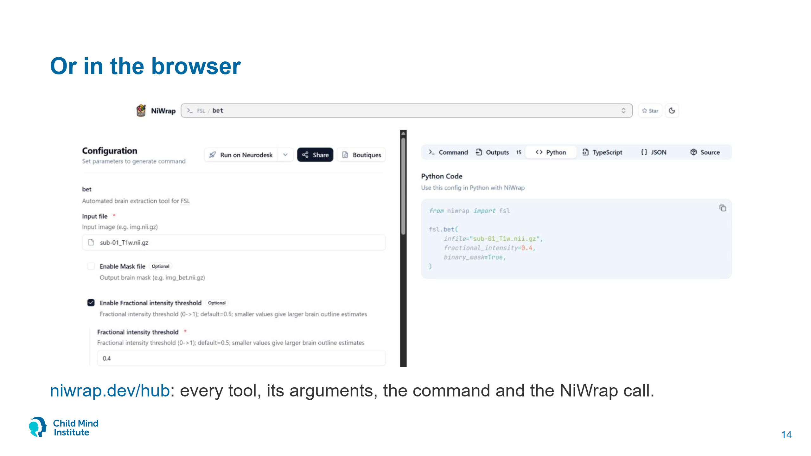
Notes:
Live at niwrap.dev/hub. Deep links work: niwrap.dev/hub?package=fsl&app=bet. Fill in the form and the Python tab gives the same call as on slide 8; the Command tab shows bet sub-01_T1w.nii.gz img_bet -f 0.4 -m. The Share button puts the whole configuration in the URL.
Good for the Try it exercise too: open FAST in the Hub.
The form's "Mask file" is BET's positional output prefix (default img_bet), not the -m mask. -m is "Binary mask flag".

Slide 15
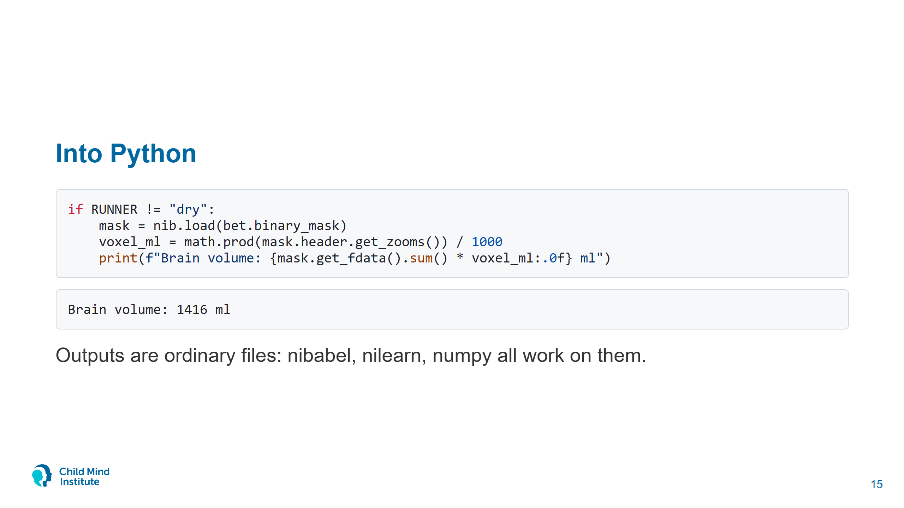

Slide 16
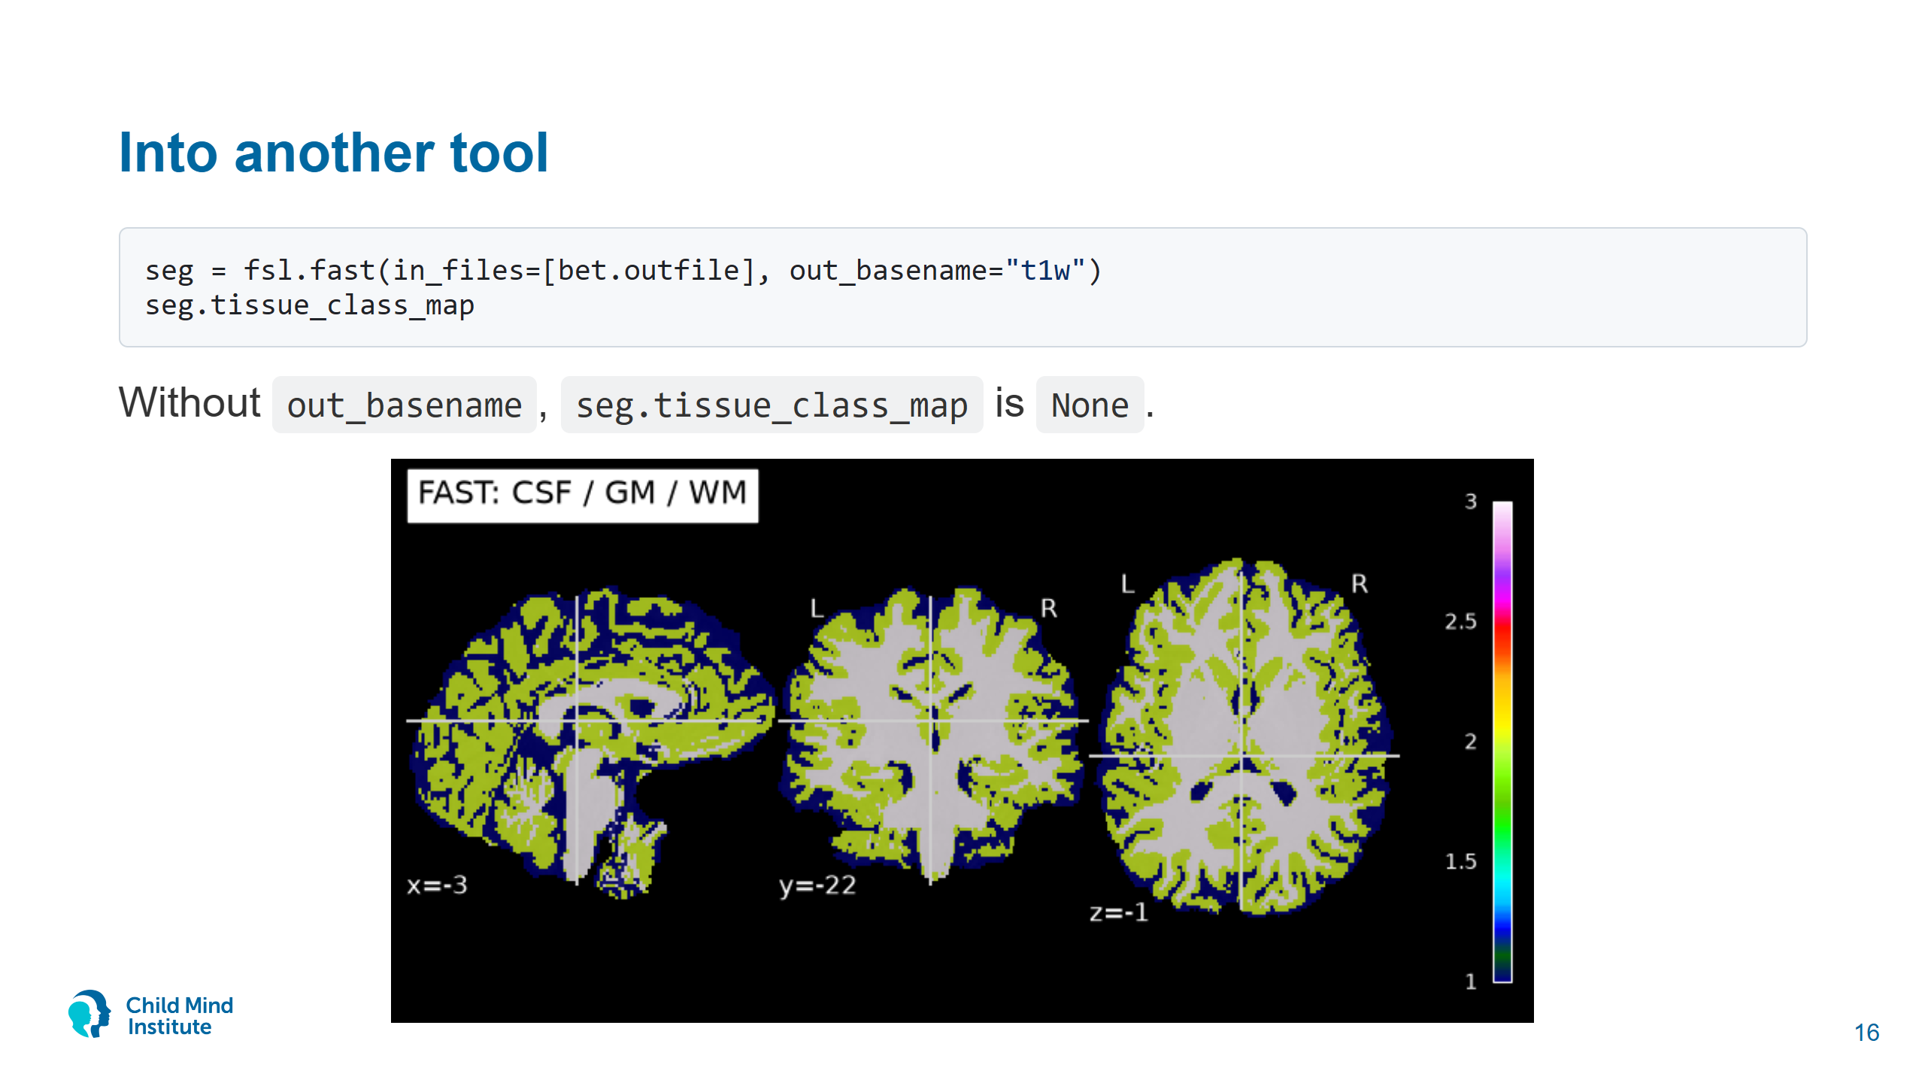
Notes:
The out_basename gotcha returns in notebook 03 for fslreorient2std and robustfov. If an output is None, look for the parameter that names it.
FAST takes ~2 minutes. Start it and move on to Runners.

Slide 17


Slide 18
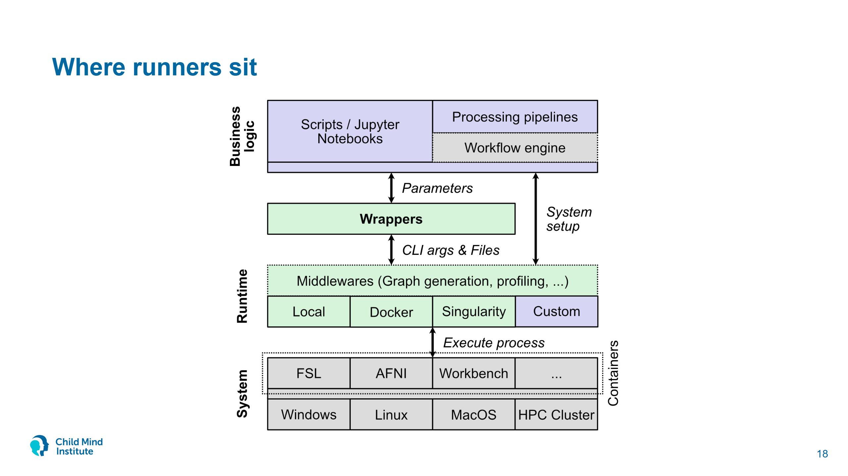
Notes:
From the Styx paper (bioRxiv 2025). Your code passes parameters to a wrapper; the wrapper turns them into command-line arguments and file paths; the runner decides where the process runs. Swapping the runner never touches the pipeline code.
Middlewares wrap another runner: GraphRunner (niwrap.use_graph) records the call graph. Custom runners are possible but out of scope today.

Slide 19
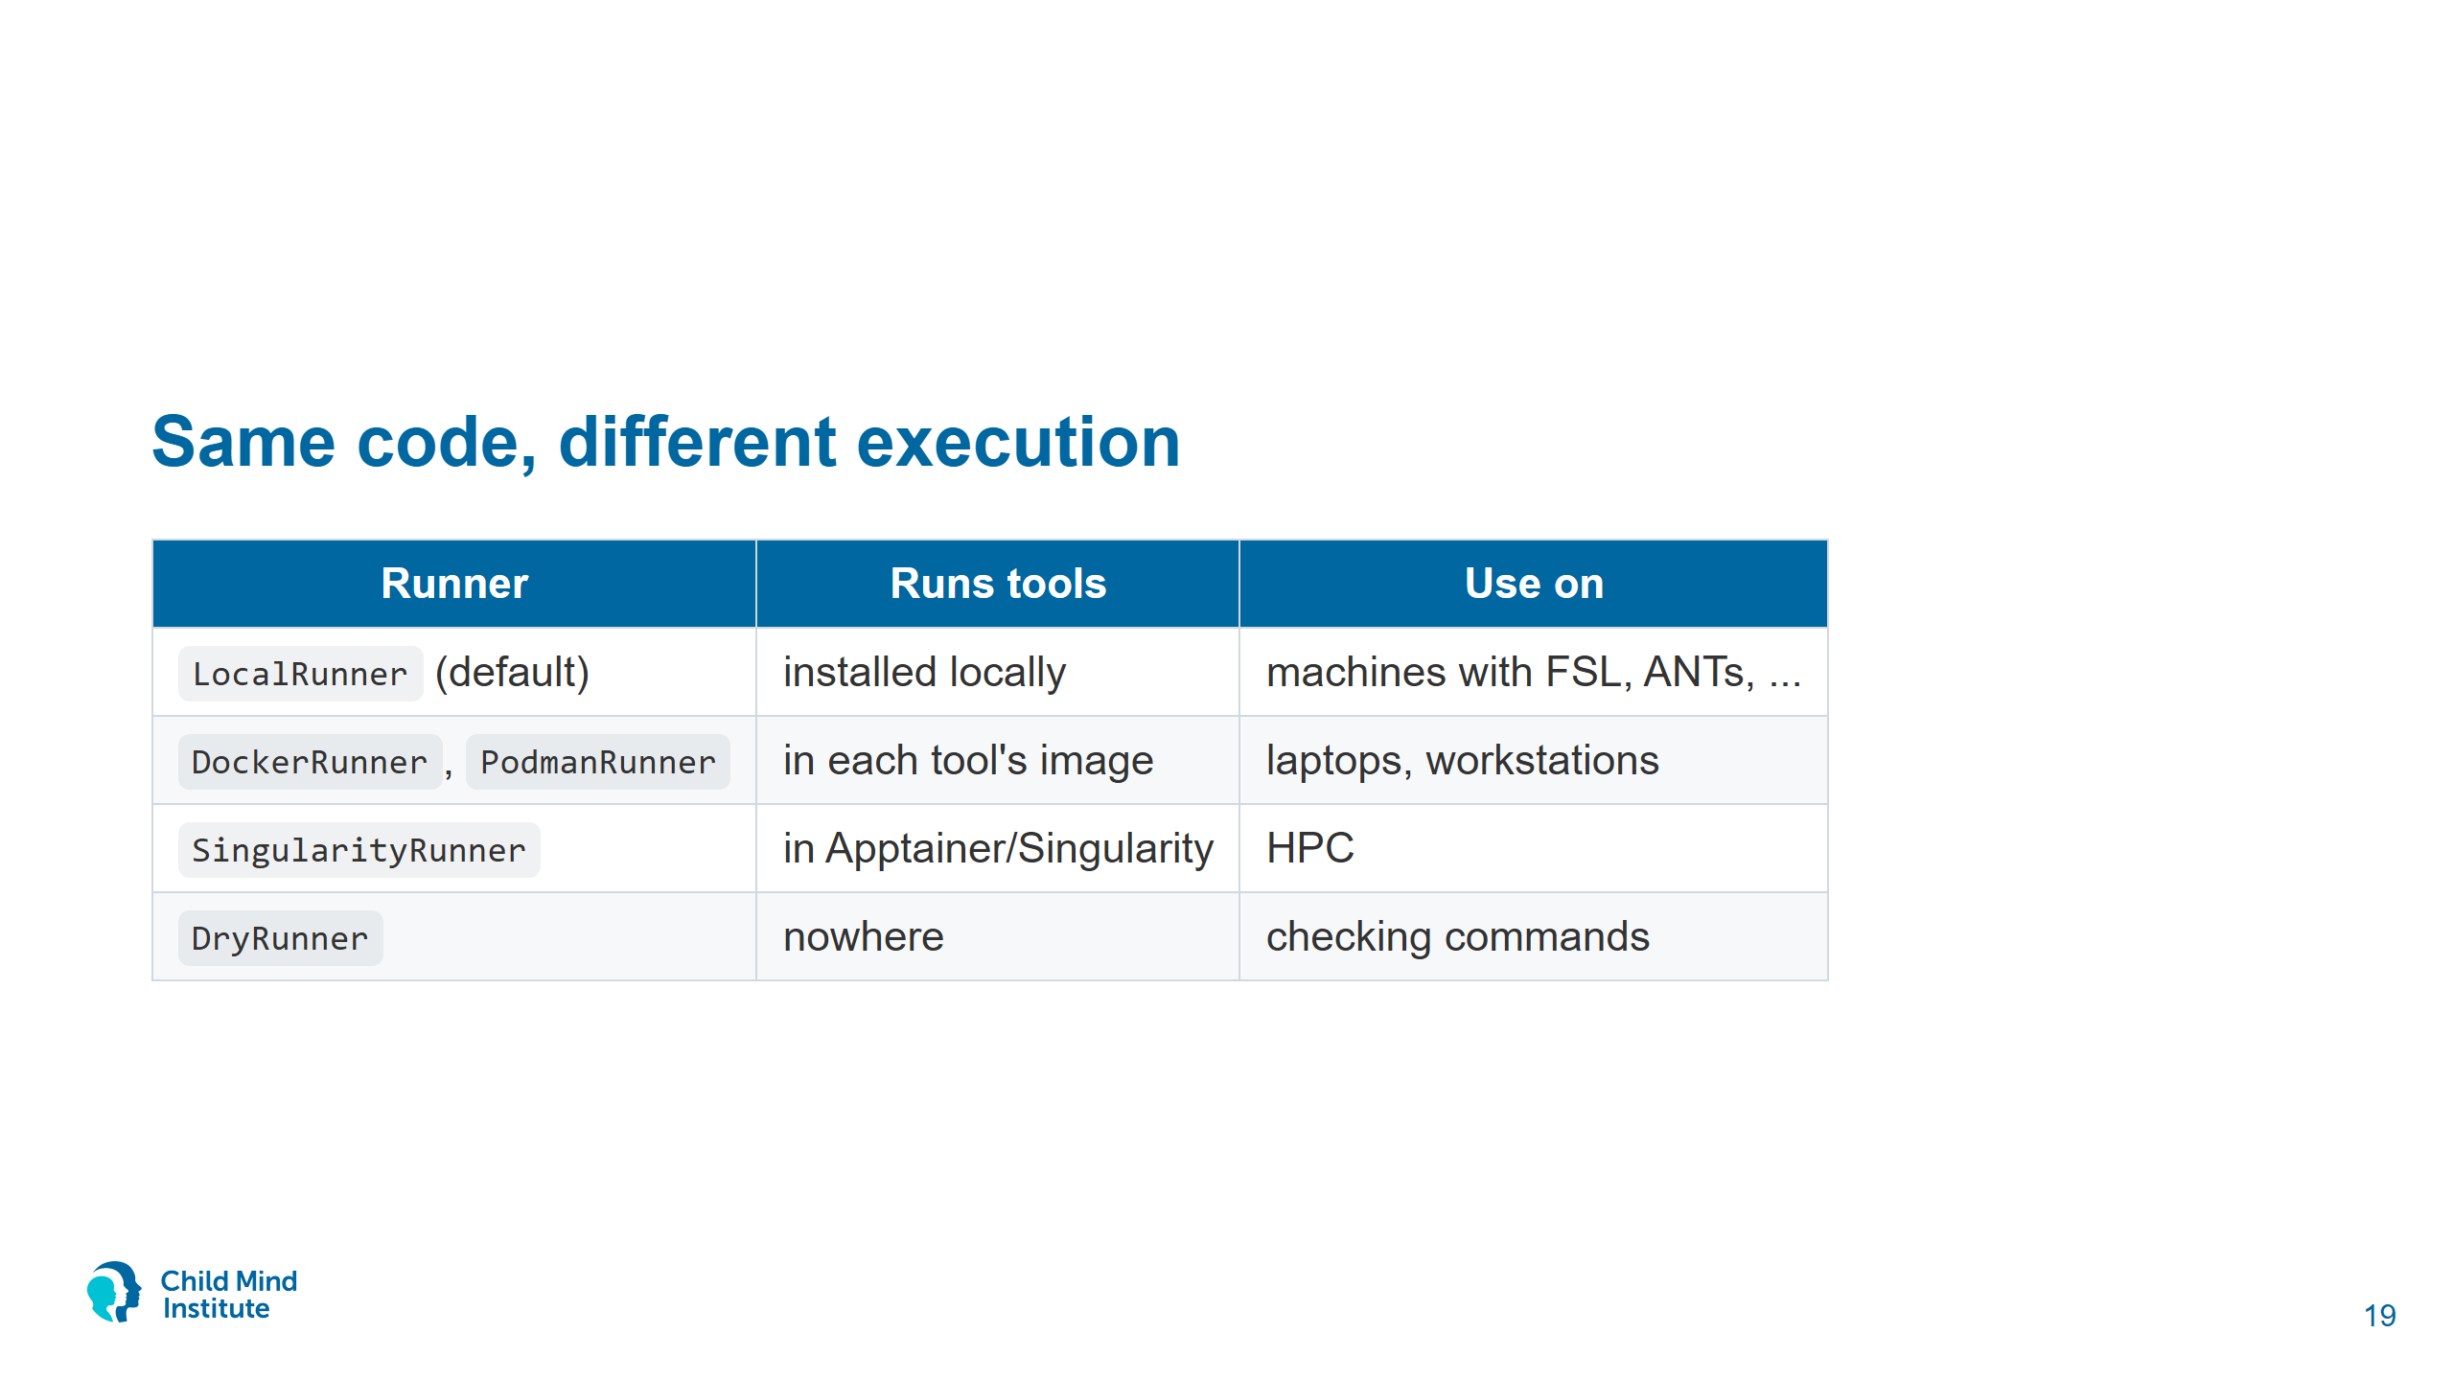

Slide 20
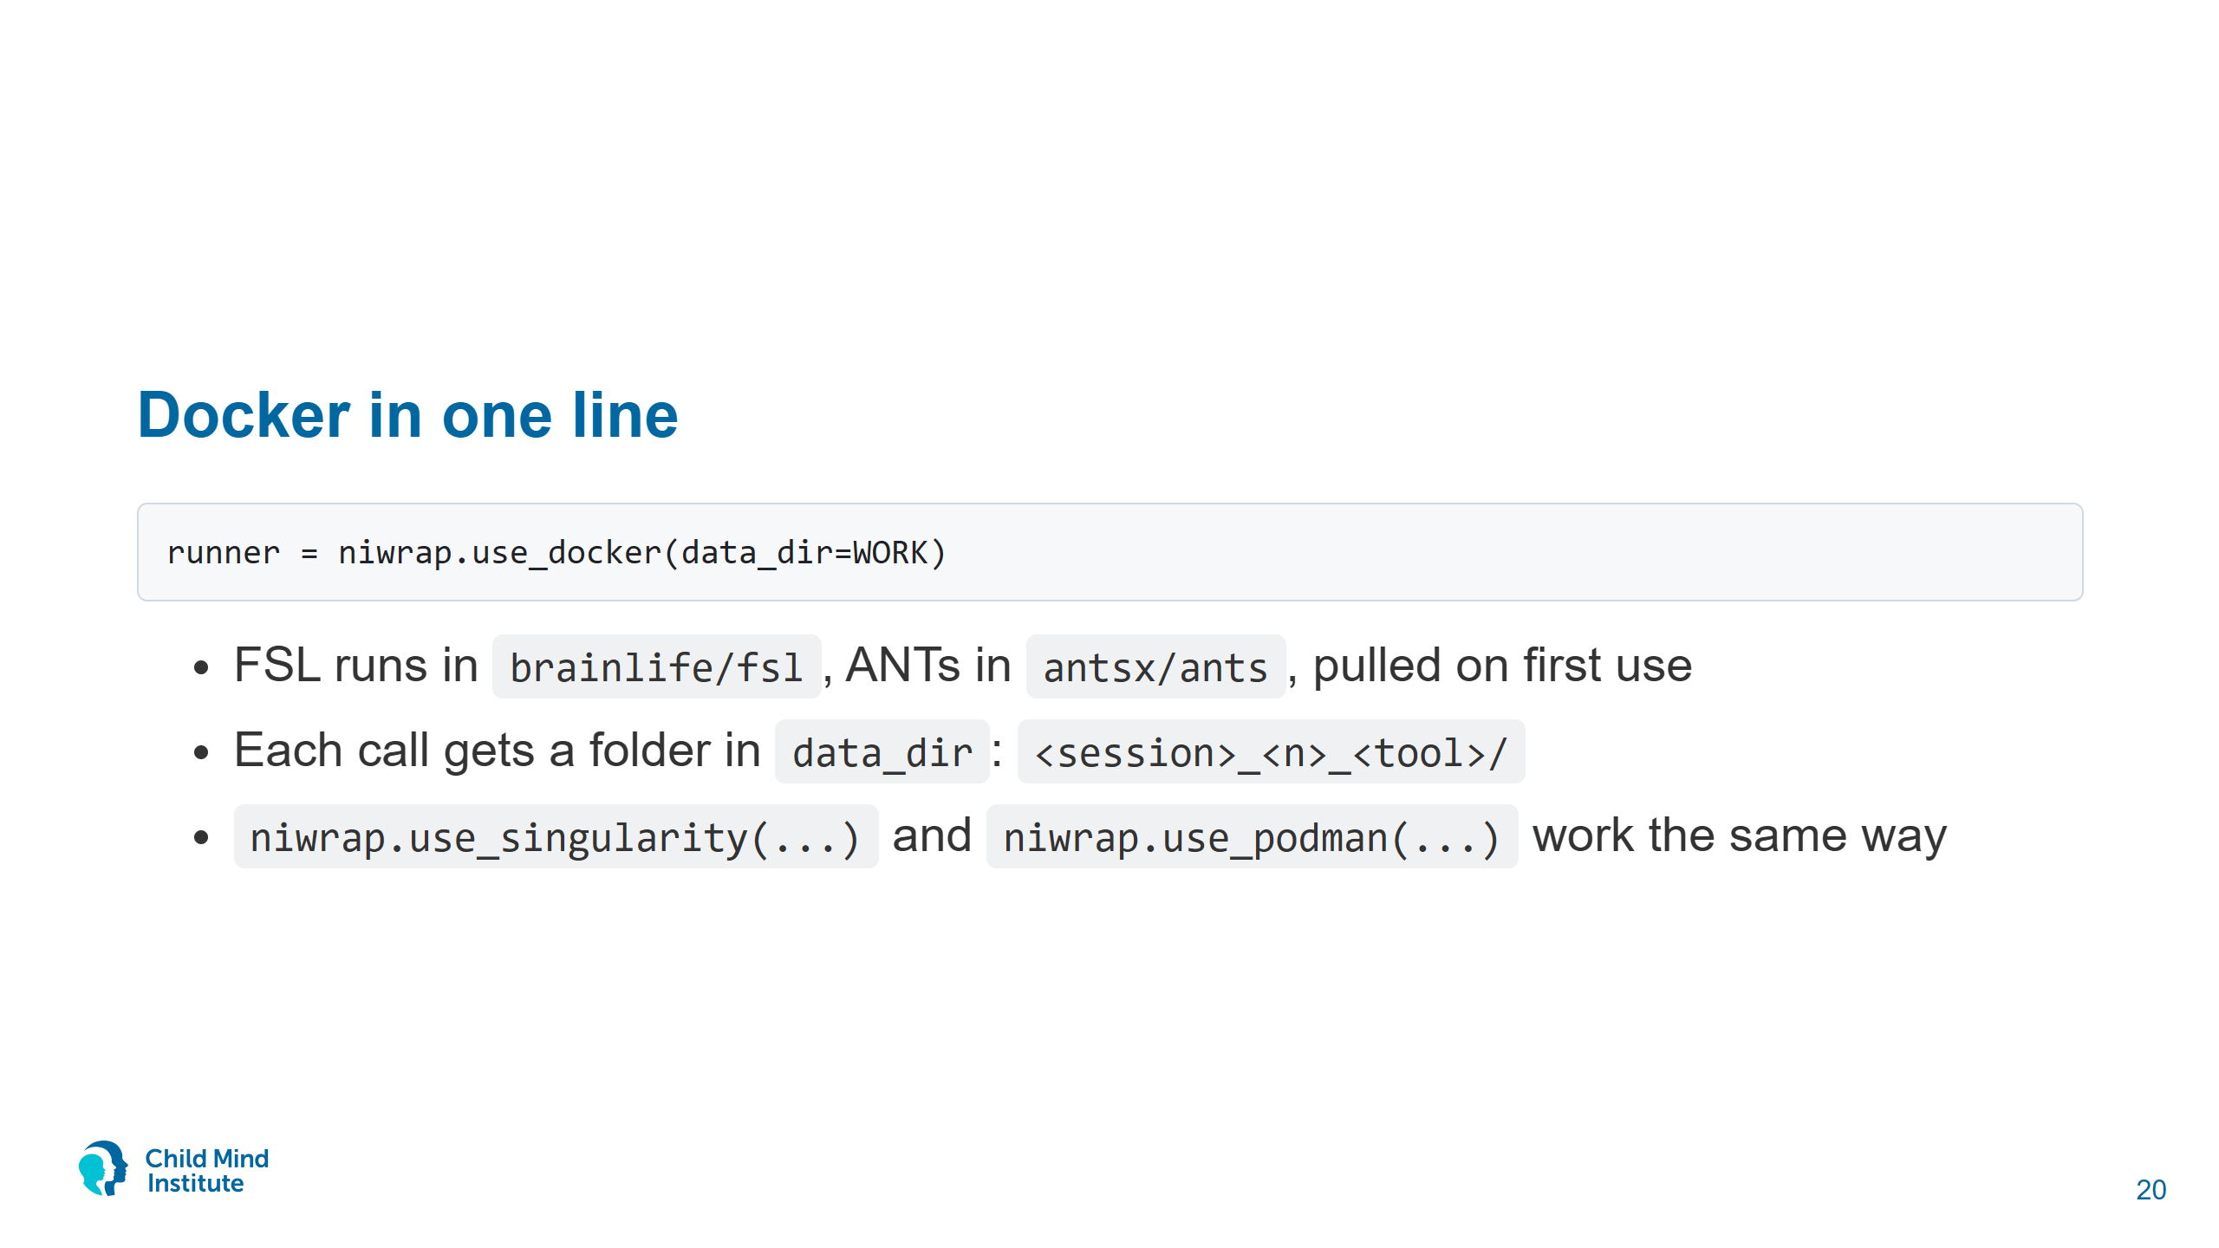
Notes:
Show work/02/<id>_0_bet/ in the file browser. run.sh holds the exact command.
data_dir is scratch: copy what you keep (notebook uses shutil.copy2), delete the rest.

Slide 21
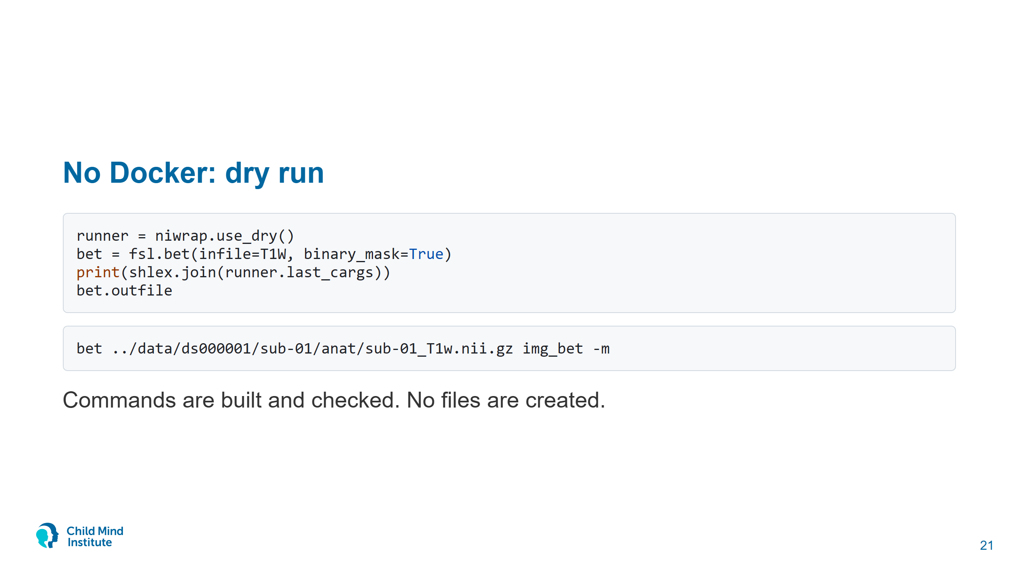
Notes:
Fallback for anyone whose Docker doesn't work today: RUNNER = "dry" at the top of each notebook.
Also handy before a long cluster job.

Slide 22
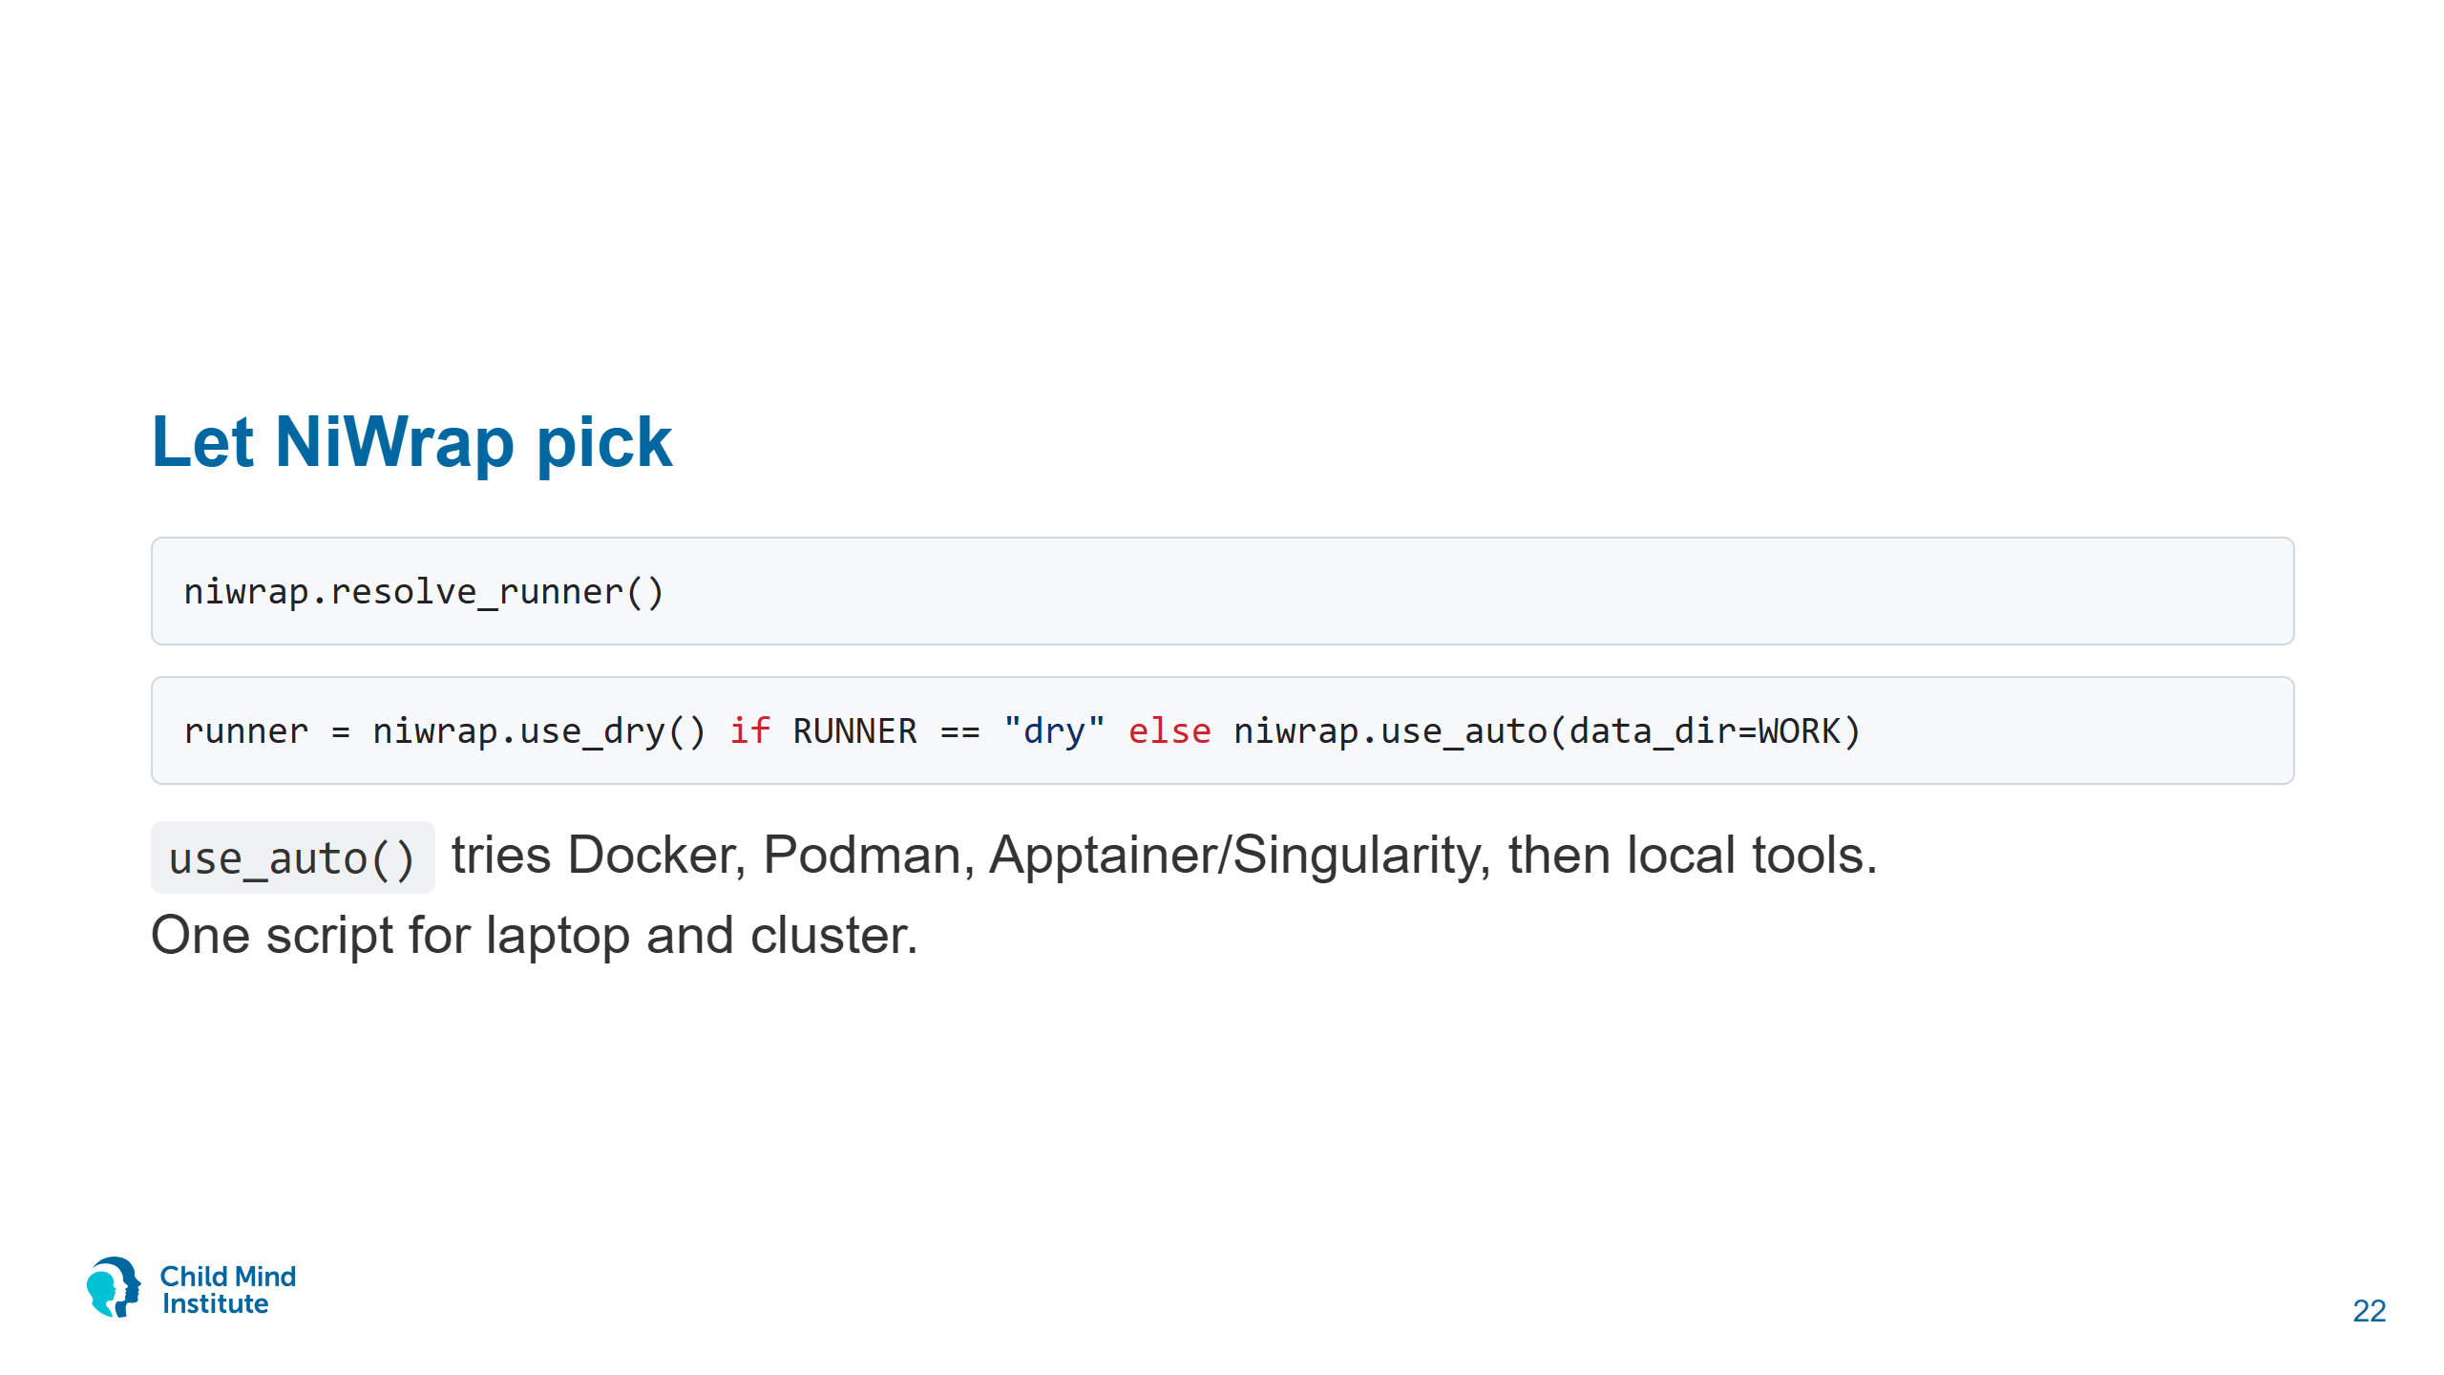
Notes:
This is what every notebook's setup cell does. The Snakemake scripts later call niwrap.use_auto() too, and RBC uses the same detection order behind --runner auto.
Quieter logs: logging.getLogger(runner.logger_name).setLevel(logging.INFO). Notebook 03 sets it because ANTs registration prints thousands of lines.

Slide 23
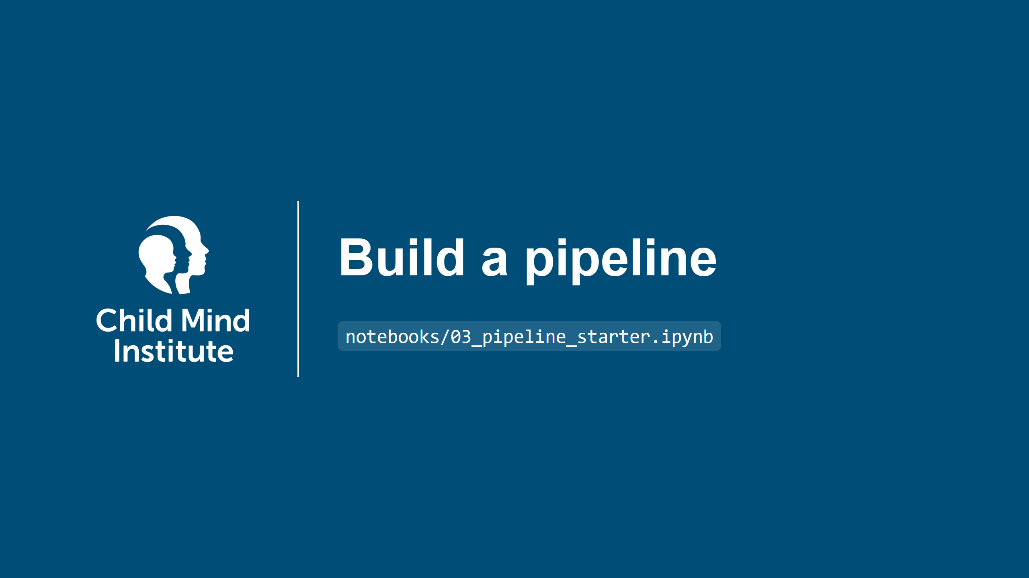
Notes:
35-65 min. Show the goal, then let people work and walk the room. Show the solution slides at ~60 min.

Slide 24
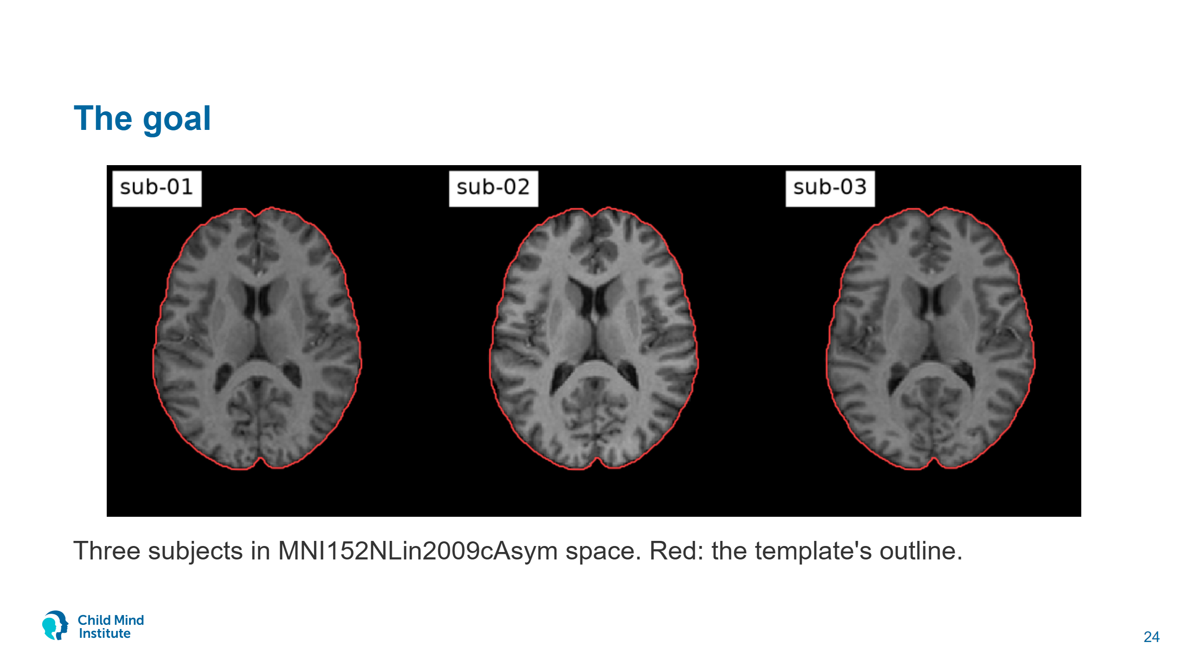
Notes:
This is the solution notebook's output. By the end of the hour every attendee with Docker has this for sub-01, most for all three.

Slide 25
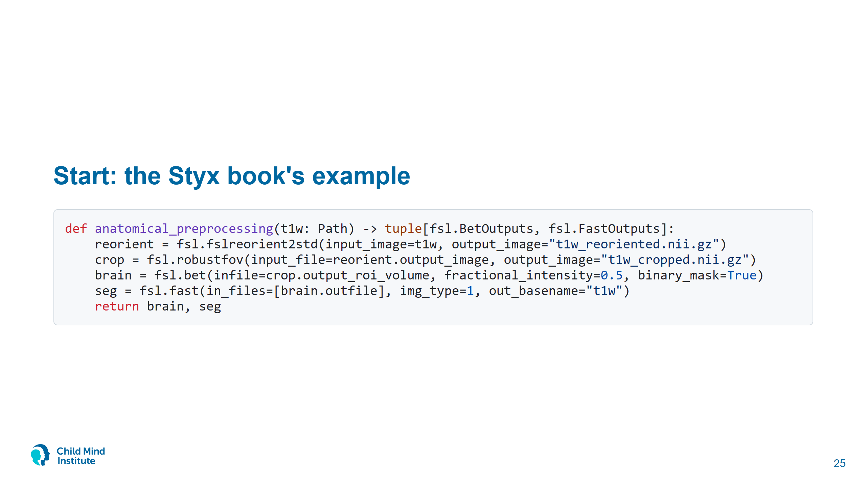
Notes:
The book's anat_preproc, updated for niwrap 1.1: outputs must be named, and BET's -R is dropped (fails in the default FSL image: dc missing).
Step 0 runs this on sub-01, ~2 min (mostly FAST).

Slide 26
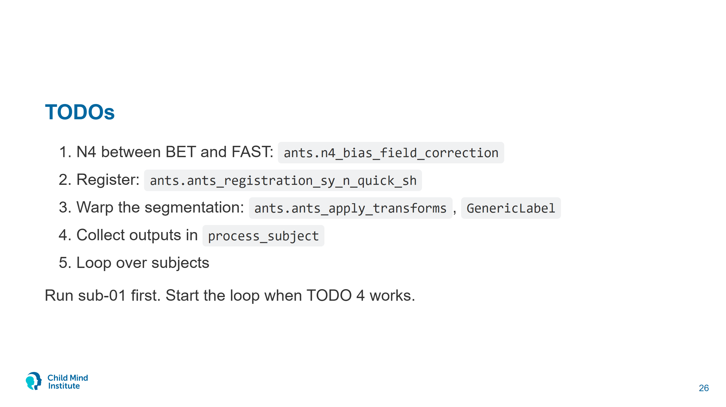
Notes:
Per subject on a laptop: FSL steps <30 s, N4 ~5 s, FAST ~2 min, registration 2-5 min. The other two subjects take ~15 min together.
Dry-run attendees: print(shlex.join(runner.last_cargs)) after a call.
Common snags: image_dimensionality=3 missing; a plain string where N4's output helper is expected; transform order (warp before affine).

Slide 27
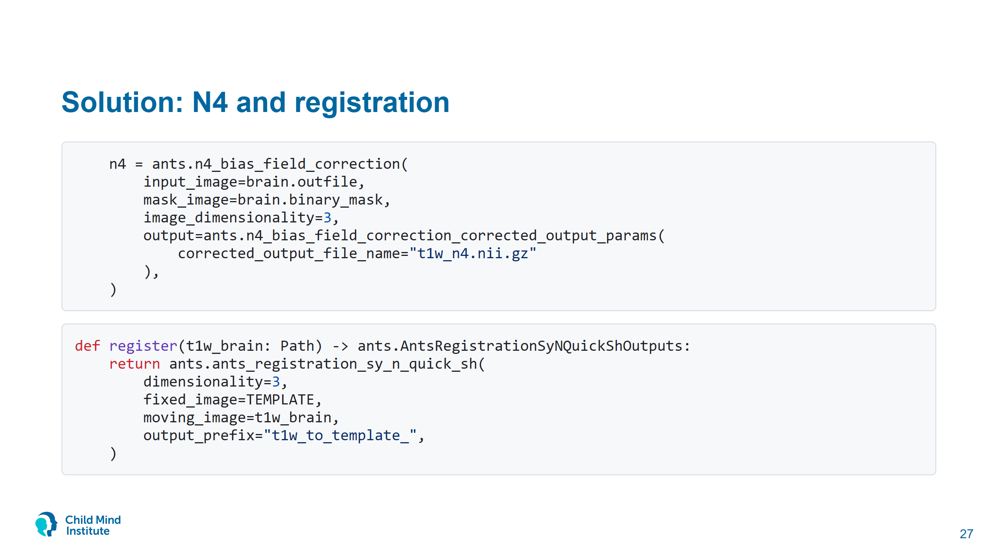
Notes:
An FSL output feeds an ANTs input. Different package, different container.
The *_params helpers build nested arguments. Type ants.n4_bias_field_correction_ and autocomplete lists them.

Slide 28
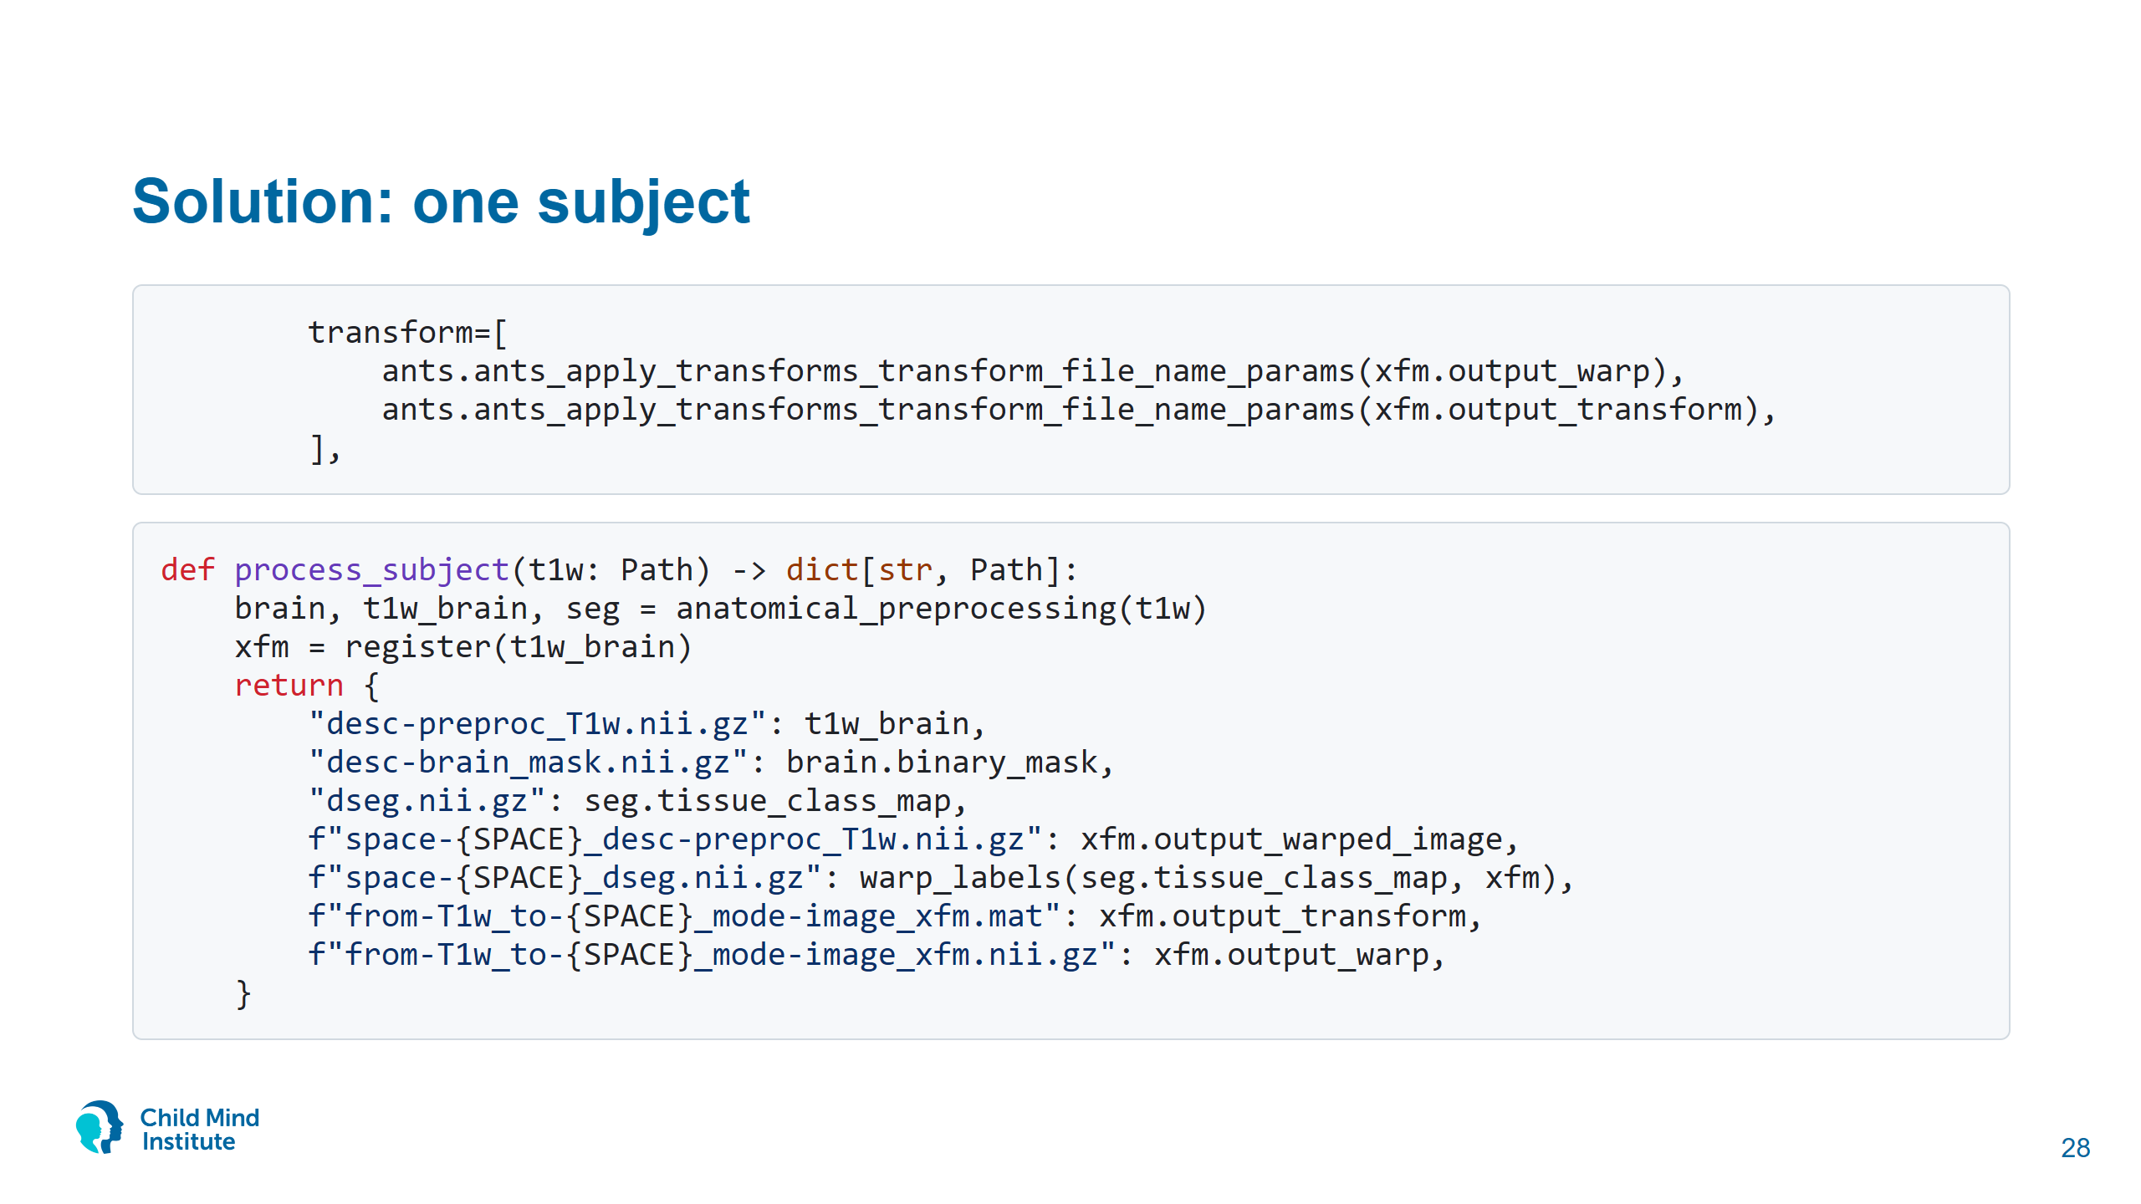
Notes:
ANTs applies transforms last to first, so the warp is listed before the affine.

Slide 29
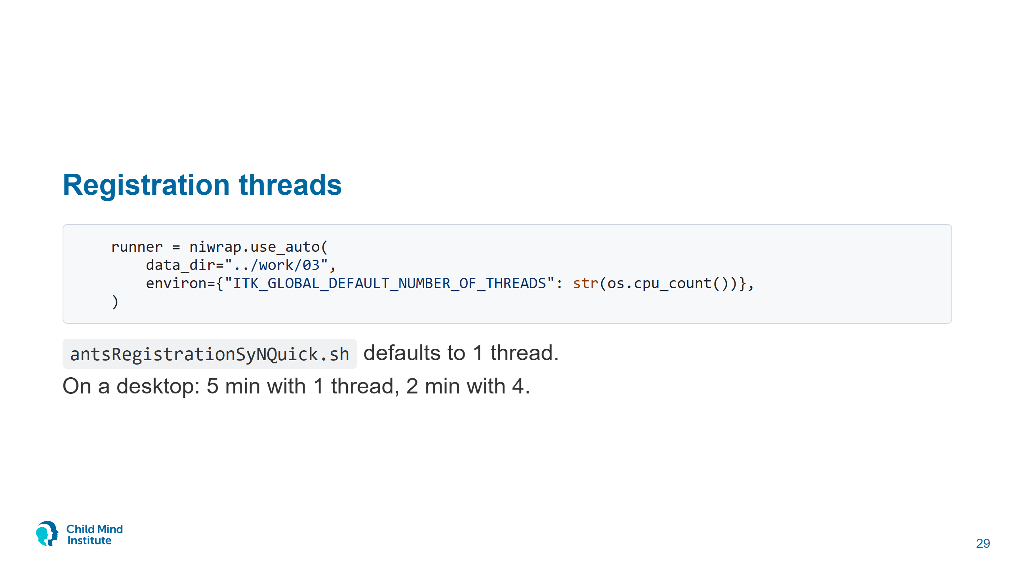
Notes:
environ goes into every container. Useful for any ITK-based tool (ANTs, c3d, greedy).

Slide 30
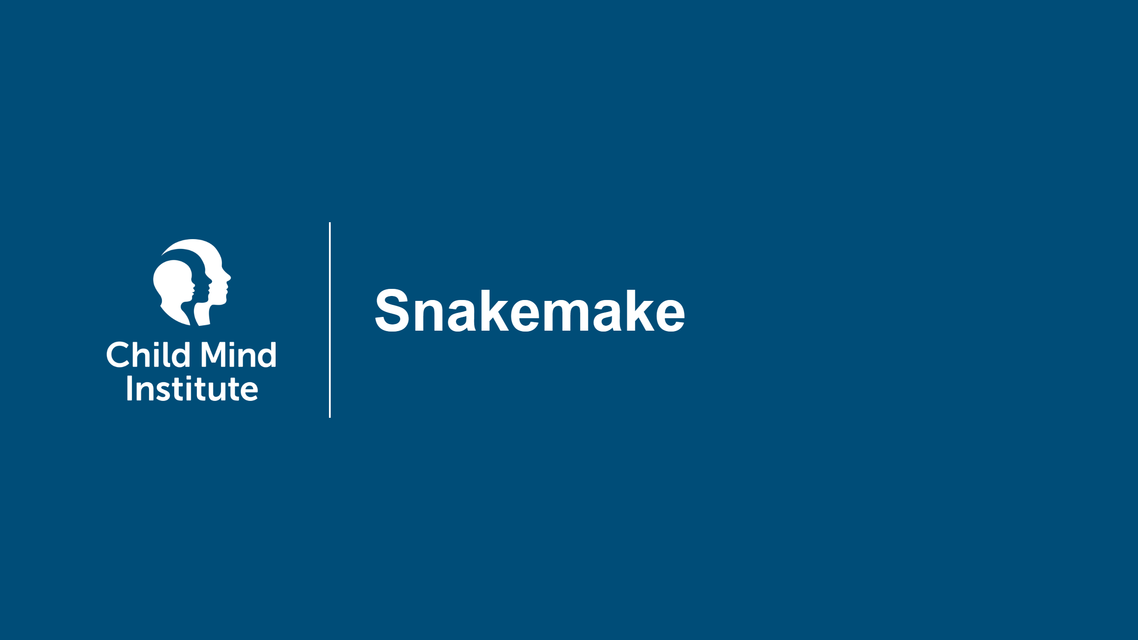
Notes:
65-75 min. Demo from the repo root.

Slide 31
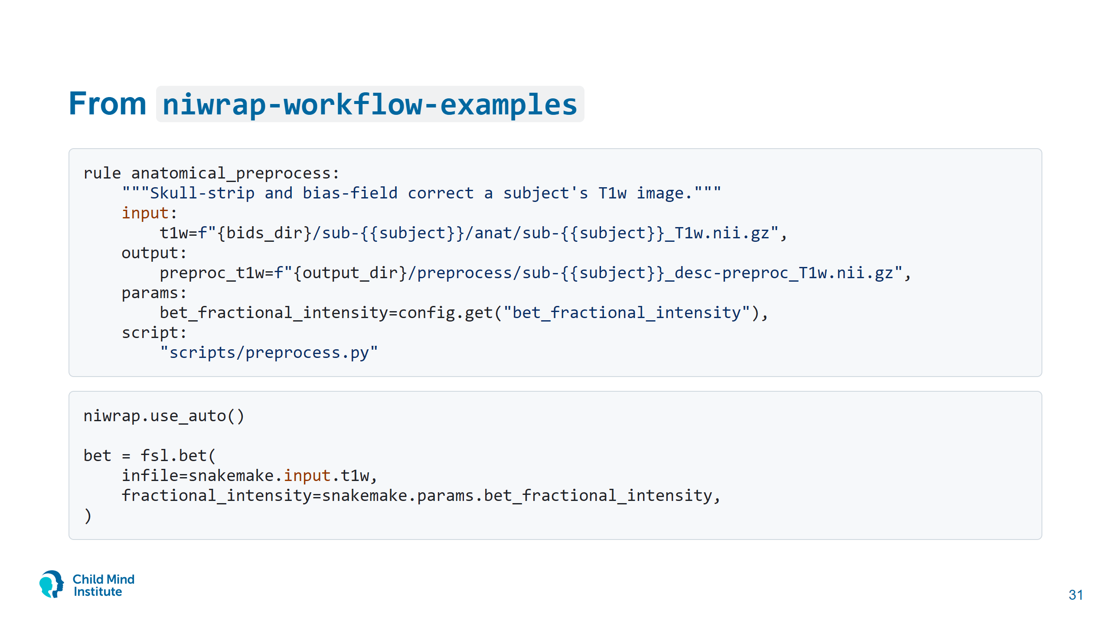
Notes:
snakemake/ is copied from github.com/styx-api/niwrap-workflow-examples (examples/snakemake-niwrap), BET -> N4 -> SyN. One fix: the scripts' `from snakemake.iocontainers import snakemake` doesn't exist in Snakemake 9.27 and crashes; Snakemake injects `snakemake` anyway.
The NiWrap code in the script is the code from the notebook. Snakemake adds file-based dependencies, re-runs only what's missing, parallel subjects, cluster submission.

Slide 32
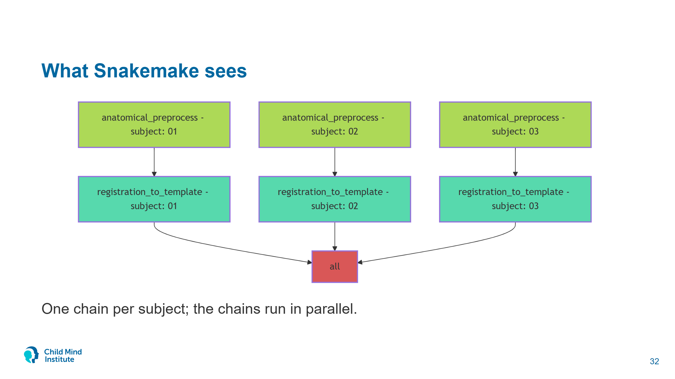
Notes:
Generated from this repo's Snakefile: uv run snakemake -s snakemake/Snakefile --dag mermaid-js --forceall, rendered with mermaid-cli. Snakemake builds the graph from input and output file patterns; the scripts never mention each other.

Slide 33
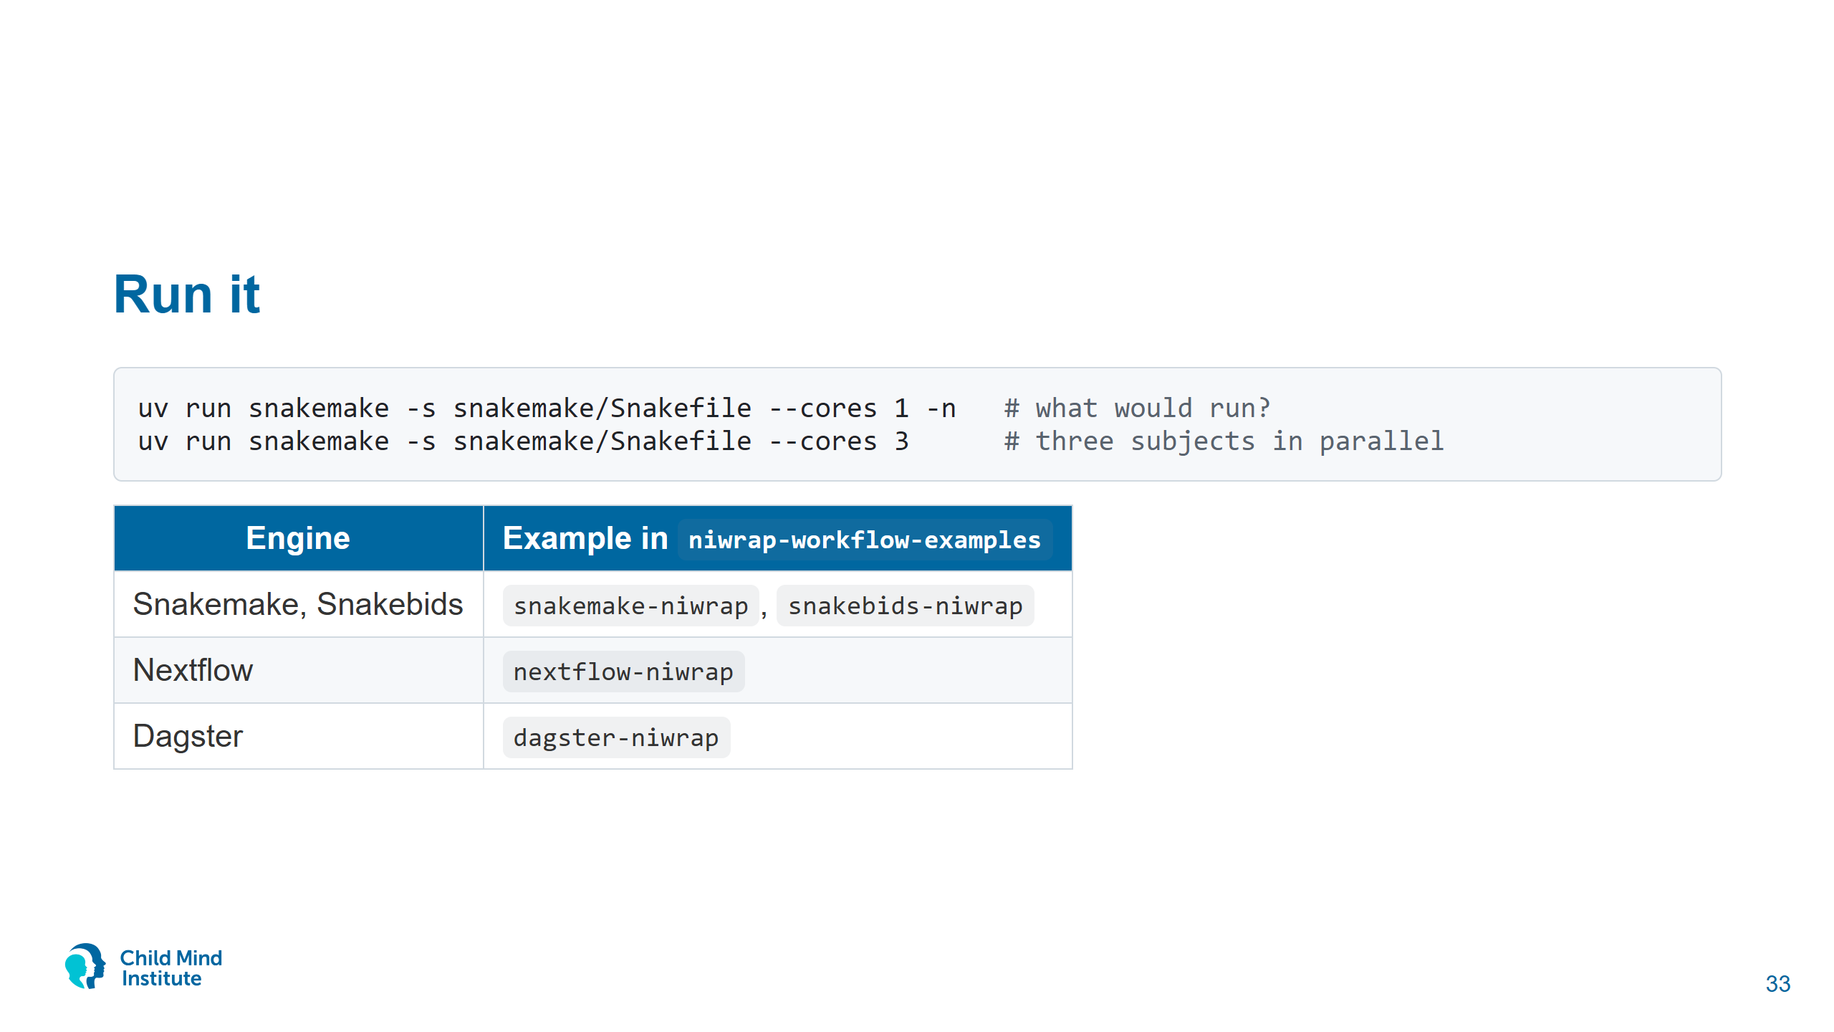
Notes:
Show -n (instant). Then start --cores 3 (4.5 min for three subjects on a 16-core desktop, longer on a laptop) or show the pre-computed derivatives/snakemake/.
Delete one subject's output and re-run: only that subject runs.
All four examples implement the same pipeline. Snakebids turns it into a BIDS app.

Slide 34
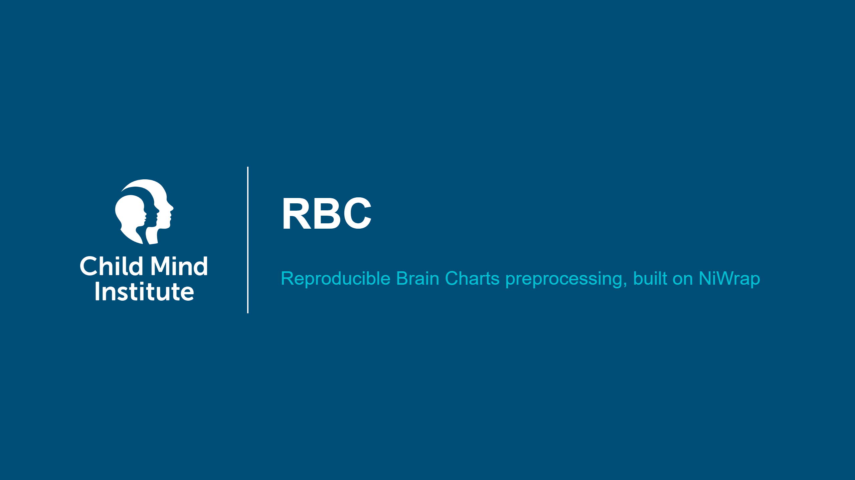

Slide 35
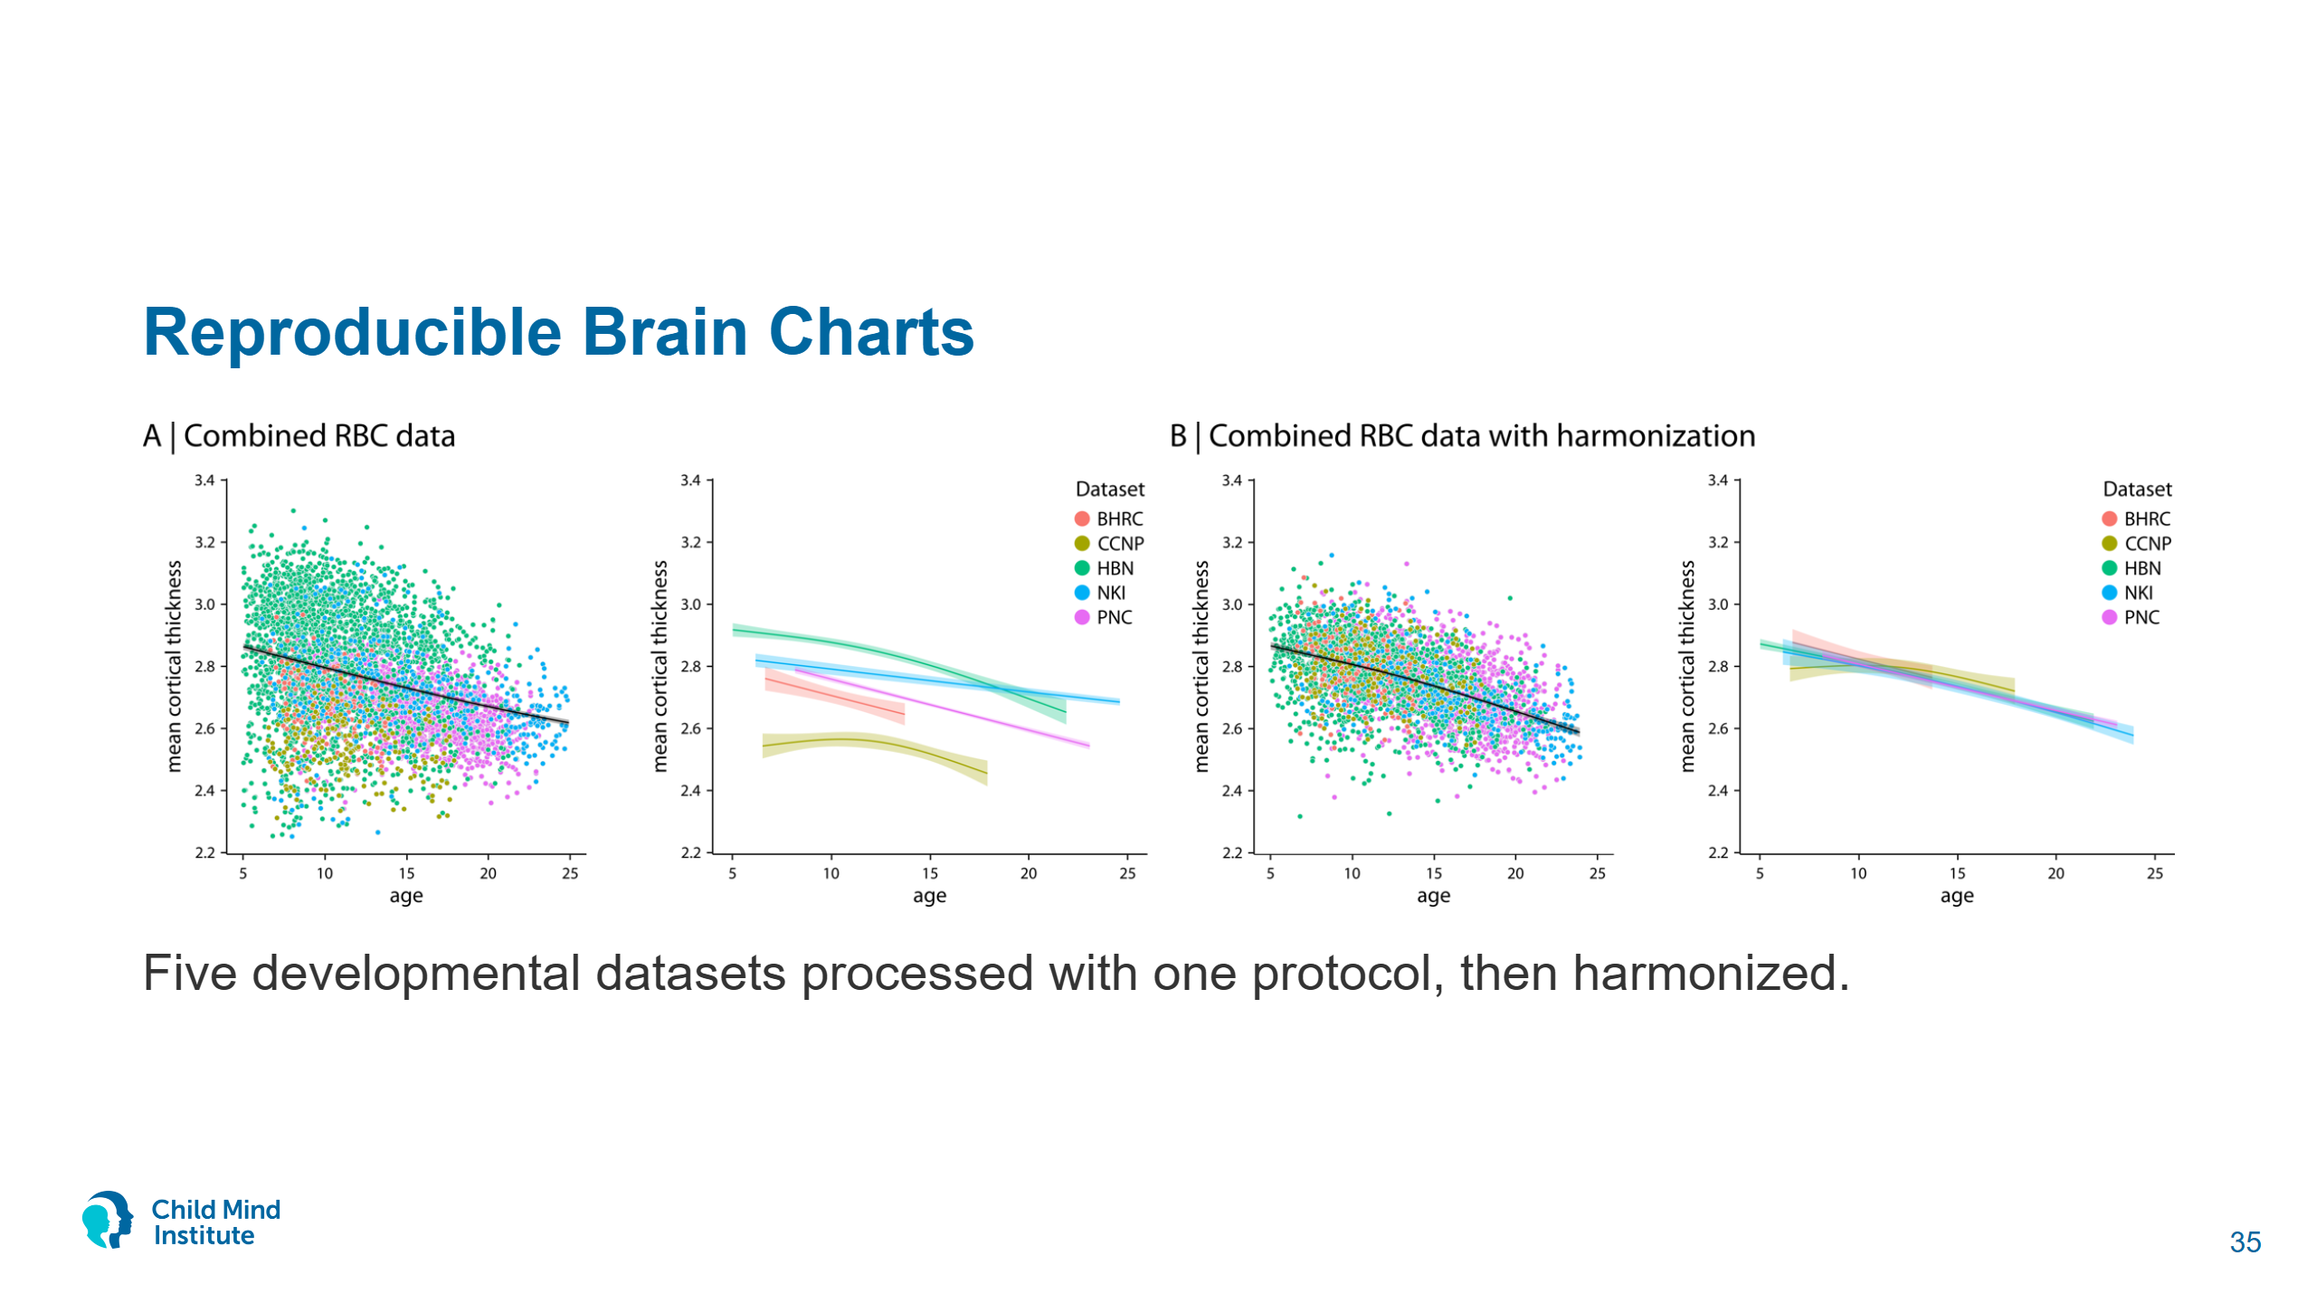
Notes:
Figure from reprobrainchart.github.io: mean cortical thickness against age in BHRC, CCNP, HBN, NKI and PNC. Pooled as-is (A) the datasets disagree; after harmonization (B) their age curves line up.
RBC: Shafiei et al. 2025, Neuron. The childmindresearch/rbc package reimplements the RBC processing protocol (previously run with C-PAC) on NiWrap. Harmonization is a separate, statistical step after processing.

Slide 36
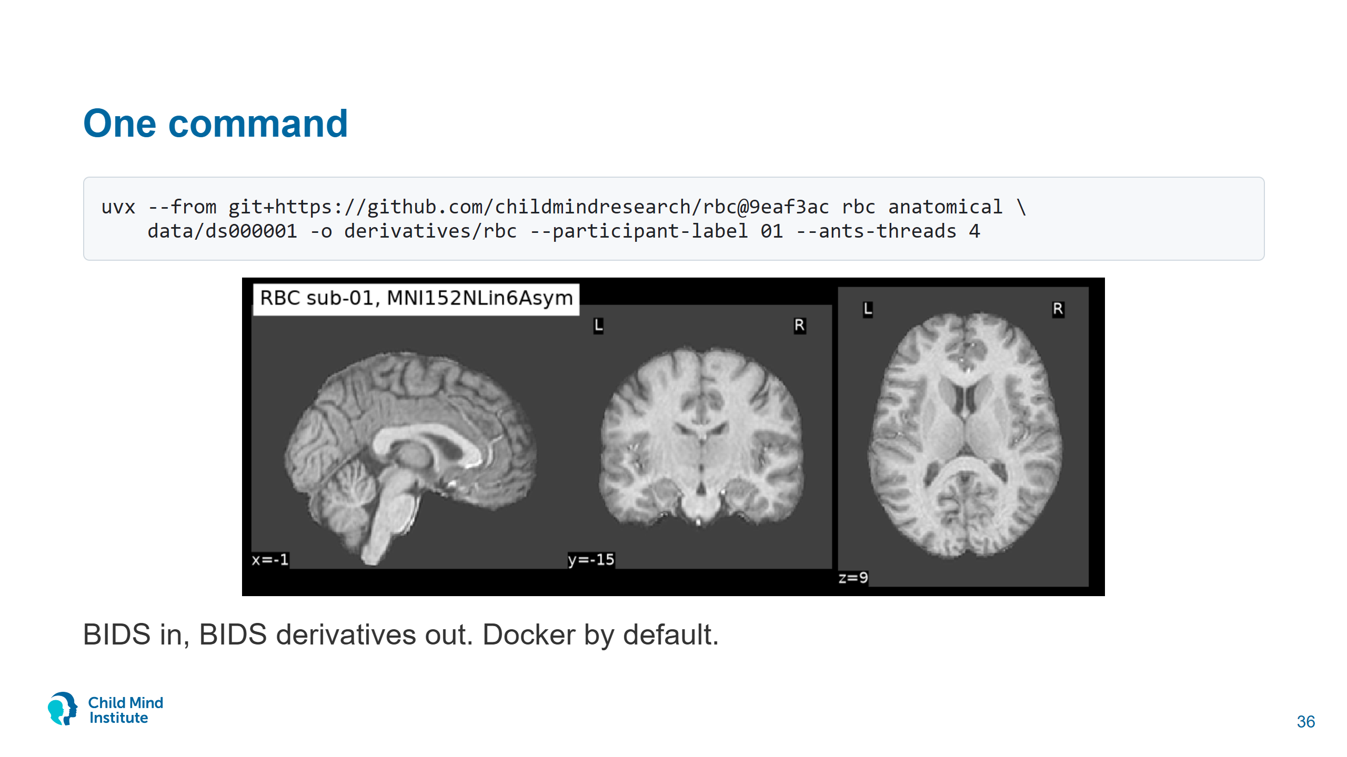
Notes:
Reference implementation of the RBC protocol (Shafiei et al. 2025, Neuron), previously run with C-PAC. Stages: anatomical, functional, metrics, qc, or all.
uvx gives RBC its own environment: it pins niwrap 0.9, the workshop uses 1.1.
Start it live if you like, but show pre-computed output. The anatomical stage took 38 min for one subject on a 16-core desktop (ANTs brain extraction plus a 3-stage registration).

Slide 37
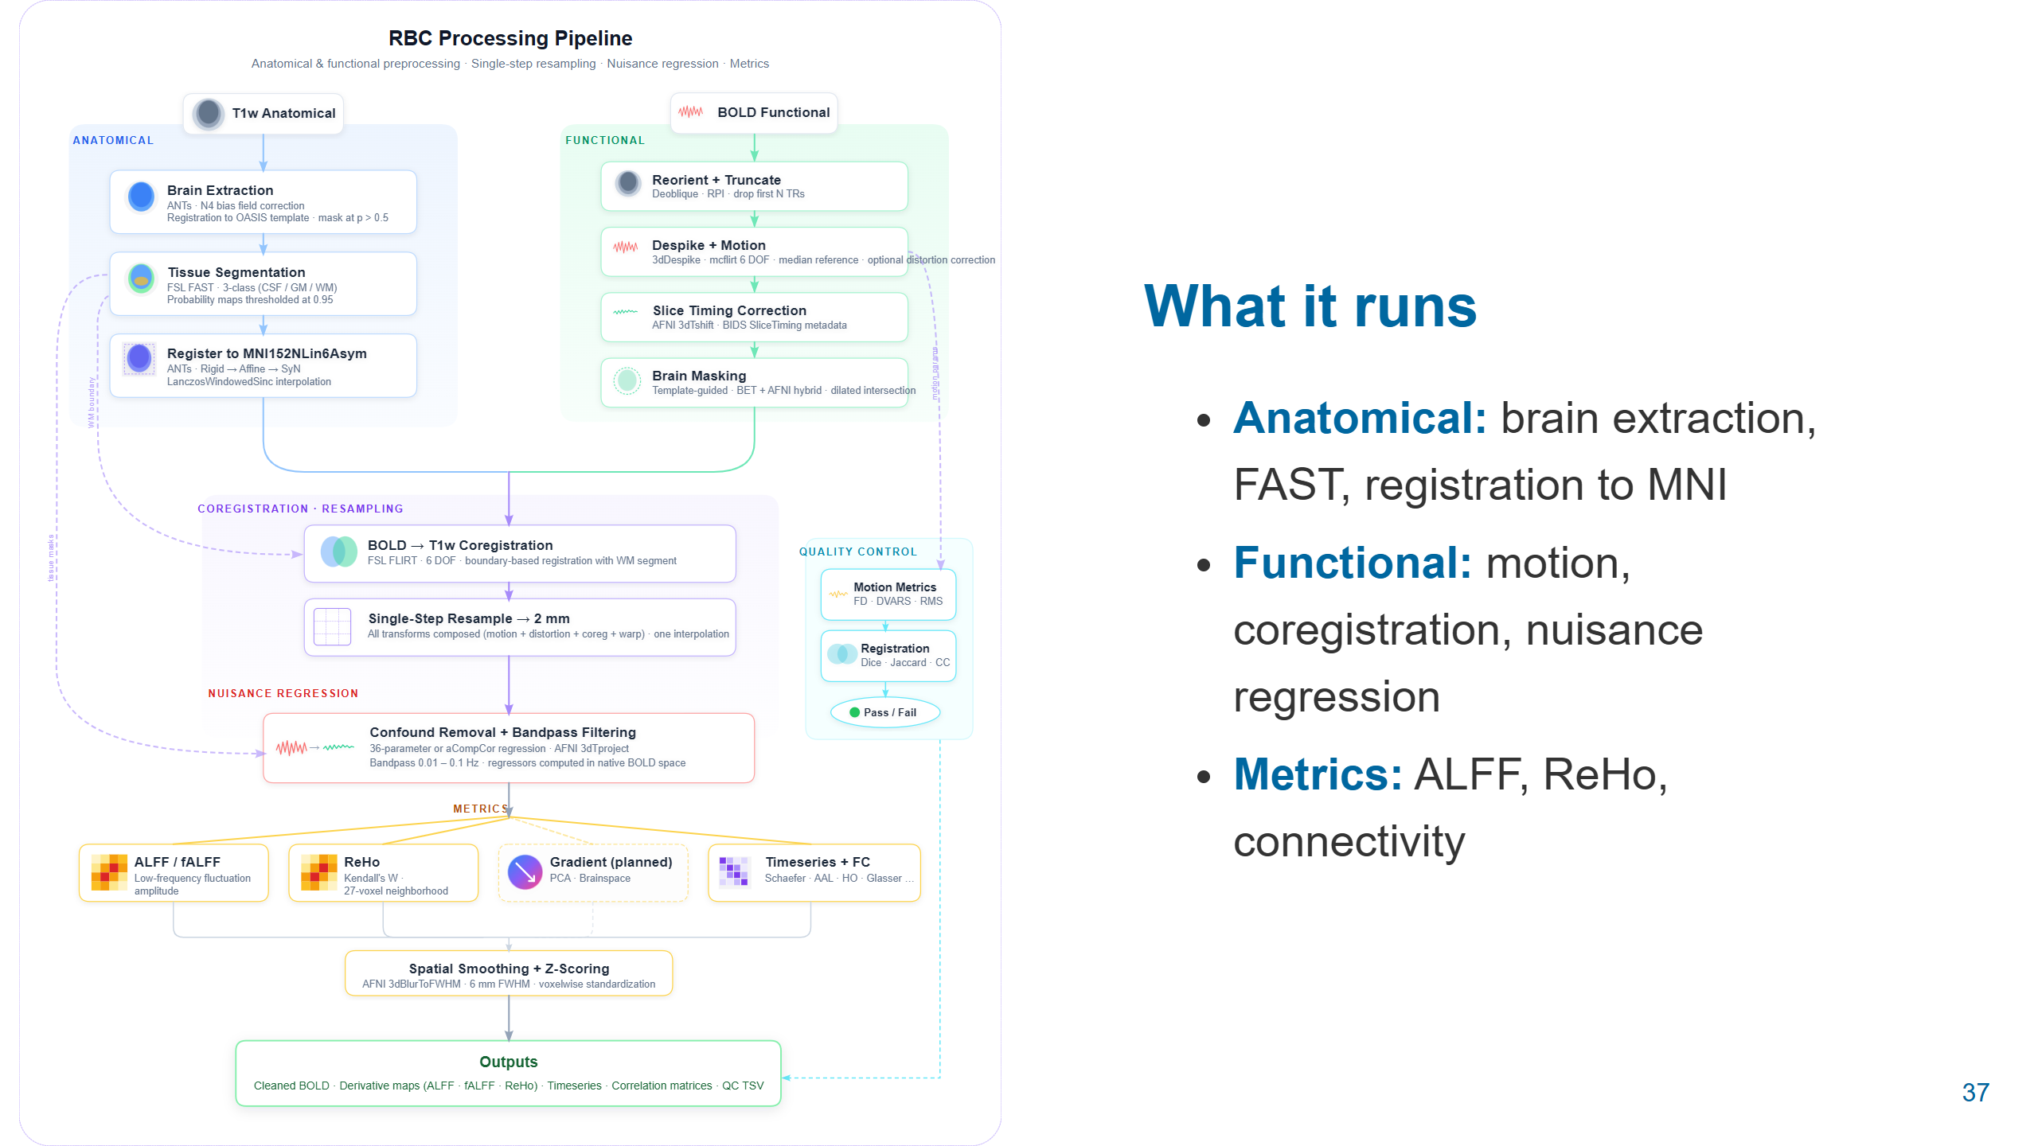
Notes:
From the rbc README (docs/pipeline_flow.svg). Today we only ran the anatomical column: ANTs brain extraction, FAST, registration to MNI152NLin6Asym. The functional stage adds AFNI motion correction, BBR coregistration, nuisance regression and the ALFF/ReHo/connectivity metrics.
Same structure as notebook 03: Python functions that call NiWrap tools and pass paths along.

Slide 38
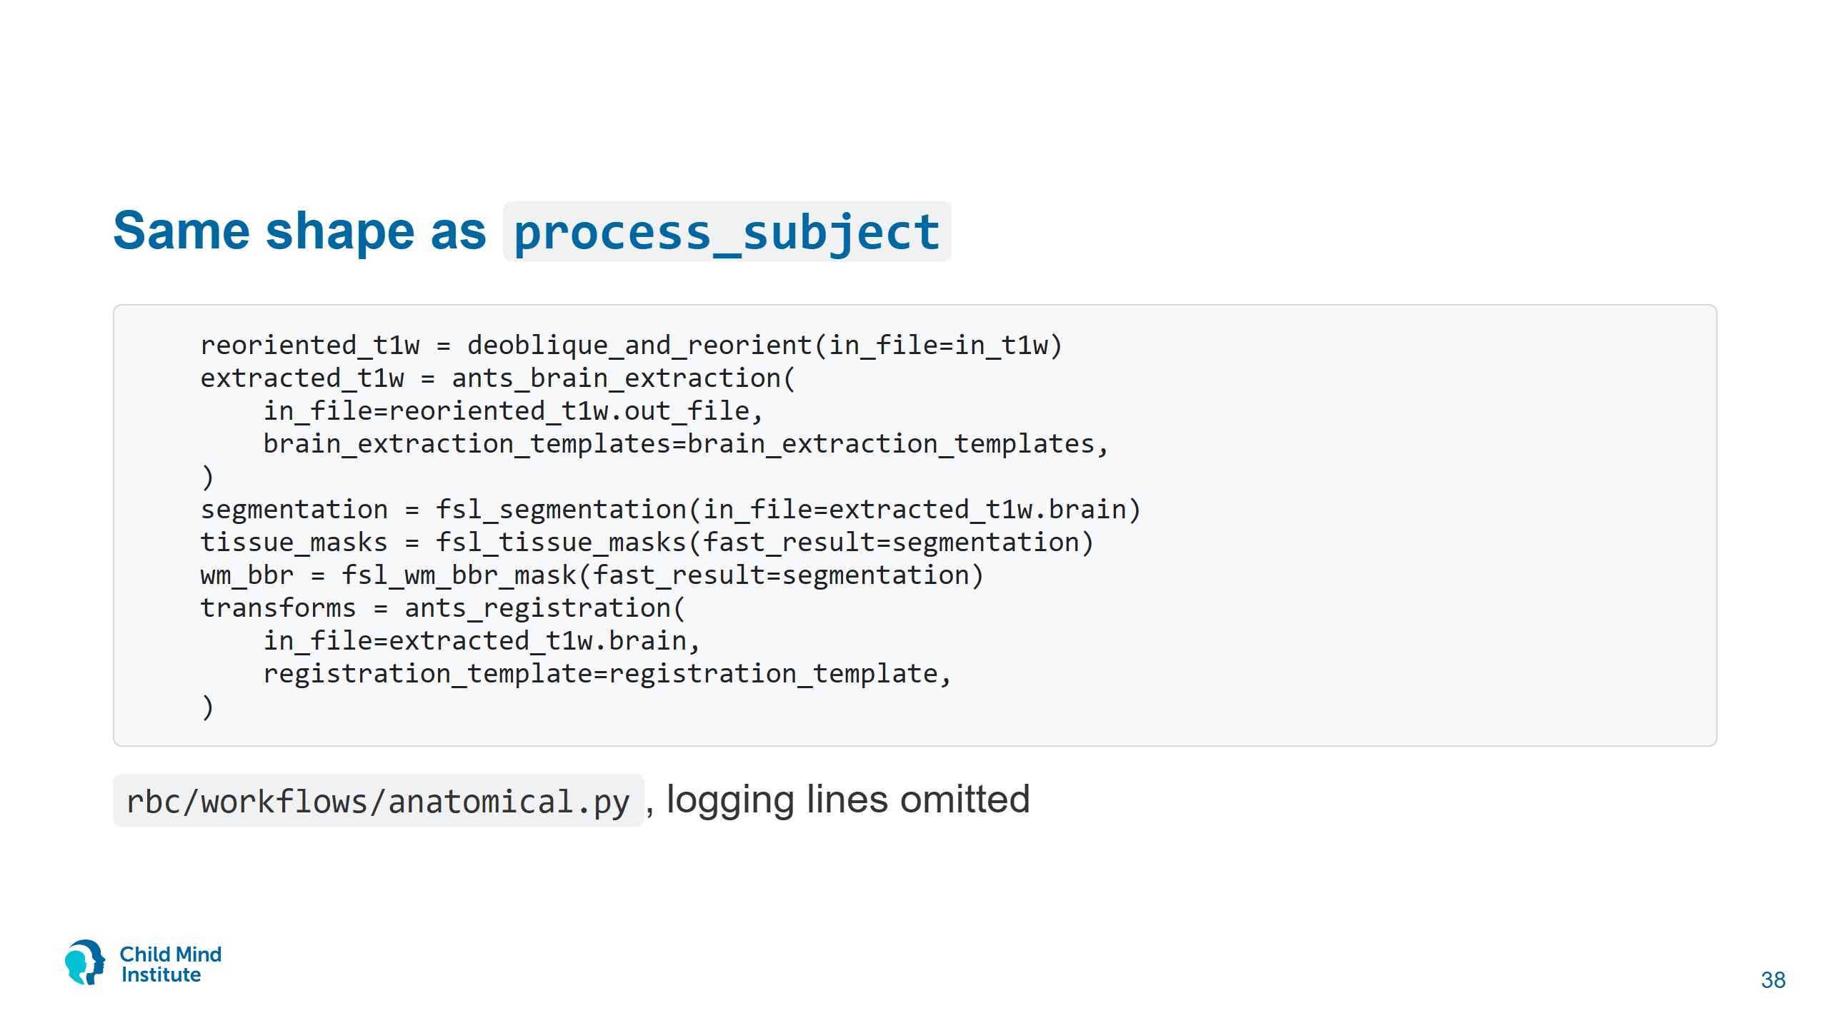
Notes:
Each step is a function that calls NiWrap and returns paths; the next step takes those paths. Notebook 03 plus a command-line interface.
Open src/rbc/core/anatomical/segmentation.py to show one step: fsl_segmentation is a single fsl.fast call.
RBC's --runner auto uses the same Docker, Podman, Apptainer, local order as niwrap.use_auto(). RBC is on niwrap 0.9, where nested-argument helpers have no _params suffix.

Slide 39
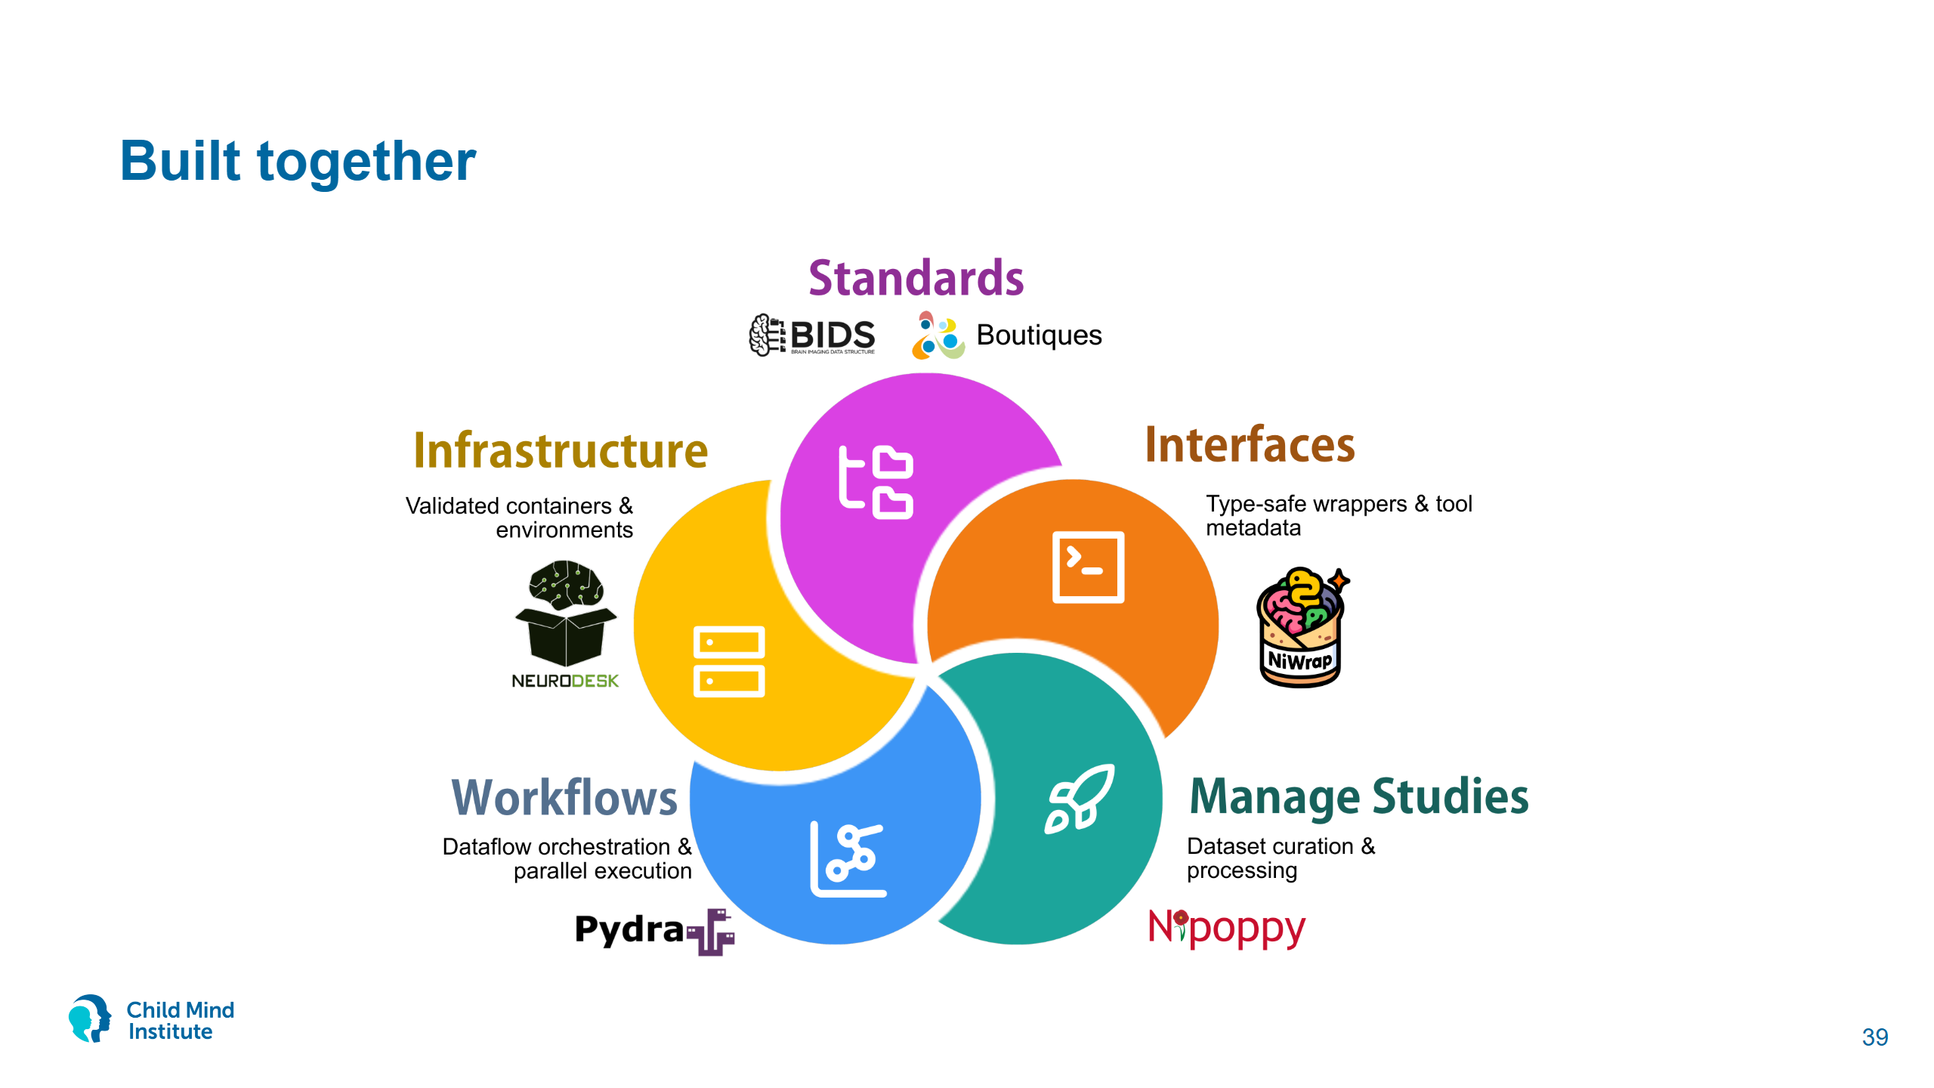
Notes:
Same OHBM 2026 poster. BIDS and Boutiques are the standards, Neurodesk the containers, Pydra the workflows, Nipoppy study management, NiWrap the interfaces.
Authors: Florian Rupprecht, Jason Kai, Joshua Scarsbrook, Ashley Stewart, Thomas Close, Nikhil Bhagwat, Mathieu Dugré, Dorota Jarecka, Christopher Markiewicz, Aswin Narayanan, Laura Newman, Michelle Wang, Ting Xu, Michael Milham, Satrajit Ghosh, Jean-Baptiste Poline, Steffen Bollmann, Tristan Glatard, Gregory Kiar.
Adding one descriptor makes a tool available on all of these.

Slide 40
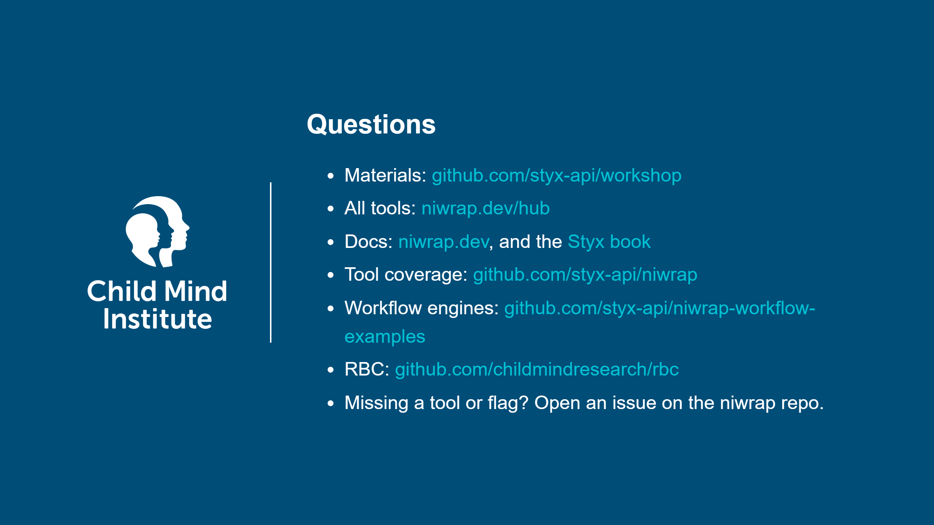
Notes:
Common questions:
- Is tool X covered? Check the coverage table, or `from niwrap import <package>` and autocomplete.
- Clusters? niwrap.use_singularity(); images are converted from Docker Hub on first use.
- Different image version? use_docker(image_overrides={"brainlife/fsl:6.0.4-patched2": "..."}).
- vs. Nipype? Nipype interfaces are hand-written and tied to its workflow engine. NiWrap wrappers are generated for many more tools and are plain functions you can use with any engine, or none.

