Slide 1

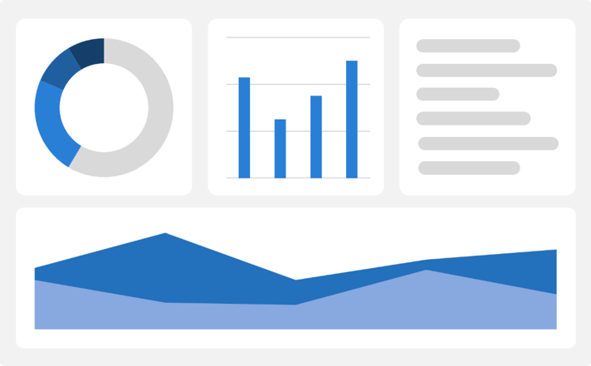
Module1_Project: Singapore Job Market Analytics
Group 4
DSAI_6 Team members:
Belina, Gary, Michael, Mustafa, Shabeena and Willie
8 Aug 2026

Slide 2
Problem Statement
This project aims to answer key business questions:
  Which industries offer the highest salaries?
  Which industries have the highest hiring demand?
  Which industries receive the most applications? Or strong Competition?
  Which industries are hardest to fill?
  How has hiring changed over time?
Target Users
Job Seekers
Compare salaries &
Identify high-demand roles
Career Coaches
Guide clients toward growing industries
HR Teams
Benchmark:
Hiring trends and salaries
Organizations, recruiters, and job seekers often have access to large volumes of job data but limited visibility into market trends.

Slide 3
The goal is solving a problem, not just writing the code
Problem
Solution
Developed an end-to-end Job Market Intelligence Dashboard by cleaning, analyzing, and visualizing over one million job postings using Python, Plotly, and Streamlit.
Outcome
Data-driven salary, hiring demand, time trend and insights
Competition Index
Interactive dashboard with dynamic filters
Decision support for job seekers, recruiters, and policymakers
.
Hiring demand analysis
Singapore's job market generates a large volume of job postings, making it difficult to identify meaningful trends in salaries, hiring demand, competition, and employment opportunities
Developed an end-to-end Job Market Intelligence Dashboard by cleaning, analyzing, and visualizing over one million job postings using Python, Pandas and numpy, Plotly, and Streamlit.

Slide 4
Challenges and Learnings
🚧 Challenges We Overcame:
Big Data Challenge Processing > 1 million records efficiently.
Data Cleaning and Messy Data Reality:
  Inconsistent salaries,
  Missing values,
  Duplicate postings
Dashboard design
Coding/debugging
🎓 What We Learned:
Transforming large datasets
  Feature Engineering
  Data Standardization
Creating meaningful KPIs from raw data
Developing interactive dashboards for decision-making
Solving real-world business problems with data
Tapping on different talents as team & learning!
Business Problem → Data Preparation → Data Analysis/EDA → Interactive Dashboard → Business Insights

Slide 5
backup

Slide 6
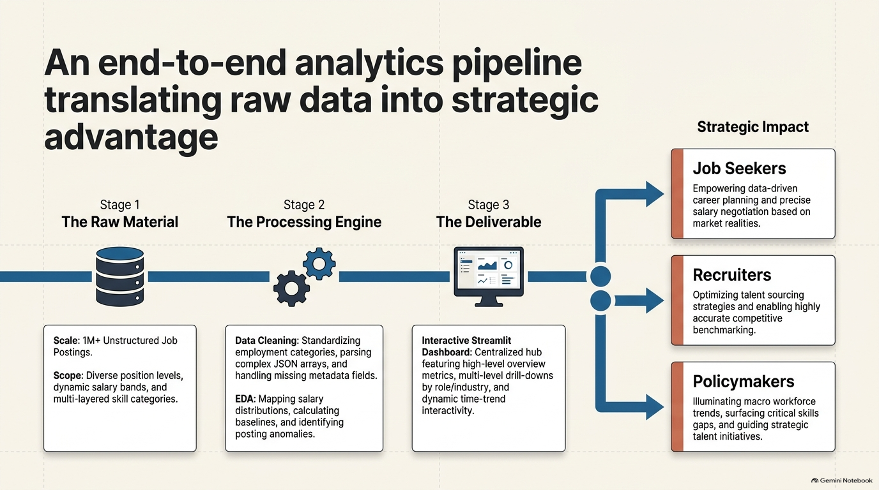

Slide 7


