Slide 1
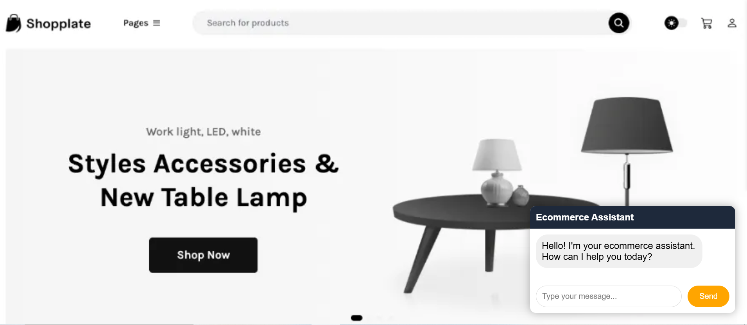
Capstone project - AI Chatbot : Using AWS services
Note: Sample Website backdrop depicted for visualization only

Slide 2

What is a chatbot?
A chatbot is a program that understands user inputs (questions or commands) and responds automatically, often mimicking human conversation
Types of chatbots :
Rule-based
AI/ML based
Notes:
A chatbot is essentially a computer program designed to simulate conversation with human users. It can understand inputs like questions or commands and reply intelligently. Chatbots are not new – and we have used them at some point when shopping online or reporting an issue. There are broadly 2 types of chatbots – rule based and AI powered ones

Slide 3
AI chatbot v/s Rule-based chatbot
Feature | Rule-Based Chatbot | AI Chatbot
Core Logic | Uses if-else conditions, flowcharts | Uses Natural Language Understanding (NLU) & Machine Learning (ML)
Input Handling | Matches exact keywords or phrases | Understands intent and context, even if phrased differently
Technology | Built using if-then logic, flowcharts | Built using AI platforms like Amazon Lex, Diagflow, GPT models
Learning ability | Cannot learn or adapt on its own | Can improve over time with training data
Example | Q. “Where is my order 123 ?” “Please enter your order number in this format: ORDXXX” | Q. “Where is my order 123 ?” A. “Your order 123 has been shipped and will arrive in 2 days”
Notes:
Some chatbots operate with predefined logic — these are rule-based. Others use machine learning and NLU, making them more intuitive, flexible and adaptive — these are AI-powered chatbots

Slide 4
Industries that use chatbots:
Ecommerce & Retail
Banking & Finance
Healthcare
IT Help desk
Notes:
- Ecommerce – order tracking, general queries
Banking & Finance – Balance & Transaction enquiry, ATM locator, product recommendations
Healthcare – appointment scheduling, doctor/clinic locators, insurance enquires etc
IT help desk – Ticket generation, status of ticket, knowledge base search etc

Slide 5
Capstone: Ecommerce (AI) chatbot using AWS
Component | Service | Role in AI chatbot
NLU Engine | Amazon Lex V2 | Handles NLU – interprets user queries ; identifies intents; invokes Lambda function & provides a response
Business Logic | AWS Lambda | Executes backend logic like fetching order status and formulating responses
Authentication | Amazon Cognito | Manages user identity & permissions
Hosting | Amazon S3 | Stores transcripts of conversations
Database | Amazon Dynamo DB | Stores order details (e.g. status and ETA) that Lambda retrieves based on the order id
UI | HTML & JavaScript | Front-end chat interface for users to interact with the bot on the website
Notes:
Developing on the knowledge received on the course on AWS services and also using the group’s theme of developing AI solutions, I decided to create an AI powered chatbot using AWS services for the project that would perform the utility of responding to user queries related to order tracking on a sample ecommerce website. Amazon Lex V2 is Amazon’s conversational AI service that lets you build, test, and deploy chatbots and voice assistants —
with built-in natural language understanding (NLU) . It understands user inputs like “Where is my order XYZ” maps these to intents, fills in slots or parameters
and is able to invoke Lambda functions to validate the query, retrieve the status and generate custom responses.
- Other components used in this model are Lambda which the business layer that receives user inputs, validates them, queries the status of the order from the database and provides appropriate responses, handles errors. Dynamodb stores the latest status of orders.

Slide 6
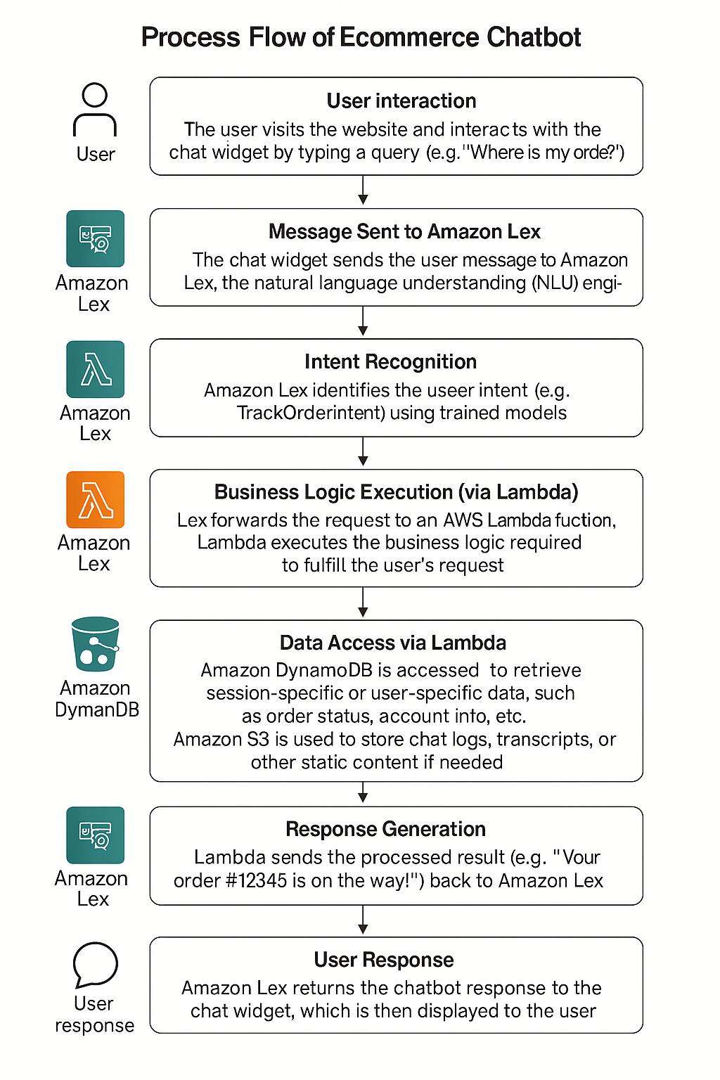
Chatbot: Process flow & Learnings
Key learnings:
Linkage of Lambda function to Lex via Alias-> Language and not via Intents
Versioning and Aliases to always be kept abreast of latest changes
Scrum/ Iterative build to reduce test complexity.
Phased testing approach - test integration in stages - firstly via Lex Console & secondly via UI testing.
Use console & browser logs to trace full message flow
Custom policies to grant access to
specific actions needed – e.g. Lex required
an explicit resource-based policy to invoke
Lambda
Notes:
Front end UI / HTML or website– uses AWS SDK for Javascript to capture user input and display a response.
This chatbot was designed to respond to user queries related to the most recent status of an order placed on the website.
Once the user types a message requesting the status of the order, the Front-end initializes Lex Runtime V2 client to send/receive messages.
Lex V2 client is part of AWS SDK that allows the UI/website to interact in real-time with the Amazon Lex chatbot.
The client can call Lex Runtime APIs like recognizetext() – for sending text inputs and receiving the bot’s response & recognizeUtterance() – for sending voice/audio inputs.
Once the API call is made Amazon Lex recognizes the intent by comparison with utterances defined in the Bot and fills any slots entered by the user.
For example if the user types “Where’s my Order?” the bot would invoke the Track Order Intent and fill the slot of Order ID provided by the user
It then triggers the lambda code where the business logic is defined to validate the request and receive the latest status of the order from the Dynamodb
Lambda then sends the response on the status of the order – e.g. Your 12345 is on the way back to Amazon Lex
Amazon Lex returns this response back to the UI and this is displayed on the chat window
Some Key learnings – read from the slide

Slide 7
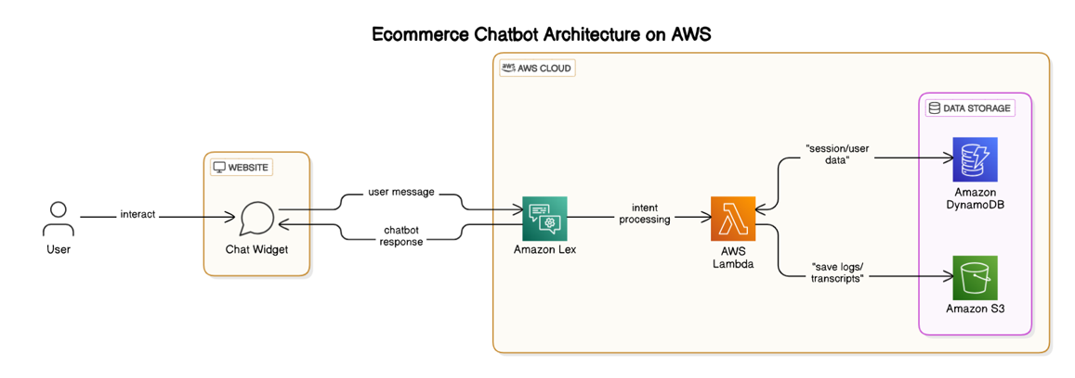
Chatbot: Key Architecture considerations
Real-Time Processing
NLP Accuracy with Amazon Lex
Easily embedded in Web Applications
Serverless & Scalable by design
Secure by default
Notes:
- Serverless to provide benefits of auto-scaling as traffic grows,
Economical - pay as you go – only pay when lex processes or downstream components process messages
uses fine-grained IAM roles and policies, Cognito
Modular and maintainable – e.g. when lambda code is updated it is not necessary to rebuild dependent components like Lex
as Lex is the alias we pointed to the latest function of Lex at all times
Amazon Lex demonstrates high NLP accuracy by understanding different ways users ask for the same thing,
extracting relevant data (slots), managing context, and improving over time with real feedback.
- The ecommerce chatbot provides real-time processing by using a fully serverless and event-driven architecture that allows instant communication between the user and backend services — all within milliseconds

Slide 8
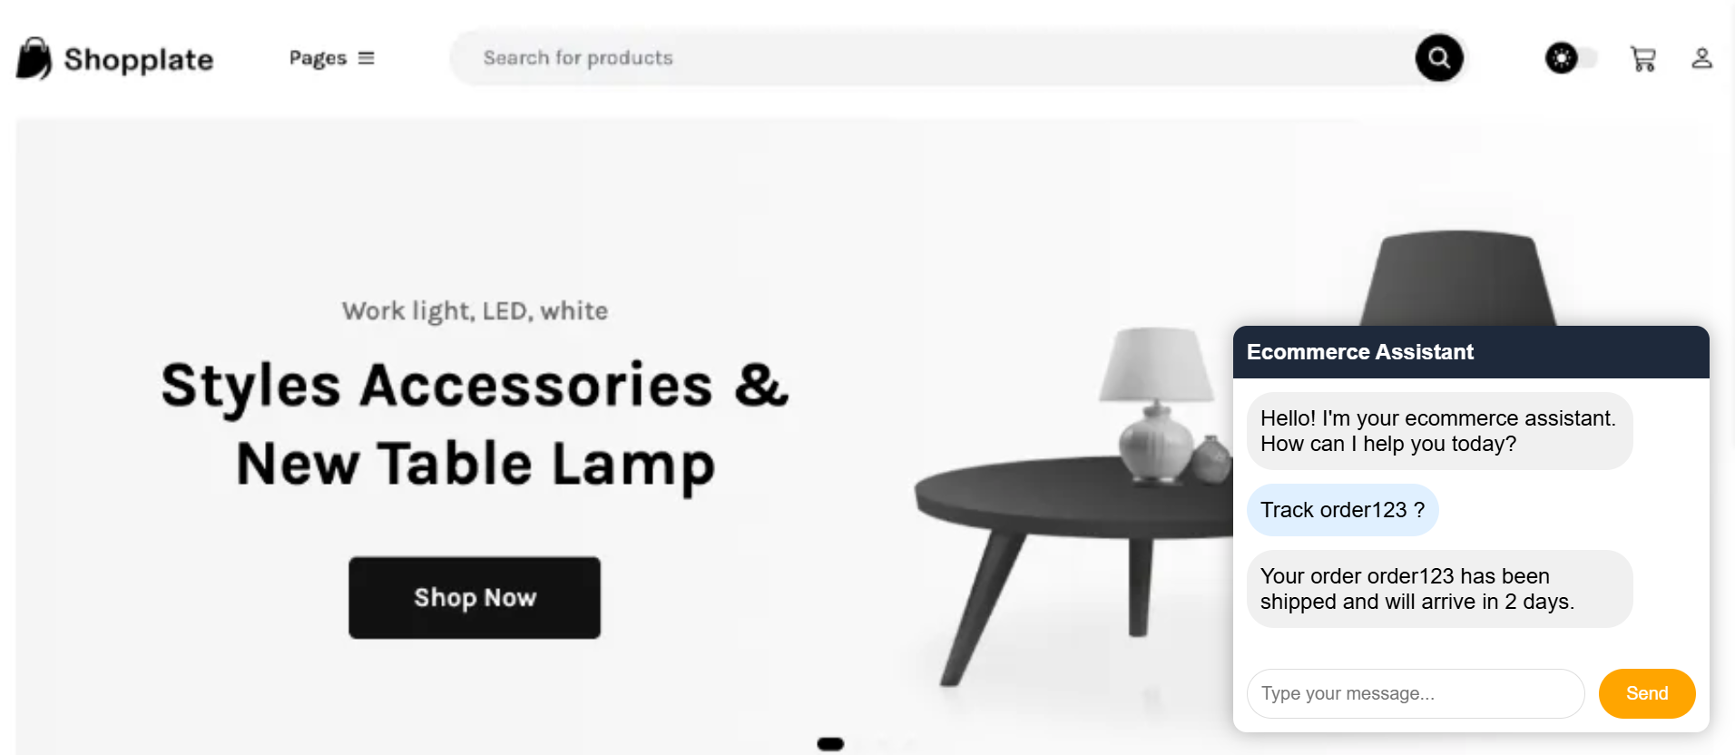
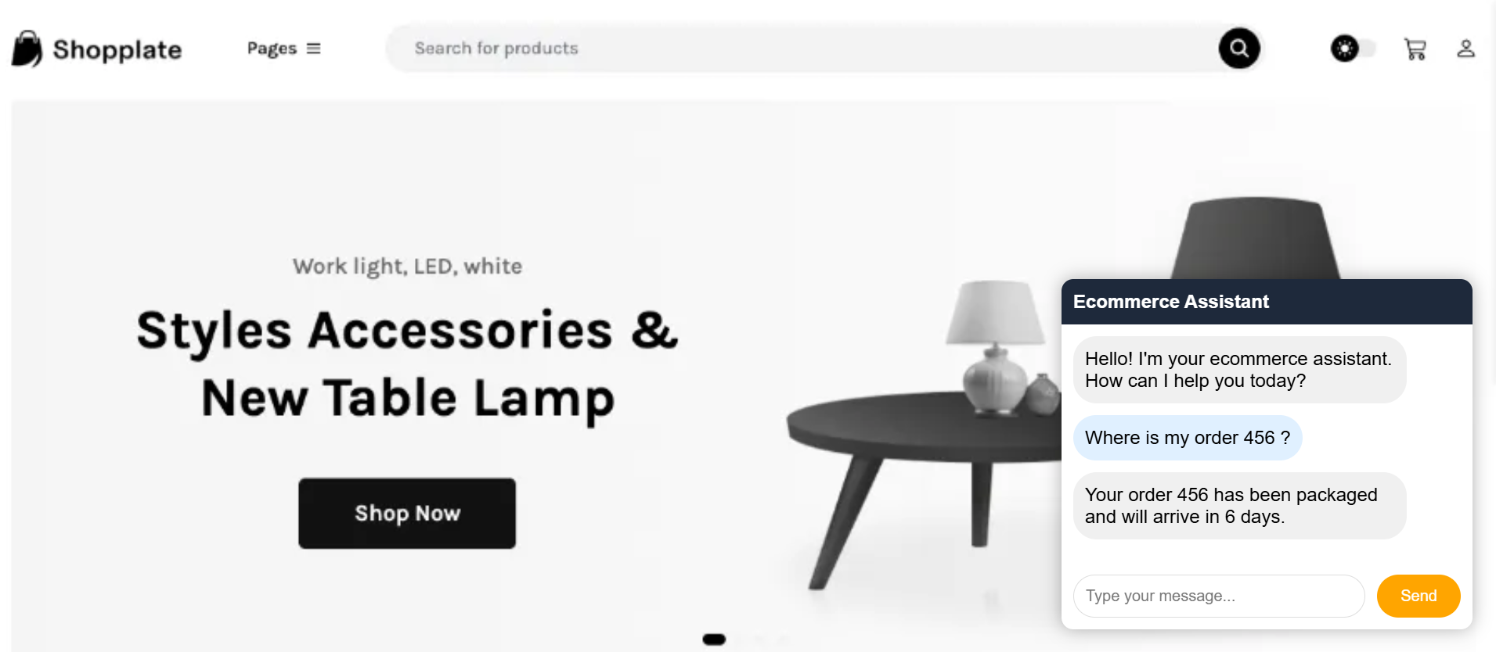
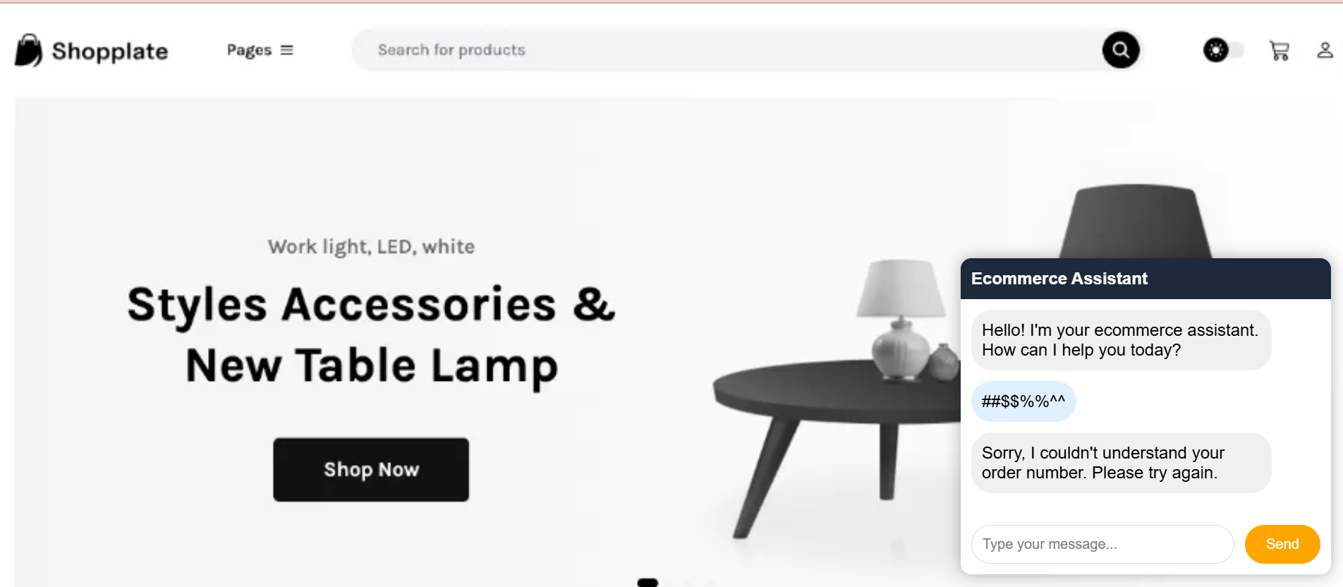
Ecommerce (AI) chatbot: Screenshots
Notes:
Explain the screenshots

Slide 9
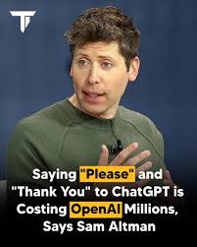
Notes:
If you say "please" and "thank you" to ChatGPT, you're not alone— but it might be costing OpenAI more than you'd expect. CEO Sam Altman said that polite users add to electricity costs, with extra responses leading to “tens of millions of dollars” in power use.
Each friendly reply you get from ChatGPT is powered by large, energy-hungry data centers. These centers use tons of electricity, not just for computing, but also for cooling the machines.
Still, Altman seems to think it’s worth it. He believes natural, human-like conversations are part of what makes AI valuable—even if it means higher energy bills.
So go ahead and be polite. As Altman put it, it’s “tens of millions of dollars well spent.”

