Slide 1
Interactive Python Exercise
Modifying the Python Scripts
SU2 Workshop Feb 3rd 2017
Heather Kline

Slide 2
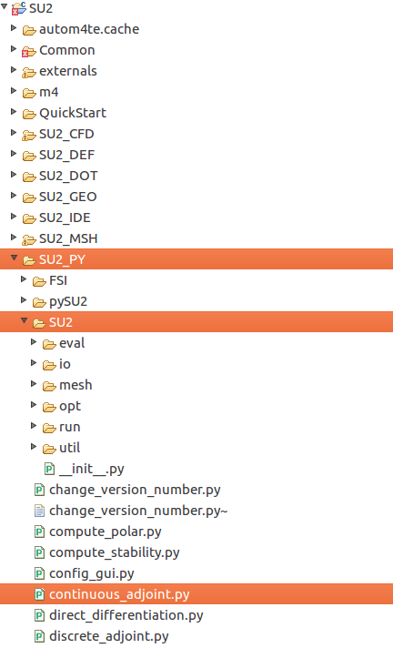
Python Scripts
Source code location: SU2/SU2_PY/
Installed location: SU2/bin/
Dependencies: SU2/bin/SU2/
(source: SU2/SU2_PY/SU2/)
To run a local version:
$ ./python_script.py
To run version installed in the bin/ directory:
$ python_script.py

Slide 3
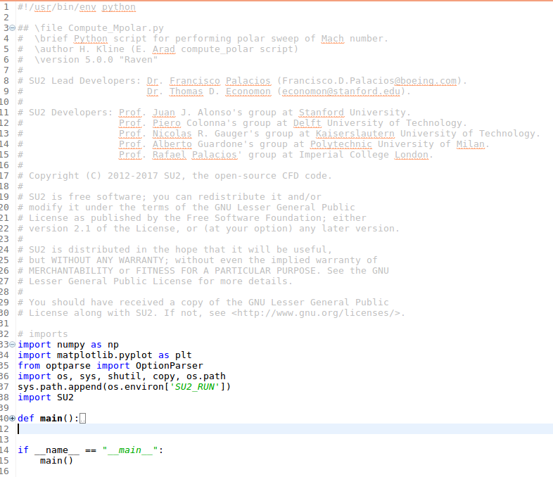
wget su2.stanford.edu/documents/WorkshopFeb2017/compute_Mpolar.py

Slide 4
Starts python environment
wget su2.stanford.edu/documents/WorkshopFeb2017/compute_Mpolar.py
Import python packages and functions defined in other files
‘import SU2’ loads numerous functions defined in SU2_PY/SU2/
Execute ‘main()’ when this script is called from terminal

Slide 5
wget su2.stanford.edu/documents/WorkshopFeb2017/compute_Mpolar.py

Slide 6
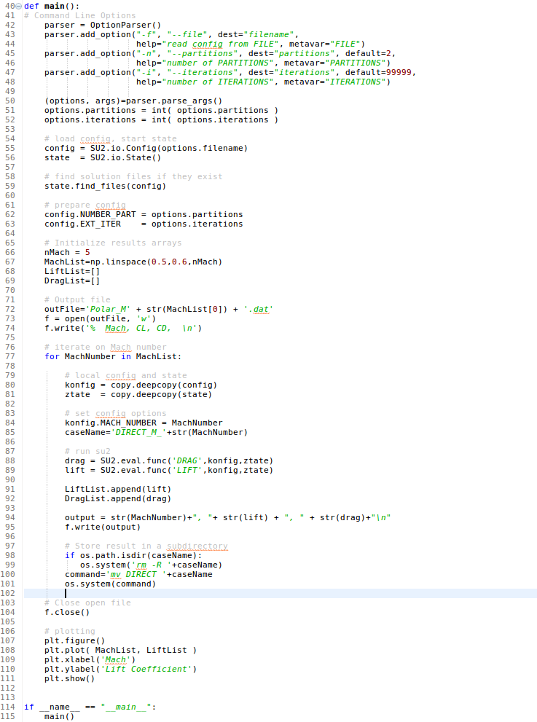
wget su2.stanford.edu/documents/WorkshopFeb2017/compute_Mpolar.py

Slide 7
Define and parse command line options (-f filename, etc)

Slide 8
Initialize python objects that run SU2, modify options.
To modify config options from the python script:

Slide 9
Set up range of Mach numbers, open the output file, and start a for loop.

Slide 10
Copy the config and state objects using copy.deepcopy and set the Mach number

Slide 11
Evaluate lift and drag using SU2.eval.func(‘DRAG’,konfig,ztate)
Note that only the first ‘eval’ runs SU2_CFD, after that the output values are stored in the state object.

Slide 12
Store results, close output file, and plot results

Slide 13
Run, and modify compute_Mpolar.py
What do we need to change to plot an additional output (ie, Cl/Cd, Cmz)?

Slide 14
Mini-project: N minutes to modify a python script
Goal: execute a problem that requires several CFD simulations (10-20).
Use the Quickstart input files
Suggested mini-projects:
  Sweep through angle of attack and output the lift coefficients.
  Estimate the standard deviation of lift with respect to an input distribution of Mach number.
Resources:
Plotting with python: http://matplotlib.org/faq/howto_faq.html
Numpy (arrays, random numbers, etc): https://docs.scipy.org/doc/numpy/reference/index.html
File I/O with Python: https://docs.python.org/2/tutorial/inputoutput.html#reading-and-writing-files
Output function names: SU2_PY/SU2/io/tools.py → get_headerMap()

