Slide 1
Tutorial 2:
Optimization & Python Scripts
SU2 Workshop Feb 3rd 2017
Heather Kline
Modified from presentations by
Francisco Palacios & T.D Economon

Slide 2
Shape Optimization
Tutorial Files & Settings
Start the Simulation
Introduction to Optimization
Optimization Problem Settings & Workflow
Shape_optimization.py and Other Python Scripts

Slide 3
Tutorial Files And Required Settings
Set PYTHONPATH (if not already done):
export SU2_RUN=<…../bin/> (path to SU2_CFD, etc)
export PYTHONPATH=$PYTHONPATH:$SU2_RUN
  Python scripts require the path in order to find all the functions that are defined in subfolders (Advanced: see SU2_PY/SU2/).
  Python scripts can now be called from any folder without moving the scripts.
Get and extract configuration, mesh and solution files:
wget su2.stanford.edu/documents/WorkshopFeb2017/WorkshopTutorial2naca.zip
unzip WorkshopTutorial2naca.zip
3D case: …WorkshopFeb2017/WorkshopTutorial2oneram6.zip
Move to the new directory:
cd WorkshopTutorial2naca/
  Similar to files needed for SU2_CFD analysis.
  Configuration file now has optimization options that are read by the python script.
  3D case: mesh file now has free-form deformation box definition that is needed for some design variables.

Slide 4

Starting the Optimization Problem
$ shape_optimization.py -f inv_NACA0012_adv.cfg -n 2 > opt.out &
Python script located in the SU2-5.0.0/bin/ folder
-f < file name > specifies the configuration file
-n <np> specifies the number of processors
> opt.out redirects the output,
& at the end ‘backgrounds’ the process
To verify the location of the script:
$ which shape_optimization.py
To check the number of available processors:
$ nproc

Slide 5
More about shape_optimization.py
shape_optimization.py -h
open shape_optimization.py in a text editor
Other python scripts are available in SU2/bin/

Slide 6
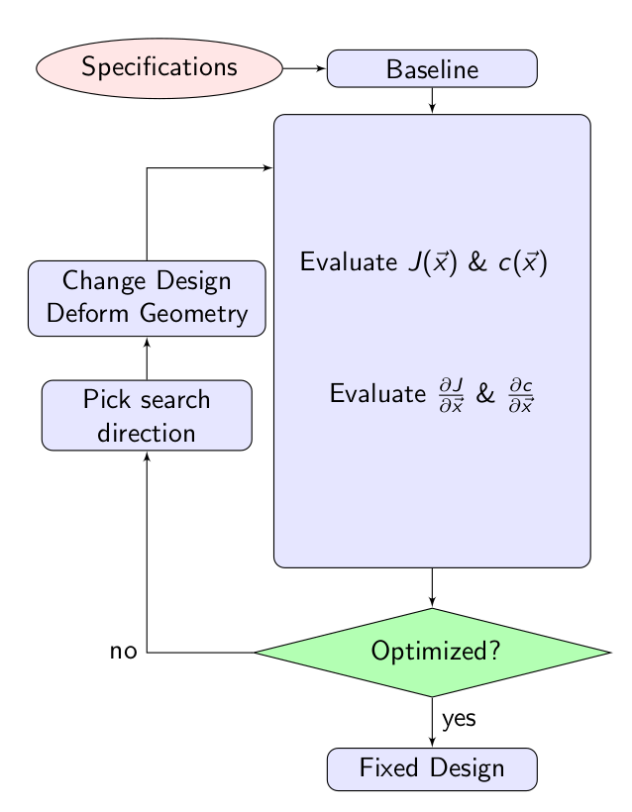
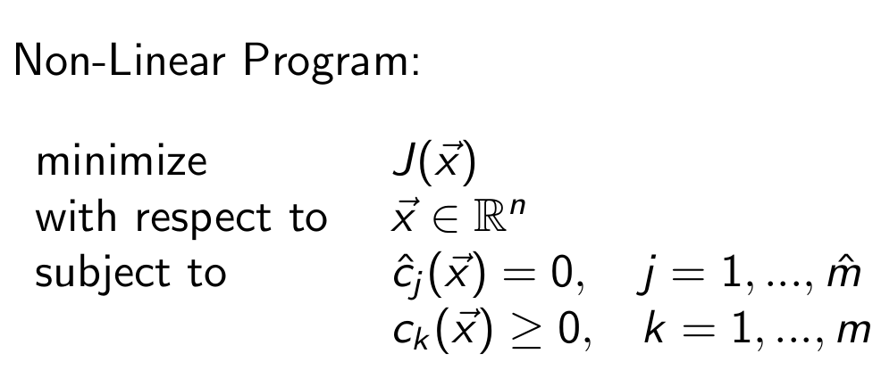
Introduction to Optimization
: bump functions, FFD control points
J : an evaluation of SU2_CFD
c : an evalution of SU2_CFD or SU2_GEO
Optimization Algorithm: SciPy SLSQP
Gradient Techniques: continuous adjoint, finite difference, discrete adjoint.

Slide 7
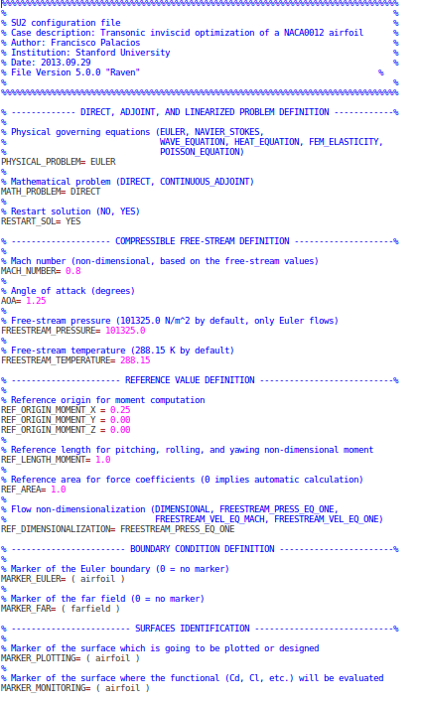
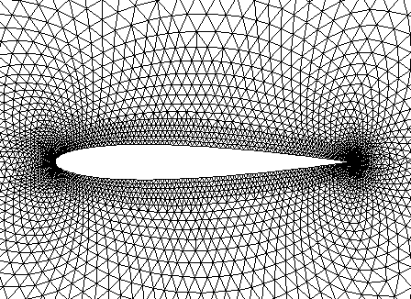
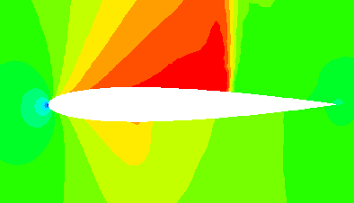
Optimization Problem Settings & Workflow
Define and run the physical problem.
Evaluate geometry (thickness, AoA, etc).
Define design variables.
Create the FFD box (.su2 file).
FFD design variables preprocessing.
Define the optimization problem
Objective function.
Constraints (flow and geometry).
Design variables.
Checks before the optimization (optional).
Compute C_{D}, and C_{L} gradients.
Compute geometric gradients.
Final checks (optional).
Restart files are available.
The grid contains the FFD information.
The stop criteria is reasonable.
The proposed optimization problem makes sense (scaling).
Run the optimization.
Analyze the solution.
Folder structure and history_project file.
Restart capability.
Notes:
6

Slide 8

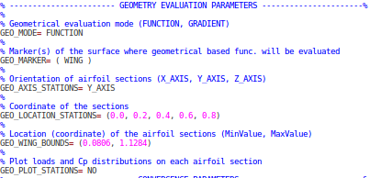
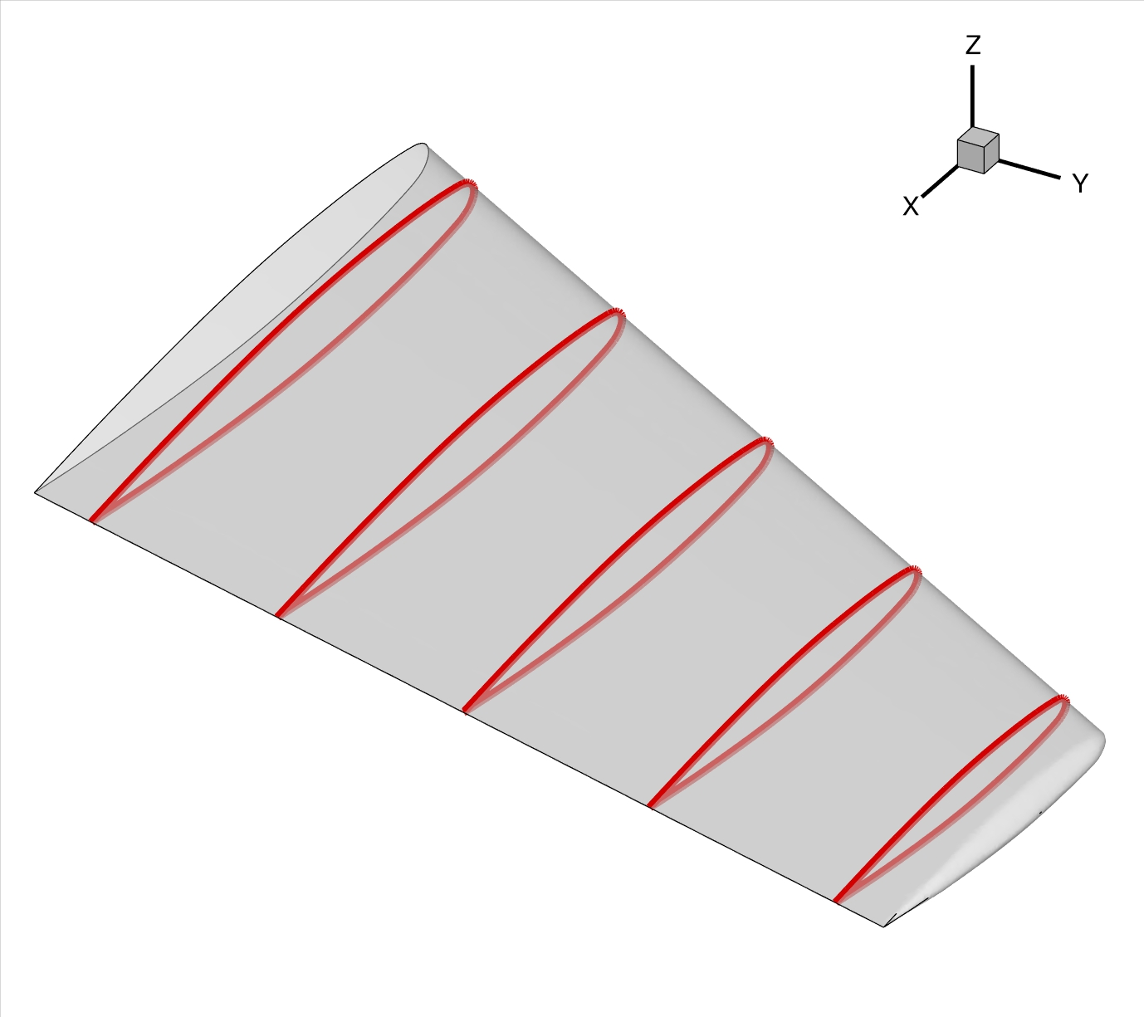
Optimization Problem Settings & Workflow
Define and run the physical problem.
Evaluate geometry (thickness, AoA, etc).
Define design variables.
Create the FFD box (.su2 file).
FFD design variables preprocessing.
Define the optimization problem
Objective function.
Constraints (flow and geometry).
Design variables.
Checks before the optimization (optional).
Compute C_{D}, and C_{L} gradients.
Compute geometric gradients.
Final checks (optional).
Restart files are available.
The grid contains the FFD information.
The stop criteria is reasonable.
The proposed optimization problem makes sense (scaling).
Run the optimization.
Analyze the solution.
Folder structure and history_project file.
Restart capability.
2D:
SU2_GEO inv_naca0012_adv.cfg
3D:
Notes:
6

Slide 9
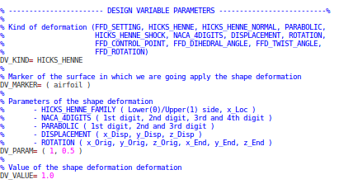
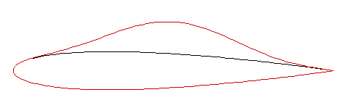
Optimization Problem Settings & Workflow
Define and run the physical problem.
Evaluate geometry (thickness, AoA, etc).
Define design variables.
Create the FFD box (.su2 file).
FFD design variables preprocessing.
Define the optimization problem
Objective function.
Constraints (flow and geometry).
Design variables .
Checks before the optimization (optional).
Compute C_{D}, and C_{L} gradients.
Compute geometric gradients.
Final checks (optional).
Restart files are available.
The grid contains the FFD information.
The stop criteria is reasonable.
The proposed optimization problem makes sense (scaling).
Run the optimization.
Analyze the solution.
Folder structure and history_project file.
Restart capability.
Notes:
6

Slide 10
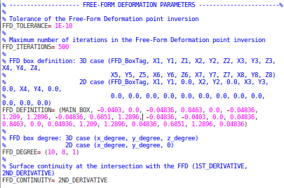
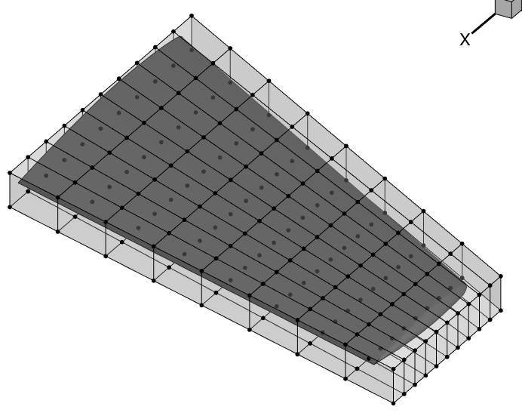
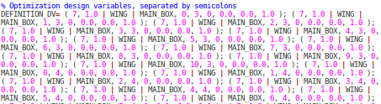
Optimization Problem Settings & Workflow
Define and run the physical problem.
Evaluate geometry (thickness, AoA, etc).
Define design variables.
Create the FFD box (.su2 file).
FFD design variables preprocessing.
Define the optimization problem
Objective function.
Constraints (flow and geometry).
Design variables based on FFD box.
Checks before the optimization (optional).
Compute C_{D}, and C_{L} gradients.
Compute geometric gradients.
Final checks (optional).
Restart files are available.
The grid contains the FFD information.
The stop criteria is reasonable.
The proposed optimization problem makes sense (scaling).
Run the optimization.
Analyze the solution.
Folder structure and history_project file.
Restart capability.
Notes:
6

Slide 11
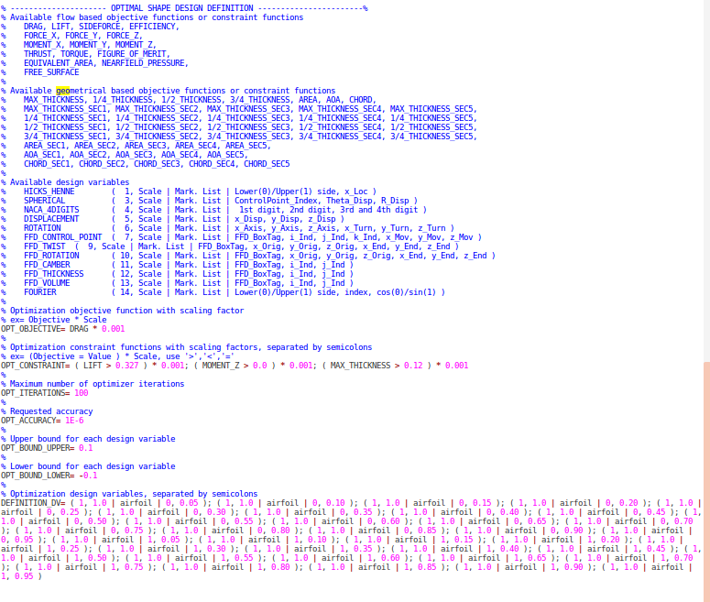
Optimization Problem Settings & Workflow
Define and run the physical problem.
Evaluate geometry (thickness, AoA, etc).
Define design variables.
Create the FFD box (.su2 file).
FFD design variables preprocessing.
Define the optimization problem
Objective function.
Constraints (flow and geometry).
Design variables.
Checks before the optimization (optional).
Compute C_{D}, and C_{L} gradients.
Compute geometric gradients.
Final checks (optional).
Restart files are available.
The grid contains the FFD information.
The stop criteria is reasonable.
The proposed optimization problem makes sense (scaling).
Run the optimization.
Analyze the solution.
Folder structure and history_project file.
Restart capability.
- Do not forget to check the name of the mesh.
- There are scripts to generate the list of design variables.
Notes:
6

Slide 12
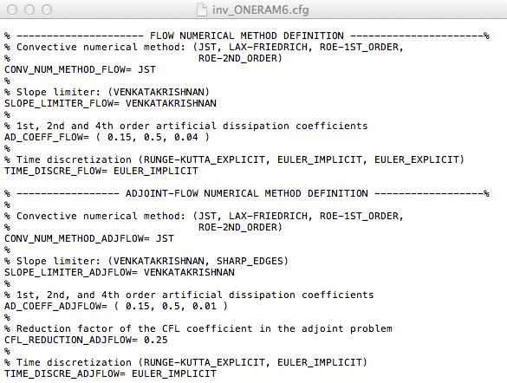
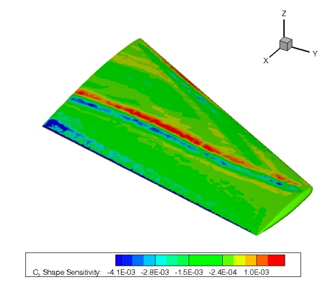
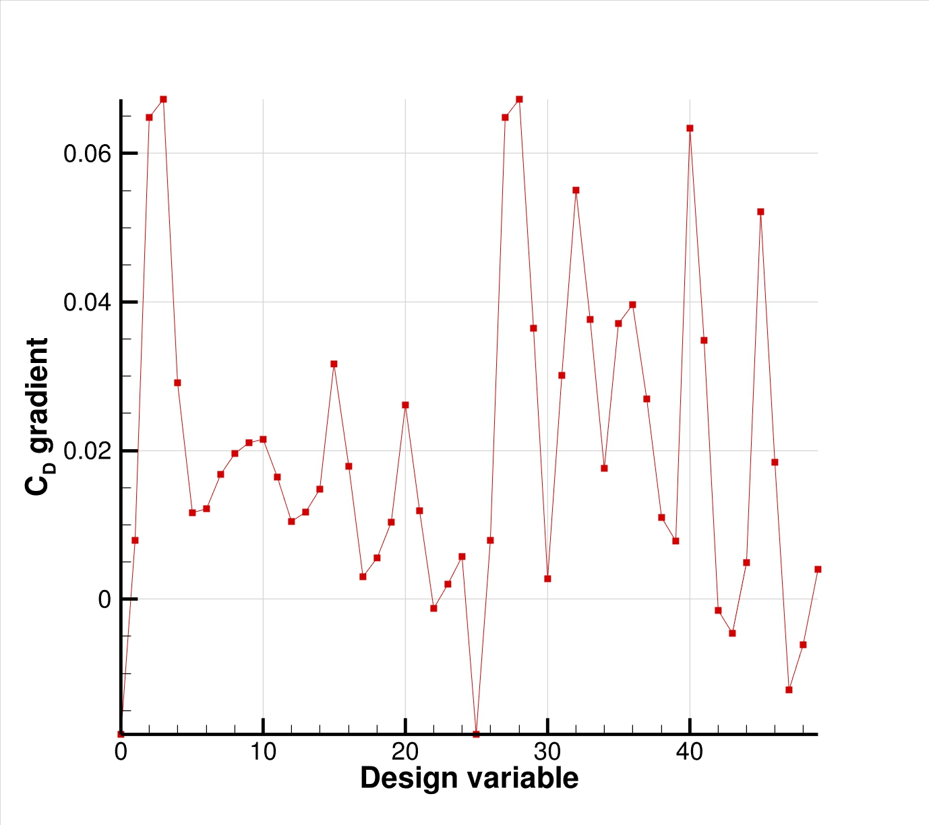
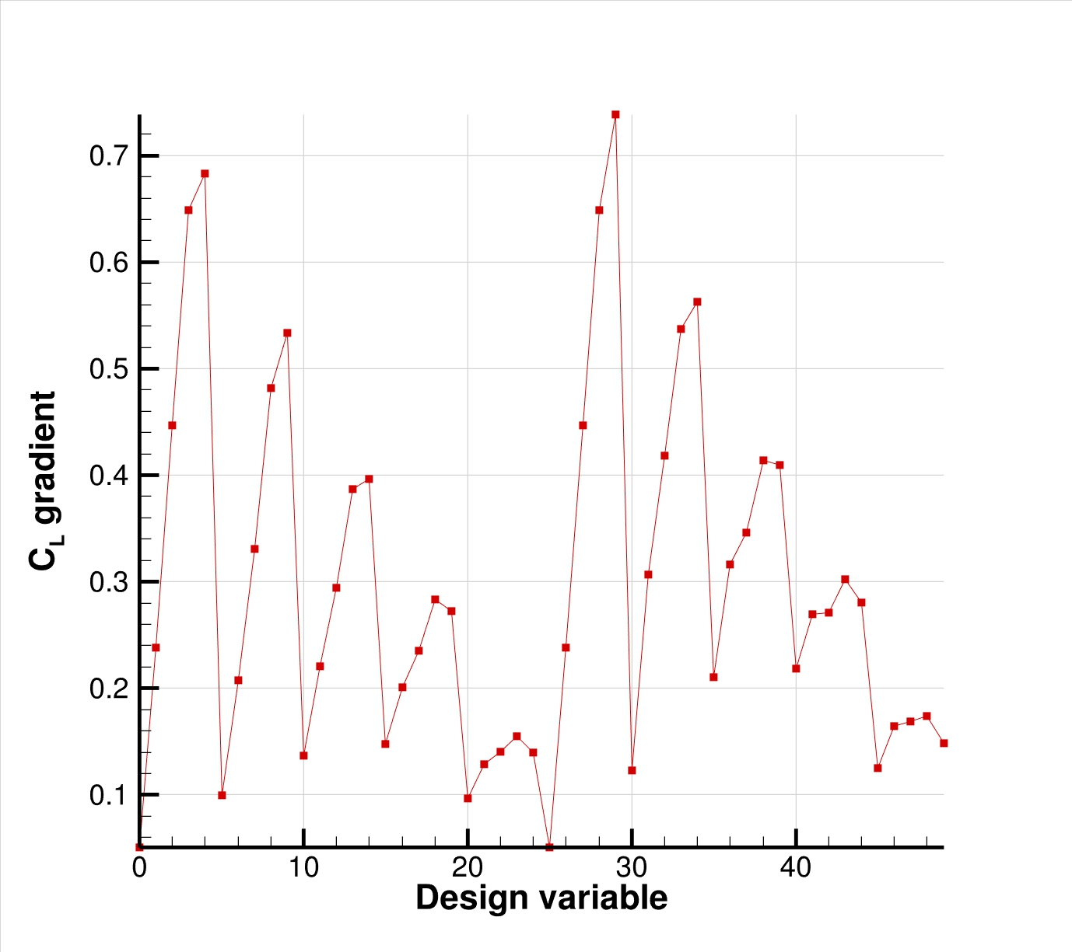
Optimization Problem Settings & Workflow
Define and run the physical problem.
Evaluate geometry (thickness, AoA, etc).
Define design variables.
Create the FFD box (.su2 file).
FFD design variables preprocessing.
Define the optimization problem
Objective function.
Constraints (flow and geometry).
Design variables.
Checks before the optimization (optional).
Compute C_{D}, and C_{L} gradients.
Compute geometric gradients.
Final checks (optional).
Restart files are available.
The grid contains the FFD information.
The stop criteria is reasonable.
The proposed optimization problem makes sense (scaling).
Run the optimization.
Analyze the solution.
Folder structure and history_project file.
Restart capability.
Notes:
6

Slide 13

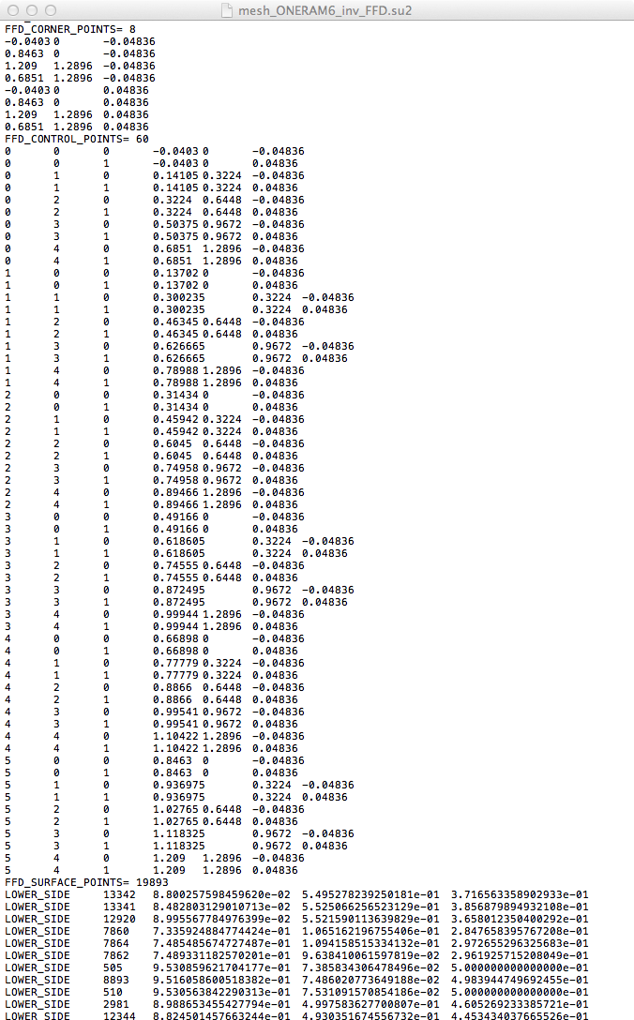
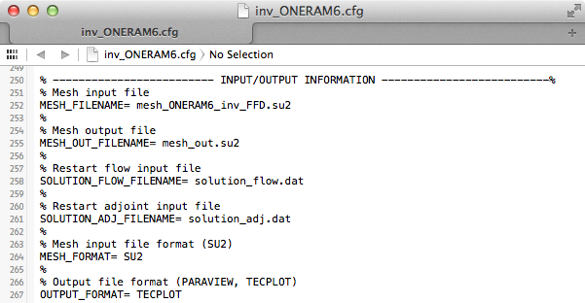
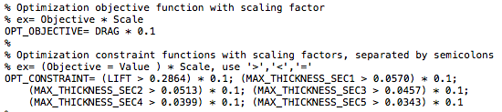
Optimization Problem Settings & Workflow
Define and run the physical problem.
Evaluate geometry (thickness, AoA, etc).
Define design variables.
Create the FFD box (.su2 file).
FFD design variables preprocessing.
Define the optimization problem
Objective function.
Constraints (flow and geometry).
Design variables.
Checks before the optimization (optional).
Compute C_{D}, and C_{L} gradients.
Compute geometric gradients.
Final checks (optional).
Restart files are available.
The grid contains the FFD information.
The stop criteria is reasonable.
The proposed optimization problem makes sense (scaling).
Run the optimization.
Analyze the solution.
Folder structure and history_project file.
Restart capability.
Notes:
6

Slide 14
Optimization Problem Settings & Workflow
Define and run the physical problem.
Evaluate geometry (thickness, AoA, etc).
Define design variables.
Create the FFD box (.su2 file).
FFD design variables preprocessing.
Define the optimization problem
Objective function.
Constraints (flow and geometry).
Design variables.
Checks before the optimization (optional).
Compute C_{D}, and C_{L} gradients.
Compute geometric gradients.
Final checks (optional).
Restart files are available.
The grid contains the FFD information.
The stop criteria is reasonable.
The proposed optimization problem makes sense (scaling).
Run the optimization.
Analyze the solution.
Folder structure and history_project file.
Restart capability.
Notes:
6

Slide 15
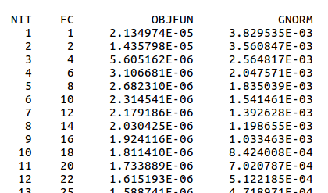
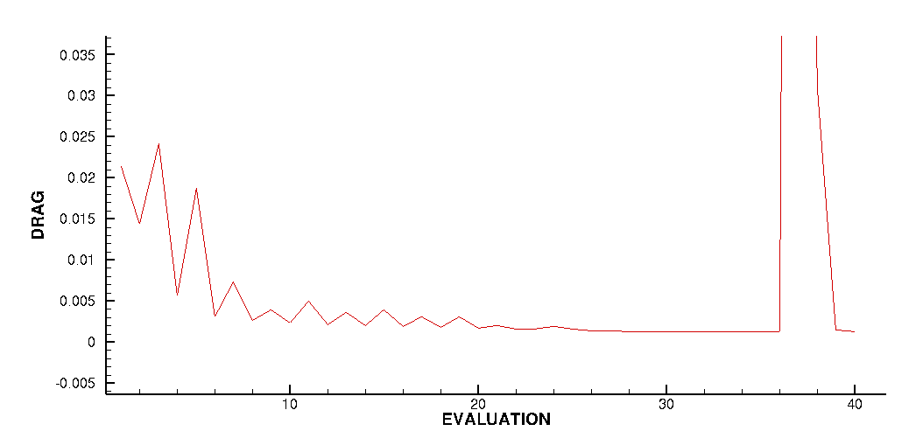
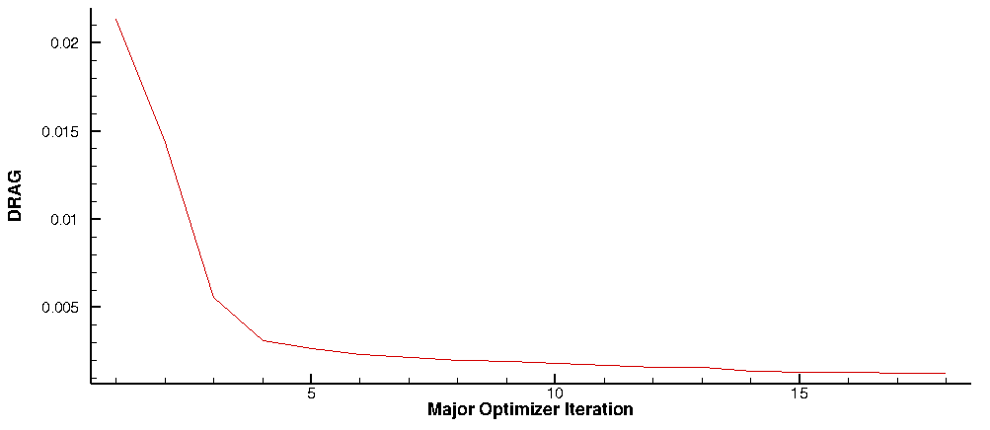
Optimization Problem Settings & Workflow
Define and run the physical problem.
Evaluate geometry (thickness, AoA, etc).
Define design variables.
Create the FFD box (.su2 file).
FFD design variables preprocessing.
Define the optimization problem
Objective function.
Constraints (flow and geometry).
Design variables.
Checks before the optimization (optional).
Compute C_{D}, and C_{L} gradients.
Compute geometric gradients.
Final checks (optional).
Restart files are available.
The grid contains the FFD information.
The stop criteria is reasonable.
The proposed optimization problem makes sense (scaling).
Run the optimization.
Analyze the solution.
Folder structure and history_project file.
Restart capability.
Notes:
6

Slide 16
Explore the Optimization Results
Track log files
  opt.out
  DESIGNS/DSN_001/DIRECT/log_Direct.out
Visualize optimization history
  history_project.dat
Visualize geometry
Stop, restart optimization
$ % (this ‘foregrounds’ the ‘backgrounded’ job)
$ Ctrl-C (this stops the job)
$ shape_optimization.py -f <...>.cfg -n <np> -r project.pkl

Slide 17
Questions?

