Slide 1
Iris example

Slide 2
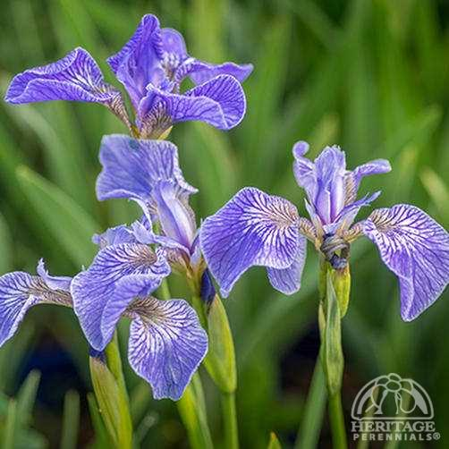
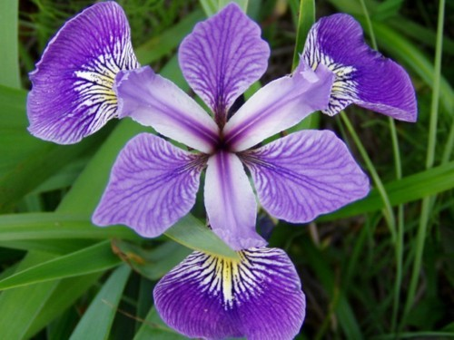
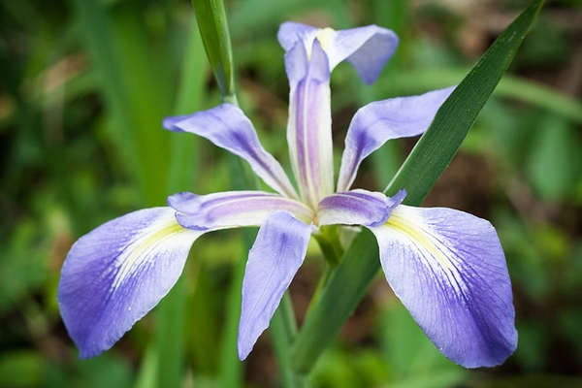
Example
versicolor
To predict the species of an Iris flower (붓꽃)
DV: the species of an Iris flower
It takes three different values
versicolor
virginica
setosa

Slide 3
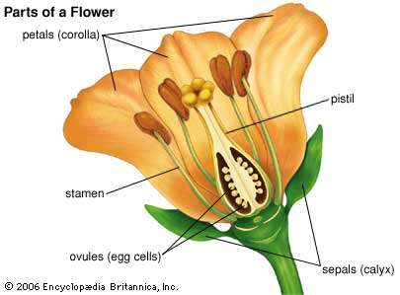
Iris example (cont’d)
Suppose that we want to predict the species of an Iris flower using its characteristics (i.e., IVs)
Sepal (꽃받침):
length and width
Petal (꽃잎)
length and width

