Slide 1
Frequency
Sang Yup Lee

Slide 2
Frequency
Process
1) Obtain text data
2) Text preprocessing
3) 특정 품사의 단어 추출하기
4) Frequency
1) To obtain text data
For this, we try to web-scrape the following article from the New York Times
https://www.nytimes.com/2017/06/12/well/live/having-friends-is-good-for-you.html

Slide 3
Frequency (cont’d)
2) Text preprocessing
Main steps
Get the article content
Preprocessing
Text cleaning (remove symbols/marks)
Case conversion
Tokenization
Parts of Speech (POS) tagging (품사 tagging)
특정 품사 단어 추출 (e.g., 명사)
Lemmatization
Removing stopwords (불용어)
Count words
use the ‘Counter’ module
See ‘English_preprocessing.ipynb’

Slide 4
Frequency – 한글
Process
Obtain news articles
Text preprocessing
Text cleaning (remove symbols/marks)
형태소 분석
특정 품사 단어 추출 (e.g., 명사)
Removing stopwords (불용어)
Count words
use the ‘Counter’ module
See ‘Korean_preprocessing.ipynb’

Slide 5
Exercise
Example article
비트코인 관련 기사
http://news.naver.com/main/read.nhn?mode=LSD&mid=sec&sid1=101&oid=277&aid=0004164498

Slide 6
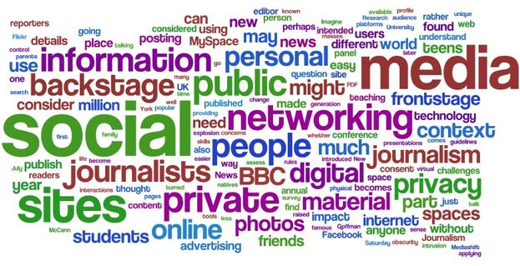
Word cloud

Slide 7
Word cloud
Word cloud
Installation
Method 1
pip install wordcloud or,
conda install -c https://conda.anaconda.org/amueller wordcloud
Method 2
Download the wordcloud module from
http://www.lfd.uci.edu/~gohlke/pythonlibs/#wordcloud
After downloading the file, on a CMD window you need to move to the folder where the file is save at
At the folder, please type the following command on the window
pip install wordcloud-1.2.1-cp36-cp36m-win_amd64.whl
Document
https://github.com/amueller/word_cloud

Slide 8
Word cloud
Examples
English text
“Wordcloud_En.ipynb”
Korean text
“Wordcloud_Kr.ipynb”

Slide 9
Q & A

