Slide 1
Antenna Types
Wire Antennas: Monopoles and Dipoles
Horn Antennas
Reflector Antennas
Array Antennas

Slide 2

Directivity, Gain, and the Isotropic Radiator
An Isotropic Radiator radiates energy equally in all directions. This is a theoretical construct. A star is probably the closest real-world example (and even they are not perfectly isotropic).
Antennas radiate spherical waves, but in the far-field, they can be approximated by plane waves in the θ and Φ directions.

Slide 3
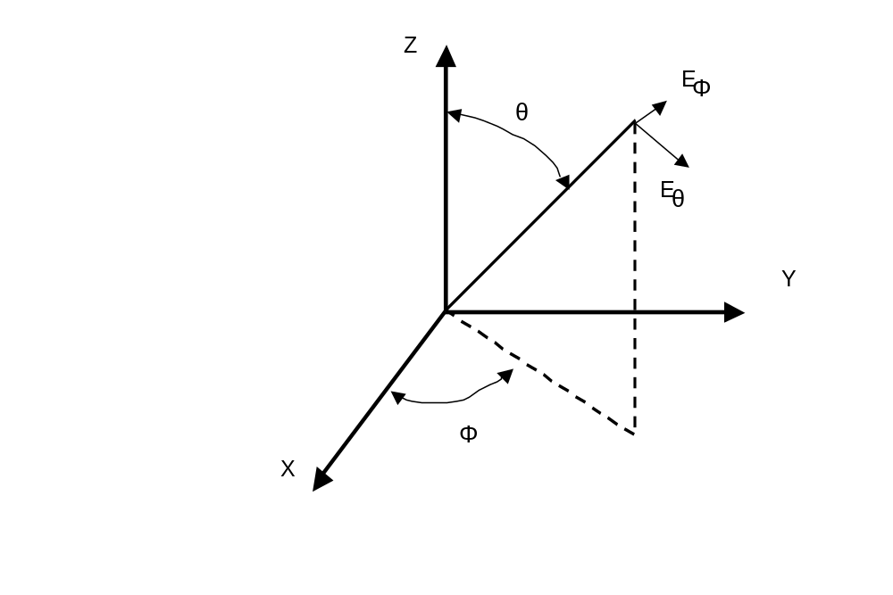
Spherical Coordinates

Slide 4
Antenna Polarization
Antennas can radiate any combination of E_{θ} or E_{Φ} components. The relative magnitude and phase of each determines the antenna polarization.
Linear Polarization
  Vertical and Horizontal
  Field vectors remain oriented as they propagate.
Circular Polarization
  Right Hand and Left Hand Circular, RHC and LHC
  Field vectors rotate in space as wave propagates.
  Thumb of right hand in direction of wave propagation, fingers show rotation of RHP wave (IEEE definition).

Slide 5
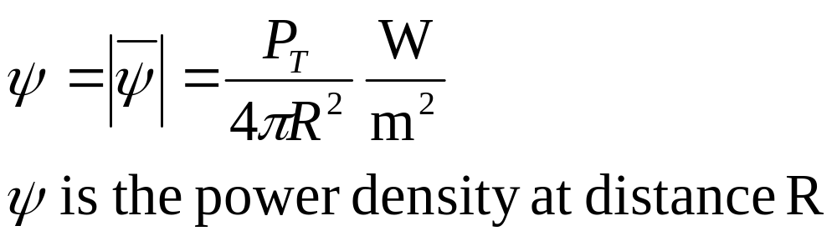
Far-Field Power Density
If P_{t} (Watts) is input to an isotropic antenna with 100% efficiency then this represents the far-field power density.
This is hypothetical since f(θ,Φ) is not 1 everywhere.

Slide 6
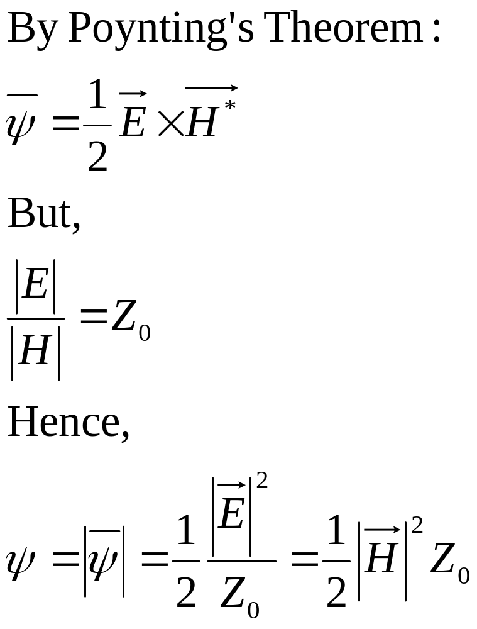
Far-Field Power Density

Slide 7
Gain and Efficiency
Gain or Directivity is commonly expressed in Decibels.
G(dBi) = 10 Log G
dBi is gain referenced to an isotropic antenna (whose gain is 1, or 0 dB).
dBd is gain referenced to a half-wave dipole (2.15 dBi).
η_{A} primarily comes from impedance mismatches and resistive losses within the antenna (usually R losses are very small-current flows in skin depth on conductors at RF). Efficiency for most antennas is approximately 1.

Slide 8
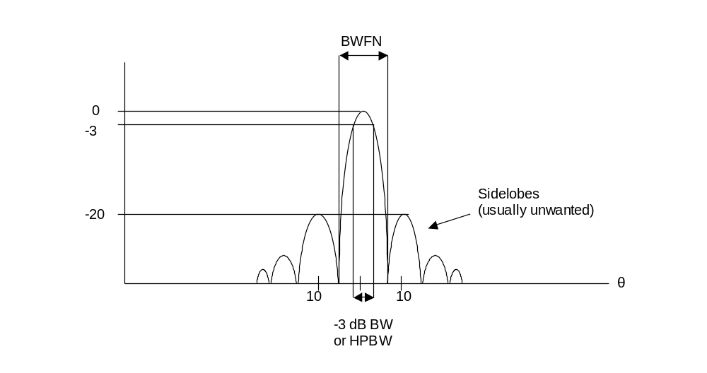
Rectangular Pattern

Slide 9
Radiation Pattern
HPBW - Half-Power Beamwidth (also called 3db or -3dB beamwidth) - the angle between points on either side of the main lobe where the power is half that at the peak.
BWFN - Beamwidth between First Nulls - angle between the first nulls in the pattern on either side of the main lobe.
Sidelobes - additional local maxima of radiation, usually unwanted in highly directional antennas.
Null - area of very low signal between sidelobes)
Main lobe - lobe of maximum radiation, should be aimed toward desired direction for communication.

Slide 10
Reciprocity
The Reciprocity Theorem says that the performance of an antenna as a receiver is identical to its performance as a transmitter, EXCEPT that antennas that transmit must be able to handle higher currents than those that only receive.
This means that the same antenna can be used for receive and transmit if the radiation pattern will meet the requirements of each, if not, use separate antennas

Slide 11
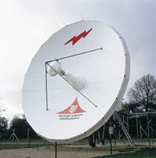
Andrew 9.3 – meter Diameter
E.S. antenna
C-band Operation
  Rx: 3.400 - 4.200 GHz
  Tx: 5.850 - 6.725 GHz
Gain:
  Rx: 50.4 dBi (midband)
  Tx: 53.9 dBi (midband)

