Slide 1

PROJECT: A Web Application For Travellers using Travel-Bhoomi
School of Computing Science and Engineering
PROJECT ID: BT2309
Project Members:
Kajal Choudhary (21SCSE1011613)
Shreya Yadav (21SCSE1011567)
Vishal Gaurav (21SCSE1011554)
Semester: IV
FALL: 2022-23
Guide: Janarthanan S

Slide 2
TABLE OF CONTENTS:
Introduction
Frontend Development Technologies
Backend Development Technologies
How to approach
Web Application Development Process
Roadmap
Basic Structure of Web Application
AI Chatbots

Slide 3

UTTRAKHAND TOURISM:TRAVELBHOOMI
A land of myths and mountains, Devbhoomi Uttarakhand, is one of the most beautiful states of India. Snow-capped Himalayan peaks, serpentine rivers, revered temples, quaint villages, vibrant culture, and World Heritage Sites, Uttarakhand's sheer natural beauty and diversity beckon travellers from across the world.
Be it river rafting in the Ganges, trekking to some of the fascinating peaks, skiing through some of the picturesque slopes, enjoying a cable-car ride, or soaking in the mesmerising views of the Himalayas, Uttarakhand is a dream destination for all. Here are the top destinations to travel to in Uttarakhand
To help boost tourism in our country and help people with self-employment the Uttarakhand Government requires an application through which we can search each and every famous thing.ie., famous places, food, fruit, handicraft, etc.) in each village/city. By having this information, tourists can easily visit the places.
This Photo by Unknown Author is licensed under CC BY-SA

Slide 4

BASIC OF WEB DEVELOPMENT?
Web Development usually refers to developing the website for the Internet (World Wide Web) or for an Intranet (Private network).
Also known as Web Programming.
It is the creation of Dynamic Web Applications.
Examples of Web Applications are Social networking sites like
Facebook or E-commerce sites like Amazon, Flipkart, etc.
There are two broad division of Web Development
Front-end Development (also called Client-side Development)
Back-end Development (also called Server-side Development).

Slide 5

FRONT END DEVELOPMENT
Front end development refers to producing a web application so that a user can see and interact with them directly.
It is also known as Client side development. It focuses on the visual elements of a website that a user will interact with.
A front end developer has one general responsibility: to ensure that website visitors can easily interact with the page. They do this through the combination of design, technology and programming to code a website's appearance, as well as taking care of debugging
The common technologies we can use in front-end development are:
.HTML CSS
JAVASCRIPT

Slide 6

FRONTEND DEVELOPMENT TECHNOLOGIES REQUIRED
HTML was first created by Tim Berners-Lee, starting in 1989. It stands for Hyper Text Markup Language. HTM
Hypertext means that the document contains links that allow the reader to jump to other places in the document.
A Markup Language is a way that computers speak to each other to control how text is processed and presented.
It describes the structure of a web page and consists series of elements.
Its elements tells browser how to display the content.
It's code is written in Notepad or any text editor but save it as .html or html extension.

Slide 7

FRONTEND DEVELOPMENT TECHNOLOGIES REQUIRED (CONT..)
CSS was first proposed by Hakon Wium Lie on October 10, 1994
at CERN (European Organization for Nuclear Research).
Cascading Style Sheets (CSS) describes how HTML elements are to be displayed on screen.
CSS saves a lot of work. It can control the layout of multiple web pages all at once.
It is also responsible for responsive layouts of a website.
It is also written in any text editor but save as .css extension.

Slide 8

FRONTEND DEVELOPMENT TECHNOLOGIES REQUIRED (CONT..)
JavaScript was invented by Brendan Eich in 1995. JavaScript is the Programming Language for the Web
JavaScript can update and change both HTML and CSS.
JavaScript is responsible for the Functioning of the website.
It is a scripting language that enables us to create dynamically updating content, control multimedia, animate images, and pretty much everything else.
It is also written in any text editor but add the .jess extension.

Slide 9

BACK END DEVELOPMENT
Backend development controls what goes on behind the scenes of the web applications
It is also known as server side development.
Backend usually consists of three parts:
• A server
• An Application • A Database
Users can't see how the backend works but this code is what communicates the database information to the browser.
Common Backend development technologies are:
SQL
PHP

Slide 10
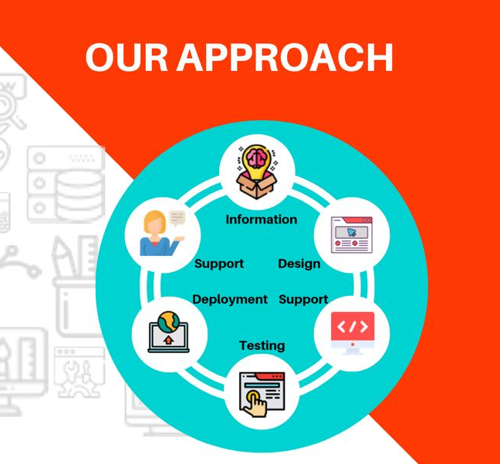
HOW TO APPROACH..
The fact that there are millions of Internet users globally and that number is expected to grow over time is a hint that websites will continue to be an important medium for the dissemination of information. The users using web application varies from place to place and region to region. In some areas where the strength of network connectivity is low there, we have to design such a web application that could get processed with the availability of low internet connectivity
One approach to developing service-oriented Web applications is to convert high-level business models to a composition language and then use web services to implement business processes.
Through that web application, those local places and also local shopkeepers will get benefit as more and more tourist visit those places which eventually led to an economic boost in Uttarakhand.

Slide 11
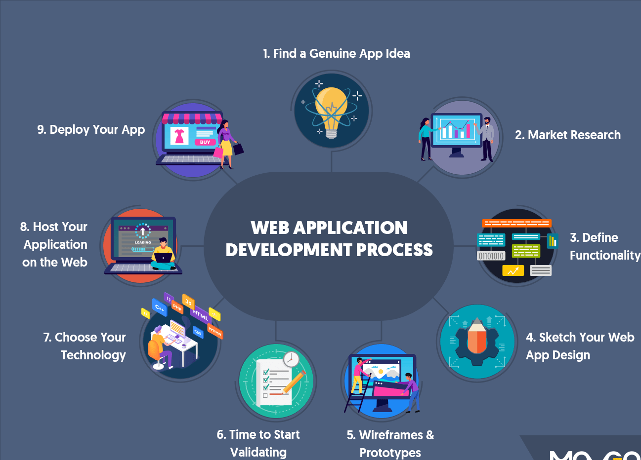
WEB APPLICATION DEVELOPMENT PROCESS
The concept of service-oriented computing reinforces Web Services technology. Web services are standards for Assimilating Web-based applications by connecting and sharing business processes across networks where applications from various vendors, languages, and platforms communicate with one another and with clients. Web applications are applications that are accessed via a Web browser over a network and are written in browser-supported languages (e.g., HTML, JavaScript).

Slide 12
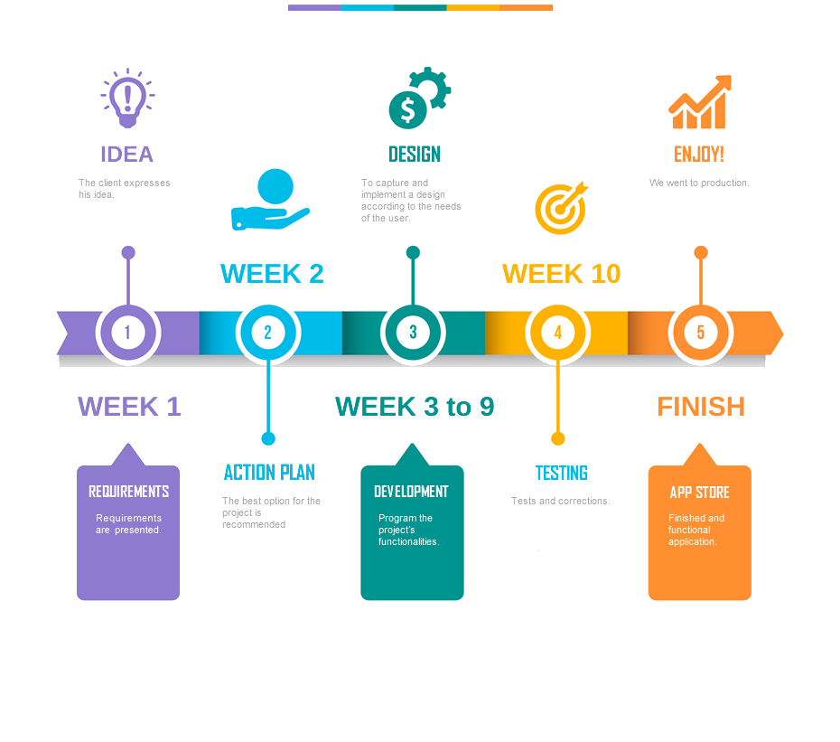
ROADMAP

Slide 13
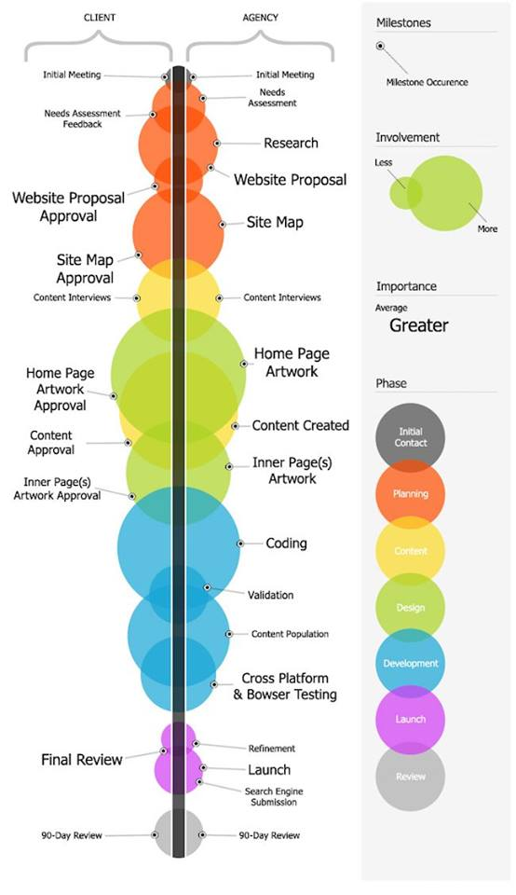
BASIC STRUCTURE FOR THE WEB APPLICATION

Slide 14
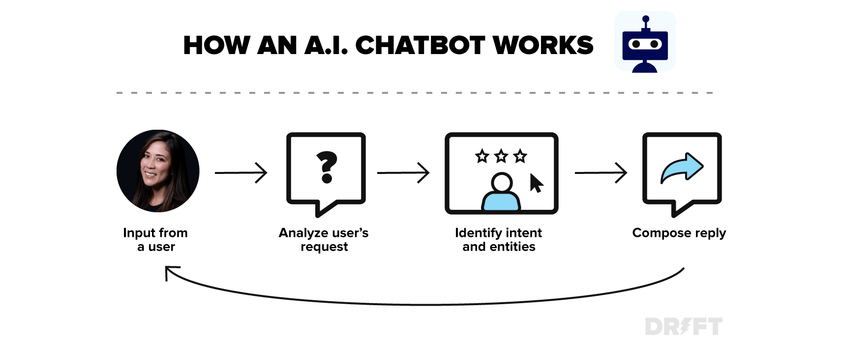
AI CHATBOTS
An AI chatbot is fed input data which it interprets and translates into a relevant output. So, if a site visitor asks a question, the AI chatbot will analyse their intent, as well as other factors like tone and sentiment, and then attempt to deliver the best possible answer.

Slide 15
THANK YOU

