Slide 1

Basic Details of the Team and Problem Statement
Ministry/Organization Name/Student Innovation: Government of Jharkhand
PS Code:SIH1369
Problem Statement Title: Online integrated platform for projects taken up by the students of various universities/colleges
Team Name: Team Vaidik
Team Leader Name: Subhash Kumar Choudhary (21scse1011526)
Institute Code (AISHE):
Institute Name: Galgotias University
Theme Name: Smart Education

Slide 2
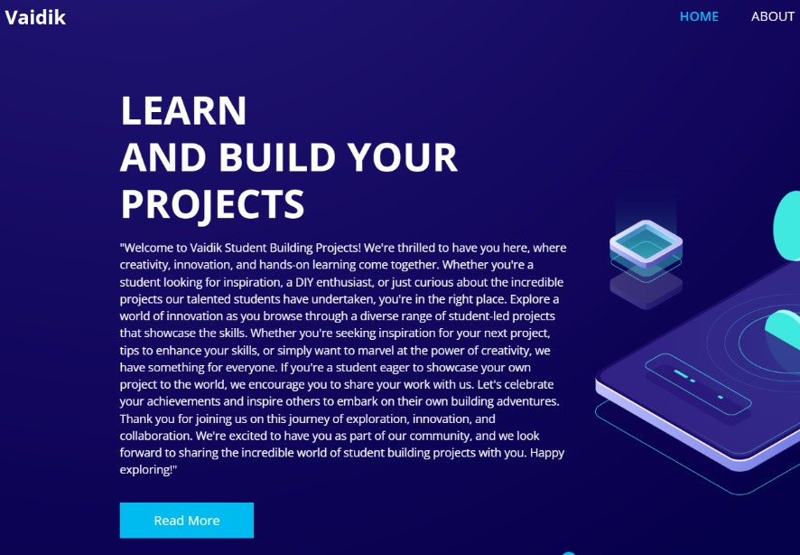
Idea/Approach Details
Add process flow chart or simulated image of prototype or any relevant image related to your idea
Describe your idea/Solution/Prototype here:
Vaidik is a cutting-edge online platform designed to connect and showcase the innovative projects undertaken by students from diverse universities and colleges.
This dynamic space fosters collaboration, knowledge sharing, and inspiration across academic boundaries.
From groundbreaking research to creative tech solutions, Vaidik is where the future of academia meets real-world impact.
Join us in celebrating the brilliance of student-driven innovation!
Describe your Technology stack here:
Serving as the cornerstone of web content structuring, HTML provides the fundamental framework and layout for our platform.
CSS : This pivotal technology governs the aesthetic presentation, allowing for precise customization of design elements, including colors, typography, and layout.
JavaScript: Employed as a versatile scripting language, JavaScript imbues our website with interactivity and dynamic functionality.
SQL: Integral to database management, SQL facilitates efficient data manipulation within our website's database.

Slide 3
Idea/Approach Details
Describe your Use Cases here
Describe your Dependencies / Show stopper here
Our platform encompasses projects ranging from school-level to college-level endeavors.
Students have the autonomy to select projects in accordance with their precise specifications.
Faculty members can seamlessly provide citations and impart their expertise to their students via our website.
Our platform will function as a guiding mentor for individuals in search of direction.
Moreover, our website will classify concepts based on proficiency tiers, spanning fundamental, intermediate, and advanced levels.
Our website may experience challenges in efficiently handling high traffic volumes, especially during peak usage periods.
We are dependent on server performance, which may lead to occasional downtime, impacting user accessibility. .
Our platform relies on contributions from various sources, occasional delays or discrepancies in content availability may arise.
Users should be aware of the potential risk of data loss, highlighting the imperative of maintaining personal backups to secure their information.
.

Slide 4
Team Member Details
Team Leader Name: Subhash Kumar Choudhary (21scse1011526)
Branch (Btech/Mtech/PhD etc): Btech Stream (ECE, CSE etc): CSE Year (I,II,III,IV): III
Team Member 1 Name: Subhash Kumar Choudhary (21scse1011526)
Branch (Btech/Mtech/PhD etc): Btech Stream (ECE, CSE etc): CSE Year (I,II,III,IV): III
Team Member 2 Name: Vikas Singh(21scse1011026)
Branch (Btech/Mtech/PhD etc): Btech Stream (ECE, CSE etc): CSE Year (I,II,III,IV): III
Team Member 3 Name: Abhishek Kumar(21scse1011029)
Branch (Btech/Mtech/PhD etc): Btech Stream (ECE, CSE etc): CSE Year (I,II,III,IV): III
Team Member 4 Name: Ankita Surbhi (21SCSE1010941)
Branch (Btech/Mtech/PhD etc): Btech Stream (ECE, CSE etc): CSE Year (I,II,III,IV): III
Team Member 5 Name: Abhinav Kumar Choudhary(21SCSE1011615)
Branch (Btech/Mtech/PhD etc): Btech Stream (ECE, CSE etc): CSE Year (I,II,III,IV):III
Team Member 6 Name: Ritik singh(21scse1011451)
Branch (Btech/Mtech/PhD etc): Btech Stream (ECE, CSE etc): CSE Year (I,II,III,IV): III
Team Mentor 1 Name: Mr Rakesh Bharati
Category (Academic/Industry): Expertise (AI/ML/Blockchain etc): Domain Experience (in years):

