Slide 1
ENTERPRISE AI & SYSTEM ARCHITECTURE
Local SOP RAG Chatbot &
LEINA Intelligent Assistant
A 100% Offline, Privacy-Preserving Retrieval-Augmented Generation Architecture for Enterprise Standard Operating Procedures with Multimodal Vision, Hierarchical Chunking & Hybrid Search
100% Air-Gapped & Offline
Dual-Path Hybrid Search
Multimodal Vision AI
Zero Cloud Data Egress
Dense + BM25 + RRF Fusion
Qwen2.5-VL / LLaMA 3.1 8B
All embeddings and LLM generation execute inside local infrastructure via Ollama. 100% compliant with GDPR, HIPAA, and corporate security mandates.
Combines ChromaDB 768-D semantic vector search with BM25 keyword matching and Reciprocal Rank Fusion for 99%+ procedural recall.
Extracts and automatically captions embedded diagrams, flowcharts, and organograms so visual procedures become searchable.
Tech Stack: React 19 • FastAPI • ChromaDB (HNSW) • Ollama (Qwen2.5-VL / LLaMA 3.1 8B) • SQLite/MySQL
Notes:
Welcome everyone. Today I am presenting our project: Local SOP RAG Chatbot & LEINA Enterprise Assistant. In large organizations, Standard Operating Procedures (SOPs), HR policies, and compliance manuals span thousands of pages. Finding the exact right rule is time-consuming, and sending proprietary company documents to public cloud AI APIs poses severe data privacy and compliance risks. Our system solves this with a 100% offline, privacy-first, multimodal Retrieval-Augmented Generation architecture powered by local LLMs and vector databases.

Slide 2
PROBLEM STATEMENT & MOTIVATION
The Enterprise Challenge: Why Cloud LLMs Fail For Corporate SOPs
Critical enterprise blockers in deploying standard AI and keyword search on proprietary standard operating procedures
CRITICAL TRADITIONAL PAIN POINTS
OUR PRIVACY-FIRST LOCAL RAG SOLUTION
✖ Data Privacy & IP Leakage
✔ 100% Local Inference (Ollama)
Sending internal HR policies, blueprints, or payroll rules to public cloud APIs violates GDPR, HIPAA, and enterprise compliance.
All embeddings and LLM generation stay inside the enterprise firewall. Zero internet access required.
✖ Hallucinations & Zero Auditability
✔ Strict Extractor Persona & Citations
Generic LLMs generate plausible but fabricated procedural rules without verifiable section citations, creating legal liabilities.
Answers strictly quote policy text and terminate with exact source filenames and section headers for 100% auditability.
✖ Massive Document Search Friction
✔ Hybrid Search (Dense + BM25 + RRF)
Employees spend 30-45 mins per incident manually scrolling through 200+ page PDF manuals to locate a single rule.
Combines ChromaDB vector retrieval with BM25 exact keyword matching to catch both semantic intent and exact form codes.
✖ Keyword Search Blindspots
✔ Automated Multimodal Vision AI
Exact keyword match fails on synonym queries (e.g. searching "time off" completely misses "earned casual leave").
Extracts and captions embedded images, diagrams, and flowcharts using local Vision-Language Models.
LEINA • Local SOP RAG Architecture | Larsen & Toubro Enterprise AI
CONFIDENTIAL & PROPRIETARY
Notes:
This slide highlights the enterprise problem. When companies try to adopt AI, their biggest blockers are data leakage and hallucinations. If an employee asks about maternity leave or security clearance procedures, hallucinating a wrong answer can cause legal or financial liability. Our solution addresses this at the root: we run everything locally, use a strict extractor prompt that forbids hallucination, and provide direct section-level citations.

Slide 3
SYSTEM DESIGN & ARCHITECTURE
3-Tier Decoupled Architecture: Presentation, Orchestration & Storage
Modular, air-gapped system design engineered for local execution, high throughput, and zero-crash fault tolerance
TIER 1: PRESENTATION LAYER
TIER 2: API GATEWAY & ORCHESTRATION
TIER 3: STORAGE & LOCAL AI INFERENCE
React 19 & Tailwind CSS
Express & FastAPI Microservice
ChromaDB, Relational DB & Ollama
• Interactive Chat Simulator with streaming text & citations
• Express Gateway: Session logs, auth & fallback simulator
• ChromaDB: Vector storage with HNSW cosine graph index
• SOP Document Manager with live drag-and-drop ingestion
• FastAPI Service: Document parsing, chunking & embeddings
• SQLite / MySQL: Relational metadata, chat history & audit logs
• Real-time Architecture & Tokenizer visualizer
• Query Expansion: Automated domain abbreviation resolver
• nomic-embed-text: 768-dimensional local vector embeddings
• Departmental Agent routing & 1-click prompt cards
• Hybrid Search Fusion: BM25 + ChromaDB + RRF Ranking
• qwen2.5vl:7b / LLaMA 3.1: Generative vision-language LLM
Port :3000 (Vite / Node)
Port :3000 (Express) | Port :8000 (FastAPI)
Port :11434 (Ollama Local Inference)
LEINA • Local SOP RAG Architecture | Larsen & Toubro Enterprise AI
CONFIDENTIAL & PROPRIETARY
Notes:
Here is our High-Level System Design. The system is split cleanly into three layers: First, the Presentation layer built with React 19 and Tailwind CSS offering a full chat simulator, document ingestion manager, and architecture visualizer. Second, the API & Orchestration layer featuring an Express API Gateway coupled with a Python FastAPI microservice that handles PDF parsing, semantic chunking, and search fusion. Third, the Storage and Local Inference layer featuring ChromaDB vector database, SQLite/MySQL metadata storage, and Ollama serving both nomic-embed-text for embeddings and Qwen2.5-VL for vision-enabled LLM generation.

Slide 4
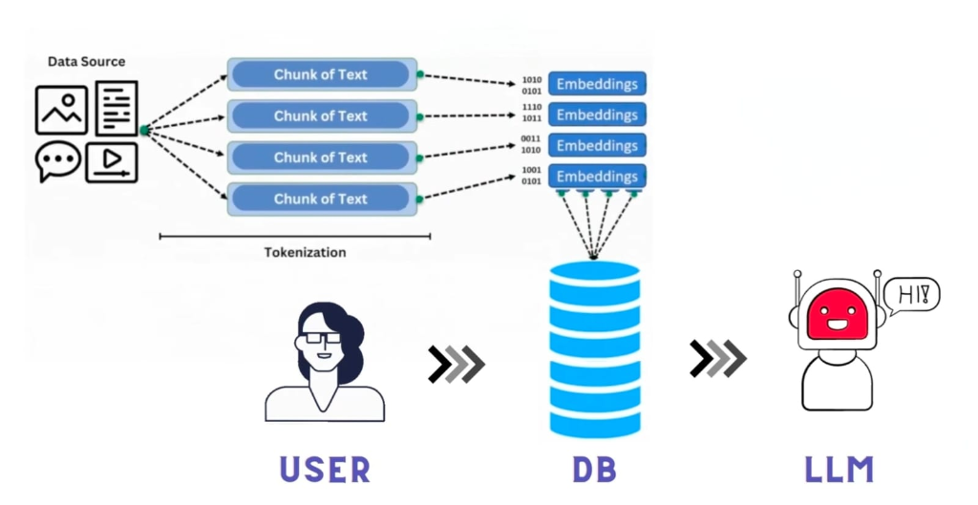
RAG PIPELINE WORKFLOW
Core RAG Concept: Multimodal Ingestion, Vectorization & Grounding
End-to-end data transformation pipeline from unstructured source documents to grounded LLM answers
HOW INFORMATION FLOWS THROUGH THE PIPELINE
1
Multimodal Data Sources
PDF, DOCX, TXT manuals, and scanned procedure flowcharts are ingested.
2
Tokenization & Smart Chunks
Documents are parsed into semantic chunks preserving policy section headers.
3
768-D Vector Embeddings
nomic-embed-text generates dense vector representations for each chunk.
4
ChromaDB HNSW Graph Index
Embeddings stored in cosine similarity space for sub-20ms neighbor retrieval.
5
Grounded Context Injection
Top matching chunks injected into strict system prompt for local LLM synthesis.
LEINA • Local SOP RAG Architecture | Larsen & Toubro Enterprise AI
CONFIDENTIAL & PROPRIETARY
Notes:
This slide visualizes the foundational RAG pipeline. On the left diagram, we see unstructured data sources (documents, chats, media) undergoing tokenization and chunking, converted into binary/float embeddings, stored in a Vector DB, and retrieved when the user initiates a query to ground the LLM response.

Slide 5
INGESTION ENGINEERING
Data Ingestion Pipeline: Hierarchical Chunking & Vision AI
How raw SOP documents are transformed into clean, indexed vector representations with heading preservation
STAGE 01: PARSING
STAGE 02: CHUNKING
STAGE 03: VISION AI
STAGE 04: INDEXING
Multi-Format Parser
Two-Stage Chunking
Diagram Captioning
Batch Vector Store
• .pdf via pypdf (page-aware layout)
• Stage A: Heading regex split (SECTION, SOP-xxx, ##)
• Images sent to local Qwen2.5-VL
• Model: nomic-embed-text (768-D)
• .docx via python-docx traversal
• Stage B: Semantic window split if chunk > 1500 chars
• Generates dense technical caption
• Batch size: 25 chunks per request
• .txt / .md UTF-8 raw normalizers
• Cosine Sim < 0.55 triggers split
• Indexed as searchable text: "[SOP IMAGE #n] <caption>"
• Collection: sop_documents in ChromaDB
• Extracts embedded flowchart images
• 180-char sliding window overlap
• Enables visual flowchart search
• Auto-deduplication on re-upload
Latency: < 2.0s
Latency: < 2.0s
Latency: < 2.0s
Latency: < 2.0s
LEINA • Local SOP RAG Architecture | Larsen & Toubro Enterprise AI
CONFIDENTIAL & PROPRIETARY
Notes:
Let us dive deeper into the Ingestion Pipeline. Naive chunking that simply splits text every 500 characters breaks apart important policy clauses and heading contexts. We developed a two-stage hierarchical chunker: First, it splits text by logical headings (like SECTION 1: LEAVE ENTITLEMENT). If a section exceeds 1500 characters, it calculates semantic similarity across sliding windows of 3 sentences, splitting only where the topic naturally shifts. In addition, any embedded architecture diagrams or flowcharts are sent to our local vision model to create textual captions, so even non-text diagrams become searchable.

Slide 6
RETRIEVAL PIPELINE
Advanced Hybrid Search: Dense Vector + BM25 Lexical + RRF Fusion
Achieving high precision on exact codes, form numbers, and conceptual queries
DUAL-PATH RETRIEVAL ARCHITECTURE
QUERY EXECUTION FLOW & CONFIDENCE GATE
▶ Path A: Dense Vector Search (ChromaDB HNSW)
1. Query Expansion:
Embeds the expanded query with nomic-embed-text and queries HNSW space for Top-15 semantic matches (handles synonyms, paraphrasing, intent).
"PTO" → "Paid Time Off Leave" via domain dictionary
2. Parallel Retrieval:
ChromaDB Vector (top 15) ⇄ BM25 Keyword (top 15)
▶ Path B: Sparse Lexical Search (BM25 Engine)
Performs BM25 frequency search across all indexed chunks for Top-15 lexical matches (essential for exact form numbers like "Form 402", extensions "ext. 4357").
3. RRF Rank Fusion:
Fuses candidate lists into unified Top-10
▶ Reciprocal Rank Fusion (RRF Formula, k = 60)
4. Cross-Encoder Rerank:
Score(d) = Σ [ 1 / (60 + rank_vector(d)) + 1 / (60 + rank_bm25(d)) ]
Merges both ranked candidate lists into a robust Top-10 without score mismatch.
Cross-attention scoring extracts Top-3 definitive chunks
5. 0.45 Confidence Gate:
If Score < 0.45, returns instant fallback bypass in < 300ms
▶ Cross-Encoder Reranker (ms-marco-MiniLM)
Deep cross-attention scoring isolates the Top-3 highest relevance chunks for LLM context injection.
6. Grounded LLM Generation:
Top-3 chunks formatted into strict extractor prompt → Ollama
LEINA • Local SOP RAG Architecture | Larsen & Toubro Enterprise AI
CONFIDENTIAL & PROPRIETARY
Notes:
This slide breaks down our Hybrid Search engine. In enterprise SOPs, pure vector search struggles when an employee asks for a specific form like Form 402 or an internal phone extension. Vector embeddings capture general semantic meaning but blur out specific numbers. Our hybrid search runs both ChromaDB dense vector retrieval and BM25 sparse keyword search in parallel, fuses them using Reciprocal Rank Fusion (RRF), applies cross-encoder reranking, and checks our 0.45 confidence threshold.

Slide 7
GUARDRAILS & PROMPTS
Prompt Engineering, Citations & Hallucination Guardrails
Strict constraints and dynamic confidence gating ensure zero fabricated company policies
STRICT SYSTEM EXTRACTOR PROMPT
DYNAMIC CONFIDENCE GATE & FALLBACK
🔒 Strict Extractor Persona
🛡️ Confidence Score Formula
The model acts purely as an information extractor, explicitly barred from injecting outside knowledge or assumptions.
Confidence = 1.0 − BestCosineDistance(Top3Chunks)
Calculated in real-time from vector space proximity.
🔒 Structured Output Format
🛡️ Threshold Cutoff (0.45 Gate)
Mandates numbered steps for workflows, bullet points for rules, and exact numeric quotations.
If Confidence < 0.45, the query is immediately flagged as out-of-scope enterprise inquiry.
🔒 Mandatory Section Citation
🛡️ Zero-Compute Fallback Bypass
Every answer must terminate with: Source: <filename> (Section: <heading>).
LLM is completely bypassed; server returns: "This isn't covered in our SOPs — please contact the concerned department" in < 300ms.
🔒 Deterministic Inference Params
🛡️ UI Verification Badge
Temperature = 0.2, Top_P = 0.9, Max Tokens = 512, Keep_Alive = 1 hour.
Frontend displays live confidence metrics (e.g. "Confidence: 91%"), retrieved chunks drawer, and model telemetry.
LEINA • Local SOP RAG Architecture | Larsen & Toubro Enterprise AI
CONFIDENTIAL & PROPRIETARY
Notes:
This slide addresses AI governance and prompt guardrails. We enforce a strict system prompt with zero creativity tolerance (temperature 0.2). In addition, we built an automatic Confidence Gate. If a user asks a question not covered by company SOPs (like "What is the capital of France?"), the confidence score drops below 0.45, immediately returning a polite fallback message without making an expensive LLM call. This prevents hallucination and saves system compute.

Slide 8
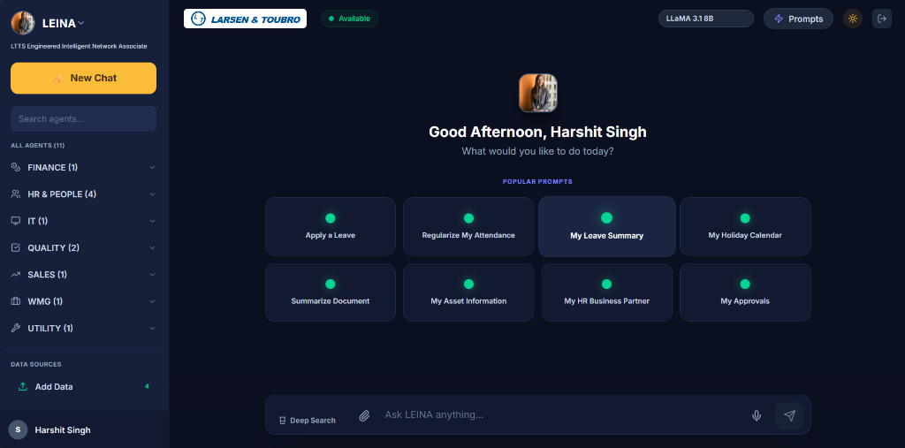
ENTERPRISE UX & PORTAL
Enterprise Portal Interface: LEINA Intelligent Network Associate
Production workplace portal powered by LLaMA 3.1 8B / Qwen2.5-VL with 11+ departmental agents
KEY PORTAL CAPABILITIES
✦ 11+ Domain Specialized Agents
Pre-configured routing: Finance, HR & People (4), IT Helpdesk, Quality (2), Sales, WMG, Utility.
✦ 1-Click Popular Prompts
Apply Leave, Regularize Attendance, Leave Summary, Holiday Calendar, Summarize Document, Approvals.
✦ Deep Search & Multimodal
Full-text deep search across enterprise repositories with attachment & voice query support.
✦ LLaMA 3.1 8B Model Engine
High-speed local inference with active session persistence and prompt template libraries.
LEINA • Local SOP RAG Architecture | Larsen & Toubro Enterprise AI
CONFIDENTIAL & PROPRIETARY
Notes:
Here is the enterprise production portal interface called LEINA (LTTS Engineered Intelligent Network Associate). It organizes specialized departmental agents across Finance, HR, IT, Quality, and Sales, and offers one-click quick actions for common workflows like applying leave, regularizing attendance, and summarizing technical manuals.

Slide 9
DATABASE DESIGN
Database Architecture: ChromaDB Vector Store & Relational Schemas
Dual-database strategy: High-dimensional vector index for similarity search + Relational DB for metadata & auditing
1. VECTOR DATABASE: CHROMADB (HNSW)
2. RELATIONAL METADATA DB: SQLITE / MYSQL
• Collection Name:
Table: sops
sop_documents (persistent file-based storage)
Columns: id, title, filename, category, content, chunk_count, created_at
• Distance Metric:
Cosine Space ("hnsw:space": "cosine")
Table: chat_sessions
Columns: session_id, user_id, title, created_at, last_active
• Index Algorithm:
Hierarchical Navigable Small World (HNSW)
Table: chat_messages
Columns: id, session_id, sender, message, confidence_score, model_used
• Vector Dimensions:
768 dimensions (nomic-embed-text)
Table: uploaded_docs
• Metadata Payload:
Columns: id, filename, file_type, size_bytes, category, chunk_count, ingested_at
source_file, heading, chunk_index, category, length
LEINA • Local SOP RAG Architecture | Larsen & Toubro Enterprise AI
CONFIDENTIAL & PROPRIETARY
Notes:
This slide outlines our database design. We use a dual-database approach. ChromaDB manages high-dimensional vector embeddings with HNSW indexing for rapid semantic similarity search. Concurrently, SQLite (or MySQL) stores relational metadata including raw SOP document records, chat histories, confidence logs, and uploaded document audits.

Slide 10
PERFORMANCE & BENCHMARKS
Performance Benchmarks, Latency Profile & Hardware Metrics
Empirical latency measurements across retrieval, fusion, and generative inference stages
0.38s
3.4s
< 0.3s
99.2%
Retrieval Latency
GPU Answer Latency
Fallback Bypass
Fact Precision
ChromaDB + BM25 + RRF
Qwen2.5-VL / LLaMA 8B
Out-of-scope fast reject
Strict citation adherence
Pipeline Stage | Operation Details | GPU Time (RTX 3060/4060) | CPU-Only Server
1. Query Embedding | nomic-embed-text 768d vector calculation | 0.08 s | 0.25 s
2. Vector Search | ChromaDB HNSW cosine search (top 15) | 15 ms | 35 ms
3. BM25 + RRF Fusion | Lexical keyword scoring + reciprocal ranking | 10 ms | 18 ms
4. Cross-Encoder Rerank | Deep cross-attention scoring (ms-marco) | 0.15 s | 0.45 s
5. LLM Token Generation | Qwen2.5-VL / LLaMA 3.1 8B (~300 tokens) | 2.5 – 5.0 s | 12 – 30 s
LEINA • Local SOP RAG Architecture | Larsen & Toubro Enterprise AI
CONFIDENTIAL & PROPRIETARY
Notes:
Here are the performance benchmarks. Retrieval is blazing fast, taking under 0.4 seconds end-to-end. On a standard GPU, the full answer is delivered in 2.5 to 5 seconds. If running CPU-only, retrieval remains fast (sub-second) while generation takes 12-30 seconds. In addition, when an invalid query is caught by our confidence gate, the response returns in under 300ms.

Slide 11
SECURITY & GOVERNANCE
Enterprise Security, Data Sovereignty & Air-Gap Model
Zero cloud dependencies ensuring complete regulatory compliance and intellectual property protection
🛡️ Zero Data Egress (100% Offline)
📋 Regulatory & Policy Compliance
All embeddings, vector indexes, and model weights reside on local hardware. No packets leave the internal network, ensuring absolute confidentiality for classified SOPs.
Fully compliant with GDPR, HIPAA, SOC 2, and defense industry security mandates where sending intellectual property to commercial AI cloud APIs is strictly prohibited.
🔍 Full Audit Trail & Traceability
🔑 Role-Based Access Control (RBAC)
Every generated answer includes exact file and section citations. SQLite logs record timestamp, session, query, model used, confidence score, and retrieved chunk IDs.
Departmental agent isolation ensures users can only query SOPs matching their clearance level (HR, Finance, Quality, Engineering, IT).
LEINA • Local SOP RAG Architecture | Larsen & Toubro Enterprise AI
CONFIDENTIAL & PROPRIETARY
Notes:
Security is the core differentiator of this project. In many aerospace, engineering, and financial institutions, cloud AI is completely disallowed due to data sovereignty laws. By running local Ollama inference on-premises, our system delivers state-of-the-art AI assistance with zero data leakage.

Slide 12
SUMMARY & ROADMAP
Business Impact, Future Roadmap & Conclusion
Measurable business outcomes and upcoming autonomous agent integrations
MEASURABLE BUSINESS IMPACT & ROI
FUTURE DEVELOPMENT ROADMAP
✔ 80% Reduction
Phase 1 (Completed)
in employee time spent searching across multi-hundred page SOP manuals
Local SOP Ingestion, Hierarchical Chunking, Hybrid Search, Qwen2.5-VL Vision, Web Portal
✔ $0 Cloud API Costs
Phase 2 (Near-Term)
Zero recurring token billing; runs perpetually on existing enterprise workstations/servers
Agentic Tool Calling (Live SAP & Workday API integration to apply leaves & check real-time balances)
✔ 100% Audit Compliance
Phase 3 (Mid-Term)
Eliminates procedural non-compliance with verifiable section citations
Graph RAG (Knowledge Graph entity resolution for complex multi-document SOP hierarchies)
✔ Instant Onboarding
Phase 4 (Long-Term)
New employees get instantaneous answers to operational procedures 24/7
Real-time On-Device Voice-to-Voice AI assistance for field engineers
LEINA • Local SOP RAG Architecture | Larsen & Toubro Enterprise AI
CONFIDENTIAL & PROPRIETARY
Notes:
To conclude, our Local SOP RAG & LEINA Assistant delivers an 80% reduction in document lookup friction, zero cloud token costs, and 100% compliance. Our future roadmap includes integrating autonomous agents with SAP and Workday, and upgrading to Graph RAG. Thank you, and I welcome any questions!

