Slide 1

Welcome

Slide 2
Node js
Tutorial 1
Subash Sapkota Hamal
subash.hamal@icp.edu.np

Slide 3
Today’s Topic
Introduction of Js and Nodejs
Installation of Nodejs
Basics of Js

Slide 4
JavaScript
JavaScript
Initially created as scripting language
Used to manipulate DOM
Handling events in browsers
Client-side validation
Most feature changed with ECMAScript (ES6)

Slide 5
JavaScript Engines
Js needs JavaScript engines to run on browser
E.g.: V8, SpiderMonkey, Chakra etc.
V8 compiles the parsed JavaScript code to machine code using its JIT compiler.
V8 – Released in 2008 AD.

Slide 6
JavaScript Engines
Nodejs
Runtime environment that allows you to run JavaScript code on the server side/device.
Built on Chrome's V8 JavaScript engine
Released: 2009 A.D
Creator: Ryan Dahl

Slide 7
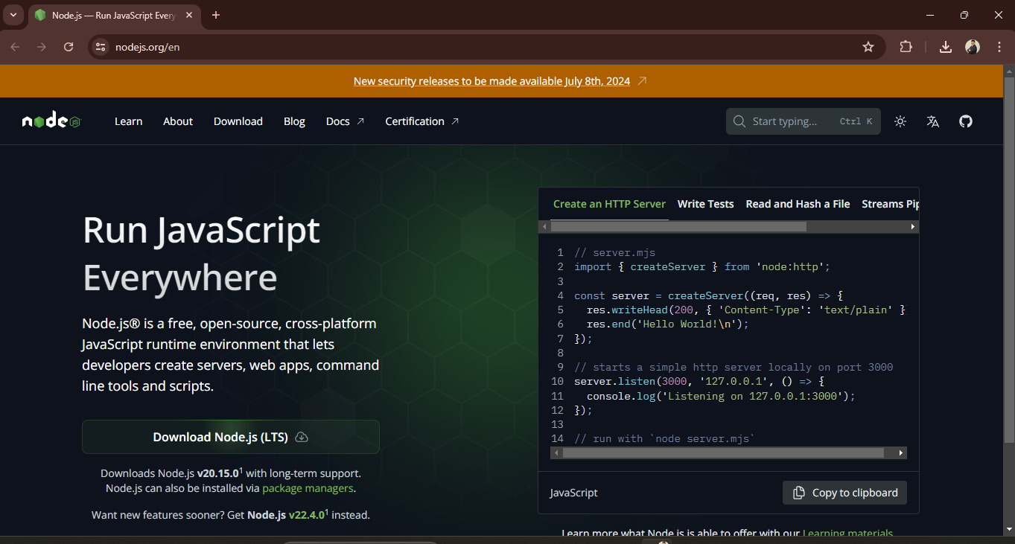
Installation
https://nodejs.org/en

Slide 8
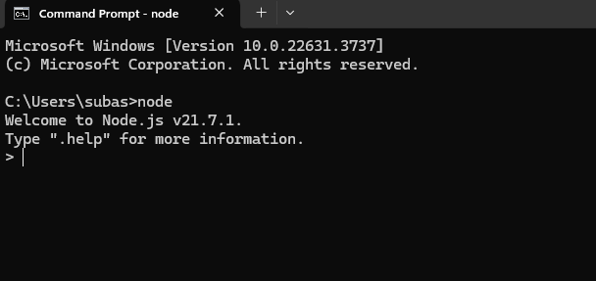
Installation Check
Go to CMD and Check node

Slide 9
Basics of Js
Use of let, const, var
How to create function (normal/arrow function)
Primitive and Non-primitive data types
Introducing object and Array
Spread and Rest Operator
De-structuring
Concept of callback functions.
Concept of Promise

Slide 10
Nodejs
Any Problem?

Slide 11
Nodejs
Thank You
Happy Coding !!

