Slide 1



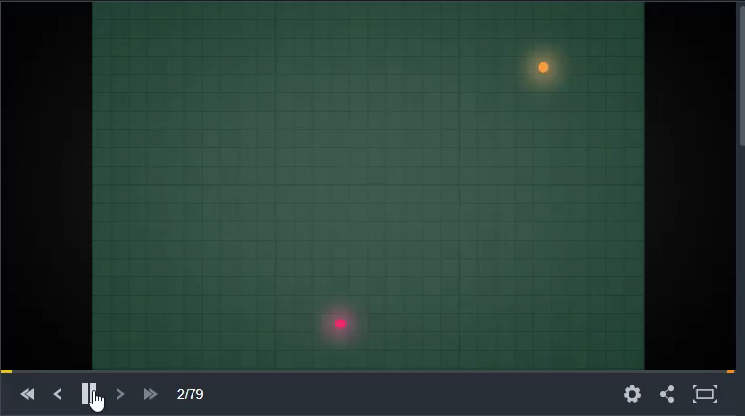
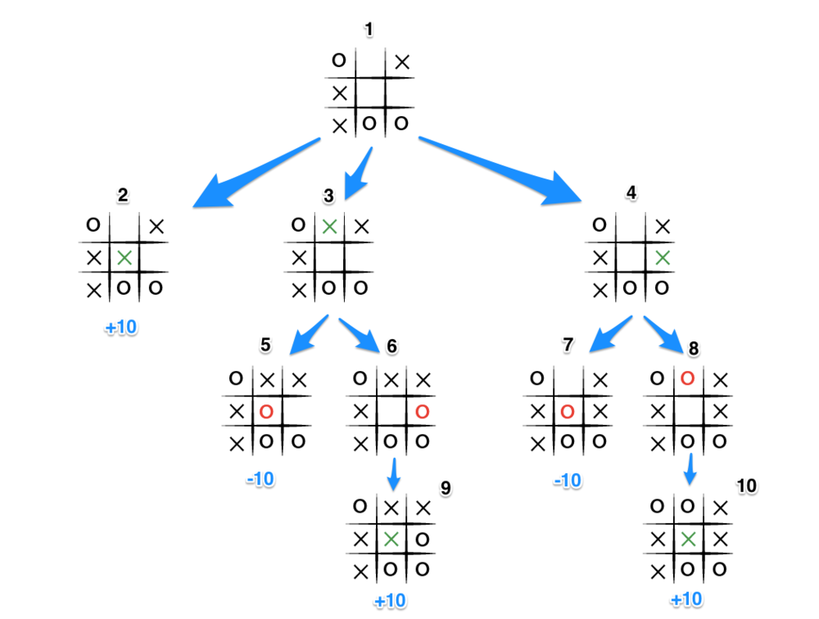
Line Racing: The use of Pathfinding Algorithms in Games
Name: Ayomide Suraj Abimbola Supervisor: Ana Matran-Fernandez
The Algorithm
The minimax algorithm is a recursive algorithm which works by creating a game tree of the available moves. The available moves are scored based on the state they put the game in (win, loss, draw). The algorithm assumes that both players are trying to win so they will make the best possible move. It also requires a means to compute a win; in this case a player wins if an opponent hits one of their cells. On each turn, the algorithm is called and the player who is the maximiser wants the maximum score whereas the minimizer wants the lowest which minimizes the maximum losses.
Example: Tic Tac Toe
A similar yet probably more straightforward way to understand how the minimax algorithm works is to look at it in relation to a simple game of tic tac toe. In order to win you must fill 3 cells in a row. If you were to play tic tac toe perfectly every time, you would always end up with a win or draw. See the end of game state in Figure 1. At this point the minimax algorithm will have created a game tree with a depth of 3. the first depth is the maximizing layer, the second the minimizing and then back to maximizing again. The maximum values are passed to the 3rd layer so moves 6 and 8 have scores of +10; then the minimum values are passed to the second depth so moves 3 and 4 have scores of -10. Finally, the first layer takes the maximum value which makes the best move number 2.
Figure 1
Alpha-beta Pruning
Game trees can grow to be very large, and it can take a relatively long time for a program to search a whole tree. Therefore, it’s worthwhile to optimize game trees by reducing computation time, allowing for the search to be carried out faster and to traverse deeper levels in a game tree much faster. The minimax algorithm does this by using alpha-beta pruning. The alpha-beta pruning algorithm works by cutting branches in a game tree which don’t need to be searched because it has found that a better move already exists. It will stop evaluating a move when it has found at least one possibility that proves the move to be worse than one already evaluated. This in turn reduces the total number of nodes that need to be evaluated by the minimax algorithm; it returns the same result, but prunes away moves that have no influence on the outcome.
Abstract
The line racing problem is a challenge which requires the use of a pathfinding algorithm to maneuverer around a grid occupying its space. On each turn a player outputs a direction to move; if the output is incorrect, leads into an occupied cell or is out of bounds, they lose. The end goal of my project was to design a program which would attack this problem using the minimax algorithm.
Analysis
This problem when broken down can be seen as a zero-sum game; each player, on their turn, wants to make a move that will maximize their payoff while minimizing their opponents. This means that the sum of payoffs to each player is constant for all possible outcomes of the game (one player wins what the other player loses). So, how does our program decide which move to make? Well, the easiest solution would be the one you see in the video above, have the program chose directions randomly (with guidance, no backtracking). However, when playing against a program with an actual strategy this isn’t very efficient. That’s where the minimax algorithm comes in.

