Slide 1

Clustering Global Air Pollution Data
School of Information Technologies and Engineering
CSCI4700 Data Mining
2025 Spring
Team 6
Suad Gafarli BSCS
Ismayil Talishinskiy BSCS

Slide 2
Agenda
Problem Statement
Data
Algorithm(s)
Results
Considerations

Slide 3
Project in a Slide
Project Title | Clustering Global Air Pollution Data Using Unsupervised Learning
Value | Analyzing global air pollution patterns to identify regions with similar air quality profiles, supporting environmental policy-making and urban planning.
Problem type | Clustering (unsupervised learning)
Original and final data shape | Original: 23,463 rows × 12 columns; Final: 23,463 rows × 5 features (after preprocessing)
Preprocessing steps | 1. Feature Selection 2. Missing Value Handling 3. Outlier Detection & Capping 4. Feature Scaling 5. Dimensionality Reduction
Algorithm(s) | 1. K-means Clustering 2. Hierarchical Clustering (Agglomerative) 3. DBSCAN
Results | Identified 2 main clusters: Cluster 0: Low AQI (Good air quality), dominated by USA, Brazil, Germany Cluster 1: High AQI (Unhealthy), dominated by India, China, Pakistan PM2.5 was the primary pollutant in both clusters
Interpretation | The results are consistent with similar works, showing that K-means clustering effectively grouped countries by air quality, with clear separation between low- and high-pollution regions.

Slide 4
Contributions
Team Member | Contribution
Suad Gafarli | Handled data preprocessing, K-Means implementation, key visualizations, and major report writing
Ismayil Talishinskiy | Worked on Hierarchical and DBSCAN clustering, evaluations, contributed to the report and slides.

Slide 5

Problem Statement
Objective : Analyze global air pollution data using clustering techniques to identify patterns in air quality across countries and cities.
Key Questions :
Which regions have similar air pollution profiles?
What are the dominant pollutants in different clusters?
Which clustering algorithm performs best on this dataset?
Why This Matters : Understanding regional air quality patterns supports environmental policy-making, urban planning, and public health initiatives.

Slide 6

Data
Dataset Overview :
Source: Global air pollution dataset (global_air_pollution_data.csv)
Rows: 23,463
Columns: 12
Data Characteristics :
Missing Values: country_name (427), others complete
Outliers: Detected and capped using IQR
Scaling: StandardScaler applied
Preprocessing Steps :
Feature selection: AQI-related numerical columns
Missing value handling: Filled with column means
Outlier capping: Using IQR method
Scaling: StandardScaler
Dimensionality Reduction :
PCA applied for visualization
Explained variance ratio: [55%, 32%]

Slide 7
Algorithm(s)
K-means Clustering | Hierarchical Clustering | DBSCAN
Centroid-based approach | Agglomerative method | Density-based clustering
Optimal clusters: 2 | Optimal clusters: 3 | Parameters: eps=0.52, min_samples=3
Best metric: Silhouette Score = 0.486 | Dendrogram visualization | Noise handling

Slide 8
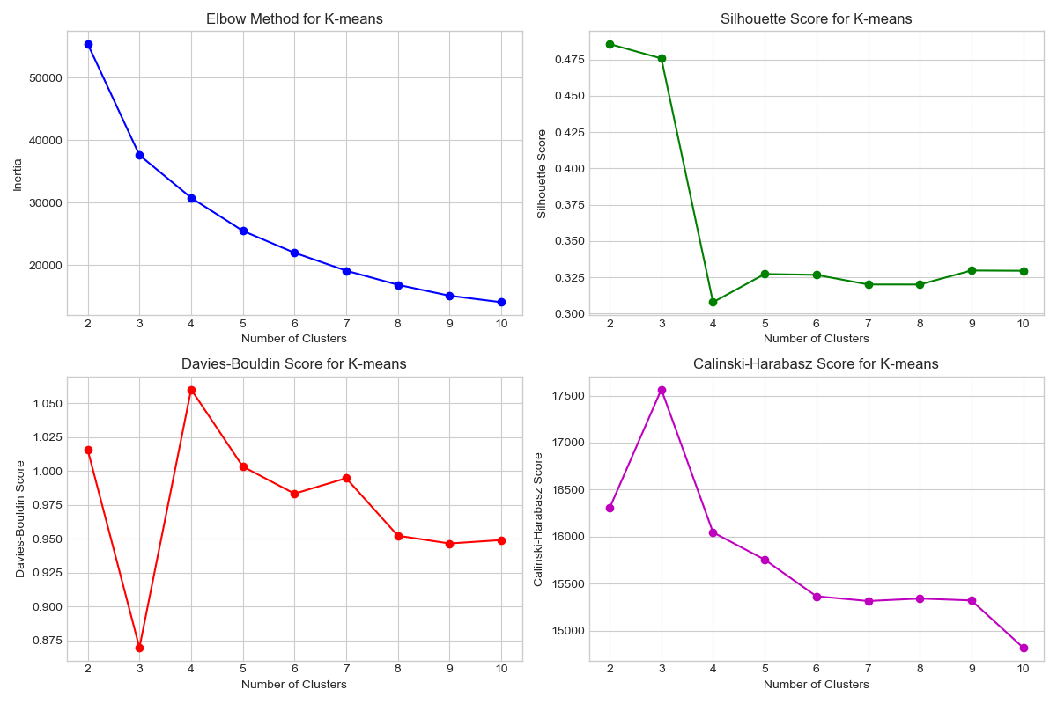
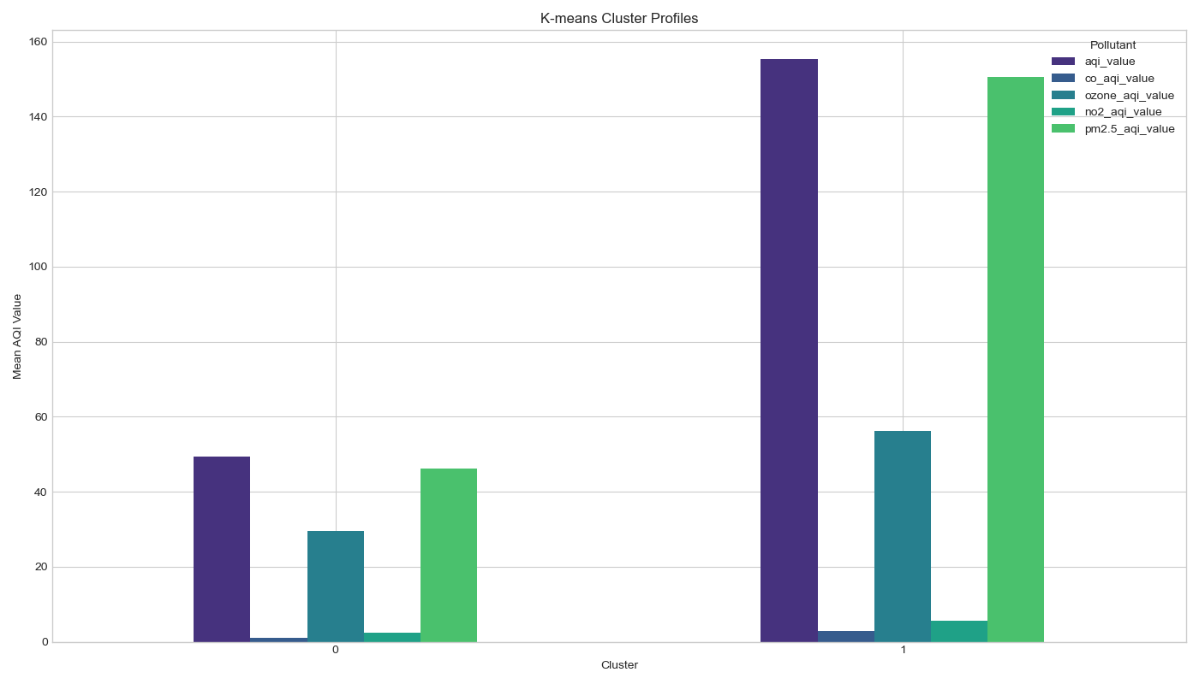
K-Means Results

Slide 9
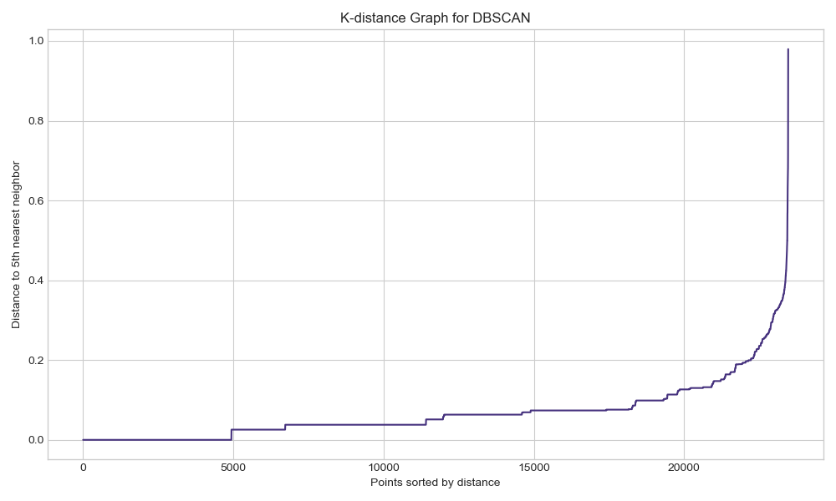
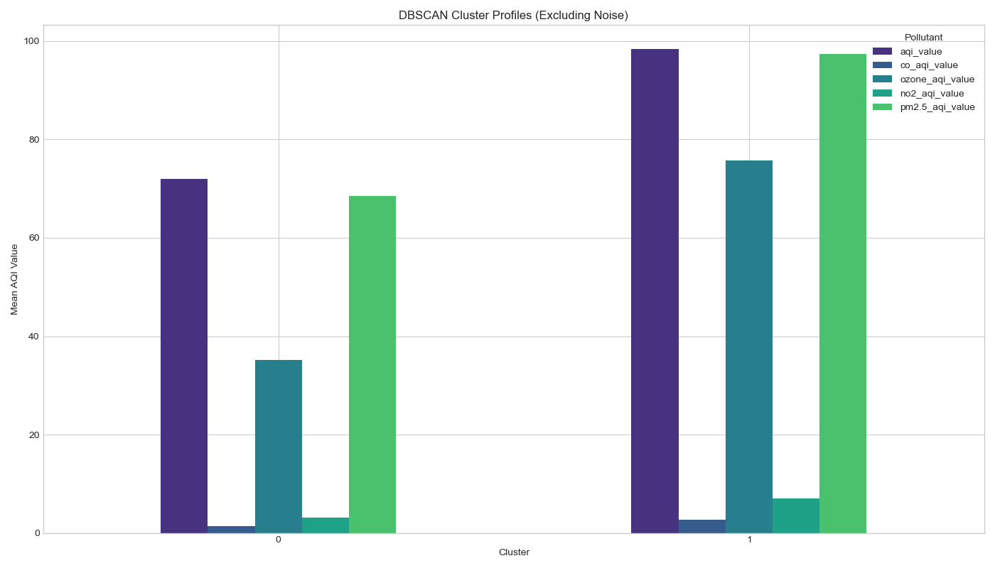
DBSCAN Results

Slide 10
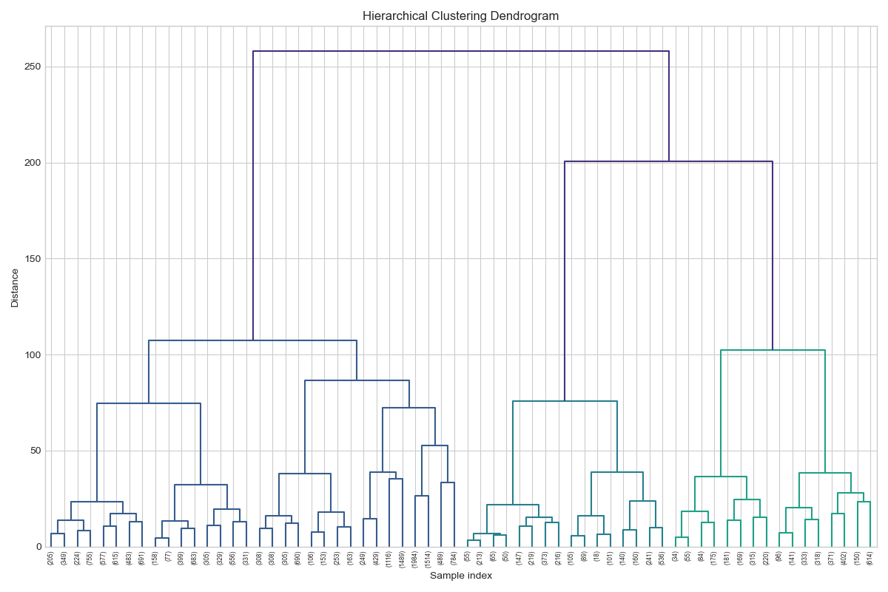
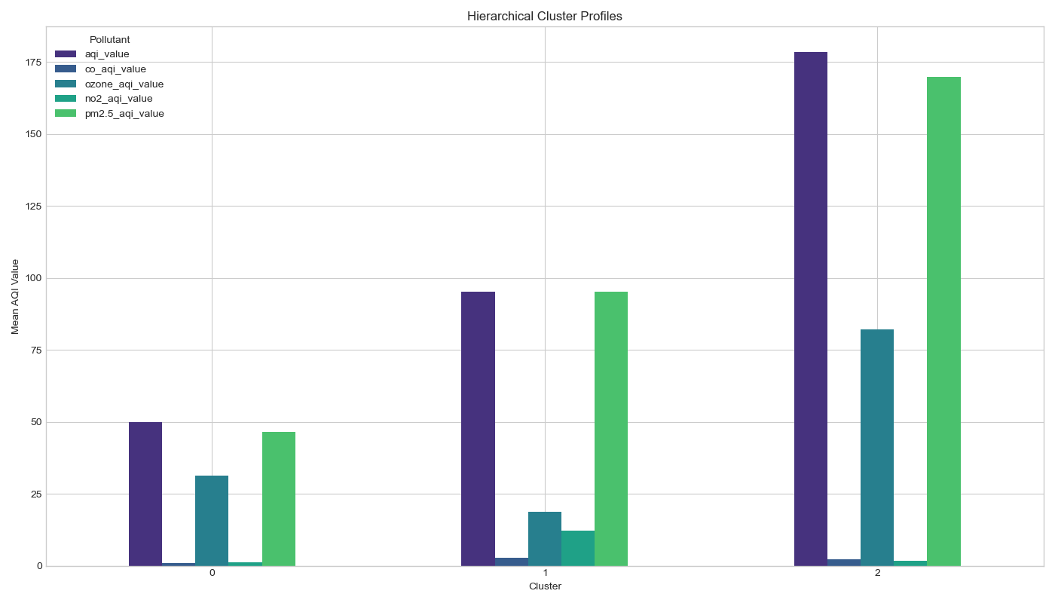
Hierarchical Clustering Results

Slide 11
Considerations
Limitations:
No Temporal Dimension : Air quality varies by season/time, but this wasn’t analyzed.
Missing Data : Some city/country names are missing or ambiguous (427 missing country names).
DBSCAN Limitations : Performance was limited due to uneven density distribution.
Unmeasured Factors : Clusters may be influenced by factors like meteorology or geography.
Potential Improvements
Temporal Analysis : Incorporate time-based trends for dynamic clustering.
Geospatial Features : Add latitude/longitude data to improve locality grouping.
Ensemble Clustering : Use multiple clustering methods for better robustness.
Real-World Impact
Policy Intervention : Clusters highlight regions needing targeted policy action.
Pollutant Regulation : Identifying dominant pollutants supports city-specific regulations.
Public Health & Urban Planning : Supports research and decisions in public health and urban planning.

Slide 12
THANK YOU FOR YOUR ATTENTION!
Questions?

