Slide 1
LECTURE 1

Slide 2
SPATIAL DATA ANALYSIS
USING R AND QGIS AS GIS FOR CORE SPATIAL DATA ANALYSIS

Slide 3
BASIC DEFINITIONS
Spatial data or geospatial data refers to data that have a geographic component to them, i.e. data with geographic coordinates or information of geographic location.
Spatial data are present everywhere- Google Earth, satnavs, satellite data, GPS units
Geographic Information Systems (GIS) are typically software where geographic information are stored in layers in order to derive spatial data insights can be created by manipulating, analysing and visualizing these.
Example- ArcGIS is a GIS software where spatial data from different sources are stored in layers or geodatabases and analysed.
QGIS is a free GIS software. R can be used as a GIS tool as well.
Latter are free, less formalized, more intuitive and very powerful.

Slide 4
RATIONALE BEHIND THIS COURSE
The course follows a project based format- we are going to work with real spatial data collected from the Tam Dao National Park, Vietnam.
Most effective way of gaining proficiency in spatial data analysis is to step back and understand the context of the spatial system you want to study.
That is- what/where is my study area, what am I hoping to learn about my study area, what are the data and tools available to help me answer the questions about my study area.
We work with real life data straight away. Real life data are complicated and messy.
Working through an actual problem gives one hands on training, helps in integrating concepts and learning how to apply concepts.
We will learn a bit about the study area and the different themes we are going to cover in this course.
Themes: What are the different things we can learn about our study area, possible questions to ask which spatial data are needed for it and which tools can best help us answer our questions.

Slide 5
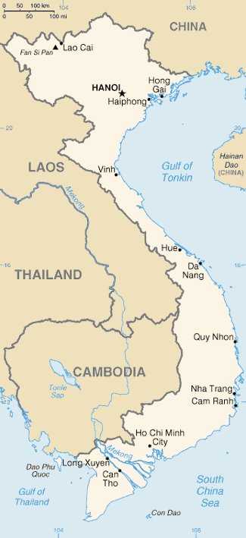
STUDY AREA: TAM DAO
Tam Dao National Park is an IUCN II national park in Vietnam.
Vietnam is a country in SE Asia with a varied topography (from flat areas to mountains).
Tam Dao national park is very important for regional biodiversity.
Vietnam has more than 150+ protected areas and they have different categories- II, IV.
Many PAs have no categories (NA) or not reported.
Vietnam and its PAs suffer from forest degradation.
https://commons.wikimedia.org/wiki/Vi%E1%BB%87t_Nam#/media/File:Vm-map.png

Slide 6
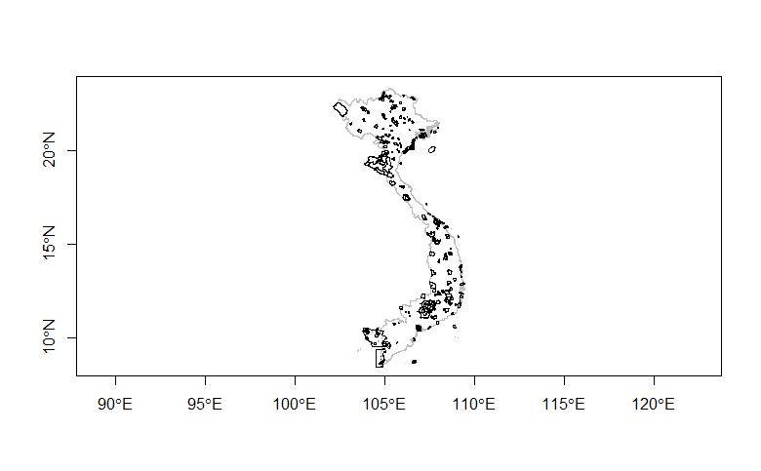
SOME OF THE POSSIBLE QUESTIONS WE CAN ASK
Where exactly is the Tam Dao National Park located?
How big is it?
What does the protected area network of Vietnam look like, i.e. where are all the PAs located?
What is the average size of a PA in Vietnam?
How are PAs distributed across the different IUCN management categories?
Which is the most common IUCN management category in Vietnam?
Protected Area (PA) network of Vietnam
(created in R)
Data for PAs taken from: http://www.protectedplanet.net/
Data for country boundary taken from: http://www.diva-gis.org/gdata

Slide 7
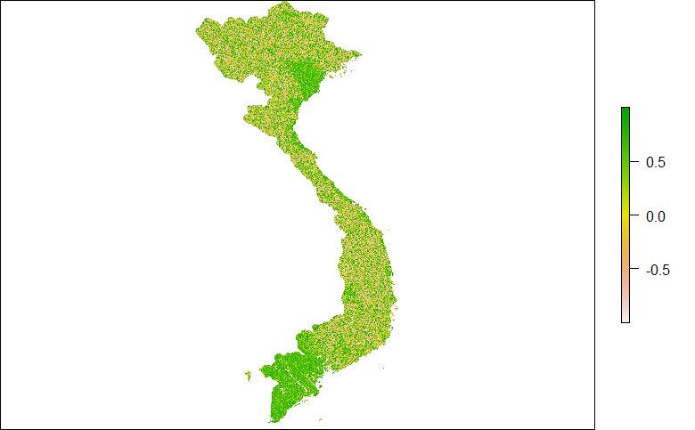
THEMES TO BE COVERED: TOPOGRAPHIC PRODUCTS
An evaluation of topography is an important component of spatial data analysis projects.
Digital Elevation Models (DEMs) are 3D representation of Earth’s terrain. Units: metres
Shuttle Radar Topography Mission (SRTM) by NASA has a near global scale collection of DEMs
DEMs can be used for deriving a number of topographic products- slope, aspect, Hillshade.
Play an important role in infrastructure planning, precision agriculture
Answer important ecological questions- is forest degradation of an area linked with its slope?
Hillshade map of Vietnam, derived from SRTM DEM (created in R)

Slide 8
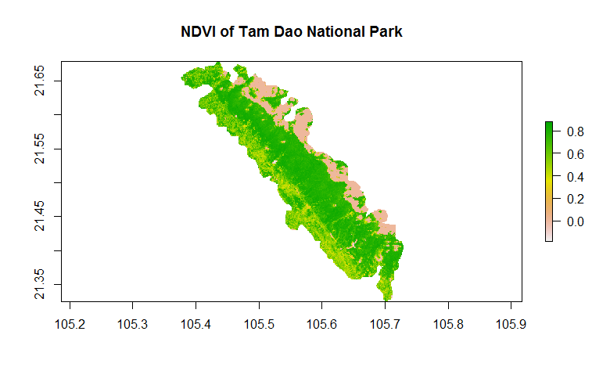
THEMES TO BE COVERED: BASIC VEGETATION MAPPING
Vegetation indices are useful for quantifying the state of vegetation and greenness in area.
This may be linked with ecological properties such as forest cover, moisture, degradation
Make use of optical bands (such as those from Landsat), apply arithmetic operations to obtain a composite vegetation index band.
Normalized Difference Vegetation Index (NDVI) is one of the most commonly indices for basic vegetation mapping
(NIR-Red band)/(NIR+ Red band)
Values ranging from 0 to 1; closer to 1 means intact healthy vegetation/dense forest cover. Lower values indicate degradation or even bare areas.
NDVI of the Tam Dao National Park (created in R)
Landsat data taken from: http://earthexplorer.usgs.gov/

Slide 9
WEAPONS OF CHOICE FOR SPATIAL DATA ANALYSIS
QGIS: Download from http://www.qgis.org/en/site/ I am using QGIS Pisa
R Programming Language: https://www.r-project.org/
For R, please install (and load these packages): raster, rgeos, rgdal, maptools
How to install packages?
Step 1: install.packages(“raster”)
Step 2: library(raster)

