Slide 1
2018 Ajou3
Jonghwa Park
suakii@gmail.com
GYEONGGI SCIENCE HIGH SCHOOL

Slide 2
Forces and Newton’s Laws of Motion
A force is a vector that causes an object with mass to accelerate.
힘은 질량 있는 객체가 가속도를 갖게 하는 벡터.

Slide 3
Newton’s First Law
다른 힘의 영향을 받지 않는다면 가만히 있는 물체는 계속 가만히 있고, 움직이는 물체는 같은 속도와 방향으로 계속 움직인다.

Slide 4

Newton’s First Law

Slide 5
Newton’s First Law
An object’s PVector velocity will remain constant if it is in a state of equilibrium.

Slide 6
Newton’s Third Law
어떤 물체에 힘을 주면 반대 방향으로도 같은 힘이 일어난다.
Forces always occur in pairs.
The two forces are of equal strength, but in opposite directions.

Slide 7
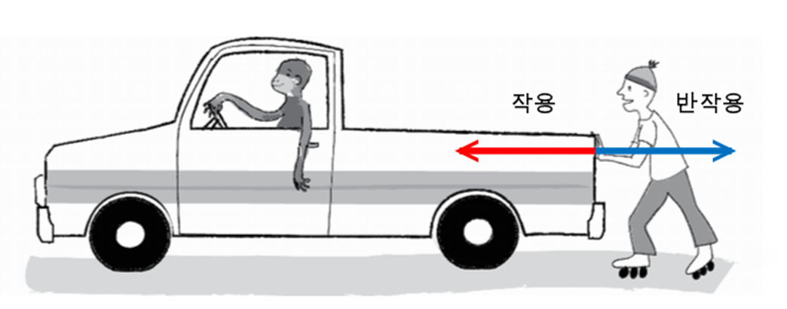
Newton’s Third Law

Slide 8
Newton’s Third Law
A라는 물체가 B라는 물체에 PVector f라는 힘을 준다면 B도 A에 PVector.mult(f,-1)만큼의 힘을 주어야 한다.

Slide 9


Newton’s Second Law
Force equals mass times acceleration.
$$F=ma$$
a$=F/m$

Slide 10
Newton’s Second Law
The acceleration of an object is equal to force.
Location is adjusted by velocity, and velocity by acceleration.
Acceleration was where it all began.
Force is truly where it all begins.

Slide 11
Newton’s Second Law
class Mover {
PVector location;
PVector velocity;
PVector acceleration;
}

Slide 12
Newton’s Second Law
void applyForce(PVector force) {
//Newton’s second law at its simplest.
//But this function has problem.
//What’s that?
acceleration = force;
}
mover.applyForce(wind);
mover.appyForce(gravity);

Slide 13
Force Accumulation
velocity.add(acceleration);
void applyForce(PVector force) {
acceleration.add(force);
}

Slide 14
Force Accumulation
if (mousePressed) {
PVector wind = new PVector(0.5,0);
mover.applyForce(wind);
}
Since we’re adding all the forces together at any given moment, we have to make sure that we clear acceleration (i.e. set it to zero) before each time update() is called.

Slide 15
Force Accumulation
void update() {
velocity.add(acceleration);
location.add(velocity);
acceleration.mult(0);// 가속도를 0으로
}

Slide 16
Dealing with Mass
class Mover {
PVector location;
PVector velocity;
PVector acceleration;
float mass;
}

Slide 17
Dealing with Mass
Mover() {
location = new PVector(random(width),random(height));
velocity = new PVector(0,0);
acceleration = new PVector(0,0);
mass = 10.0;
}

Slide 18
Creating Forces
Make up a force.
Model a force

Slide 19
Gravity on Earth and Modeling a Force
for (int i = 0; i < movers.length; i++) {
PVector wind = new PVector(0.001,0);
float m = movers[i].mass;
//Scaling gravity by mass to be more accurate
PVector gravity = new PVector(0,0.1*m);
movers[i].applyForce(wind);
movers[i].applyForce(gravity);
movers[i].update();
movers[i].display();
movers[i].checkEdges();
}

Slide 20
Reference
void applyForce(PVector force) {
//Making a copy of the PVector before //using it!
PVector f = force.get();
f.div(mass);
acceleration.add(f);
}

Slide 21
Test

Slide 22
Friction
마찰력
흩어지는 힘으로 물체가 움직일 때 전체 에너지를 감소 시키는 힘
static friction
kinetic friction

Slide 23
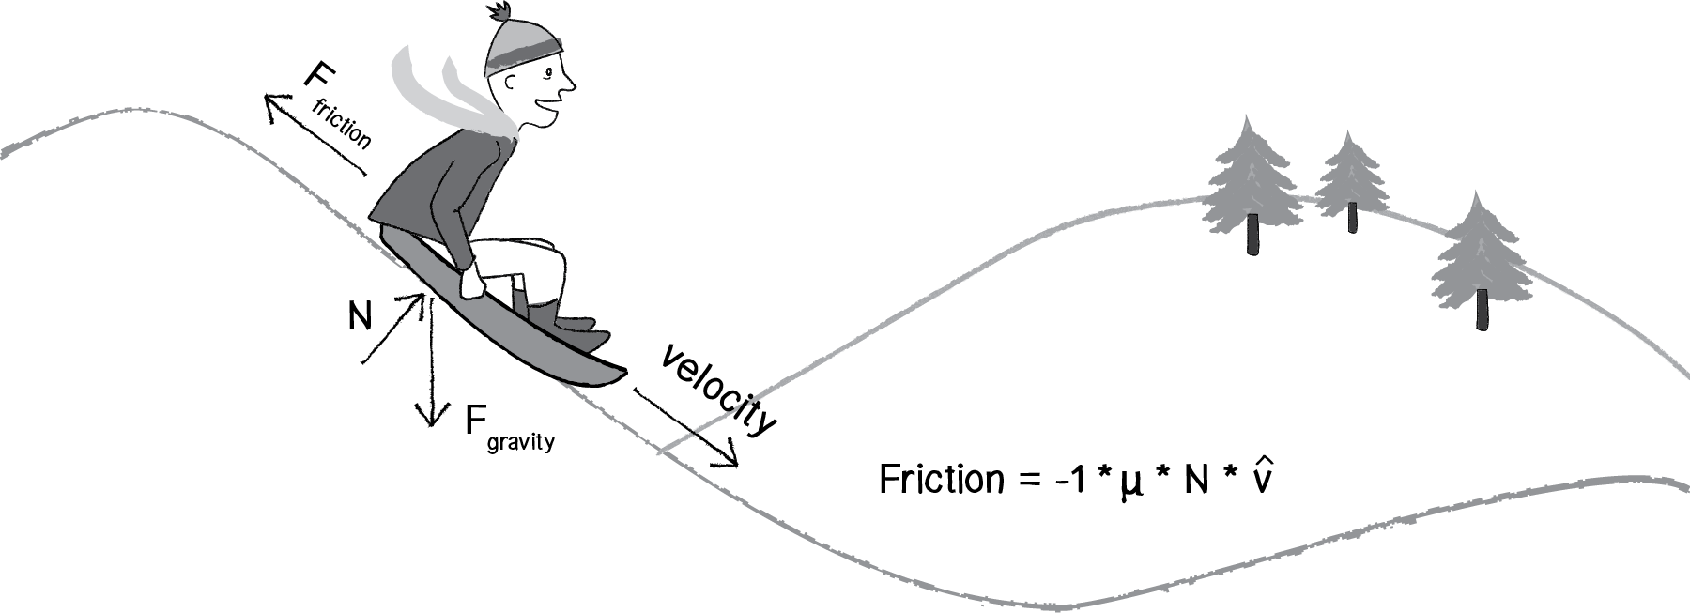
Friction

Slide 24
Friction
PVector friction = velocity.get();
friction.normalize();
friction.mult(-1);

Slide 25
Friction
μ * N
μ : coefficient of friction
N : Normal force
float c = 0.01;
float normal = 1;
float frictionMag = c*normal;
PVector friction = velocity.get();
friction.mult(-1);
friction.normalize();
friction.mult(frictionMag);

Slide 26
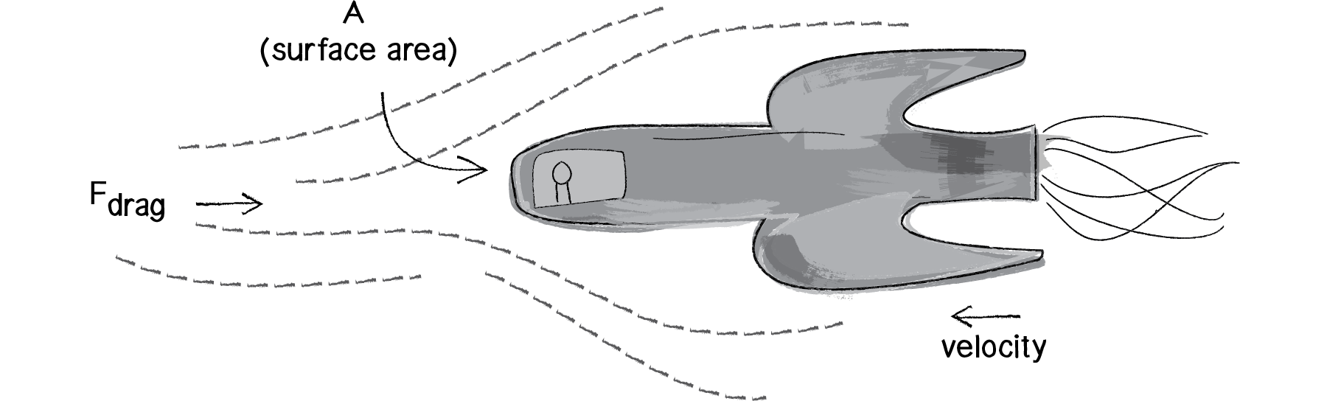
Air and Fluid Resistance

Slide 27
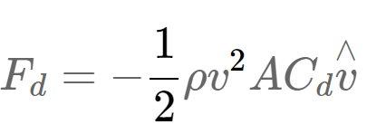
Air and Fluid Resistance
Fd = 저항력
P = 액체밀도
V = 객체의 속력
A = 액체와 닿는 앞쪽 면적
Cd = 저항 계수
V^ = 속도의 방향 단위 벡터

Slide 28

Air and Fluid Resistance

Slide 29
Air and Fluid Resistance
float c = 0.1;
float speed = v.mag();
float dragMagnitude = c * speed * speed;
PVector drag = velocity.get();
drag.mult(-1);
drag.normalize();
drag.mult(dragMagnitude);

Slide 30
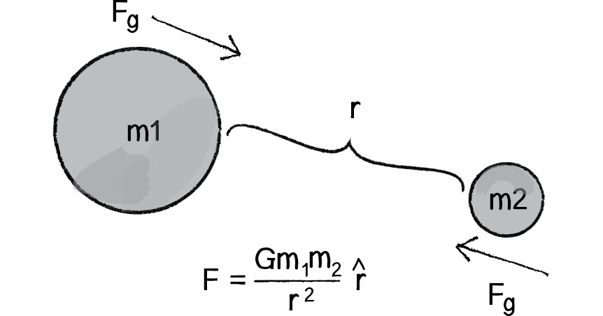
Gravitational Attraction

Slide 31
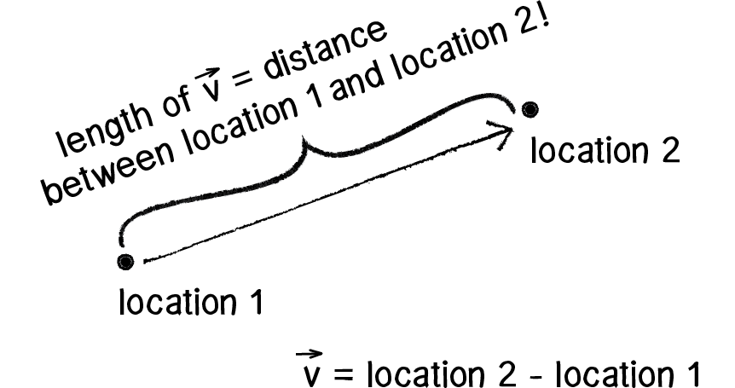
Gravitational Attraction

Slide 32
Gravitational Attraction
PVector force = PVector.sub(location1,location2);
float distance = force.magnitude();
float m = (G * mass1 * mass2) / (distance * distance);
force.normalize();
force.mult(m);

Slide 33
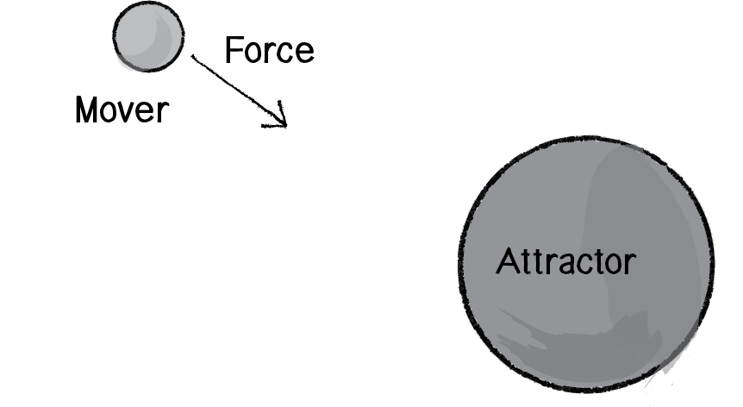
Gravitational Attraction

Slide 34
Attractor
Attractor is simple object that doesn’t move.
We just need a mass and a location.

Slide 35
Break...
CU..

