Slide 1
2018 Ajou
Jonghwa Park
suakii@gmail.com
GYEONGGI SCIENCE HIGH SCHOOL

Slide 2
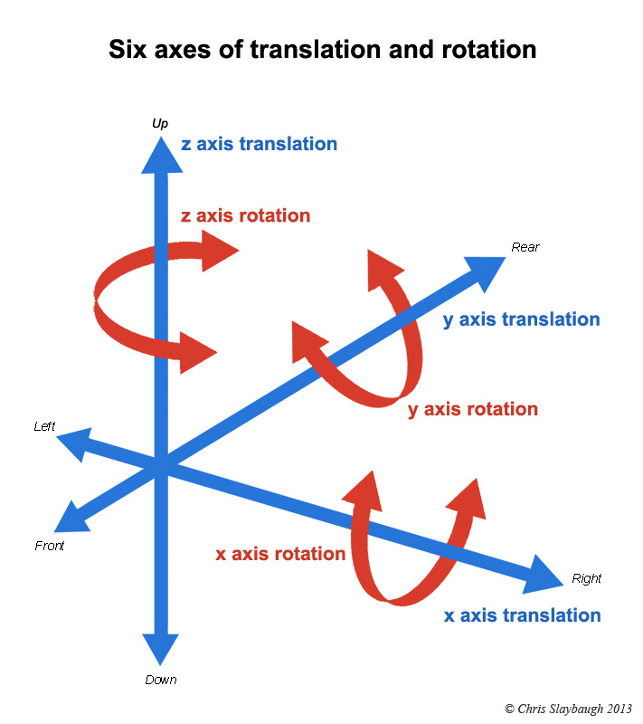
3D: Translation and Rotation
http://photomacrography.net/

Slide 3
Z Axis
In three-dimensional space a third axis refers to the depth of any given point.
In a Processing sketch’s window, a coordinate along the Z-axis indicates how far in front or behind the window a pixel lives.
The Z-axis will create the illusion of three-dimensional space in your Processing window.

Slide 4
A growing rectangle
float r = 8;
void setup() {
size(200,200);
}
void draw() {
background(255);
// Display a rectangle in the middle of the screen
stroke(0);
fill(175);
rectMode(CENTER);
rect(width/2,height/2,r,r);
// Increase the rectangle size
r++ ;
}

Slide 5
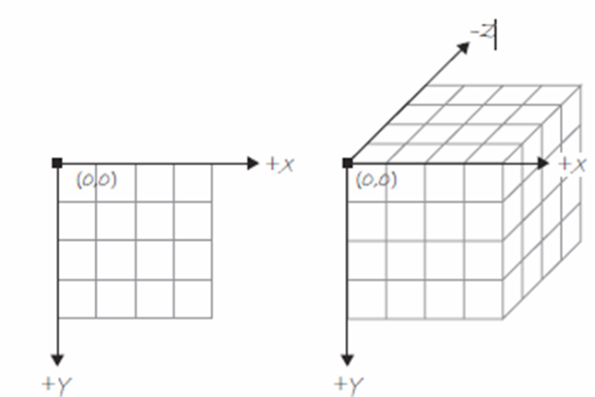
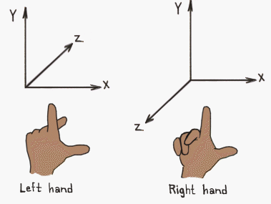
3D
If we choose to use 3D coordinates, Processing will create the illusion for us.

Slide 6
Translate() function
There is no rect(x, y, z…) in Processing.
In order to user the z axis, we need to learn translate().
The function translate() moves the origin point (0,0) relative to its previous state.

Slide 7
Translate
void setup() {
size(200, 200);
}
void draw() {
background(255);
stroke(0);
fill(175);
// Grab mouse coordinates, constrained to window
int mx = constrain(mouseX, 0, width);
int my = constrain(mouseY, 0, height);

Slide 8
Translate
// Translate to the mouse location
translate(mx, my);
ellipse(0, 0, 8, 8);
// Translate 100 pixels to the right
translate(100, 0);
ellipse(0, 0, 8, 8);
// Translate 100 pixels down
translate(0, 100);
ellipse(0, 0, 8, 8);
// Translate 100 pixels left
translate(-100, 0);
ellipse(0, 0, 8, 8);
}

Slide 9
3D
float z = 0; // a variable for the Z (depth) coordinate
void setup() {
size(200,200,P3D);
}
void draw() {
background(0);
stroke(255);
fill(100);
// Translate to a point before displaying a shape there
translate(width/2,height/2,z);
rectMode(CENTER);
rect(0,0,8,8);
z++; // Increment Z (i.e. move the shape toward the viewer)
}

Slide 10
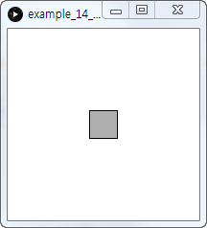
3D

Slide 11
Vertex Shapes
beginShape()
vertex()
endShape()
beginShape();
vertex(50,50);
vertex(150,50);
vertex(150,150);
vertex(50,150);
endShape(CLOSE);

Slide 12
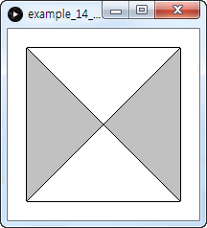
Vertex

Slide 13
Vertex Shapes in loops
stroke(0);
for (int i = 0; i < 10; i++) {
beginShape();
fill(175);
vertex(i*20,10-i);
vertex(i*20 + 15,10 + i);
vertex(i*20 + 15,180 + i);
vertex(i*20,180-i);
endShape(CLOSE);
}

Slide 14
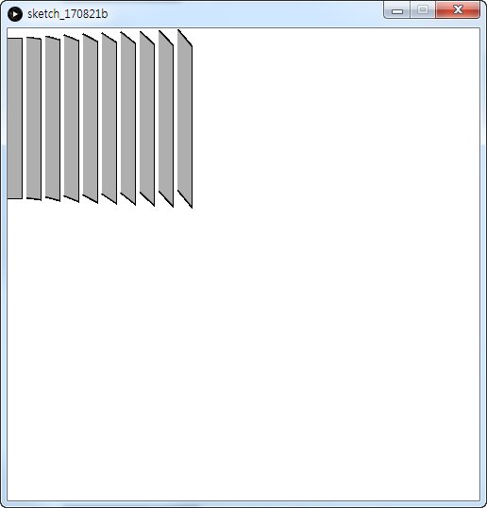
Vertex Shapes in loops

Slide 15
Continuous Shape
noFill()
beginShape before loop(no argument)
endShape after loop

Slide 16
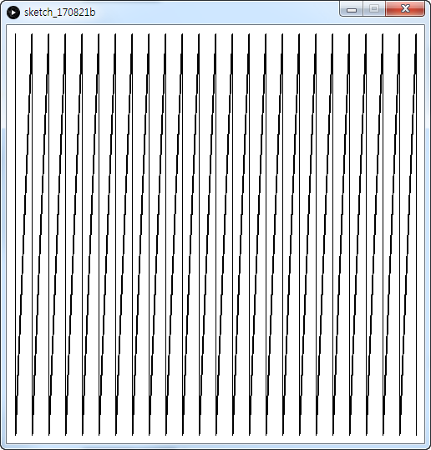
Continuous Shape

Slide 17
Continuous Shape
noFill();
stroke(0);
beginShape(); // No argument
for (int i = 10; i < width; i+= 20) {
vertex(i,10);
vertex(i,height–10);
}
endShape(); // No CLOSE

Slide 18
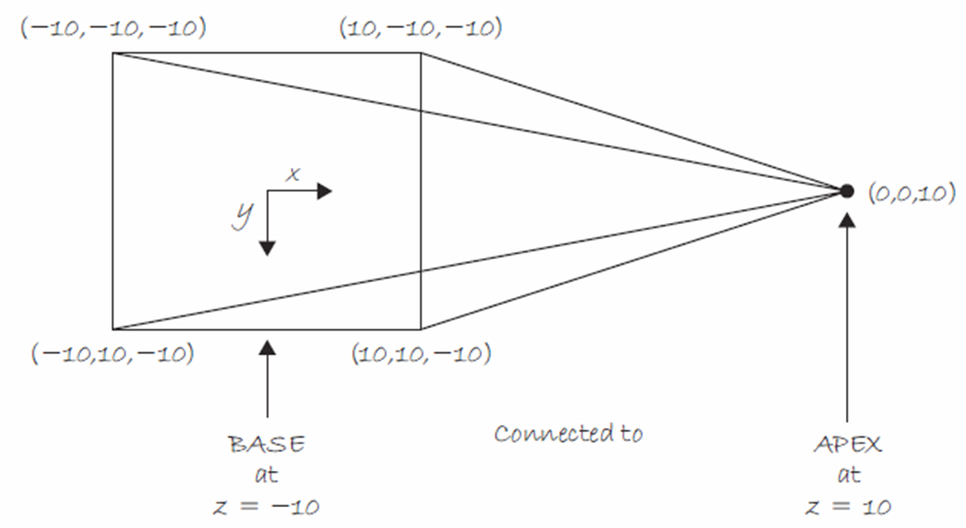
Custom 3D Vector Shapes

Slide 19
Pyramid
Four Triangles
“Back” x y z
vertex(–10,–10,–10);
vertex(–10, 10,–10);
vertex( 0, 0, 10); // apex
“Top”
vertex(–10,–10,–10);
vertex( 10,–10,–10);
vertex( 0, 0, 10); // apex
“Bottom”
vertex(–10, 10,–10);
vertex( 10, 10,–10);
vertex( 0, 0, 10); // apex
“Right”
vertex( 10,–10,–10);
vertex( 10, 10,–10);
vertex( 0, 0, 10); // apex

Slide 20
Simple Rotation
1. rotate() function
2. rotate() function takes one argument, an angle measured in radians.
3. rotate() will rotate the shaped in the clockwise direction.

Slide 21
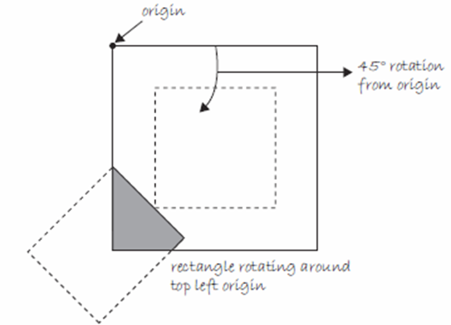
Simple Rotation
rotate(radians(45));
rectMode(CENTER);
rect(width/2,height/2,100,100);

Slide 22
Rotating after translating
translate(width/2,height/2);
rotate(radians(45));
rectMode(CENTER);
rect(0,0,100,100);

Slide 23
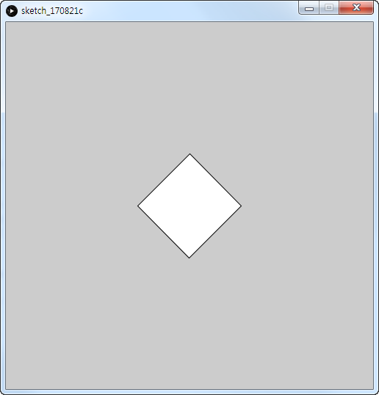
Rotating after translating

Slide 24
Mouse controlled rotation
void setup() {
size(200,200);
}
void draw() {
background(255);
stroke(0);
fill(175);
translate(width/2, height/2);
float theta = map(mouseX, 0, width, 0, TWO_PI);
rotate(theta);
rectMode(CENTER);
rect(0, 0, 100, 100);
}

Slide 25
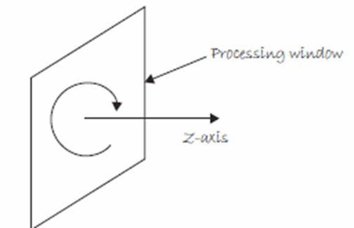
Rotation around different axes

Slide 26
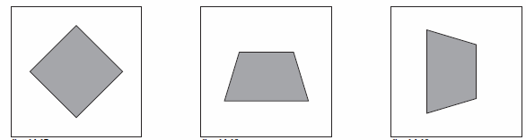
Rotation Axes
Z X Y
Around center Flip (Rotisserie) Spin (like a top)
float theta = 0.0;
void setup() {
size(200,200,P3D);
}
void draw() {
background(255);
stroke(0);
fill(175);
translate(width/2,
height/2);
rotateZ(theta);
rectMode(CENTER);
rect(0,0,100,100);
theta + = 0.02;
}
float theta = 0.0;
void setup() {
size(200,200,P3D);
}
void draw() {
background(255);
stroke(0);
fill(175);
translate(width/2,
height/2);
rotateX(theta);
rectMode(CENTER);
rect(0,0,100,100);
theta + = 0.02;
}
float theta = 0.0;
void setup() {
size(200,200,P3D);
}
void draw() {
background(255);
stroke(0);
fill(175);
translate(width/2,
height/2);
rotateY(theta);
rectMode(CENTER);
rect(0,0,100,100);
theta + = 0.02;
}

Slide 27
Rotation Around Multiple axes
void setup() {
size(200,200,P3D);
}
void draw() {
background(255);
stroke(0);
fill(175);
translate(width/2,height/2);
rotateX(PI*mouseY/height);
rotateY(PI*mouseX/width);
rectMode(CENTER);
rect(0,0,100,100);
}

Slide 28
Matrix
In order to keep track of rotations and translations and how to display the shapes according to different transformations, Processing uses a matrix.

Slide 29
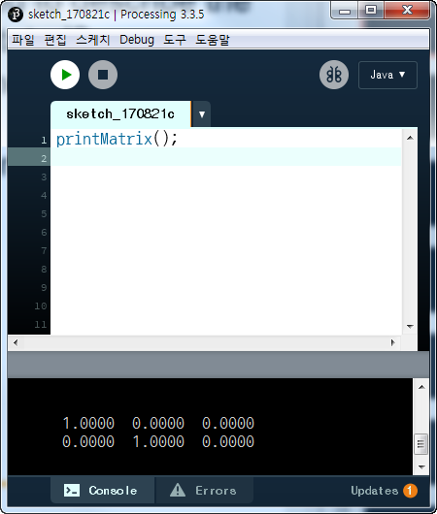
Matrix

Slide 30
ModelX, Y, Z
void setup() {
size(500, 500, P3D);
noFill();
}
void draw() {
background(0);
float x = modelX(0, 0, 0);
float y = modelY(0, 0, 0);
float z = modelZ(0, 0, 0);
println("x : " + x + ", y : " + y + ", z : " + z);
}

Slide 31
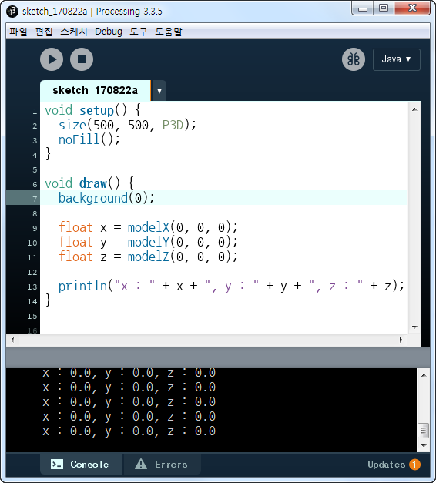
Model X, Y, Z

Slide 32
Model X, Y, Z
void setup() {
size(500, 500, P3D);
noFill();
}
void draw() {
background(0);
translate(50, 100, 50);
float x = modelX(0, 0, 0);
float y = modelY(0, 0, 0);
float z = modelZ(0, 0, 0);
println("x : " + x + ", y : " + y + ", z : " + z);
}

Slide 33
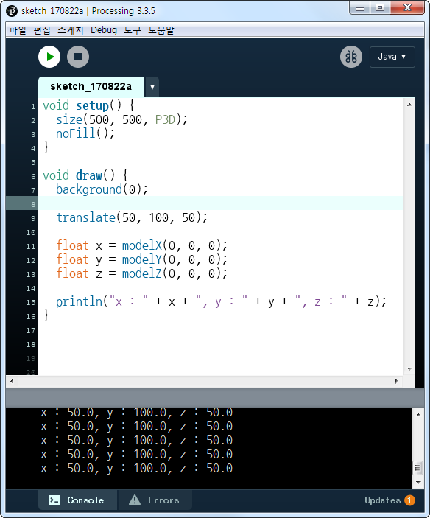
Model X, Y, Z

Slide 34
Model X, Y, Z
void setup() {
size(500, 500, P3D); noFill();
}
void draw() {
background(0);
translate(50, 100, 50);
rotateX(PI);
translate(1, 2, 3);
float x = modelX(0, 0, 0);
float y = modelY(0, 0, 0);
float z = modelZ(0, 0, 0);
println("x : " + x + ", y : " + y + ", z : " + z);
}

Slide 35
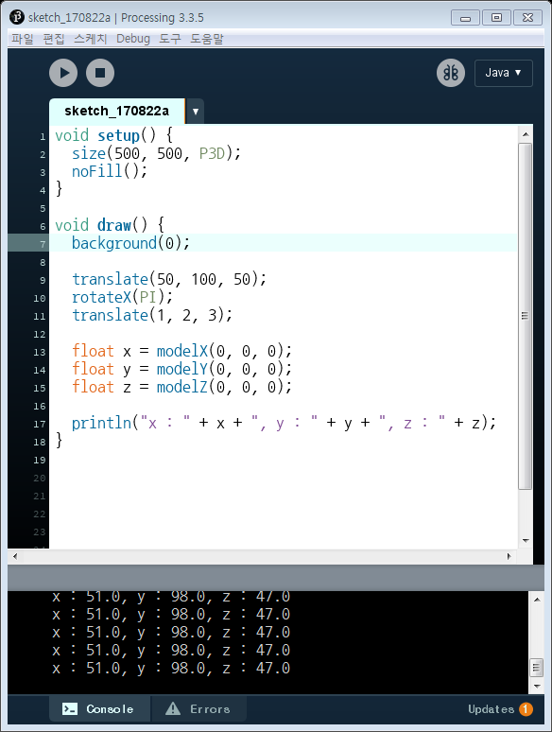
Model X, Y, Z

Slide 36
pushMatrix, popMatrix
void setup() {
size(500, 500, P3D);
noFill();
}
void draw() {
background(0);
pushMatrix();
translate(50, 100, 50);
rotateX(PI);

Slide 37
pushMatrix, popMatrix
translate(1, 2, 3);
popMatrix();
translate(10,10,10);
float x = modelX(0, 0, 0);
float y = modelY(0, 0, 0);
float z = modelZ(0, 0, 0);
println("x : " + x + ", y : " + y + ", z : " + z);
}

Slide 38
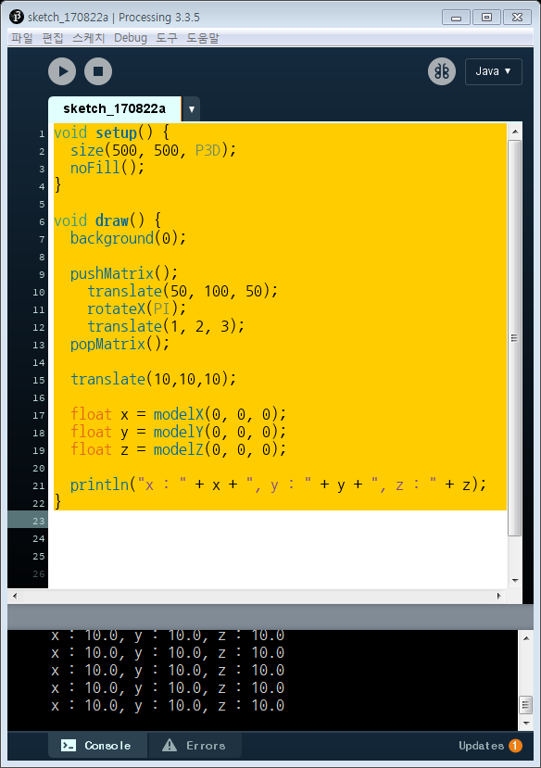
pushMatrix, popMatrix

Slide 39
Rotating one Square
float theta1 = 0;
void setup() {
size(200, 200, P3D);
}
void draw() {
background(255);
stroke(0);

Slide 40
Rotating one Square
fill(175);
rectMode(CENTER);
translate(50, 50);
rotateZ(theta1);
rect(0, 0, 60, 60);
theta1 += 0.02;
}

Slide 41
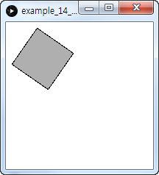
RotateZ

Slide 42
Rotating another square
float theta2 = 0;
void setup() {
size(200, 200, P3D);
}
void draw() {
background(255);

Slide 43
Rotating another square
stroke(0);
fill(175);
rectMode(CENTER);
translate(150, 150);
rotateY(theta2);
rect(0, 0, 60, 60);
theta2 += 0.02;
}

Slide 44
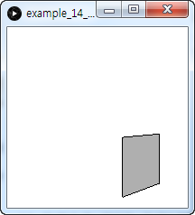
RotateY

Slide 45
Combine
float theta1 = 0;
float theta2 = 0;
void setup() {
size(500, 500, P3D);
}
void draw() {
background(255);
stroke(0);
fill(175);
rectMode(CENTER);

Slide 46
Combine
translate(50, 50);
rotateZ(theta1);
rect(0, 0, 60, 60);
translate(150, 150);
rotateY(theta2);
rect(0, 0, 60, 60);
theta1 += 0.02;
theta2 += 0.02;
}

Slide 47
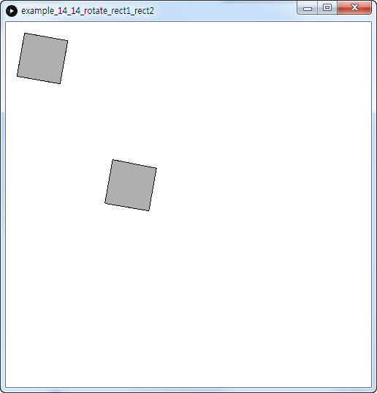
Combine

Slide 48
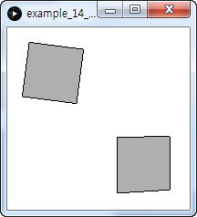
Your turn

Slide 49
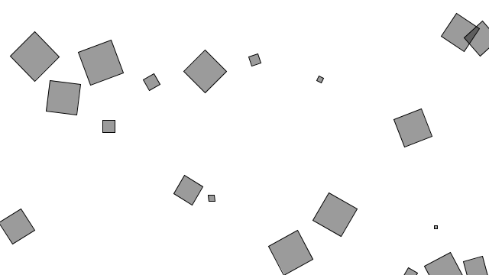
Spinning objects

Slide 50
Rotater
class Rotater {
float x, y; // x,y location
float theta; // angle of rotation
float speed; // speed of rotation
float w; // size of rectangle
Rotater(float tempX, float tempY, float tempSpeed, float tempW) {

Slide 51
Rotater
x = tempX;
y = tempY;
// Angle is always initialized to 0
theta = 0;
speed = tempSpeed;
w = tempW;
}
// Increment angle

Slide 52
Rotater
void spin() {
theta += speed;
}
// Display rectangle
void display() {
rectMode(CENTER);
stroke(0);
fill(0, 100);

Slide 53
Rotater
pushMatrix();
translate(x, y);
rotate(theta);
rect(0, 0, w, w);
popMatrix();
}
}

Slide 54
Spinning objects
Rotater[] rotaters;
void setup() {
size(640, 360);
rotaters = new Rotater[20];
for (int i = 0; i < rotaters.length; i++ ) {
rotaters[i] = new Rotater(random(width), random(height), random(-0.1, 0.1), random(48));
}

Slide 55
Spinning objects
}
void draw() {
background(255);
for (int i = 0; i < rotaters.length; i++ ) {
rotaters[i].spin();
rotaters[i].display();
}
}

Slide 56
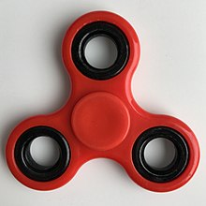
Spinner

Slide 57
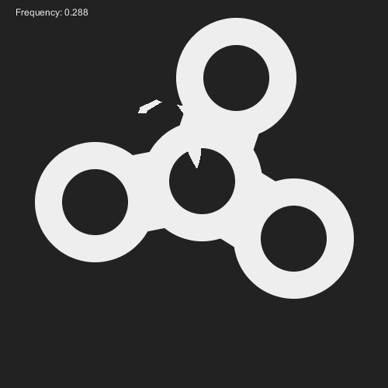
PSpinner

Slide 58
Spinner
float x0, y0,
x1, y1,
x2, y2,
ang, freq,
r1, r2;
final float rad = TWO_PI/3;
void setup() {
size(500,500);
r1 = 140;
r2 = 120;
ang = freq = 0;
stroke(#eeeeee);
}

Slide 59
Spinner
void draw() {
background(#222222);
fill(#eeeeee);
text("Frequency: " + nf(freq, 1, 3), 20, 20);
translate(mouseX, mouseY);
x0 = r1 * cos(ang);
y0 = r1 * sin(ang);

Slide 60
Spinner
ang += freq;
if (freq > 0) freq -= 0.0005;
else freq = 0;
x1 = r1 * cos(ang + rad);
y1 = r1 * sin(ang + rad);
x2 = r1 * cos(ang + rad * 2);

Slide 61
Spinner
y2 = r1 * sin(ang + rad * 2);
fill(#222222);
strokeWeight(100);
line(0, 0, x0, y0);
line(0, 0, x1, y1);
line(0, 0, x2, y2);
strokeWeight(35);

Slide 62
Spinner
ellipse(0, 0, r2, r2);
ellipse(x0, y0, r2, r2);
ellipse(x1, y1, r2, r2);
ellipse(x2, y2, r2, r2);
}
void mouseClicked() {
freq = 0.6;
}

Slide 63
Obj file
The OBJ file format is a simple data-format that represents 3D geometry alone — namely, the position of each vertex, the UV position of each texture coordinate vertex, vertex normals, and the faces that make each polygon defined as a list of vertices, and texture vertices.

Slide 64
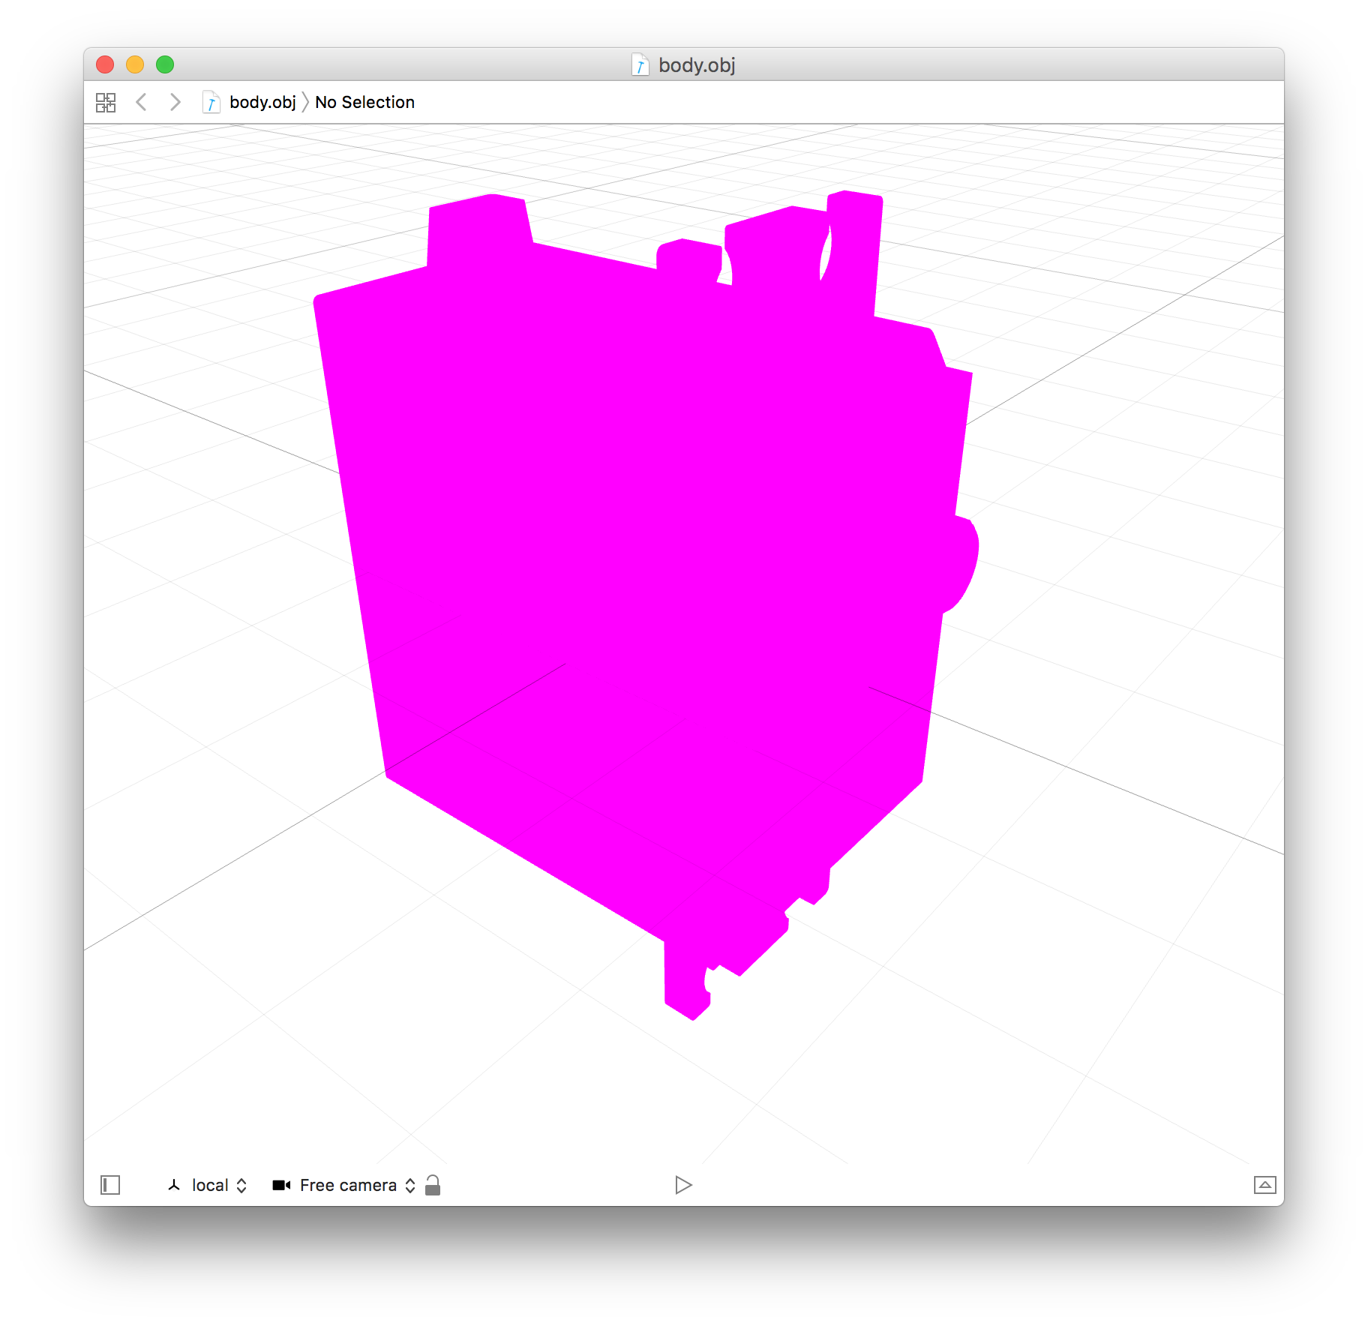
Servo Body

Slide 65
Servo Shape
PShape body;
void setup() {
size(600,600,P3D);
smooth();
body = loadShape("body.obj");
}
void draw() {
shape(body);
}

Slide 66
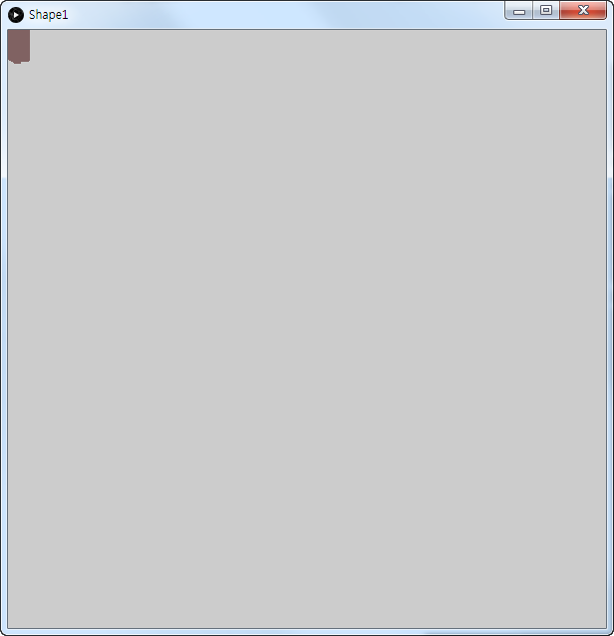
But...

Slide 67
Servo body
PShape body;
float rotX, rotY;
void setup() {
size(600,600,P3D);
smooth();
body = loadShape("body.obj");
}
void draw() {
lights();
background(32);

Slide 68
Servo Body
translate(width/2, height/2, -100);
rotateX(rotX);
rotateY(-rotY);
scale(4);
shape(body);
}
void mouseDragged() {
rotY -= (mouseX - pmouseX) * 0.01;
rotX -= (mouseY - pmouseY) * 0.01;
}

Slide 69
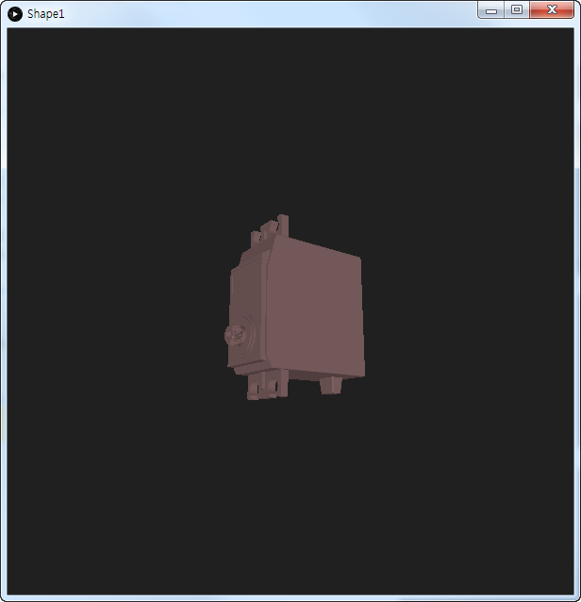
Servo body

Slide 70
Together
PShape body, horn;
float rotX, rotY;
void setup() {
size(600,600,P3D);
smooth();
body = loadShape("body.obj");
horn = loadShape("tmp.obj");
}
void draw() {
lights();
background(32);

Slide 71
Together
translate(width/2, height/2, -100);
rotateX(rotX);
rotateY(-rotY);
scale(4);
shape(body);
translate(0, 10, 20);
rotateZ(radians(frameCount));
shape(horn);
}
void mouseDragged() {
rotY -= (mouseX - pmouseX) * 0.01;
rotX -= (mouseY - pmouseY) * 0.01;
}

Slide 72
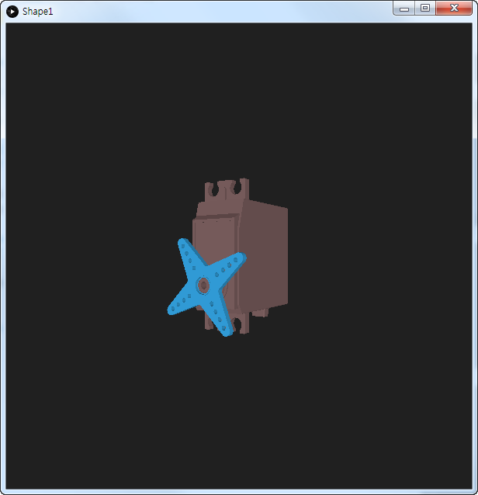
Together

Slide 73
Break...
CU..

