Slide 1

Import & Export Forecasting
Image Set

Slide 2
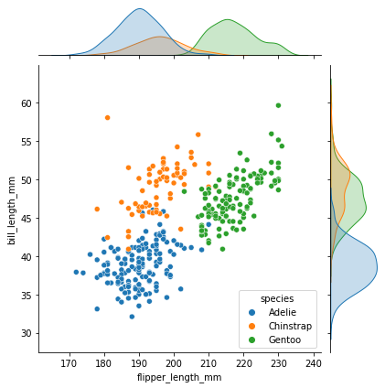
Image Description

