Slide 1
A Data-Driven Approach Towards NIF Neutron Time-of-Flight Diagnostics Using Machine Learning and Bayesian Inference
Su-Ann Chong
Summer Internship Final Wrap-up
Dave Schlossberg, Jim Gaffney, Luc Peterson, Kelli Humbird
August 13, 2021

Slide 2
Outline
Background
Neutron time-of-flight (nToF) diagnostics
nToF physics-driven approach
Motivation
Approaches
Approach overview and project scope
Data generation using physics model (Ballabio)
Surrogate model for data generation using machine learning (DJINN)
Posterior distribution approximation using Bayesian inference (MCMC)
Summary
Work accomplished
Future work

Slide 3
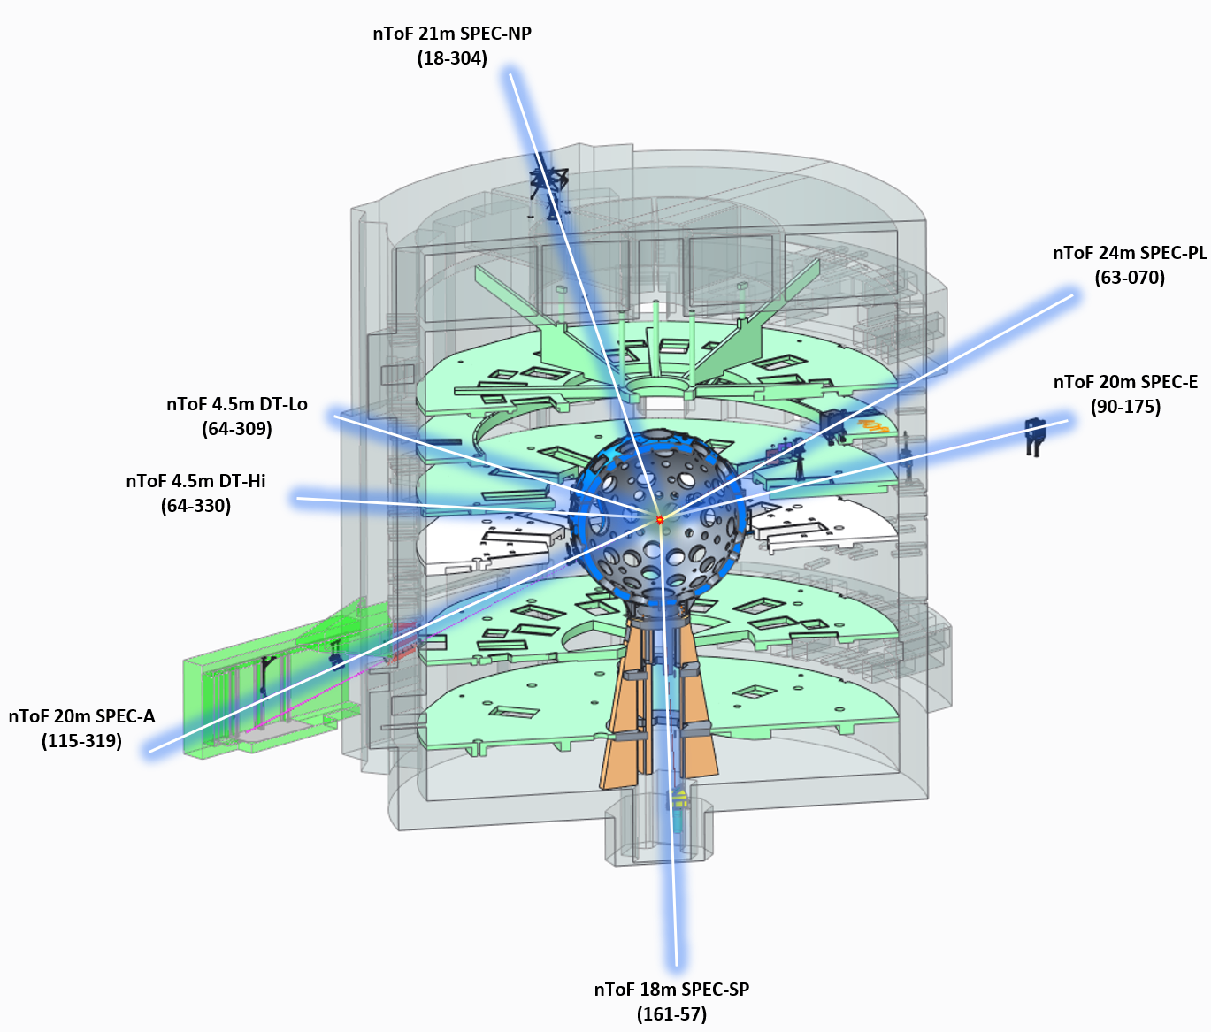
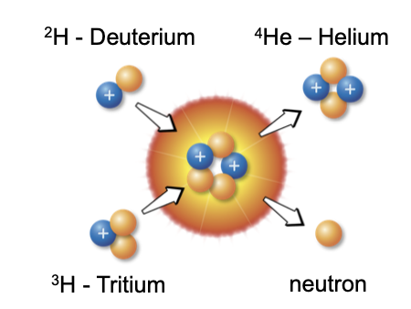
Background: Neutron Time-of-Flight (nToF) Diagnostics
Neutron time-of-flight (nToF) diagnostics
is an essential tool for diagnosing implosions at the NIF.
analyzes the nToF spectrum produced from the fusion reactions to provide important details of the performance of the implosion:
neutron yield
(DT reaction, DD reaction)
ion temperature
down-scatter ratio (DSR)

Slide 4
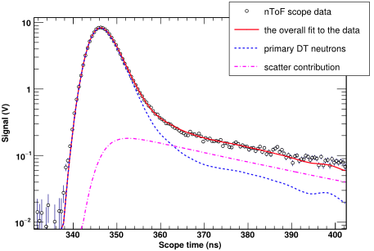

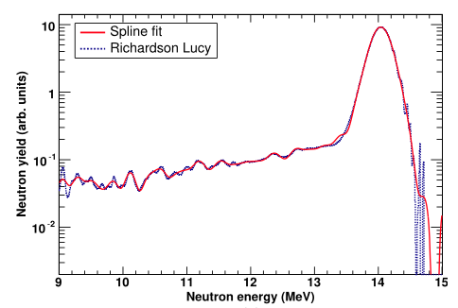

Background: nToF Physics-Driven Approach
The neutron time-of flight spectrum:
From target chamber to nToF detector
With a known distance and time-of-flight, neutron energy can be calculated.
The fit function¹:
The Ballabio distribution²:
[1] R. Hatarik et al J. Appl. Phys. 118, 184502 (2015) [[2] L. Ballabio et al 1998 Nucl. Fusion 38 1723

Slide 5
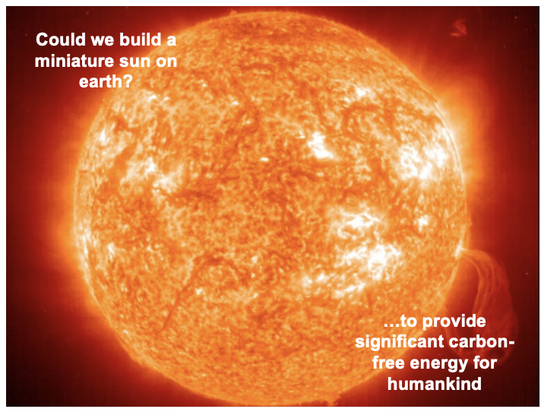
Background: Problem Statement
Motivation behind using data-driven approaches:
To complement the power of physics modeling and simulations
To provide more insights about the underlying physics in complex systems
Goal:
To approximate the probability distributions of fusion quantities
To quantify correlation between fusion quantities
Big picture:
Provide more information for nToF diagnostics to help ICF experiments to achieve higher performing implosions

Slide 6
Approaches: Project Scope
Due to the complexity of the problem, we are narrowing down our problem to start out:
DT reactions (DD reaction excluded)
North pole detector (NTOF-21M-SPEC-NP)
Detector #4
Shots from 2017 – 2021
Data generation routine
31 DT shots that have nToF analysis from 2017 – 2021
Took the fitted Ballabio model to generate scope traces by specifying model parameters and initial conditions
Validated the model with experimental measurements.

Slide 7
Approaches: RoadMap
Running simulation models can be computationally expensive
Bayesian inference (MCMC) (#3)
Prior probability of fusion quantities
Generated by a surrogate ML model
(DJINN) ^{[1]}
--------- OR ----------
Generated by modeling ^{[2,3]}
Data generation using ML model (#2)
Accept/reject
algorithm
Form a Likelihood function
Data generation using physics model (#1)
Compare to observations
[1] K. Humbird, et al 2019. IEEE Transactions on Neural Networks and Learning Systems, 30(5), 1286–1295.
[2] R. Hatarik et al J. Appl. Phys. 118, 184502 (2015)
[3] L. Ballabio et al 1998 Nucl. Fusion 38 1723

Slide 8
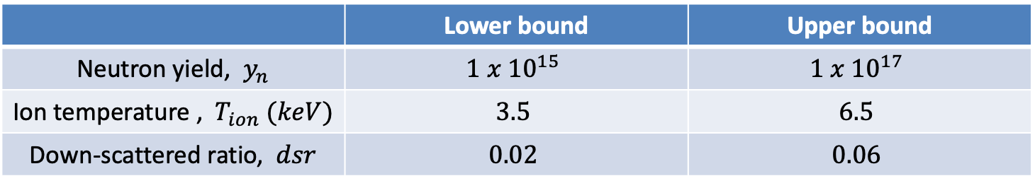
Approaches: Data Generation
Using the Ballabio fit model routine, 10,000 data points are generated using a single shot --- N210605-001-999.
instrument response function (IRF)
detector sensitivity
beam attenuation factors
model parameters:
Random sampling using Latin hypercube sampling
Different shots (taken at different time) may have different IRFs, detector sensitivities and beam attenuation factors due to instrument modifications or performance degradation over time.
 | Lower bound | Upper bound
Neutron yield, $y_{n}$ | $$1 x {10}^{15}$$ | $$1 x {10}^{17}$$
Ion temperature , $T_{ion} (keV)$ | $$3.5$$ | $$6.5$$
Down-scattered ratio, $dsr$ | $$0.02$$ | $$0.06$$

Slide 9
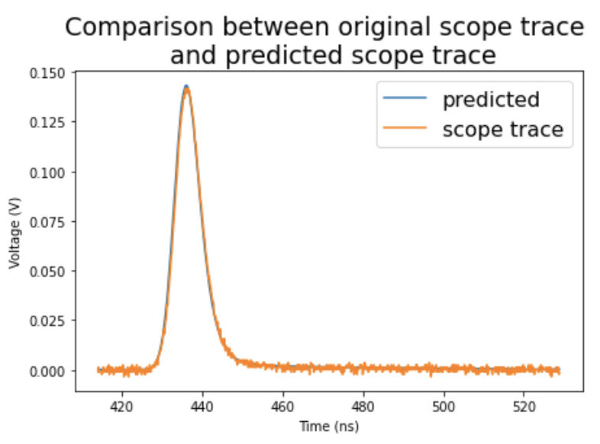
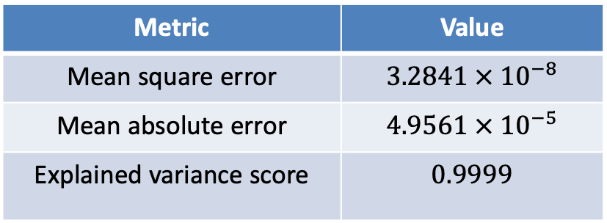
Approaches: Surrogate Model Data Generation Using DJINN
Deep Jointly Informed Neural Network (DJINN)
Network architecture
Evaluation
Hyperparameters | Values
Number of tree | 1
Depth of tree | 6
Metric | Value
Mean square error | $3.2841 × {10}^{−8}$
Mean absolute error | $$4.9561 × {10}^{−5}$$
Explained variance score | $$0.9999$$
Speedup achieve: x1000
Surrogate model: ~1ms Ballabio fit model: ~1s

Slide 10
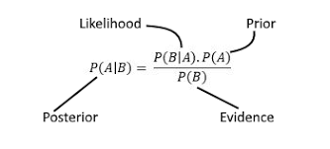
Approaches: Approximate Posterior Probability Using MCMC
Markov Chain Monte Carlo
Based on Bayes theorem
Combination of Markov Chain and Monte Carlo
Random sampling from distributions such that the current state is probabilistically dependent on the previous state
MCMC Parameters | Values
Framework | PyMC3 + Theano
Prior probability distribution | Normal distribution Uniform distribution
Likelihood function | DJINN surrogate model
Sampling method | No U-Turn Sampler (NUTS)
Multiprocessing | 4
Number of iterations | 3,000 (x4)
Number of burn samples | 1,000 (x4)
Execution time | ~ 1.5 mins

Slide 11
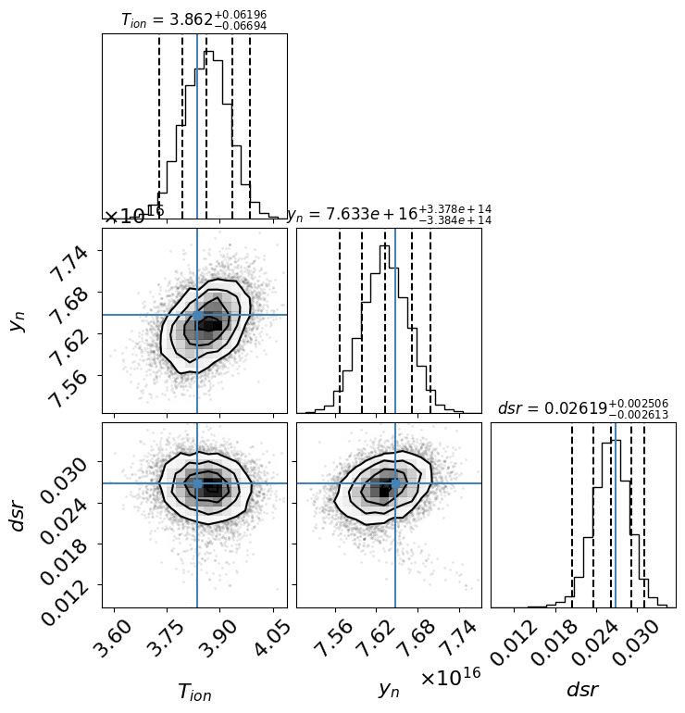
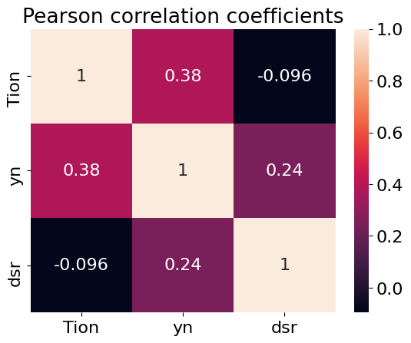
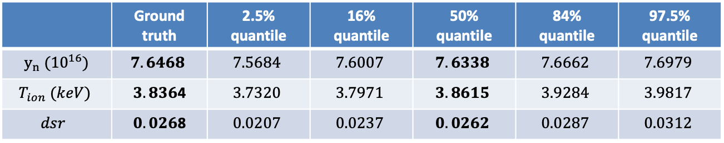
Summary: Preliminary Results From MCMC
 | Ground truth | 2.5% quantile | 16% quantile | 50% quantile | 84% quantile | 97.5% quantile
$y_{n} ({10}^{16})$ | $$7.6468$$ | $$7.5684$$ | $$7.6007$$ | $$7.6338$$ | $$7.6662$$ | $$7.6979$$
$$T_{ion} (keV)$$ | $3.836$4 | $$3.7320$$ | $$3.7971$$ | $$3.8615$$ | $$3.9284$$ | $$3.9817$$
$$dsr$$ | $0.026$8 | $$0.0207$$ | $$0.0237$$ | $$0.0262$$ | $$0.0287$$ | $$0.0312$$
Currently, result reported
are performed on
test data without noise.
Accurate modeling of signal noise is needed before it can be performed on experimental data

Slide 12
Disclaimer
This document was prepared as an account of work sponsored by an agency of the United States government. Neither the United States government nor Lawrence Livermore National Security, LLC, nor any of their employees makes any warranty, expressed or implied, or assumes any legal liability or responsibility for the accuracy, completeness, or usefulness of any information, apparatus, product, or process disclosed, or represents that its use would not infringe privately owned rights. Reference herein to any specific commercial product, process, or service by trade name, trademark, manufacturer, or otherwise does not necessarily constitute or imply its endorsement, recommendation, or favoring by the United States government or Lawrence Livermore National Security, LLC. The views and opinions of authors expressed herein do not necessarily state or reflect those of the United States government or Lawrence Livermore National Security, LLC, and shall not be used for advertising or product endorsement purposes.

