Slide 1


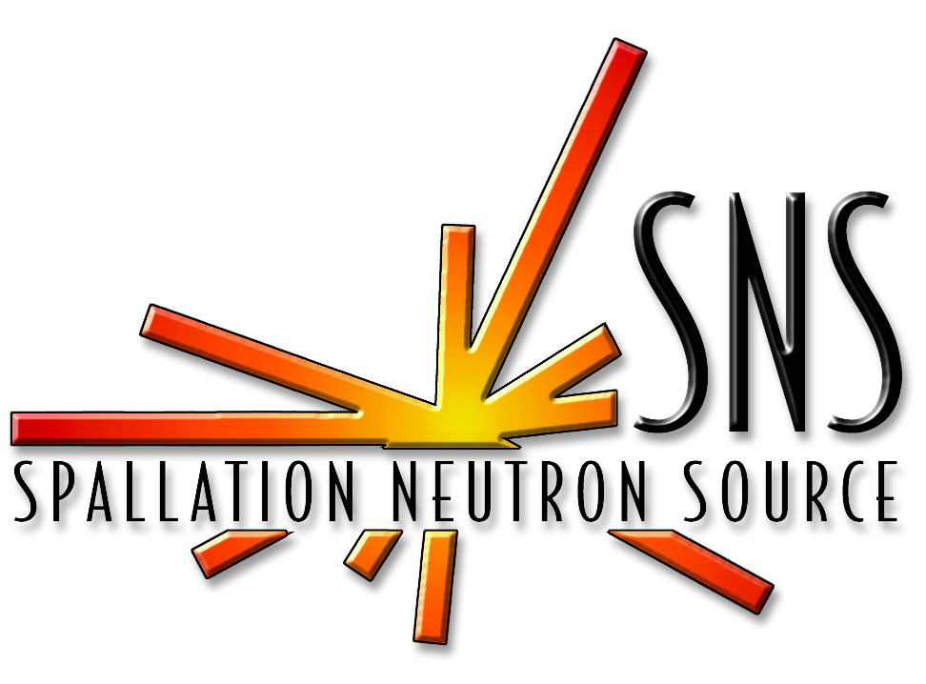
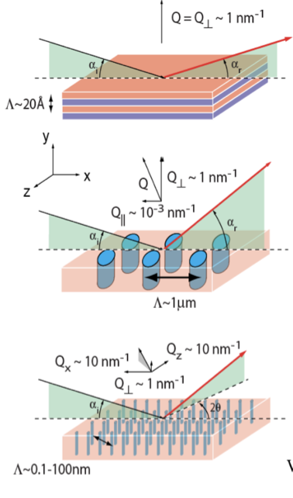
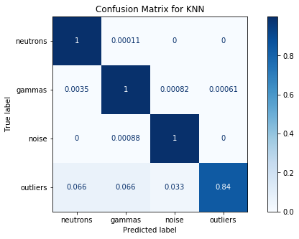
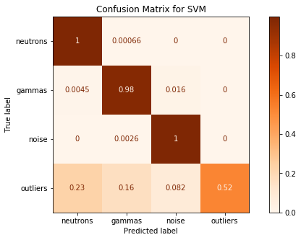
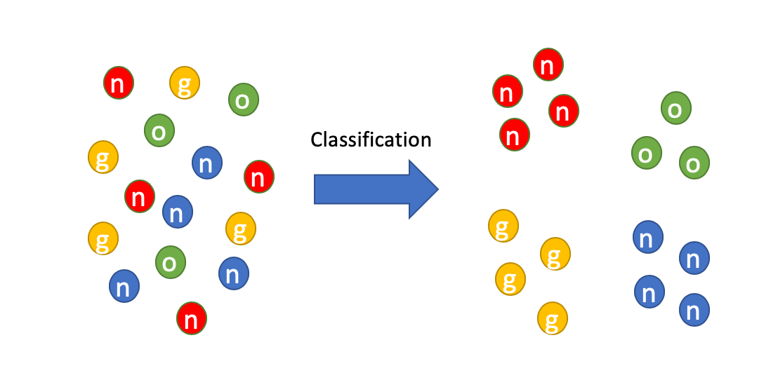
Neutron Event Detection Using Machine Learning R.Brink², S.-A. Chong¹, M. Wyatt¹, Dr. M. Taufer¹ 1 Department of Electrical Engineering and Computer Science, University of Tennessee, Knoxville 2 Bredesen Center, University of Tennessee, Knoxville
Introduction
Neutron scattering is a powerful probe to study the atomic structure and dynamics of materials in a broad range of applications.
Accurate determination of neutrons is important in neutron detection system to ensure accurate studies of materials
Data
Evaluation
Accuracy and Computational Cost
Confusion Matrices .
10-Fold Cross Validation
Unlabeled Data
Number of Features: 2
Number of Samples: 60,000
Missing Values: None
Data Preprocessing: Min-Max Normalization
Labeled Data
Annotation of data is needed for supervised learning
Using domain knowledge, linear boundaries were defined to assign label to each data point
Source: Pynn, Roger. “An Introduction to Neutron and X-Ray Scattering: SANS ...” Neutron Science, ORNL, neutrons.ornl.gov/sites/default/files/Pynn_2019_part_2.pdf..
Confusion Matrix for KNN
Confusion Matrix for SVM
neutrons
gammas
noise
outliers
neutrons
gammas
noise
outliers
Motivation
Detection of neutron events are usually accompanied by other events such as gamma
events, noise and background radiation.
We want to explore the potential of machine learning in improving neutron event detection to enhance the performance of neutron detectors.
Models
True Label
Unsupervised: K-Means Clustering
neutrons
gammas
noise
outliers
True Label
neutrons
gammas
noise
outliers
Using data after pre-processing but not annotations we ran K-means with 2, 3, 4, and 5 seed points.
These attempts failed because K-means looks for circular clusters and we have more oblong clusters.
True Label
True Label
K-Fold Cross Validation
(Accuracy)
K-Fold Cross Validation
(Computational Cost)
Supervised: K-Nearest Neighbor (KNN)
Methodology
Started with unlabeled dataset
Implemented unsupervised learning
Annotated data based on domain knowledge
Applied supervised learning
Evaluated the performance of all classifiers
This method successfully classified the annotated data.
We ran with k values between 3 and 10. K=3 was chosen as the optimal value as it achieved the best accuracy.
Conclusions
K-Means clustering showed sub-par performance with unlabeled dataset.
KNN and SVM both consistently perform classification with accuracy well above 95.0%. The stark difference between the two is the computational cost. KNN is significantly less computationally expensive compared to SVM. KNN is more preferred to SVM in this case.
Supervised: Support Vector Machine (SVM)
This method is also successful at classification.
Hyper parameters chosen:
Kernel = ‘rbf’
Gamma = ‘scale’
C = 1.0
Max_iter = -1 (no limits)

