Slide 1
UUB Baseline Studies

Slide 2
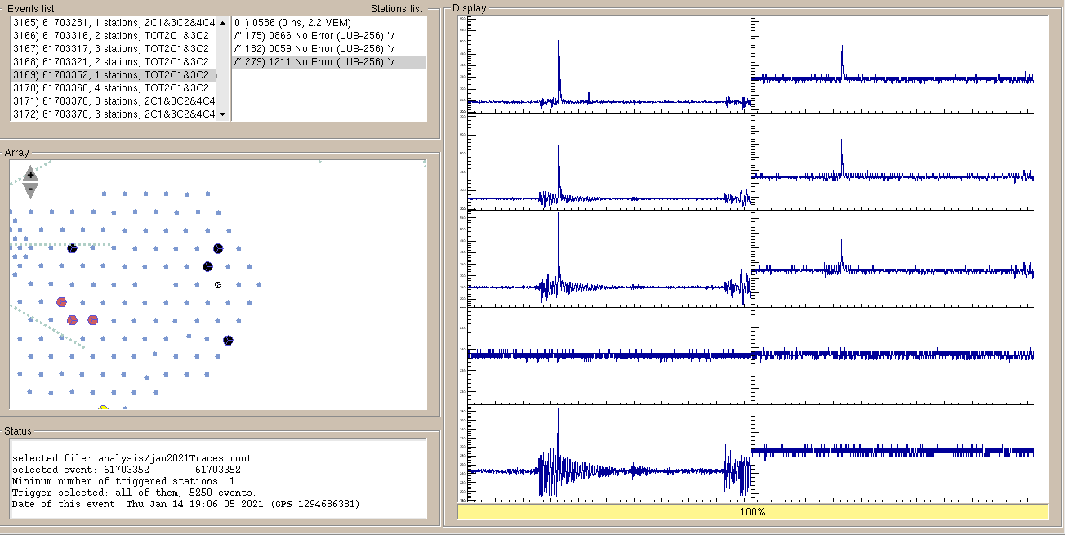
Event 61703352, KS value of 0.27 for PMT 1 HG

Slide 3
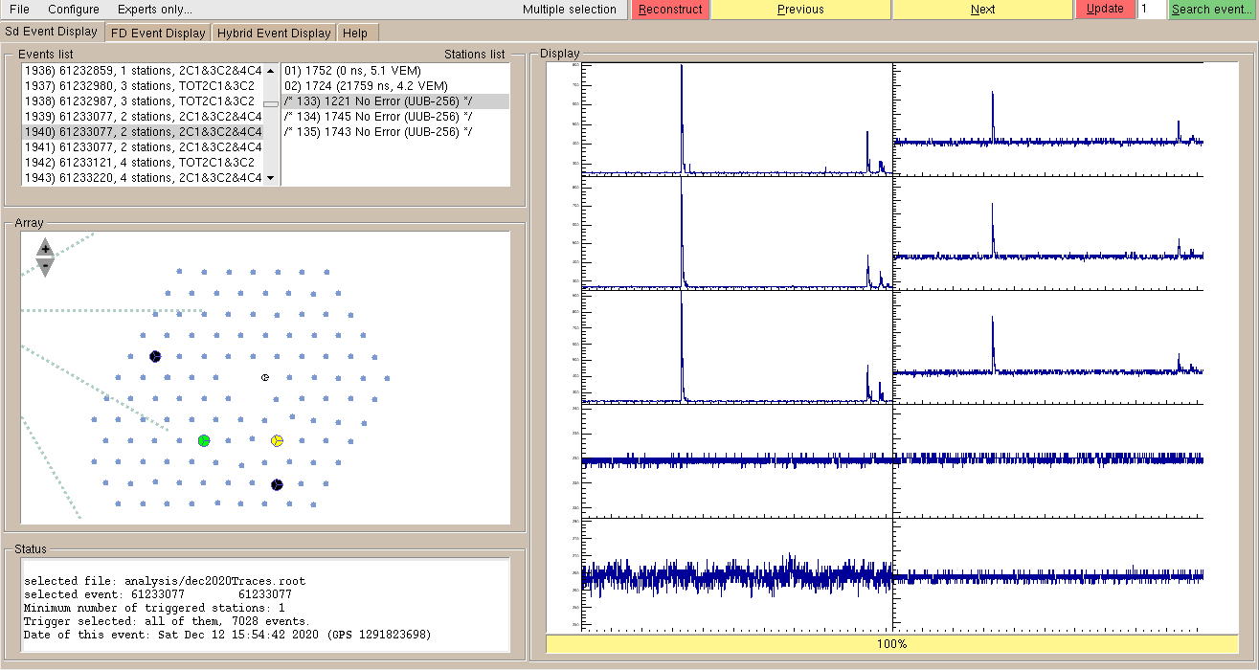
Event 61233077, KS value of 0.31 for PMT 1 HG

Slide 4
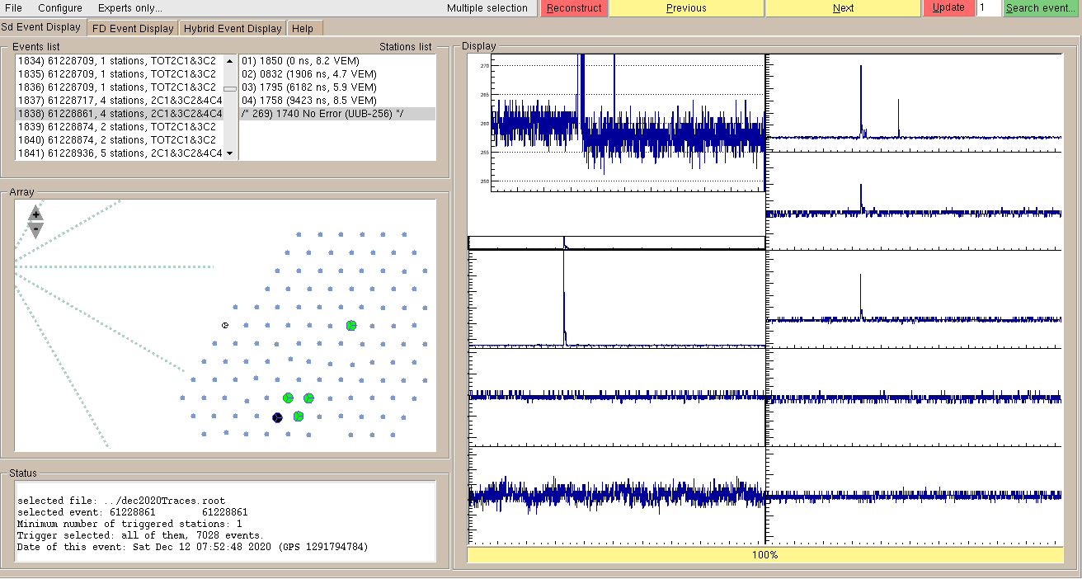

Slide 5
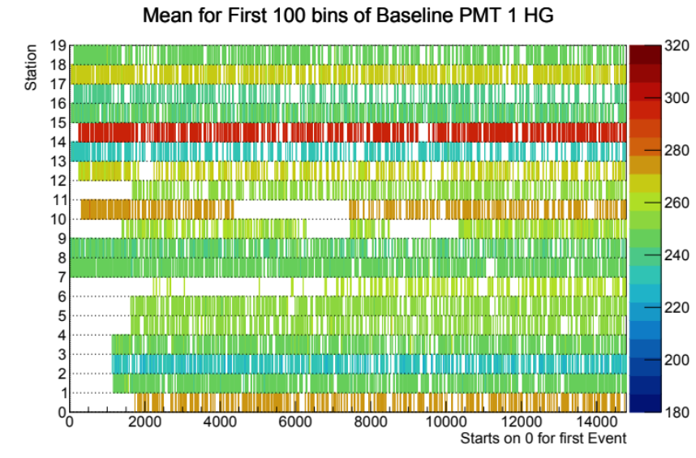
Station ID
0.5 -> 863
1.5 -> 1211
2.5 -> 1217
3.5 -> 1219
4.5 -> 1221
5.5 -> 1222
6.5 -> 1223
7.5 -> 1729
8.5 -> 1735
9.5 -> 1740
10.5 -> 1741
11.5 -> 1743
12.5 -> 1745
13.5 -> 1746
14.5 -> 1747
15.5 -> 1791
16.5 -> 1818
17.5 -> 1819
18.5 -> 1851
Event 0: 61081885, Tuesday December 1, 11:26:48, 2020
Last Event: 61805833, Thursday January 21, 23:20:32, 2021

Slide 6
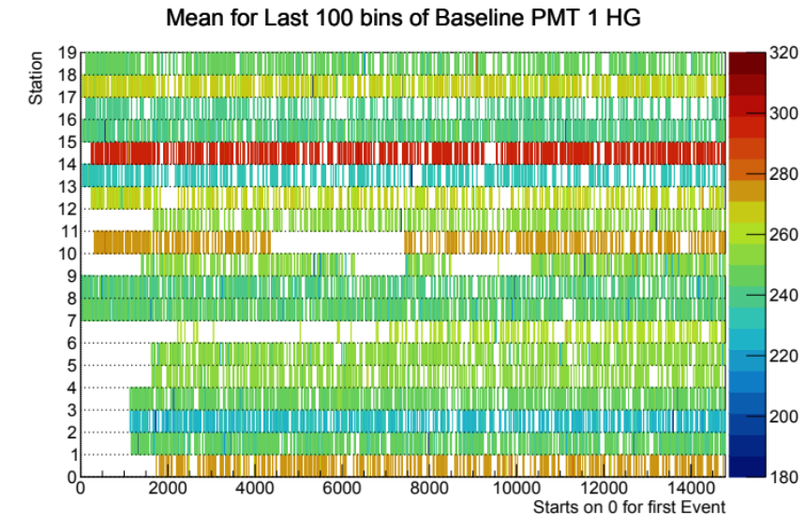
Station ID
0.5 -> 863
1.5 -> 1211
2.5 -> 1217
3.5 -> 1219
4.5 -> 1221
5.5 -> 1222
6.5 -> 1223
7.5 -> 1729
8.5 -> 1735
9.5 -> 1740
10.5 -> 1741
11.5 -> 1743
12.5 -> 1745
13.5 -> 1746
14.5 -> 1747
15.5 -> 1791
16.5 -> 1818
17.5 -> 1819
18.5 -> 1851
Event 0: 61081885, Tuesday December 1, 11:26:48, 2020
Last Event: 61805833, Thursday January 21, 23:20:32, 2021

Slide 7
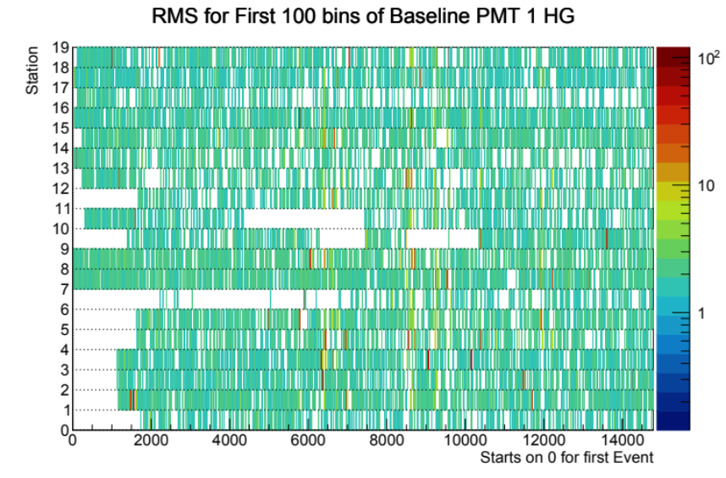
Station ID
0.5 -> 863
1.5 -> 1211
2.5 -> 1217
3.5 -> 1219
4.5 -> 1221
5.5 -> 1222
6.5 -> 1223
7.5 -> 1729
8.5 -> 1735
9.5 -> 1740
10.5 -> 1741
11.5 -> 1743
12.5 -> 1745
13.5 -> 1746
14.5 -> 1747
15.5 -> 1791
16.5 -> 1818
17.5 -> 1819
18.5 -> 1851
Event 0: 61081885, Tuesday December 1, 11:26:48, 2020
Last Event: 61805833, Thursday January 21, 23:20:32, 2021

Slide 8
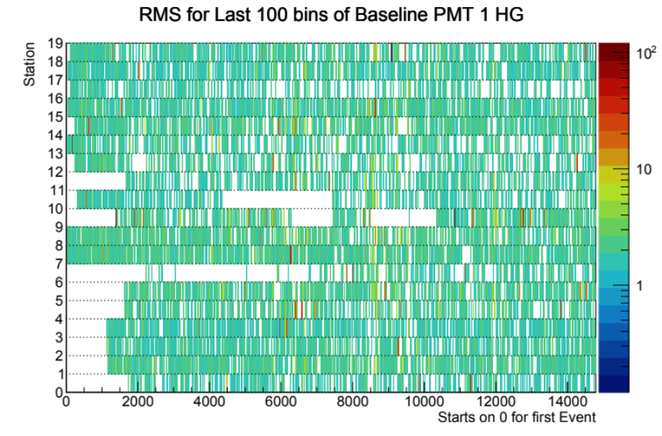
Station ID
0.5 -> 863
1.5 -> 1211
2.5 -> 1217
3.5 -> 1219
4.5 -> 1221
5.5 -> 1222
6.5 -> 1223
7.5 -> 1729
8.5 -> 1735
9.5 -> 1740
10.5 -> 1741
11.5 -> 1743
12.5 -> 1745
13.5 -> 1746
14.5 -> 1747
15.5 -> 1791
16.5 -> 1818
17.5 -> 1819
18.5 -> 1851
Event 0: 61081885, Tuesday December 1, 11:26:48, 2020
Last Event: 61805833, Thursday January 21, 23:20:32, 2021

Slide 9
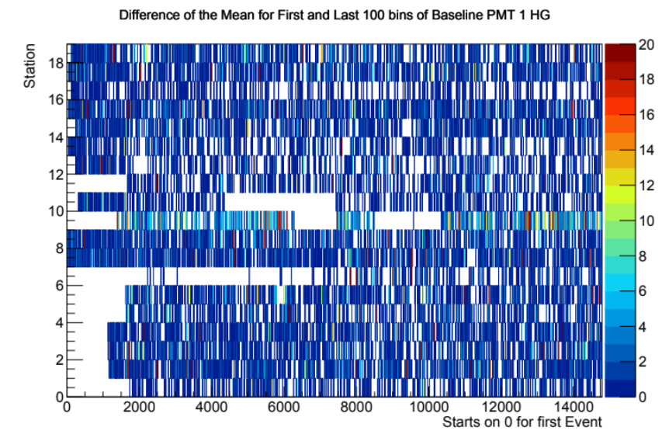
| Mean_First – Mean_Last |

Slide 10
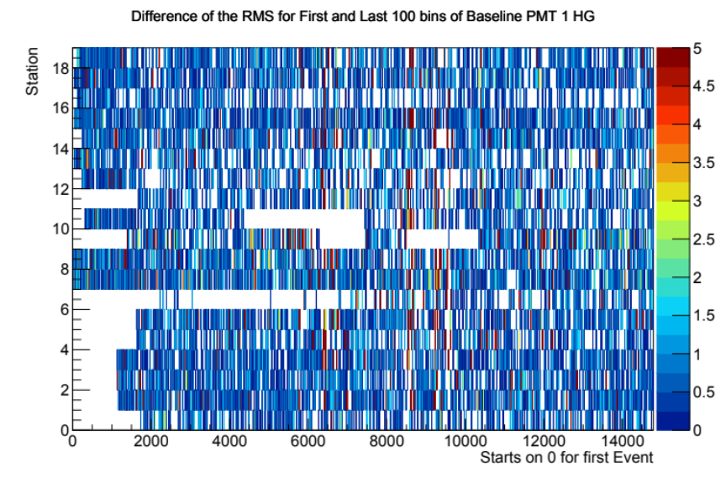
61400409: Thursday December 24, 13:16:08, 2020
61603094: Thursday January 07, 16:41:45, 2021

Slide 11
