Slide 1
D’WORKBENCH
TRADES CRM + ERP
ONE OPERATIONAL MEMORY
The trades CRM
that carries the
whole job.
SELL
PLAN
DELIVER
LEARN
From first inquiry to final invoice—without losing context between teams, tools or handoffs.

Slide 2
The work is connected. The software isn’t.
A trade job crosses customers, sites, crews, suppliers, money and service. Fragmented tools force people to become the integration layer.
01
02
03
The handoff gap
The visibility gap
The memory gap
A promise made in sales arrives late—or stripped of the detail operations needs.
The diary shows time, but not readiness, travel, materials, risk or commercial context.
Decisions disappear into inboxes, notes and the heads of the people holding everything together.
D’Workbench removes the need for heroic memory.
02
02

Slide 3
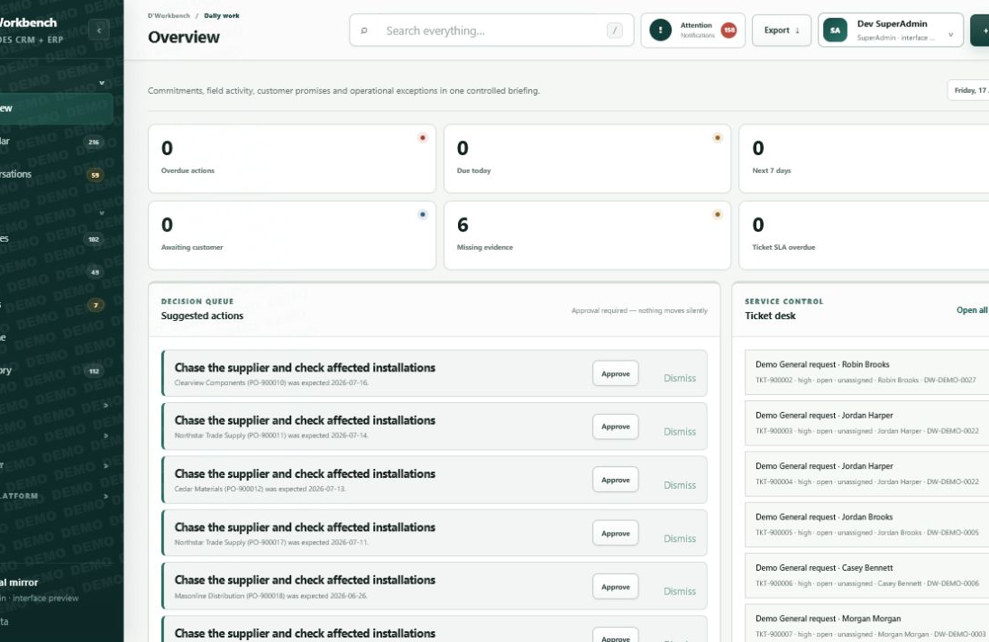
A CRM first. An ERP when the job demands it.
01
CRM holds the relationship
Inquiries, contacts, sites, conversations and the pipeline stay human-readable.
02
The Job is the harness
Contracts, documents, costs, evidence, purchasing and service attach to one durable reference.
03
The Calendar runs the day
People, teams, travel, clashes, readiness and customer commitments meet in one view.
Job is the harness. Calendar runs the day.
03
03

Slide 4
One connected lead-to-cash spine.
Every stage advances the work while preserving the customer, job, commercial and service context behind it.
01
02
03
04
05
06
Inquiry
Qualify
Commit
Deliver
Settle
Support
Capture need
Survey + quote
Contract + deposit
Buy + schedule + install
Invoice + reconcile
Ticket + warranty
Pipeline moves the commercial story. Parallel tracks expose purchasing, scheduling, finance and service truth without pretending every exception is a stage.
04
04

Slide 5
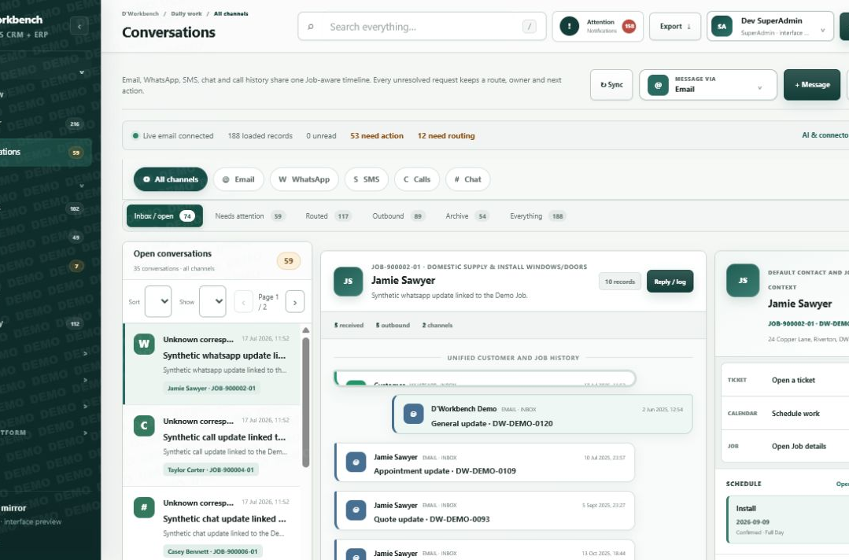
Every message lands in Job context.
ONE CUSTOMER TIMELINE
Email, WhatsApp, SMS, chat and calls stop behaving like separate worlds.
Templates auto-fill the customer, contract, estimate and invoice references.
AI can rewrite tone and structure using the business’s own connected provider.
Open a ticket, schedule work or inspect the Job without leaving the conversation.
Routing remains visible—even when a client forgets to reply all.
05
05

Slide 6
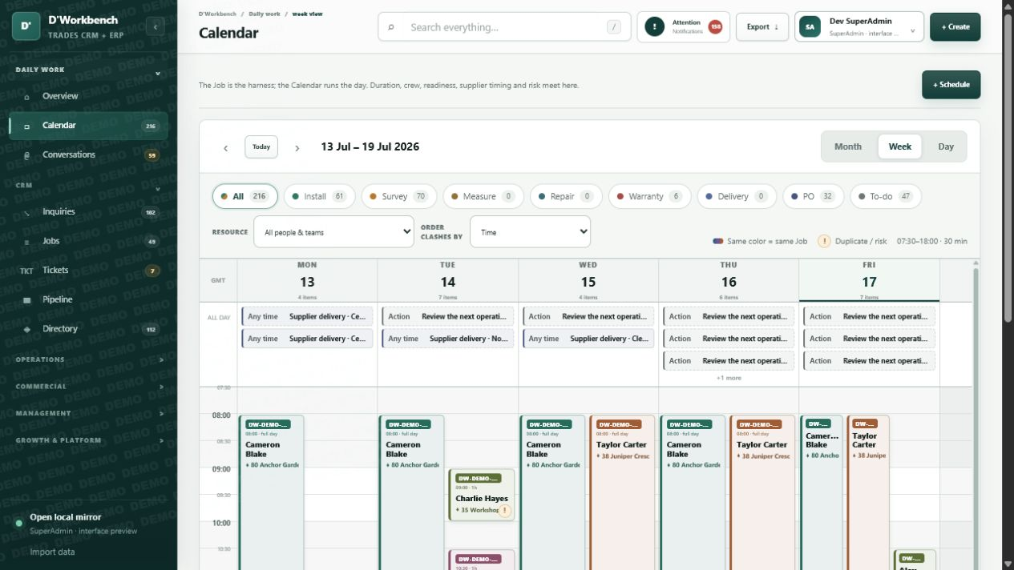
The calendar is command—not decoration.
SEE WORK
Addresses, crews, job references and type stay legible at a glance.
SEE RISK
Clashes, provisional work, absences and duplicate bookings flag—without blocking judgment.
ACT NOW
Open the Job, PO or hover preview directly from the entry.
MONTH · WEEK · DAY
06
06

Slide 7
Depth where trade businesses actually need it.
The CRM stays familiar. Operational depth appears exactly where the work requires it.
PURCHASING + INVENTORY
FINANCE + EVIDENCE
POS-familiar ordering, supplier products, job-cost allocation, templates, restock and delivery tracking.
Contracts, deposits, invoices, reconciliations, documents and audit-ready records remain Job-linked.
TICKETS + SERVICE
WORKFORCE + ACCESS
Every request gets a durable reference, owner, SLA, investigation timeline and resolution trail.
Teams, multi-role users, working hours, holidays and hierarchical access shape dispatch and risk.
07
07

Slide 8
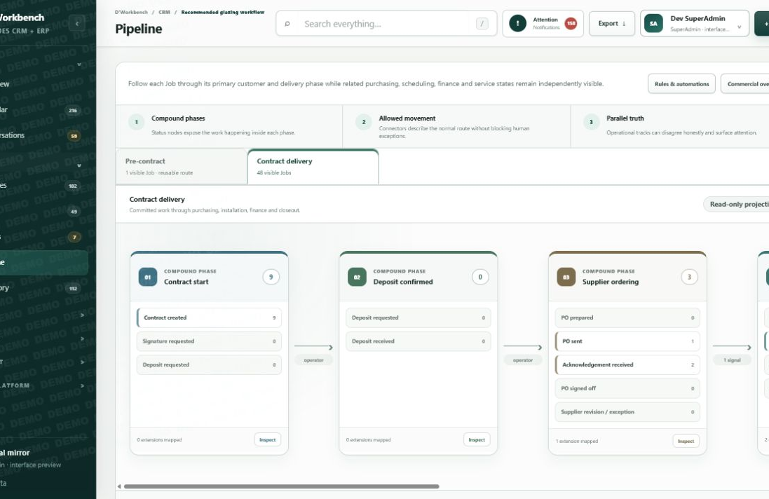
Custom without cutting the operational wires.
THE COMPROMISE
A solid spine.
Editable extensions.
GUARDED CORE
Job identity · contracts · addresses · audit trail · reference integrity
EDITABLE LAYER
Industry templates · stages · rules · messages · reminders · automations
08
08

Slide 9
Built to sell honestly—and operate safely.
The same product has two clear environments. One demonstrates the complete experience. The other refuses to fake a connection that is not configured.
DEMO
LIVE
Always ready to show.
Truth over theatre.
Anonymized, realistic data. Simulated email, SMS, WhatsApp, Xero and AI flows. No dead ends during a sales conversation.
Real business data. Real permissions. Missing integrations raise a visible setup error instead of pretending the message, sync or payment succeeded.
INTEGRATION READY
EMAIL
WHATSAPP
SMS
XERO
MAKE / N8N
BYO AI
09
09

Slide 10
D’WORKBENCH
Stop adapting your
business to generic
software.
Give the business a system that understands the work.
BOOK A WORKING DEMO
CRM first · Operations connected · Memory retained

