Slide 1

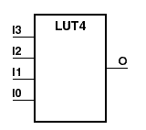

CflexHDL
Design digital circuits in C
Simulate really fast with a regular compiler
© Victor Suarez Rovere

Slide 2
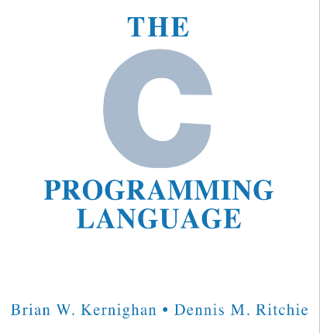
Language benefits
C is much more known than
Verilog/VHDL
Helps to break the "scary" barrier to enter circuit design by embedded software developers
Automatic FSMs from control flow ("while loops")
Comfortable debugging (tools new and upcoming like gdbwave)

Slide 3

Simulation speed benefits
Running compiled C code is even
faster than fast HDL simulators
Simulator runs at 220MHz clock speed (LED glow demo)
The 3D-like video demo surpasses realtime, even with a 15 years old CPU: 126FPS - 38M pixel/s
Original demo: 0.82 FPS (156X slower) - Silice’s “make verilator”

Slide 4

Development time benefits
Compiling C is much faster than doing synthesis (seconds instead of minutes)
240X to 1028X faster than common
synthesis toolchains (led glow demo)
Notable exception: Yosys + NextPNR (just 67X slower)

Slide 5
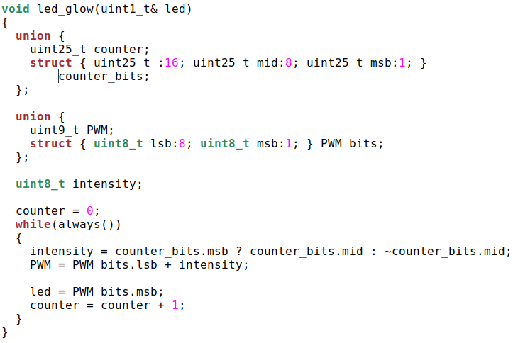
Led glow demo
Argument led represents
the output pin
Bit range access using C
Bitfields, and a union for aliasing
When not translated to verilog,
the always() function defers
execution to the simulator
Sets bit output
and updates register.
The function never returns

Slide 6
Synthesis Workflow
.cc file
C parsing
.ice file
Silice
generated
source
.v file
Verilog
source
Migen /
LiteX
integration
Bitstream
Synth
& load
The C files are translated to verilog and integrated into existing toolchains

Slide 7

Development innovations
The tool is novel in itself, but also required the development of non-existing modules such as:
  CflexParser: the first C++ parser/generator for python. Based on clang indexer’s bindings (tool to be released stand-alone)
  Adding previously unsupported boards to Silice projects
  Graphic display on the simulator: running the original C code or the Verilator output using a same codebase
  Integration of Yosys+NextPNR into LiteX framework: mainlined

Slide 8
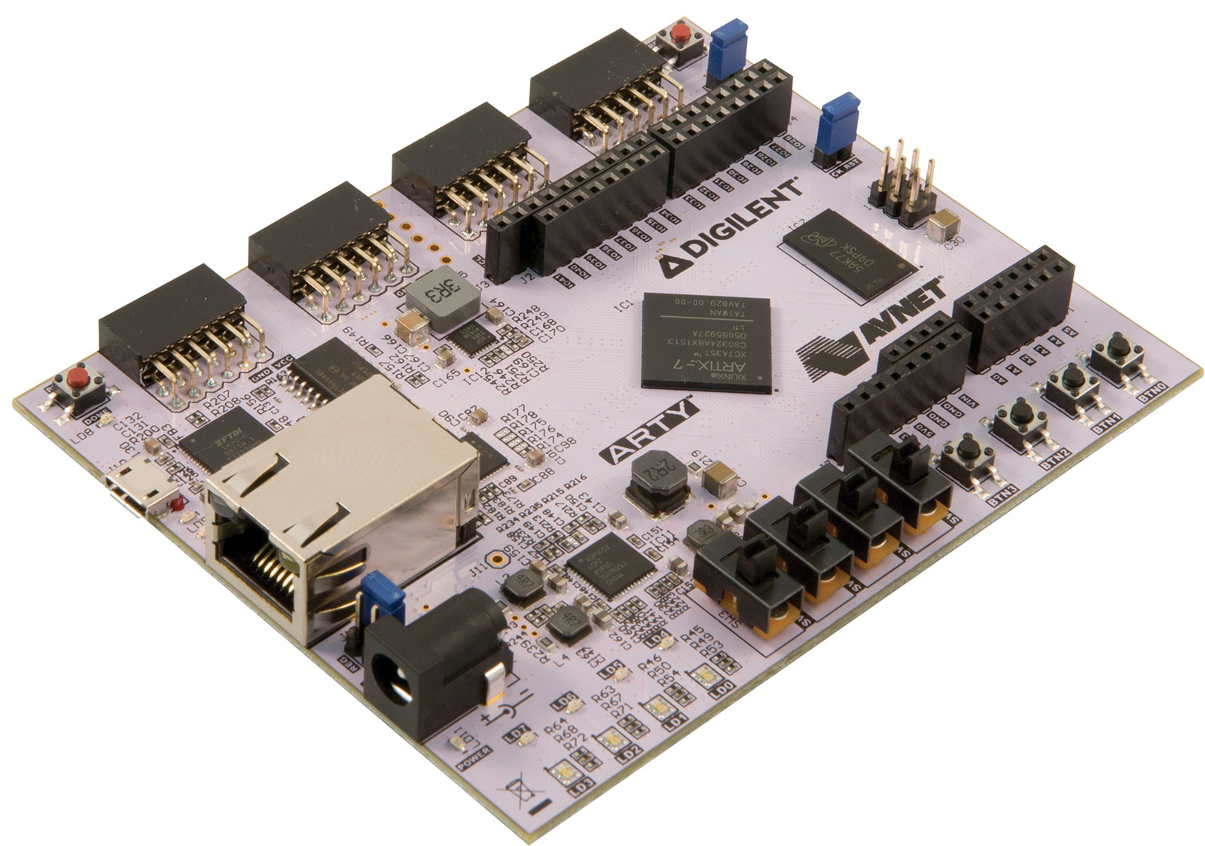
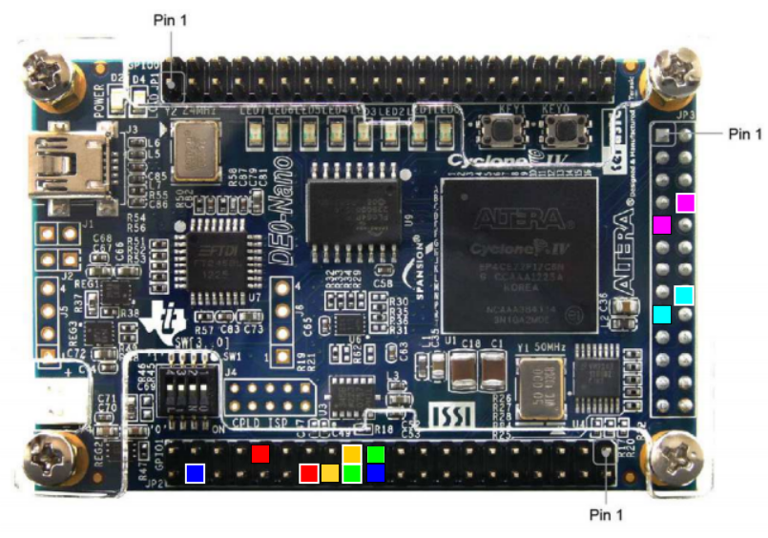
Ease of running & testing
Compile project (for simulation) or synth the bitstream and load, using just make
Currently supporting:
  Digilent Arty A7 board (Xilinx Artix-7)
  Terasic DE0-Nano (Intel Cyclone IV)
  All boards supported by LiteX, easy to add

Slide 9
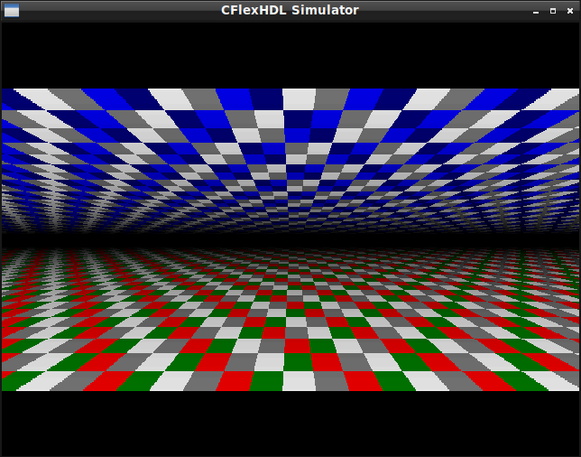
3D-like video generation demo
A VGA demo* was manually ported to C
CflexHDL runs the C logic using any of:
  A simulator that opens a window, after compiling the C sources in 1.3 seconds
  A FPGA board with analog or digital video output (automatically generates and loads the bitstream)
  Verilator output on the simulator window (same graphics but at lower FPS)
* https://github.com/sylefeb/Silice/blob/master/projects/vga_demo/vga_flyover3d.ice

Slide 10
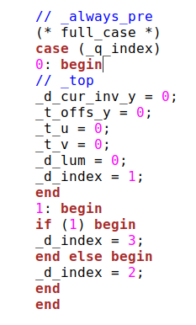
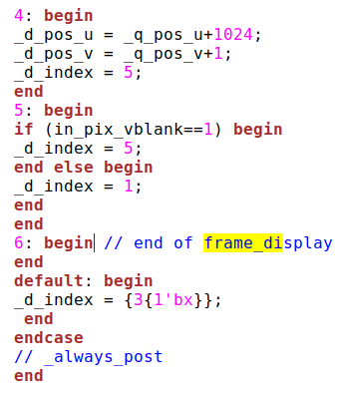
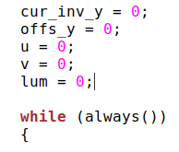
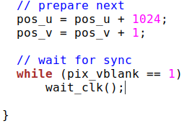
Example C & generated code (FSM)

Slide 11
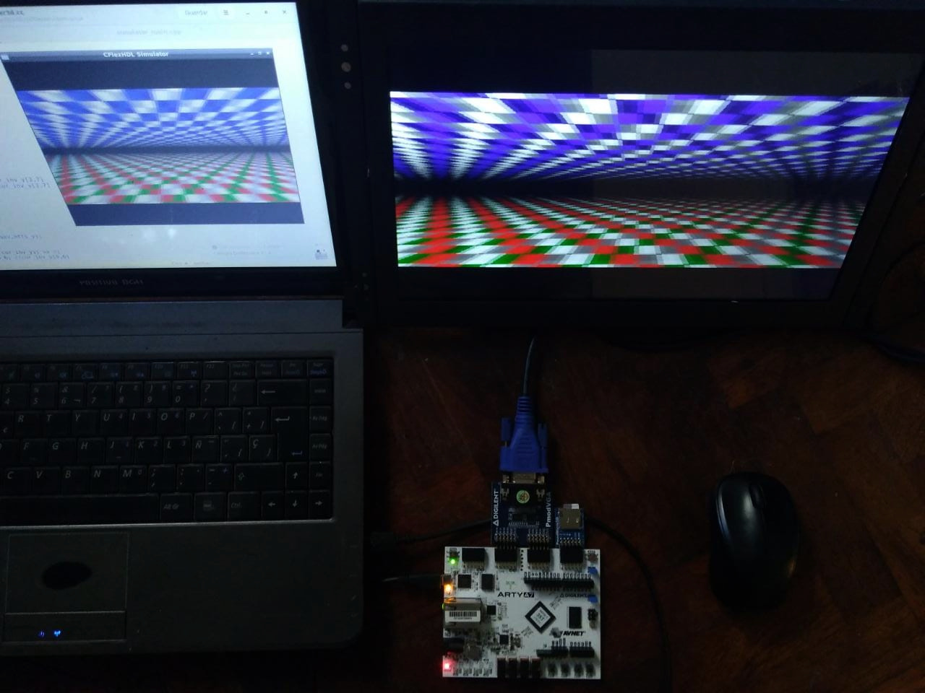
It works! (TM)
$ cd demos/vga
$ make load run
  Makes bitstream,
  loads it,
  compiles the C source,
  and runs it in the simulator window

Slide 12
Dependencies
Sylvain Lefebvre’s Silice HDL: https://github.com/sylefeb/Silice
Clang’s indexer bindings: https://pypi.org/project/clang/
Enjoy Digital’s LiteX: https://github.com/enjoy-digital/litex
Open FPGA Loader: https://github.com/trabucayre/openFPGALoader
SDL 2: https://www.libsdl.org
GNU gcc or Clang
Python 3.x

Slide 13

Planned improvements
Remove depedency with Silice HDL (needs
to add FSM logic generation)
Adopt some C++ syntax like templates to access bit fields
Port a C soft-float library to support floating point in the FPGA
Integrate the soon to be released CflexTypes library, currently providing:
  Integer, fixed point and floating point types of variable widths
  Instrumented templates with operator overloading, for benchmarking resource usage at simulation time and effect of varying bit widths (already tested)

Slide 14

Thanks!
https://github.com/suarezvictor/CflexHDL/

