Slide 1
Using Candle Stick Patterns for Day-Trade
The Data Incubator - Capstone Project
Suat Akbulut

Slide 2
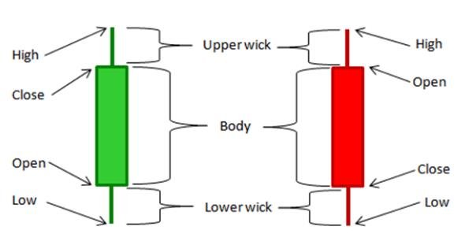
Candle Sticks
Green
(White)
Red
(Black)

Slide 3
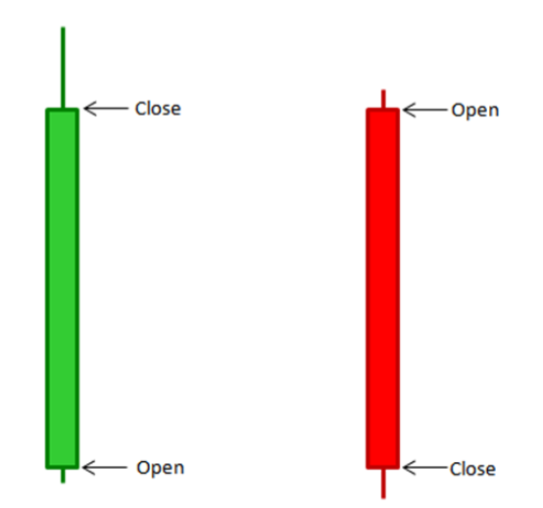
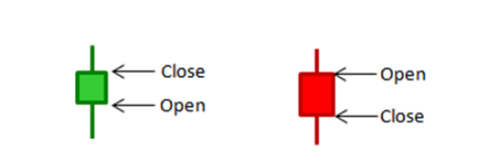
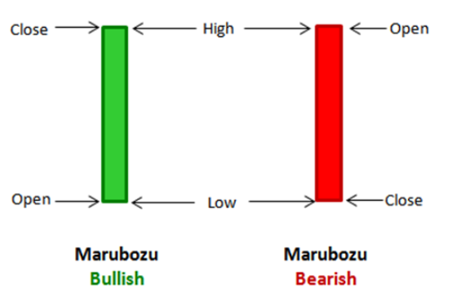
Long Green (Long White)
Short Green
(Short White)
Short Red
(Short Black)
Long Red
(Long Black)

Slide 4
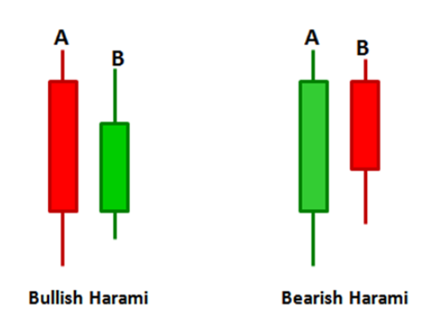
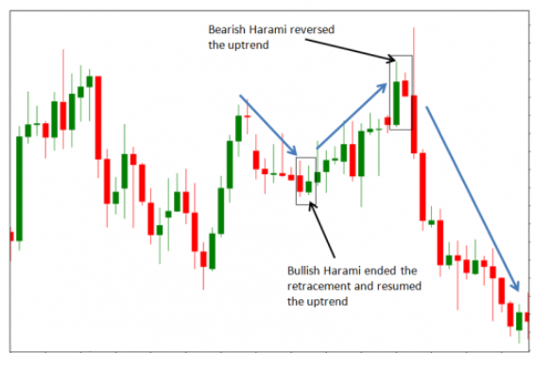
Examples of Candle Stick Patterns

Slide 5
What I do? Statistical significance between Candlestick patterns and Mean Return of Day-Trade ?
Scrape 300,000 daily price data about the top 250 S&P500 stocks
Create candlesticks, day-trade return
Predict whether a day-trade is likely to be profitable with acceptable precision.
Model | Accuracy | Presicion | Recall
Logit (Non-Opt) | 0.521 | 0.528 | 0.756
Random Forest (Non-Opt) | 0.513 | 0.526 | 0.764
NN | 0.516 | 0.530 | 0.674

Slide 6
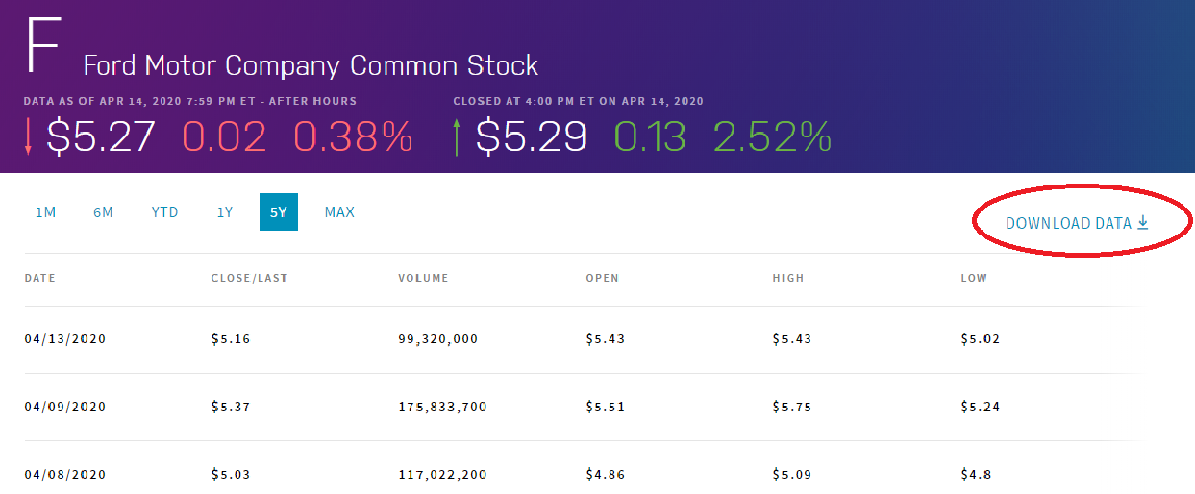
Part 1: Scrape Data
www.nasdaq.com, Top 250 S&P500 Stocks Last 5 year’s daily
Open, High, Low, Close, Volume Used requests Saved as .csv files ticks and Label the Patterns

Slide 7
Part 2: Create Candlesticks and Label the Patterns
First 18 different candle sticks for the last 4 days
Volumes for the last 4 days
Day Trade Profit (%)
Day Trade Profit (Binary)
Labelling the patterns (NEXT)

Slide 8
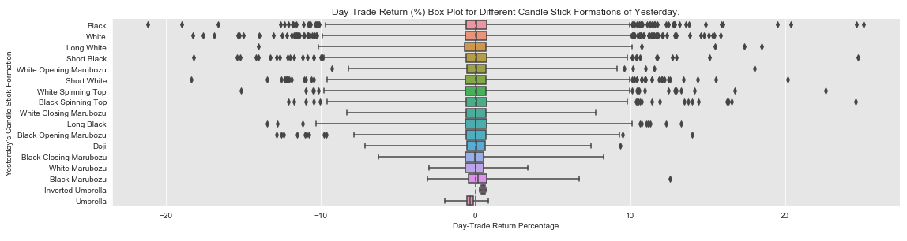
Part 3: Exploratory Data Analysis

Slide 9
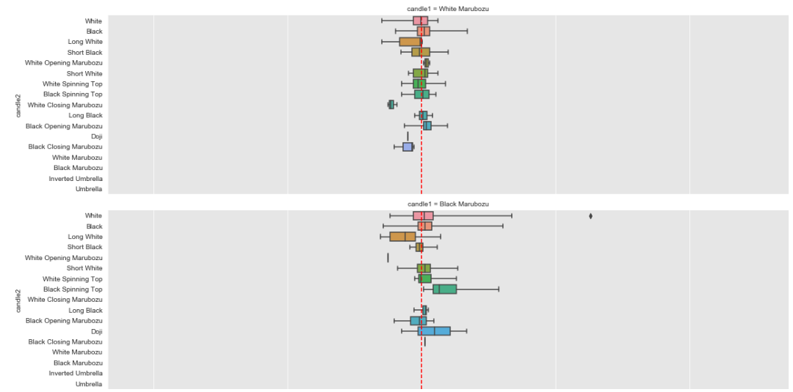
Last Two Day’s Candle Stick Formation vs Percentage Return

Slide 10
Part 4: Preprocess and ML:
Logistic Regression, Random Forest Classifier, and Neural Network
Model | Accuracy | Presicion | Recall
Logit (Non-Opt) | 0.521 | 0.528 | 0.756
Random Forest (Non-Opt) | 0.513 | 0.526 | 0.764
NN | 0.516 | 0.53 | 0.674

Slide 11
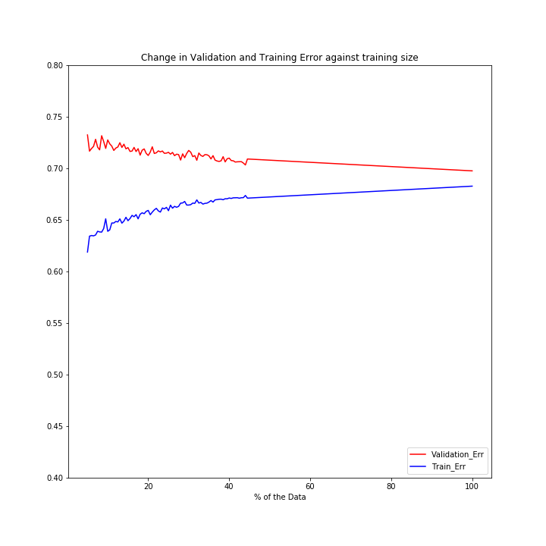
Part 5: More data or More Complication?

Slide 12
Next: More Complexity
First 18 different candle sticks for the last 4 days
Volumes for the last 4 days (std)
Day Trade Profit (%)
Day Trade Profit (Binary)
(NEXT) Labelling the patterns, e.g. Bearish Harami, Bullish Engulfing, Bearish Evening Star, etc.
Maybe candlestick pattern is more effective for smaller capitalized stocks

