Slide 1
The Fundamentals of Network Analysis
Dr. Suat ATAN 19.01.2021

Slide 2
Section 1: Warm-up

Slide 3
Dr. Suat ATAN www.suatatan.com suatatan.wordpress.com
Introduction

Slide 4
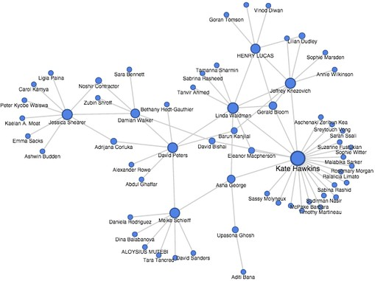
What are networks?
Figure 1: A network

Slide 5
Where are networks?
All around us are networks. Naturally, individuals organize networks themselves. Our families and friends are forming our social groups around each of us. We are living in the networks like:
Twitter, Facebook and other social media
Friendships
Telephone communications

Slide 6

How big are networks?
Figure 2: Bigger networks

Slide 7
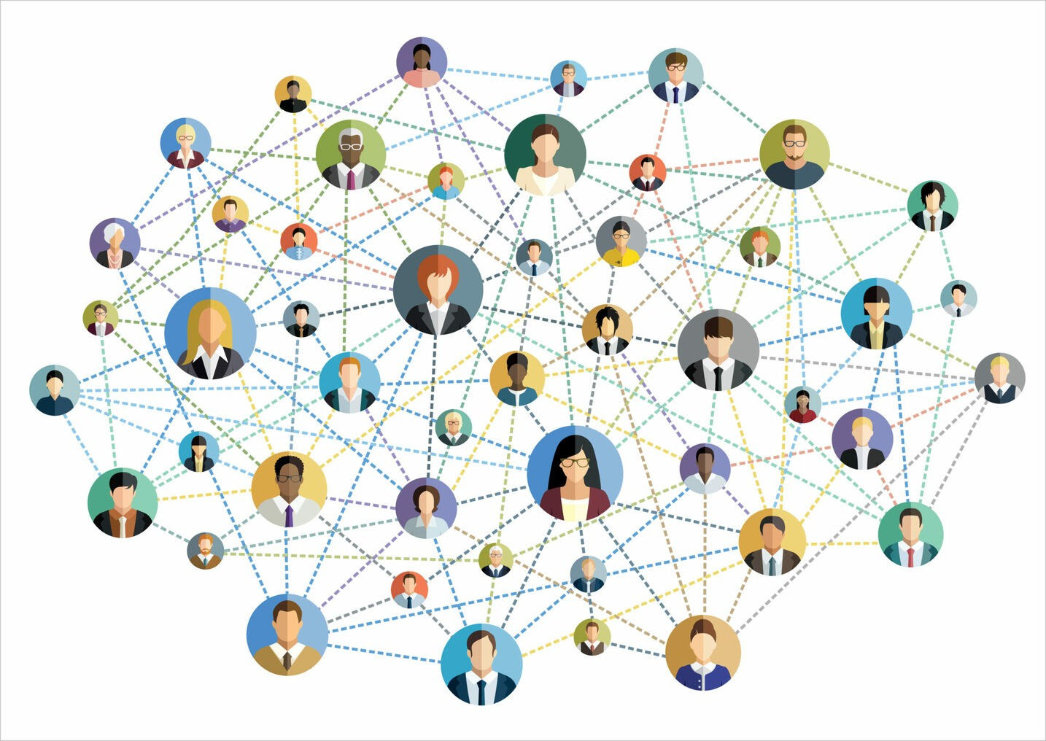
Who or what is in the networks?
Figure 3: Human Network

Slide 8
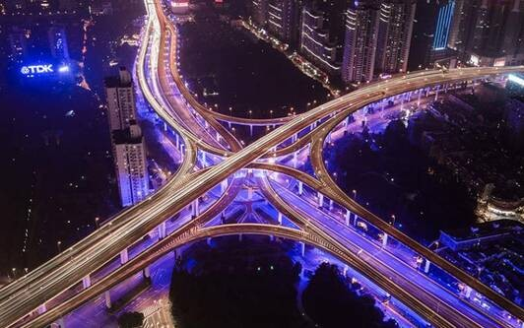
What happens inside networks?
Figure 4: n3

Slide 9
Wrap-up: More examples about networks?
Money transfers
Drug sellers
Stakeholders - Partnerships
Terrorist organizations

Slide 10
What makes a thing ‘network’?
Network is consist two fundamental element:
Points = Asset = Actor = Vertex = Node = Person = Organization
Line = Connection = Edge = Transfer = Relation ## Let’s ask again
How do they connect? What happens when they connect? In this series of lectures, we will focus on questions like.
What is the connection?
Who or what can connect?
What happens when everything becomes connected

Slide 11
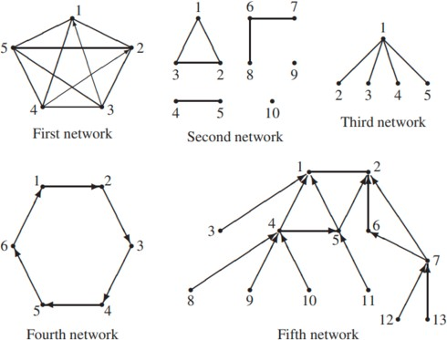
Network Imaginations

Slide 12
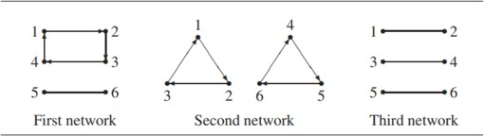
Network Imaginations 2
Figure 6: Types

Slide 13
Show me an example!
John Templon, Data Reporter for Buzzfeed, decided to use Social Network Analysis to create an interactive map to showcase Donald Trump’s affiliations with various organi- zations.
https://digitaluncovered.com/use-social-network-analysis/

Slide 14
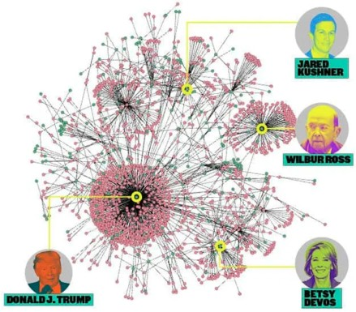
A ‘Very’ Real Network

Slide 15

Bird-eye-view
Figure 8: Dubai

Slide 16
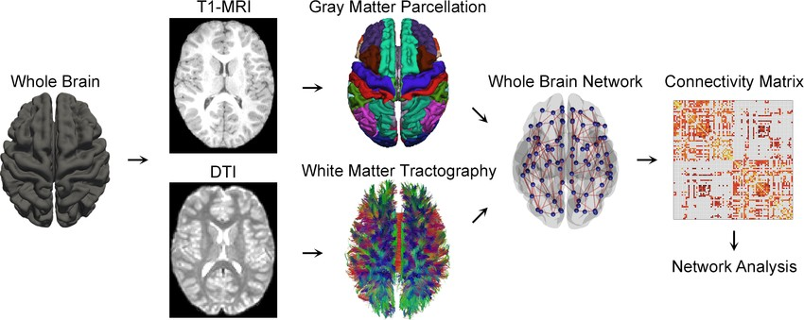
Non-Human Networks
Figure 9: Brain Network
Besides, non-human network systems exist nearly anyplace you see. Our genes and proteins are connected through complex networks. Our brain is presently seen as a complex network of neurons.

Slide 17
Section 2: Theory

Slide 18
Get the ball rolling! Definition
A network consists of a set of nodes (also called vertices) and a set of links (also called edges) connecting some of them
from Great Principles of Computing by Peter J. Denning, Craig H. Martell, Vint Cerf MIT Press, 2015 - Science

Slide 19
Another definition of network
A network is the connecting system (wireline or wireless) that allows shared resources among different computers, and usually among a wide range of users.
from Contemporary Business by Louis E. Boone, David L. Kurtz, Susan Berston Wiley, 2019 Current events

Slide 20
Why I should learn the networks
Assumption: You are like the statistic and data analytics. Imagine this scenario: Some companies have money transfer data like this. Let’s name this scenario as Antares Alliance
From | To | Amount
A | B | 100
A | C | 120
A | D | 200
B | E | 20

Slide 21
Why I should learn the networks
From | To | Amount
B | F | 10
F | C | 100
C | B | 100
D | E | 100
Now, try to answer these questions:
Which company is strong
Is there any similarity between company A and company B
Which company is has not any money transfer (as sender or receiver)

Slide 22
Last and biggest questions:
What if we cannot visualize this?
What if we visualize but we just see the messy points and lines?

Slide 23
Network analysis can help you
To understand big-picture
To analyze smallest picture with its relations to the whole.
Ang Sang Wahe Guru? (to be explained).
https://www.youtube.com/watch?v=lPp2wtVquBU

Slide 24
Network Analysis with Breaking Bad:
Gustavo’s e-mail traffic:
Of course, we have not this kind of data however let’s imagine:
From | To | Hour
Gustavo | El-Capo | 5.00 am
Gustavo | Mr. White | 8.00 am
Pinkman | Gustavo | 9.00 am
Pinkman | El-Capo | 7.00 am

Slide 25
Why Should You Use Social Network Analysis?
Visualization and Effectiveness and mapping
Pattern detection
Hypothesis test

Slide 26
Section 3: Tool

Slide 27
Which tool we’ll use? : R
Integtrated
Flexible
Open Source

Slide 28
R is Open source
Open source software is software with source code that anyone can inspect, modify, and enhance.
“Source code” is the part of software that most computer
users don’t ever see; it’s the code computer programmers can manipulate to change how a piece of software—a “program” or “application”—works. Programmers who have access to a computer program’s source code can improve that program by adding features to it or fixing parts that don’t always work correctly.
https://opensource.com/resources/what-open-source

Slide 29
R is compact
Comparison of R with commerical tools like SPSS/SAS
Network analysis capacity
Reporting possibilities (shiny).
e.g: https://suatatan.shinyapps.io/JournalAnalytics/

Slide 30
R package ecosystem
Traditional statistic is just simple attribute of R
R provides to import and export from various alternantives like Gephi or Ucinet.
R package ecosystem are vibrant and well documented.

Slide 31
Recall R Fundamentals
myvar = 120
list_a = c(10,20,30) list_b = c(11,21,33)
mydataframe = data.frame(list_a,list_b)

Slide 32
Recall R Fundamentals
mydataframe
## list_a list_b
## 1 | 10 | 11
## 2 | 20 | 21
## 3 | 30 | 33

Slide 33
Filtering Data Frames by Dplyr
library(dplyr)
mydataframe %>% filter(list_a == 10)
## list_a list_b ## 1 10 11

Slide 34
Recall Dplyr Methods
select(), which is used to subset a dataframe by its columns;
arrange(), which is used to sort rows in a dataframe based on attributes held by particular columns;

Slide 35
Recall Dplyr Methods
mutate(), which is used to create new variables, by altering and/or combining values from existing columns; and
summarize(), also spelled summarise(), which is used to collapse values from a dataframe into a single summary.

Slide 36
Reading Data From CSV
df = read_csv("table.csv")

Slide 37
Section: Quick-Start

Slide 38
Installation
#install.packages("statnet")
#install.packages("devtools") #devtools::install_github("DougLuke/UserNetR")

Slide 39
Calling packages
library(statnet)
library(UserNetR)

Slide 40
Inspecting Data
data(Moreno)
Moreno
## Network attributes: ## vertices = 33
## directed = FALSE ## hyper = FALSE
## loops = FALSE
## multiple = FALSE ## bipartite = FALSE ## total edges= 46
## missing edges= 0
## non-missing edges= 46 ##
## ##
Vertex attribute names: gender vertex.names
##
## No edge attributes

Slide 41
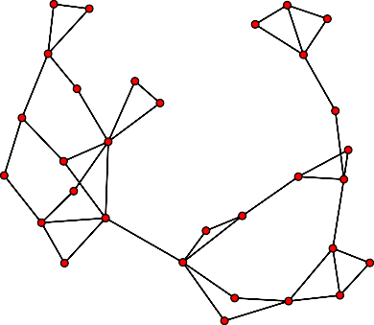
Introduction to Visualization
plot(Moreno)

Slide 42
Visualization by Gender
## [1] 2 2 2 2 2 2 2 2 2 2 2 2 2 2 2 2 2 1 1 1 1 1 1 1 1

Slide 43
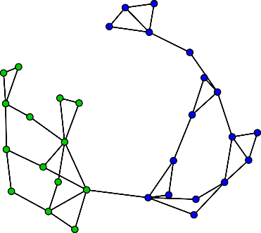
Visualization by Gender

Slide 44
Explaining Visualization
The resulting plot makes it clearly obvious how two subtly different subgroups, based on gender, make up the friendship network. The most significant structural characteristics found in the social network can often be revealed by a rapidly generated network graphic like this.

Slide 45
Size
network.size(Moreno)
## [1] 33

Slide 46
The Fundamentals of Network Analysis Section: Quick-Start
Size
2021-01-30
network.size(Moreno)
## [1] 33
Size
The most basic characteristic of a network is its size. The size is simply the number of members, usually called nodes, vertices or actors. The network.size() function is the easiest way to get this. The basic summary of a statnet network object also provides this information, among other things. The Moreno network has 33 members, based on the network.size and summary calls. (Setting the print.adj to false suppresses some detailed adjacency information that can take up a lot of room.)

Slide 47
Summarizing the descriptive characteristics of the ^{net}s^{w}uºmm^{r}a^{k}ry(Moreno,print.adj=FALSE)
## Network attributes: ## vertices = 33
## directed = FALSE ## hyper = FALSE
## loops = FALSE
## multiple = FALSE ## bipartite = FALSE ## total edges = 46
## missing edges = 0
## non-missing edges = 46 ## density = 0.08712121
##
## Vertex attributes: ##
## gender:
## numeric valued attribute

Slide 48
Density (For Directed Networks)
L number of observed connection in the network
k maximum number of possible actors
D is between 0 and 1:
0: no connection
1: full connection
L
× (k − 1)
D_{d} = _{k}

Slide 49
Density (For Undirected Network)
2L
× (k − 1)
D_{u} = _{k}
## Density Function
gden(Moreno)
## [1] 0.08712121

Slide 50
Density (Zoom ++)
This network shows the interactions among the Jemaah Islamiyah terrorist group that carried out the bombings in Bali in 2002.
http://dougluke.github.io/UserNetR/reference/Bali.html
gden(UserNetR::Bali)
## [1] 0.4632353
This network object contains collaboration ties among 493 members of Washington University’s Institute of Clinical and Translational Sciences (ICTS).
http://dougluke.github.io/UserNetR/reference/ICTS_G10.html
gden(UserNetR::ICTS_G10)
## [1] 0.01120566

Slide 51
Reviewing Network Fundamentals
Let’s read data from our local file system:
local <- read.csv("local.csv")
local
## from to ## 1 a b
## 2 a c
## 3 a d
## 4 b c
## 5 b e
## 6 b f
## 7 a f
## 8 c f
## 9 a f
## 10 b f
## 11 c f

Slide 52
Why?
library(statnet)
plot(local)
1.0
f
0.8
e
0.6
to
d
0.4
c
0.2
b
0.0
a
b
c
from

Slide 53
Nature of objects
Whereas we are working on data science we still need to be aware some concepts of OOP.
The variable named by local is standard data frame object we need to convert it into statnent graphic data.
►

Slide 54
Type Conversion
network_obj = network(local)

Slide 55
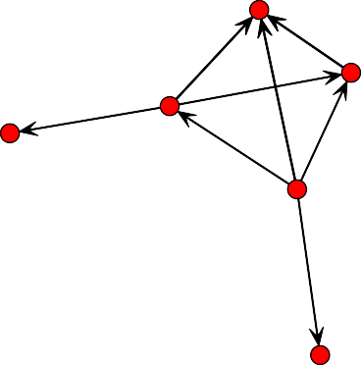
Plotting from Data Frame
gplot(network_obj,displaylabels=TRUE)
f
c
b
e
a
d
## Network Size

Slide 56
Network Density
gden(network_obj)
## [1] 0.3666667

Slide 57
What we learned?
What is the network analysis
Why it is important
Recalling R data frames
Installing statmet

Slide 58
What we learned?
Size
Density
Interpreting density

Slide 59
End
Dr. Suat ATAN

