Slide 1

Network Analysis
AS-516
Dr. Suat ATAN
Week:2

Slide 2
Lesson Plan
Understanding network metrics
Degree and Degree Distribution
Density
Shortest Paths & Average Path
Comparison of Networks

Slide 3
Degree & Degree Distribution

Slide 4
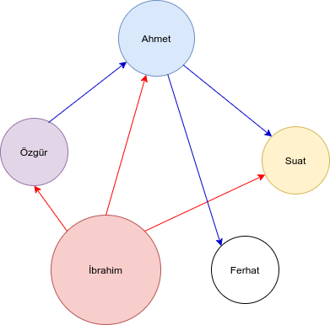
Degree and degree distribution
Node | Degree
Ahmet | 4
Özgür | 2
İbrahim | 3
Ferhat | 1
Suat | 2
How many e-mail you get or send? İbrahim: 3

Slide 5
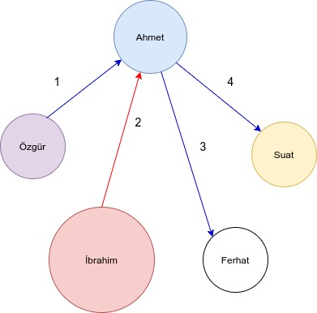
Degree and degree distribution
Node | Degree
Ahmet | 4
Özgür | 2
İbrahim | 3
Ferhat | 1
Suat | 2
Degree: Number of connection

Slide 6
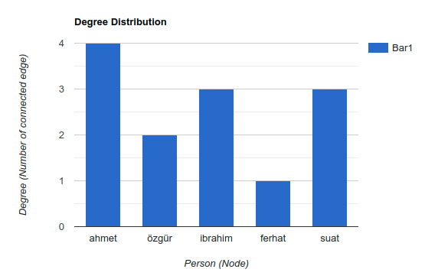
Degree and degree distribution
Degree distribution: Tally of degree of all nodes

Slide 7
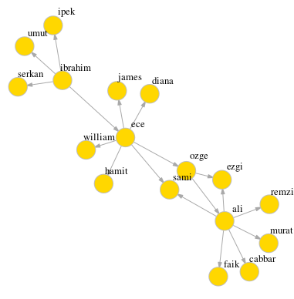
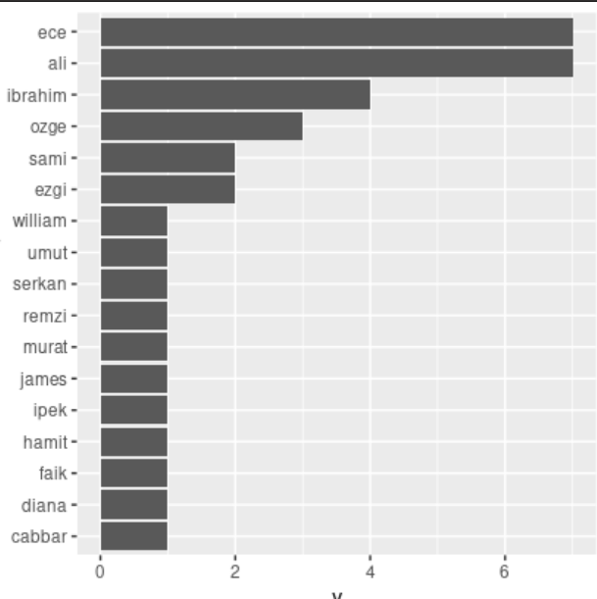
Imbalanced Degree Distribution

Slide 8
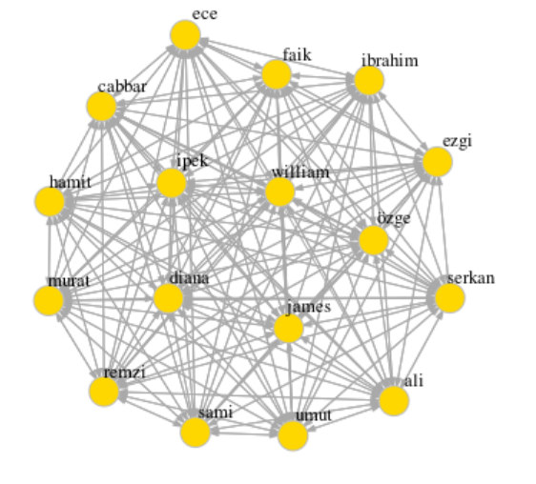
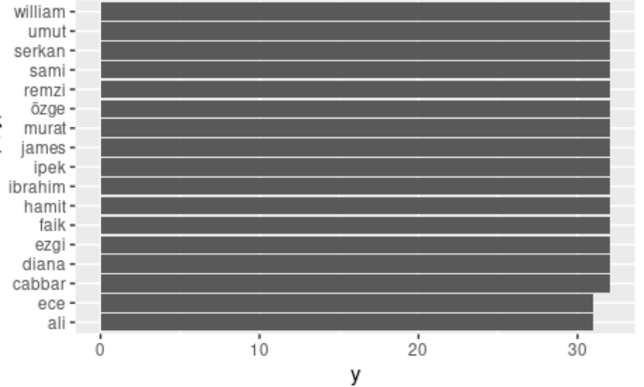
Balanced Degree
Distribution

Slide 9
Degree & Degree Distribution (Application)

Slide 10
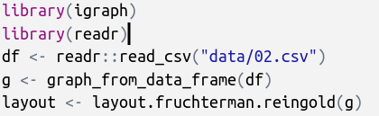
Calculating Degree
reading data
importing libraries
converting data frame to graph object
Setting layout of network
(optional)

Slide 11
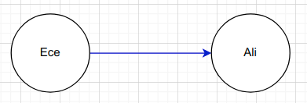
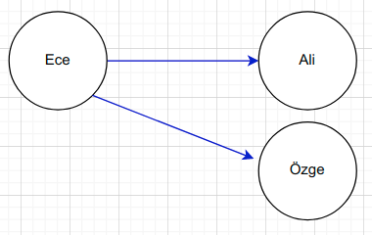
Data File (02.csv)
ece | ali
ece | özge
ece | ibrahim
ece | ahmet
ece,ali
ece,özge
ece,ibrahim
ece,ahmet
ece,suat
suat,ibrahim
suat,özge
suat,sabri
ali,ahmet
ali,mehmet

Slide 12
Plotting the graph object
plot(g,
edge.arrow.size=.1,
vertex.color="gold",
vertex.size=15,
vertex.frame.color="gray",
vertex.label.color="black",
vertex.label.cex=0.8,
vertex.label.dist=2,
edge.curved=0,
layout=layout)
Graph object “g” that we generated before
quick code
Visual Attributes
plot(g)
Layout that we generated from “g” object.

Slide 13
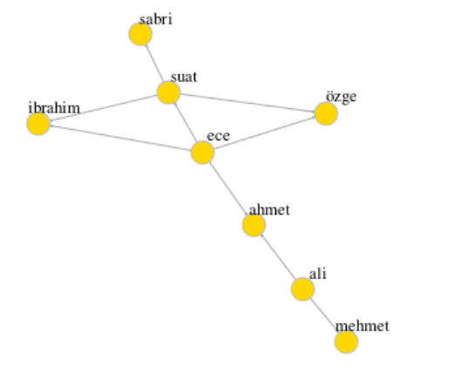
Plot result

Slide 14
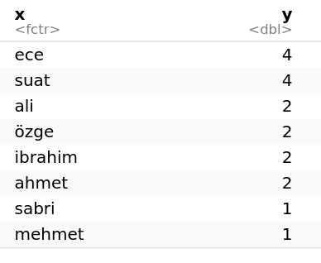
Calculating Degree Distribution
special function for
calculating degree
deg <- degree(g)
x = names(deg)
y = deg
ddist = data.frame(x,y)
ddist

Slide 15
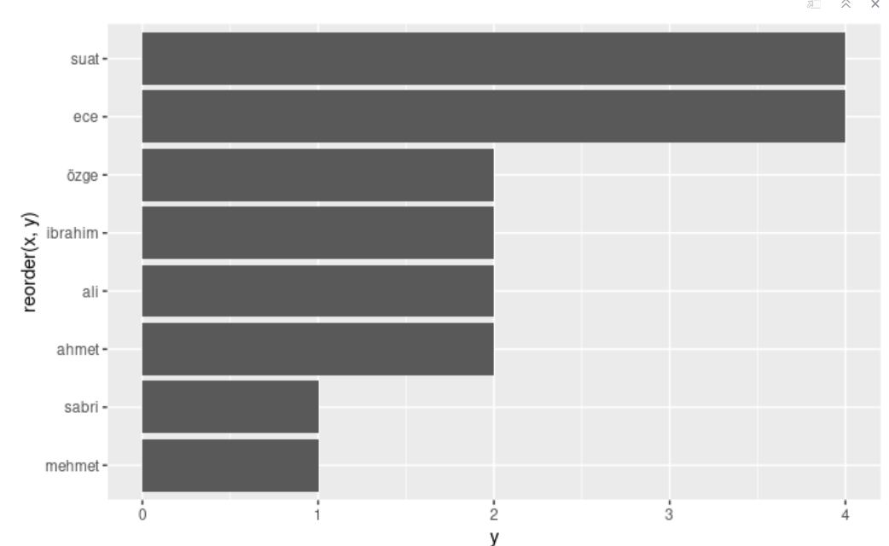
Plotting degree distribution
library(ggplot2)
ggplot(ddist, aes(x=reorder(x,y), y=y)) +
geom_bar(stat = "identity") + coord_flip()

Slide 16
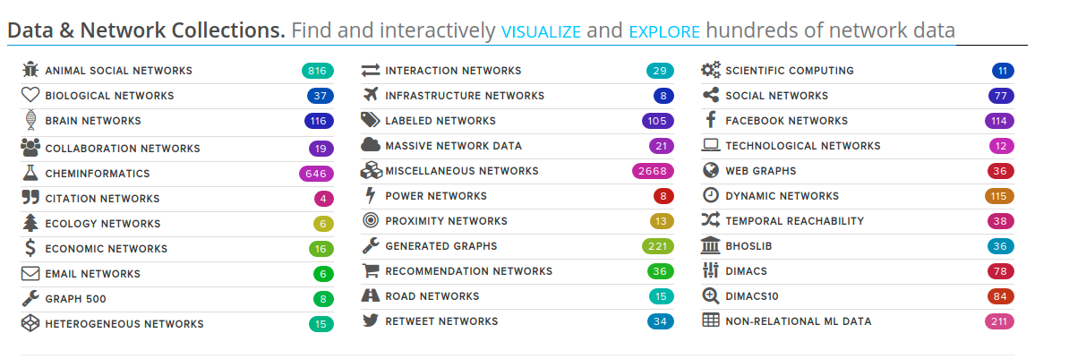
Network Data Resources
http://networkrepository.com/

Slide 17
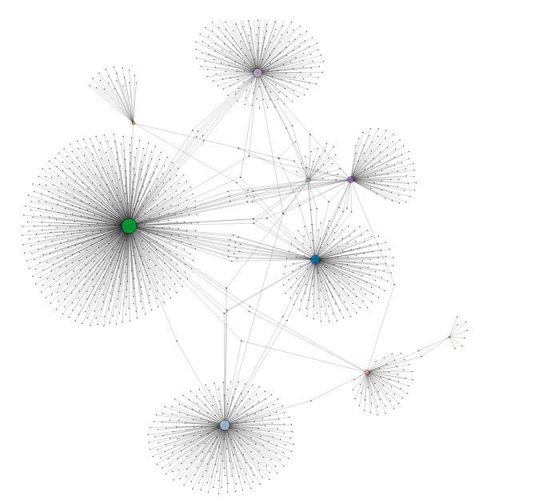
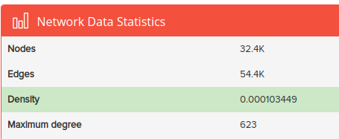
EU Research Email traffic
Your turn:
What do you think about this visualization?
Why some of the nodes have so many connections?
Can you see bridges between the subgroups?
Task: Can you find first 3 nodes has maximum connection! (Deadline 1 week)
http://networkrepository.com/ia-email-EU.php

Slide 18
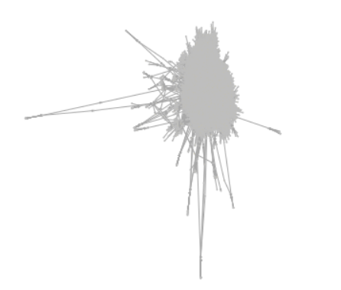
Messy Diagrams
geu <- graph_from_data_frame(eu)
layout <- layout.fruchterman.reingold(geu)
# Plotting with configuration
plot(geu,
vertex.label=NA,
edge.arrow.size=.1,
vertex.color="gold",
vertex.size=.2,
vertex.frame.color="gray",
vertex.label.color="black",
vertex.label.cex=0.8,
vertex.label.dist=2,
edge.curved=0,
layout=layout)

Slide 19
Indegree & Outdegree

Slide 20
In-degree
Node | Degree | In-degree
Ahmet | 4 | 2
Özgür | 2 | 1
İbrahim | 3 | 0
Ferhat | 1 | 1
Suat | 2 | 2

Slide 21
Out-degree
Node | Degree | In-degree | Out-degree
Ahmet | 4 | 2 | 2
Özgür | 2 | 1 | 1
İbrahim | 3 | 0 | 3
Ferhat | 1 | 1 | 0
Suat | 2 | 2 | 0
Degree =
In-degree +
Out-degree

Slide 22
Density (Recall)

Slide 23
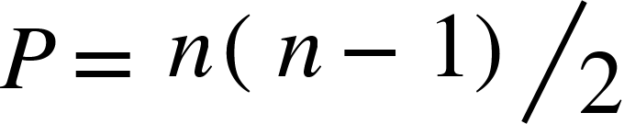

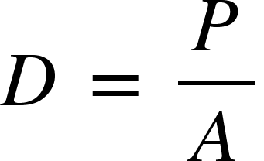
Density
The density of a network is simply the pro­portion of all possible ties that are actually present.
Number of all possible connections: P
Number of actual connections: A
n: Number of nodes
Density: D
from Research Methods and Design in Sport Management
by Damon P. S. Andrew, Paul Mark Pedersen, Chad D. McEvoy
Human Kinetics, 2019

Slide 24
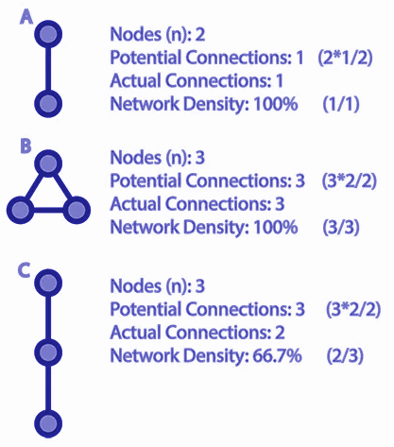
Density
Number of all possible connections: P
Number of actual connections: A
n: Number of nodes
Density: D

Slide 25
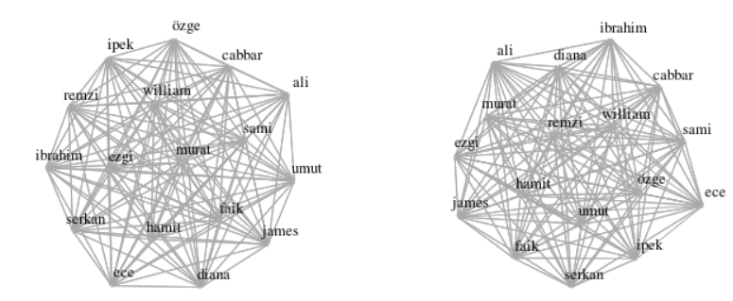
Comparison of two network by density
01.csv
03.csv

Slide 26
Density computation
library(igraph)
library(readr)
network1 <- readr::read_csv("../data/01.csv")
network2 <- readr::read_csv("../data/03.csv")
g1 <- graph_from_data_frame(network1)
g2 <- graph_from_data_frame(network2)
Comma seperated
values:
ali,ayşe
ali,sami
Importing data as data frame
Converting data frame to igraph object

Slide 27
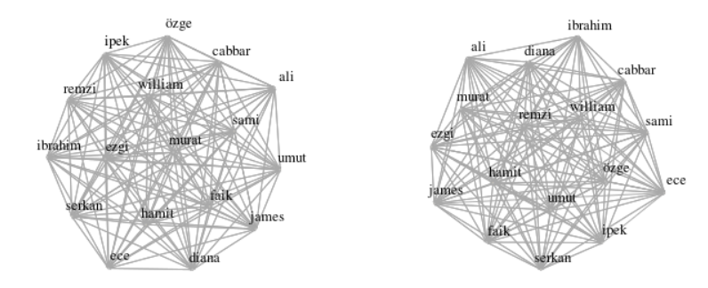
Density computation
edge_density(g1)
edge_density(g2)
0.9963235
0.9816176

Slide 28
Shortest Path

Slide 29
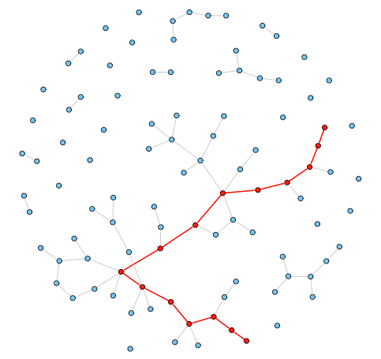
Shortest Path
A shortest path, or geodesic path, between two nodes in a graph is a path with the minimum number of edges.

Slide 30
Small Word Theory
“I read somewhere that everybody on this planet is separated by only six other people. Six degrees of separation. Between us and everybody else on this planet. The president of the United States. A gondolier in Venice. Fill in the names. . . . How every person is a new door, opening up into other worlds. Six degrees of separation between me and everyone else on this planet. But to find the right six people . . .” – John Guare, Six Degrees of Separation (1990)
we’ve crunched the Facebook friend graph and determined that the number is 3.57. Each person in the world (at least among the 1.59 billion people active on Facebook) is connected to every other person by an average of three and a half other people
Facebook: https://research.fb.com/three-and-a-half-degrees-of-separation/

Slide 31
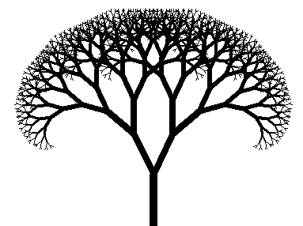
Computation for 1.6 billion person
Me: Suat ATAN
Friends of your friends
Your friends
You

Slide 32
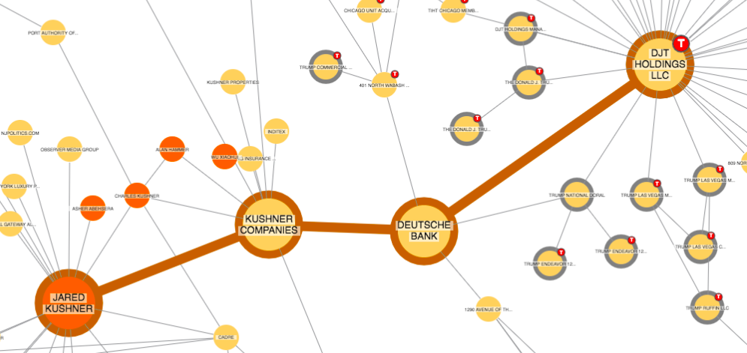
Shortest path (review)
Source: Cambridge Intelligence

Slide 33

Calculating Shortest Path with
library(readr)
library(igraph)
networkb = read_csv("../data/02.csv")
graphb = graph_from_data_frame(networkb)
plot(graphb, vertex.label.cex=0.8, vertex.color="yellow")

Slide 34
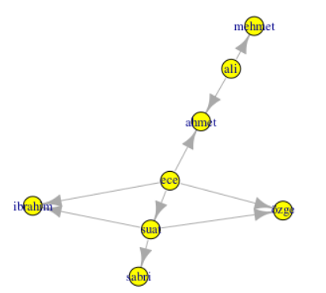
Visualization
My friend: Path distance: 1
Friend of my friend: Path distance 2
So on...
Shortest path
Longest path
Shortest path

Slide 35
Tabulating entire path distances
shortest.paths(graphb)
 | ece | suat | ali | özge | ibrahim | ahmet | sabri | mehmet
ece | 0 | 1 | 2 | 1 | 1 | 1 | 2 | 3
suat | 1 | 0 | 3 | 1 | 1 | 2 | 1 | 4
ali | 2 | 3 | 0 | 3 | 3 | 1 | 4 | 1
özge | 1 | 1 | 3 | 0 | 2 | 2 | 2 | 4
ibrahim | 1 | 1 | 3 | 2 | 0 | 2 | 2 | 4
ahmet | 1 | 2 | 1 | 2 | 2 | 0 | 3 | 2
sabri | 2 | 1 | 4 | 2 | 2 | 3 | 0 | 5
mehmet | 3 | 4 | 1 | 4 | 4 | 2 | 5 | 0
What is the shortest path(s) ?
What is the longest path(s) ?
What is the distance between Suat and İbrahim?
How did we get this table?

Slide 36
To obtain the "average path length" value:
average.path.length(graphb)
1.1

Slide 37
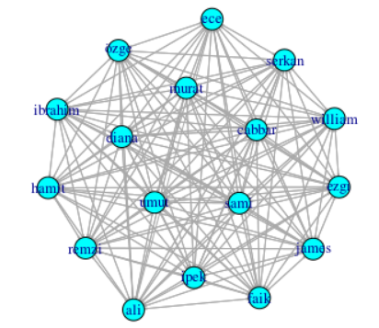
Comparison of two network in terms of average path length
Average Path Length: 1.1
Average Path Length: 1.003676

Slide 38
Thanks

