Slide 1

Network Analysis
ADS-516
Dr. Suat ATAN
Week:3

Slide 2
Understanding Network Metrics (2)

Slide 3
Lecture Plan
Closeness Centrality
Betweenness Centrality
Eigenvector Centrality
CINNA package
Zachary Karate Club & PCA

Slide 4

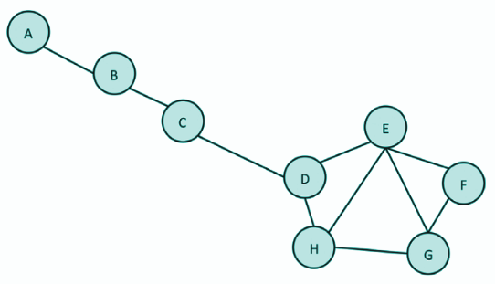

Closeness Centrality
A: I can access to others but it requires more step
D: I can access to others, it requires a few step.

Slide 5
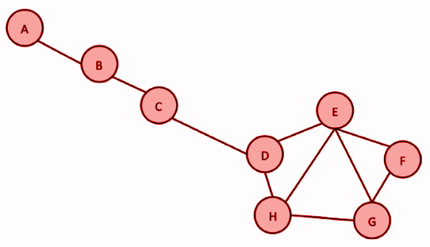

Closeness Centrality
“Closeness centrality simply means that nodes that are central are the shortest distance away from all other nodes. The more central a node is, the shorter its total distance to all other nodes.”

Slide 6
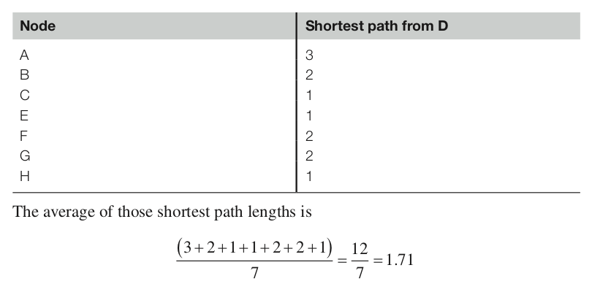
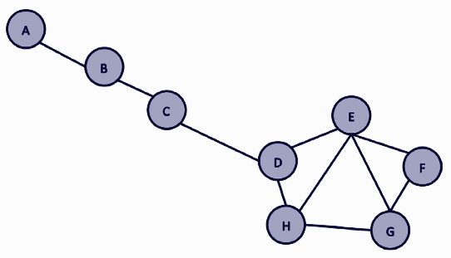
Closeness Centrality
Calculation for Node D

Slide 7
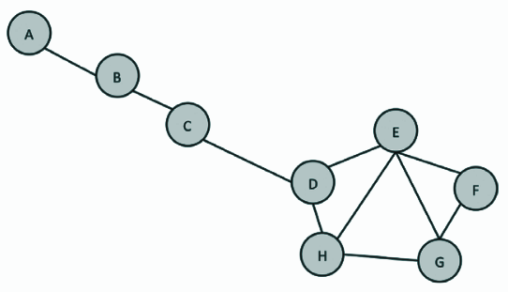
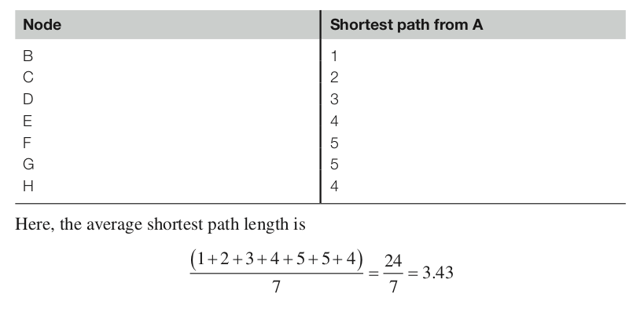
Closeness Centrality
Calculation for Node A

Slide 8
Comparison of Node A and D
In contrast to degree centrality, closeness centrality has smaller values. indicate that the node is more central since it requires less steps to reach it.
A: 3.43
D: 1.71

Slide 9
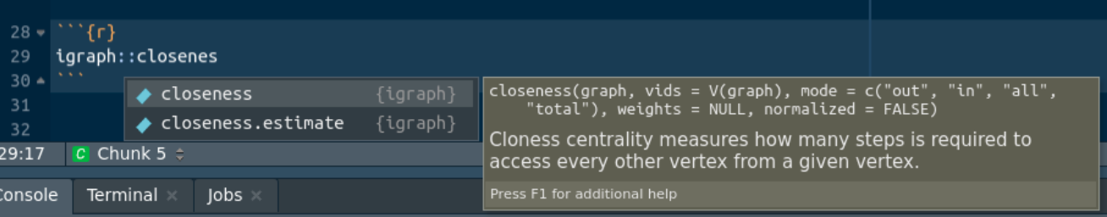
Compute Closeness Centrality with R
R Help / Documentation

Slide 10
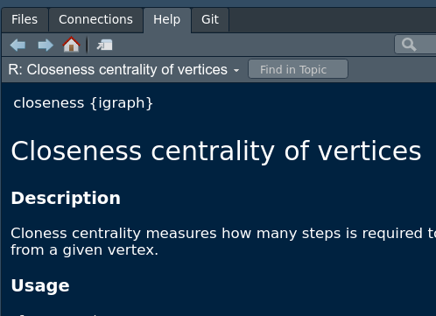
F1 Help Menu
Closeness centrality of vertices
Description:
Closeness centrality measures how many steps is required to access every other vertex from a given vertex.

Slide 11
Function documentation
Arguments
graph
The graph to analyze.
vids
The vertices for which closeness will be calculated.
mode
Character string, defined the types of the paths used for measuring the distance in directed graphs. “in” measures the paths to a vertex, “out” measures paths from a vertex, all uses undirected paths. This argument is ignored for undirected graphs.
Usage
closeness(
graph,
vids = V(graph),
mode = c("out", "in", "all", "total"),
weights = NULL,
normalized = FALSE
)

Slide 12
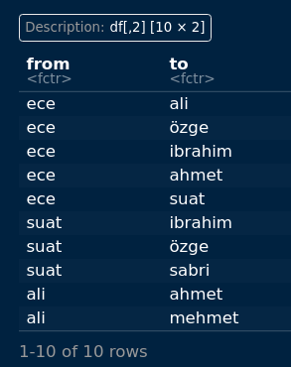
Practise
df = read.csv("../data/02.csv")
df

Slide 13

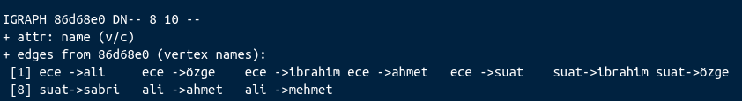
Practise

Slide 14
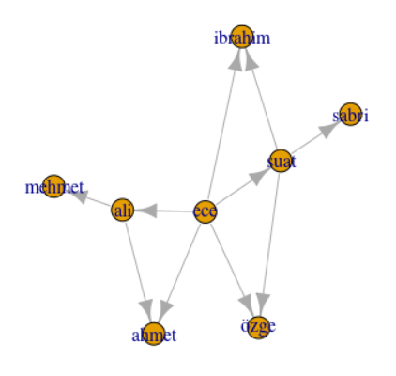
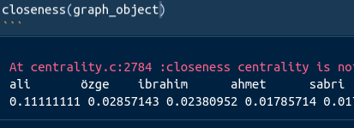
Computation of “closeness centrality”
closeness(graph_object)

Slide 15
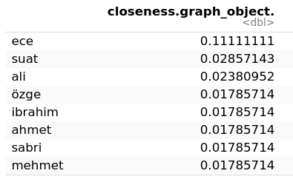
Tabulating the closeness of each node
data.frame(closeness(graph_object))

Slide 16
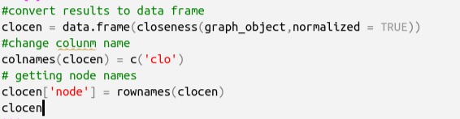
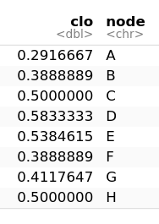
Better styling the data

Slide 17
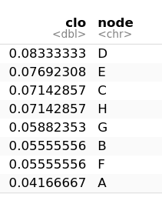
Finding the top list for “closeness centrality”
A: 3.43
library(dplyr)
clocen %>% arrange(desc(clo))
Confusion!
D: 1.71
The numerical results are different
The order is same but inverted
Why?

Slide 18
Answer: The difference of Formula in Literature
Although there are several different formulations for closeness centrality metrics goal is the same: Average shortest path of any node.
For the formulation of igraph package highest "closeness value" reflects the most closer node than other nodes. (Inverted!)
Discussion: https://stackoverflow.com/questions/51270369/how-does-the-r-igraph-package-compute-closeness-centrality

Slide 19
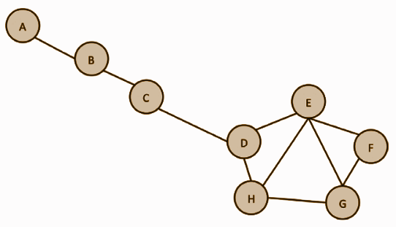

What if I have best “closeness” score.
Closeness centrality reflects how quickly information from a given node in the network spreads to other reachable nodes.
from Oxford Textbook of Cancer Biology
by Francesco Pezzella, Mahvash Tavassoli, David Kerr
Oxford University Press, 2019 ⦁ Medicine and Health

Slide 20
Betweenness Centrality

Slide 21
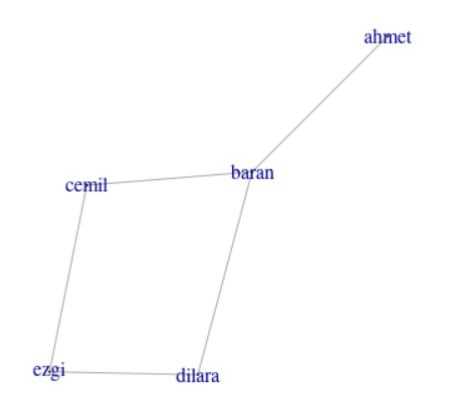
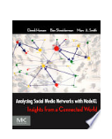
Betweenness Centrality
Betweenness centrality is a measure of how often a given vertex lies on the shortest path between two other vertices.
from Analyzing Social Media Networks with NodeXL: Insights from a Connected World
by Derek Hansen, Ben Shneiderman, Marc A. Smith
Elsevier Science, 2010 ⦁ Science

Slide 22
Calculation of Betweenness Centrality
Betweenness centrality for node Baran:
The way that Baran is on:
Step 1: Path(s) between ahmet--cemil is 1
B is on this path 1 ⇒ 1/1 = 1
Step 2: For ahmet--dilara is like step 1: 1/1 =1
Step 3: ahmet-ezgi there are two paths: 2
B is on both path 2⇒ 2/2 = 1
Step 4: cemil--dilara: There are two path: 2
B is only on one path 1 ⇒ 1 / 2 = 0.5
Betweenness Centrality = 1 + 1 + 1 + 0.5 = 3.5

Slide 23
Computation of Betweenness Centrality
library(igraph)
g = graph_from_data_frame(df)
estimate_betweenness(g,cutoff = -1)
ahmet baran dilara cemil ezgi
0.0 3.5 1.0 1.0 0.5

Slide 24
Meaning of Betweenness Centrality
The Control of Information Flow

Slide 25
Practise on larger network
library(igraph)
df2 = read.csv("../data/cit-DBLP.edges",sep = "")
g2 = graph_from_data_frame(df2,directed = FALSE)
x = estimate_betweenness(g2,cutoff = -1)
y = as.data.frame(x)
y$nodes = names(x)
y

Slide 26
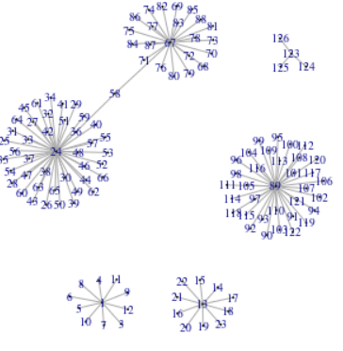
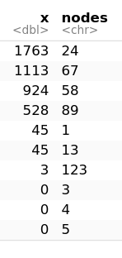
Betweenness on the Citation Networks
library(dplyr)
y %>% arrange(desc(x))

Slide 27
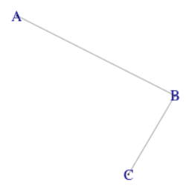
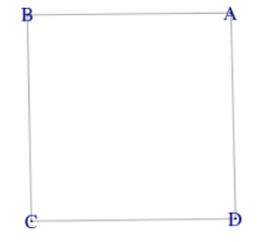
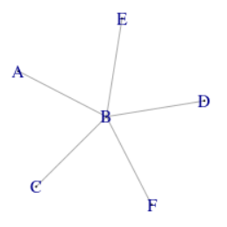
Betweenness Centrality Scenarios
A B C
0 1 0
A B C D
0.5 0.5 0.5 0.5
A B C D E F
0 10 0 0 0 0
Betweenness
A B C
1 2 1
A B C D
2 2 2 2
A B C D E F
1 5 1 1 1 1
Degree

Slide 28
Eigenvector Centrality

Slide 29
Eigenvector Centrality
Eigenvector centrality. It measures the influence that a node has in a network: Again, the computation is quite complex, but any software package you use will compute it for you.
A node may have a low-degree centrality—and maybe even weak closeness centrality and betweenness centrality—but it can still be influential. Although a node that is central by one measure is often central by several other measures, this is not necessarily always the cas

Slide 30
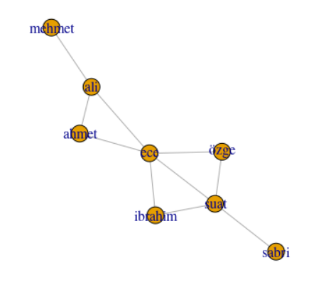
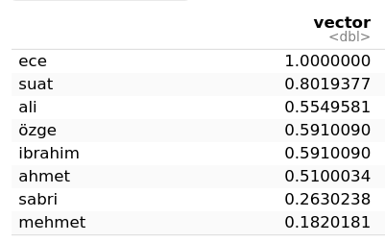
Computation of Eigenvector Centrality
library(igraph)
g <- graph_from_data_frame(“02.csv”)
eigen_centrality(g)
02.csv

Slide 31




Interpretation of Centrality Measures
Degree centrality shows people with many social connections.
Closeness centrality indicates who is at the heart of a social network.
Betweenness centrality describes people who connect social circles.
Eigenvector centrality is high among influential people in the network.
(Golbeck, 2015)

Slide 32
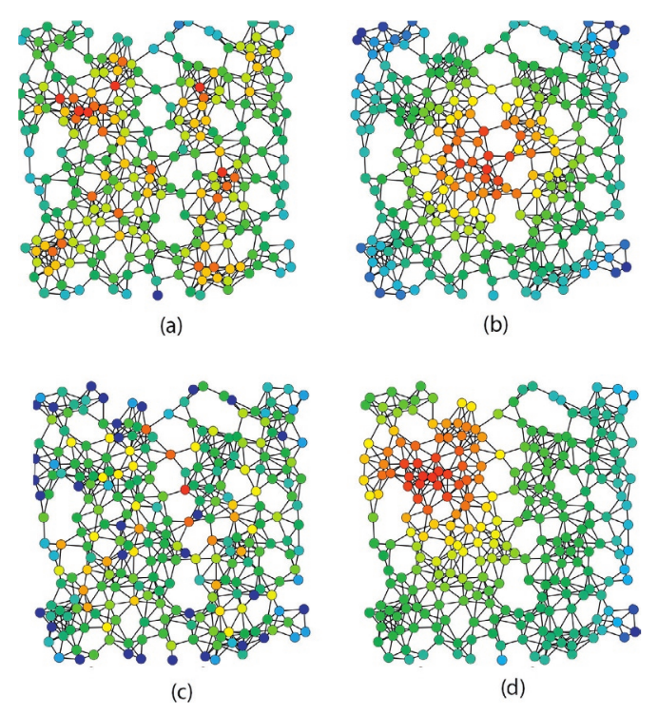
Comparison of
Centrality
Measures
This is the same network shown four times. Color coding indicates centrality according for different measures.
Red nodes are more central and blue nodes are less central. Version
(a) is degree centrality,
(b) uses closeness centrality,
(c) shows betweenness centrality, and
(d) is eigenvector centrality.
(Rocchini)

Slide 33
CINNA (Central Informative Nodes in Network Analysis)
Authors of CINNA: Minoo Ashtiani, Mehdi Mirzaie, Mohieddin Jafari

Slide 34
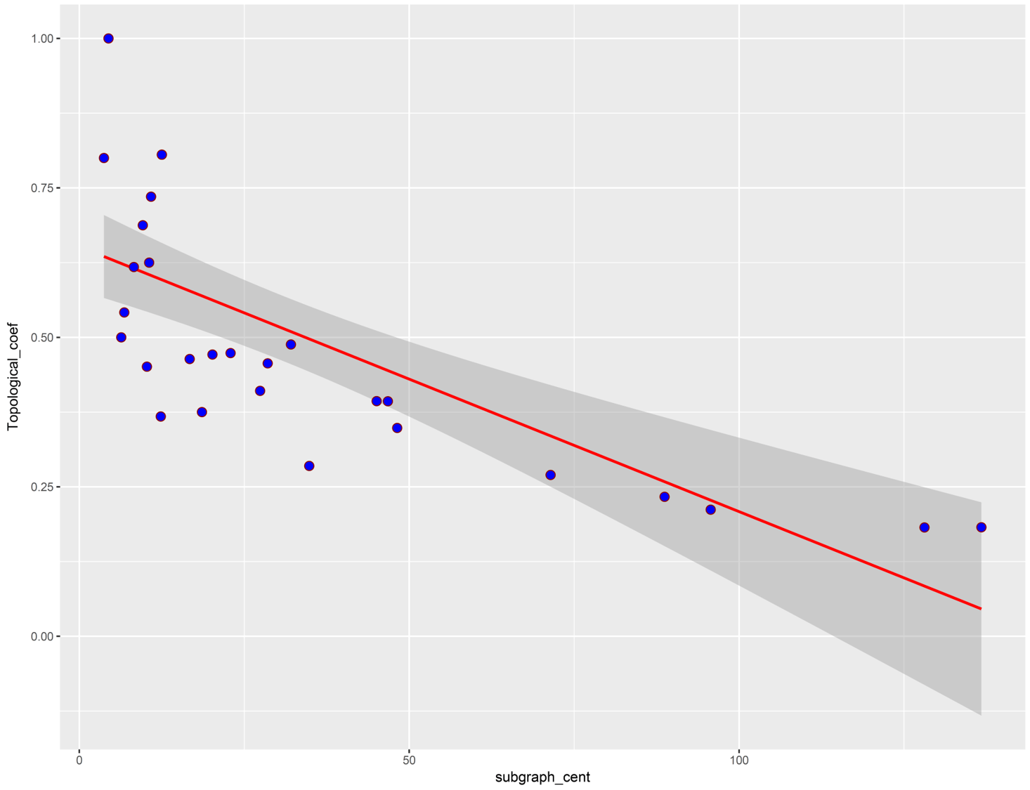
Why CINNA ⇒ 140 “centrality measure”
Any two centralities may have inverse relationships, they can distinguish the central nodes within a network based on different patterns and so the result of centrality calculation would be variant according to the centrality type.
There are more than 140 benchmarks currently available to identify the central vertices, but which one should be used to calculate the influential nodes?

Slide 35
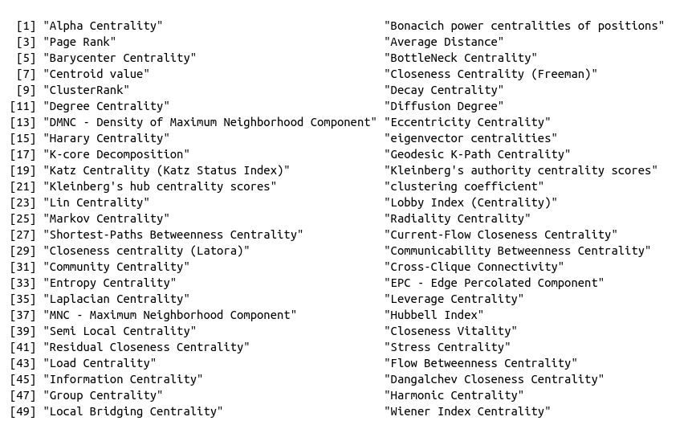



Getting list of the proper centrality mesasures

Slide 36
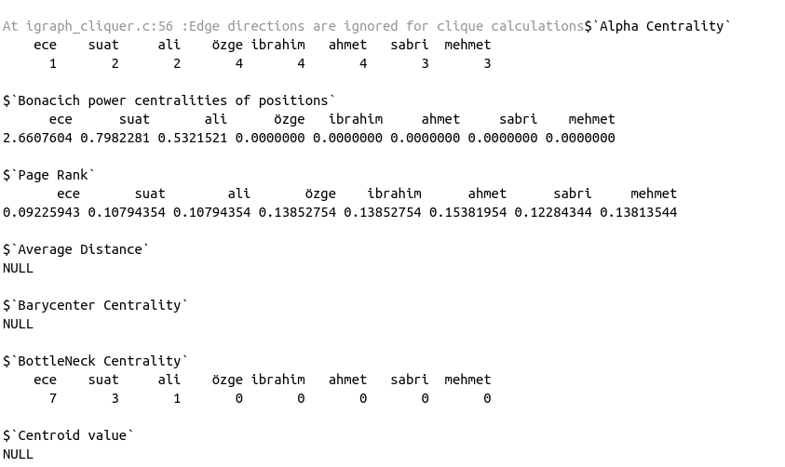
Computing all of the centrality measures
calculate_centralities(g)

Slide 37
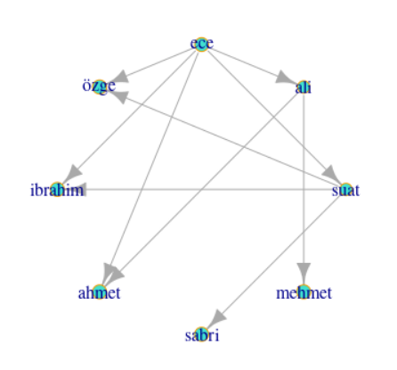
Visualizing different centrality types
visualize_graph(
g,
computed_centrality_value = NULL,
centrality.type = "Degree Centrality"
)

Slide 38
(Bonus) Visualizing all centrality types
ctypes <- proper_centralities(g)
ctypes <- head(ctypes,3)
draw_centrality_graph<-function(graph_object,ctype){
visualize_graph(
graph_object,
computed_centrality_value = NULL,
centrality.type = ctype
)
title(ctype,cex.main=2,col.main="orange")
}
for(ctype in ctypes){
tryCatch({
draw_centrality_graph(g,ctype)
},
error=function(cond){
message("----------Error----------")
message(cond)
return(NULL)
})
}

Slide 39
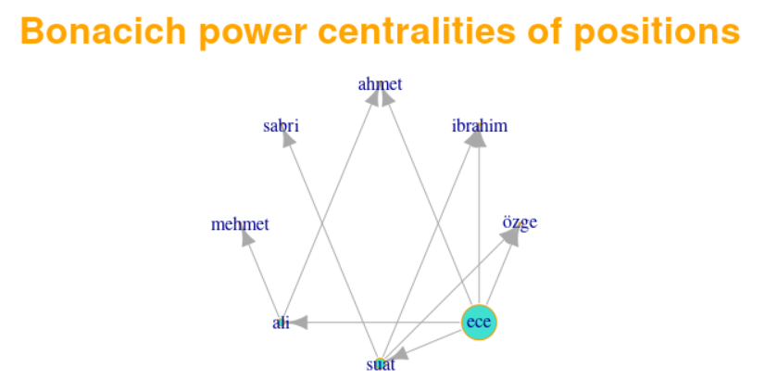
Bonacich

Slide 40
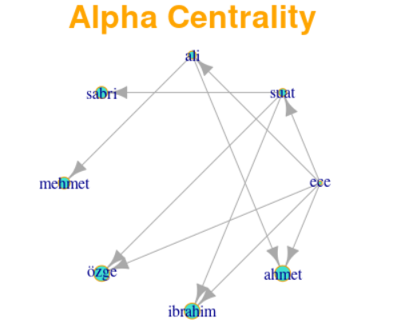
Alpha

Slide 41
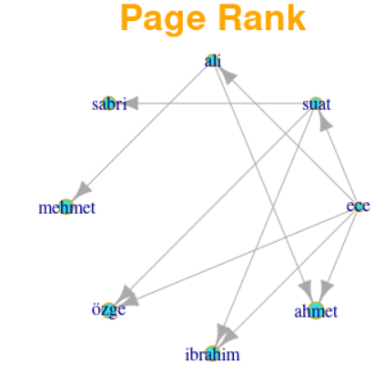
Page Rank

Slide 42
A CINNA practise on Zachary Karate Club

Slide 43
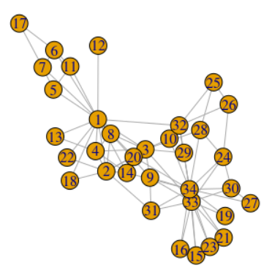
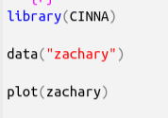
Visualization

Slide 44
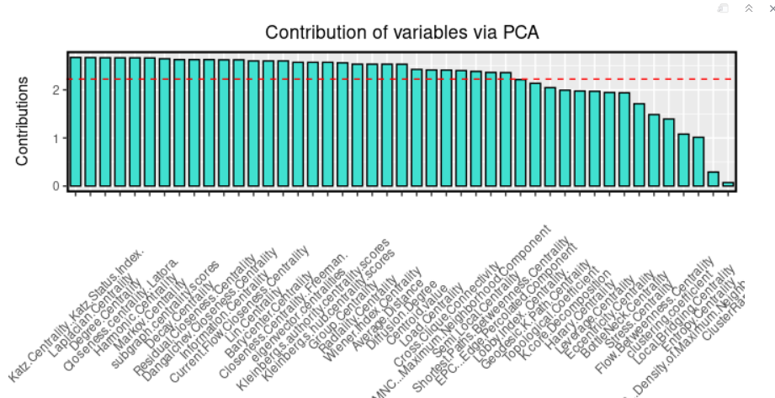

Which centrality measure is most “informative”

Slide 45
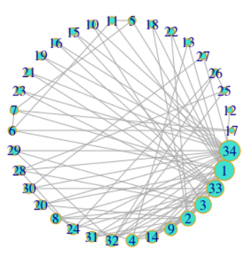
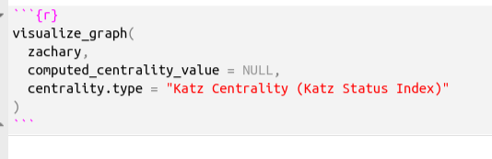
The Computation with Katz Centrality
https://www.geeksforgeeks.org/katz-centrality-centrality-measure/

Slide 46
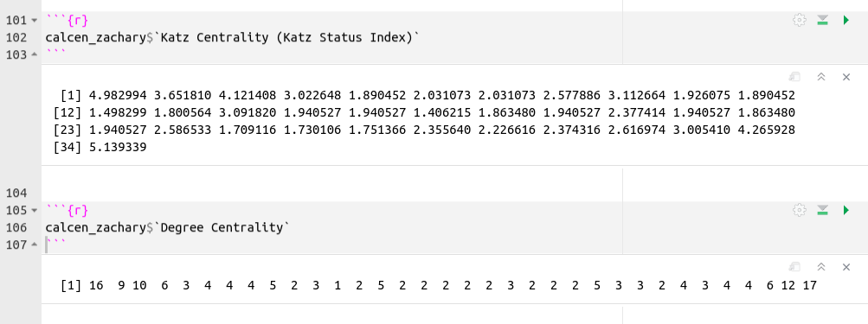
Comparison with Degree Centrality

Slide 47
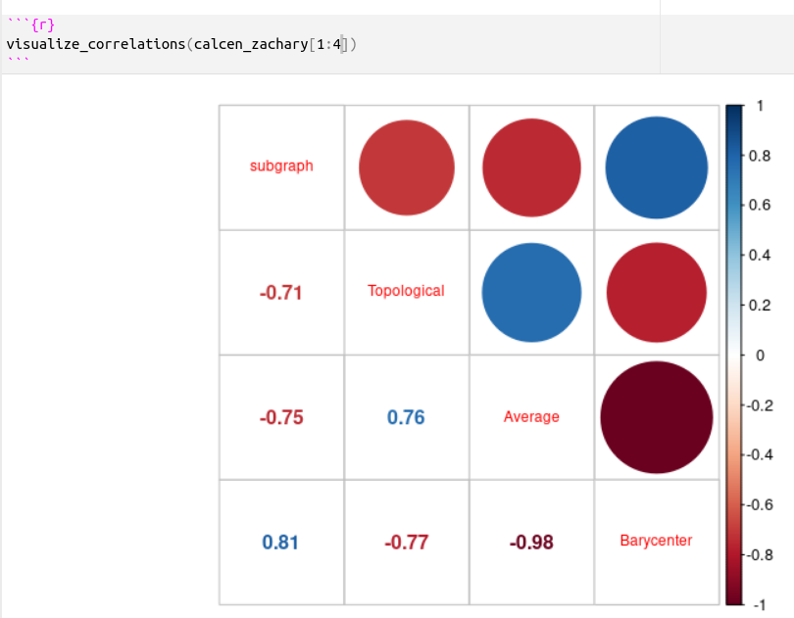
Correlogram for Centralities

Slide 48
Thanks
Dr. Suat ATAN

