Slide 1

Network Analysis
AS-516
Dr. Suat ATAN
Week:2
Notes:
Ok so now that we have learned the basic vocabulary of networks we're gonna describe network structure and some network statistics for understanding roles within these networks.
let's pick back up with the example we have been working so far.
Now just focus on the new things and don’t worry about the previous lessons. Do not try to remember them all. We will somehow repeat them all implicitly.
In this lesson, I will keep things simple and clear-cut. Please don’t hesitate to cut whenever you struggled or confused within any slides or explanations.
Here we go

Slide 2
Lesson Plan
Understanding network metrics
Degree and Degree Distribution
Density
Shortest Paths & Average Path
Comparison of Networks
Notes:
Before the start let's just take a look into the lecture plan to be aware of what we will discuss.
The first pillar of this lecture is the "network metrics": What are the metrics. They are just kind of single or set of values about a specific attribute of the network. It may connotate nothing but you will be realized and comprehend them when you see them. Sometimes this kind of metric is just counting things in real life.

Slide 3
Degree & Degree Distribution

Slide 4
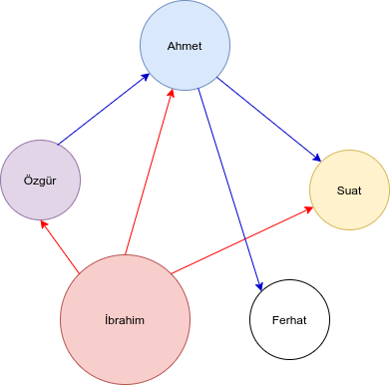
Degree and degree distribution
Node | Degree
Ahmet | 4
Özgür | 2
İbrahim | 3
Ferhat | 1
Suat | 2
How many e-mail you get or send? İbrahim: 3
Notes:
The degree is the number of edges connected to the node so here Ahmet has a degree of four. Namely, Ahmet has four connections with other nodes. In the same way, Özgür has two connections, İbrahim has three Ferhat a just one connection. Ferhat may be a new student or kinda asocial. Finally, Suat has two connections therefore we can say "the degree of Suat node is two".
It is a common way that we describe a network is by giving a degree distribution. The degree distribution is simply a tally of how many nodes have each degree. You can see the tally of all degrees on the right side.

Slide 5
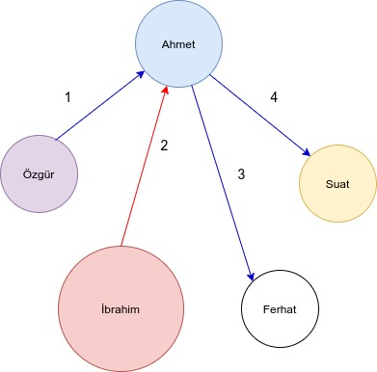
Degree and degree distribution
Node | Degree
Ahmet | 4
Özgür | 2
İbrahim | 3
Ferhat | 1
Suat | 2
Degree: Number of connection
Notes:
Now to verify our comprehension I deleted all connections except the Ahmet to see Ahmet closer. Ahmet has four connections and we are saying "the degree of Ahmet is four". You may notice there is no difference in the direction of the arrow. If we think this graphic is an e-mail traffic report Ahmet has received one and send three e-mail but we just focusing on how many e-mails are received or sent by any pf person.

Slide 6
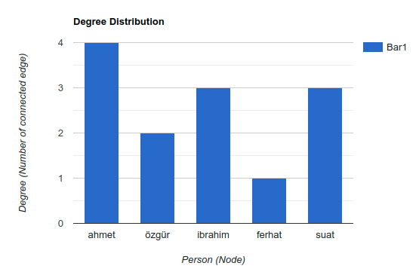
Degree and degree distribution
Degree distribution: Tally of degree of all nodes
Notes:
Now, how it's going? Can you get a clear picture of that? [WAIT 3 breath]. So, ok, what we do now is not different we just converted our tally or table of degree distribution into a bar chart. Why is this happening? Because we need to focus and understand what distribution is.
In fact, the networks in the real life are more complex than this. Naturally, the degree distribution of these complex networks are different. Some of them very balanced but some of them very unbalanced. Especially degree distribution of any network among the humans often unbalanced because there is a few peoples has hundreds even thousands of connections meanwhile rest of them has just a couple of connections. We will look this closer.

Slide 7
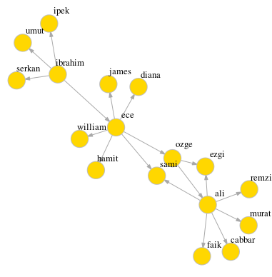
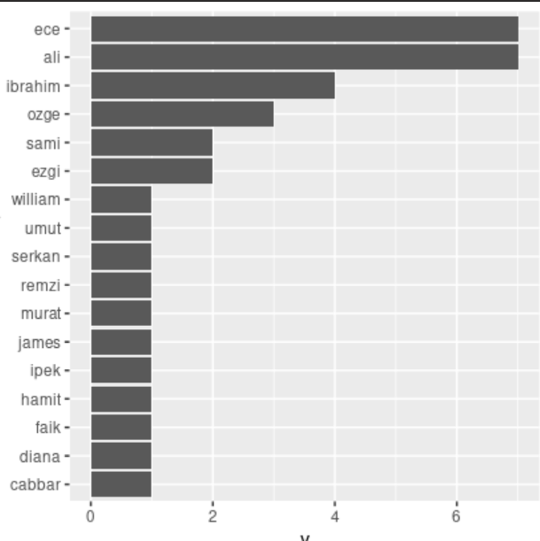
Imbalanced Degree Distribution
Notes:
Let's take a closer look. I added some new members to our network to show how complex networks like. In this scenario, you may notice 'Ece' and 'İbrahim' from the right side. They are 'hub'. They have a lot of connections. You can see this from the distribution table on the left. They are on the top. Now we understand that degree distribution table works for us to see who has the more connections.
The story is not just about this. You may also notice the group of super-social friends like İbrahim and Ece is very narrow. The rest of our team have just a few connections.
This is power-law. Power law reflects the imbalanced distribution of super-connected nodes and less-connected ones.

Slide 8
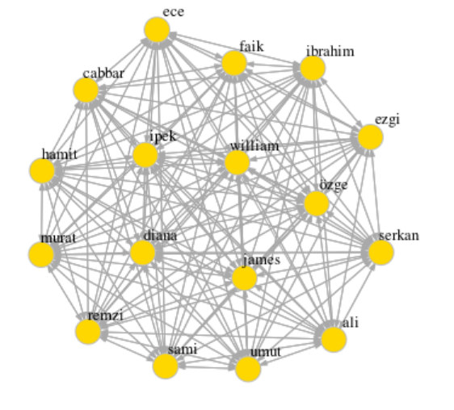
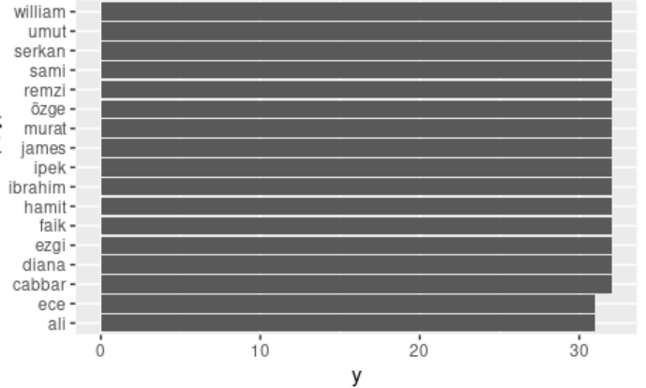
Balanced Degree
Distribution
Notes:
Now, let's make a connection between each person and each person and see what's going on? Keep your eyes on the right side! Every person has connected to all others. What do you think will happen on the left side? [WAIT 3 breath] As you can see, all the bars are identical. Every node has an equal number of connections except two ones. This kind of distribution is balanced. However please keep in mind that as you suppose this circumstance is not common in real networks.

Slide 9
Degree & Degree Distribution (Application)

Slide 10
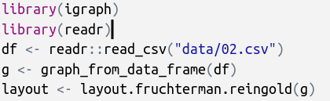
Calculating Degree
reading data
importing libraries
converting data frame to graph object
Setting layout of network
(optional)
Notes:
So let's make our hands a bit dirty. Time to application. Here we will see how we apply what we learned so far to our real-life project. We will calculate the degree of a network and will get all degree values of each node.
Here we are starting with importing our data from the 02.csv file ([EMPHASIZE] zero two-dot si es vi) file. Then before the show this network visually we are setting the positional distribution on the graph therefore we are using the layout. The visual layouts are a different topic in network visualization. For now, skip to think about this line and focus on rest.

Slide 11
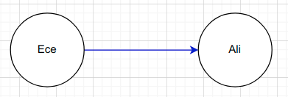
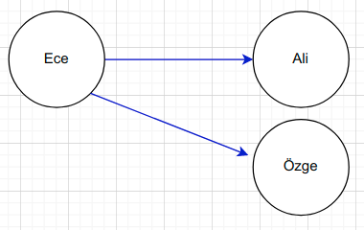
Data File (02.csv)
ece | ali
ece | özge
ece | ibrahim
ece | ahmet
ece,ali
ece,özge
ece,ibrahim
ece,ahmet
ece,suat
suat,ibrahim
suat,özge
suat,sabri
ali,ahmet
ali,mehmet
Notes:
Now you find our data file. As you can see, there are only two columns. The columns separated with a comma Besides, the sequence is important. Each line reflects a unique connection from a left node to a right node.
This file is so small that you can figure out the prevalence of 'Ece' by looking at the data file. The repetition is matters. However, as we see in the big cases, that is not something we can do just by looking.

Slide 12
Plotting the graph object
plot(g,
edge.arrow.size=.1,
vertex.color="gold",
vertex.size=15,
vertex.frame.color="gray",
vertex.label.color="black",
vertex.label.cex=0.8,
vertex.label.dist=2,
edge.curved=0,
layout=layout)
Graph object “g” that we generated before
quick code
Visual Attributes
plot(g)
Layout that we generated from “g” object.
Notes:
Now, showtime, are you ready! We are plotting the graph by these codes. Frankly, you can do this just the code in the violet box on the right side quickly. However, if you want to polish your graph and set the attributes you should use the codes in the left side. As you see, attributes like color, size of arrows, edges, and other things are clearly defined.

Slide 13
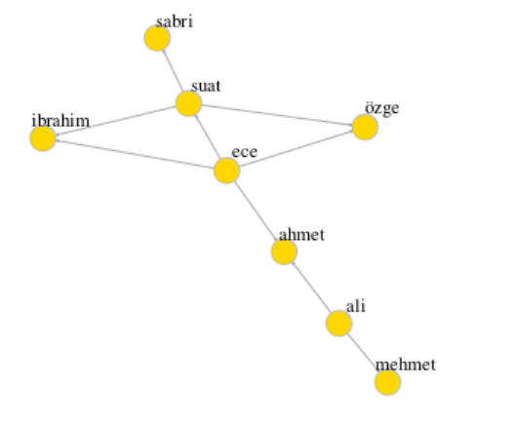
Plot result
Notes:
Here you are seeing the result from our data file.

Slide 14
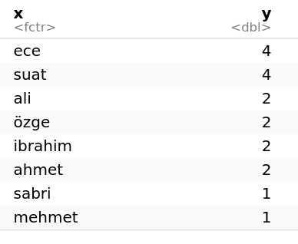
Calculating Degree Distribution
special function for
calculating degree
deg <- degree(g)
x = names(deg)
y = deg
ddist = data.frame(x,y)
ddist
Notes:
Now we calculate the degree of each node. How can we do this? It is quite easy! [WAIT 2 breath] We use degree function. What [EMPHASIZE] degree function. Focus the red colored line. This functions gets the graph object as input parameter (look again to red area) then gets the list of degree of each node. In fact we could print it directly however we need to show it as data frame. Therefore we get the name of each object with ‘di ey ci’ variable as x (eks) and values as y (vay) then merged them into a single variable. You are seeing the result in the right.
Keep in the mind that degree function is comes from `igraph` library. If you don’t impot it by calling library function it give error.

Slide 15
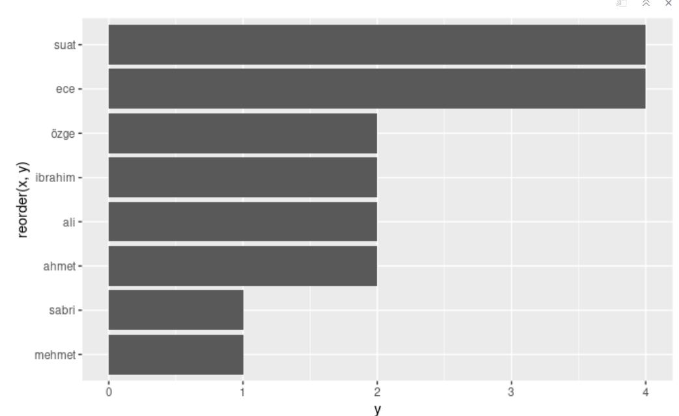
Plotting degree distribution
library(ggplot2)
ggplot(ddist, aes(x=reorder(x,y), y=y)) +
geom_bar(stat = "identity") + coord_flip()
Notes:
OK we are using the ggplot (ci ci plot two library) here. This library works for showing barchart, piechart and other standard graphics. It is looks a bit complicated. Even I cannot remember their properties but you can seek the documentation whenever you want from web) Now we are using ddist (di dist) variable colored with violet. You may remember this is a dataframe from our previous computation. Remaineder of the codes are special codes of the ggplot (ciciplot) and you don’t need to focus oto them.
Now keep your eye in right side. We are seeing which nodes have high connections. I think up to now you understand sharply what is degree distribution. Now it’ time to fight bigger data from real life. We will use degree distribution to interpret real life example

Slide 16
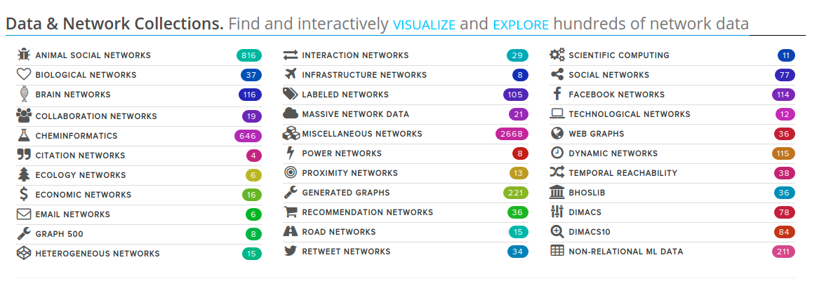
Network Data Resources
http://networkrepository.com/
Notes:
You may ask yourself how can I find the real network data examples. Frankly speaking, in the old times, people collected data by hand. However, nowadays we have a lot of sources like Twitter, corporate e-mail corpus, and numerous other examples. You can check this website to see them. The best property of this web page is you can check the data without download. Even the distribution charts are available.

Slide 17
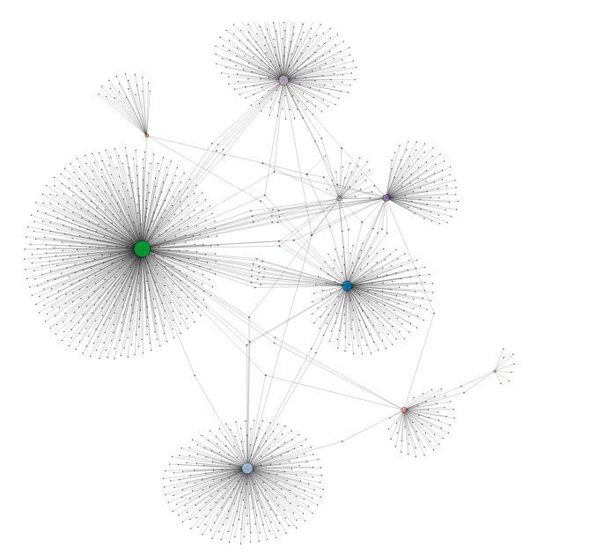
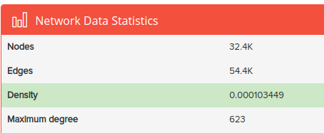
EU Research Email traffic
Your turn:
What do you think about this visualization?
Why some of the nodes have so many connections?
Can you see bridges between the subgroups?
Task: Can you find first 3 nodes has maximum connection! (Deadline 1 week)
http://networkrepository.com/ia-email-EU.php
Notes:
[IMPROPTU] Read the questions please [WAIT 3 min]
This network includes thirty two thousand something nodes and fifty four something connections or e-mail. Keep your eye in the right-top legend. Do you remember density from previous lesson? Is there anybody want to say? Ok [Wait 3 Min]
OK is there anyone want to interpret maximum degree here. [Answer: The biggest nudge in the picture has the maximum degree)
So let me explain your first small task. You should find the number of first three nodes. If you find somehow it’s OK. If you explained or coded it from anywhere or on your own way it’s appreciated.

Slide 18
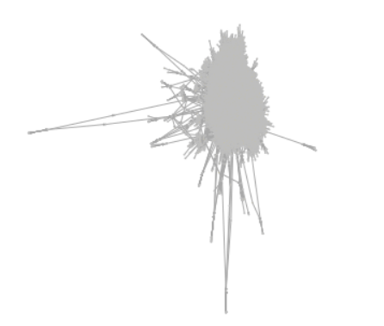
Messy Diagrams
geu <- graph_from_data_frame(eu)
layout <- layout.fruchterman.reingold(geu)
# Plotting with configuration
plot(geu,
vertex.label=NA,
edge.arrow.size=.1,
vertex.color="gold",
vertex.size=.2,
vertex.frame.color="gray",
vertex.label.color="black",
vertex.label.cex=0.8,
vertex.label.dist=2,
edge.curved=0,
layout=layout)
Notes:
What happened? When we tried to visualize a real network often we experience this kind of overwhelming situation. Do not vex yourself. Because it is the way it is. When you confronted with this kind of situation the best thing is to modify the layout first. Then you may try to change visual properties. If nothing does work you can avoid the visualization and focus just the computation like degree and degree distribution. If you persevere to visualize the network you have options like Gephi.
Besides, this kind of situation is very often. Sometimes you may struggle and cannot achieve complete visualization. Another method to deal with this problem is simplifying the network. By this method imagine you are deleting the low-level degree nodes and get just the picture of the most important nodes.

Slide 19
Indegree & Outdegree

Slide 20
In-degree
Node | Degree | In-degree
Ahmet | 4 | 2
Özgür | 2 | 1
İbrahim | 3 | 0
Ferhat | 1 | 1
Suat | 2 | 2
Notes:
Do you remember this diagram? The table on the left side is the same as before however we added a novel column into the right with the color pink: What is this? [WAIT 3 breath] You can discern. In degree can be defined the directed connection to a given node. If we are talking about e-mail transactions in-degree is how many e-mails you received. In this diagram, Ibrahim’s in-degree for example zero but his degree is three. It means nobody sends an e-mail to Ibrahim but he sends to email to almost everyone.
In-degree metrics is also a metric of the network node and reflect the degree of directed connection of a node in the network. But the reference is the target. Let's say you are a node. How many times you are targeted. That is in-degree metrics.

Slide 21
Out-degree
Node | Degree | In-degree | Out-degree
Ahmet | 4 | 2 | 2
Özgür | 2 | 1 | 1
İbrahim | 3 | 0 | 3
Ferhat | 1 | 1 | 0
Suat | 2 | 2 | 0
Degree =
In-degree +
Out-degree
Notes:
Now I added one more column to rightmost of our table and colored with green. Our new term is “out-degre”. You may infer from in-degree, out-degree refers to how many connection stems from you if you are a node. For e-mail transactions the number of e-mail that you send is out-degree. In our example Suat never send an e-mail therefore outdegree is zero while his indegree is two. For özgür, he has one connection directed to him therefore indegree is one and he has one connection directed to out also we are saying Özgür’s outdegree is one either.
Did you notice the relation of degree, in-degree and outdegree.

Slide 22
Density (Recall)

Slide 23
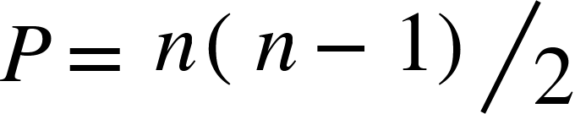

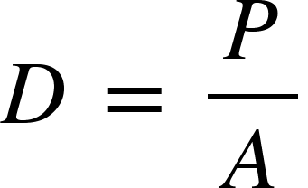
Density
The density of a network is simply the pro­portion of all possible ties that are actually present.
Number of all possible connections: P
Number of actual connections: A
n: Number of nodes
Density: D
from Research Methods and Design in Sport Management
by Damon P. S. Andrew, Paul Mark Pedersen, Chad D. McEvoy
Human Kinetics, 2019
Notes:
Network density” as a measure of network health and effectiveness. I think network density has important ramifications for the way business works and for making the world a better place. To better understand what it is, this section will show you how to easily calculate network density.
“Network density” describes the portion of the potential connections in a network that are actual connections. A “potential connection” is a connection that could potentially exist between two “nodes” – regardless of whether or not it actually does. This person could know that person; or if we are talking about computers this computer could connect to that one. Whether or not they do connect is irrelevant when you’re talking about a potential connection. By contrast, an “actual connection” is one that actually exists. This person does know that person; this computer is connected to that one.
If we focus in the formula let’s define P (pi) as number of all connections in given nodes named with n (en). To calculate this we are using the formula pi reflects all possible connections. Simply for instance we have 10 person as nodes this 10 person can ten multiple nine divide it two it becomes fourty five possible connections. So if the actual number of the connections are fourty five ve are saying the density is 1 or hundred percent it means the network is fully connected.

Slide 24
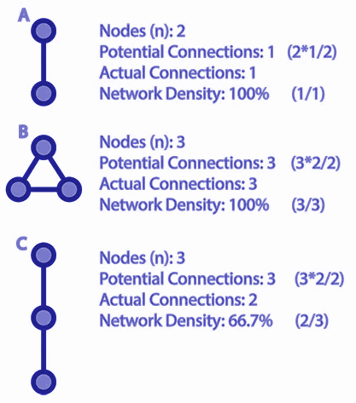
Density
Number of all possible connections: P
Number of actual connections: A
n: Number of nodes
Density: D
Notes:
Let’s imagine density with just a couple of points. Let’s focus on the right side, the first two nodes make one actual connection and potential is also just one. The calculation is so easy. When we concentrate the triangle. Potential connections are three by the functions. Actual connections are also three so density hundred percent. The third one looks entirely connected but one possible connection is missing, therefore, density is sixty-six percent. Quite easy isn't it? [WAIT 2 breath]

Slide 25
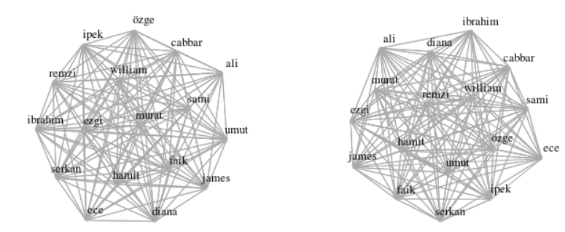
Comparison of two network by density
01.csv
03.csv
Notes:
Let’s try this on a bigger network.
Density metric is pretty useful for comparison of two separate networks especially for the effectiveness of the members of this network. Assume there are two different companies. You have e-mail transaction logs of both. When you calculate the density you can say the company which has a higher density scale is possibly more effective.
This is an extremely common situation for citation networks. As you know, the scholars cite others in their works to refers to other studies before theirs. It is very fruitful beginning for network analysis. If there is a literature that has a stronger citation network than the others, it means that the flow of information within that network is better.
Anyone have any ideas? You will appreciate that a lecture or discussion in which only one person speaks will not be fruitful. To be honest this would be boring too. Therefore, please express your opinion, if you have comments, you can explain it in the chat or verbally. Yes, in which of these two networks the connections are stronger?
In this example let’s focus these two networks. But it is not easy to find the answer. Let’s start to get data and compute to find answer.

Slide 26
Density computation
library(igraph)
library(readr)
network1 <- readr::read_csv("../data/01.csv")
network2 <- readr::read_csv("../data/03.csv")
g1 <- graph_from_data_frame(network1)
g2 <- graph_from_data_frame(network2)
Comma seperated
values:
ali,ayşe
ali,sami
Importing data as data frame
Converting data frame to igraph object
Notes:
As you can find this code in github repository we just imported data of two different network as comma sepeated value to data frame then we are converting the dataframe to nework object

Slide 27
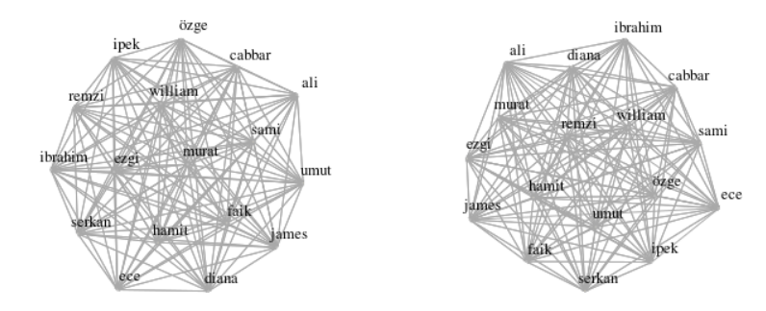
Density computation
edge_density(g1)
edge_density(g2)
0.9963235
0.9816176
Notes:
Computation of the density of any network is quite easy. You cast usie “edge_density” function. Input g1 (ci van and ci to) should be igraph object. And result is singular or scalar value as you se zero point ninety nine and zero point ninety eight something.
May be you noticed. Density is an attribute about whole network not about a set of nodes however degree metric is about nodes. This is important thing because we should be differentiate the which attribute is about which part of network.

Slide 28
Shortest Path

Slide 29
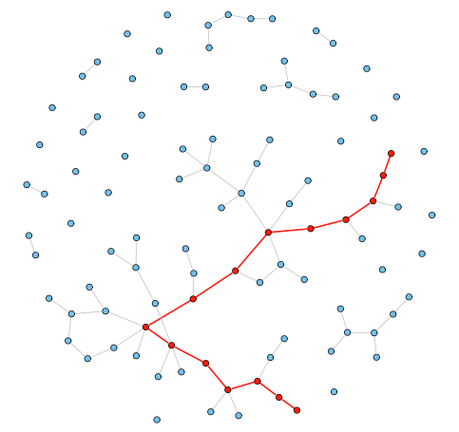
Shortest Path
A shortest path, or geodesic path, between two nodes in a graph is a path with the minimum number of edges.
Notes:
Thinka about a story. You have a problem and want to find a solution. You need to see some important persons to access most important one. You have tons of path to access to the most important person. Your path may be long or short. However there is a bottom bar for your path. You cannot access everyone via six person every time. It depends the nature of the network. Some network are fully connected as you remember from previous slides. You can access to anyone directly. OK I am asking: Think about density metric. Is density increases the your opportunites to access others? [WAIT breath] Nobody wants to answer :) Again. It’s my turn. Yes. Density is matters.
So shortest path is another metric of network. A shortest path, or geodesic path, between two nodes in a graph is a path with the minimum number of edges. If the graph is weighted, it is a path with the minimum sum of edge weights. The length of a geodesic path is called geodesic distance or shortest distance.

Slide 30
Small Word Theory
“I read somewhere that everybody on this planet is separated by only six other people. Six degrees of separation. Between us and everybody else on this planet. The president of the United States. A gondolier in Venice. Fill in the names. . . . How every person is a new door, opening up into other worlds. Six degrees of separation between me and everyone else on this planet. But to find the right six people . . .” – John Guare, Six Degrees of Separation (1990)
we’ve crunched the Facebook friend graph and determined that the number is 3.57. Each person in the world (at least among the 1.59 billion people active on Facebook) is connected to every other person by an average of three and a half other people
Facebook: https://research.fb.com/three-and-a-half-degrees-of-separation/
Notes:
One large-scale property of networks is the average geodesic distance between pairs of nodes in the network. One of the most discussed network phenomena is the small-world effect. In most real network the typical geodesic distance is surprisingly short, in particular when compared with the number of nodes of the network.
Small world theory is based on the idea that two individuals will be connected through a series of intermediaries. In the 1960s, Stanley Milgram tested this theory.
Recently Facebook focused to thi: A collective named “degrees of separation” have shrunk over the past five years. In 2011 (twenty eleven), researchers at Cornell, the Università degli Studi di Milano, and Facebook computed the average across the 721 (seven hundred twenty) million people using the site then, and found that it was 3.74 [4,5]. (three point five) Now, with twice as many people using the site, They say: we’ve grown more interconnected, thus shortening the distance between any two people in the world.
By this course you can read and criticize this research claims.

Slide 31
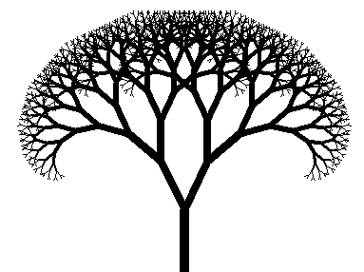
Computation for 1.6 billion person
Me: Suat ATAN
Friends of your friends
Your friends
You
Notes:
Imagine a person with 100 friends. If each of his friends also has 100 friends, then the number of friends-of-friends will be 10,000. If each of those friends-of-friends also has 100 friends then the number of friends-of-friends-of-friends will be 1,000,000. Some of those friends may overlap, so we need to filter down to the unique connections. We’re only two hops away and the number is already big. In reality this number grows even faster since most people on Facebook have more than 100 friends. We also need to do this computation 1.6 billion times; that is, for every person on Facebook. If we work there

Slide 32
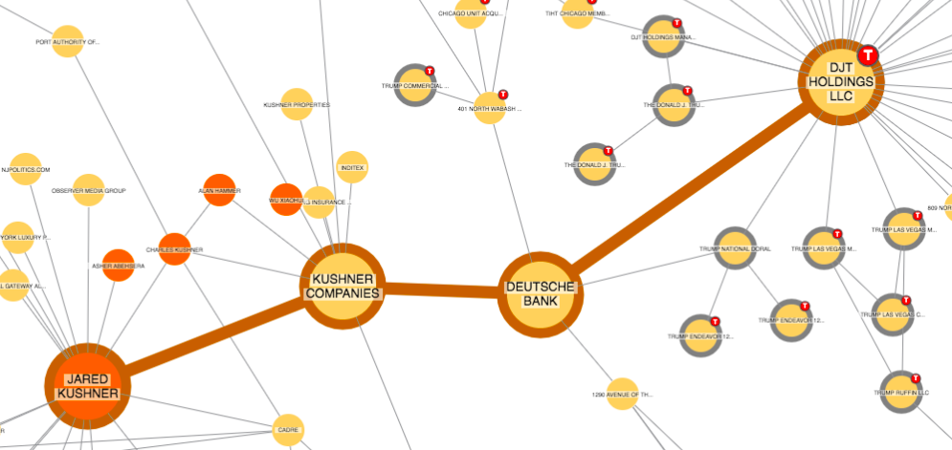
Shortest path (review)
Source: Cambridge Intelligence
Notes:
Now we can see these two networks differently than before. At least, we know that these networks have different "shortest path" values. In other words, let's say the second network may have a shorter path. What does it mean? If so, we can say that in the second network information flow and finding the most relevant person is easy? If these network about the contracting coronavirus we can say ... The million-dollar question is this? Which network is risky? Come one? Ideas? Does nobody want to say anything? Or do I not hear the voices?
Again, yes the network that has the shortest path is riskier than others.
Here we go, we will compute like facebook

Slide 33

Calculating Shortest Path with
library(readr)
library(igraph)
networkb = read_csv("../data/02.csv")
graphb = graph_from_data_frame(networkb)
plot(graphb, vertex.label.cex=0.8, vertex.color="yellow")
Notes:
OK, Let’s visualize our first case first. Nothing new here. As you see we have done just two-parameter in the plot function.

Slide 34
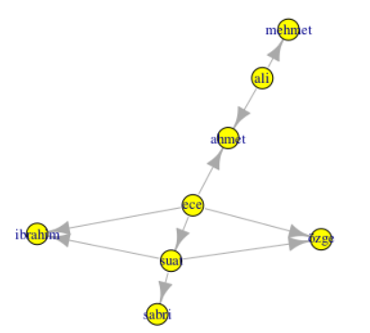
Visualization
My friend: Path distance: 1
Friend of my friend: Path distance 2
So on...
Shortest path
Longest path
Shortest path
Notes:
Before getting the shortest path just by function let’s try to guess them by observing our veteran visualization. As you see Mehmet and Sabri are like Alaska and Argentinia. They are at the most ends. The path between them is 5 (why not 6 because the first step is zero) In the other words if two persons are connected the path is zero. Longest path no need to be just one it may be more than one. It is true for the shortest path too.

Slide 35
Tabulating entire path distances
shortest.paths(graphb)
 | ece | suat | ali | özge | ibrahim | ahmet | sabri | mehmet
ece | 0 | 1 | 2 | 1 | 1 | 1 | 2 | 3
suat | 1 | 0 | 3 | 1 | 1 | 2 | 1 | 4
ali | 2 | 3 | 0 | 3 | 3 | 1 | 4 | 1
özge | 1 | 1 | 3 | 0 | 2 | 2 | 2 | 4
ibrahim | 1 | 1 | 3 | 2 | 0 | 2 | 2 | 4
ahmet | 1 | 2 | 1 | 2 | 2 | 0 | 3 | 2
sabri | 2 | 1 | 4 | 2 | 2 | 3 | 0 | 5
mehmet | 3 | 4 | 1 | 4 | 4 | 2 | 5 | 0
What is the shortest path(s) ?
What is the longest path(s) ?
What is the distance between Suat and İbrahim?
How did we get this table?
Notes:
Let’s scrutinize these questions. What is the shortest path: The all binary intersection corresponding with one. For instance, Ali and Ahmet on the shortest path both are not alone. What is the longest path: Only one answer: five. Mehmet and Sabri. As you know from the previous slide. So between Suat and İbrahim is one. So the last question: We get this table just by writing function in the yellow area.

Slide 36
To obtain the "average path length" value:
average.path.length(graphb)
1.1
Notes:
We can obtain the average path length of any network just by writing this function. For our last network, the average value is one point one. It means any person in this network can access anyone just via one point one person.

Slide 37
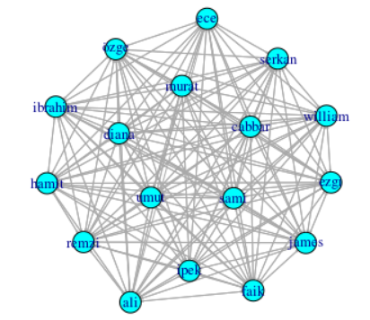
Comparison of two network in terms of average path length
Average Path Length: 1.1
Average Path Length: 1.003676
Notes:
As you notice right ant messy network has slightly shorter than the left one. Why? Because there are too many people and too many ties amongst them.
Welcome to think like Facebook’s data scientists. If you read the article I shared on the Facebook webpage you may discern this statement: “The humans in social media are more connected”. It is true because real life does not allow us to the right. It is similar to the left one. However, in Facebook, we can access our primary school teacher and ex-girlfriend or ex-boyfriend. Even their siblings. Therefore path length becomes shorter. Accessibility is increasing.

Slide 38
Thanks

