Slide 1
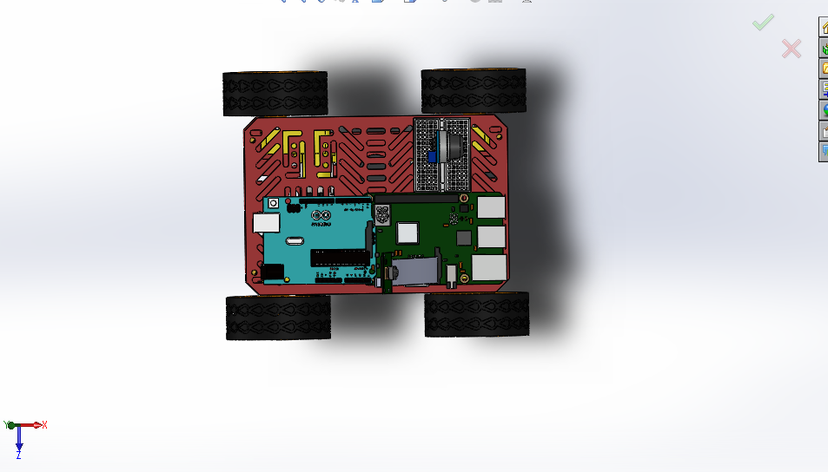
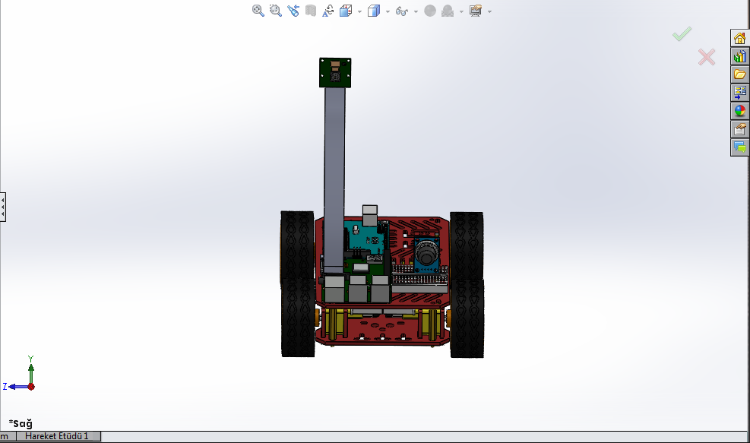
EE444-IMAGE PROCESSING UNIT
ŞUAYB TALHA ÖZÇELİK
ANIL AYDINER
METİN OZAN HAZAR

Slide 2
Materials
Raspberry Pi 3 Model B+
L9110 Dual Motor Driver Board
Carbon monoxide and Combustible Gas Sensor Board - MQ-9
Arduino UNO R3
ESP8266 NodeMCU Cp2102 V2 Development Card
4wd Smart Car
Raspberry Pi Camera
Gear Motor

Slide 3
Introduction
In the 21st century, Internet has become a worldwide mean of communication and a place to express ideas. Using internet in electrical engineering project is also become a phenomenon. People use mobile phones in every where we think that if we combine electrical engineering and android devices maybe it become more useful. In our group we have 2 Computer Engineers we have a code knowledge so we try to make text recognition in android devices with raspberry pi camera . We try to transfer the live stream video to android devices. In this way we see our raspberry camera image in every where with internet. We build the raspberry camera in car devices to make it portable. So our document is about car device(motor control), gas sensor, Raspberry Pi 3 B+, Raspberry Cam, Android Studio coding to image process.

Slide 4
Software (Code)
@Override protected void onCreate(Bundle savedInstanceState) { super.onCreate(savedInstanceState); setContentView(R.layout.activity_image); // graphicOverlay=(GraphicOverlay)findViewById(R.id.graphic_overlay); btnCapture=(Button)findViewById(R.id.btn_capture); rel=(RelativeLayout)findViewById(R.id.rel); ımage_view=(ImageView)findViewById(R.id.image_view); textToSpeech=new TextToSpeech(this, new TextToSpeech.OnInitListener() { @Override public void onInit(int status) { if(status==TextToSpeech.SUCCESS){ int result = textToSpeech.setLanguage(Locale.ENGLISH); if(result==TextToSpeech.LANG_MISSING_DATA || result==TextToSpeech.LANG_NOT_SUPPORTED){ Log.e("TTS","Language not supported!"); }else{ System.out.print("Listen Enabled"); } }else{ Log.e("TTS","Initiliaze failed!"); } } }); if (android.os.Build.VERSION.SDK_INT > 9) { StrictMode.ThreadPolicy policy = new StrictMode.ThreadPolicy.Builder().permitAll().build(); StrictMode.setThreadPolicy(policy); } streamView = (WebView)findViewById(R.id.streamview); Uri video = Uri.parse(videoUrL); streamView.loadUrl(videoUrL); btnCapture.setOnClickListener(new View.OnClickListener() { @Override public void onClick(View v) { // create bitmap screen capture bitmap=getBitmapFromWebView(streamView); ımage_view.setImageBitmap(bitmap); //ımage_view.setVisibility(View.VISIBLE); textRecognize(bitmap); } });}
public void textRecognize(Bitmap photo){ FirebaseVisionImage image = FirebaseVisionImage.fromBitmap(photo); FirebaseVisionTextRecognizer detector = FirebaseVision.getInstance() .getOnDeviceTextRecognizer(); Task<FirebaseVisionText> result = detector.processImage(image) .addOnSuccessListener(new OnSuccessListener<FirebaseVisionText>() { @Override public void onSuccess(FirebaseVisionText firebaseVisionText) { for(FirebaseVisionText.TextBlock block:firebaseVisionText.getTextBlocks()){ Rect rect=block.getBoundingBox(); Point[] corner=block.getCornerPoints(); text=block.getText(); Toast.makeText(Image.this,"t: "+text,Toast.LENGTH_SHORT).show(); AlertDialog.Builder builder1=new AlertDialog.Builder(Image.this); builder1.setTitle("Your Text"); builder1.setMessage("Recognized Text: "+ text); builder1.setCancelable(false); builder1.setPositiveButton("Repeat", new DialogInterface.OnClickListener() { @Override public void onClick(DialogInterface dialogInterface, int i) { } }); builder1.setNegativeButton("Listen", new DialogInterface.OnClickListener() { @Override public void onClick(DialogInterface dialog, int which) { speak(); } }); builder1.show(); } } }) .addOnFailureListener( new OnFailureListener() { @Override public void onFailure(@NonNull Exception e) { Toast.makeText(Image.this,"Failed to Recognize",Toast.LENGTH_SHORT).show(); } }); }
UP.setOnClickListener(new View.OnClickListener() { @Override public void onClick(View v) { //yukarı kod komutları buraya mediaController = new MediaController(CarControl.this); mediaController.setAnchorView(streamView); streamView.loadUrl(videoUrLUp); }});

Slide 5
Car Control Ardunio
void loop() {
while(ArduinoUno.available()>0){
float val= ArduinoUno.parseFloat();
if(ArduinoUno.read()=='\n'){
Serial.println(val);// this is the value coming from nodemcu
if(val==1){//if val is equal to 1 is going to move forward
digitalWrite(MotorA1, HIGH);
digitalWrite(MotorA2, LOW);
digitalWrite(MotorB1, HIGH);
digitalWrite(MotorB2, LOW);
delay(2000);
digitalWrite(MotorA1, LOW);
digitalWrite(MotorA2, LOW);
digitalWrite(MotorB1, LOW);
digitalWrite(MotorB2, LOW);
}
#include <SoftwareSerial.h>
SoftwareSerial ArduinoUno(2,3);
#define MotorA1 8
#define MotorA2 9
#define MotorB1 6
#define MotorB2 7
void setup() {
pinMode(MotorA1, OUTPUT);
pinMode(MotorA2, OUTPUT);
pinMode(MotorB1, OUTPUT);
pinMode(MotorB2, OUTPUT);
Serial.begin(9600);
ArduinoUno.begin(4800);
}

Slide 6
Gas Sensor NodeMcu
void setup() {
pinMode(BUILTIN_LED, OUTPUT);
pinMode(D5, INPUT);
pinMode(D7, OUTPUT);
Serial.begin(9600);
ESP8266WiFi.begin(4800);
setup_wifi();
client.setServer(mqtt_server, 10876);
client.setCallback(callback);
reconnect();
server.on("/sensorvalue.txt", [](){
text = (String)sensorValue;
server.send(200, "text/html", text);
});
server.on("/", [](){
page = "<h1>Sensor to Node MCU Web Server</h1><h1>Sensor Value:</h1> <h1 id=\"sensorvalue\">""</h1>\r\n";
page += "<script>\r\n";
page += "var x = setInterval(function() {loadData(\"sensorvalue.txt\",updateData)}, 1000);\r\n";
page += "function loadData(url, callback){\r\n";
page += "var xhttp = new XMLHttpRequest();\r\n";
page += "xhttp.onreadystatechange = function(){\r\n";
page += " if(this.readyState == 4 && this.status == 200){\r\n";
page += " callback.apply(xhttp);\r\n";
page += " }\r\n";
page += "};\r\n";
page += "xhttp.open(\"GET\", url, true);\r\n";
page += "xhttp.send();\r\n";
page += "}\r\n";
page += "function updateData(){\r\n";
page += " document.getElementById(\"sensorvalue\").innerHTML = this.responseText;\r\n";
page += "}\r\n";
page += "</script>\r\n";
server.send(200, "text/html", page);
});
//server.begin();
//Serial.println("Web Server Started");
server2.begin();
}

Slide 7
sensorValue = analogRead(A0);
Serial.println("Current gas value "+String(sensorValue));
server.handleClient();
String gas= String(sensorValue);
//ESP8266WiFi.print(sensorValue);
//ESP8266WiFi.println("\n");
Serial.println("Publish message: ");
Serial.println(gas);
int numgas= sensorValue;
char csgas[16];
itoa(numgas, csgas, 10);
delay(1500);
client.publish("Gas", csgas);
}
String s = "HTTP/1.1 200 OK\r\n";
s += "Content-Type: application/json\r\n\r\n";
s += "{\"data\":{\"message\":\"success\",\"value\":\"";
s += value;
s += "\"}}\r\n";
s += "\n";
// Send the response to the client
client2.print(s);
delay(1);
Serial.println("Client disconnected");

Slide 8
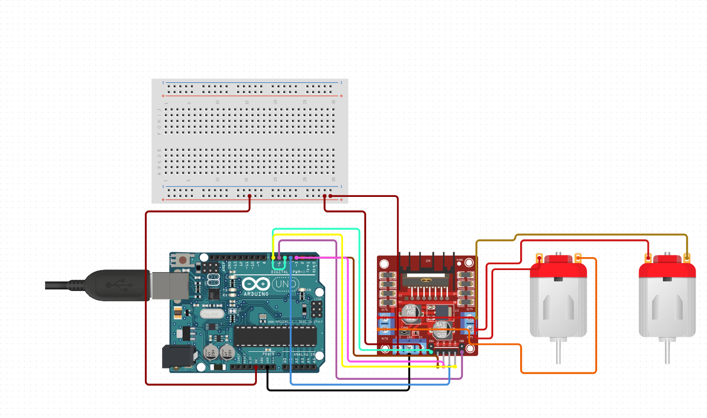
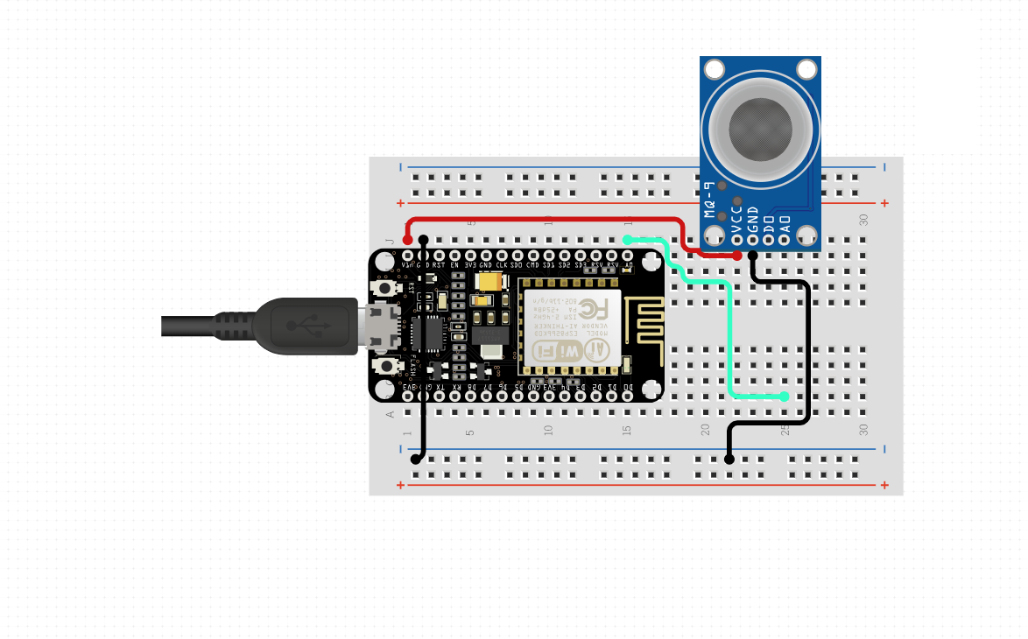
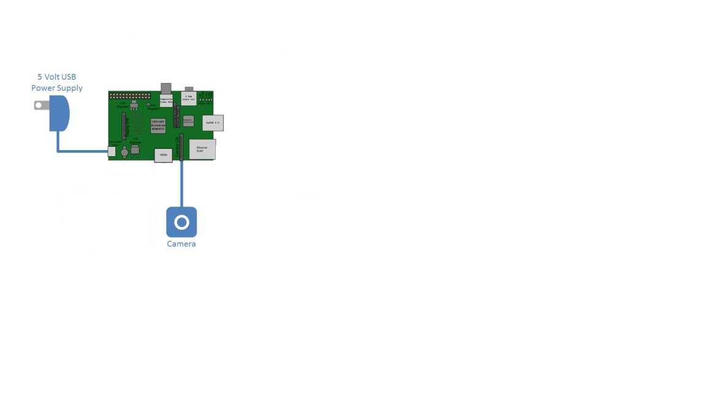

Slide 9
Conclusion
In the final, being able to finish this project has shifted our motivation upwards for the bigger projects in the future. It was a big move for us to optimize an android application with microprocessors which helped us to have a better understanding of IOT. We successfully managed to control the three different microprocessor and made them communicate with each other which enabled us to reduce their workloads to run in underload. This project helped us to understand the techniques of working with multiple microprocessors and have taught us the fundamentals of image processing.

Slide 10
References
[1] Ramazan Köprü, “On PWM generation via Raspberry platform”, April 1, 2019, Radioengineering, pp. 12-34.
[2] Isaac Newton, “Planatery motion equations”, April 1, 1717, Physics, pp. 212-134.
[3] http://helloraspberrypi.blogspot.com/2016/07/stream-video-from-raspberry-pi-3-camera.html
[4] https://www.sitepoint.com/a-step-by-step-guide-to-building-an-android-audio-player-app/

