Slide 1
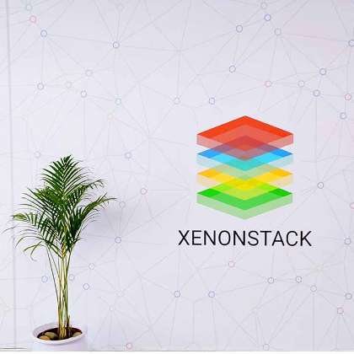
L1:Module-1
Presented By: Suraj Singh

Slide 2

Overview
Introduction to Database Management System
Types of databases
Relational Database Management System
SQL
Test Driven Development
Cloud Computing
How Analytics Help Buisness
OWASP
The Twelve-Factor App
Agile Manifesto

Slide 3
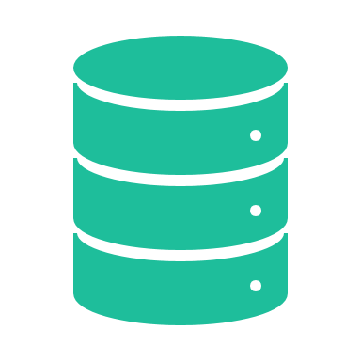
Introducing the Database and the DBMS

Slide 4
Types of Databases
1
2
3
4
4
.
Relational Database
NO SQL Database
Graph Databases
Time-Series Databases
Tabular Data Structure Uses SQL ACID Properties Suitable for Structured Data, Complex Queries, transactions Example : MYSQL, Postgres SQL, Oracle Database
Unstructured Data Flexible Schema Scalable for Big Data Types: Document, Key-value Example : MONGO-Db, Redis, Neo4j
Store Data as nodes, edges,properties ideal for Complex relationships queries Uses high-level query language like Cypher Example : Amazon Neotune Neo4j

Slide 5
Why we Need DBMS
.
Data Organization and Management:​
Data Analysis and Reporting
Database Management System
Data Integrity and Consistency:​
Data Security and Privacy:​
Concurrent Data Access
Scalability and Flexibility

Slide 6
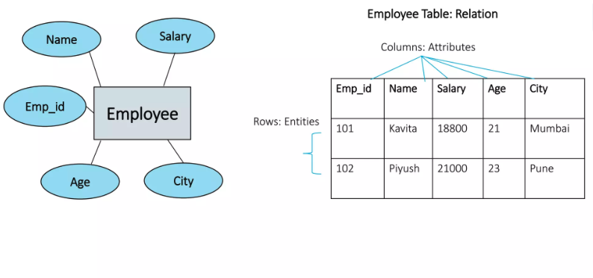
Relational Database
A relational database is a type of database that organizes data into rows and columns, which collectively form a table where the data points are related to each other.
Terminologies:
Tuple: Row of a table known as Tuple
Attribute : Column of a table known as Attribute
Domain:
Degree :in a relation, no. Of Attribute known as Degree

Slide 7
SQL
SQL (Structured Query Language) is used to perform operations on the records stored in the database​
SQL (Structured Query Language) is used to Create Relational Database and Operate them
It allows SQL users to create, drop, and manipulate the database and its tables.
SQL Commands are mainly categorized into five categories: ​
DML
DDL
DCL
TCL
DQL
Create
Insert
Grant
Commit
Select
Drop
Update
Revoke
Savepoint
Alter
Delete
Rollback
Truncate
Truncate

Slide 8

Test Driven Development

Slide 9
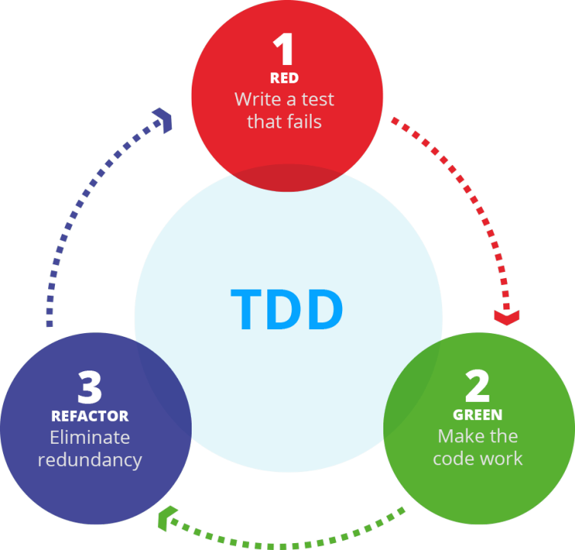
What is TDD .?
Test-Driven Development (TDD) is a technique for building software that guides software development by writing tests. It was developed by Kent Beck in the late 1990's as part of Extreme Programming. In essence we follow three simple steps repeatedly:
Write a test for the next bit of functionality you want to add.​
Write the functional code until the test passes.​
Refactor both new and old code to make it well structured.​

Slide 10
Three phases of TDD (Test driven development cycle)​
Red: In this phase, the developer writes a failing test to represent a new feature or change in functionality. The test should be specific, automated, and written to fail.​
Green: In this phase, the developer writes the code that makes the failing test pass. The primary goal is to write the minimum amount of code necessary to meet the test's requirements.
Start Here
Write a test
Test Fails
Clean Code
Refactor: In this phase, the developer reviews the code that was just written and looks for ways to improve its design, structure, and performance. The goal is to make the code more maintainable and easier to understand.
Write Code to test pass
Workable Code How to Improve
Code pass test

Slide 11

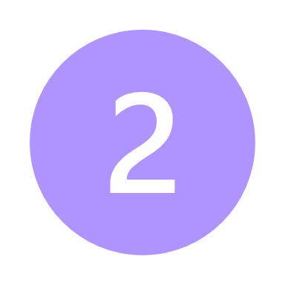
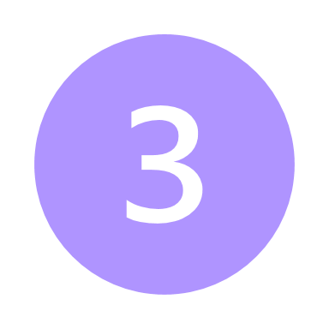


Pros and Cons
PROS
CONS
It helps to prioritize the development process and focus on what needs to be built rather than piling feature upon feature.​
TDD can be too rigid when making changes or adding new features, which isn’t ideal if you need to adjust your project quickly.
TDD ensures that software is thoroughly tested before it is released to production.​​
All the emphasis on tests and following the rules of testing can stop you from being creative and coming up with new ideas during the making process.
TDD provides a clear specification or contract for what the code should do, making it easier for developers to create software that meets the requirements.​​​
Creating effective and comprehensive test cases using the TDD methodology may pose challenges for some users.
It can help reduce the time spent debugging and troubleshooting as defects are discovered early in development.​
cgdfgfdg
TDD can help to improve overall development speed by allowing developers to catch issues earlier in the process.

Slide 12




TDD Vs. Traditional Testing
TDD
Traditional Testing
TDD is an agile development methodology
where
tests are written before the code is developed
Approach
traditional testing is performed after the code is written.
TDD focuses on testing small code units at a time​
Testing Scope
traditional testing covers testing the system as a whole, including integration, functional, and
acceptance testing
TDD aims to catch errors as early as possible in
the development process, making debugging and
fixing them easier.
Debugging
Traditional testing, on the other hand, may require more
effort to debug errors that are discovered later in
the development process.
TDD documentation typically focuses on the test ​
cases and their results​
Documentation
traditional testing documentation may include more
detailed information about the testing process,
the test environment, and the system under test.

Slide 13
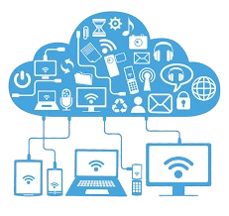
Cloud Computing

Slide 14

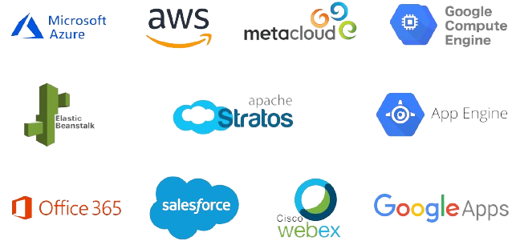
What is Cloud Computing
Simply put, Cloud Computing is the delivery of Computing Services server, Storage, databases , networking , software, and analytics and more over the internet
Cloud Computing is Consist of Hardware and Software Resources made available on the internet as they are managed by the third party services. These services typically provide access to advance software applications. High end networks of server computer.

Slide 15
How cloud computing helps business ?

Slide 18
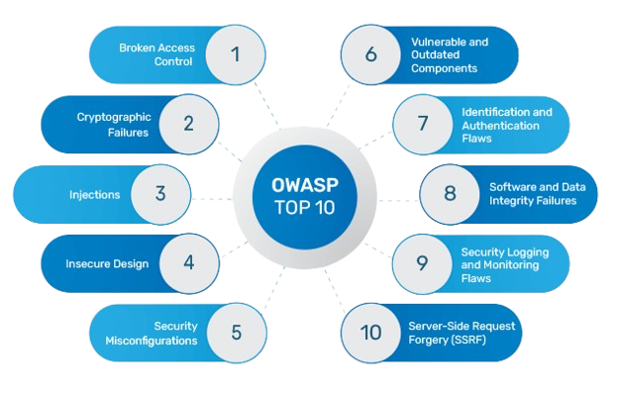
OWASP TOP 10

Slide 19

What is OWASP .?
The Open Web Application Security Project (OWASP) is a non-profit organization founded in 2001, with the goal of helping website owners and security experts protect web applications from cyber attacks.
The OWASP Top 10 list of security threats is based on the experience and expertise of an open community of contributors and consensus among the world’s security experts.
The risks are ranked according to several factors, including how often each security vulnerability occurs and the severity and magnitude of its potential impact.

Slide 20
OWASP TOP 10
Broken Access Control
If authentication and access restriction are not properly implemented, it's easy for attackers to take whatever they want. With broken access control flaws, unauthenticated or unauthorized users may have access to sensitive files and systems, or even user privilege settings.
2. Cryptographic Failures
Common errors such as using hardcoded passwords, outdated cryptographic algorithms, or weak cryptographic keys can result in the exposure of sensitive data
3. Injection
Injection attacks occur when attackers exploit vulnerabilities in web applications that accept untrusted data. Common types include SQL injection and OS command injection. This category now also includes Cross Site Scripting (XSS). By inserting malicious code into input fields, attackers can execute unauthorized commands, access sensitive databases, and potentially gain control over systems
4. Insecure Design
Insecure design is a new category in the 2021 OWASP Top Ten which focusses on fundamental design flaws and ineffective controls as opposed to weak or flawed implementations.
5. Security Misconfiguration
Application servers, frameworks, and cloud infrastructure are highly configurable, and security misconfigurations such as too broad permissions, insecure default values left unchanged, or too revealing error messages can provide attackers easy paths to compromise applications.
.

Slide 21
OWASP TOP 10
7. Identification and Authentication Failures
Application functions related to authentication and session management are often implemented incorrectly, allowing attackers to compromise passwords, keys, or session tokens, or to exploit other implementation flaws to assume other users’ identities temporarily or permanently.
8. Software and Data Integrity Failures
Software and data integrity failures relate to code and infrastructure that does not protect against integrity violations. An example of this is where an application relies upon plugins, libraries, or modules from untrusted sources, repositories, and content delivery networks (CDNs). An insecure deployment pipeline can introduce the potential for unauthorized access, malicious code, or system compromise. Lastly, many applications now include auto-update functionality, where updates are downloaded without sufficient integrity verification and applied to the previously trusted application. Attackers could potentially upload their own updates to be distributed and run on all installations.
9. Security Logging and Monitoring Failures
Insufficient logging and monitoring, coupled with missing or ineffective integration with incident response, allows attackers to further attack systems, maintain persistence, pivot to more systems, and tamper, extract, or destroy data.
10. Server-Side Request Forgery
Server-Side Request Forgery (SSRF) flaws occur whenever a web application fetches a remote resource without validating the user-supplied URL. It allows an attacker to coerce the application to send a crafted request to an unexpected destination, even when protected by a firewall, VPN, or another type of network access control list (ACL).
.

Slide 22
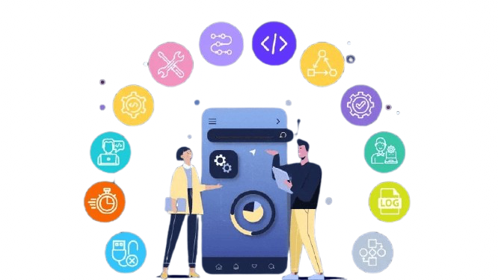
The Twelve Factor App

Slide 23
What is a Twelve-Factor App?
In the modern era, software is commonly delivered as a service: called web apps, or software-as-a-service. ​
The twelve-factor app is a methodology for building software-as-a-service apps that:
Use declarative formats for setup automation, to minimize time and cost for new developers joining the project;
Have a clean contract with the underlying operating system, offering maximum portability between execution environments;
Are suitable for deployment on modern cloud platforms, obviating the need for servers and systems administration;
Minimize divergence between development and production, enabling continuous deployment for maximum agility;
And can scale up without significant changes to tooling, architecture, or development practices.
The twelve-factor methodology can be applied to apps written in any programming language, and which use any combination of backing services (database, queue, memory cache, etc).

Slide 24
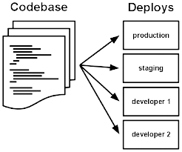
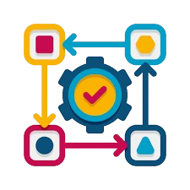

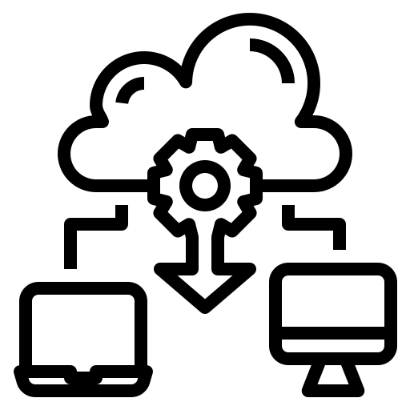
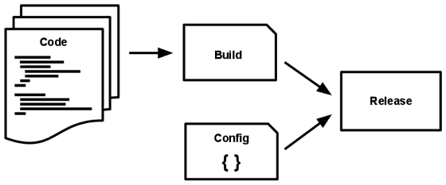

The Twelve Factors
1.CodeBase
There is only one codebase per app, but there will be many deploys of the app.
2.Dependencies
Explicitly declare and isolate dependencies
3.Config
Store config in the environment
4. Backing Services
Treat backing services as attached resources
5.Build, release, run
Store config in the environment
6. Process
Execute the app as one or more stateless processes

Slide 25
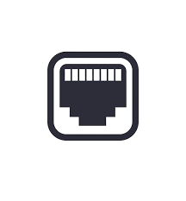
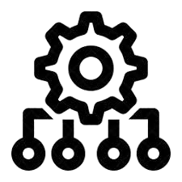
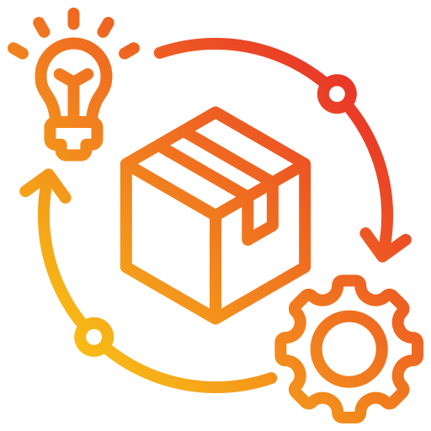


The Twelve Factors
7. Port Binding
Export services via port binding
8.Concurrency
Scale out via the process model
9.Disposability
Maximize robustness with fast startup and graceful shutdown
10. Dev/prod parity
Keep development, staging, and production as similar as possible
11.Logs
Treat logs as event streams
12. Admin processes
Run admin/management tasks as one-off processes

Slide 26
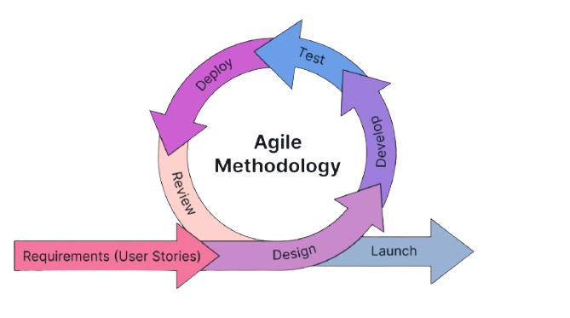
Agile Methodology

Slide 27
Manifesto for Agile Software Development
The Manifesto for Agile Software Development is a foundational document produced by 17 developers at Snowbird, Utah in 2001.
This document consists of 4 Agile Values and 12 Agile Principles, emphasizing collaboration, flexibility, and customer satisfaction. These 12 principles and 4 agile values provide a guide to Software Developers.
The primary purpose of the Agile Manifesto is to provide a foundation for developing software in a way that responds effectively to changing requirements and delivers value to customers.

Slide 28
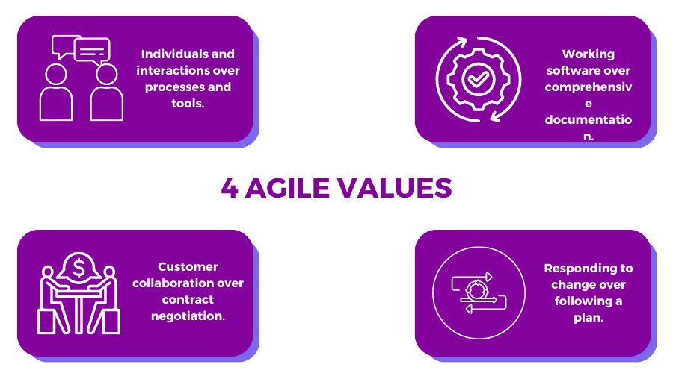
Agile Values

Slide 29
Agile Principles
Frequent
Delivery
Changing
requirement
3
Customer
Satisfaction
2
1
Autonomy ​
and motivation
Promoting
Collaboration
5
4
Face to face Communication
6
Stable work environments
9
7
8
Measure Progress
Working
software
Self-Organized
Team
11
12
10
Continuous
Improvement
Simplicity

