Slide 1
COVID-19 PREDICTION USING THREE DIFFERENT MODELS
Group 7
Presenters:​
Fariha Ferdousi 1706143​
Nausin Tabassum Kudrot 1706158​
Sadia Afrose 1706161​
Raisa Mashtura 1706163​
Subah Karnine 1706174​
Presented To:​
Tanvir Mahmud
Satyaki Banik​

Slide 2
WORK FLOW
Error Calculation
PREDICTION MODEL
DATA
Filtering
Calculating the error in order to measure the accuracy of the model
DATA
Processing
Fitting the dataset in appropriate model in order to predict the future data.
DATA
COLLECTION
Remove unnecessary ripples from the data
Organize the raw data
Collecting necessary dataset

Slide 3
Why Data Processing?
Data processing starts with data in its raw form and converts it into a more readable format
1
Data processing synchronizes data from various sources..
2
Predefined data helps the proceeding processes.
3
The processed facts and figures can be organized in such a way that they help to conduct analysis quickly.
4
Importance of data processing includes increased productivity and profits, better decisions, more accurate and reliable. .

Slide 4
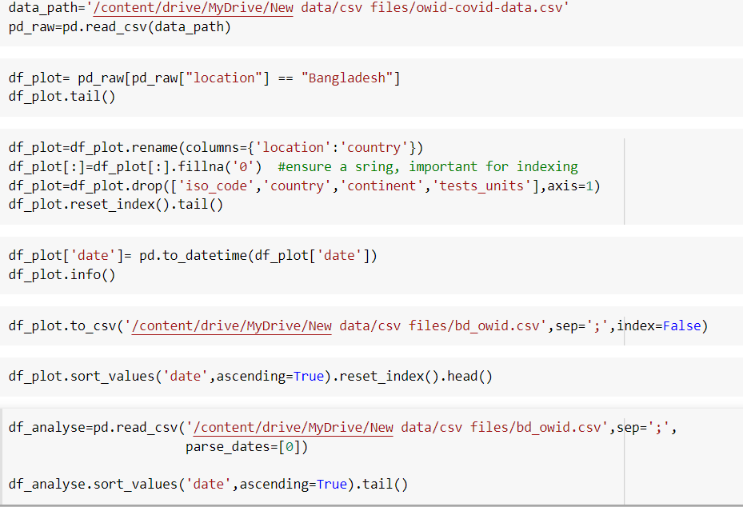
Data Processing code
READ DATASET
RENAMING AND REMOVING UNNECESSARY COLUMNS
EXPORTING THE PROCESSED DATA TO A NEW DATASET

Slide 5
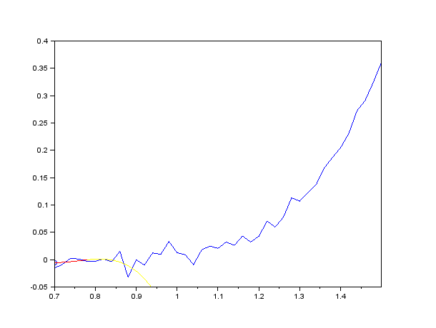
Dataset Filtering
We used Savizky-Golay filter for the purpose of smoothing the data, that is, to increase the precision of the data without distorting the signal.
This is achieved, in a process known as convolution, by fitting successive sub-sets of adjacent data points with a low-degree polynomial by the method of linear least squares.

Slide 6
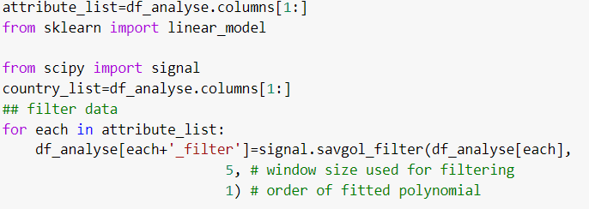
Data Filtering Code
We did filtering for Bangladesh confirmed covid data set.
Savgol filter is coming with two parameters.
a.1st parameter Window size across how many data points we spread this polynomial filter. We took 5 days for setting this input.
b. 2nd parameter for defining the polynomial's degree. We used one degree polynomial function for our data set.

Slide 7
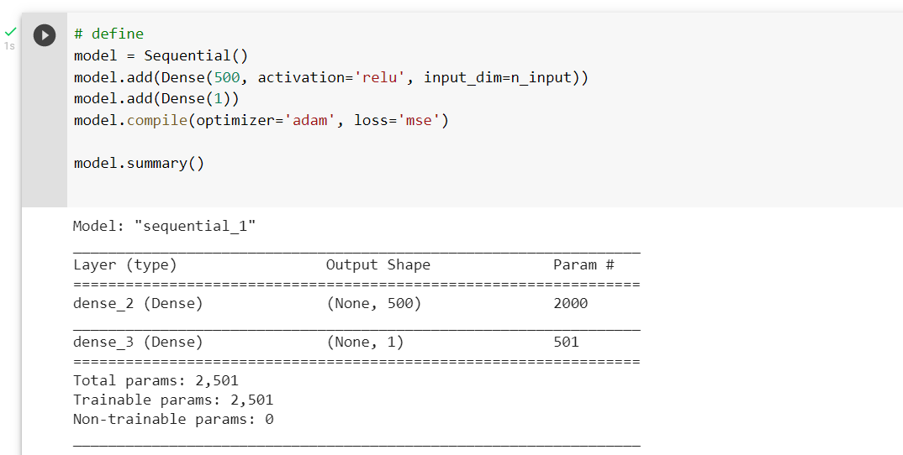
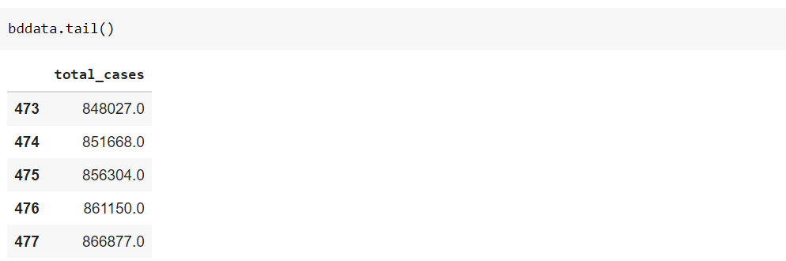
Multilayer Perceptron Layer Architecture
Key points:
This has only one hidden layer.
We used the univariate time series forecasting using “total cases” only.

Slide 8
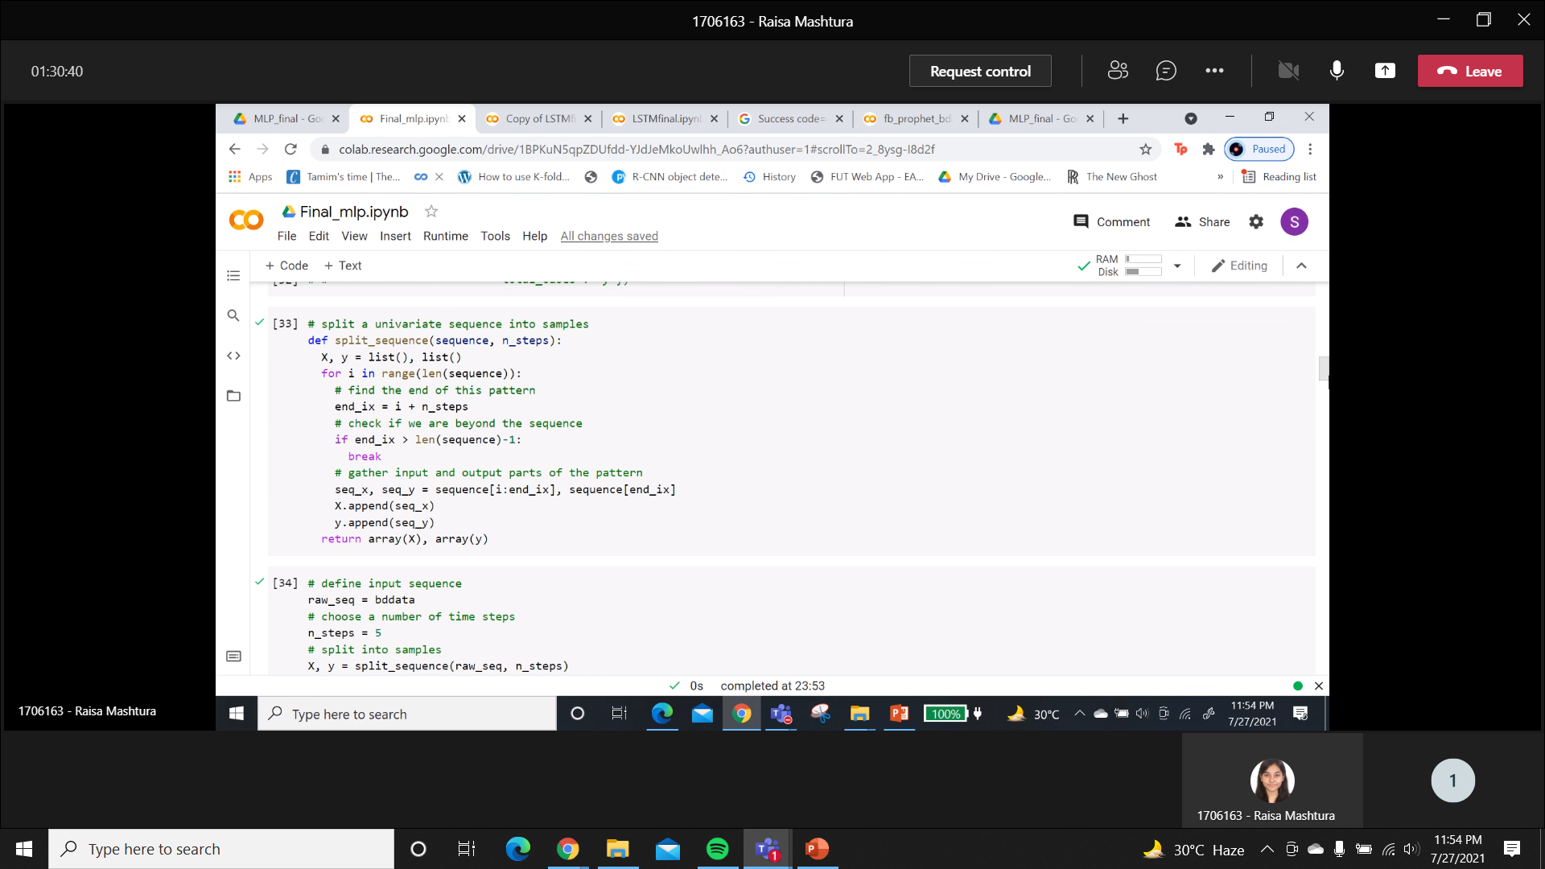
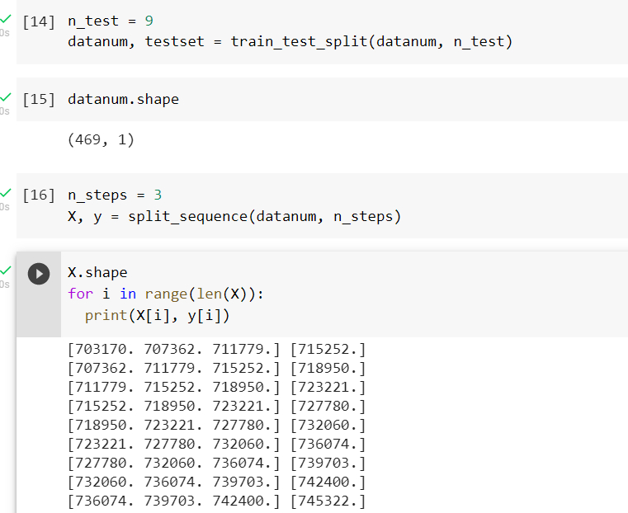
The Preprocessing
The sequence input in the function is the total cases column.
The Y data must be generated by taking values at regular intervals from the sequence.
The remaining data is our X (training + testing data).

Slide 9
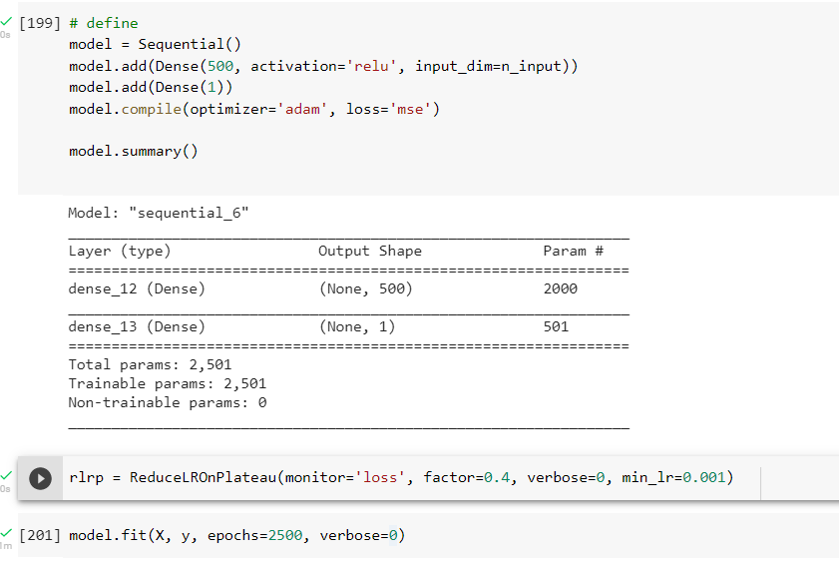
The Hyperparameters
The learning rate was set at 0.001
Epochs trained were 2500
Optimum batch size of 15% were selected
9 data points were set aside for the final prediction

Slide 10
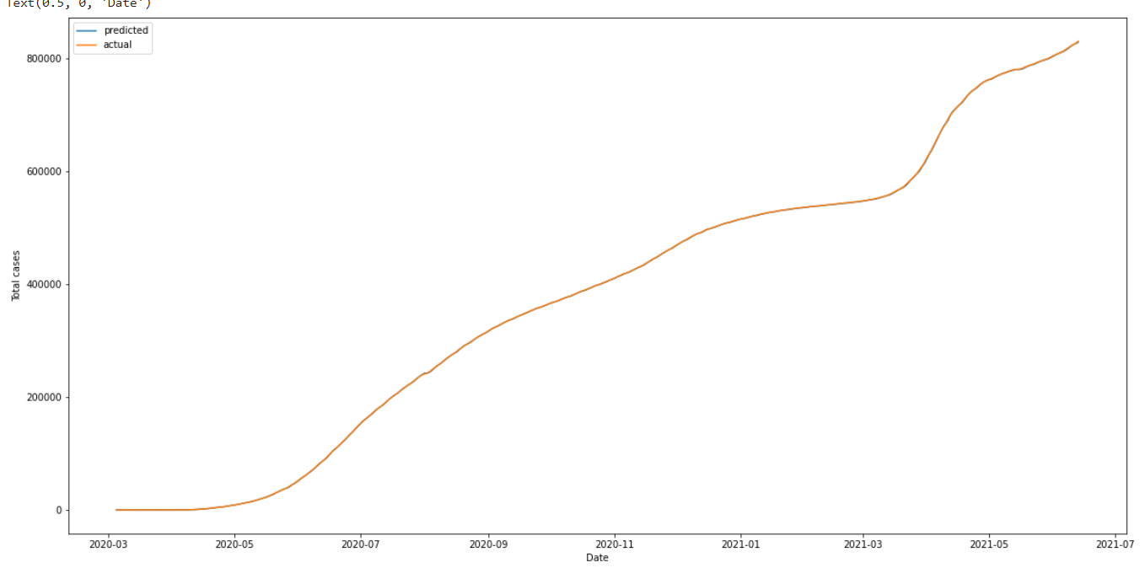
The result on the train set
We can see that the predicted and actual graphs are almost exact matches
This means that out model is performing very well on our training set.

Slide 11
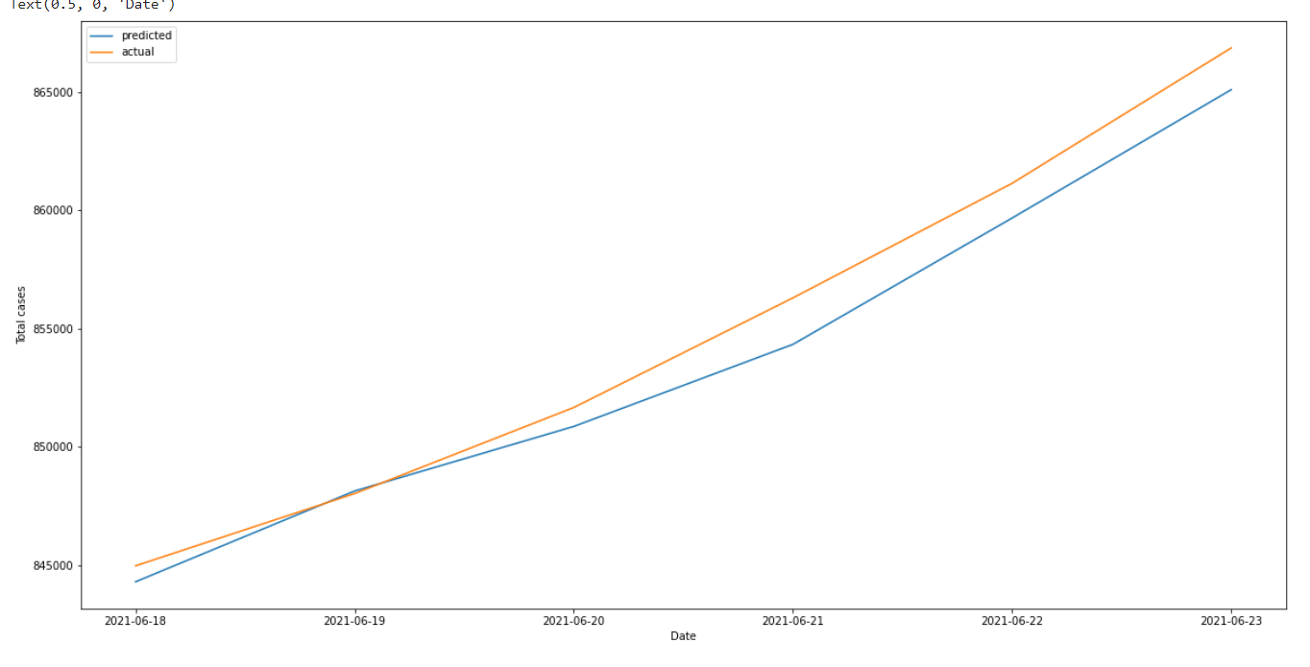
The result on the test set
We can see that the predicted and actual graphs are very close together
This means that out model is performing very well on our test set.

Slide 12
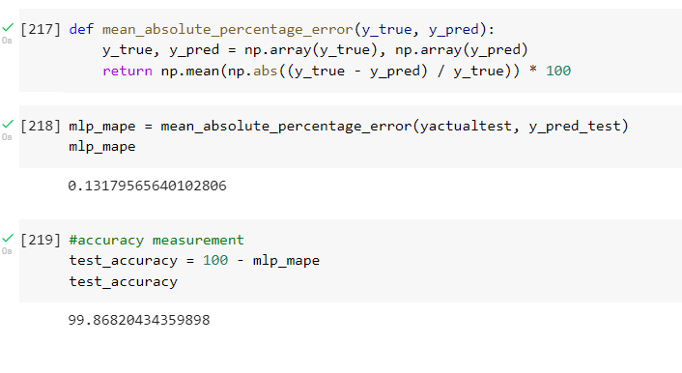
What about the accuracy?
The accuracy on the test was reasonably high.
Was found to be 99.8%
Thus univariate MLP works pretty well for our dataset

Slide 13

LSTM
Special kind of RNN
Able to connect previous data to present data
Remembers information for long periods
Good for time series analysis
Information can pass through the ‘cell states’ for a long time unchanged
Filters help add or remove information from cell state
Forget gates decide which past information to throw away
Input gates decide which new information to add
Output gates decide which information to give as result
Inside an LSTM cell

Slide 14
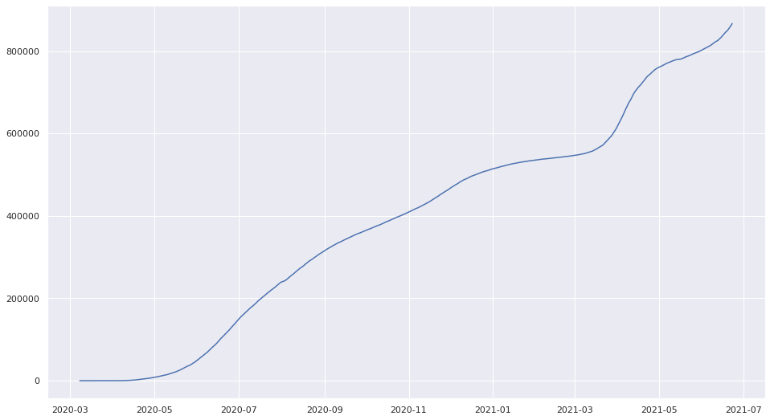
Total Covid-19 cases in Bangladesh from 08/03/2020 to 23/06/2021
Dataset taken from Our World In Data website

Slide 15
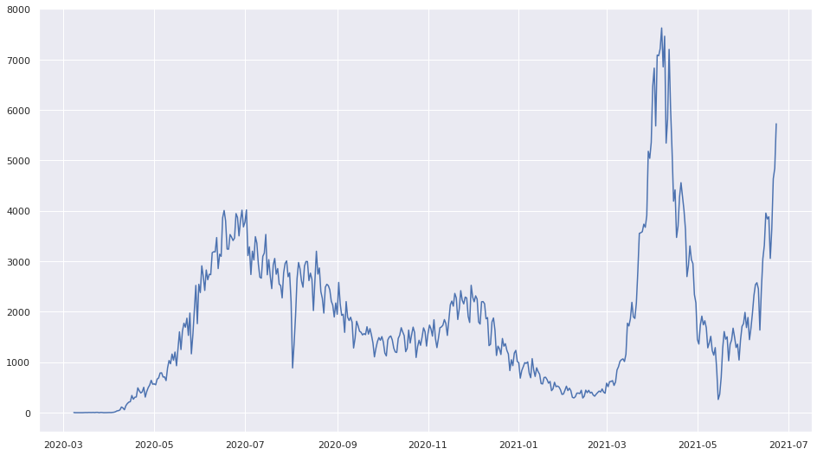
New Covid-19 cases in Bangladesh from 08/03/2020 to 23/06/2021
Dataset taken from Our World In Data website

Slide 16
Relevant dataset elements – 473
Training Set (95%)
Test Set (5%)
Data divided with time step of 7 days
Data Preprocessing

Slide 17
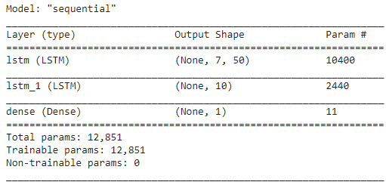
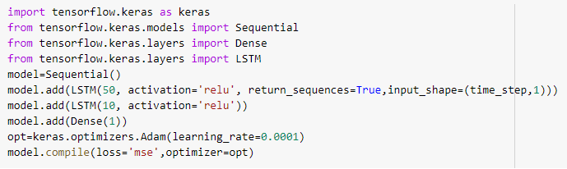
Model Parameters
Activation: Rectified Linear Unit (ReLu)
Optimizer: Adam with a learning rate of 0.001
Loss: MSE
Epochs: 1000
Model Summary

Slide 18
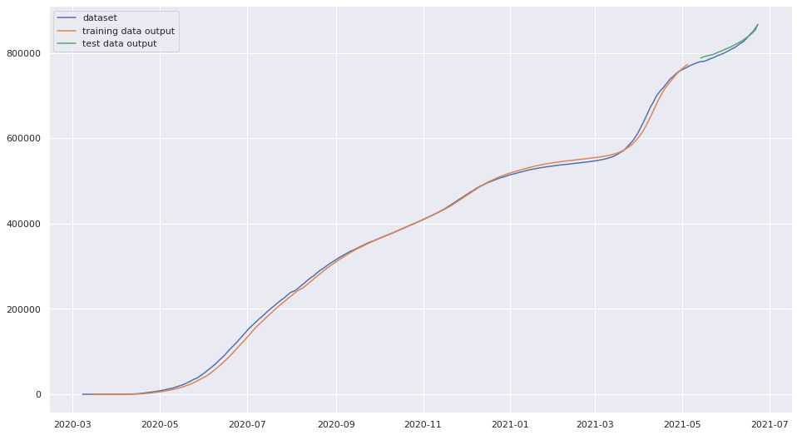
RMSE Train:7885.621 Test:4121.001 MAPE:1.8366 Accuracy:98.16334%

Slide 19
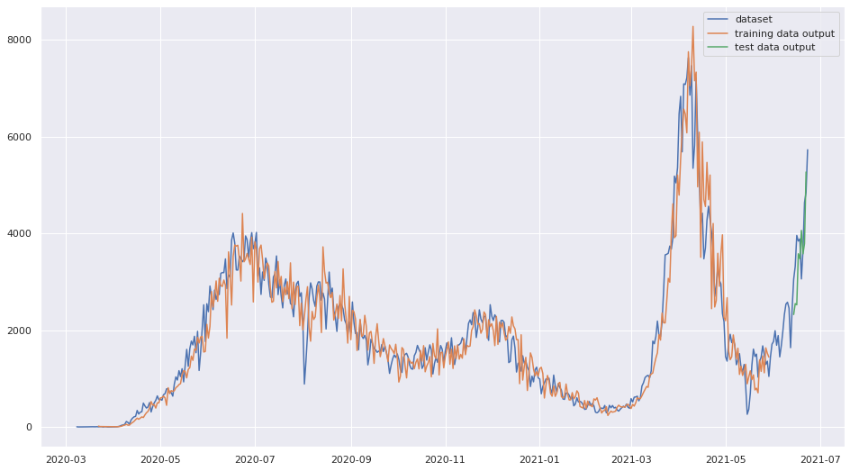
Time Step: 7>>14 Learning Rate 0.001>>>0.0001
RMSE Train:454.3044 Test:769.331 MAPE:23.4229 Accuracy: 76.57%

Slide 20
FB Prophet Model
Plotting helps us visualize the dataset.
Useful to measure forecast error
Load and Summarize Dataset
Plot Dataset
Fit Prophet model
Cross validation
Performance metrics
Filtered Dataset containing total covid cases of Bangladesh loaded
Appropriate model is chosen looking at the plot
used to compute some useful statistics of the prediction performance

Slide 21
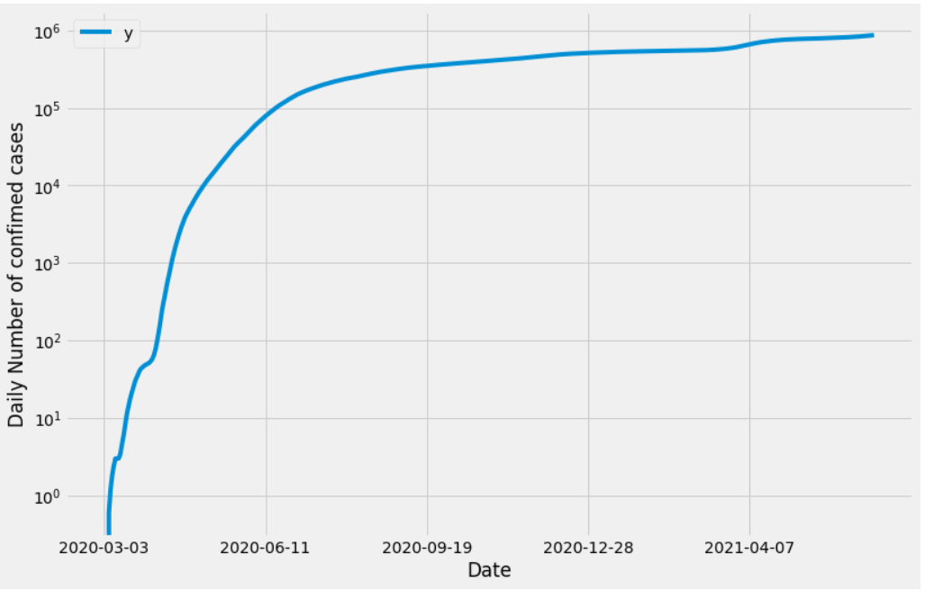
Dataset Loading And Plotting
Plotting a time series helps us actually see if there is a trend, a seasonal cycle, outliers, and more. It helps us visualize the data which helps in chosing approriate model
It is seen that the model exhibits saturating growth.

Slide 22

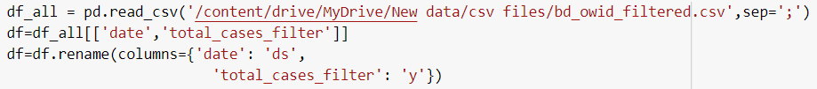
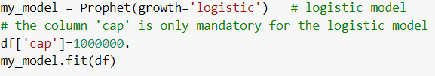
Fitting Prophet Model
Since the dataset exhibits satuaration growth,
Non-linear saturating growth model is used
This sort of growth is typically modeled using the logistic growth model, which in its most basic form is
with C the carrying capacity, k the growth rate, and m an offset parameter.

Slide 23
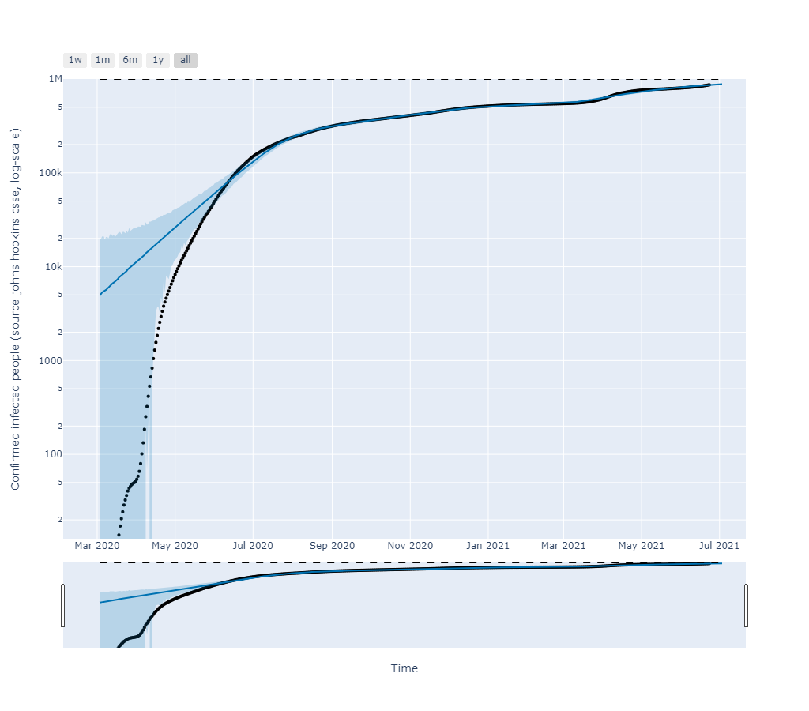
Plotting forecasts along with the actual data
We entered the dataset as training set and predicted the total case for next 10 days in the future
1

Slide 24
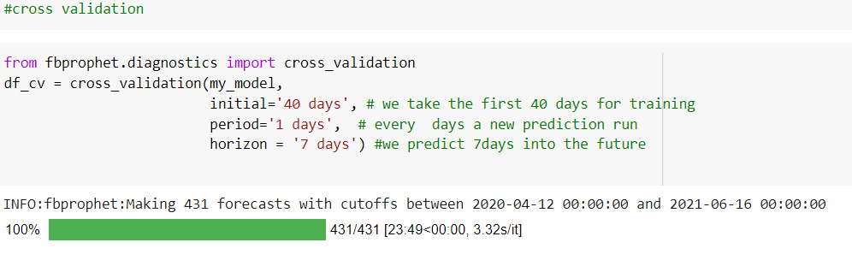
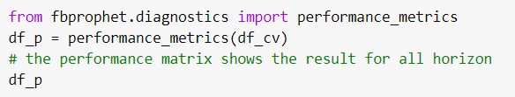
Cross validation and Performance metrics
Cross validation
Prophet includes functionality for time series cross validation to measure forecast error using historical data. This is done by selecting cutoff points in the history, and for each of them fitting the model using data only up to that cutoff point. We can then compare the forecasted values to the actual values. This code illustrates a simulated historical forecast on the dataset, where the model was fit to a initial history of 40 days, and a forecast was made on a 7 days horizon.
Performance metrics
The performance_metrics utility can be used to compute some useful statistics of the prediction performance (yhat, yhat_lower, and yhat_upper compared to y), as a function of the distance from the cutoff (how far into the future the prediction was). The statistics computed are mean squared error (MSE), root mean squared error (RMSE), mean absolute error (MAE), mean absolute percent error (MAPE), and coverage of the yhat_lower and yhat_upper estimates.

Slide 25
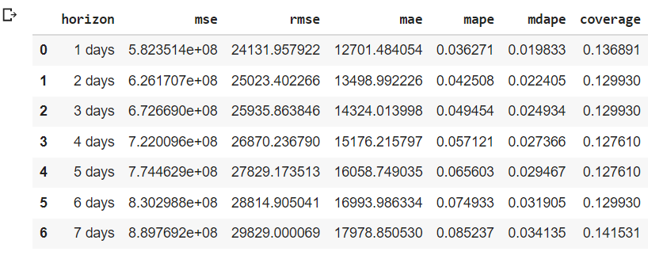
Performance metrics output

Slide 26
Model comparison
MLP
LSTM
FB PROPHET
ACCURACY :
99.8%
ACCURACY:
98.16%
ACCURACY:
99.93%.

Slide 27
Contribution
FB Prophet
Nausin Tabassum Kudrot (1706158)
Data filtering
Sadia Afrose (1706161)
LSTM
Subah Karnine (1706174)
Data processing
Fariha Ferdousi (1706143).
MLP
Raisa Mashtura (1706163)

Slide 28
THANK YOU

