Slide 1

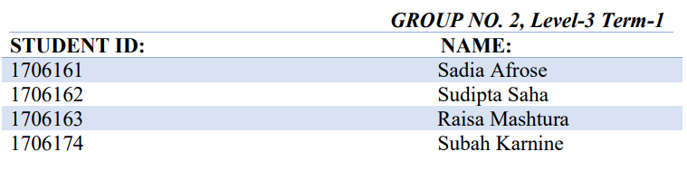
PRESENTED TO: Arik Subhana Satyaki Banik Md. Sadman Sakib PRESENTED ON: 24/07/2021 COURSE: EEE 306: Power Systems I Laboratory
INVESTIGATING THE EFFECT OF HVDC CONNECTION AND LARGE INDUSTRIAL LOADS IN IEEE-39 BUS NETWORK
PRESENTED BY:

Slide 2
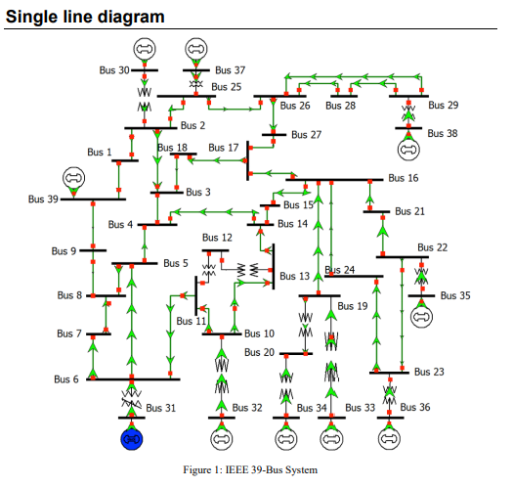
About the Project
At first we perform Load flow analysis using Newton-Raphson method on a IEEE-39 Bus AC system.
Replaced the HVAC between B9 and B39 with
an HVDC line and studied its effects.
Added an Induction motor loads to B23 and studied its effects.
Solve abnormalities by: Distributed swing option,
SVC.
Draw comparison between SVC and Shunt capacitor banks

Slide 3
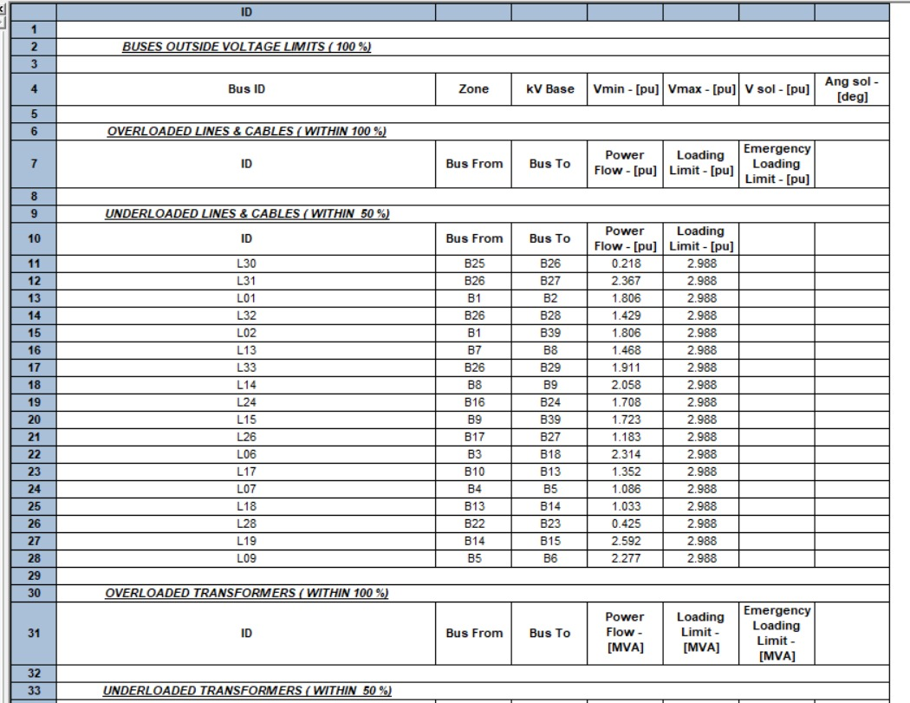
Base Case report:
We do not have any overloaded components in this case.

Slide 4
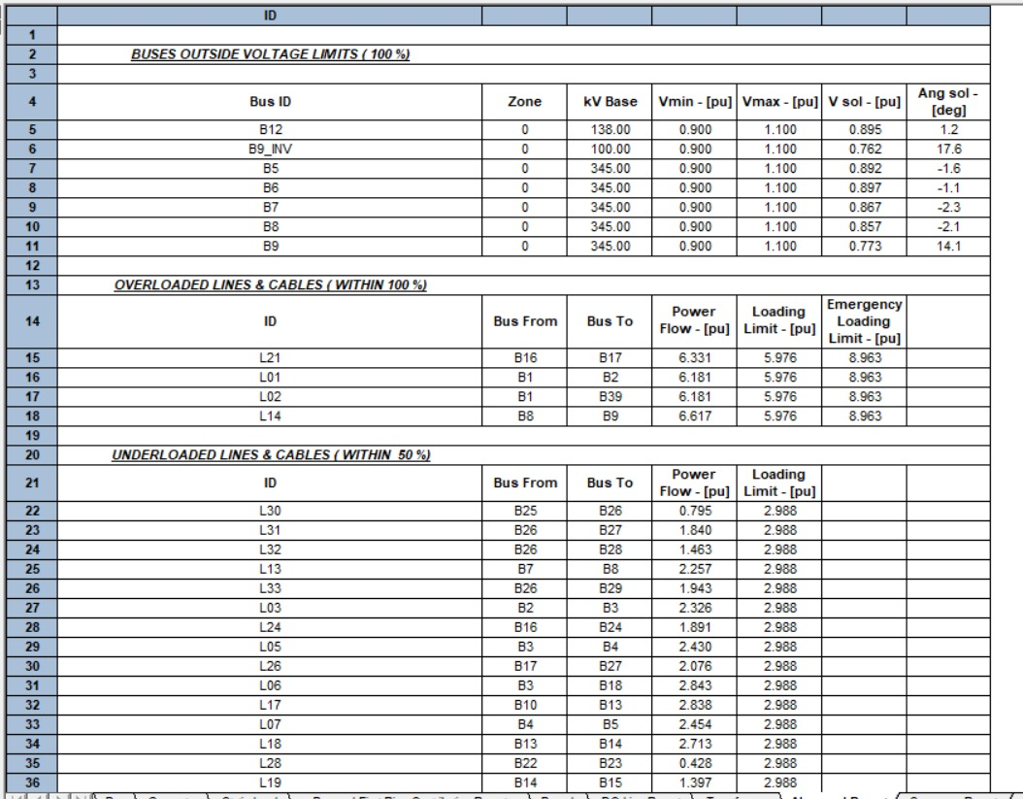
HVDC line effect:
A few buses have voltages below their lower limits due to the presence of rectifier circuit.
A few lines get overloaded because....

Slide 5
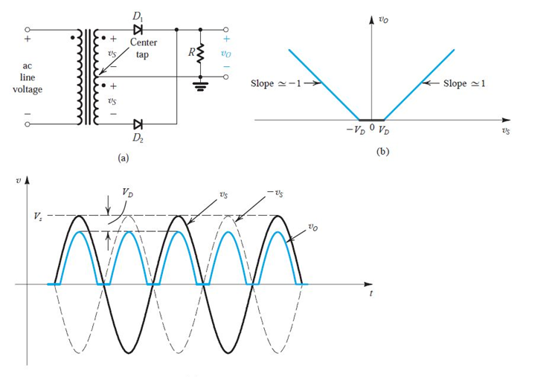
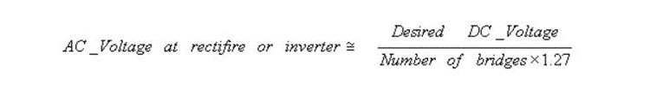
HVDC line effect:
Bus voltages were reduced due to diode barrier voltages in rectifier circuit.

Slide 6
Induction motor effect:
3 Generators exceed their reactive limits due to high increases in load
T03 is overloaded due to increased pressure on slack bus
A few more buses attain voltages below Vmin
A few more lines get overloaded too due to increased load

Slide 7
Comparing summary reports
Case | Total generation |  | Total load |  | Total loss
 | P (MW) | Q (MVar) | P(MW) | Q(Mvar) | P(MW) | Q(MVar)
Base | 6180.36 | 1749.76 | 6097.10 | 1408.90 | 83.26 | 340.85
HVDC | 6216.78 | 2751.67 | 6097.10 | 1408.90 | 119.67 | 1342.48
Induction Motor | 7026.94 | 3809.04 | 6897.10 | 2008.90 | 129.84 | 1799.85
*mismatches for HVDC: for P=0.003, Q=0.285

Slide 8
Analysis:
HVDC:
Current increases due to step down transformer
I²R loss increases
Increase in current means increase in P_{load}
P_{gen} also increases
Induction Motor:
Increased load increases current
Loss increases
P_{gen} increases
Before HVDC:
Total current = 3× I_{L}=3×288.34=865.021 A
After adding HVDC:
I_{DC}= 1000 A

Slide 9
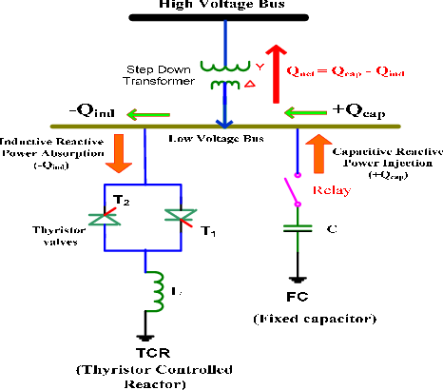
Removing abnormalities: STEP ONE
Adding Static VAR compensators for generators exceeding reactive limits
For providing fast acting reactive power on high voltage electricity transmission network
Can also increase transfer capability, reduce losses, mitigate active power oscillations and prevent over voltages at loss of load
It improves the system stability, voltage regulation and system power factor.

Slide 10
Removing abnormalities: STEP ONE
We add SVC of rating Qmax= 150Mvar at B35
We add SVC of rating Qmax= 150Mvar at B36
At first we added SVC at G03 but later it wasn’t needed after Distributed Swing was implemented.
Example of calculation: For G06 at B35,
Qmax of SVC= Qgen- Qmax
=130.33 MVar
=150 MVar (approx.)
GENERATORS | Qgen before SVC | p.f before SVC | Qgen after SVC | p.f after SVC
G06 | 578.33 | 74.5 | 433.01 | 83.2
G07 | 519.91 | 73.3 | 375.72 | 83.0

Slide 11
Removing abnormalities: STEP TWO
Distributed Swing option
Pgen of swing must be defined.
Pswing= Total Pgen- (Sum of Pgen of all PV buses from Bus report)
Allotting excess power to a single generator can prove unacceptable if the deviation from the desired value is large.
Distributed swing option makes selected buses act like auxiliary swing generators, contributes to the swing generation in the ratio of the given active generation.

Slide 12
Removing abnormalities: STEP TWO
All buses included
T03 overloaded gets removed.
L22, L10, L21, L13, L06 still overloaded
Standard loading limit set accordingly
L10, L21, L13, L06 no longer overloaded
L22 still overloaded
B33 & B34 excluded
L22 no longer overloaded.
G06 & G07 generated S MVA greater than rated S MVA.
B35 & B36 excluded
Distributed Swing option
G06 & G07 generated power within their desired limits.

Slide 13
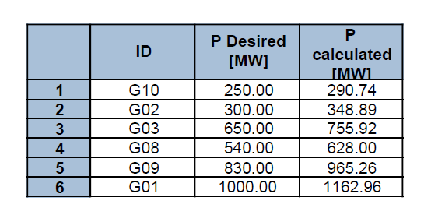
Removing abnormalities: STEP TWO
Distributed Swing option
By comparing First Ring Contribution reports, we see that Pgen of other buses have decreased

Slide 14
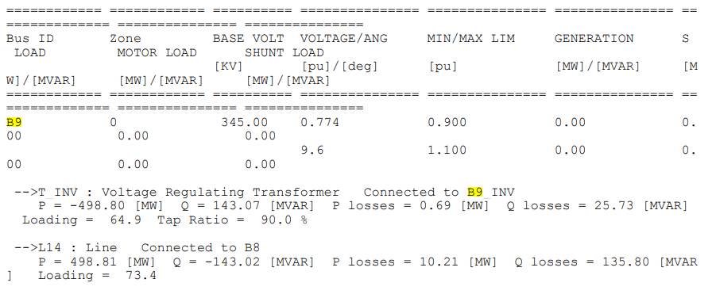
Removing abnormalities: STEP THREE
Static Var Compensator for Buses beyond voltage limit
A major drawback of HVDC systems using is that the converters inherently consume reactive power
In most cases the reactive power consumed by the converter must be provided by banks of shunt capacitors connected at the AC terminals of the converter.
SVC of rating 340 Mvar is connected to B9 (required Q is calculated using P and Q values of B9 from the first ring contribution report)
Q= VIcos(Ѳ)
Vnew= 1
Vold=0.774

Slide 15
Co
Why not shunt capacitor bank?
1
Easily damaged
2
Fixed Capacitance
Unlike static var compensators which have variable capacitance
Cost comparison:
Shunt capacitor bank in MVar range very costly
Needs high installation and maintenance costs
One SVC is more cost efficient
Multiple shunt capacitors needed if in Kvar range.
Example, for Q=400MVar
Cost of shunt capacitor capacitor= $800,000~1600000
Cost of SVC= $5000~12000
1
2
3

Slide 16
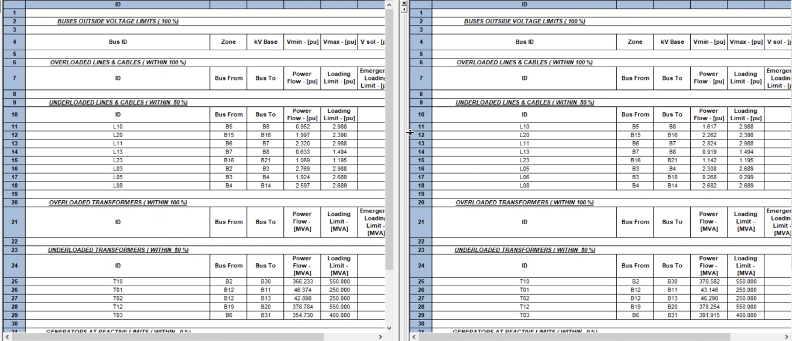
Comparison
Shunt capacitors were connected to B5-9. The abnormal report is identical. However, only one SVC is needed opposed to 5, when SVC is used.

Slide 17
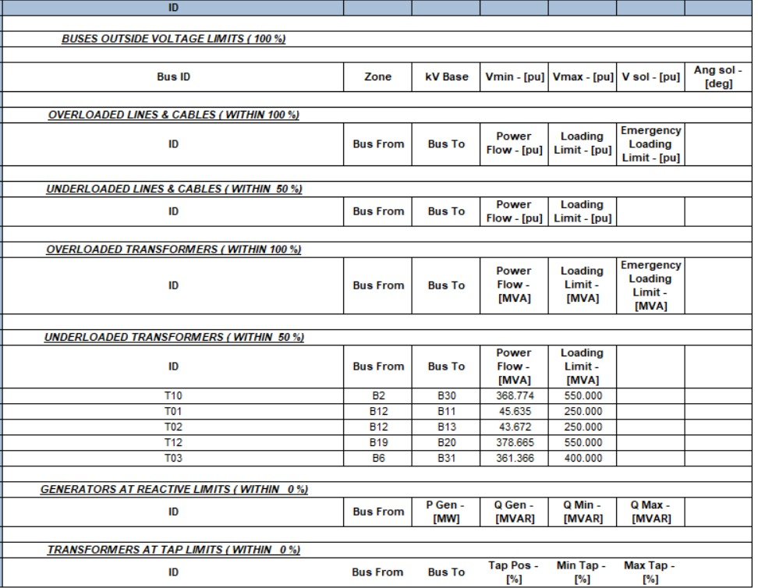
Final report
Base case report
*underloaded components can be resolved by changing ratings

Slide 18
THANK YOU..
Every one of us compiled this project together in MS teams.

