Slide 1
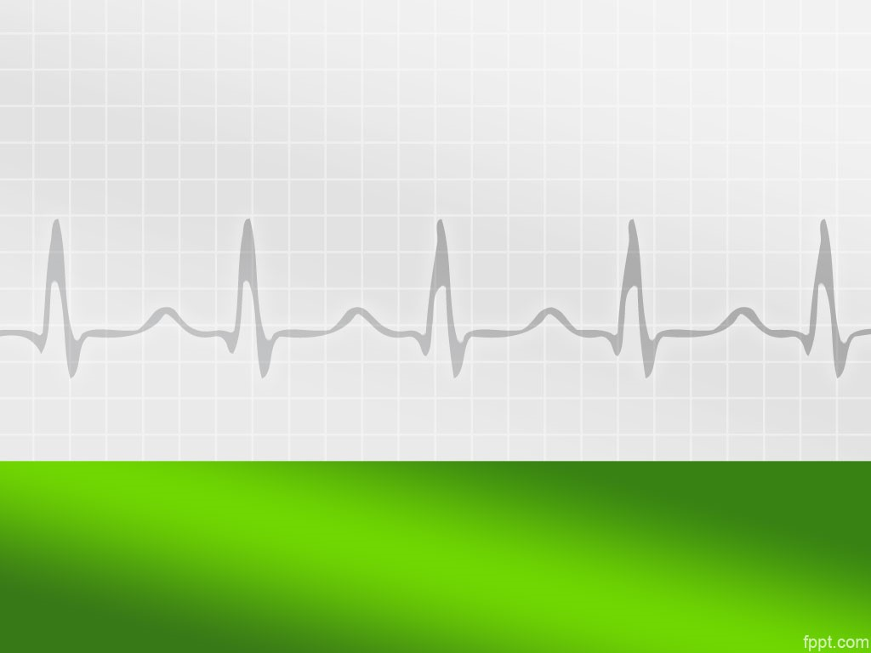

EEE 426: Biomedical Signals, Instrumentation and Measurement Laboratory
An IoT Based Remote Health Monitoring System Using Integrated ECG Module and Pulse Oximeter

Slide 2







Group01: Lab Group G2
Farhan Hamid
1706175
Sadia Afrose
1706161
Shafim Bin Hassan
1706172
Subah Karnine
1706174
Joy Saha
1706189
Md Al Amin Patwary
1706127
Ishtiaque Ahmed
1706190

Slide 3
Aim Of This Project
Creating a smart non-invasive heart monitoring system with integrated sensors
Uploading the real time data to IoT cloud for remote access
Finding heart rate from the acquired ECG signal and cross validating with a pulse oximeter

Slide 4
Societal Impact
Health care for people in living in remote areas without direct access to medical professionals
A cheap home monitoring system for patients
Easily portable alternative that will be convenient for use during different rescue operations in disaster zones

Slide 5
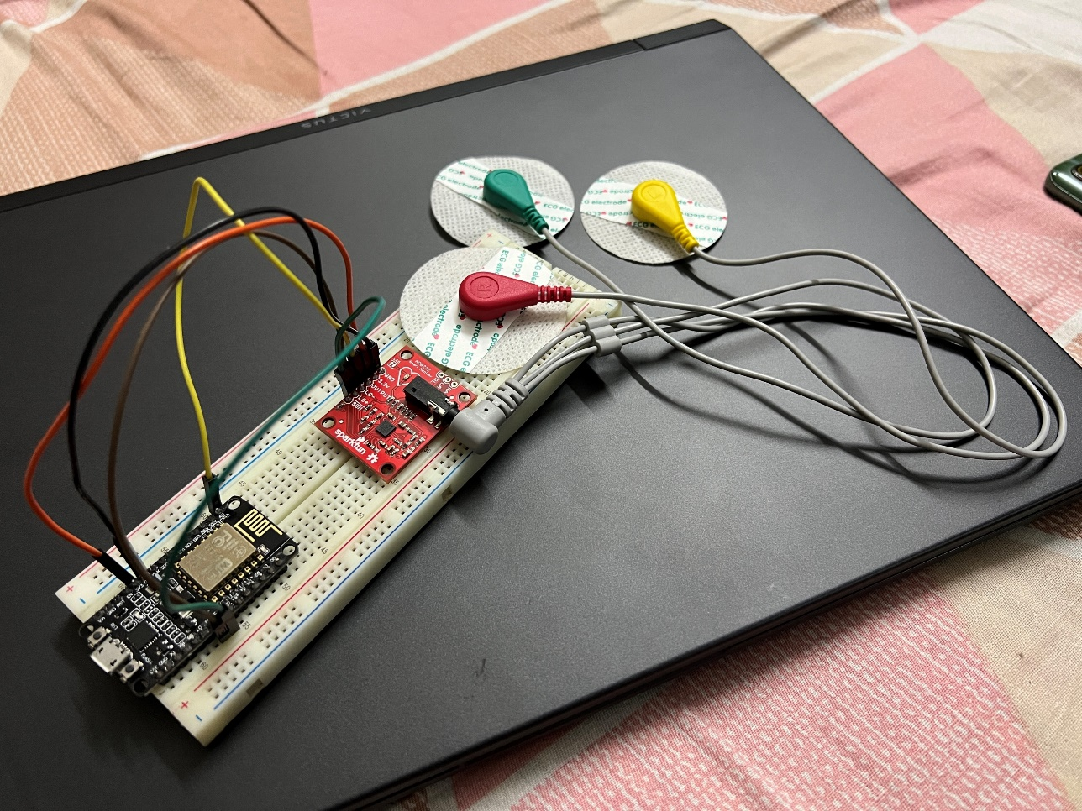
Hardware Setup
Setup consisted:
NodeMCU (ESP8266)
AD8232
3-lead electrodes

Slide 6
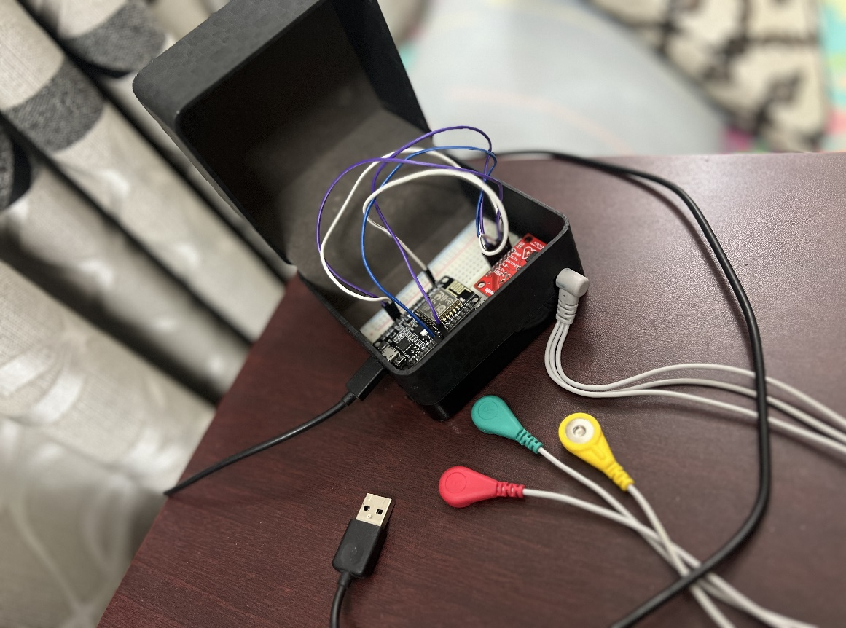
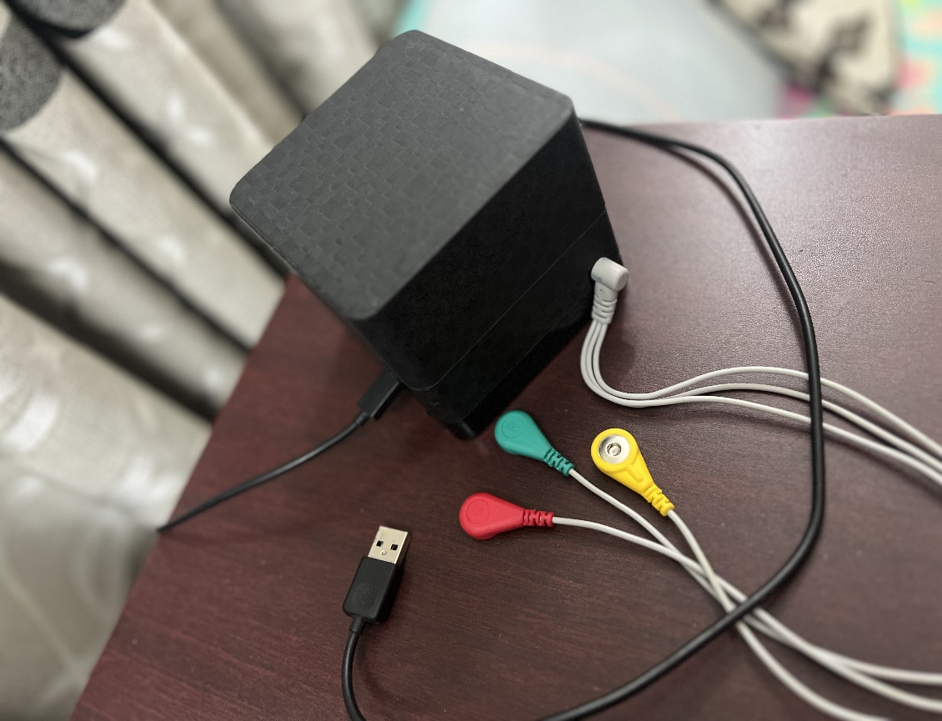
Final Hardware Setup

Slide 7
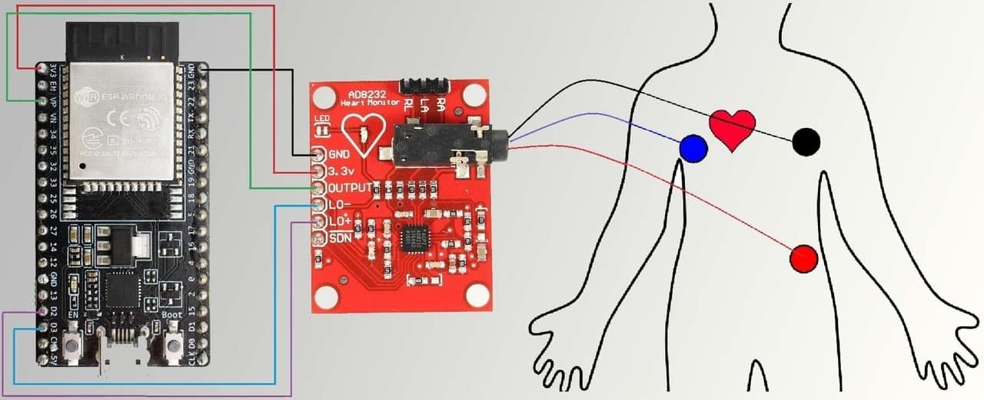
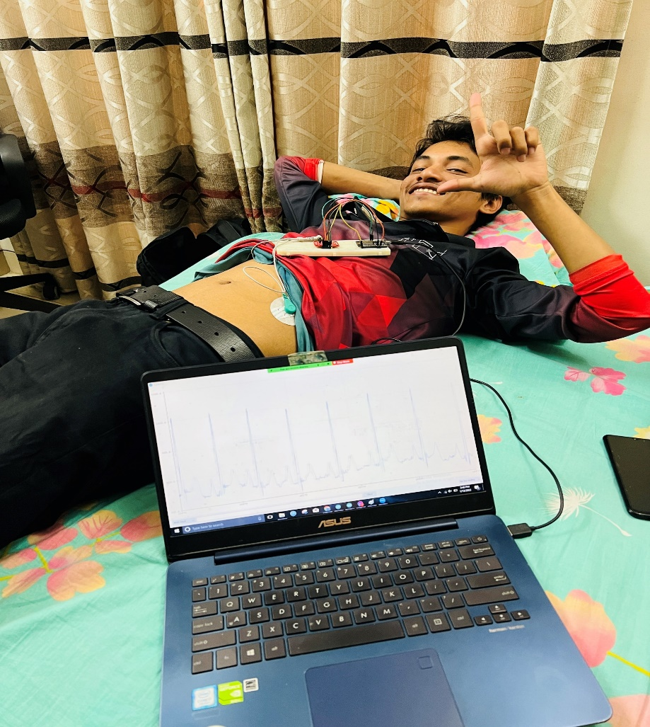
Real Time Data Acquisition

Slide 8
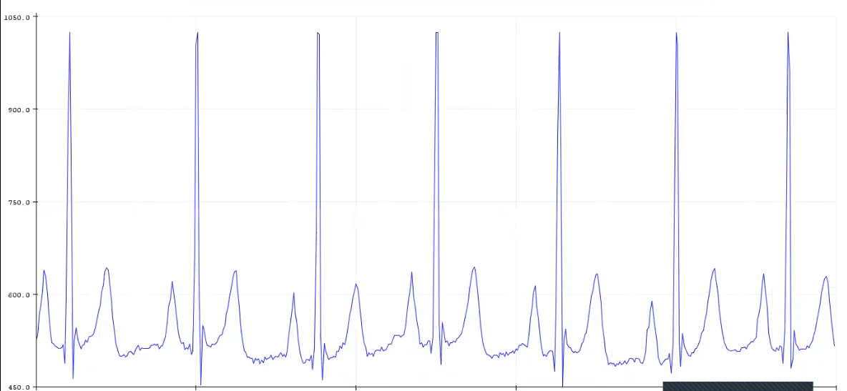
Identifying The Relevant Peaks from Acquired ECG signal
R
T
P
Q
S

Slide 9
Uploading BPM to ThingSpeak
Reading data from AD8232 for approx. 3 sec at 100sample/sec
Detrend and normalize the signal
Find the local maxima and identify the R peaks
Calculate the heart rate from mean R-R interval
Upload BPM to Thingspeak
Wait 30 seconds then repeat

Slide 10
Calculating BPM
R
R
R
R
R
R
R
Heart Rate = $\frac{60}{Ts(time of one sample)∗R−R Interval(avg no of samples)}$
Notes:
/

Slide 11
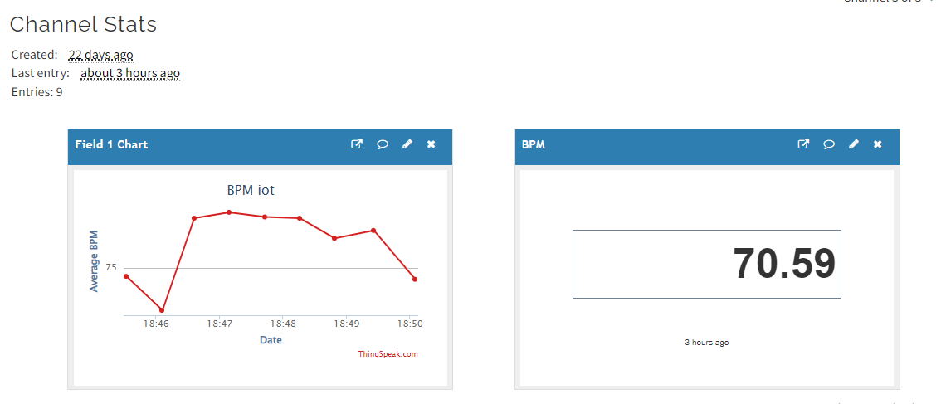
IoT Infrastructure
ThingSpeak dashboard showing BPM graph and current value

Slide 12
Sending ECG signal by mail
Problem: Uploading the entire ECG signal to a IoT platform is not possible due to data loss and delay.
Solution: Send the signal via mail with attached image of the signal and the related CSV file for further processing if desired.

Slide 13
Sending Mail
Start
Acquire ECG signal for 12 seconds
Send image and CSV file via mail
Read ECG signal for 3 seconds
Calculate inst. BPM and avg. BPM (latest 8 chunks)
No
Inst. BPM
abnormal (<60 or >120) for 5 consecutive reads?
Yes
Acquire ECG signal for 12 seconds

Slide 14
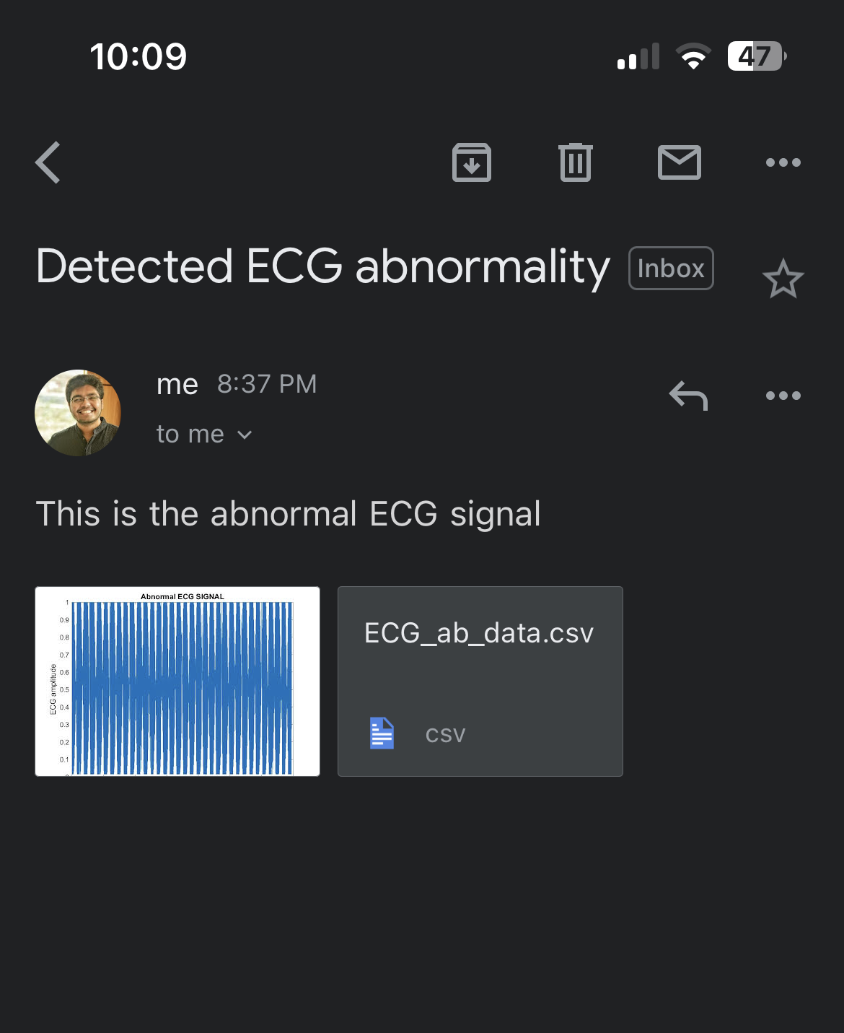
Mails sent under the two situations

Slide 15
Uploading to Drive
Attached image file from the mail is automatically uploaded to Google Drive.
Pabbly connect is an intermediary mail parser that connects the two platforms
Mail containing ECG image and CSV file received from MATLAB
Pabbly Connect
Image uploaded to Google Drive

Slide 16
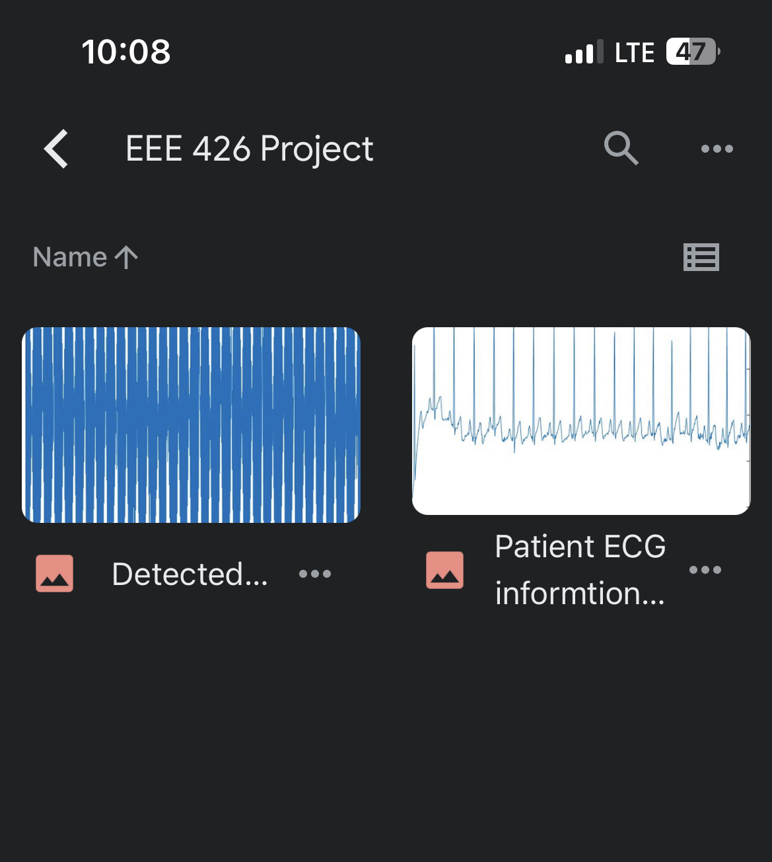
Image uploaded to Google Drive

Slide 17
Innovations and Findings
Use of IoT cloud platforms in remote health monitoring
Instant mailing for relevant information in case of abnormalities detected.
Automatic information upload to Google drive

Slide 18
Cost Sheet
Equipment | Cost(BDT)
AD3232 ECG MODULE | 1800
Disposable ECG Electrodes pad | 1200
ESP8266 | 345
Transport | 500
Bread Board | 70

Slide 19
Future of the Project
Provide greater reach to rural and underserved communities
Enables frequent patient monitoring and data collection
Don’t have to drive to the doctor’s office or clinic
Help to prevent the spread of COVID-19, flu and other infectious diseases
promote a healthier environment for everyone
A family member can help by providing information, asking questions

Slide 20
THANK YOU!!!
Any Questions?

